Slide 1
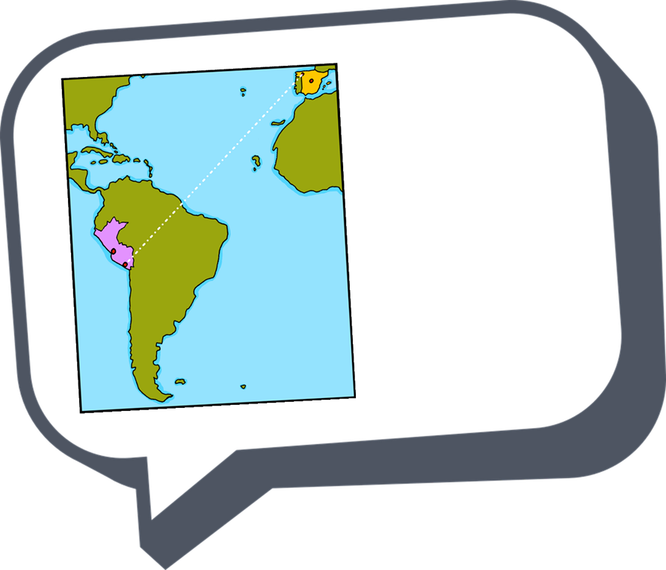
español - cover
Rojo Term 2
¡hola!
español
Nombre : ……………………………………………….
Profesor (a) : ……………………………………..
Clase : ……………………………………………..

Slide 2
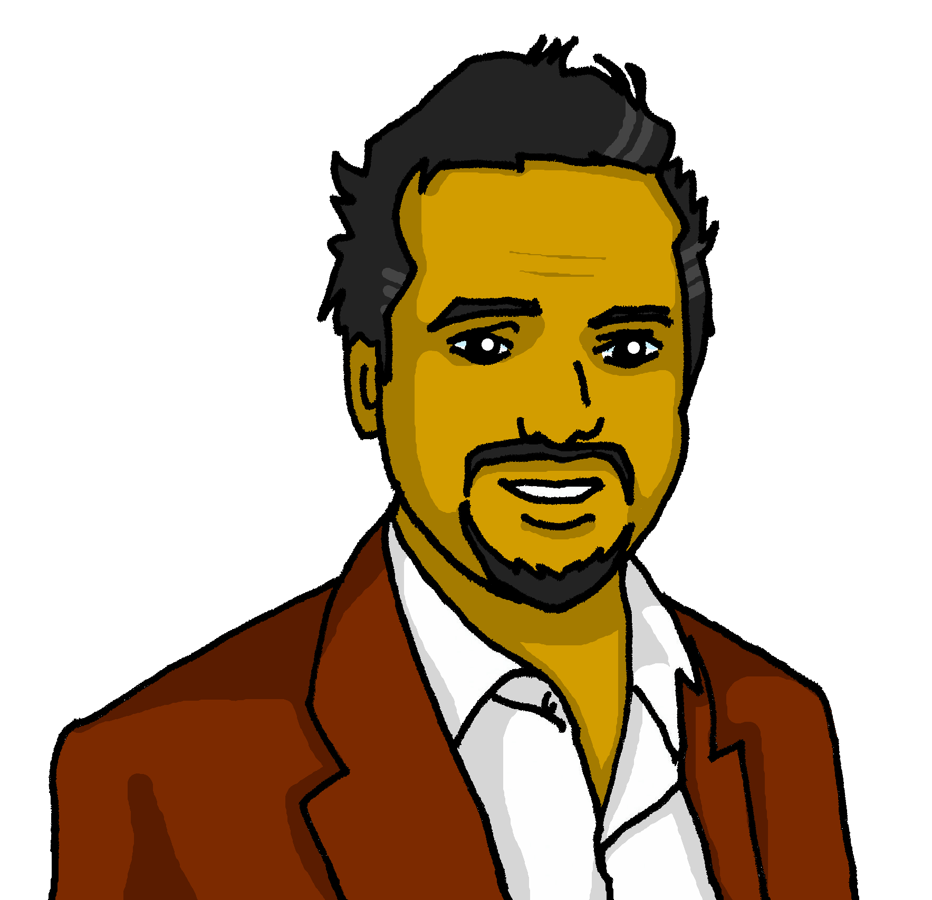
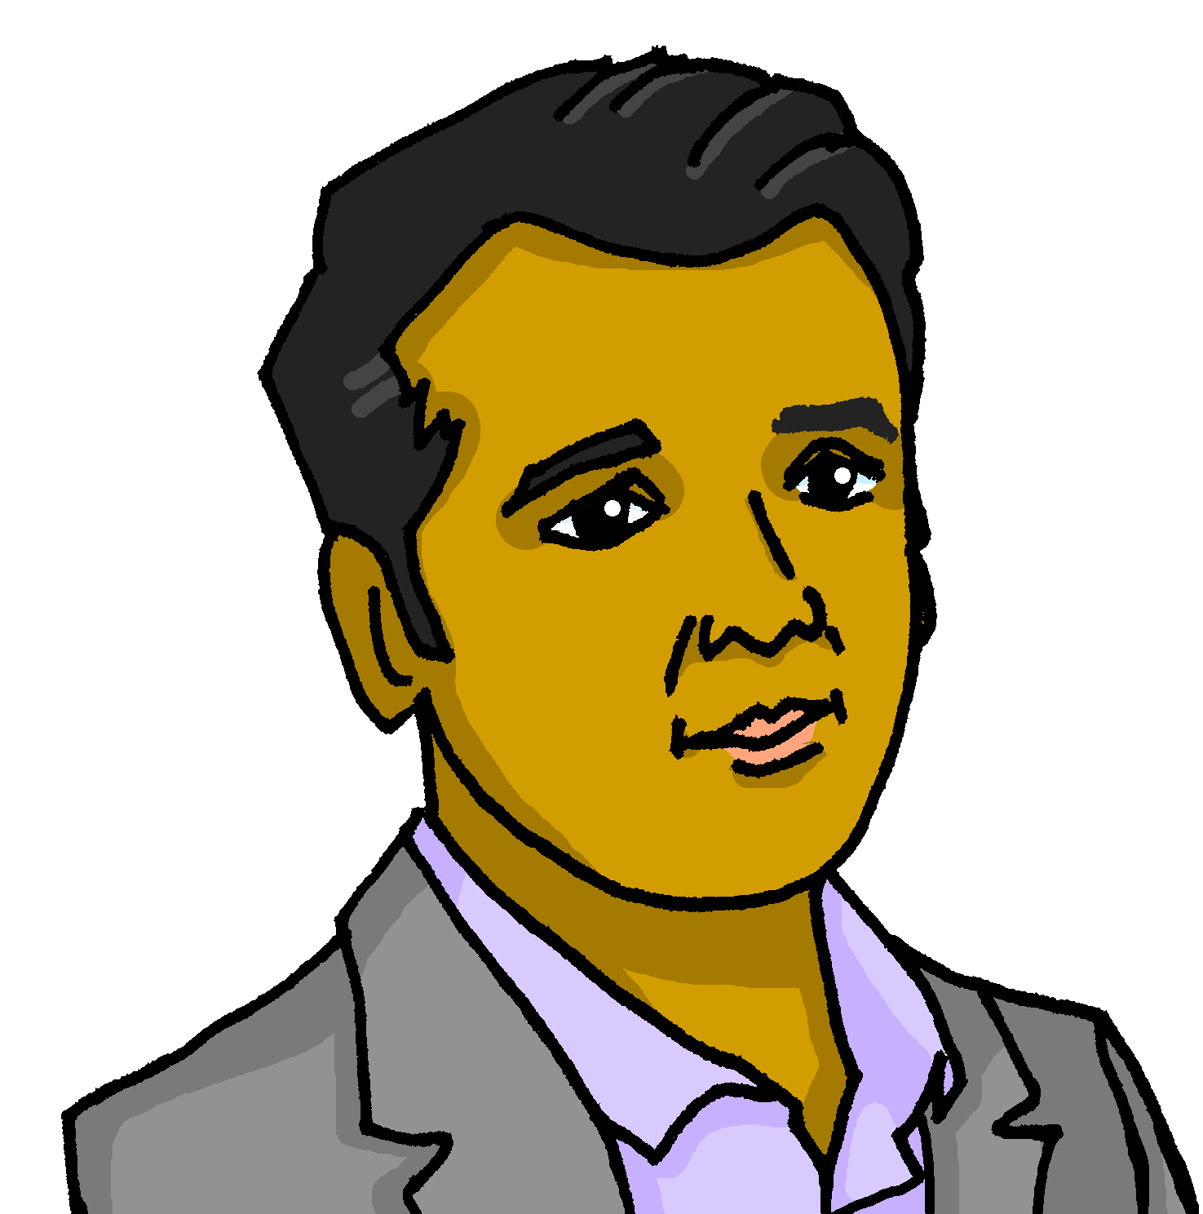
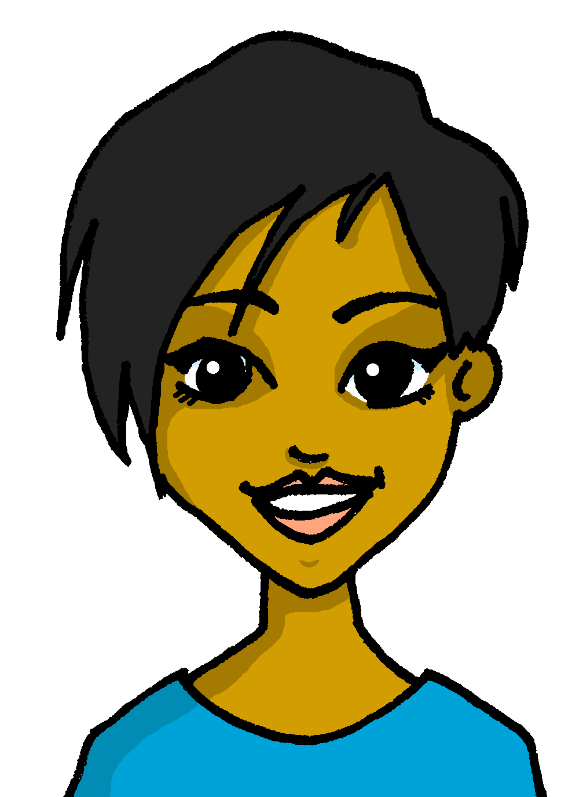
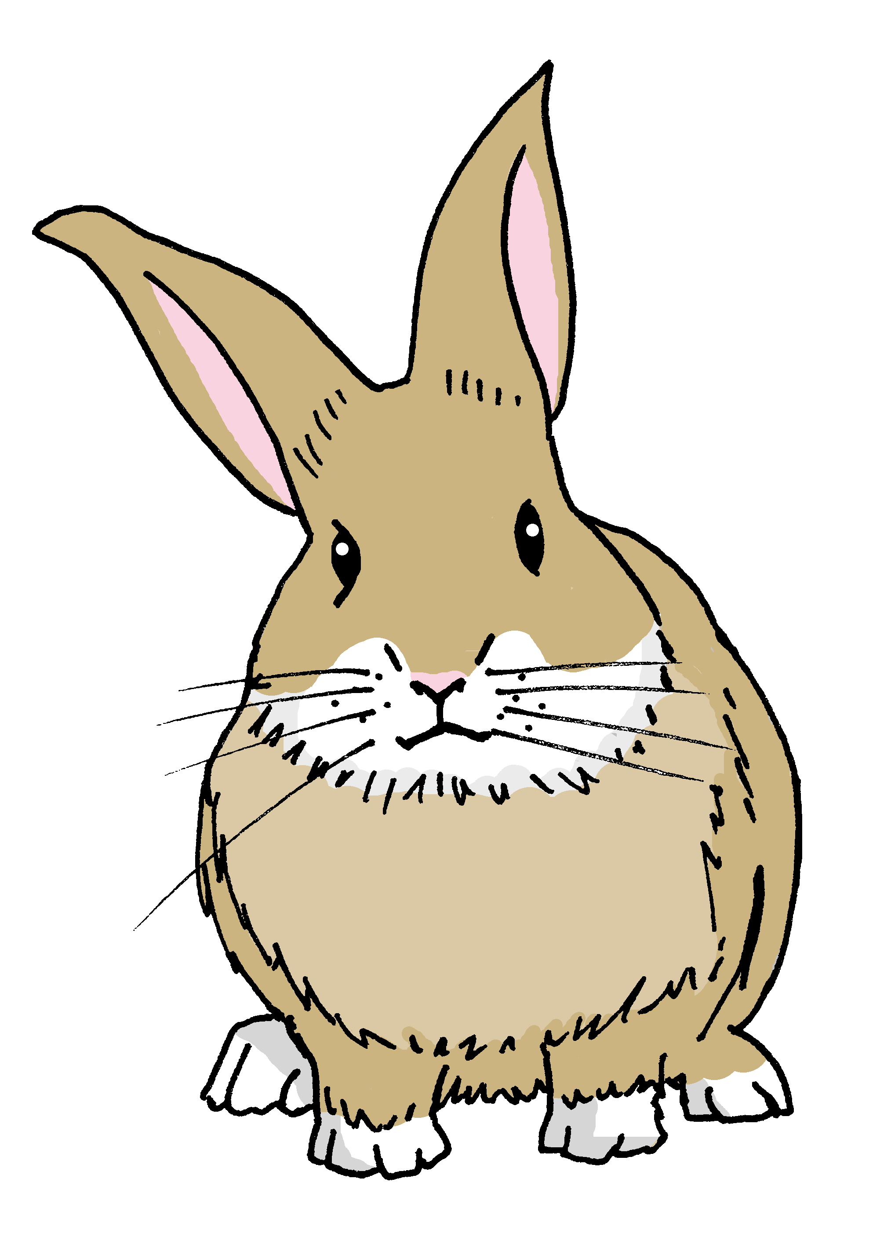
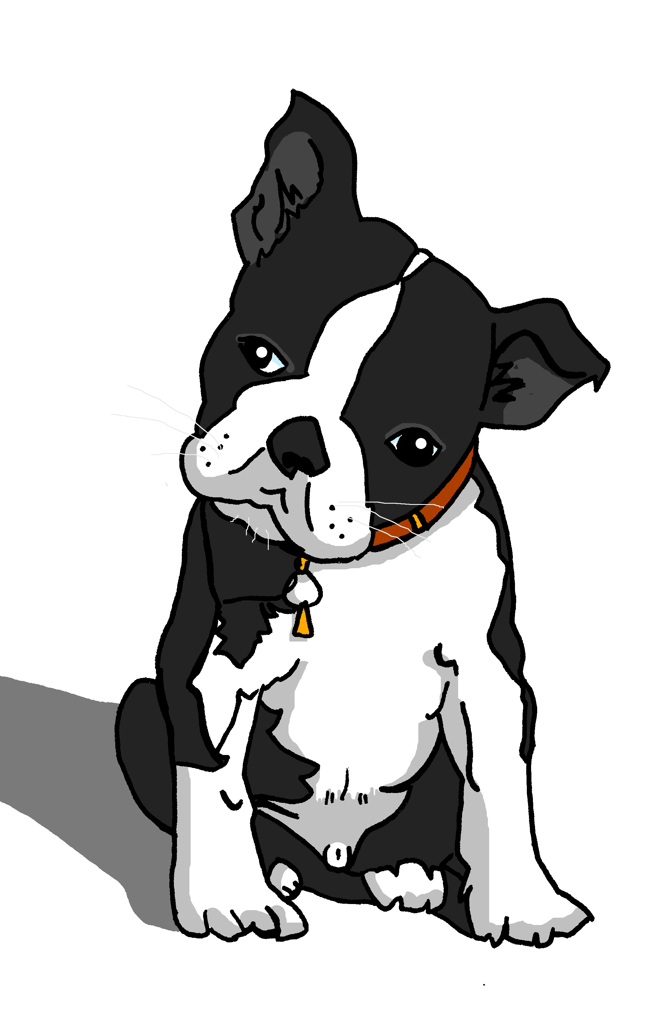
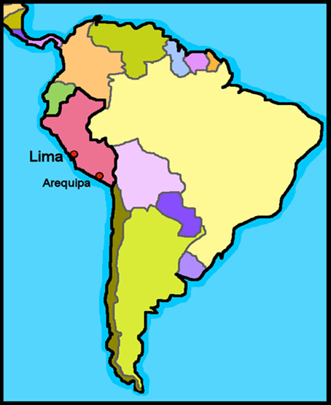
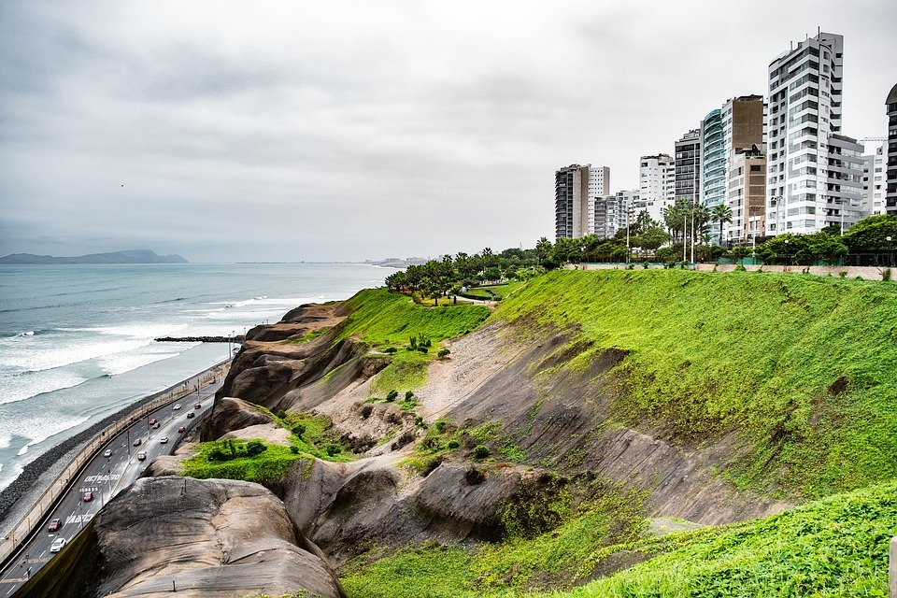
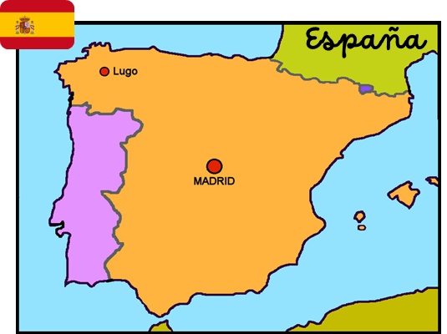
Characters
La familia Mamani Flores
Valeria
Miguel
Elena
Pedro
Hugo
Jorge
Ceci
Quique
Sofía
Luis
amigos
mascotas
Ángela
Pancho
Rubén
Manchita
Santi
Perú
Lima es la capital de Perú y está en el océano Pacífico.

Slide 3
Contents
Contents | page
Introduction: La familia Mamani Flores | 1
Fonética | 2
Term 1 Learning Overview | 3
1. Understanding and talking about activities in class. | 4-7
2. Talking about what activities you and others do. | 8-11
3. Talking about activities you and others do outdoors. | 12-17
4. Talking about activities you and others do in the morning | 18-22
5. Talking about activities you and others do in and outside the classroom. [1] | 23-27
6. Understanding and talking about activities I and others do in the classroom. [2] | 28-31
7. Talking about how many things you and others have | 32-36
8. Saying how many things there are | 37-41
9. Describing things; Reading a Spanish poem | 42-44
10 & 11. Revisión & Easter Saying what I have and someone else has | 45

Slide 4
Term overview
Term 2 learning
UNIT | Context CommunicationCulture | Key ideas (GRAMMAR) | PHONICS | VOCABULARY
Unit 4a (W1-4) | Saying what I and others do activities in class in the week outside in the morning | Talking about doing Infinitive – regular AR verbs (singular) Definite articles – el, la | SSC [l] [ll] SSC [ga] [go] [gu] | Range of regular –AR verbs Family members Range of nouns, adjectives and adverbs
Unit 4b (W5-6) | Saying what I and others do activities in and out of class | Talking about doing (2) Infinitive – regular ER verbs (singular) Personal ‘a’ | SSC [ga] [go] [gu] SSC [ca] [co] [cu] SSC [que] | Range of regular –ER verbs Range of singular masculine and feminine nouns
Unit 5 (W7-9) | Saying how many, describing things Carnaval Un poema | Talking about more than one Essential verb: there is/are – hay Plural indefinite articles – unos, unas Regular plural marking on nouns [-s] | SSC [qui] Revisit [que] [qui] [ce] [ci] | Numbers 1-12
Unit 6 (W10-11) | Revision Easter | Revisit key ideas | Revisit SSC | Revisit vocabulary

Slide 5
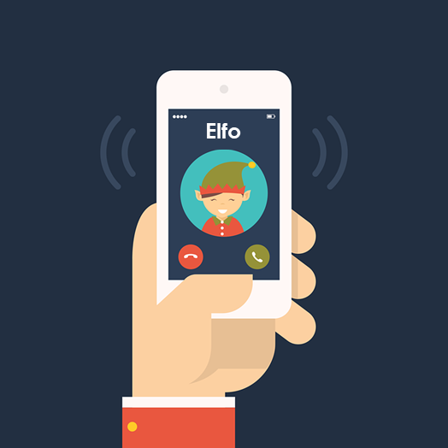
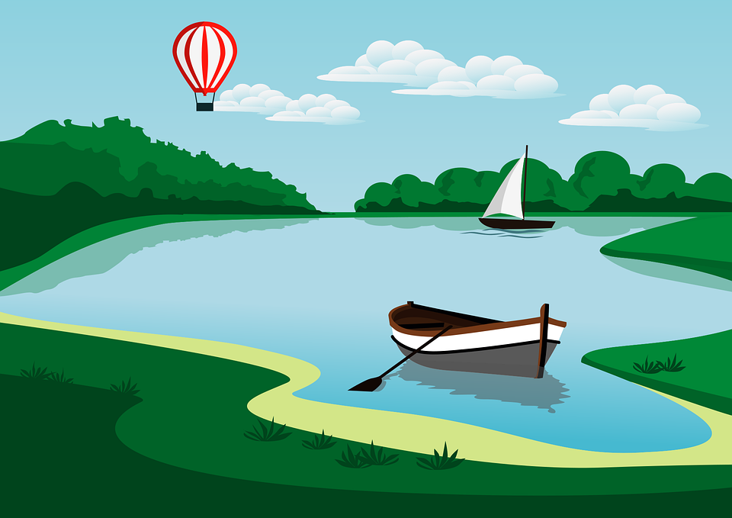
Phonics
Phonics
Spanish vowels are usually short and open!
[l]
[ll]
libro
llamar
[ga]
[go]
[gu]
ganar
lago
gusano
[que]
[qui]
These 3 sound like [k]
You know the SSC
[ca], [co], [cu].
paquete
quince
The same /k/ sound in front of ‘e’ and ‘i’. E.g. bicicleta & celebrar.

Slide 6
Rojo term 2 week 1
Saying what I and others do
1
Rojo term 2
pronunciar
Understanding and talking about activities in class.
[l]
[ll]
Describing activities
libro
llamar
en clase
Luis
Write down the key language for this week.
vocabulario
cantar |  | español
escuchar |  | inglés
hablar |  | frase
necesitar |  | fantástico
importante |  | normal
Infinitives: -ar verbs
gramática
[to ____]
The infinitive often describes the general meaning of the verb.
In English, this is often written ‘to + verb’:
It’s important to listen.
In Spanish, many infinitives end in –ar:
Es importante escuchar.
You can also begin a Spanish sentence with the infinitive:
Escuchar es importante.
Listening is important.
Here we
translate the Spanish infinitive with the –ing form of the verb in English.
Translate the examples.
Hablar es importante. → _______________________________.
Es importante hablar. → ______________________________.
4

Slide 7
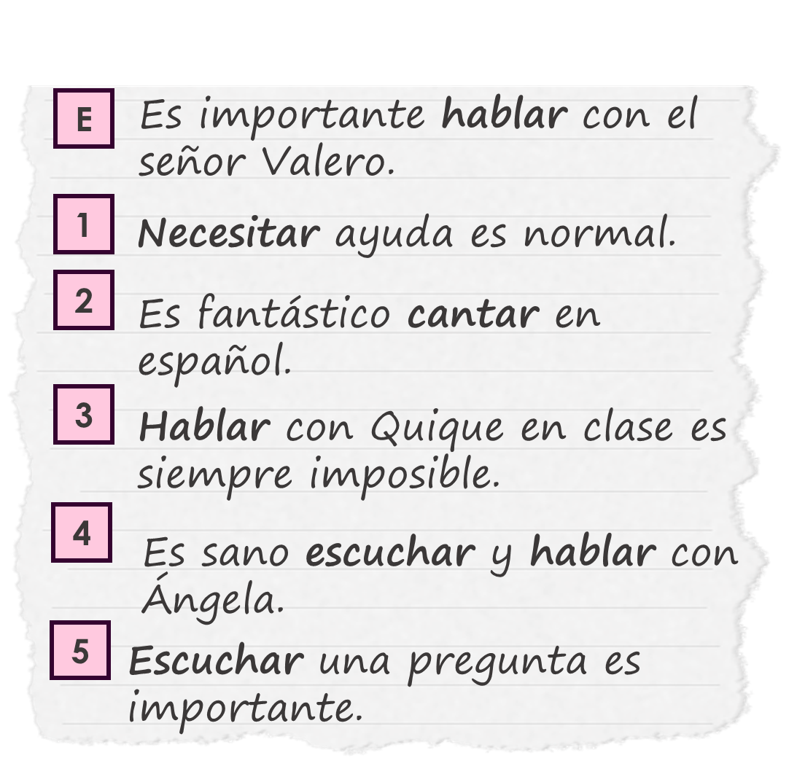
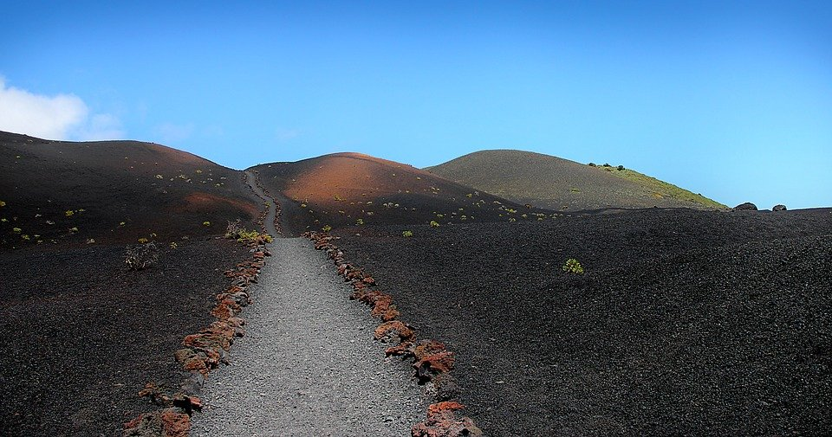
Rojo term 2 week 1
Saying what I and others do
1
Rojo term 2
escuchar
El señor Valero habla. ¿Dónde está el infinitivo?
Escucha y marca .
El señor Valero =
Mr Valero
 | at the beginning | at the end
E
1
2
3
4
5
infinitivo en español | adjetivo en inglés
esc_ _ _ _ _
leer
After a term in her school, Sofía writes what she’s learned.
Sofía escribe. Lee y completa las frases.
It is important ____ _________
to Mr Valero.
E
to
1
___________ help is normal.
2
It is fantastic ____ ________ in Spanish.
3
___________ to Quique in class is always ___________.
4
It is ___________ ____ ________ and to talk to Ángela.
5
___________ to a question is ___________.
escuchar
Escucha. Escribe [l] o [ll].
1 | To _ _ do
2 | Sevi _ _ a
3 | Monti_ _ a
4 | Va _ encia
5 | Tome _ _ oso
6 | La Pa_ma
La Pa_ma tiene
un volcán activo.
5

Slide 8
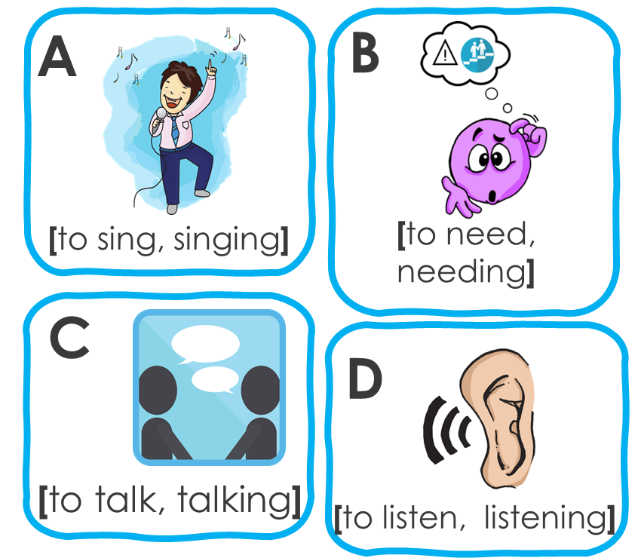
Rojo term 2 week 1
Saying what I and others do
1
Rojo term 2
escuchar
Sofía habla con su primo Luis. Escucha.
¿Qué infinitivo es?
Escribe la letra (A-D) y el adjetivo en inglés.
 | imagen | adjetivo | información extra
E
1
2
3
4
5
A
fan…
su = his/her | con = with
primo = male cousin
leer
[A] Lee las frases y marca la opción correcta.
 | Frase en español
E | Es fantástico cantar el domingo.
1 | Hablar en clase es importante.
2 | Es normal necesitar una mochila.
3 | Escuchar a* un sacapuntas es imposible.
4 | Es fantástico hablar rápido en español.
5 | Es normal necesitar un amigo en clase.
verbo en inglés
to sing | singing | to talk | talking
to listen | listening | talking | to talk
singing | to sing | needing | to need
talking | to talk | listening | to listen
needing | to need | to talk | talking
singing | needing | to sing | to need
a = to
[B] Escribe las frases en inglés .
E | It’s ______________ to sing on __________.
1
2
3
4
5
6

Slide 9
Rojo term 2 week 1
Saying what I and others do
1
Rojo term 2
escribir
Escribe en español. Can you get at least 15 points?
 | slow (m) | fast (f) | today
 | a cat | in class | curious (f)
 | a friend (f) | a bicycle | a bed
 | normal | s/he, it has | a friend (m)
 | a phrase | fantastic | important
 | to speak, speaking | Spanish | English
 | to sing, singing | to need, needing | to listen, listening
x3
x2
x1
escribir
Escribe 5 frases en español.
Not all
combinations
are possible so translate your sentences into English to ensure they make
sense!
1
2
3
4
5
7

Slide 10
Rojo term 2 week 2
Saying what I and others do
2
Rojo term 2
pronunciar
Talk about what activities you and others do.
[l]
[ll]
Describing activities
libro
llamar
Luis
Write down the key language for this week.
vocabulario
llevar |  | película (f)
comprar |  | sombrero (m)
con |  | Uniforme (m)
Knowing who does what
[–ar verbs: ‘I’]
gramática
We have learned the infinitive form of a verb often describes the general meaning of a verb. In English, this is often written ‘to + verb’.
In Spanish, the infinitive of the verb often ends in –ar.
To mean ‘I’ with a verb, the verb ending changes.
We don’t
We remove –ar and add – o.
need pronouns because the verb ending tells us who is doing the action.
Ejemplo
General meaning
I
hablar
Hablo en clase.
Es importante hablar.
+ o
I speak in class.
It’s important to talk.
Here we
translate the Spanish infinitive with the –ing form of the verb in English.
Translate the examples.
Hablar con amigos es importante. → ___________________________.
Hablo con amigos. → ______________________________.
8

Slide 11
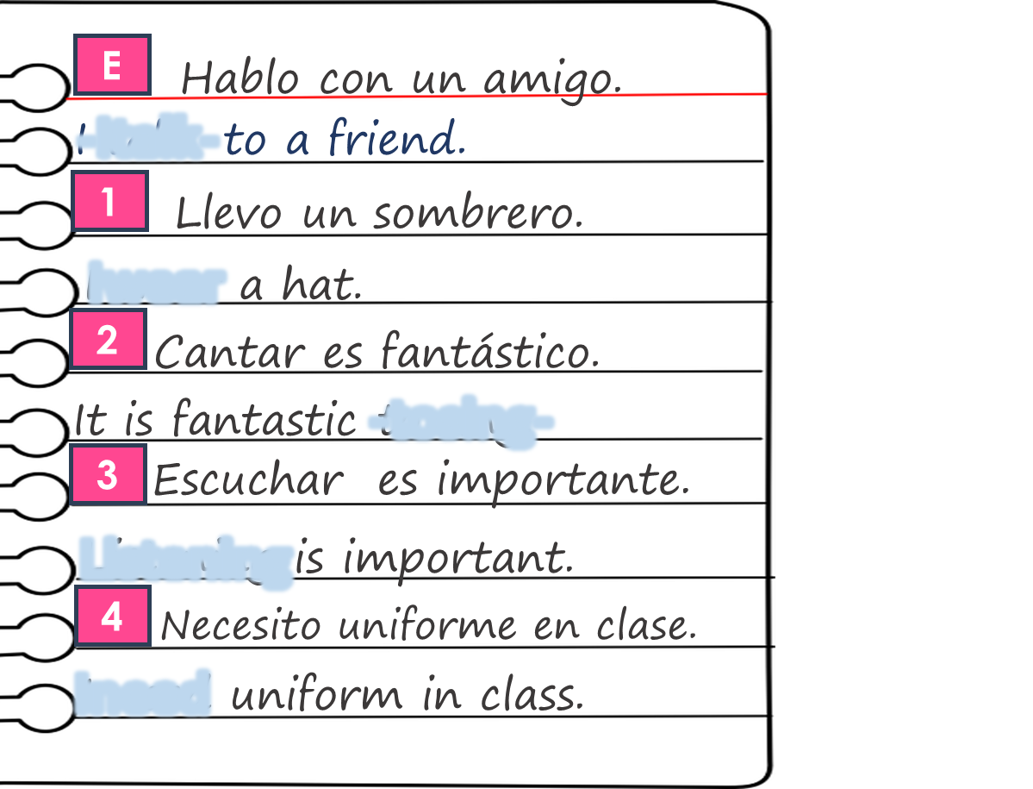
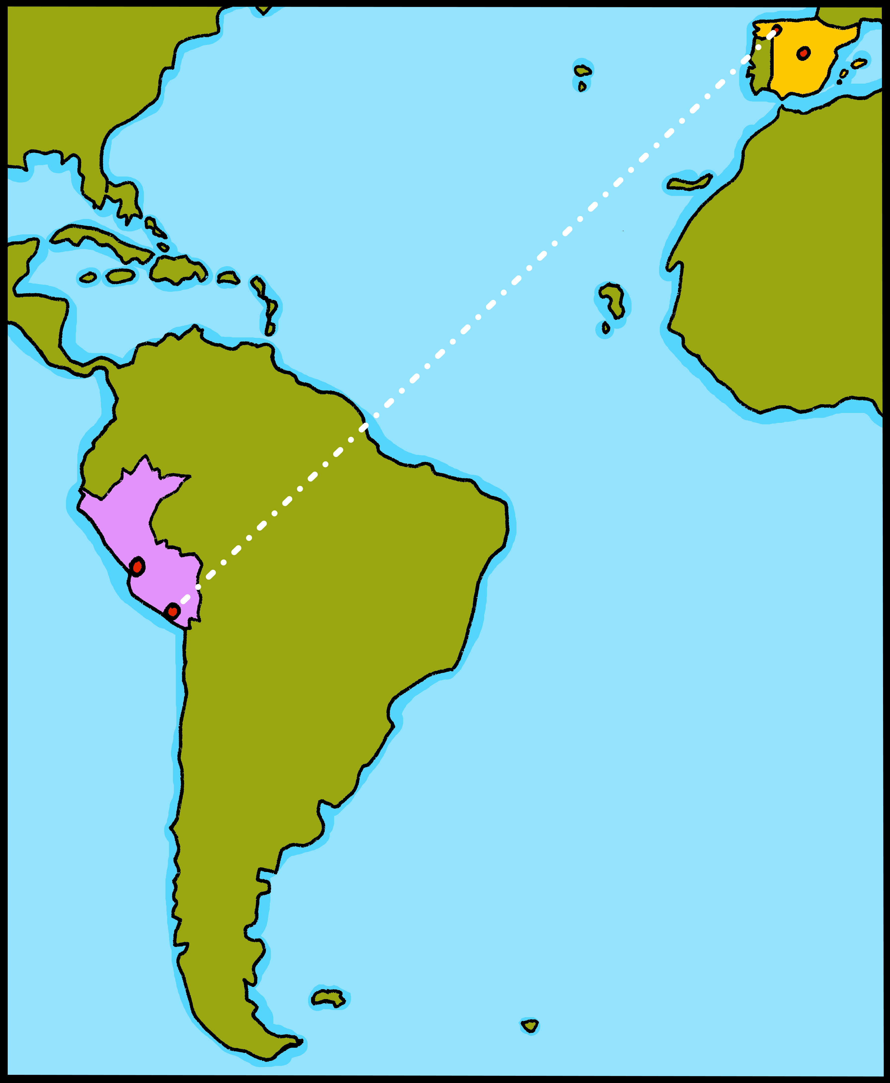
Rojo term 2 week 2
Saying what I and others do
2
Rojo term 2
leer
Agua 💦 en los deberes de Sofía.
Lee las frases y marca .
Escribe en verbo en inglés.
 | general meaning | I
E
1
2
3
4
5
verbo
When the sentence
begins with the infinitive, we use the –ing form of the English verb.
Knowing who does what
[–ar verbs: ‘I’ vs. s/he, it]
gramática
In Spanish, the words for ‘I’ and ‘s/he’ (pronouns) are often unnecessary.
To mean ‘I’ with a verb, we remove –ar and add – o.
To mean ‘s/he, it’ with a verb, we remove –ar and add – a.
I
Ejemplo
s/he, it
Llevo uniforme en clase.
llevar
Lleva un sombrero en casa.
I wear uniform in class.
S/he wears a hat at home.
escuchar
Sofía compara su semana con Luis.
Escucha, marca y escribe la Información.
 | Sofía (I) | Luis (he)
E
1
2
3
4
5
verbo | información extra
9

Slide 12
Rojo term 2 week 2
Saying what I and others do
2
Rojo term 2
pronunciar
Pronuncia las palabras y colecciona monedas .
Write your favourite words with the sound [l] and [ll] here.
leer
[A] Lee las frases. Marca la opción correcta para el verbo.
 | Sofía (I) | Ángela (she)
1
2
3
4
5
6
7
1
Llevo un sombrero en clase.
Necesita uniforme en clase.
Hablo inglés con una amiga de Perú.
Llevo una mochila a clase.
Habla español en casa.
Canto en clase.
Escucha vocabulario en clase.
2
3
4
5
6
7
[B] Lee otra vez. ¿La respuesta es normal o rara? Escribe [N] o [R] 📝.
otra vez = again
escuchar
¿Quién es? Marca .
Escucha y escribe.
I
s/he, it
1 | _________ una película en Internet.
2
3
4
5
Com_ _ _
10

Slide 13
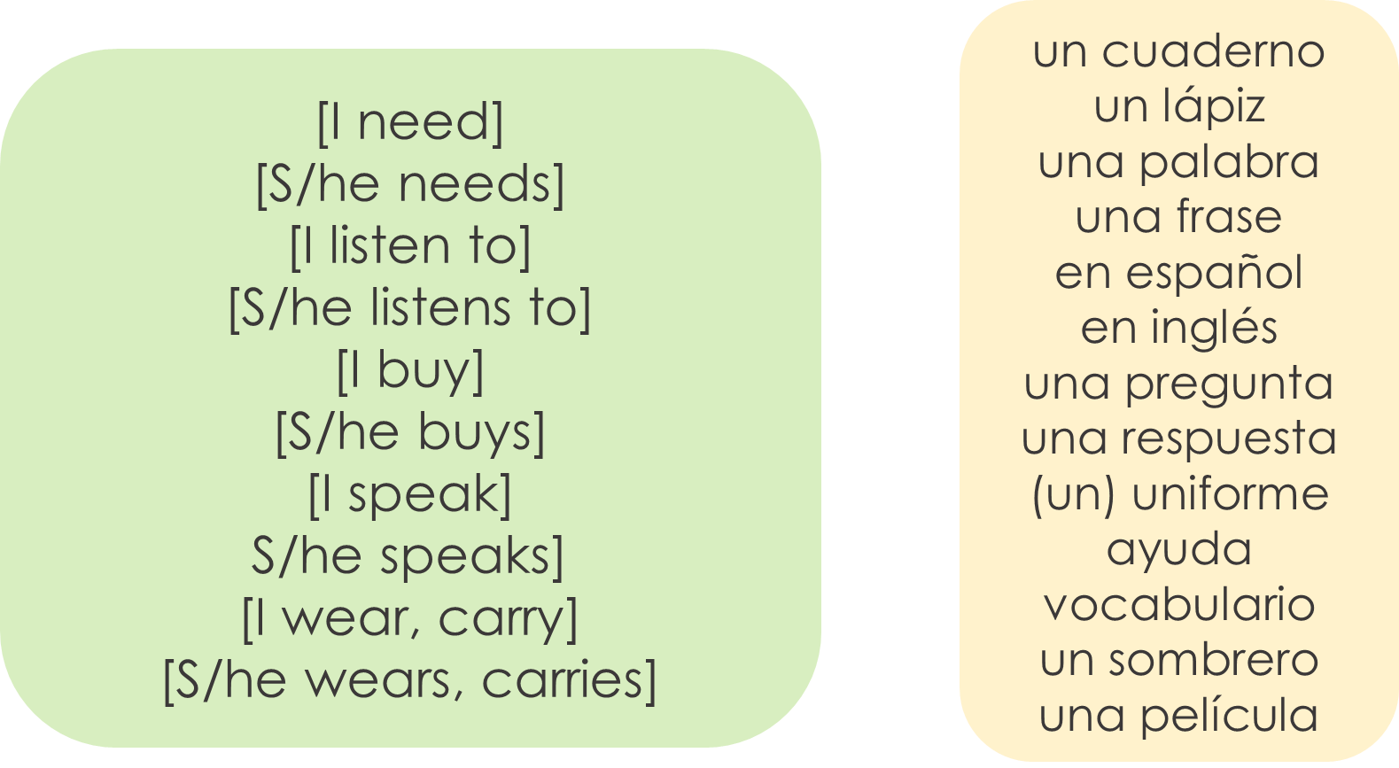
Rojo term 2 week 2
Saying what I and others do
2
Rojo term 2
escribir
Escribe en español. Can you get at least 15 points?
 | sad | where? | Do you have?
 | fantastic | smart, elegant | happy
 | a book | a question | an answer
 | you have | a bottle | a pencil case
 | I have | a pencil sharpener | important
 | a uniform | a film | with
 | to wear, carry | to buy, buying | a hat
x3
x2
x1
escribir
Escribe 5 frases en español.
Not all
combinations
are possible so translate your sentences into English to ensure they make
sense!
1
2
3
4
5
11

Slide 14
Rojo term 2 week 3
Saying what I and others do
3
Rojo term 2
pronunciar
Talking about activities you and others do
[ga]
[go]
Outdoor activities
ganar
lago
Write down the key language for this week.
vocabulario
caminar |  | el
nadar |  | la
mar |  | playa
pueblo |  | de
por
Definite articles: singular and plural
gramática
[the]
Remember! In Spanish, things, as well as people and animals, are either masculine or feminine. We say that they have gender.
This is
grammatical, not biological gender! A house (una casa) is not female, it is a feminine noun.
To say a (or an) in Spanish use un before a masculine noun and una before a feminine noun.
To say the before a singular noun, you use ‘el’ or ‘la’.
masculine |  | masculine
un pueblo | a village | el pueblo | the village
un uniforme | ___ uniform | el uniforme | ___ uniform
un museo | ___ museum | el museo | ___ museum
feminine |  | feminine
una playa | a beach | la playa | the beach
una montaña | ___ mountain | la montaña | ___ mountain
una fruta | ___ fruit | la fruta | ___ fruit
12

Slide 15
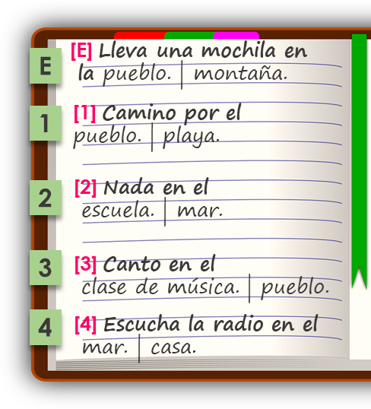
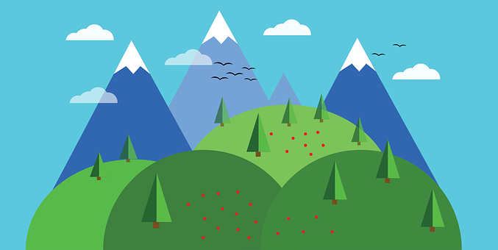
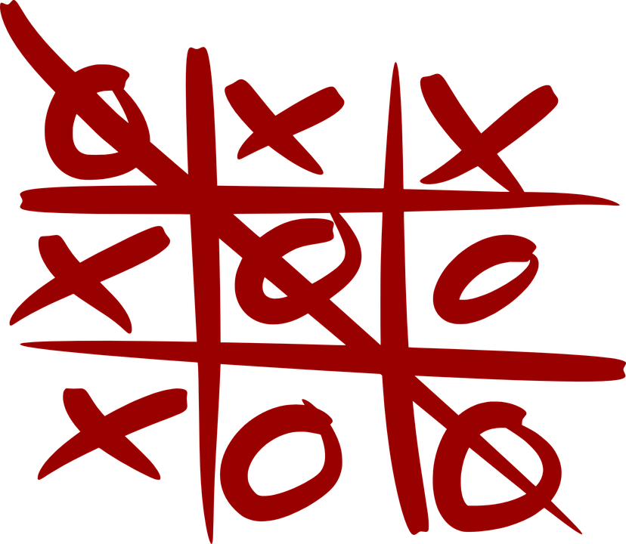
Rojo term 2 week 3
Saying what I and others do
3
Rojo term 2
leer
Sofía habla de actividades al aire libre*.
[A] ¿Es ‘I’ (Sofía) o ‘she’ (Ángela)?
[B] Choose the correct noun. Where is it?
Sofía (I) | Ángela (she) | Where?
E
mount_ _ _
1
2
3
4
(el) aire libre – the open air
escuchar
Sofía habla de las actividades al aire libre.
Escucha.
¿Es ‘el’ o ‘la’?
¿Quién es?
¿Es al aire libre?
¿dónde?
Playa | mar
Clases de inglés | pueblo
Mar | playa
Casa de Ángela | pueblo
Montaña | lago
Playa | pueblo
Sofía (I) or Ángela (she) | ¿al aire libre?
E | el | la
1 | el | la
2 | el | la
3 | el | la
4 | el | la
5 | el | la
escuchar
Escucha y escribe las letras.
pronunciar
 | ga | go
 |  |  | ma _ _
 |  |  | ne _ _ r
 |  |  | pe _ _ r
 |  |  | al _ _
 |  |  | jue _ _
 |  |  | pa _ _ r
 |  |  | fue _ _
Lee en orden alfabético.
E
ganar
1
domingo
a
↓
z
gato
lago
2
negar
mago
3
[something]
tengo
algo
4
pegar
pagar
5
juego
6
fuego
13

Slide 16
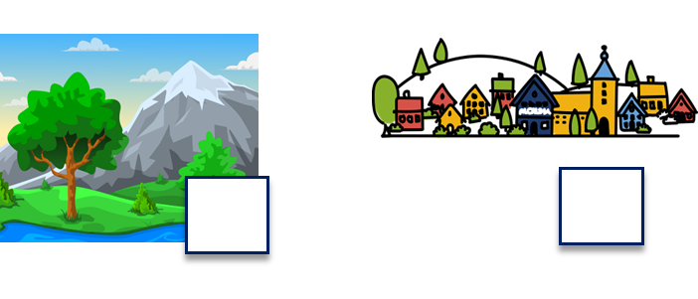
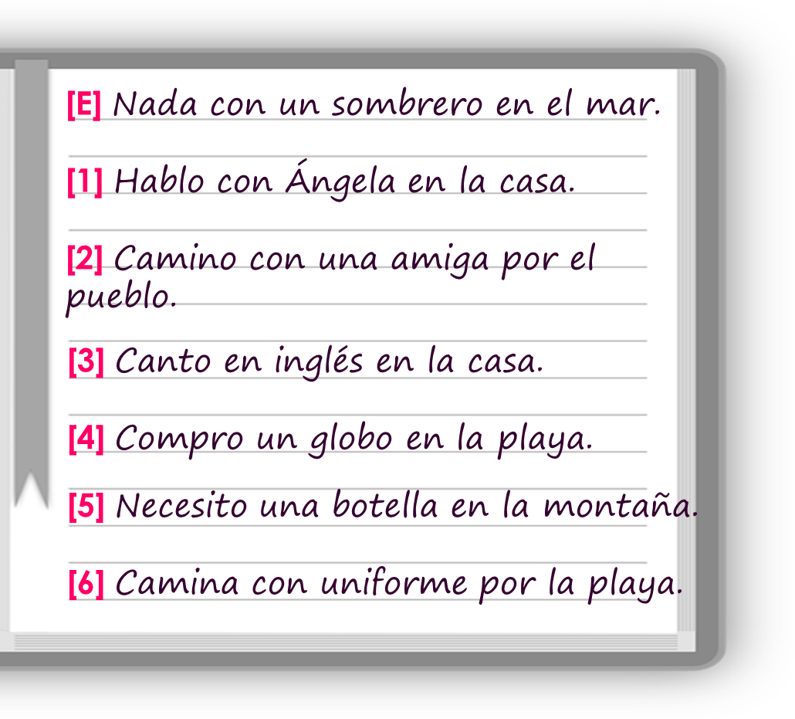
Rojo term 2 week 3
Saying what I and others do
3
Rojo term 2
a b ñ
vocabulario
[A] Escribe “un” / “una” o “el” / “la”.
 | definite (the) | indefinite (a/an)
E | ____ montaña | ____ montaña
1 | ____ regalo | ____ regalo
2 | ____ silla | ____ silla
3 | ____ mar | ____ mar
4 | ____ playa | ____ playa
5 | ____ familiar | ____ familiar
6 | ____ pueblo | ____ pueblo
[B] Escribe el número.
en & por
gramática
[prepositions]
To say ‘in’ in Spanish, we use ‘en’.
Ejemplo
Nado en el lago.
I swim in the lake.
‘Por’ is a preposition that is often used with verbs of movement. It can be translated in different ways in English,
Ejemplo
Camino por la playa.
I walk along the beach.
You can
decide which translation is best by looking at the context 😊.
I walk around the village.
Camino por el pueblo.
leer
Sofía habla sobre ella* y Quique. Completa las frases y escribe en inglés 📝.
14

Slide 17
Rojo term 2 week 3
Saying what I and others do
3
Rojo term 2
 | He swims with _____ hat in _____ __________.
 | _____ talk to Ángela in ____ ______________.
 | I _______ _______ _____ friend ______ the village.
 | _______ sing in English _______ _______ _______.
 | I buy ______ balloon _____ _______ ______________.
 | _____ _________ a bottle ____ the __________.
 | _____ _________ ______ uniform _______ ____ beach.
E
a
the
1
2
3
4
5
6
escuchar
Sofía habla con mamá Elena sobre* ella* y Luis.
Escucha y escribe el verbo.
¿Es una pregunta o una respuesta? Escribe ¿? o .
E | __________ a mi amigo en la clase
1 | __________ en inglés con el professor
2 | __________ una tarta en playa
3 | __________ el cuaderno en la excursion
4 | __________ por la montaña
5 | __________ con un familiar en el pueblo
sobre = about
ella = she
Add
Ahora traduce* las frases.
a full stop / question mark to your translations too!
traduce = translate
E | ___ _______ to my friend in __________
1 | _____ he _____ ___ ________ with ___ (male) ___________
2 | ___ _______ a cake ___ _____ __________
3 | ___ ___ _______ ___ ________ ________ on the trip
4 | _____ ____ _____ _______ the mountain(s)
5 | __ _____ to a _________ in ___ __________
15

Slide 18
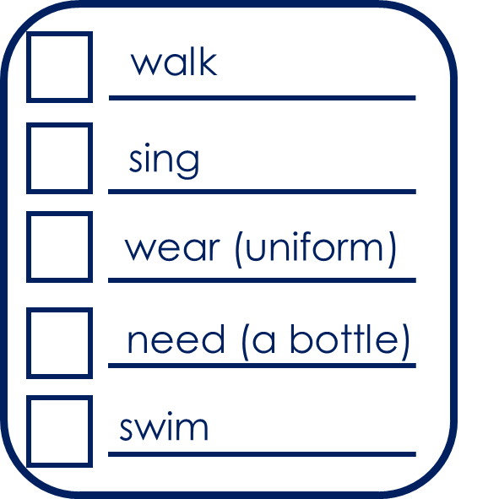
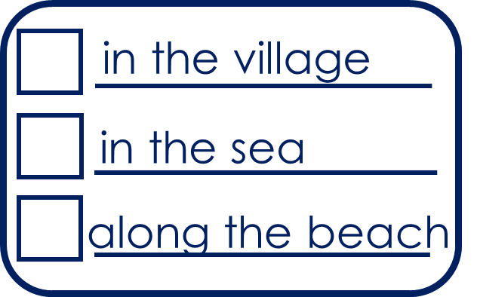
Rojo term 2 week 3
Saying what I and others do
3
Rojo term 2
hablar
Persona A: (Person B – turn to the next page.)
Round 2
Round 1
Your turn to ask!
Use your prompt card to ask questions.
Now listen to your partner and respond. Use your card to answer ‘yes’ or ‘no.
1) Pregunta y marca .
2) Escucha y responde.
leer
Escribe en inglés. Can you get at least 15 points?
 | es | siempre | normalmente
 | la silla | ser | soy
 | roja | amarillos | el familiar
 | de² | bonita | pequeñas
 | el | la | por
 | la montaña | la playa | el pueblo
 | caminar | nadar | el mar
x3
x2
x1
16

Slide 19
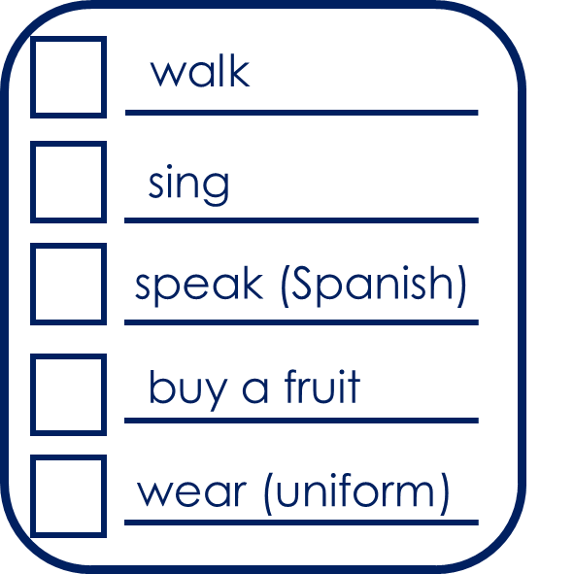
Rojo term 2 week 3
Saying what I and others do
3
Rojo term 2
hablar
Persona B. (Person A – see previous page.)
Round 2
Your turn to ask!
Round 1
Your turn to respond!
Listen to your partner and respond. Use your card to answer ‘yes’ or ‘no’.
Now use your prompt card to ask questions.
1) Escucha y responde.
2) Pregunta y marca .
escribir
Escribe en español. Can you get at least 15 points?
 | s/he, it is (trait) | always | usually
 | (the) chair | to be, being (trait) | I am (trait)
 | red (m) | yellow (m) | (the) relative
 | from, of | pretty (m) | small (m)
 | the (m) | the (f) | through, around, along
 | (the) mountain | (the) beach | (the) village
 | to walk, walking | to swim, swimming | (the) sea
x3
x2
x1
17

Slide 20
Rojo term 2 week 4
Saying what I and others do
4
Rojo term 2
pronunciar
Talking about activities you and others do
[gu]
por la mañana
Morning activities
gusano
La abuela Valeria
Write down the key language for this week.
vocabulario
pasar |  | (el) tiempo
visitar |  | (la) mañana
(la) mamá |  | (la) semana
(el) papa |  | de
Knowing who does what
gramática
[-ar verbs: ‘I’ vs. ‘you’]
In Spanish, the words for ‘I’ and ‘s/he’ (pronouns) are often unnecessary.
To mean ‘I’ with a verb, we remove –ar and add – o.
To mean ‘you’ with a verb, we remove –ar and add – as.
I
Ejemplo
you
Camino por la playa.
Caminas por la playa.
I walk along the beach.
You walk along the beach.
Translate the examples.
Nado en el mar. → ___________________________.
Nadas en el mar. → ______________________________.
18

Slide 21
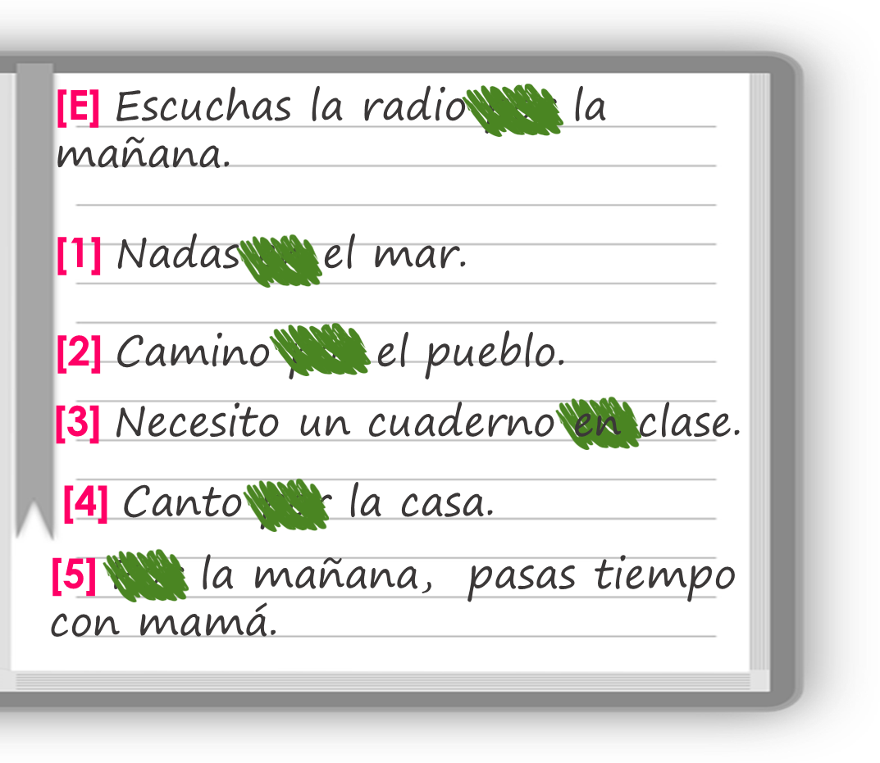
Rojo term 2 week 4
Saying what I and others do
4
Rojo term 2
escuchar
Sofía habla con Quique: ¿De quién habla?
Marca .
¿Qué información menciona? Marca .
Sofía (I) | Quique (you)
object | place | person
en inglés
E
f _ _ _ _
1
2
3
4
5
leer
Multiple meanings of ‘por’
Sofía escribe 📝.
gramática
You learnt ‘por’ is a preposition that is often used with verbs of
Habla de la rutina por la mañana.
movement.
Lee las frases ¿’en’ o ‘por’?
Marca
It can be translated in different ways in English.
Camino por el pueblo.
I walk around the village.
Camino por la playa.
I walk along the beach.
We also use ‘por’ to indicate the time of the day (morning, evening). In this case, it is translated as ‘in’.
Nado en el mar por la mañana.
I swim in the sea in the morning.
 | in | around
E
1
2
3
4
5
la rutina = routine
corrige = check, correct
Ahora escucha y corrige* la respuesta.
19

Slide 22
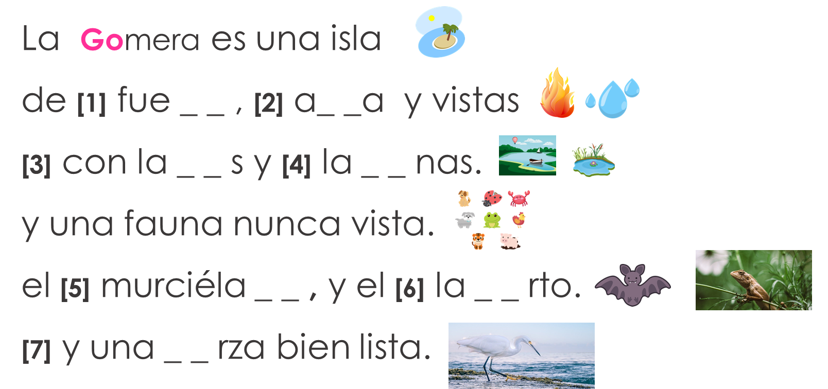
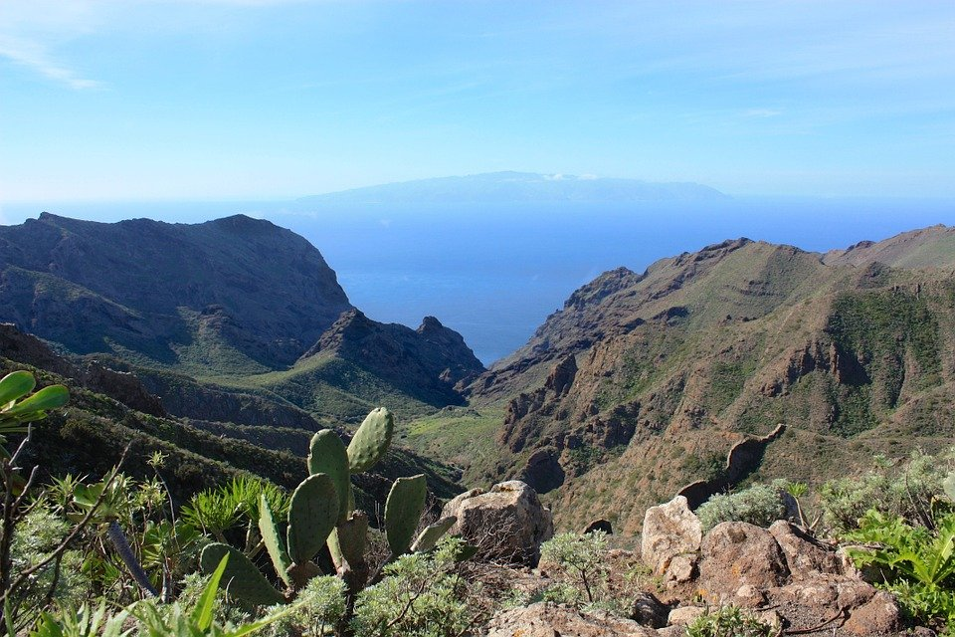
Rojo term 2 week 4
Saying what I and others do
4
Rojo term 2
leer
Ahora traduce* las frases al inglés.
traduce = translate
You
 | ____ listen to the radio __ the ________.
 | ____ ______ in the sea.
 | ____ walk ________ the village.
 | ____ ______ an exercise book ____ class.
 | ____ sing ________ the house.
 | ____ ____ _________, ____ _______ time with mum.
pronunciar
[A] Escucha. Escribe [ga] [go] or [gu].
La Gomera
[B] Practica el poema con tu pareja.
Knowing who does what
gramática
[-ar verbs: ‘I’, ‘you’, s/he, it’]
Camino - ____ walk
N _ _ _ - I swim
Caminas - ____ walk
N _ _ _ _ - you swim
Camina - ____ walks
N _ _ _ - s/he swims
20

Slide 23
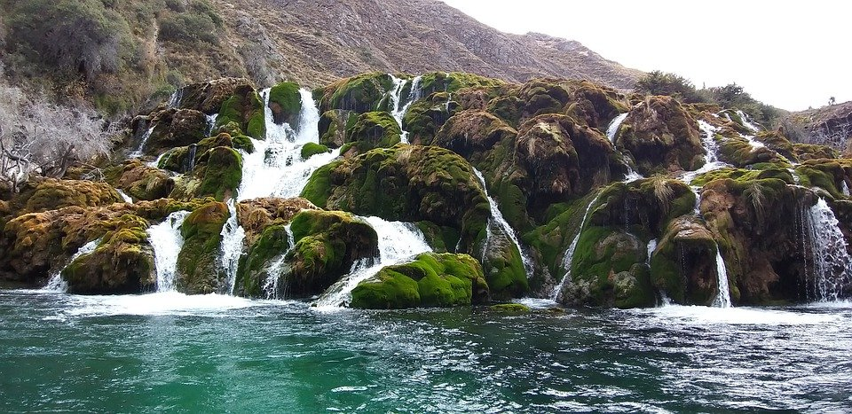
Rojo term 2 week 4
Saying what I and others do
4
Rojo term 2
leer
Sofía pasa tiempo con la abuela Valeria. ¿Quién es?
Sofía (I) | la abuela (she)
¿Qué?
pueblo casa
playa mar
montaña pueblo
mañana teléfono
tarta regalo
pueblo playa
E
1
2
3
4
5
As part of her English homework,
Sofía has tried to translate her list into English,
but she’s made some mistakes. Can you help her?
la abuela = grandma
 | You visit the beach with your grandma.
 | I swim in the lake with Quique.
 | She walks in the sea.
 | You talk with a relative for the morning.
 | You buy a ruler for Rubén and Ángela.
 | She wears a hat in the village.
I visit,
En Perú, Sofía visita Huancaya. Es un pueblo muy bonito y está en Lima.
Lima es la capital de Perú y está en el océano Pacífico.
Huancaya
Lima
21

Slide 24
Rojo term 2 week 4
Saying what I and others do
4
Rojo term 2
leer
Traduce la postal.
traduce = translate
(la) postal = postcard
escribir
Escribe en español. Can you get at least 15 points?
 | you are (trait) | Spain | Peru
 | fantastic | important | England
 | (the) Spanish | (the) phrase | (the) English
 | to sing, singing | to speak, speaking | to need, needing
 | (the) time | through, around, in | to listen, listening
 | (the) morning | (the) dad | (the) week
 | to spend (time) | to visit, visiting | (the) mum
x3
x2
x1
22

Slide 25
Rojo term 2 week 5
Saying what I and others do
5
Rojo term 2
pronunciar
Actividades…
Talking about activities you and others do.
Activities in and outside the classroom.
…con Ángela y Quique.
Write down the key language for this week.
vocabulario
aprender |  | (el) deporte
leer |  | (el) idioma
ver |  | (el)juego
Knowing who does what
gramática
[-er verbs: ‘I’ vs. ‘s/he, it’]
Some Spanish infinitives end in –er.
We know to mean ‘I’ & ‘s/he, it’ with a verb, the verb ending changes.
To mean ‘I’ with a verb, we remove –ar and add – o.
To mean ‘s/he, it’ with a verb, we remove –ar and add – e.
I
Ejemplo
s/he, it
Aprendo español en clase.
Aprende español en clase.
I learn Spanish in class.
S/he learns Spanish in class.
Translate the examples.
Aprendo inglés en clase. → ___________________________.
Aprende inglés en clase. → ___________________________.
23

Slide 26
Rojo term 2 week 5
Saying what I and others do
5
Rojo term 2
escuchar
Sofía habla de ella* y Ángela.
¿Quién es? Marca .
Rodea* la respuesta correcta.
Sofía (I) | Ángela (she)
información extra
with… a friend | mum | dad
a game | a sport | a question
at home | in class | in bed
a film | a present | a friend
in the mountain| in the morning
an answer | a language | a book
E
1
2
3
4
5
ella = she
rodea = circle
leer
¡Mi gemelo es diferente!
Personal ‘a’
gramática
Sofía habla de ella y de Quique.
[A] Lee. ¿Quién es? Marca .
In Spanish, after verbs such as ‘ver’ [to see, seeing] and ‘visitar’ [to visit, visiting], we need to use ‘a’ if what we see, or visit is a person or a pet.
This does not happen in English!
Place/object
person/pet
Visito el pueblo.
Visito a un amigo.
I visit the village.
I visit a friend.
 | Sofía | Quique | ‘a’
E
1
2
3
4
5
(el) gemelo = twin brother
[B] ¿Necesita ‘a’ o no?
24

Slide 27
Rojo term 2 week 5
Saying what I and others do
5
Rojo term 2
leer
[C] Ahora taduce las frases al inglés .
see
traduce = translate
 | I ____ my (female) __________ in class.
 | I ______ the ________ of Ángela.
 | He ________ a _______.
 | He _________ a _______ ____ mum.
 | He ______ Manchita from ____ ______.
 | I ______ with a _______ _____ vocabulary.
pronunciar
Escribe 📝 cinco palabras en secreto.
Tu compañero/a, adivina.
Escribe en inglés .
leer
1 |  | 6
2 |  | 7
3 |  | 8
4 |  | 9
5 |  | 10
(el/la) compañero/a = male/female partner
adivina = guesses
Yes/No questions
gramática
[A] Escucha.
¿Qué palabra es?
Turn a statement into a yes/no question by making your voice go up at the end.
escuchar
Leo un libro.
I read a book.
I learn | s/he learns | I read
¿Leo un libro?
Do I read a book?
s/he sees | s/he reads | I read
This works for any verb and any person (e.g., I, you, s/he).
s/he learns | I learn | I see
¿Lee una revista?
I see | s/he learns | s/he sees
Does she read a magazine?
I learn | s/he reads | I see
I read | I watch | s/he watches
25

Slide 28
Rojo term 2 week 5
Saying what I and others do
5
Rojo term 2
escuchar
¿Es una pregunta (?) o una respuesta (.)?
E | 1 | 2 | 3 | 4 | 5
otra vez = again
[B] Escucha otra vez. Use the correct words to translate what you hear. ⚠️There are some extra ones!
 | a game | a sport| at home | in class
 | an answer| a question| in Spanish | in English
 | a language | a sport | with mum| with dad
 | the mountain| the beach | the sea | and
 | a book | a newspaper | of | sport | culture
 | a concert| the| in | morning | a film
E
1
2
3
4
5
leer
Escribe en inglés. Can you get at least 15 points?
 | viernes | sábado | domingo
 | martes | miércoles | jueves
 | el día | ¿qué? | lunes
 | comprar | el sombrero | con
 | de | la película | llevar
 | el deporte | el idioma | el juego
 | aprender | leer | ver
x3
x2
x1
26

Slide 29
Rojo term 2 week 5
Saying what I and others do
5
Rojo term 2
escribir
Escribe en español. Can you get at least 15 points?
 | Friday | Saturday | Sunday
 | Tuesday | Wednesday | Thursday
 | (the) day | What? | Monday
 | to buy, buying | (the) hat | with
 | of, from | (the) film | to wear, carry
 | (the) sport | (the) language | (the) game
 | to learn, learning | to read, reading | to see, seeing
x3
x2
x1
escribir
Escribe cinco frases lógicas en español.
I | learn(s) | a film | with my teacher (f)
 |  | a friend (m) | on the beach
 |  | an answer | in class
He | read(s) | a question | of Spain
 |  | a book | of Perú
 |  | a magazine | in the morning
She | see(s) | a game | every day
 |  | a language | every week
 |  | a sport | in English
1
2
3
4
5
27

Slide 30
Rojo term 2 week 6
Saying what I and others do
6
Rojo term 2
pronunciar
Understanding and talking about activities I and others do in the classroom.
[que]
You know the SSC
en clase
paquete
[ca], [co], [cu].
The same /k/ sound in front of ‘e’ is [que] because [ce] is always a soft ‘c’ sound. E.g. celebrar.
Write down the key language for this week.
vocabulario
comprender |  | (la) información
(la) instrucción |  | (el) texto
Knowing who does what
gramática
[-er verbs: ‘I’ vs. ‘you’]
We know to mean ‘I’ & ‘you’ with a verb, the verb ending changes.
To mean ‘I’ with a verb, we remove –er and add – o.
To mean ‘you’ with a verb, we remove –er and add – es.
Ejemplo
I
comprender
you
Comprendo la instrucción.
Comprendes la instrucción.
I understand the instruction.
You understand the instruction.
Translate the examples.
Comprendo el texto. → _______________________________.
Comprendes el texto. → _______________________________.
28

Slide 31
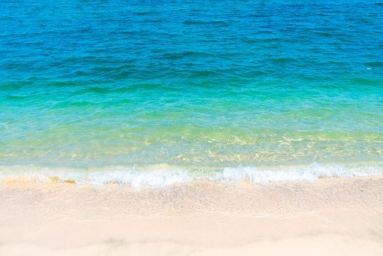
Rojo term 1 week 6
Saying what I and others do
6
Rojo term 2
escuchar
Sofía habla con Quique. ¿Quién es? Escribe ‘A’ o ‘B’.
Escucha y escribe el verbo. ¿Qué imagen es correcta?
 | verbo | imagen
E
1
?
2
3
4
5
pronunciar
Pronuncia las palabras y colecciona monedas .
Write your favourite words with the sound [que] and [ce] here.
[A] Escucha.
¿Qué palabra es?
[B] Escribe.
escuchar
the | a/an
___ __________ | una pelota
el boli | ___ __________
___ __________ | un teléfono
___ __________ | una pregunta
el gato | ___ __________
___ __________ | una botella
E
a | the
village | ball
1
a | the
pen | balloon
2
a | the
phone | sea
3
a | the
question | text
4
a | the
fruit | cat
5
a | the
bike | bottle
29

Slide 32
Rojo term 2 week 6
Saying what I and others do
6
Rojo term 2
Knowing who does what
gramática
[-er verbs: ‘I’, ‘you’, s/he, it’]
Leo - ____ read
A _ _ _ _ d _ - I learn
Lees - ____ read
A _ _ _ _ d _ _ - you learn
Lee - ____ reads
A _ _ _ _ _ _ - s/he learns
You can do this
with any –er verb
Try writing the I, you & s/he form of ‘comprender’ and ‘ver’. This is call ‘conjugating’ a verb 😉 .
leer
Escribe en inglés. Can you get at least 15 points?
 | el teléfono | un | una
 | tengo | la fruta | la pelota
 | de | por | tener
 | el pueblo | el | la
 | el mar | la montaña | la playa
 | el texto | caminar | nadar
 | comprender | la información | la instrucción
x3
x2
x1
30

Slide 33
Rojo term 2 week 6
Saying what I and others do
6
Rojo term 2
leer
Sofía escribe a Quique. ¿Quién es?
¿Es Sofía (I), Quique (you), o la abuela* (she)?
Escribe el verbo y el número (1-5) de la frase.
1 | Lees un libro en la cama.
2 | Aprendo el vocabulario con mamá.
3 | Ve la playa de casa.
4 | Comprendes el texto en inglés.
5 | Ves la información en clase.
[I]
[you]
[she]
escribir
Escribe en español. Can you get at least 15 points?
 | (the) phone | a/an (m) | a/an (f)
 | I have | (the) fruit | (the) ball
 | from, of | through, along | to have, having
 | (the) village | the (m) | the (f)
 | (the) sea | (the) mountain | (the) beach
 | (the) text | to walk, walking | to swim, swimming
 | to understand | (the) information | (the) instruction
x3
x2
x1
What do you do in class? And your friend?
31

Slide 34
Rojo term 2 week 7
Saying what I and others do
7
Rojo term 2
pronunciar
Using ‘tengo’, ‘tienes’ and ‘tiene’ to say how many things you and others have
[qui]
You know the SSC
quince
[ca], [co], [cu].
The same /k/ sound in front of ‘e’ is [que] because [ci] is always a soft ‘c’ sound. E.g. bicicleta.
Write down the key language for this week.
vocabulario
uno |  | siete
dos |  | ocho
tres |  | nueve
cuatro |  | diez
cinco |  | once
siete |  | doce
Tener: I have & s/he, it has
gramática
[to have, having]
To mean ‘I have’, use ‘tengo’.
To mean ‘you have’, use ‘tienes’.
I
you
Tengo una botella.
Tienes un juego.
I have a bottle.
You have a game.
💡 To talk about something in the plural (more than one), Spanish often adds an ‘s’ to the end of nouns ending in –o, -a or –e.
Tengo tres botellas.
Tienes cuatro juegos.
I have three bottles.
You have four games.
32

Slide 35
Rojo term 2 week 7
Saying what I and others do
7
Rojo term 2
escuchar
Sofía compite* con Quique.
¿Quién tiene qué? ¿1 o +1? Marca .
Escribe el número.
Sofía (I) | Ángela (she)
1 | +1
número
E
1
2
3
4
5
compite = competes
Tener: I, you, s/he
Translate the examples.
[to have, having]
tengo - ____ have
Ángela tiene un gato.
→ _______________________.
tienes - ____ have
Ángela tiene dos gatos.
tiene - ____ has
→ _______________________.
leer
Lee las frases y decide.
Who has more items?
_____________________________
b. Who could play tennis?
_____________________________
c. Who could look up words in a dictionary?
____________________________________________
d. Who has more valuable items?
e. Whose items do you prefer?
33

Slide 36
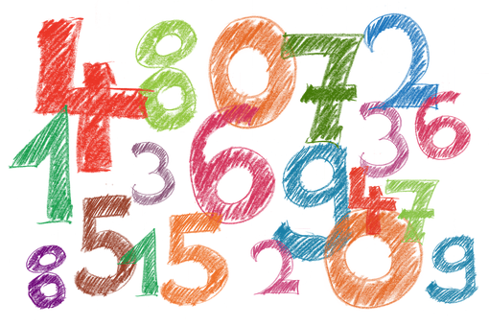
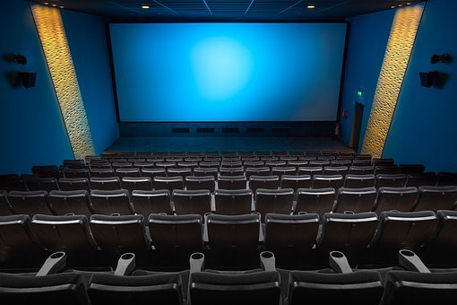
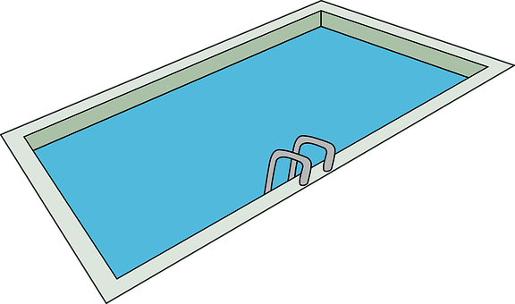
Rojo term 2 week 7
Saying what I and others do
7
Rojo term 2
escuchar
¡Bingo! Escribe seis números.
escuchar
¿Qué sonido es?
pronunciar
Escribe una palabra.
Tu compañero/a adivina.
 | qui | ci
 |  |  | a ____
 |  |  | ____ ne
 |  |  | tran____lo
 |  |  | pis____na
 |  |  | po____to
 |  |  | mari____ta
E
cocina
bicicleta
aquí
1
equipo
2
cine
mariquita
3
quince
poquito
piscina
4
[little bit]
tranquilo
5
la palabra = word
adivina = guess
Con un seis
y un cuatro
tengo la cara
de mi retrato
leer
Completa la suma y escribe el número.
 | la suma | el resultado 📝
 | dos (+) cuatro =
 | cinco (+) seis =
 | tres (+) dos =
 | ocho (+) uno =
 | doce (-) dos =
 | doce (-) ocho =
 | diez (-) tres =
E
1
2
3
4
5
6
34

Slide 37
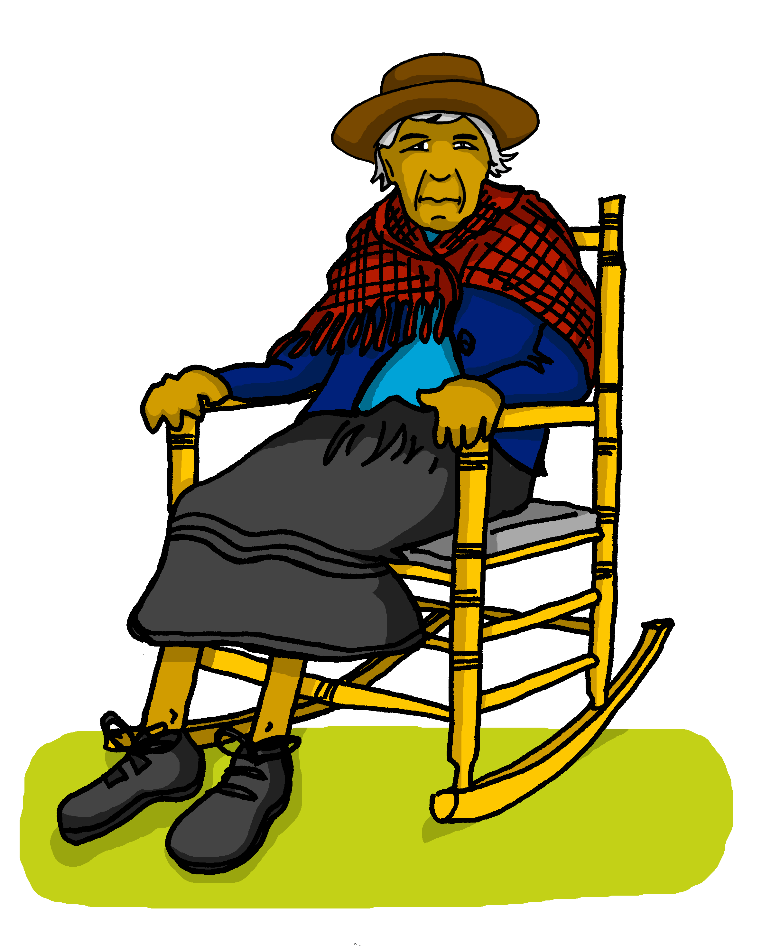
Rojo term 2 week 7
Saying what I and others do
7
Rojo term 2
Nouns in plural
Translate the examples.
Tengo dos sombreros.
💡 To talk about something in the plural (more than one), Spanish often adds an ‘s’ to the end of the noun ending in
–o, -a or –e.
→ _______________________.
Tienes tres regalos.
→ ___________________.
leer
Sofía manda mensajes a la abuela. Lee las frases.
¿Quién es? Marca .
 | Sofía (I) | Abuela Valeria (She)
E
1
2
3
4
5
manda = she sends
para mí = for me
leer
Escribe en inglés. Can you get at least 15 points?
 | la bicicleta | la cama | el gato
 | por | tiene | la amiga
 | la mañana | la semana | el tiempo
 | pasar | visitar | la mamá
 | diez | cinco | doce
 | siete | once | nueve
 | cuatro | ocho | seis
x3
x2
x1
35

Slide 38
Rojo term 2 week 7
Saying what I and others do
7
Rojo term 2
hablar
Escribe un número en secreto (1-8).
Tu compañero/a, adivina.
adivina = guess
¿Tienes [number] [item] ?
¡Sí…😊!
¡No…👎!
Remember
to make the nouns plural by adding an
‘s’ to the end of the noun ending in
–o, -a or –e.
escribir
Escribe en español. Can you get at least 15 points?
 | (the) bicycle | (the) bed | (the) cat
 | through, along | s/he, it has | (the) friend (f)
 | (the) morning | (the) week | (the) time
 | to pass, spend (time) | to visit, visiting | (the) mum
 | six | nine | eight
 | five | ten | eleven
 | four | seven | twelve
x3
x2
x1
36

Slide 39
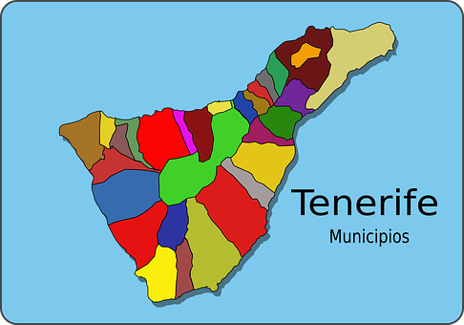
Rojo term 2 week 8
Saying what I and others do
8
Rojo term 2
pronunciar
Using ‘hay’, to say how many things there are.
Using ‘unos’ and ‘unas.
El carnaval
Write down the key language for this week.
vocabulario
hay |  | ¿cuántos?
unos |  | ¿cuántos?
unas
Talking about things in the plural
gramática
[Indefinite articles: unos / unas]
To mean ‘a/an’, use either un or una.
un libro
una pregunta
a book
a question
To mean ‘some’ before a plural noun, use ‘unos’ or ‘unas’.
unos libros
unas preguntas
some books
some questions
To mean ‘some’ for masculine plural noun, use ‘unos’.
To mean ‘some’ for feminine plural noun, use ‘unas’.
37

Slide 40
Rojo term 2 week 8
Saying what I and others do
8
Rojo term 2
leer
La lista de Sofía. [A] Escribe I o I+.
1+
[B] Escribe el número.
Hay
gramática
[there is; there are]
To mean ‘there is’ or ‘there are’ in Spanish, use ‘hay’.
Use ‘hay’ with both singular and plural nouns.
Hay unos estuches.
Hay una respuesta.
There are some pencil cases.
There is an answer.
escuchar
Sofía viaja* con la familia. Escucha y marca .
There is | There are
Ahora escucha y lee. ¿Es diferente?
Escribe la palabra 📝.
E
1
E
4
2
1
5
3
2
6
4
3
7
5
viaja = she travels
6
7
38

Slide 41
Rojo term 2 week 8
Saying what I and others do
8
Rojo term 2
¿Cuántos? | ¿Cuántas?
gramática
[How many?]
The question word ‘¿cuántos?’ & ‘¿cuántas?’agrees with the gender and number of the noun it describes.
Use ‘¿cuántos?’ with masculine plural nouns, and ‘¿cuántas?’ with feminine plural nouns.
¿Cuántos bolígrafos hay?
¿Cuántas botellas hay?
How many pens are there?
How many bottles are there?
escuchar
[A] Escucha las palabras y clasifica*.
¡Escribe la palabra 📝 !
[que] | [qui] | [ce] [ci]
___________ es una ciudad* de Perú.
___________ es la capital* de Ecuador.
pronunciar
la ciudad = city | la capital = capital
[B] Practica el trabalenguas .
Quique quiere cinco quesos y quince taquitos chiquitos.
lento
normal
rápido
la suma = sum
más = plus menos = minus
igual a = equals
leer
[A] Lee las sumas y escribe el resultado.
 | dos + cinco =
 | cuatro + seis =
 | uno + siete =
 | nueve + tres =
 | once - dos =
 | ocho + cuatro =
E
3
1
4
2
5
39

Slide 42
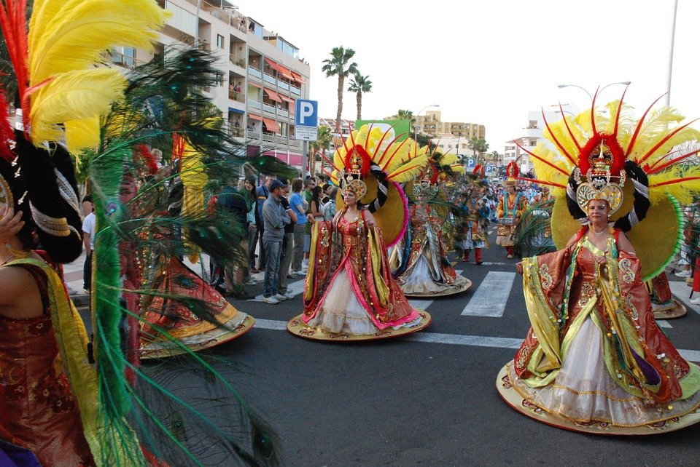
Rojo term 2 week 8
Saying what I and others do
8
Rojo term 2
hablar
[B] Continúa la serie.
 | 2, ___, 6, ___, 10
 | 12, 11, 10, ___ ___ ___ ___
 | 1, 3, 5, ___ ___ ___
 | 11, 9, 7, ___ ___ ___
3
 | 1, 2, 3, 4, 5, ___ ___ ___ ___
 | 10, 9, 8, 7, ___ ___ ___ ___
 | 2, 1, 3, 1, 4, 1 ___ ___ ___ ___ ___ ___
4
E
1
5
2
6
leer
[A] Lee y busca el vocabulario.
1
Las Islas Canarias es un grupo de islas al oeste de África.
Hay siete islas en total.
En Tenerife hay un carnaval muy importante en febrero.
2
3
escuchar
[B] Escucha y escribe en inglés.
In Tenerife ___________________.
In Carnaval ________ more than __________.
In Tenerife ___________________.
In Tenerife ___________________.
In Tenerife __________ more than ______________.
In Tenerife ___________________.
E
3
1
4
2
5
leer
Escribe en inglés. Can you get at least 15 points?
 | la pregunta | la respuesta | el sacapuntas
 | tienes | la botella | el estuche
 | el idioma | el juego | de
 | leer | ver | el deporte
 | aprender | una | tiene
 | cuántos | hay | unas
 | cuántas | unos | un
x3
x2
x1
40

Slide 43
Rojo term 2 week 8
Saying what I and others do
8
Rojo term 2
escribir
Escribe en español. Can you get at least 15 points?
 | (the) question | (the) answer | (the) pencil sharpener
 | you have | (the) bottle | (the) pencil case
 | (the) language | (the) sport | of, from
 | to read, reading | to see, seeing | (the) sport
 | to learn, learning | a/an (f) | s/he, it has
 | how many (mpl) | how many (fpl) | a/an (m)
 | there is, there are | some (f., pl.) | some (m., pl.)
x3
x2
x1
escribir
Escribe en español. You can use the words to help you.
Don’t
forget capital letters and full stops!
1
There is a question.
_________________________________
2
There are some answers.
_____________________________
2
There are 11 mountains.
______________________________
3
How many balls are there?
_____________________________________________
4
How many games are there?
_____________________________________________
41

Slide 44
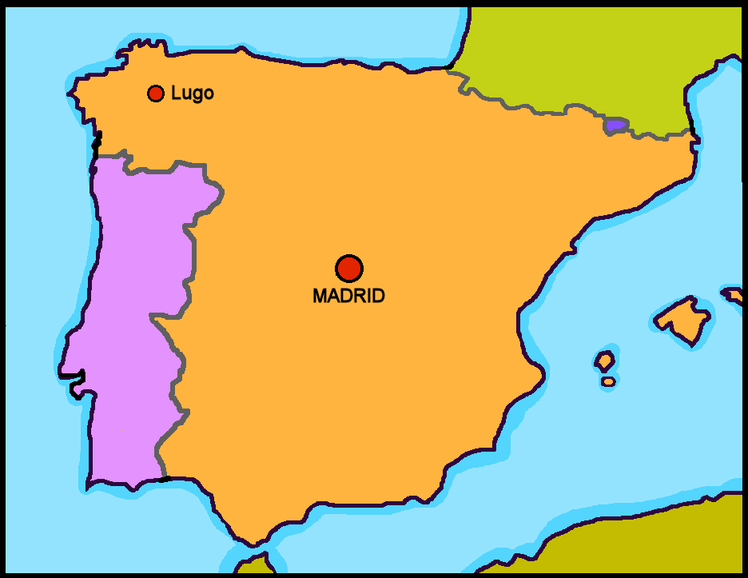
Rojo term 2 week 9
Saying what I and others do
9
Rojo term 2
Poesía
Read a Spanish poem.
‘Redondo’ de Gloria Fuertes
pronunciar
[A] Lee los nombres* con tu compañero/a.
¿Es un nombre de chica o de chico ?
[B] ¿Cuál es tu nombre favorito?
el nombre = name, noun
leer
Gloria Fuertes: una poetisa
Gloria Fuertes es una poetisa* de España.
Es de Madrid.
En la imagen hay ….
un perro.
una silla.
un gato.
(la) poetisa = female poet
42
la poetisa = female poet

Slide 45
Rojo term 2 week 9
Saying what I and others do
9
Rojo term 2
escuchar
Escucha y completa el poema.
tío Ramón el sol la pelota el reloj
la luna el botón la galleta el tambor
Completa = complete
E
Redonda es ____________ ____________ .
Redondo es ____________ ____________ .
Redonda es ____________ ____________ .
Redondo es ____________ ____________ .
Redonda es ____________ ____________ .
Redondo es ____________ ____________ .
Redondo es ____________ ____________ .
de mi tío ____________ ____________ .
1
2
3
4
5
6
7
hablar
Lee el poema con tu compañero/a.
Lee el poema con tono triste 😞.
Lee el poema con tono contento 😊.
el tono = tone
43
la poetisa = female poet

Slide 46
Rojo term 2 week 9
Saying what I and others do
9
Rojo term 2
escribir
Adapta el poema con palabras ‘redondas’.
Unos ejemplos
el yoyó la tarta el globo la pizza
la fruta el queso el sombrero
adapta = adapt
[OR 🏆 use a dictionary to look up other ‘round’ nouns]
E
Redonda es ____________ ____________ .
Redondo es ____________ ____________ .
Redonda es ____________ ____________ .
Redondo es ____________ ____________ .
Redonda es ____________ ____________ .
Redondo es ____________ ____________ .
Redondo es ____________ ____________ .
de mi tío ____________ ____________ .
1
2
3
4
5
6
7
Gloria Fuertes
44
la poetisa = female poet

Slide 47
Rojo term 2 week 10+11
Revisión
10
11
Rojo term 2
escribir
Busca 🔎 en la imagen.
huevos 🥚
conejos 🐰
flores🌷
1 Escribe 📝.
¿Cuántos huevos hay?
Hay _____ ___________.
¿Cuántos conejos hay?
Hay _____ ___________.
¿Cuántas flores rosas hay?
Hay _____ ___________.
leer
Un mensaje:
2 Use the eggs to decipher the message:
3 Unscramble the English letters to translate the message into English.
pahpy sEtare ➡ _ _ _ _ _ _ _ _ _ _
45
la poetisa = female poet

Slide 48
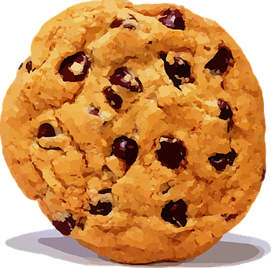
Rojo term 2 week 9 - materials
¦
¦
¦
¦
¦
¦
¦
¦
¦
¦
¦
¦
¦
¦
¦
¦
¦
¦
¦
¦
¦
¦
¦
¦
¦
¦
¦
¦
¦
¦
¦
¦
¦
¦
¦
Rojo term 2
Redonda es | la luna
Redondo es | el sol
Redonda es | la pelota
Redondo es | el tambor
Redonda es | la galleta
Redondo es | el botón
Redondo es | el reloj
de mi tío | Ramón
46

