Slide 1
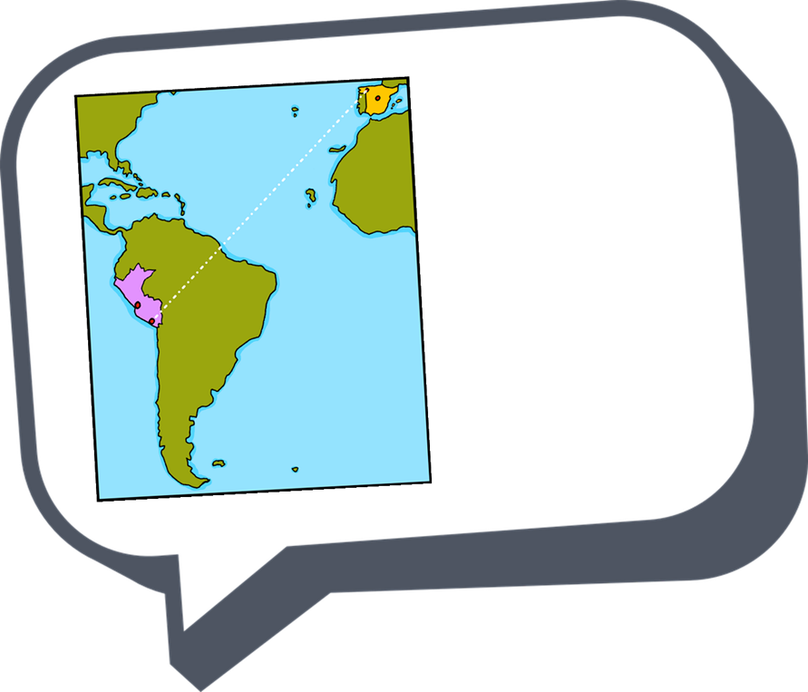
español - cover
Rojo Term 1
¡hola!
español
Nombre : ……………………………………………….
Profesor (a) : ……………………………………..
Clase : ……………………………………………..

Slide 2
Contents
Contents | page
Introduction: La familia Mamani Flores | 1
Fonética | 2
Term 1 Learning Overview | 3
1. Greeting and responding to the register | 4-6
2. Greeting and responding to the register | 7-9
3. Describing how I’m feeling | 10-12
4. Describing how someone else is feeling; asking questions | 13-15
5. Describing how someone else is feeling; asking questions | 16-18
6. Describing myself, describing someone else | 19-21
7. Describing myself, describing someone else; talking about origin | 22-24
8. Saying what day of the week it is today | 25-27
9. Saying what I have | 28-30
10. Saying what I have and someone else has | 31-33
11. Talking about having, asking yes/no questions | 34-36
12. Talking about having; describing | 37-39
13 & 14. Christmas in Spain | 40-43

Slide 3
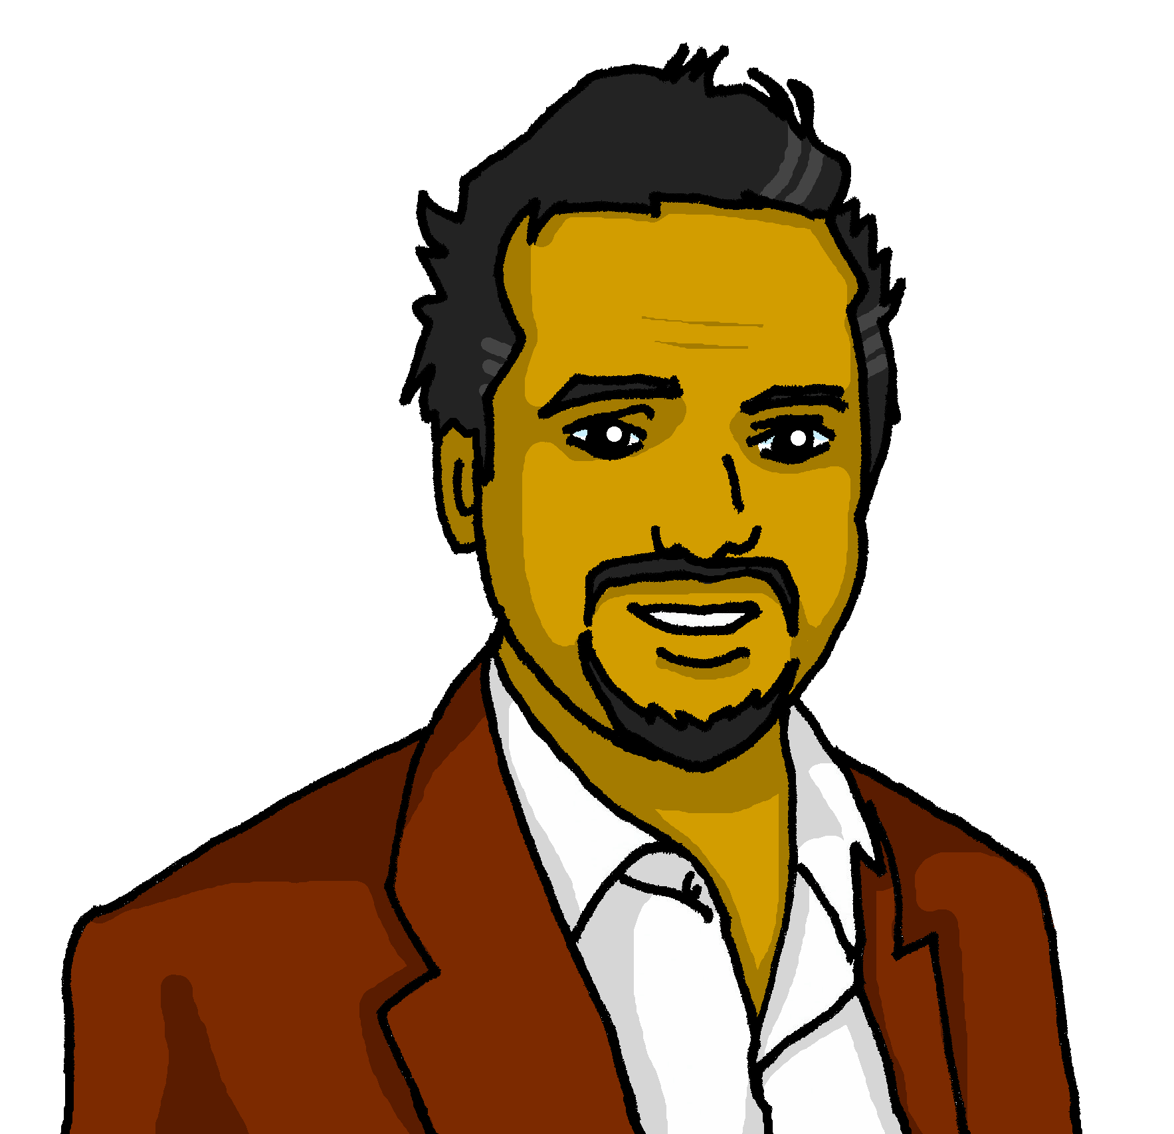
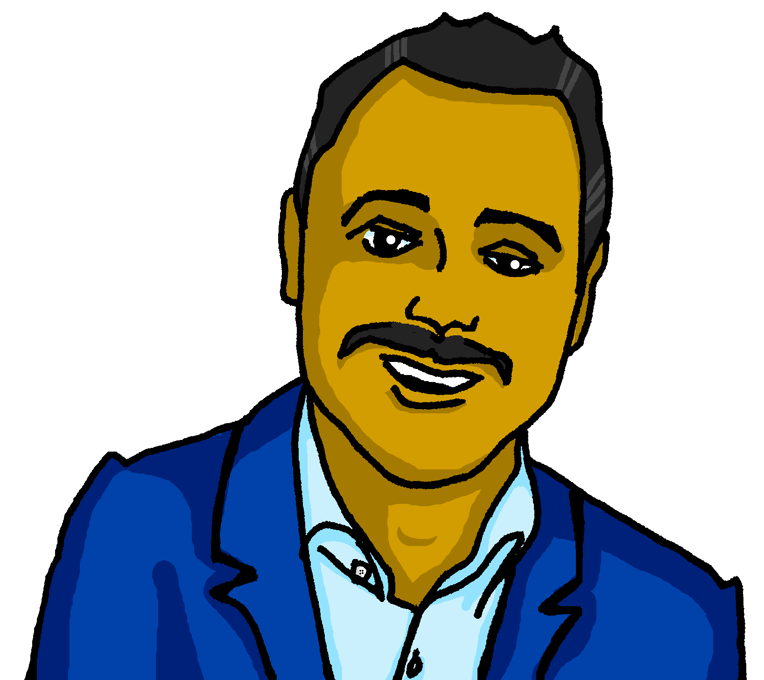
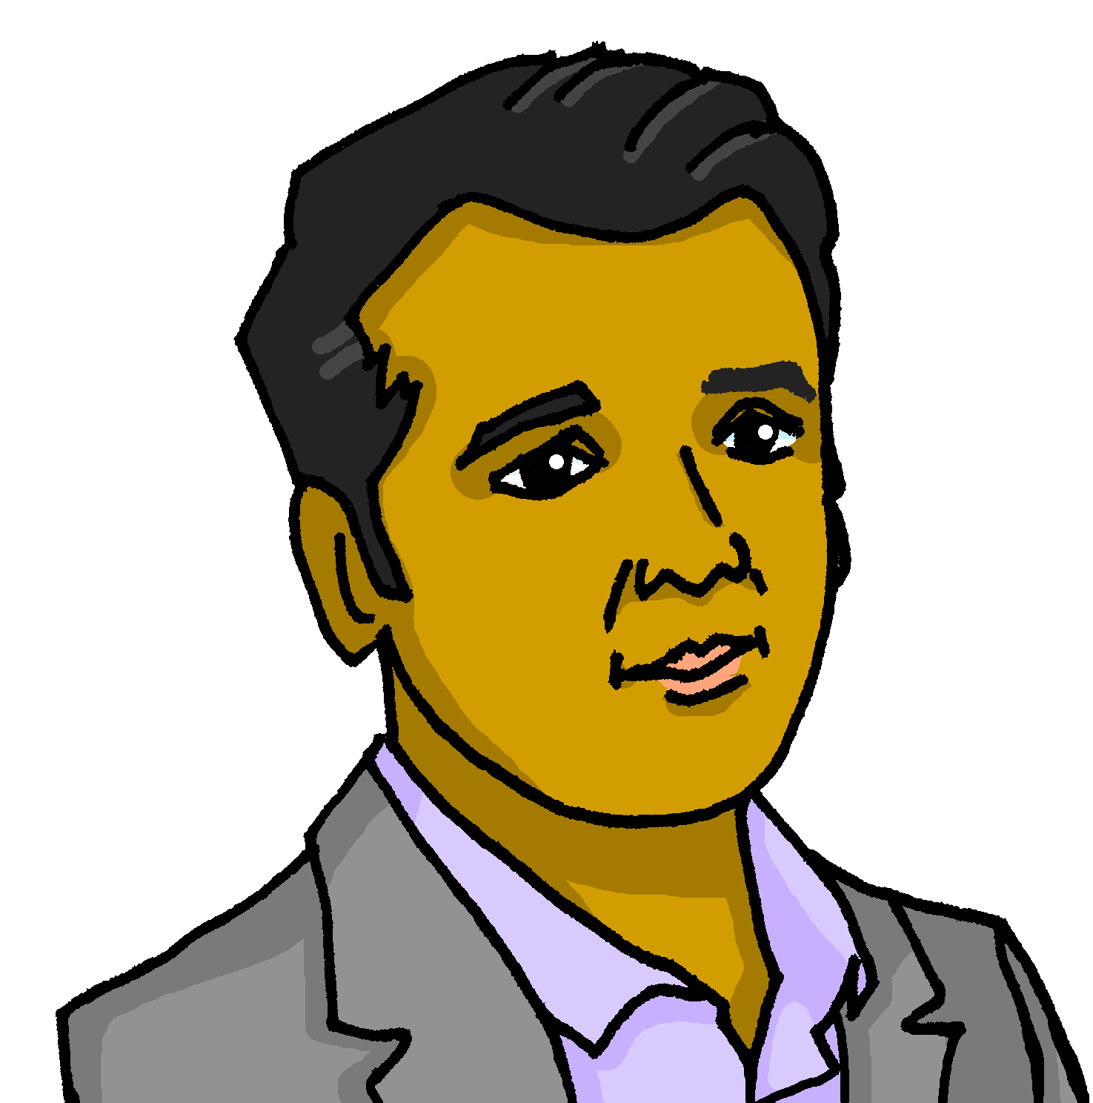
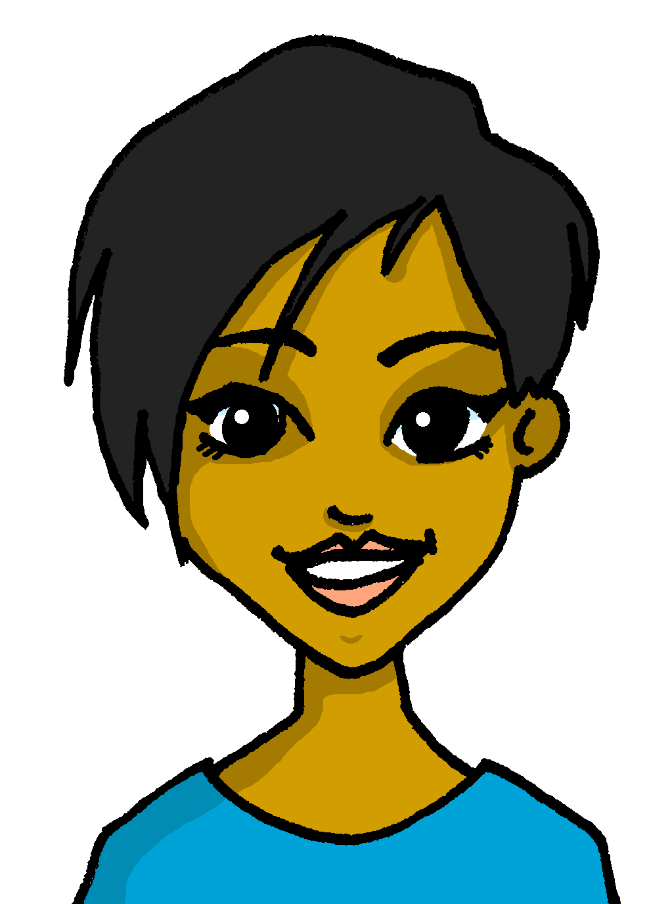
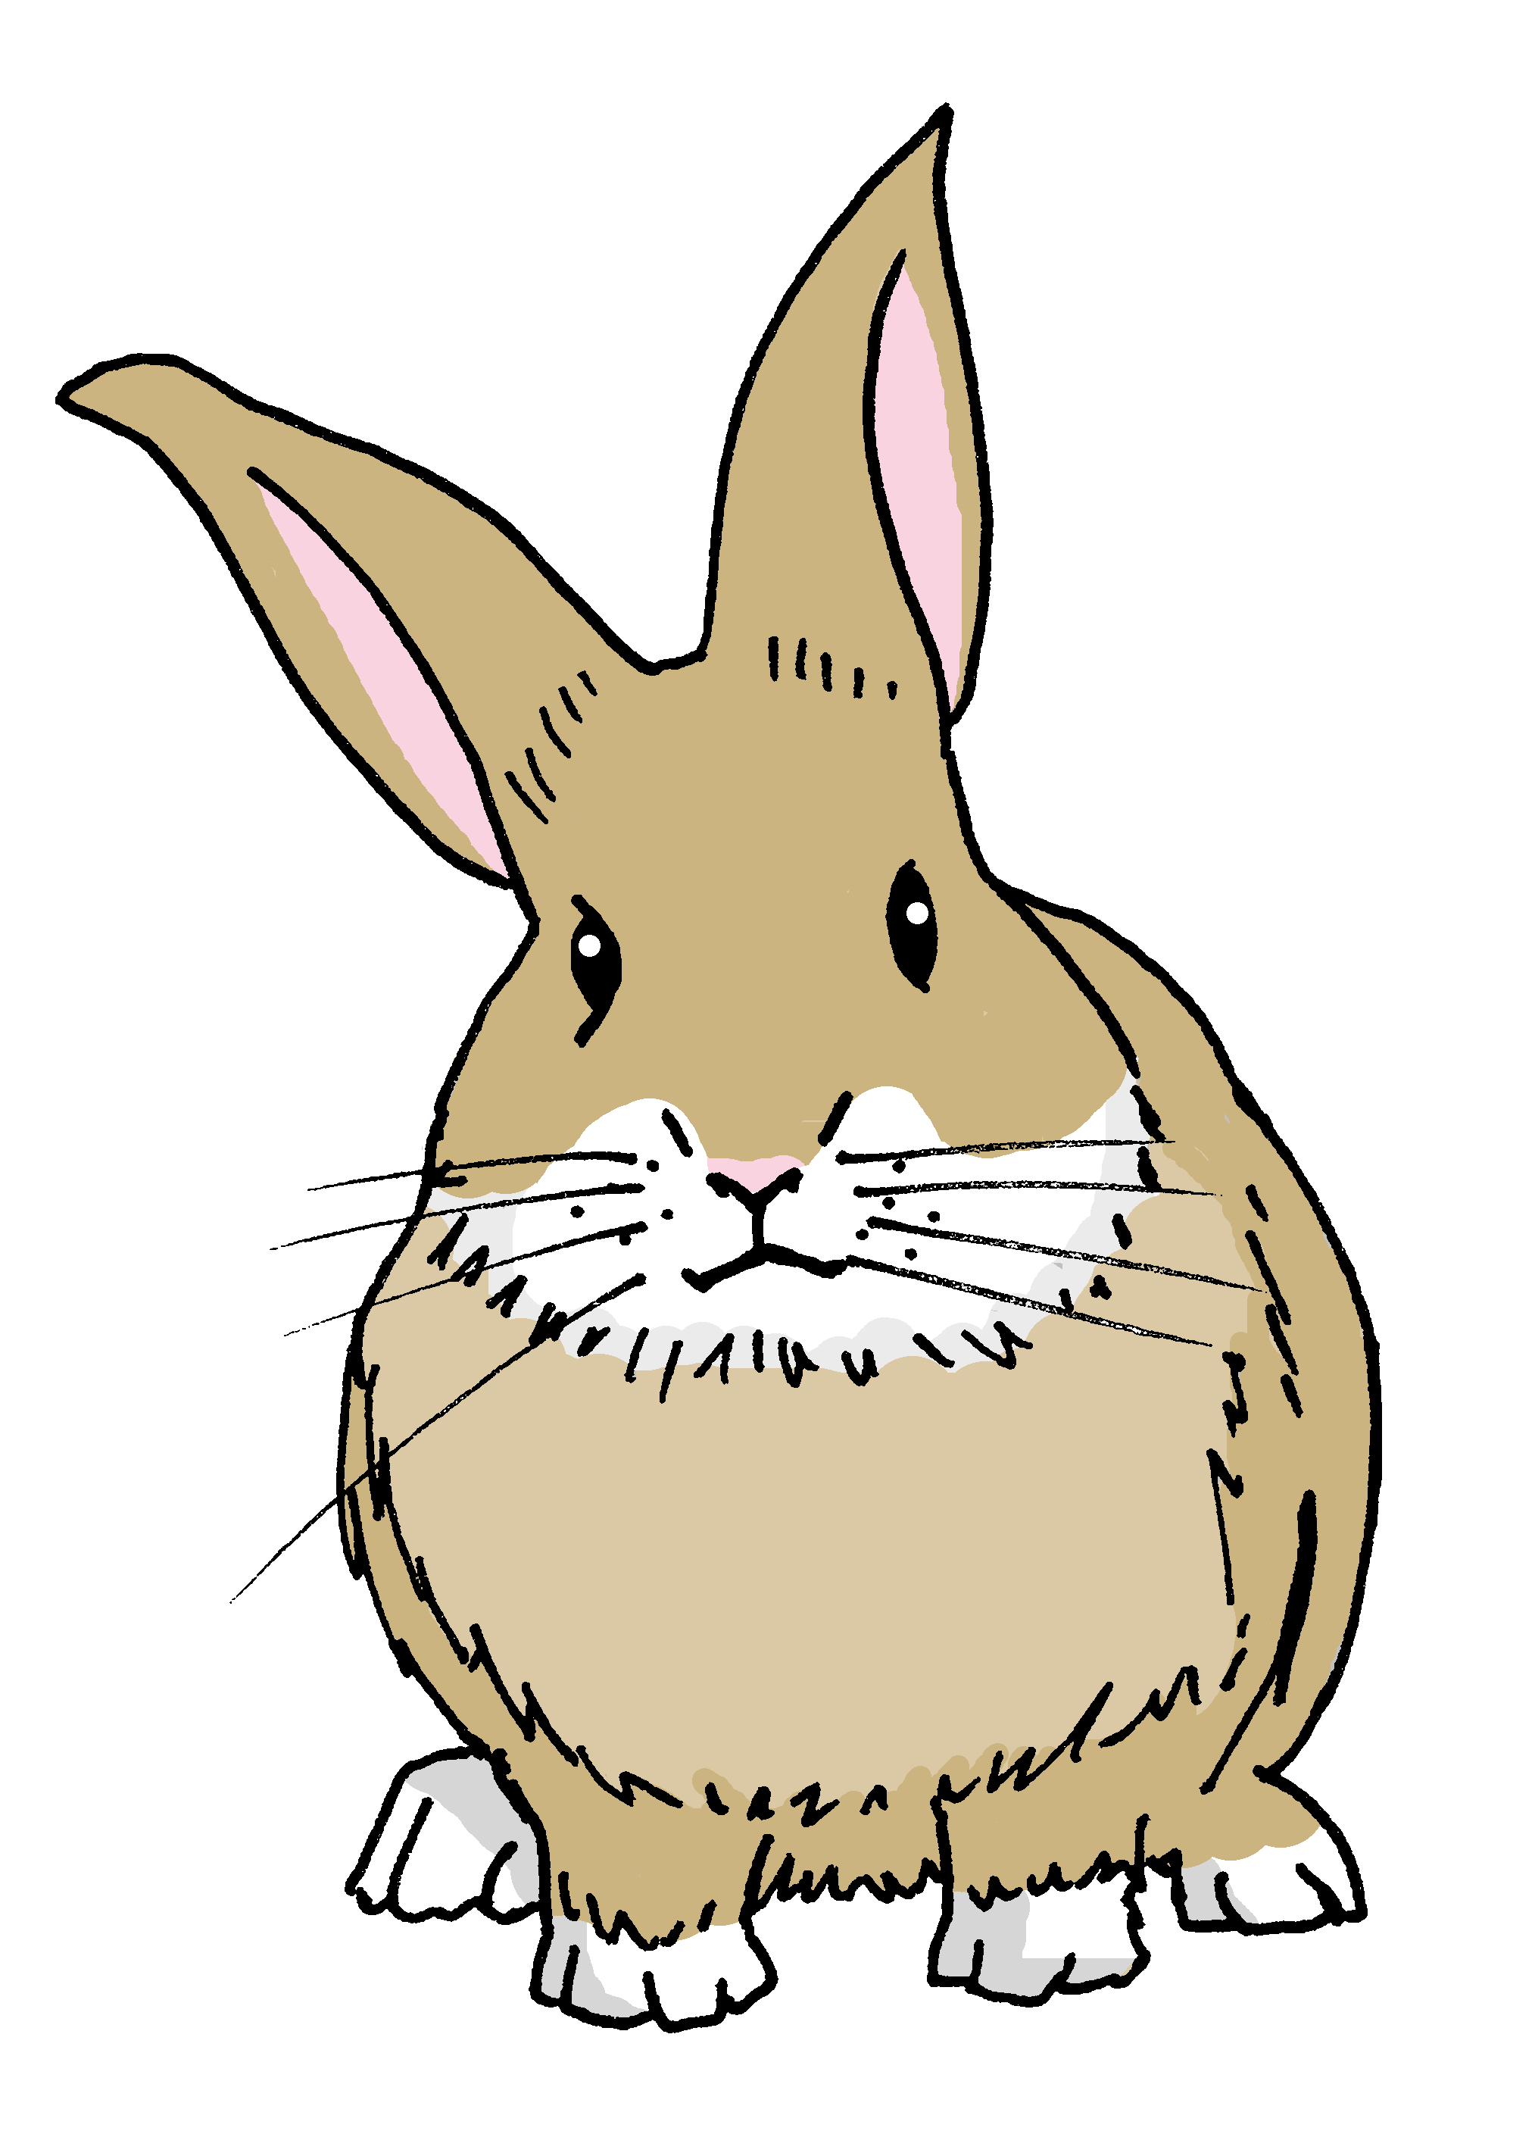
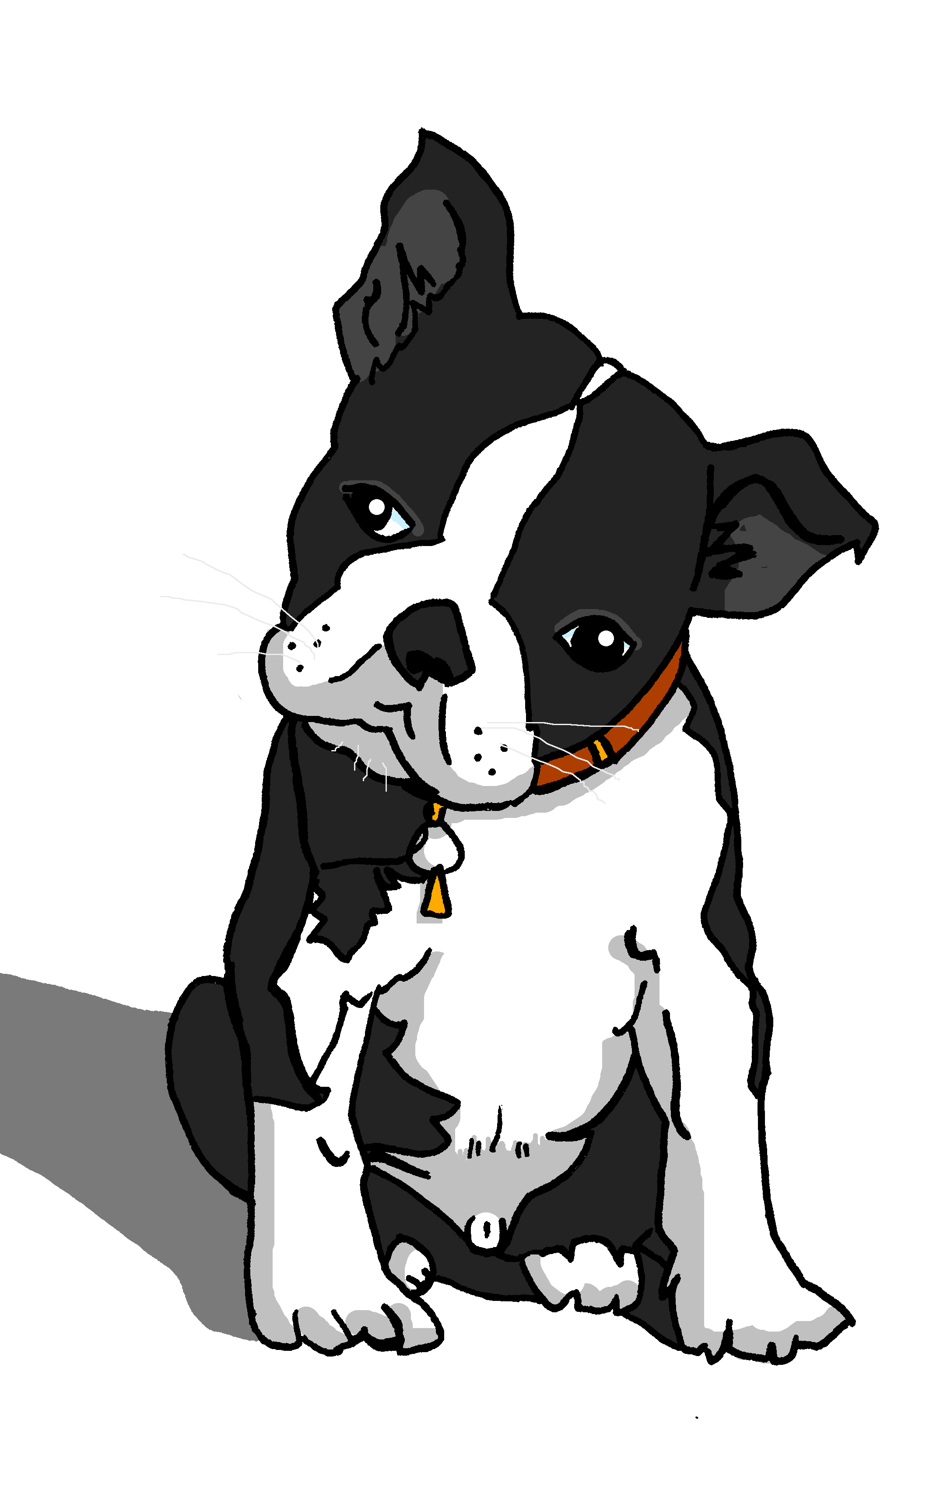
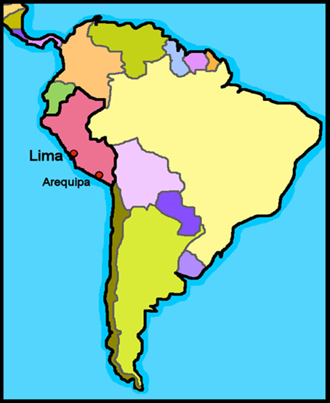
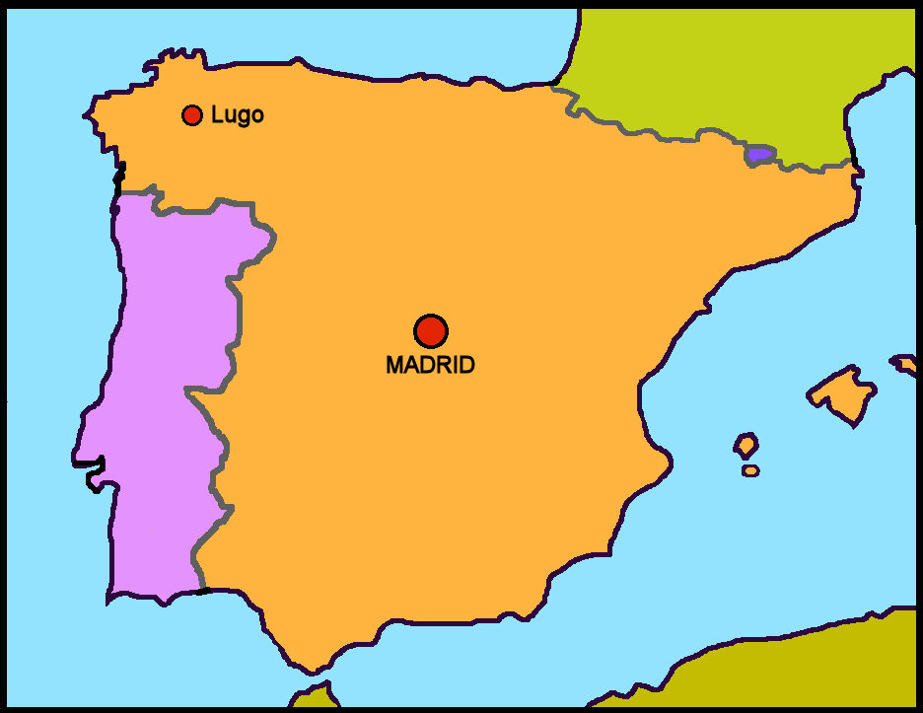
Characters
La familia Mamani Flores
Valeria
Miguel
Elena
Pedro
Hugo
Jorge
Ceci
Quique
Sofía
Luis
amigos
mascotas
Ángela
Pancho
Rubén
Manchita
Santi
España
Barcelona
Perú
Valencia
Granada
We say ‘Hispanic World’ to mean Spanish-speaking peoples and countries.
Spanish is the official language of 20 countries across. 18 of these countries are in America, 1 in Europe (Spain) and 1 in Africa (Equatorial Guinea).

Slide 4
Term overview
Term 1 learning
UNIT | Context CommunicationCulture | Key ideas (GRAMMAR) | PHONICS | VOCABULARY
Unit 1 (W1-8) | Describing me and others in class in Perú and in Spain | Talking about being Essential verb: to be, being – ESTAR I am – estoy you are – estás he is – está she is – está it is, it’s – está Essential verb: to be, being – SER I am – soy you are – eres he is – es she is – es it is, it’s – es Adjective agreement for masculine/feminine Yes/no questions with raised intonation | Vowels [a] [e] [i] [o] [u] SSC [ca] [co] [cu] | Simple greetings Verb estar Range of adjectives Days of the week
Unit 2 (W9-12) | Saying what I and others have at home with friends | Talking about having Essential verb: to have, having – TENER I have – tengo you have – tienes he has – tiene she has –tiene Indefinite, singular Post-nominal adjective gender agreement Yes/no questions with raised intonation | SSC [ce] SSC [ci] SSC [z] | Verb tener Range of singular masculine and feminine nouns
Unit 3 (W13-14) | Revision Christmas | Revisit key ideas | Revisit SSC | Revisit vocabulary

Slide 5
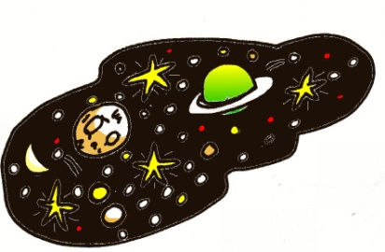
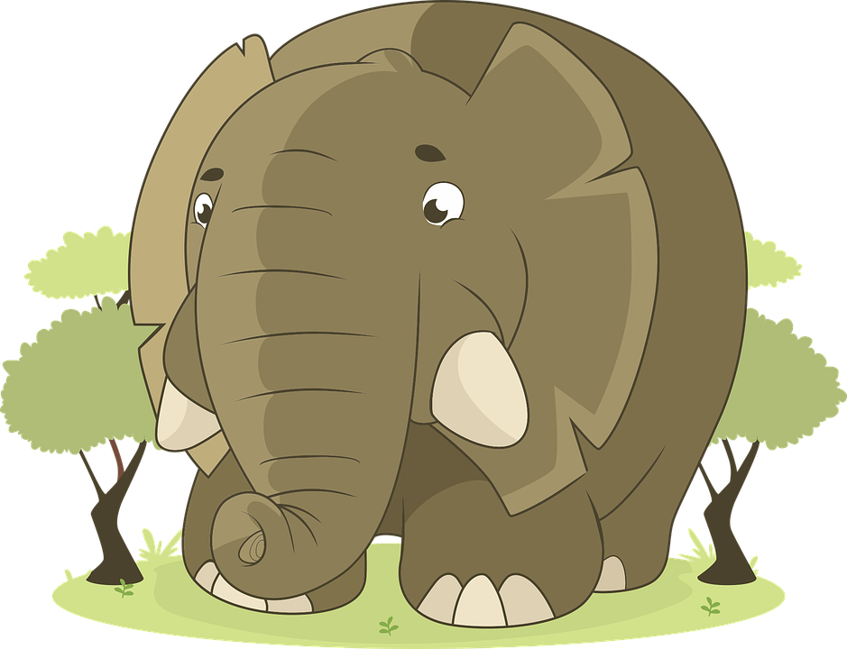
Phonics
Phonics
[a]
[o]
[u]
Phonics
Spanish vowels are usually short and open!
casa
dos
universo
[e]
[i]
elefante
idea
[ca]
[co]
[cu]
These 3 sound like [k]
cama
[to count]
contar
cucaracha
[ce]
[ci]
[z]
These 3 sound like [th] in ‘theatre’.
centro
[to say, tell]
decir
zapato

Slide 6
Rojo term 1 week 1
Describing me and others
1
Rojo term 1
pronunciar
Greetings
Understanding and responding to the register in class
[a]
[o]
casa
dos
Write down the key language for this week.
vocabulario
presente |  | estar
ausente |  | estoy
aquí |  | está
allí |  | hola
‘estar’ [to be | being] (with location)
gramática
In Spanish the verb estar means ‘to be’ when describing location.
Estoy
I am
he is ,
she is
=
Está
It is,
=
Translate the examples.
Estoy presente. → _______________________________.
Está presente. → _______________________________.
4

Slide 7
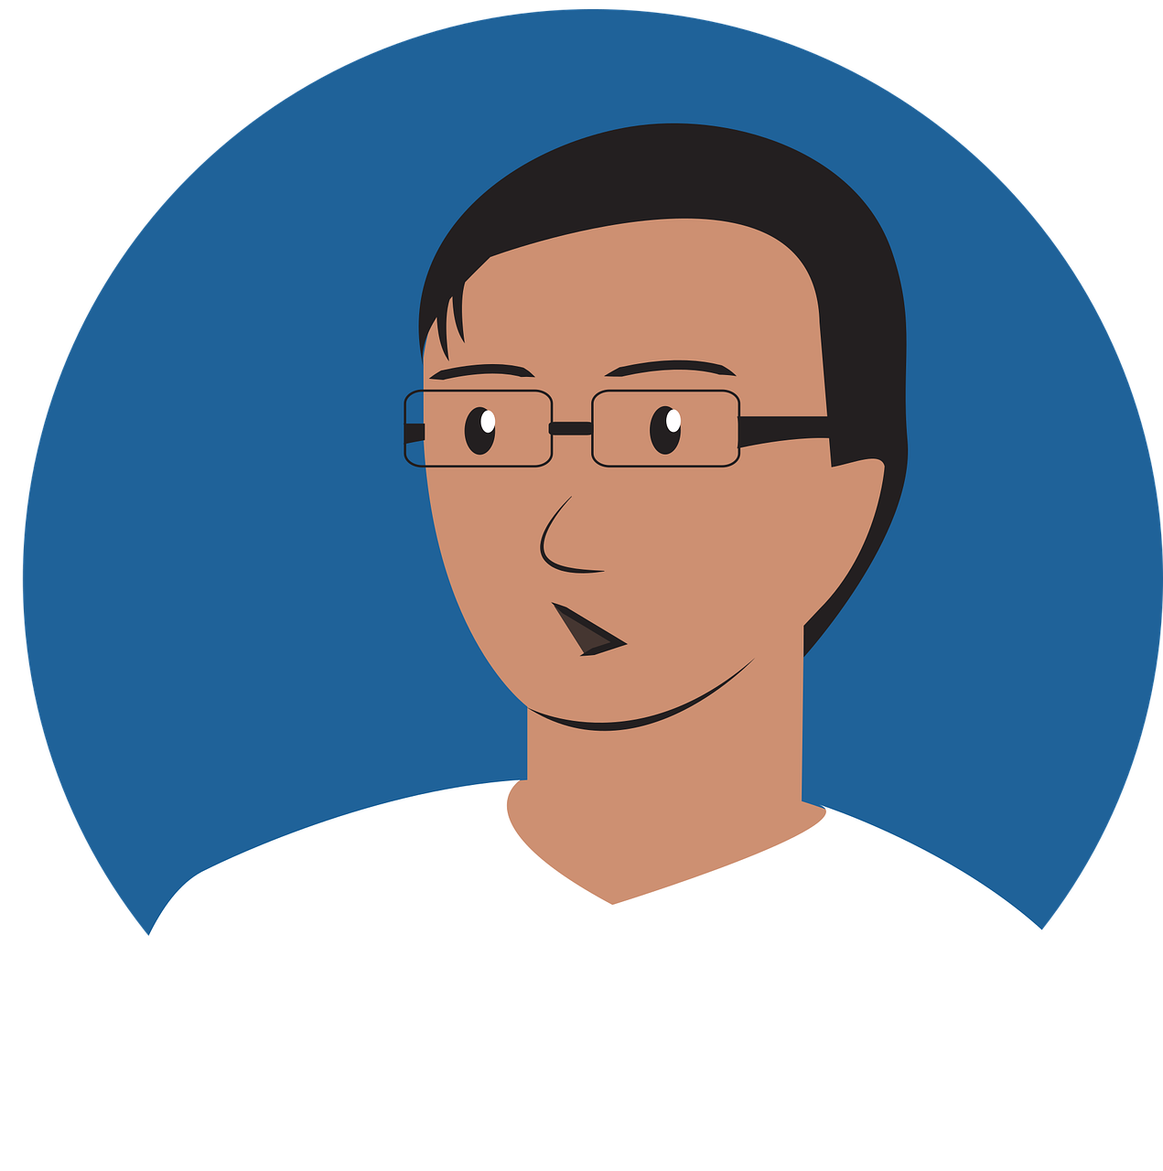
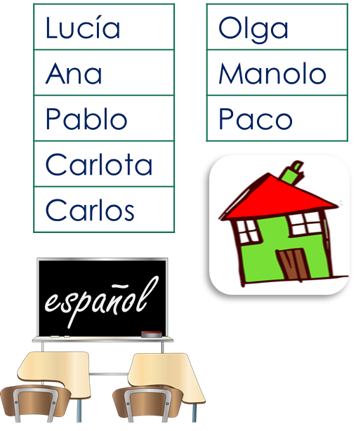
Rojo term 1 week 1
Describing me and others
1
Rojo term 1
leer
El señor Mora has taken the register.
Circle the correct answer.
E | Lucía está | ausente. | presente.
1 | Ana está | ausente. | presente.
2 | Manolo está | ausente. | presente.
3 | Carlos está | ausente. | presente.
4 | Paco está | ausente. | presente.
5 | Pablo está | ausente. | presente.
6 | Olga está | ausente. | presente.
7 | Carlota está | ausente. | presente.
El señor Mora =
Mr Mora
escuchar
Now la señora Cano takes the register.
Tick the correct box.
 |  | The pupil (I) | Someone else (S/he)
E | Coral
1 | Lara
2 | Lorna
3 | Tamara
4 | Carlos
5 | Paloma
6 | Gaspar
verb | inglés
La señora Cano =
Mrs Cano
hablar
Tell a classmate who is in the class.
¡Hola! | Estoy | presente.
 | Está | ausente.
 |  | aquí.
 |  | allí.
5
Notes:
gramática

Slide 8
Rojo term 1 week 1
Describing me and others
1
Rojo term 1
escribir
Write the word that you would not need when translating the following sentences into Spanish.
1. He is present. ➡ _______________.
Example: I am here ➡ I am here
English uses pronouns (I, she, we)
to indicate the person who is carrying out the action of the verb.
I am present.- Estoy presente.
S/he, it is present. - Está presente.
2. She is absent. ➡ _______________.
3. I am there. ➡ _______________.
In Spanish, we often don’t need to use the pronoun.
4. It is here. ➡ _______________.
5. She is here. ➡ _______________.
escuchar
[A] Listen and circle the word that is mentioned.
E
absent | here | present
3
here | in | class
1
here | I am | s/he is
4
absent | I am | present
2
present | here | I am
5
absent | class | s/he is
Use your answers to A. Write the correct verb in Spanish.
escribir
Write the missing Spanish word. Translate into English.
[she is] en clase.
E
hablar
____________________________
[I am] aquí.
Be ready to respond to the register in Spanish!
1
You can
____________________________
prepare your
answer first, and
practise saying
it aloud a few times.
[He is] ausente.
2
1 | Hello! I am here.
2 | [Name] is absent.
____________________________
3
[She is] allí.
____________________________
4
[I am] presente.
____________________________
6
Notes:
gramática

Slide 9
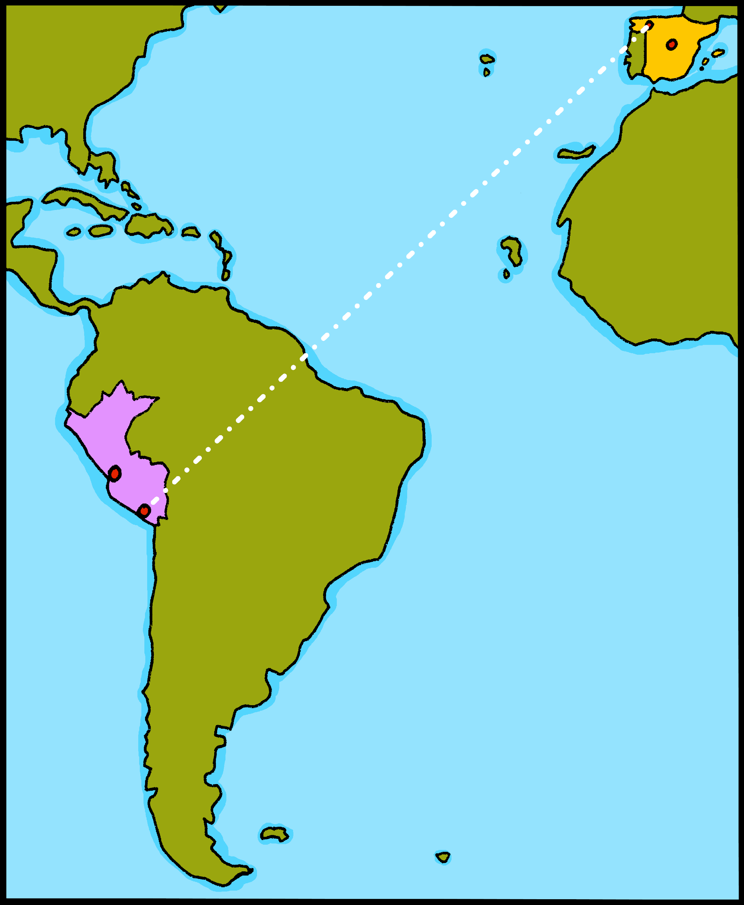
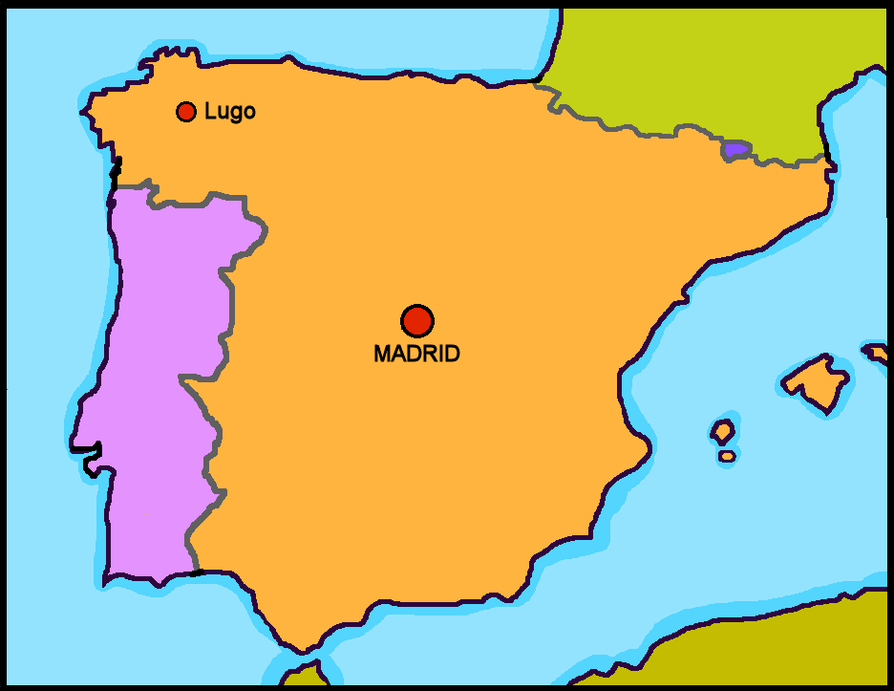
Rojo term 1 week 2
Describing me and others
2
Rojo term 1
pronunciar
España
Perú
Greetings
Understanding and responding to the register in class
[u]
¡hola!
Asking questions
universo
Sofía
vocabulario
Write down the key language for this week.
vocabulario
sí |  | ¡Buenos días!
no |  | estoy
en |  | estás
¡Buenos días! |  | adiós
‘estar’ [to be | being] (with location)
gramática
In Spanish the verb estar means ‘to be’ when describing location.
Estás
You are
=
To change a statement into a question, raise your voice at the end.
Estás presente.
¿Estás presente?
You are present.
Are you present?
Translate the examples.
Estás en España. → _______________________________.
¿Estás en España? → _______________________________.
7

Slide 10
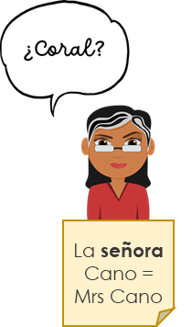
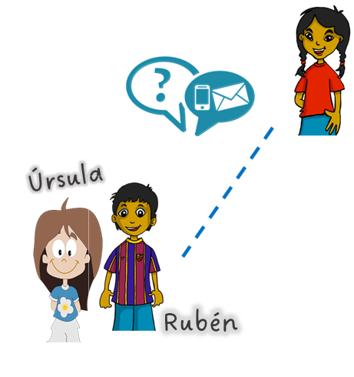
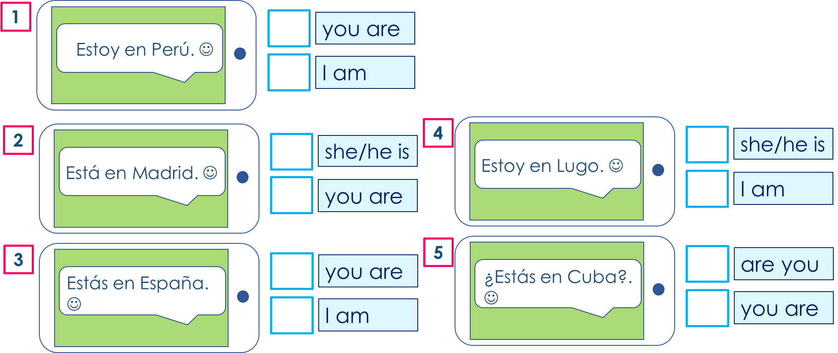
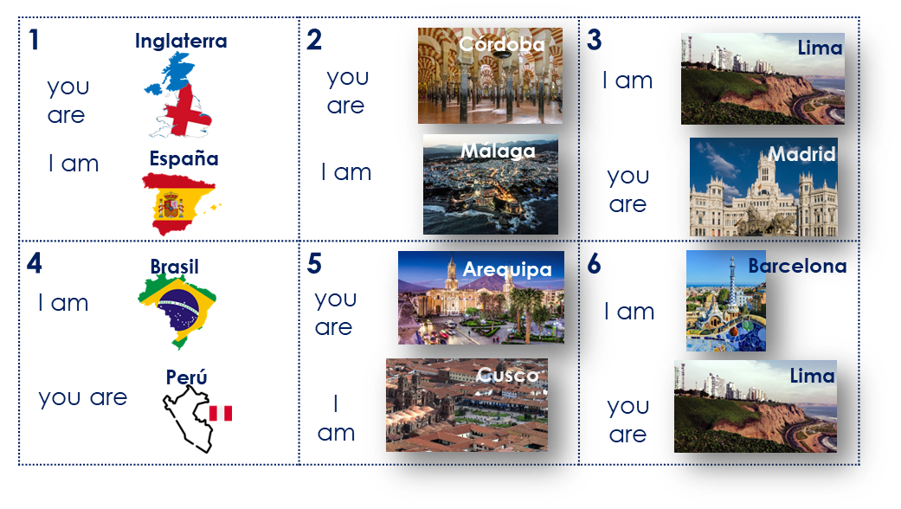
Rojo term 1 week 2
Describing me and others
2
Rojo term 1
escuchar
Escucha a la señora Mora. Write ¿…? or .
.
 | Coral, estás presente
 | Lara, estás presente |  | Carlos, estás aquí
 | Lorna, estás allí |  | Paloma, estás presente
 | Tamara, estás presente |  | Gaspar, estás allí
leer
Sofía gets lots of messages. What do they mean?
hablar
Person A. (Person B – turn to the next page.)
Start each sentence in Spanish. Write the city or country your partner says.
Now your turn to listen to your partner. Do you hear estoy or estás? Say the correct city or country.
1 | I am …………………..
2 | I am …………………..
3 | you are …………………..
4 | I am …………………..
5 | you are …………………..
6 | you are …………………..
8

Slide 11
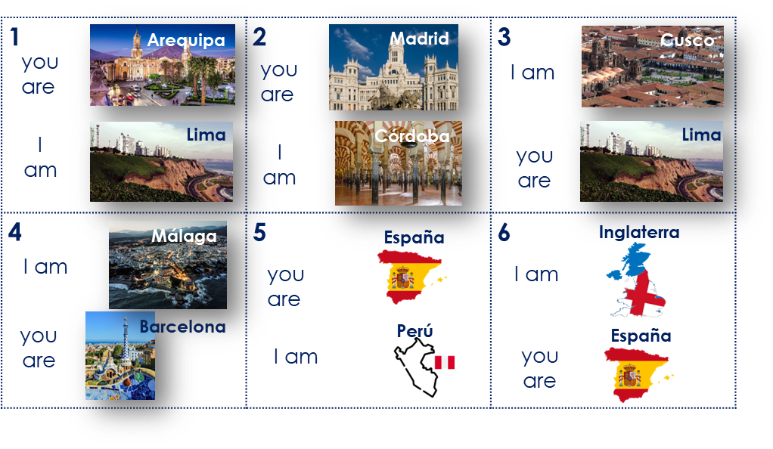
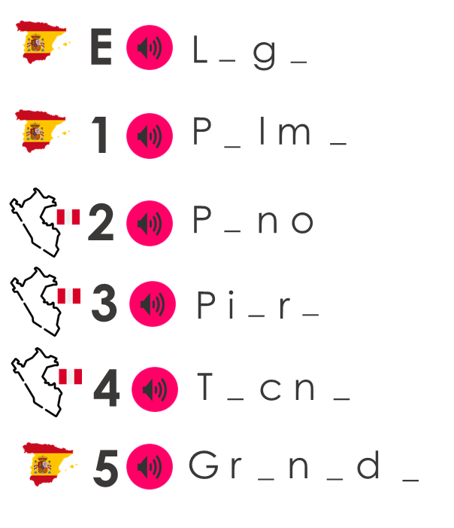
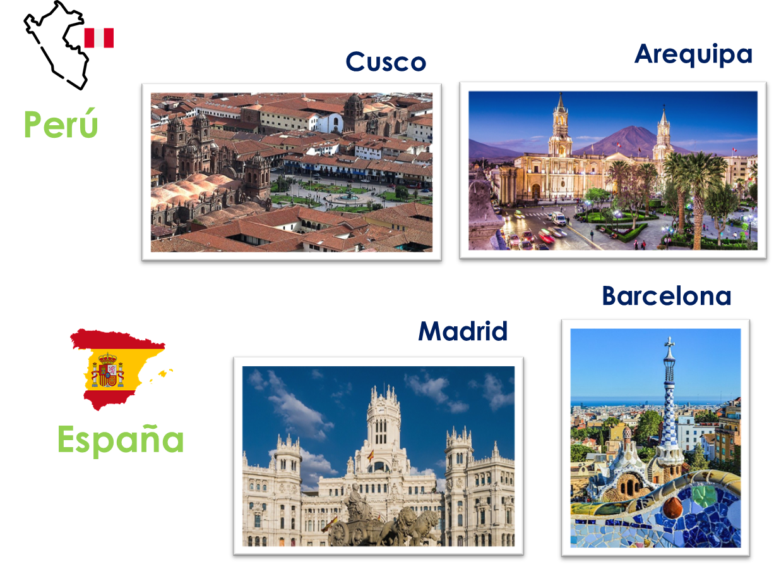
Rojo term 1 week 2
Describing me and others
2
Rojo term 1
hablar
Person B. (Person A – see previous page.)
Listen to your partner. Do you hear estoy or estás? Say the correct city or country.
Now your turn to start each sentence in Spanish. Write the city or country your partner says.
1 | I am …………………..
2 | you are …………………..
3 | I am …………………..
4 | you are …………………..
5 | I am …………………..
6 | you are …………………..
escuchar
C Fill the gaps with [a] or [u].
u
A Escucha. Listen
and write down the number.
B Draw it!
o
Proper
nouns start
with a capital letter!
‘Universo’ is number ______.
‘Casa’ is number ______.
escribir
Escribe. Choose the city and country.
1 _________________________________.
(You are in____________).
2 _________________________________.
(I am in____________).
3 _________________________________.
How can
(She is in____________).
you turn these statements into questions?
9

Slide 12
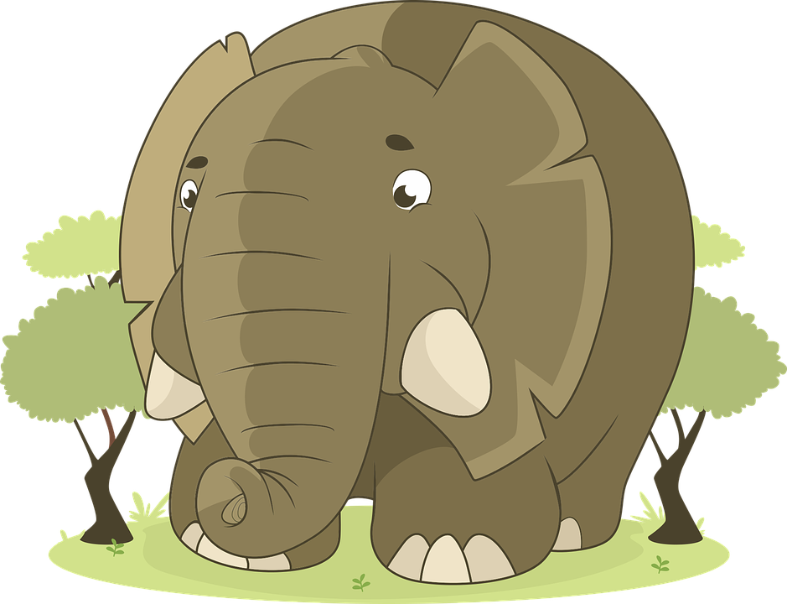
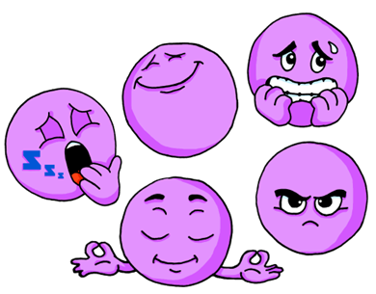
Rojo term 1 week 3
Describing me and others
3
Rojo term 1
pronunciar
Describing how I’m feeing
[e]
¡hola!
Describing how someone else is feeling
Asking questions
elefante
Quique
Sofía
Rubén
Write down the key language for this week.
vocabulario
cansado |  | tranquilo
contento |  | ahora
nervioso |  | ¿cómo?
serio
In writing,
Spanish uses 2
question marks. The one at the front is upside down!
‘estar’ [to be | being] (with location)
gramática
In Spanish the verb estar means ‘to be’ when
describing location, mood or temporary states.
To change a statement into a question, raise your voice at the end.
‘estar’ [to _____ | being]
Translate the examples.
estoy - ____ have
¿Estoy cansado?
→ _________________________.
estás - ____ have
¿Está nervioso?
está - ____ _______
→ _________________________.
¿Estás contento?
está - ____ _______
→ _________________________.
10

Slide 13
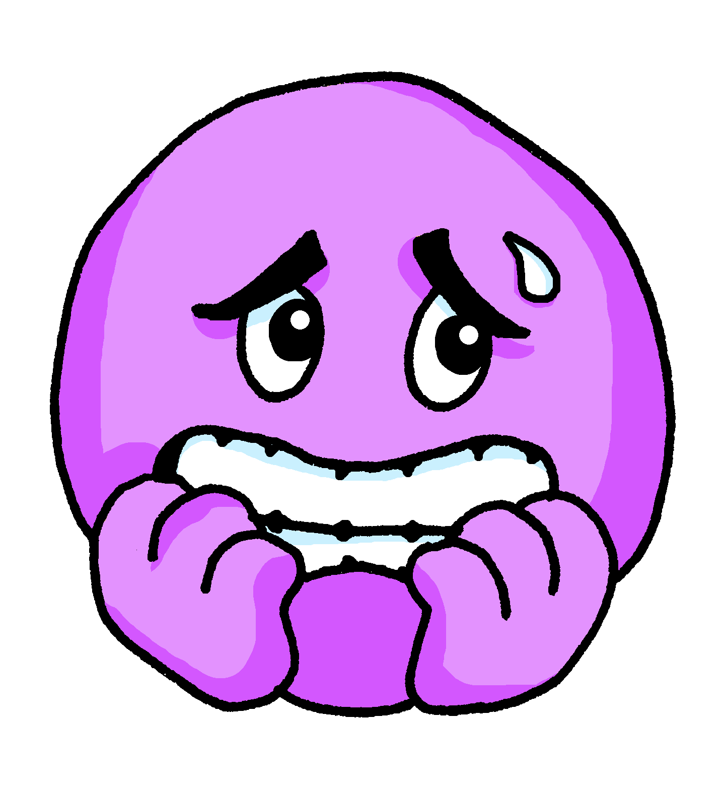
Rojo term 1 week 3
Describing me and others
3
Rojo term 1
escuchar
Escucha. Who does Quique describe?
A) Marca .
B) Escucha y escribe📝.
Write down the number.
 |  | You | He
E
1
2
3
4
5
6
I
quiet / calm
nervous
pleased
serious
tired
Sofía
Rubén
Q
Sometimes we refer to people by name
in a sentence:
pronunciar
Emanuel is here.
(3) Tres en elefante
(2) Dos en Estrella
(1) Una en tren
¿Qué es?
Es la letra __________
He is nervous.
Here we use the pronoun he because we don’t need to repeat Emanuel.
In Spanish, we often don’t need to use the pronoun.
Emanuel está aquí.
Está nervioso.
[is]
[He is]
This means that está can mean is and
he is, she is, it is.
leer
Lee. Write the meaning of ‘está’ for each sentence.
1
Elena está en casa. ________ ________ ___ __________.
Eduardo está en clase. Está contento.
________ _____ ___ _______. _______ ________.
¿Eva? No, está ausente. ______ ? ___ _________ __________.
¿Cómo está Edgar? Está tranquilo ahora. _____ ______ _______? ______ _________ ________.
¿ Enrique está nervioso? No, está serio. ___ __________ _________? ____ ________ _______.
Elena
at
home
2
in
pleased
Eduardo
class
3
Eva
No
absent
4
How
Edgar
calm now
5
Enrique
nervous
No
serious
11

Slide 14
Rojo term 1 week 3
Describing me and others
3
Rojo term 1
leer
Escribe en inglés 📝. Can you get at least 15 points?
 | aquí | allí | estoy
 | hola | presente | ausente
 | sí | España | adiós
 | en | Buenos días | Buenas tardes
 | nervioso | estás | ahora
 | está | ¿cómo? | serio
 | cansado | tranquilo | contento
x3
x2
x1
escribir
Don’t
Escribe. You can use the words to help you.
forget capital letters and full stops!
I am serious.
____________________________
1
Rubén is calm.
____________________________
2
You are nervous.
____________________________
2
3
Are you tired?
____________________________
4
Quique is pleased.
____________________________
hablar
Escribe y habla.
How are you feeling?
12

Slide 15
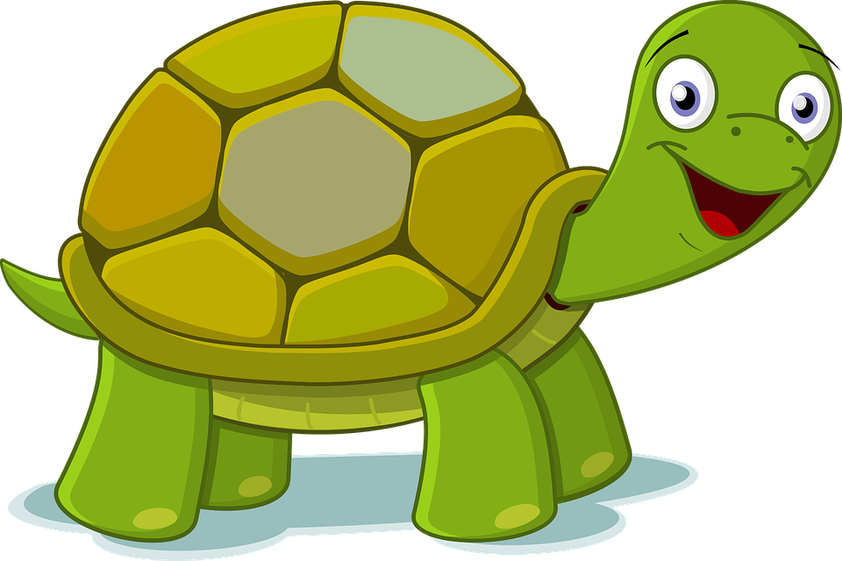
Rojo term 1 week 4
Describing me and others
4
Rojo term 1
pronunciar
Describing how I’m feeing
[i]
Describing how someone else is feeling
Asking questions
idea
Santi
Irene
Pancho
Manchita
Write down the key language for this week.
vocabulario
clase |  | lento
(en) clase |  | hoy
curioso |  | rápido
Gender and agreement on adjectives
gramática
In Spanish, adjectives change depending on
whether the person or animal they describe is male or female.
Adjectives that are masculine (end in ‘o’) change to an ‘a’
when the person or animal being described is female.
Translate the examples.
Manchita
is a female rabbit, so the adjective also ends in –a.
Rubén está contento. → _________________________.
Sofía está contenta → _______________________________.
Pancho está serio → _______________________________.
Manchita está seria → _______________________________.
13

Slide 16
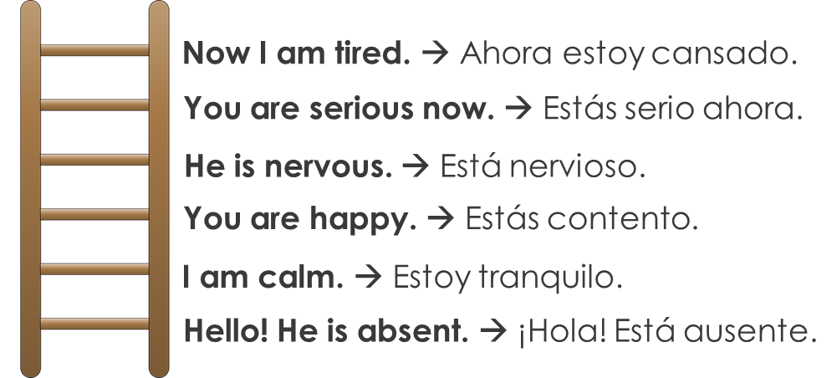
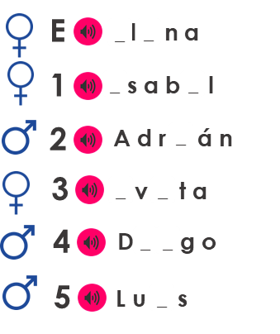
Rojo term 1 week 4
Describing me and others
4
Rojo term 1
hablar
Person A. (Person B – turn to the next page.)
Read the sentence in English. If your partner answers correctly, ask for the following sentence. You can help your partner 😊!
Now your turn to be the student. Translate the sentences your partner is going to ask you (you can use the hints ⬇). If you make a mistake, you will start from the bottom again!
A _ _ r_ e _ t _ tr_ _qu _ l _.
E _ t _ s n _ r v _ o _ o ah _ r _.
E _ t _ y s _ r _ _.
E _ t _ c _ _ s _ d _.
E _ t _ c _ _ t _ nt _.
¡H _ l _! E _ t _ y pr _ s _ nt _.
escuchar
Escucha. Circle the correct adjective. Who is it?
 |  |  |  |  | Santi | Irene
E | curioso | curiosa | rápido | rápida
1 | lento | lenta | curioso | curiosa
2 | rápida | rápido | nerviosa | nervioso
3 | tranquilo | tranquila | lento | lenta
4 | seria | serio | tranquila | tranquilo
5 | nerviosa | nervioso | contenta | contento
6 | cansado | cansada | rápido | rápida
Irene
Santi
Remember!
Santi is male, and Irene is female.
pronunciar
e
E
Escucha. Fill the gaps with [e] or [i].
Don’t
forget capital letters and full stops!
These are all popular names in Peru!
14

Slide 17
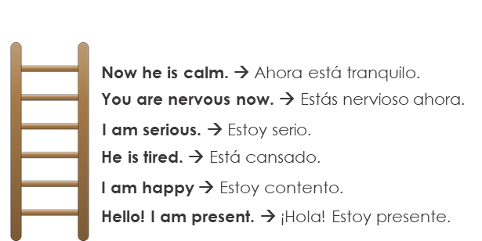
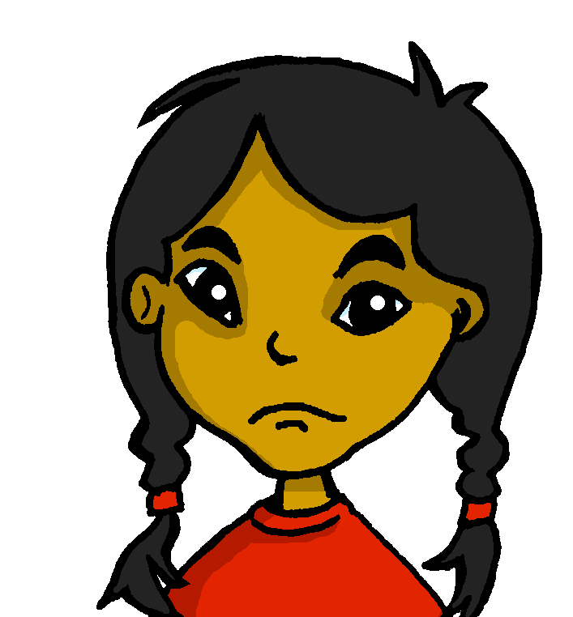
Rojo term 1 week 4
Describing me and others
4
Rojo term 1
hablar
Person B. (Person A – see previous page.)
Translate the sentences your partner is going to ask you (you can use the hints ⬇). If you make a mistake, you will start from the bottom again!
Now your turn to be the teacher. Read the sentence in English. If your partner answers correctly, ask for the following sentence. You can help your partner 😊!
A _ _ r _ e _ t _ y c _ _ s _ d _.
E _ t _ _ s _ r _ o ah _ r _.
E _ t _ n _ rv _ o _ o.
E _ t _ _ co _ t _ _ t _.
E _ t _ y tr _ nqu _ l _.
¡H _ l _! E _ t _ aus _ nt _.
escribir
Escribe. Translate the sentences.
Pay careful
attention to ensure you use the correct ending (-o OR –a)
1
Manchita is serious today.
__________________________________________________.
2
Irene is happy in class.
__________________________________________________.
3
Quique is curious now.
__________________________________________________.
4
Santi is slow today.
__________________________________________________.
5
Sofía is nervous now.
__________________________________________________.
¿Cómo estás hoy en clase?
[I am]…
15

Slide 18
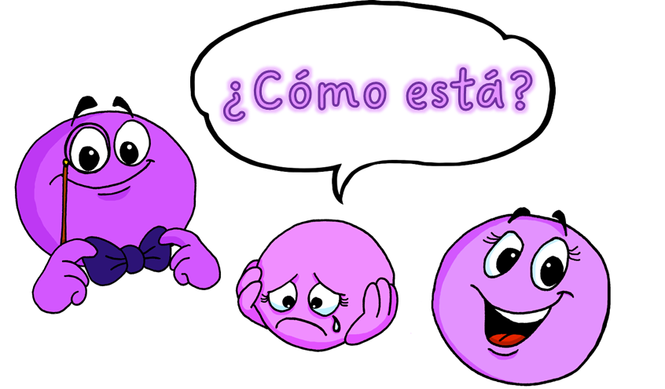
Rojo term 1 week 5
Describing me and others
5
Rojo term 1
pronunciar
Describing how I’m feeing
[a]
[o]
[u]
Describing how someone else is feeling
Asking questions
casa
dos
universo
Ángela
Write down the key language for this week.
vocabulario
elegante |  | ¿dónde?
triste |  | está
feliz |  | estoy
Gender and agreement on adjectives
gramática
Adjectives that are masculine (end in ‘o’)
change to an ‘a’ when the person or animal being described is female.
When an adjective ends in –e or -z it can describe a female and male person or animal. It does not change.
Translate the examples.
Manchita
is a female rabbit, so the adjective also ends in –a.
Quique está feliz. → _________________________.
Sofía está feliz. → _______________________________.
Santi está triste. → _______________________________.
Manchita está triste. → _______________________________.
16

Slide 19
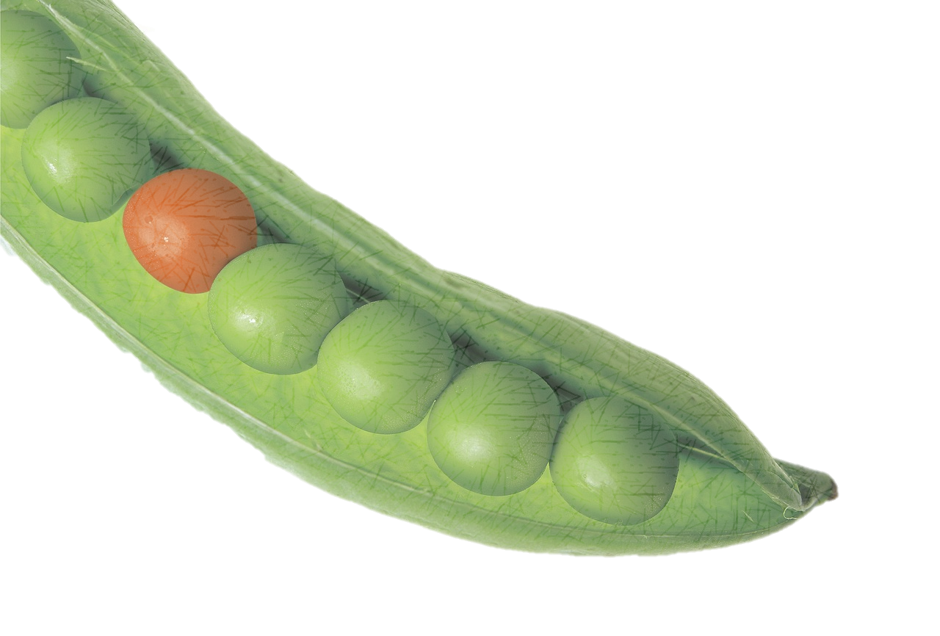
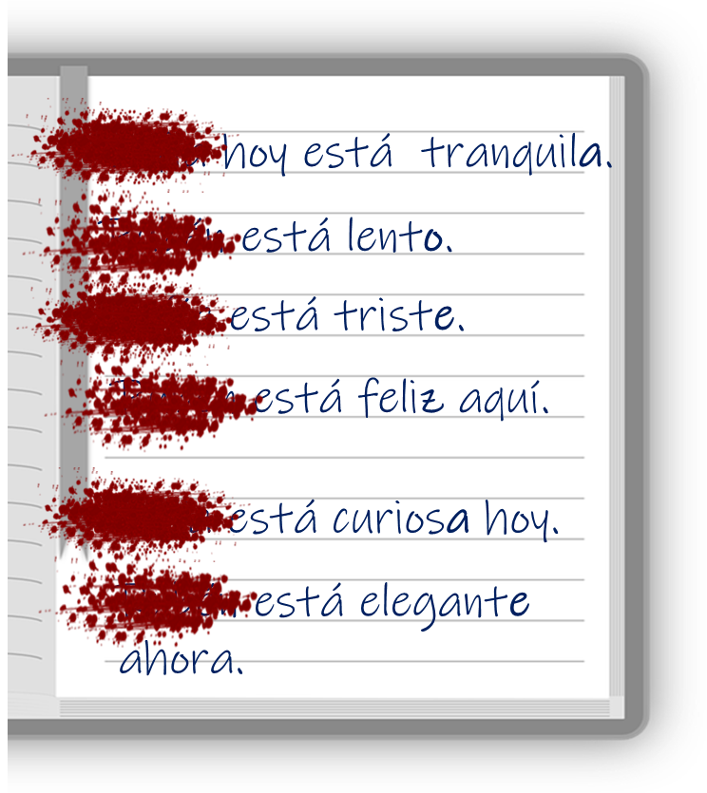
Rojo term 1 week 5
Describing me and others
5
Rojo term 1
leer
Lee. ¿Dónde está el instruso?
el instruso = the odd one out
E | contento | tranquilo | ahora
1 | curioso | rápida | seria
2 | ¿cómo? | nervioso | ¿dónde?
3 | seria | cansada | lento
4 | hoy | serio | ahora
5 | nervioso | curioso | tranquila
leer
Lee. Is it Sofía (a girl), Rubén (a boy) or could it be either?
adjetivo | Sofía | Rubén | either | inglés
tranquila
calm
escuchar
Escucha. Who is it?
Yes / No questions
Write the statement/question.
In Spanish, change a statement into a question by raising your voice at the end:
 | Ángela [?] | Sofía [.] | 🏆
E
1
2
3
4
5
6
¿Estás feliz?
Estás triste.
You are sad.
¿Estás triste?
Are you sad?
In writing,
Spanish uses 2
question marks. The one at the front is upside down!
17

Slide 20
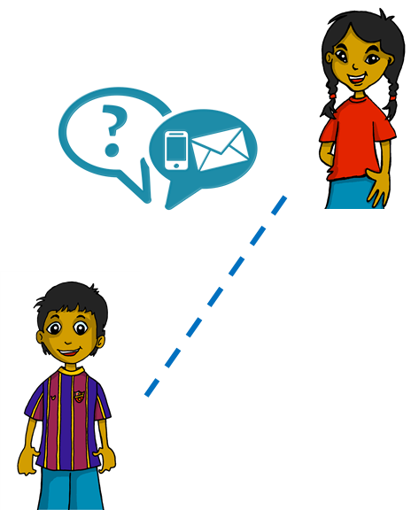
Rojo term 1 week 5
Describing me and others
5
Rojo term 1
leer
Sofía sends messages to Rubén. Lee y marca .
Está feliz. ☺
Angela
Está tranquilo.
escribir
Escribe en español. Can you get at least 15 points?
 | Good morning | I am (state) | Good afternoon
 | there | here | how?
 | curious (m) | pleased (f) | in class
 | fast (m) | today | yes
 | slow (m) | sad | happy
 | you are (state) | elegant | s/he is (state)
 | calm/quiet (f) | now | where?
x3
x2
x1
vocabulario
Write your favourite words in Spanish, here.
18

Slide 21
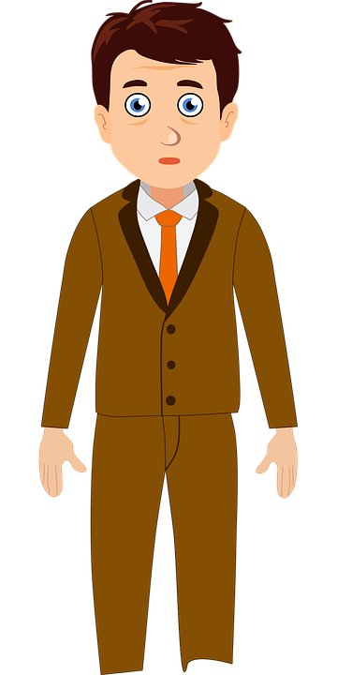
Rojo term 1 week 6
Describing me and others
6
Rojo term 1
pronunciar
Describing what I’m like
[e]
[i]
Describing what someone else is like
tres
interesante
Write down the key language for this week.
vocabulario
ser |  | siempre
soy |  | normalmente
es |  | ¿cómo?
Ser [to be, being]
gramática
In Spanish, the verb ser means ‘to be’ when describing general traits.
To mean I am for general traits, use soy.
To mean she, he or it is for general traits use es.
Translate the examples.
Soy feliz. → _________________________.
Es sero. → _______________________________.
el señor Valero
escuchar
Sofía habla. Escucha. Who is she describing?
 | Sofía [herself] | or [s/he]
E
1
2
 | Sofía [herself] | or [s/he]
4
5
¿en inglés ?
19

Slide 22
Rojo term 1 week 6
Describing me and others
6
Rojo term 1
escuchar
Escucha y escribe.
Soy
elegant
I am
always
1 | _______ elegante siempre.
2
3
4
leer
Write the English meaning of es for each sentence.
Ejemplo [1]: Iker es siempre tranquilo ➡ Iker is always calm.
2
3
4
5
Sometimes we refer to people by name
in a sentence:
Emanuel is always serious. .
He is nervous.
Here we use the pronoun he because we don’t need to repeat Emanuel.
In Spanish, we often don’t need to use the pronoun.
Emanuel está aquí.
Está nervioso.
[is]
[He is]
This means that está can mean is and
he is, she is, it is.
hablar
Person A: (Person B – turn to the next page.)
Your turn to be the teacher! Read the sentences to your partner..
Now listen to your partner and write M (male), F (female) or M/F (male/female) if it could be either.
Pupil B
1 | Es tranquila.
2 | Es elegante.
3 | Es lento.
4 | Es feliz.
5 | Es serio.
6 | Es curiosa.
1
2
3
4
5
6
20

Slide 23
Rojo term 1 week 6
Describing me and others
6
Rojo term 1
hablar
Person B. (Person A – see previous page.)
Listen to your partner and write M (male), F (female) or M/F (male/female) if it could be either.
Now your turn to be the teacher! Read the sentences to your partner..
Pupil A
1 | Es tranquilo.
2 | Es feliz.
3 | Es lenta.
4 | Es elegante.
5 | Es seria.
6 | Es curioso.
1
2
3
4
5
6
escribir
Escribe en español. Can you get at least 15 points?
 | tired (m) | serious (m) | pleased (f)
 | nervous (f) | calm (m) | now
 | how? | quick (f) | in class
 | today | curious (m) | slow (m)
 | elegant | sad | happy
 | always | normally | to be, being
 | I am (trait) | S/he, it is (trait) | where?
x3
x2
x1
21

Slide 24
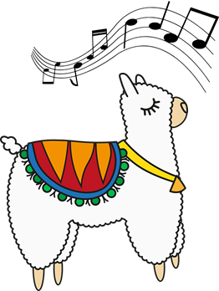
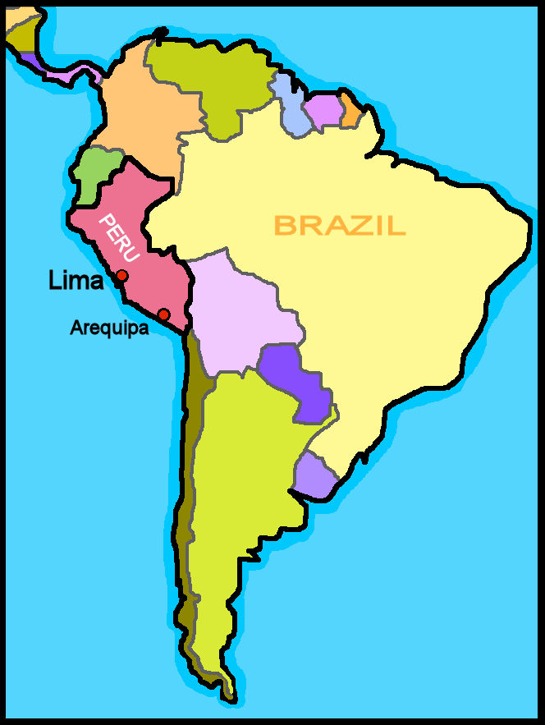
Rojo term 1 week 7
Describing me and others
7
Rojo term 1
pronunciar
Describing what me and someone else is like
Con a, alpaca baila
con e, Pepe bebe té
con i, Iris está aquí
con o, oso Ramón
con u, estás tú.
Talking about origin (where you are from).
Write down the key language for this week.
vocabulario
eres |  | España
de1 |  | Perú
Inglaterra
Ser [to be, being]
gramática
In Spanish, the verb ser means ‘to be’ when
describing general traits.
Soy feliz.
Soy de España y Perú.
Spanish uses,
I am happy
I am from Spain and Peru.
2 question
marks. The one at
the front is upside down!
To mean you are for general traits, use eres.
‘ser’ [to _____ | being]
Translate the examples.
soy - ____ am
¡Eres de España!
→ ___________________________.
eres - ____ _____
¿Eres de Perú?
es - ____ _______
→ ___________________________.
es - ____ _______
Perú está en Latinoamérica.
22

Slide 25
Rojo term 1 week 7
Describing me and others
7
Rojo term 1
escuchar
Sofía habla con mamá Elena. Escucha.
 | verbo | Sofía [I] | Mamá Elena [you] | Quique [he]
E
1
2
3
4
5
Who is she describing?
¿en inglés ?
soy
from Spain
leer
Escribe en inglés. Can you get at least 15 points?
 | estoy | allí | ¿dónde?
 | ausente | está | aquí
 | en clase | ahora | curioso
 | ¿cómo? | hoy | triste
 | es | normalmente | nerviosa
 | soy | feliz | eres
 | tranquilo | siempre | de
x3
x2
x1
escuchar
[A] Escucha. ¿Qué palabra es? Circle the word.
[B] Complete the poem with a word that rhymes.
1 | casa | cosa
2 | luna | lana
3 | masa | mesa
4 | rosa | risa
5 | dedo | dado
6 | lima | lema
Málaga
Con a, casa en __________.
Con e, Inés con Andrés __________.
Con i, aquí en __________.
Con o, el oso __________.
Con u, el universo __________.
curioso - Andrés - azul - Granada Pol - Cortés - Málaga - Madrid
23

Slide 26
Rojo term 1 week 7
Describing me and others
7
Rojo term 1
escuchar
[A] Escucha. Circle the 2 words mentioned.
[B] Escribe. Write in English.
He / she / it is
5. serio ___________________
6. soy ___________________
7. feliz ___________________
8. rápido ___________________
9. de ___________________
1. es __________________
2. siempre ___________________
3. eres ___________________
4. normalmente _____________
escribir
Escribe en español. Can you get at least 15 points?
1 | I am elegant
2 | You are from Spain.
3 | S/he is from Peru.
4 | I am from England.
Can you make these sentences into a question?
24

Slide 27
Rojo term 1 week 8
Describing me and others
8
Rojo term 1
pronunciar
Saying what day of the week it is today.
[ca]
[co]
[cu]
cama
contar
cucaracha
Write down the key language for this week.
vocabulario
qué |  | martes |  | viernes
día |  | miércoles |  | sábado
lunes |  | jueves |  | domingo
Ser [to be, being]
gramática
We use ser when talking about what day it is.
To say ‘it is’ + day of the week, use es.
Hoy es martes.
Es martes.
Today is Tuesday.
It is Tuesday.
Translate the examples.
Days of the
week are not
capitalised in
Spanish.
Hoy es jueves. → ________________________.
Es jueves. → ___________________________.
¿Qué día es hoy? → ___________________________.
pronunciar
Make any gesture. Your partner says the day.
25

Slide 28
Rojo term 1 week 8
Describing me and others
8
Rojo term 1
escuchar
Sofía habla con mamá Elena. Escucha.
E | Tuesday | Wednesday | Monday | Thursday | Tuesday
1 | Wednesday | Friday | Thursday | Saturday | Wednesday
2 | Tuesday | Sunday | Wednesday | Thursday | Tuesday
3 | Friday | Saturday | Monday | Wednesday | Friday
4 | Thursday | Friday | Sunday | Tuesday | Thursday
5 | Sunday | Monday | Tuesday | Saturday | Sunday
leer
Escribe en inglés. Can you get at least 15 points?
 | estás | aquí | ¿dónde?
 | soy | ahora | eres
 | triste | feliz | perdido
 | ¿cómo? | estoy | hoy
 | día | viernes | domingo
 | jueves | ¿qué? | es
 | lunes | martes | miércoles
x3
x2
x1
escuchar
[A] Escucha y marca .
 | [ca] | [co] | [cu]
E |  |  |  | _ _ na
1 |  |  |  | _ _ n
2 |  |  |  | _ _ ma
3 |  |  |  | _ _ enta
4 |  |  |  | _ _ ando
5 |  |  |  | _ _ nta
el trabalenguas = tonguetwister
cu
[B] ¡Habla!
Cuando Carlos
canta con Paca
en Salamanca,
Concha cuenta con Lucas en la cuna.
26

Slide 29
Rojo term 1 week 8
Describing me and others
8
Rojo term 1
leer
Lee. ¿Qué día es? Complete the sentences.
y = and
muy = very
Sofía is (feeling) very _____________ but tired on _____________.
1
happy
2
Sofía is (feeling) elegant and ___________ on ____________.
3
On ____________ , Sofía is (feeling) very nervous.
4
Sofía is feeling _____________. It’s ___________.
escuchar
[B] Use the correct words to write the sentences you hear. There are some extra ones!
E
1
1
3
2
5
3
4
Hoy es sábado.
escribir
Escribe. Make a note of how you’re feeling this week.
 | Today is...
 | I am (feeling…)
Hoy es lunes
Estoy feliz.
27

Slide 30
Rojo term 1 week 9
Saying what me and others have
9
Rojo term 1
pronunciar
Saying what I have
[ce]
centro
Write down the key language for this week.
vocabulario
tener |  | bolígrafo |  | fruta
tengo |  | cámara |  | mochila
cámara |  | cuaderno |  | pelota
teléfono |  | un |  | una
Gender | Indefinite articles (a/an)
gramática
In Spanish, things as well as people and animals, are either masculine or feminine. We say that they have gender.
To say a (or an) in Spanish use un before a masculine and una before a feminine noun.
Most
masculine
nouns end in -o and most feminine nouns end in -a.
Translate the examples.
una cama → ______________.
una cama → ______________.
una idea → _____________.
una idea. → _____________.
una casa → ______________.
una casa → ______________.
28

Slide 31
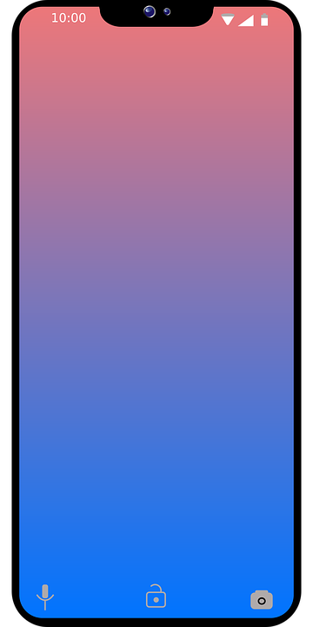
Rojo term 1 week 9
Saying what me and others have
9
Rojo term 1
escuchar
Una excursión a la montaña.
La señora Cano lee la lista. ¿Es ‘un’ o ‘una’?
E | un | una | cuaderno | cámara
1 | un | una | teléfono | pelota
2 | un | una | cámara | bolígrafo
3 | un | una | oso | fruta
4 | un | una | mochila | teléfono
leer
Escribe dos listas en inglés .
hablar
Persona A: (Person B – turn to the next page.)
Your turn to speak! Say ‘tengo’ and the correct article (un/una).
Now listen to your partner and tick the correct noun.
Round 1
Round 2
 |  | un / una
1 | Tengo |  | cuaderno
2 | Tengo |  | teléfono
3 | Tengo |  | cámara
4 | Tengo |  | oso
5 | Tengo |  | casa
 | Which noun must it be?
1
2
3
4
5
29

Slide 32
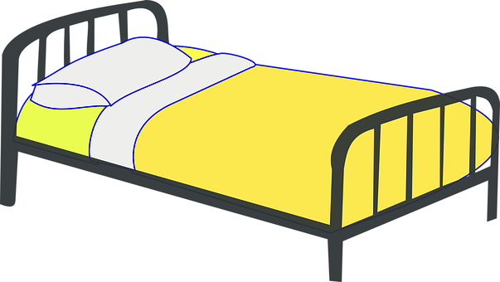
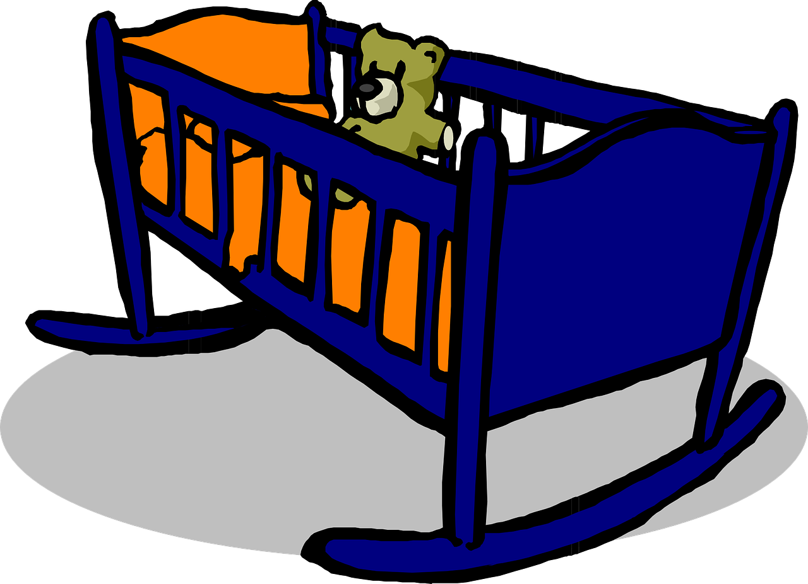
Rojo term 1 week 9
Saying what me and others have
9
Rojo term 1
hablar
Persona B. (Person A – see previous page.)
Now listen to your partner and tick the correct noun.
Your turn speak! Say ‘tengo’ and
the correct article (un/una).
Round 1
Round 2
 | Which noun must it be?
1
2
3
4
5
 |  | un / una
1 | Tengo |  | mochila
2 | Tengo |  | cámara
3 | Tengo |  | universo
4 | Tengo |  | fruta
5 | Tengo |  | bolígrafo
escuchar
Escribe ‘un’ o ‘una’.
Escucha y marca . .
leer
un
 | ca | co | cu | ce
E |  |  |  |  | _ _ sa
1 |  |  |  |  | _ _ ro
2 |  |  |  |  | _ _ ma
3 |  |  |  |  | _ _ na
4 |  |  |  |  | pe _ _ ra
5 |  |  |  |  | _ _ na
1. _________ bolígrafo.
2. _________ pelota.
3. _________ cámara.
4. _________ fruta.
5. _________ cuaderno.
6. _________ idea.
7. _________ mochila.
8. _________ teléfono.
co
[thing]
leer
I have
Escribe
en inglés .
30

Slide 33
Rojo term 1 week 10
Saying what me and others have
10
Rojo term 1
pronunciar
Saying what someone else has
[ci]
decir
Write down the key language for this week.
vocabulario
tiene |  | bicicleta
amigo |  | cama
amiga |  | gato
tener [to have, having]
gramática
The verb tener means ‘to have’ or ‘having’.
To say I have, use ‘tengo’.
To say s/he or it has, use ‘tiene’.
Translate the examples.
Tengo un amigo. → ________________________.
Tiene una amiga. → ________________________.
Write your favourite words in Spanish, here.
31
el diario = the diary

Slide 34
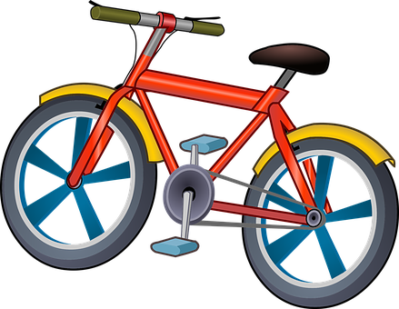
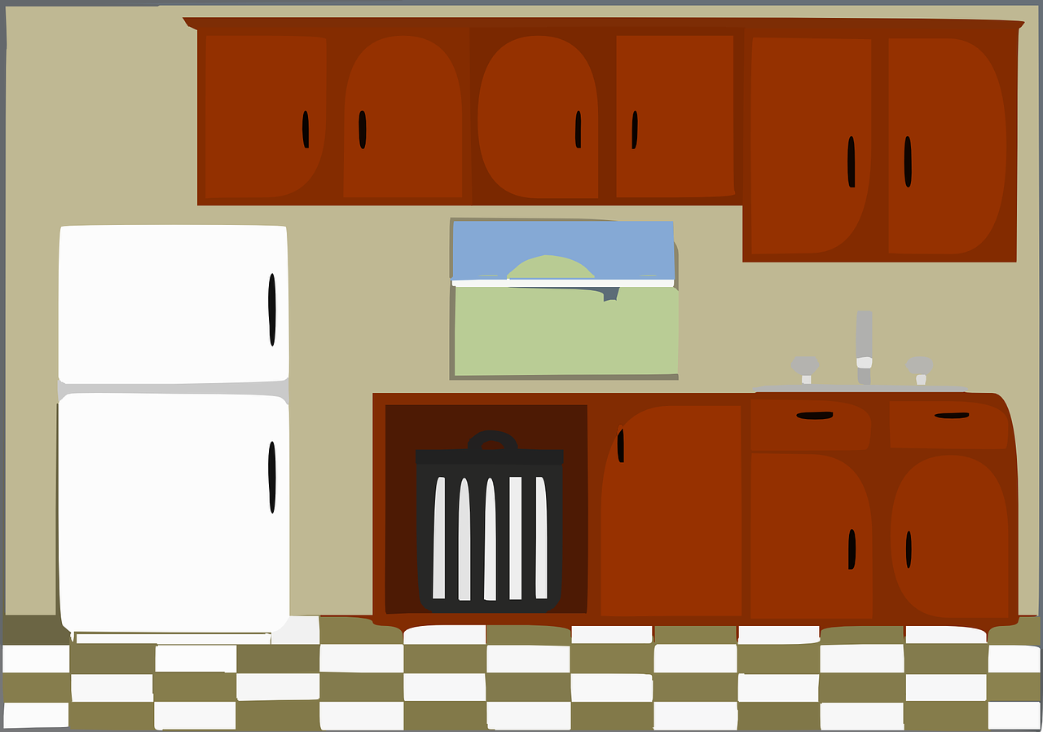
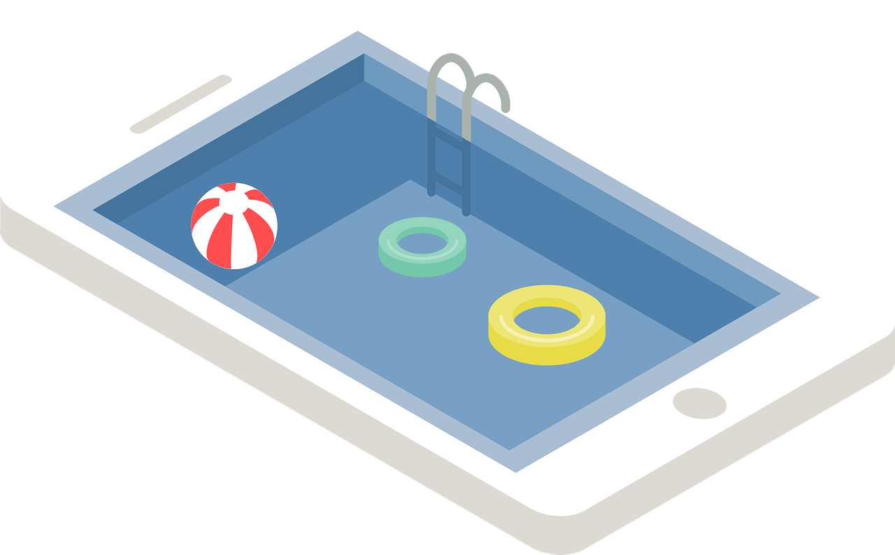
Rojo term 1 week 10
Saying what me and others have
10
Rojo term 1
leer
Lee y escribe en español.
Escribe la letra (a-g).
Sofía (I) | Ángela(she)
a
e
bicicleta
b
c
f
d
g
escuchar
¿Es Sofía o Quique? Escribe el objeto en inglés .
objeto
escuchar
 | Sofía (I)
E
1
2
3
4
Quique
(he)
Escucha y marca .
an idea
 | ca | co | cu | ci
E |  |  |  |  | _ _ ma
1 |  |  |  |  | _ _ _ _ n a
2 |  |  |  |  | _ _ _ _ racha
3 |  |  |  |  | _ _ en
4 |  |  |  |  | _ _ la
5 |  |  |  |  | pis _ _ na
100
escuchar
escribir
Escucha y escribe.
1 | _______ una mochila y un teléfono.
2
3
4
5
Tengo
I
rucksack
phone
32

Slide 35
Rojo term 1 week 10
Saying what me and others have
10
Rojo term 1
leer
Lee y escribe en español.
un
una
cámara
amigo
pelota
___________
___________
cuaderno
bolígrafo
___________
___________
___________
___________
cama
bicicleta
___________
___________
teléfono
___________
___________
amiga
gato
escribir
Escribe en español. Can you get at least 15 points?
 | I am (state) | you are (state) | to be|being (state)
 | there | absent | present
 | Spain | here | hello
 | you are (trait) | from | England
 | a friend (m) | a ball | I have
 | a bed | a friend (f) | a school bag
 | s/he, it has | a bicycle | a cat
x3
x2
x1
escribir
Escribe en español.
When translating a / an, consider the gender of the noun.
Don’t
forget capital letters and full stops!
_________________________________.
1
I have a camera.
Rubén has a (female) friend.
She has a bicycle.
I have a cat and a (piece of) fruit.
Quique has a pen and an exercise book.
2
_________________________________.
3
_________________________________.
4
______________________________.
5
_____________________________.
33

Slide 36
Rojo term 1 week 11
Saying what me and others have
11
Rojo term 1
pronunciar
Asking what someone else has
[ce]
[ci]
centro
decir
Write down the key language for this week.
vocabulario
botella |  | pregunta
estuche |  | respuesta
libro |  | sacapuntas
Yes/no questions
gramática
Turn a statement into a yes/no question by making your voice go up at the end.
Tengo un libro.
I have a book.
¿Tengo un libro?
Do I have a book?
tener [to have, having]
Translate the examples.
tengo - ____ have
Tienes un libro.
→ ________________________.
tienes - ____ have
¿Tienes una pregunta?
tiene - ____ _______
→ ________________________.
tiene - ____ _______
34

Slide 37
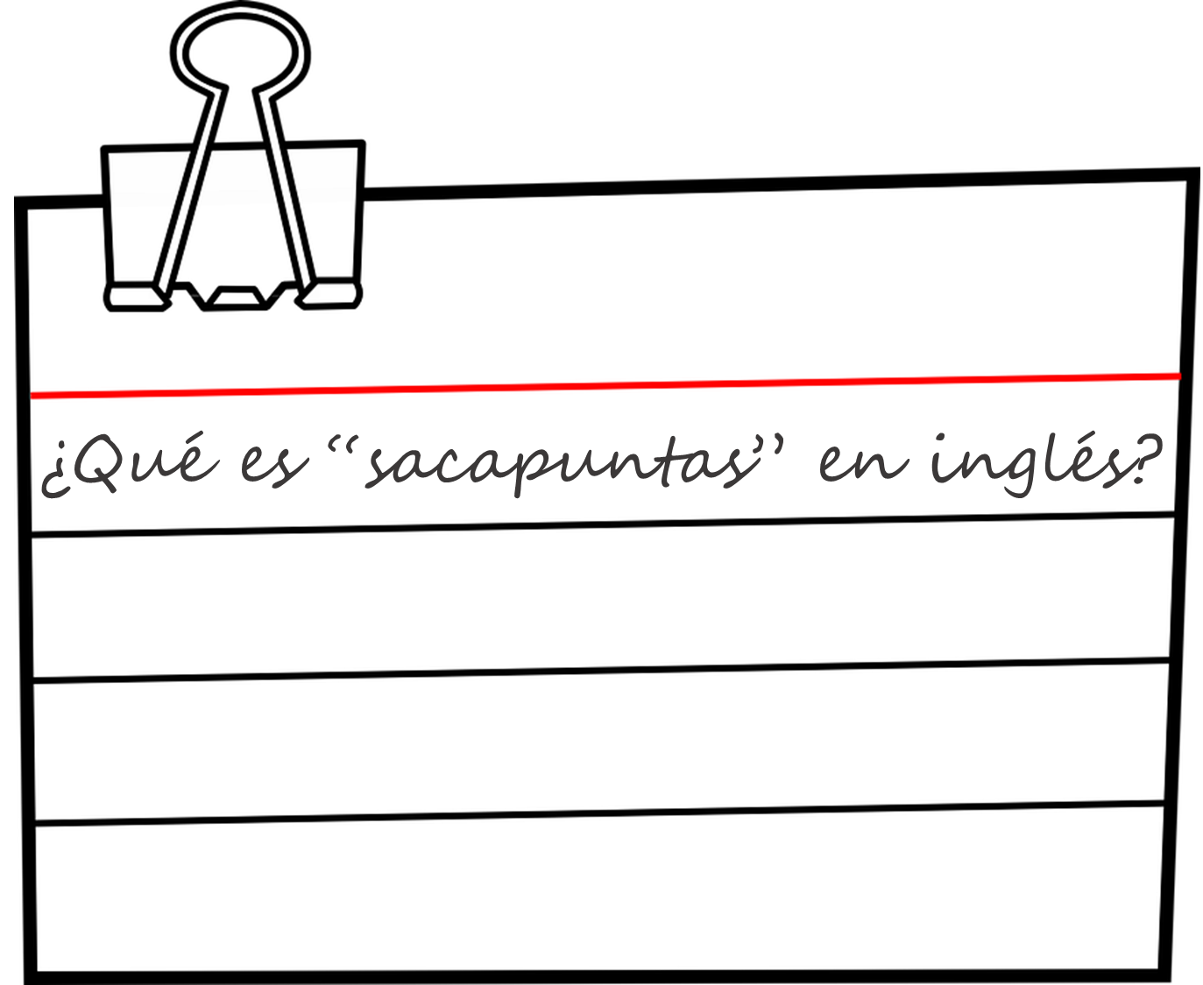
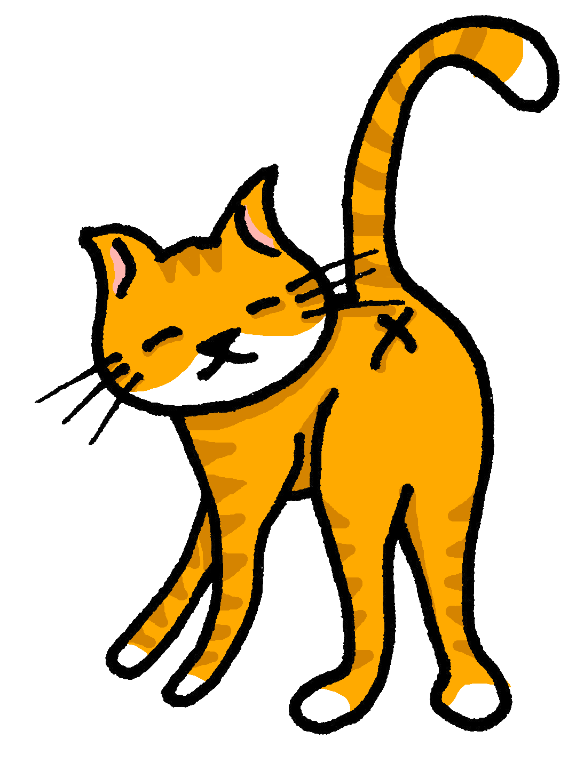
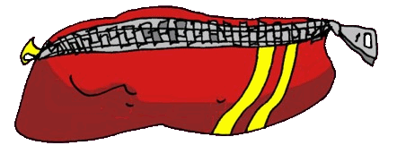
Rojo term 1 week 11
Saying what me and others have
11
Rojo term 1
leer
¿Es ‘un’ o ‘una’?
¿Es posible [P] o imposible [I] ?
escuchar
Marca .
Do I have…? | Do you have…? | objeto en inglés
E
a book
1
2
3
4
5
6
hablar
Persona A: (Person B – turn to the next page.)
Round 1
Round 2
Your turn to speak! Say the word in Spanish. Then listen to your partner and write the missing sentence beginning in English.
Now listen to your partner and reply with the full sentence, using either tengo or tienes.
1
2
3
4
5
Tengo…
Tienes…
1. _____ _______ a book.
2. _____ _______ a question.
3. _____ _______ a sharpener.
4. _____ _______ a pencil case.
5. _____ _______ a phone.
35

Slide 38
Rojo term 1 week 11
Saying what me and others have
11
Rojo term 1
hablar
Persona B. (Person A – see previous page.)
Round 1
Round 2
Listen to your partner
Your turn to speak! Say the word in Spanish. Then listen to your partner and write the missing sentence beginning in English.
and reply with the full sentence, using either tengo or tienes.
1
2
3
4
5
Tengo…
Tienes…
1. _____ _______ a pencil case.
2. _____ _______ a male friend.
3. _____ _______ a bottle.
4. _____ _______ an answer.
5. _____ _______ a bike.
?
escuchar
Escucha. ¿Es [ce] o [ci]?
1 | _ _ r v o
2 | Palen _ _ ia
3 | Bar_ _ lona
4 | Cá_ _ res
5 | Valen_ _ ia
6 | Alba_ _ te
7 | Mur_ _a
8 | _ _ uta
leer
Escribe en inglés. Can you get at least 15 points?
 | ¿qué? | lunes | miércoles
 | un día | jueves | viernes
 | estás | ¡Buenos días! | sí
 | no | tiene | ¡Buenas tardes!
 | una pregunta | un estuche | tengo
 | una botella | un sacapuntas | un libro
 | tienes | una respuesta | una
x3
x2
x1
36

Slide 39
Rojo term 1 week 12
Saying what me and others have
12
Rojo term 1
pronunciar
Talking about having
[z]
describing things
zapato
Write down the key language for this week.
vocabulario
familiar |  | silla
globo |  | tarta
regalo |  | amarillo
bonito |  | pequeño
rojo
Adjectives following the noun
gramática
In Spanish, many adjective follow the noun.
un estuche amarillo
In English the adjective comes before the noun.
Spanish
a yellow pencil case
tells you what it is, and then how it is.
Translate the examples.
un amigo feliz
→ ________________________.
→ ________________________.
una tarta bonita
37

Slide 40
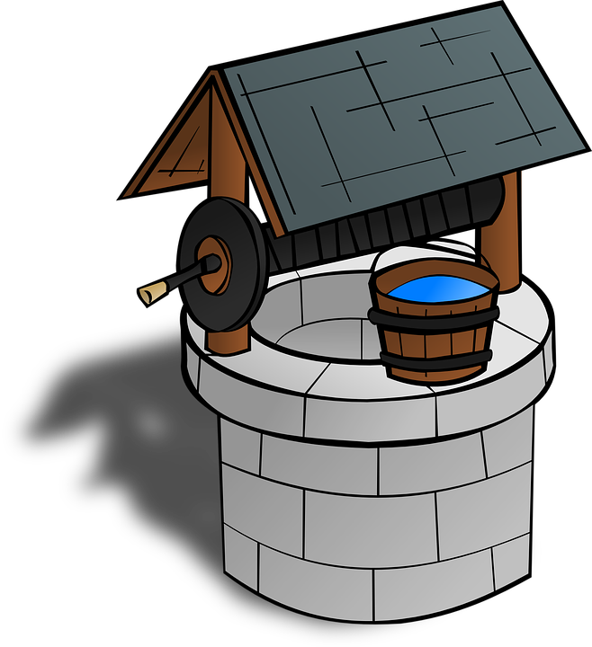
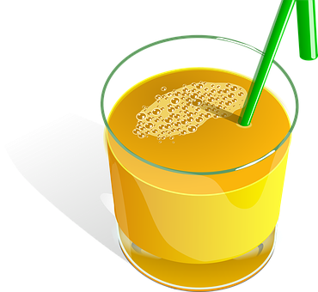
Rojo term 1 week 12
Saying what me and others have
12
Rojo term 1
leer
Lee la lista. Escribe en inglés .
In English
adjective comes before the noun.
E
1
2
3
4
5
a small cake
escuchar
 | descripción | objeto
E | amarillo / amarilla
1 | pequeño / pequeña
2 | bonito / bonita
3 | rojo / roja
4 | feliz / bonita
5 | curioso / curiosa
6 | amarillo / amarilla
I have | you have
Escucha y
rodea el adjetivo.
a present
escuchar
Escucha y marca .
[z] sounds
 | z | s
E |  |  | co _ _
1 |  |  | ca _ _
2 |  |  | pa _ _
3 |  |  | _ _ na
4 |  |  | po _ _
5 |  |  | _ _ mo
¿Es [____] ?
Is it…?
the same as [c] in front of [e] [i].
38

Slide 41
Rojo term 1 week 12
Saying what me and others have
12
Rojo term 1
leer
Put the adjectives in the correct group.
The ending changes when the noun is masculine/feminine | The ending is the same for a masculine/feminine noun
serio
feliz
bonito
rápida
elegante
pequeña
triste
Now complete the sentences.
💡 Gender & adjectives
Adjectives change depending on whether they describe a masculine or feminine noun.
- When referring to a singular masculine noun, these
adjectives end in _______.
- When referring to a singular feminine noun, these adjectives end in ____.
- Adjectives ending in ______ or –z have the same ending for a masculine/feminine noun.
escribir
Escribe en español. Can you get at least 15 points?
 | tired (m) | calm (f) | nervous (m)
 | now | pleased (f) | how?
 | a phone | a school bag | to have / having
 | a pen | a / an (feminine) | an exercise book
 | small (m) | a cake | a present
 | red (m) | yellow (f) | a chair
 | pretty (m) | a balloon | a relative (m/f)
a b ñ
x3
x2
x1
39

Slide 42
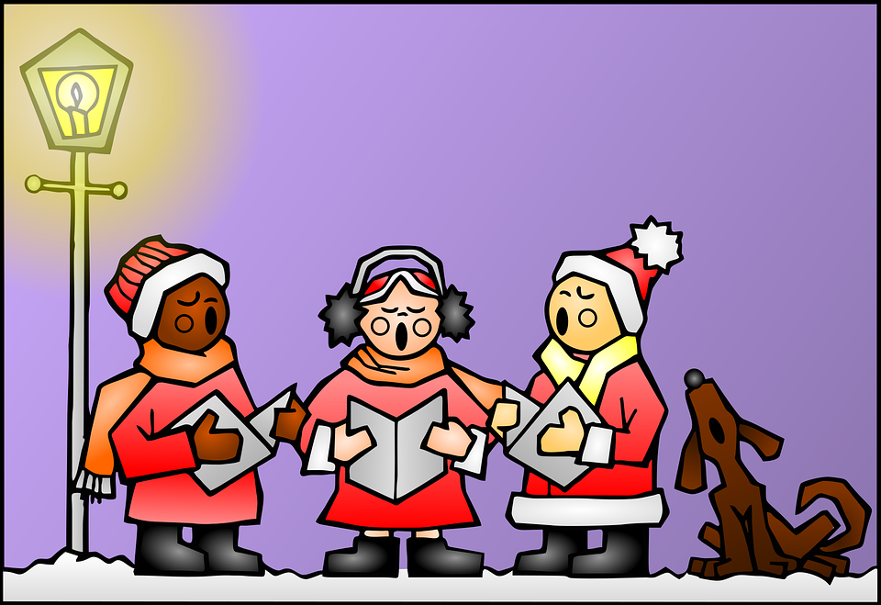
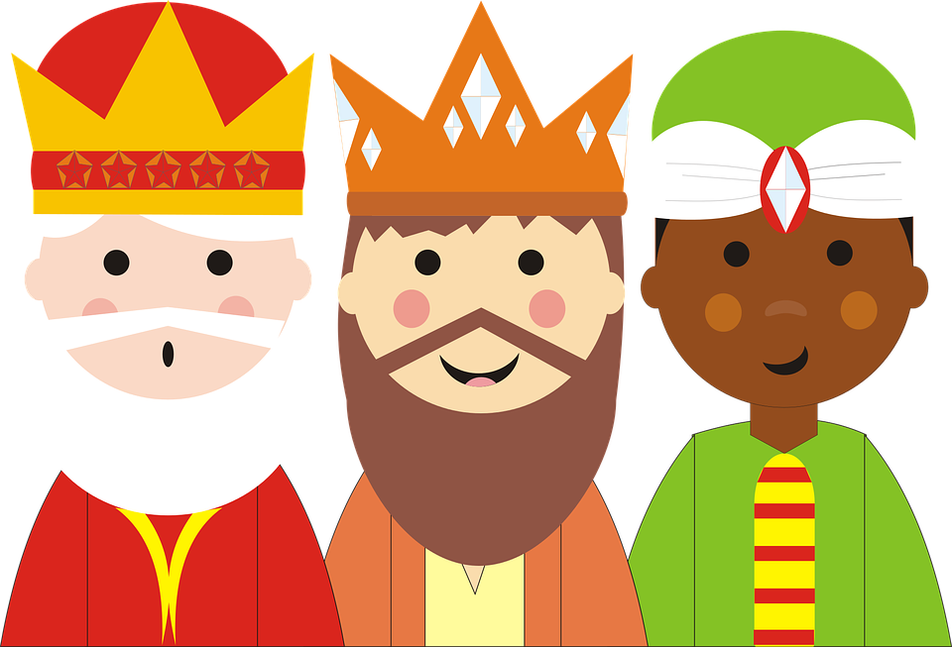
Rojo term 1 week 13
¡Feliz Navidad!
Rojo term 1
13
escuchar
Escucha y completa el villancico.
[1] _________________ por doquier resuenan sin cesar proclaman con placer que hoy es Navidad. Los [2] _________ que aquí están no dejan de [3] _________________ En este día de amor y buena voluntad. (¡ey!)
[Estribillo] (chorus)
[4] _______________ , Navidad, [5] __________ (5) es Navidad Es un día de alegría y felicidad. (¡ey!) x2
villancico = Christmas Carol
pronunciar
¡A cantar! 🎤 Sing along!
hablar
The Three Wise men prepare themselves to deliver presents to Spanish children.
¿Qué Rey Mago es? Write the correct name.
‘para’
means ‘for’ here.
Gaspar
____ __________ para Ángela.
____ __________ para Elena.
____ __________ para Rubén.
____ __________ para Sol.
____ __________ para Quique.
____ __________ para Asunción.
una canción | una flor | un teléfono
una silla | un estuche | una cámara
Spanish kids normally address
their letters to one of the
three Wise Men who is the one in charge of bringing the desired presents on 6th January.
Melchor
Gaspar
Baltasar
They travel by camel!
40

Slide 43
Rojo term 1 week 14
¡Feliz Navidad!
Rojo term 1
14
leer
El Roscón de Reyes
¡Es un donut gigante!
A ‘Roscón de Reyes’ is a traditional
Spanish brioche-like sweet bread eaten the night before or morning of Reyes or King’s Day (6th January).
Hidden inside, there are a small toy and a small dried kidney bean. The person who finds the small toy will be crowned king for the day and the lucky person who finds the bean has the honour of paying for the whole cake!
el haba
el juguete
A ‘corona’ also accompanies the Roscón, and the king or queen gets to wear it. 😊
hablar
In secret, choose a space and draw your ‘haba’ and ‘juguete’.
1 Do you have…?
2 S/he has …
3 You have …
4 I have
41

Slide 44
Rojo term 1 week 14
¡Feliz Navidad!
Rojo term 1
14
leer
El Portal de Belén
One of the main features of
the nativity scene which appears in the windows of houses as well as the living room. There are also larger versions commissioned by the town hall in large spaces across towns and villages.
Christmas in Spain is the belén,
la estrella
José
el niño Jesús
Gaspar
Melchor
el establo
María
Gaspar
la oveja
El ‘Belén’ más grande del mundo 🌍 está en Alicante.
grande = large
crear
Una tarjeta de Navidad
1 Dobla el papel
2 Corta y colorea
3 Escribe ‘Feliz Navidad’
doblar = to fold, folding
cortar = to cut out
colorear = to colour
escribir = to write
42

Slide 45
Rojo term 1 week 14 - materials
¦
¦
¦
¦
¦
¦
¦
¦
¦
¦
¦
¦
¦
¦
¦
¦
¦
¦
¦
¦
¦
¦
¦
¦
¦
¦
¦
¦
¦
¦
¦
¦
¦
¦
¦
Rojo term 1
43

