Slide 1
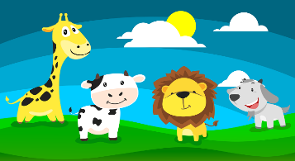
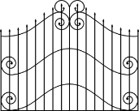
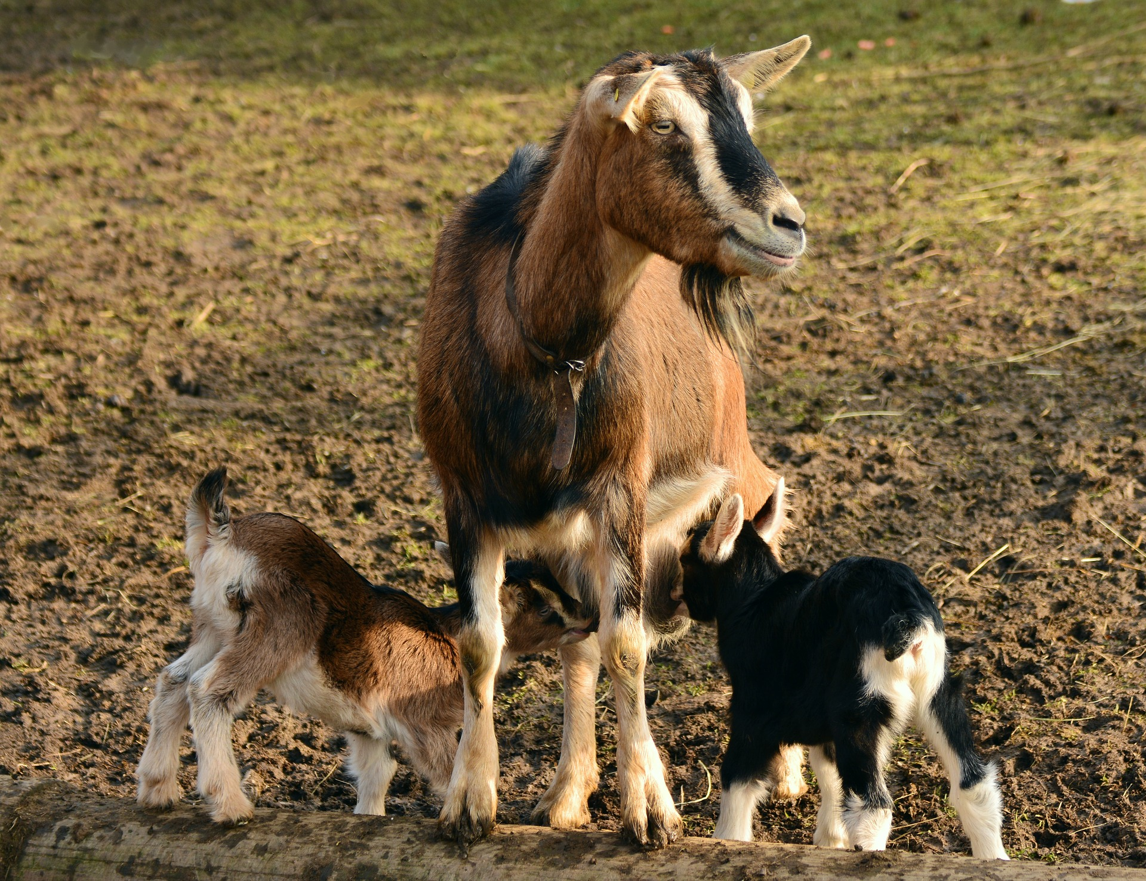
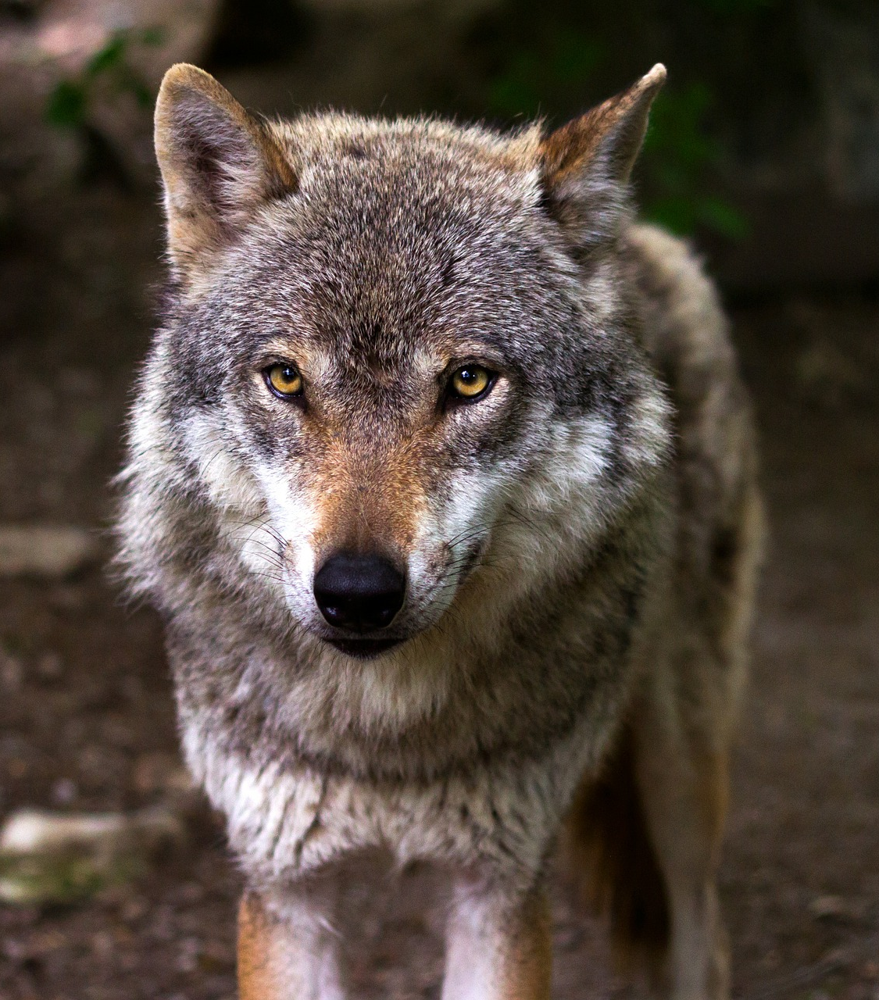
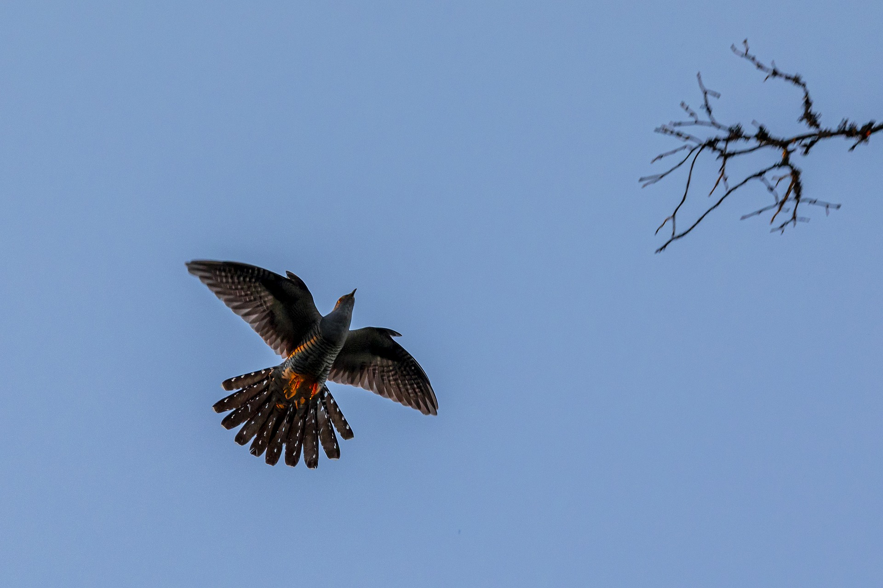
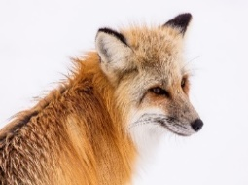
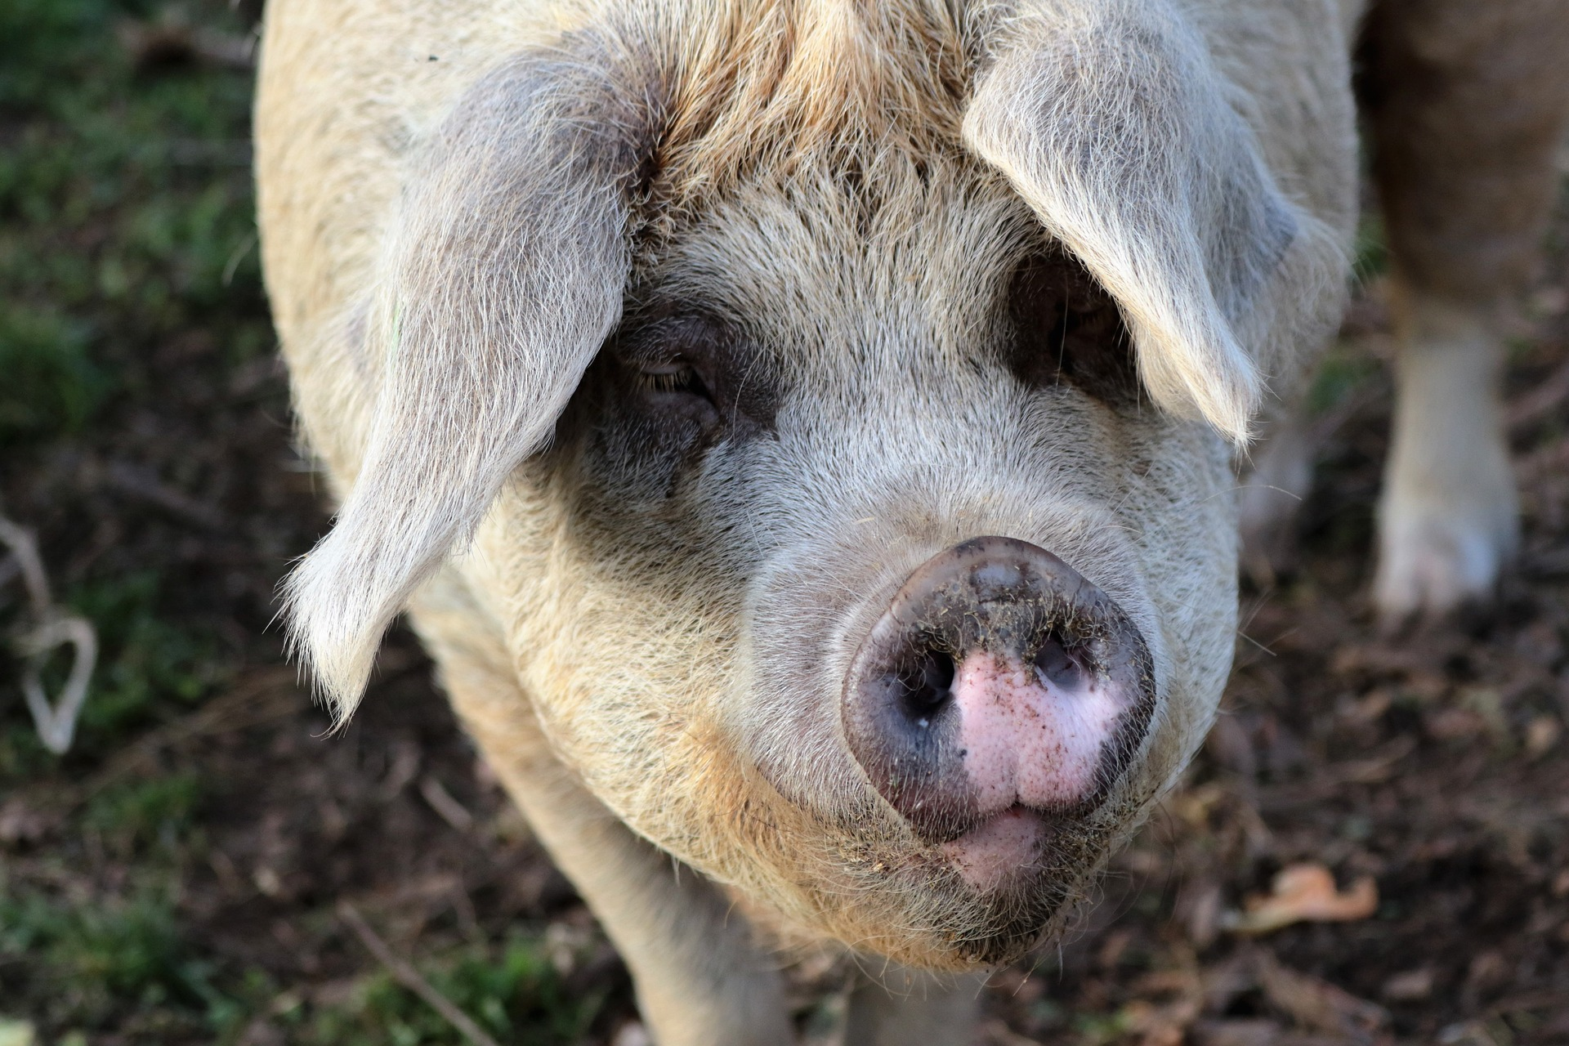
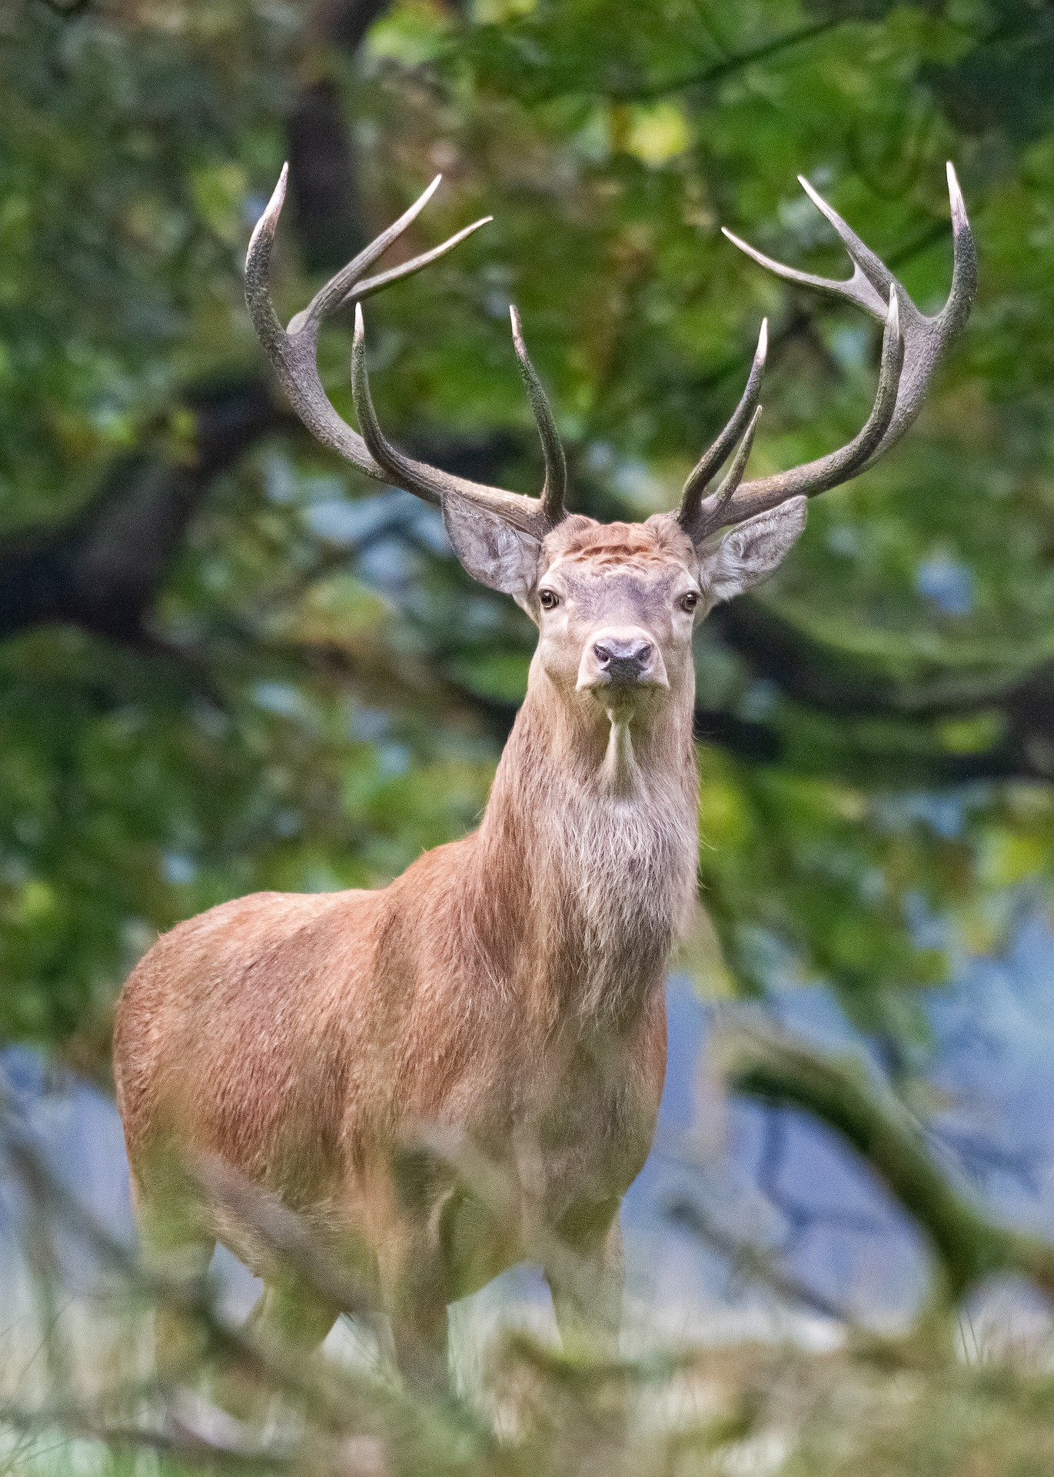
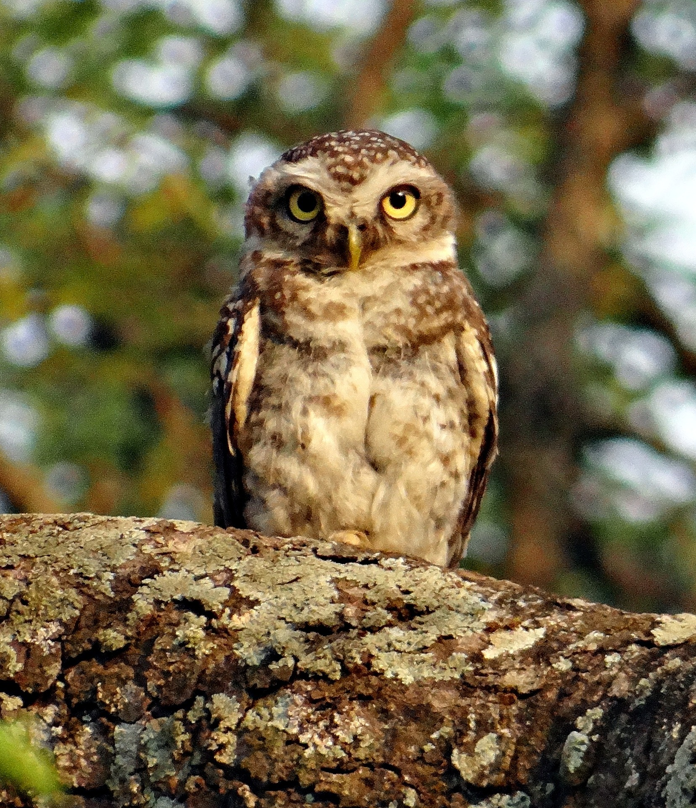
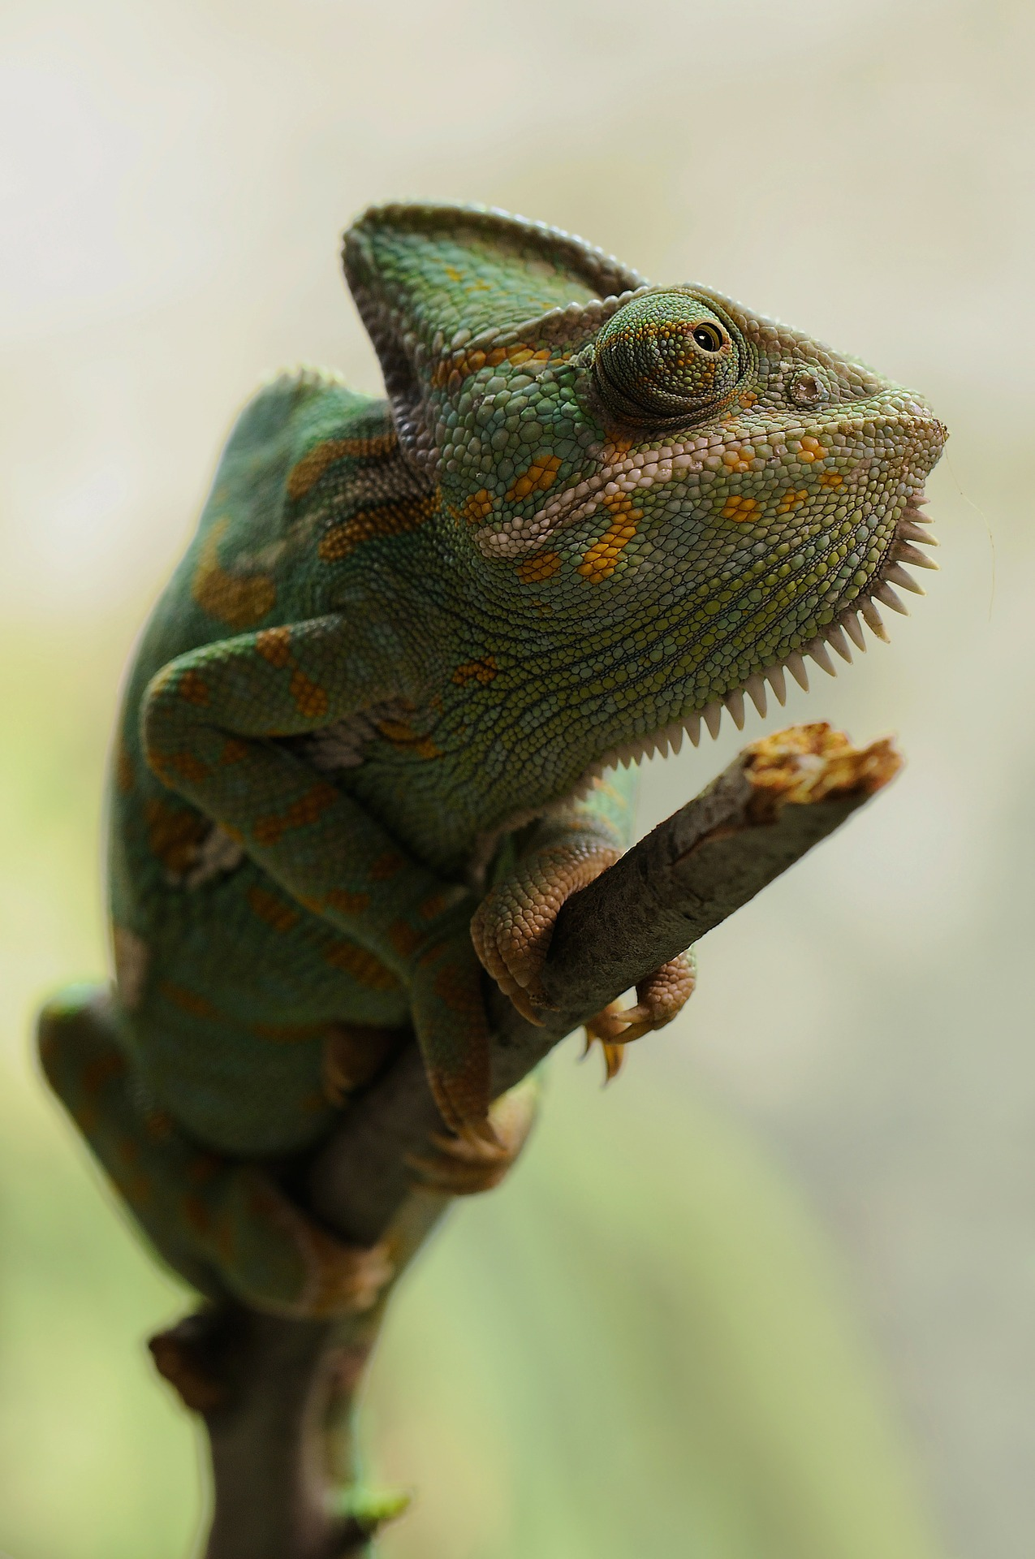
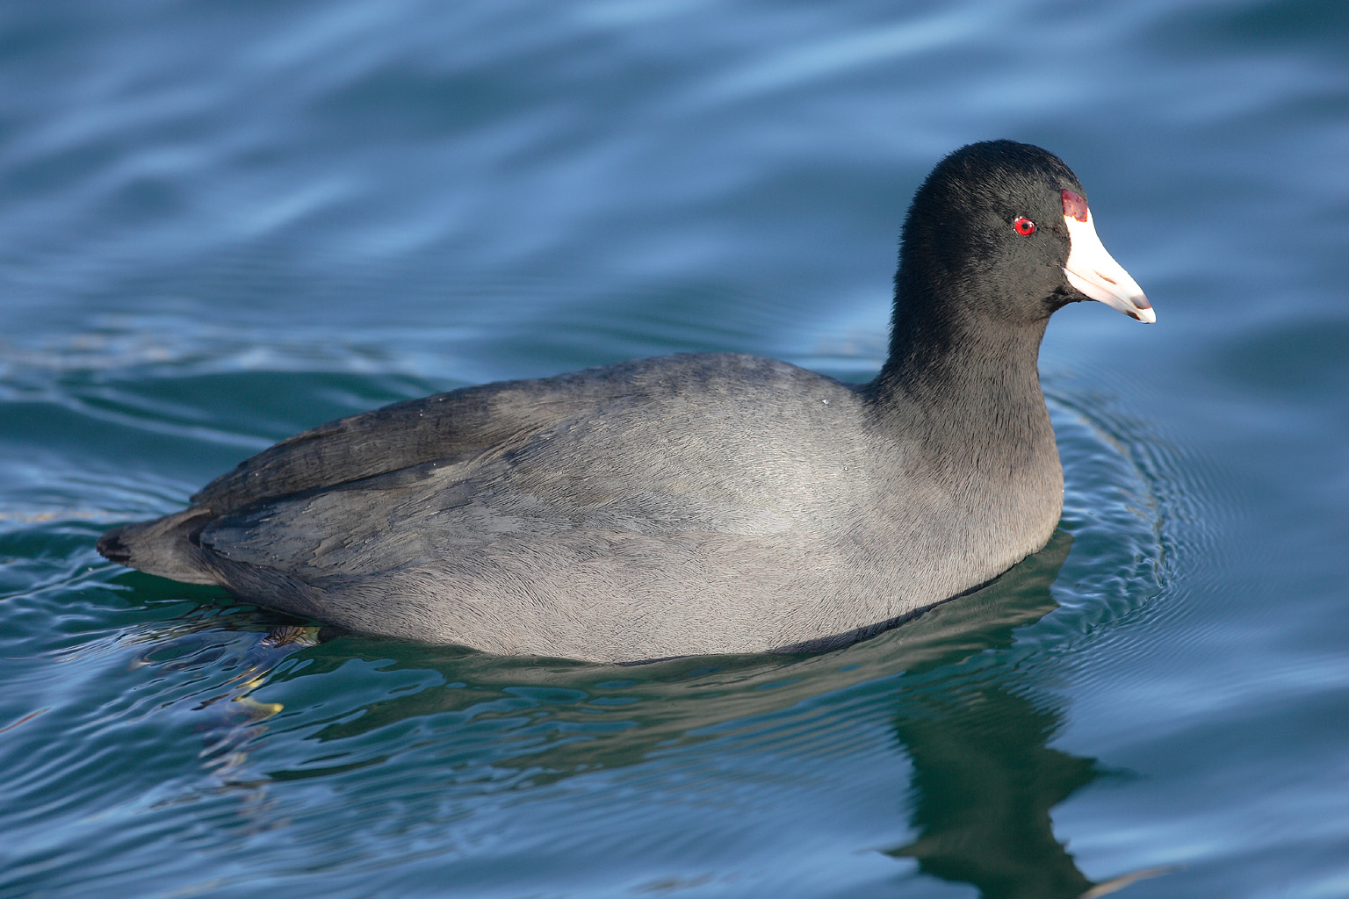
El zoo Read aloud the Spanish name of each animal.
El zoo Read aloud the Spanish name of each animal.
You have not learnt these words so just use what you know about how to pronounce Spanish. ☺
Concentrate on the underlined letters.
ZOO
You have not learnt these words so just use what you know about how to pronounce Spanish. ☺
Concentrate on the underlined letters.
ZOO
1 | 2 | 3
4 | 5 | 6
1 | 2 | 3
4 | 5 | 6
la cabra
el lobo ibérico
el cuco
la cabra
el lobo ibérico
el cuco
el lince
el porcino
el zorro
el lince
el porcino
el zorro
7 | 8 | 9 | 10
7 | 8 | 9 | 10
la focha
el ciervo
el mochuelo
el camaleón
la focha
el ciervo
el mochuelo
el camaleón
For numbers 8, 9 and 10 write the number of syllables in each word here: 8. [___] 9. [___] 10. [___]
For numbers 8, 9 and 10 write the number of syllables in each word here: 8. [___] 9. [___] 10. [___]
Notes:
Pupil handout To copy and cut in half
Attribution: Focha - No machine-readable author provided. Mdf assumed (based on copyright claims)., CC BY-SA 3.0 via Wikimedia Commons

