Slide 1
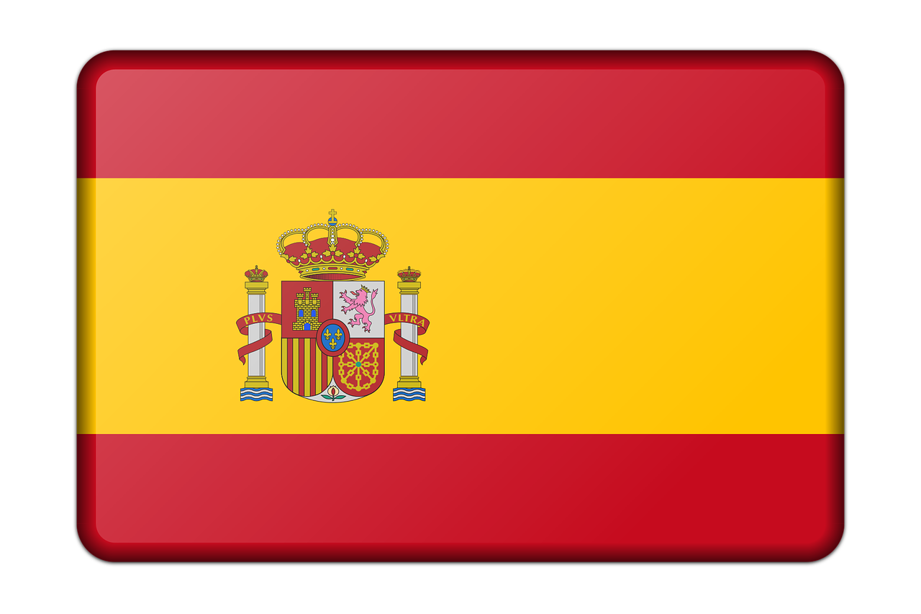
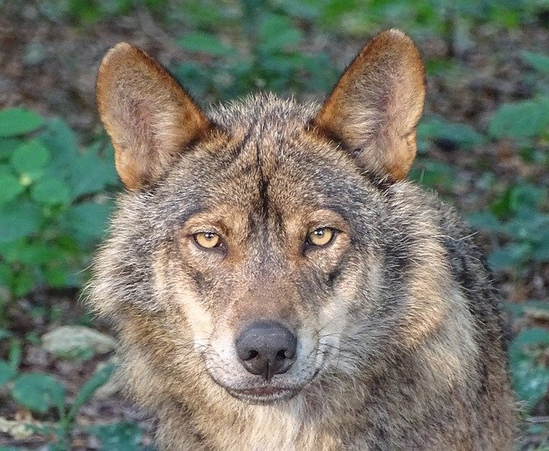
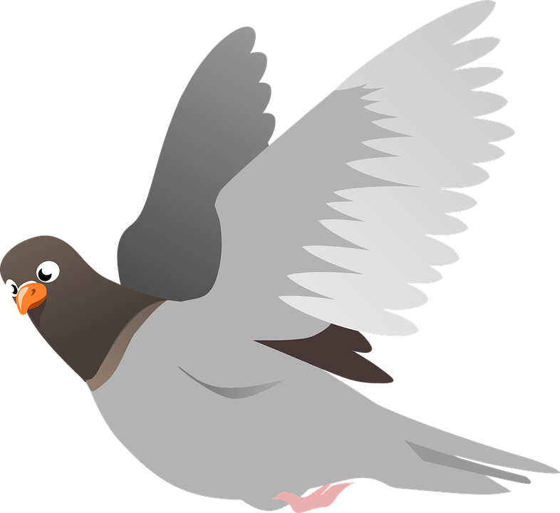
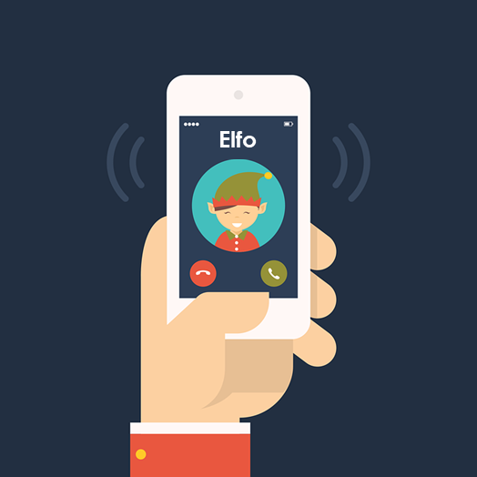
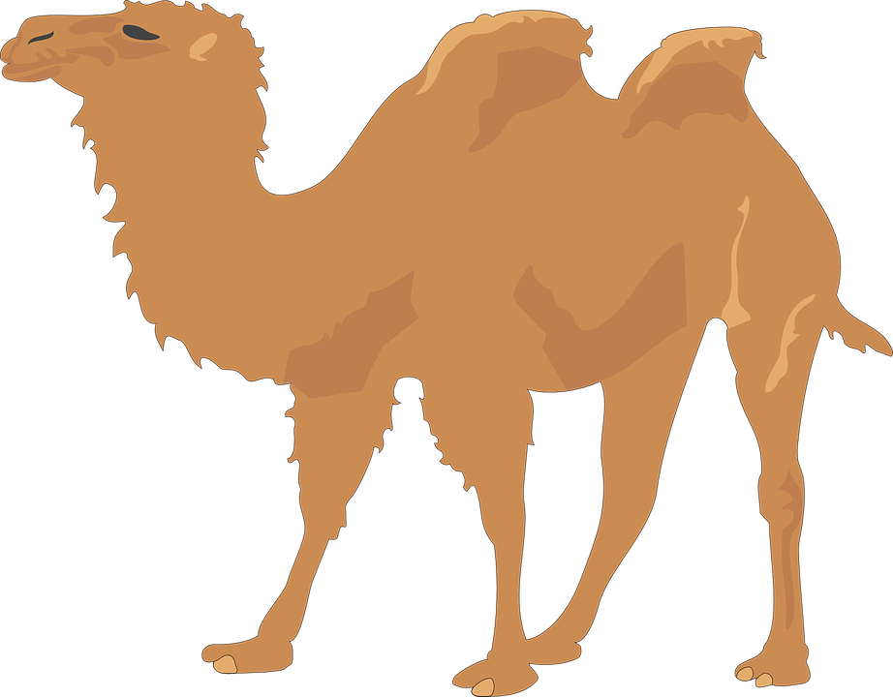
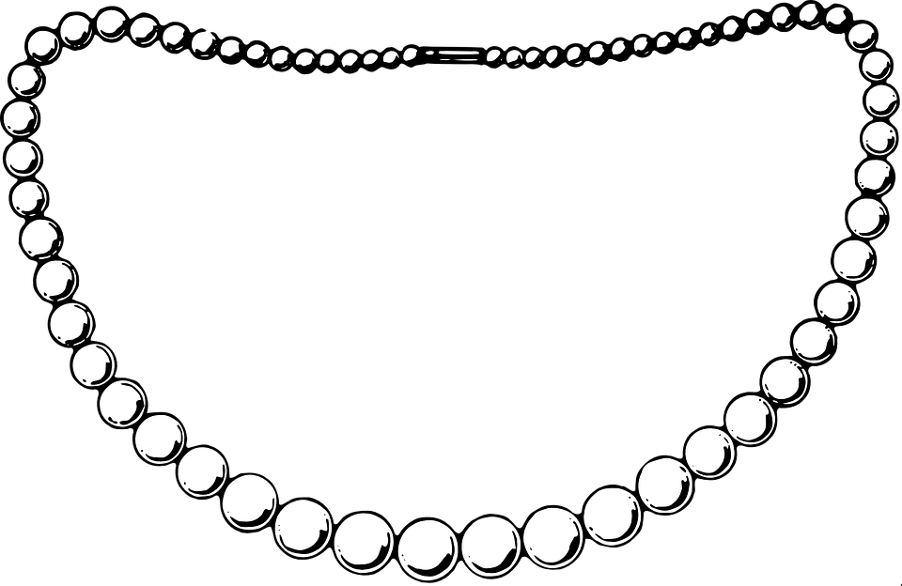
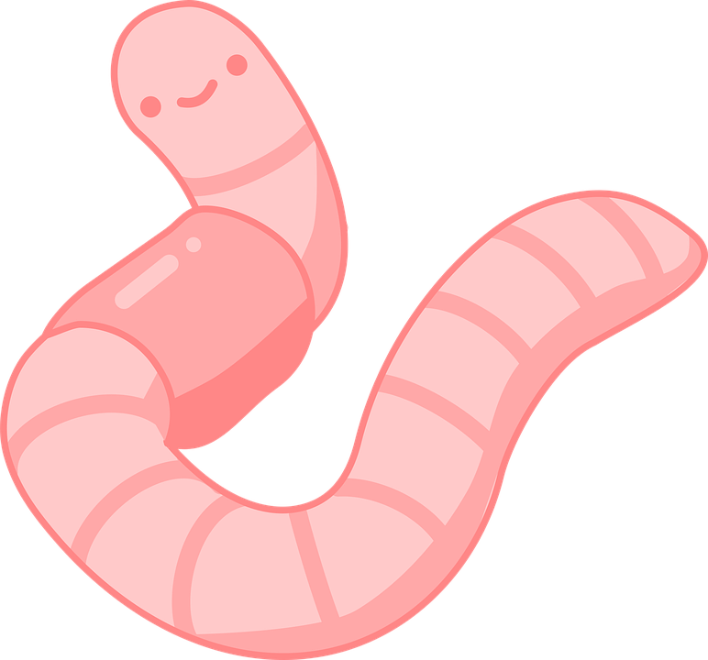
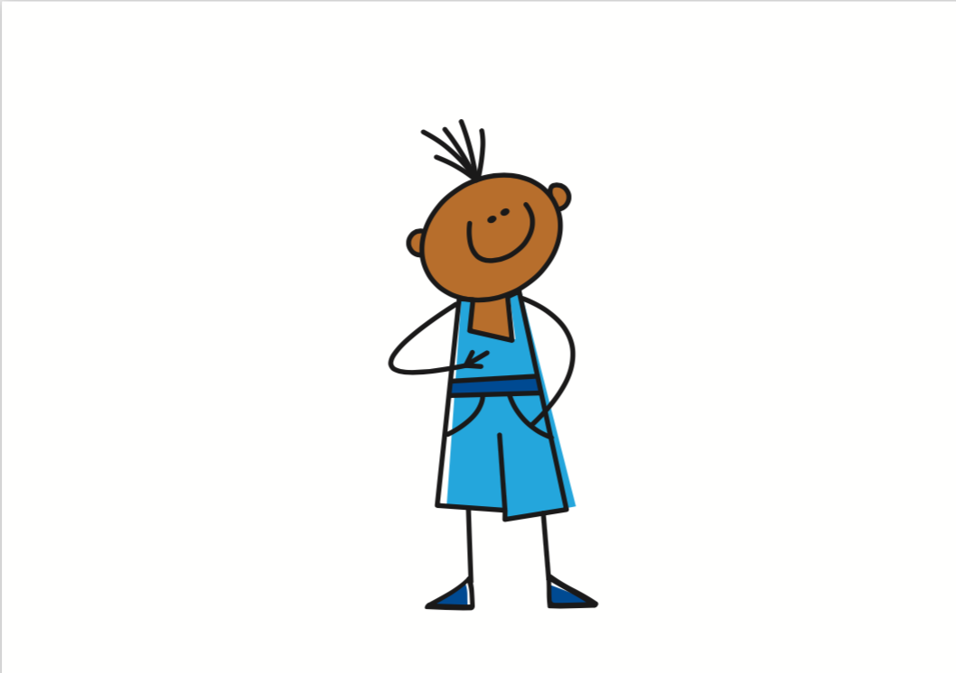
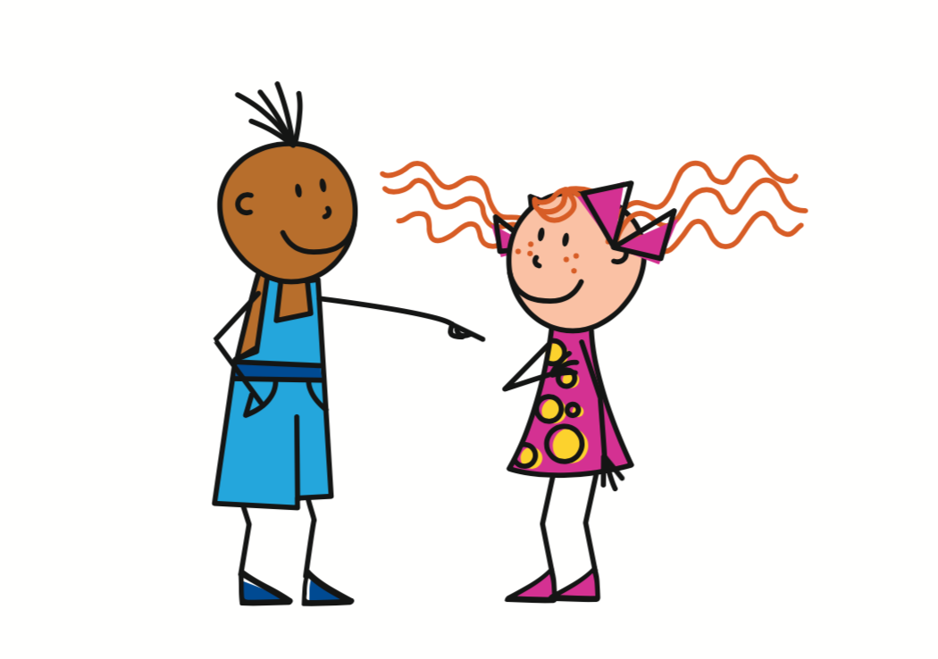
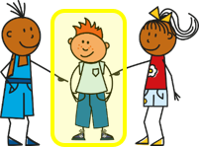
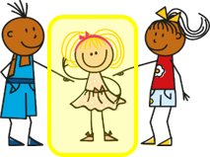
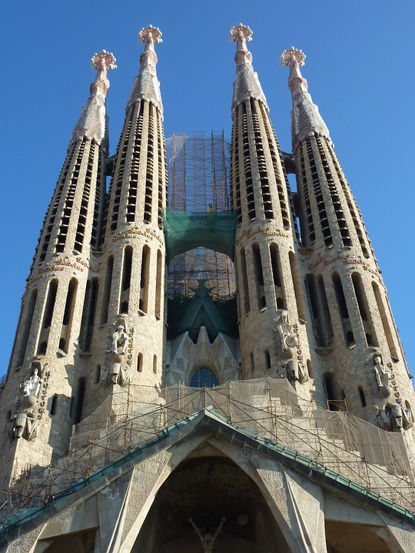
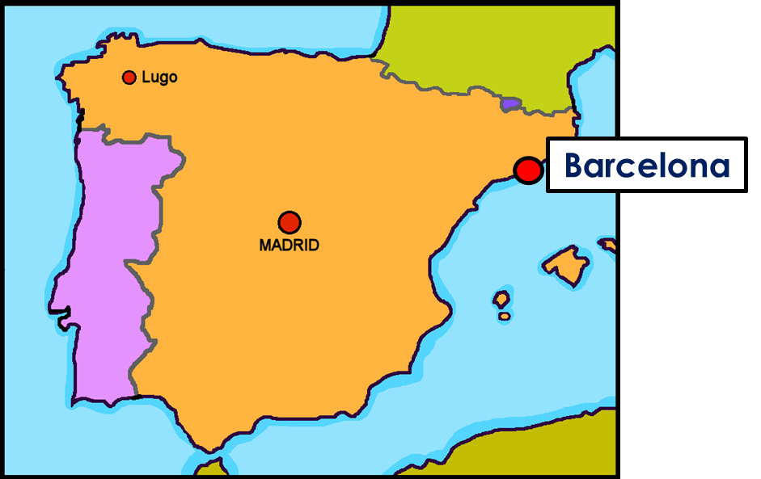
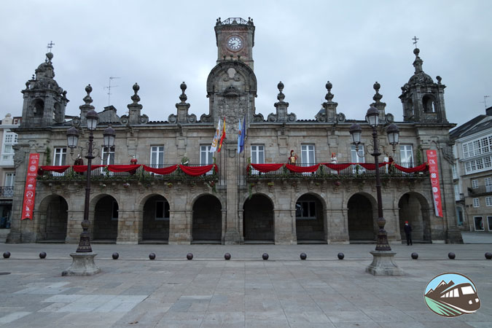
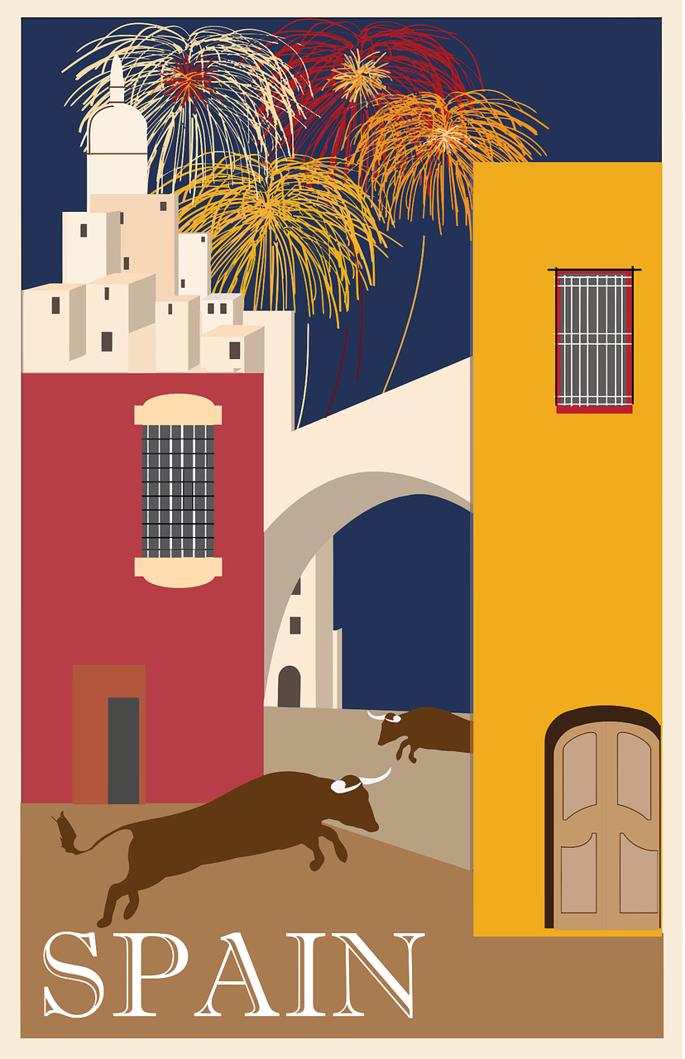
Amarillo Knowledge Organiser - Spring Term A
Las actividades
hacer – to do, make
hago – I do, make
hace – s/he, it does, makes
aprender – to learn| learning
buscar – to look for, search
comer – to eat, eating
crear – to create, creating
descansar – to relax, rest
leer – to read, reading
montar – to ride, mount
pasear – to go for a walk
presenter – to present, presenting
responder (a) – to reply, replying (to)
visitor – to visit, visiting
usar – to use, using
La descripción
con - with
de – from, of
el – the (m), la – the (f)
por – through, around, along
por la tarde – in the afternoon
divertido, divertida – fun, funny
importante – important
interesante - interesante
Las cosas
actividad (f) – activity
bicicleta (f) – bicycle
bocadillo (m) – sandwich
carta (f) – letter
ejercicio (m) – exercise
español (m) – Spanish
información (f) – information
inglés (m) – English
naranja (f) – orange
noticia (f) – a piece of news
ordenador (m) – computer
revista (f) – magazine
tarde (f) – afternoon
Los lugares (places)
campo (m) – countryside
ciudad (f) – city, town
estadio (m) – stadium
habitación (f) - room
iglesia (f) – church
museo (m) – museum
país (m) – country
parque (m) – park
plaza (f) – square
Phonics
[l] | libro | lobo | paloma | lavar | película
[ll] | llamar | amarillo | llover | camello | collar
[to call]
[ga] | ganar | [go] | lago | [gu] | gusano
Infinitive verbs | Present tense –AR verbs hablar - to speak|speaking hablo ➜ I speak hablas ➜ you speak habla ➜ he speaks habla ➜ she speaks habla ➜ it speaks | Present tense – ER verbs leer - to read|reading leo ➜ I read lees ➜ you read lee ➜ he reads lee ➜ she reads lee ➜ it reads
Las personas | Definite articles – ‘the’ To say the in Spanish use el before a masculine noun and la before a feminine noun. el campo la plaza | The personal ‘a’
The infinitive describes the general meaning of the verb. In English, we often write ‘to + verb’:
It’s important to listen.
In Spanish, many infinitives end in –AR:
Es importante escuchar.
Escuchar es importante.
(Listening is important.)
➜
Note the difference in English.
la madre – mother
el padre - father
la mamá – mum
el papá- dad
In Spanish, after verbs such as ‘ver’ [to see, seeing] and ‘visitar’ [to visit, visiting], we use ‘a’ if what we see or visit is a person or a pet. This does not happen in English!
Visito a un amigo.
I visit a friend.
Plaza Mayor is the main square in many towns and cities in Spain. In Latin America, the main square is Plaza de Armas.
Visito el museo.
Barcelona
I visit the museum.

Slide 2
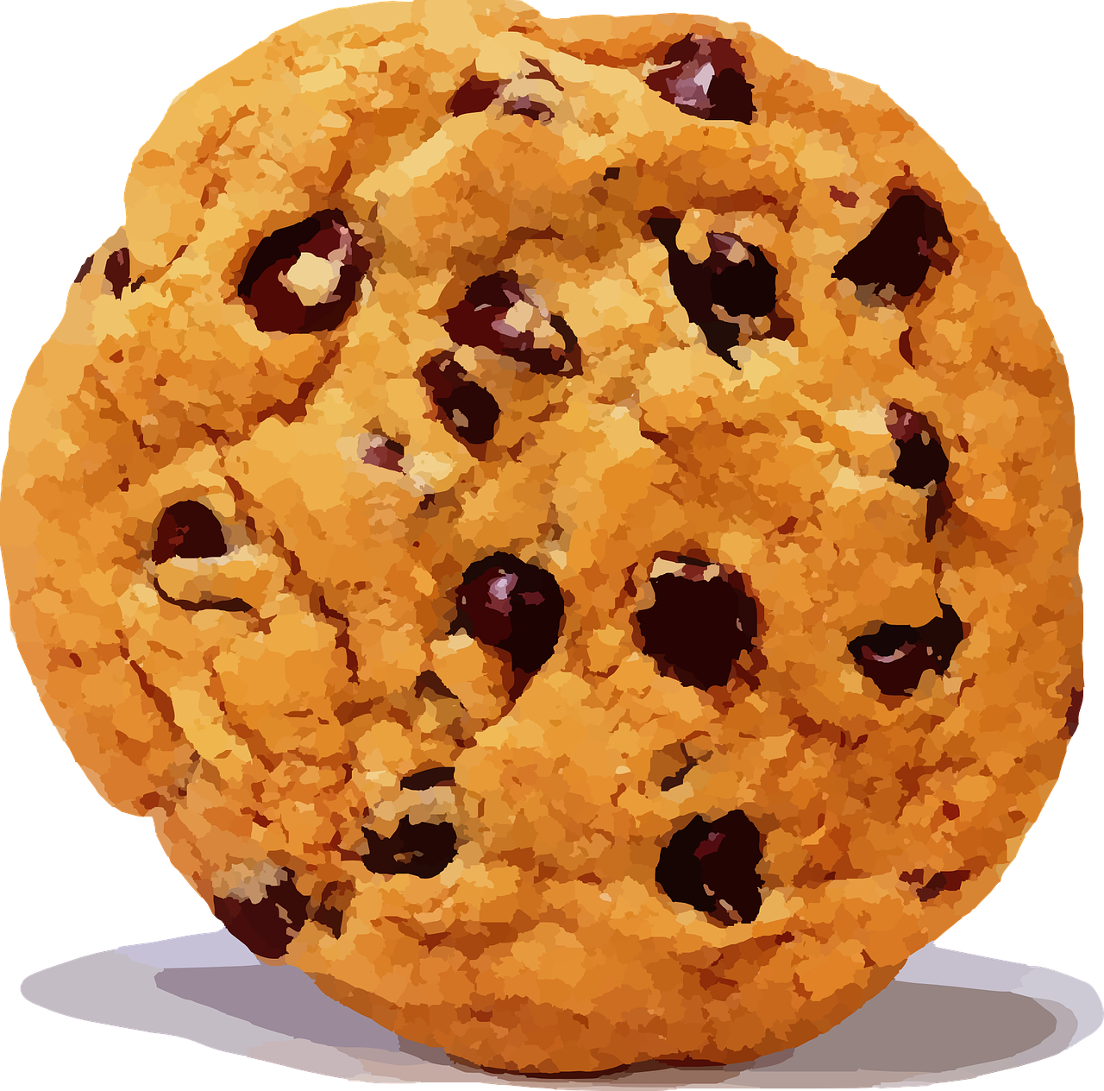
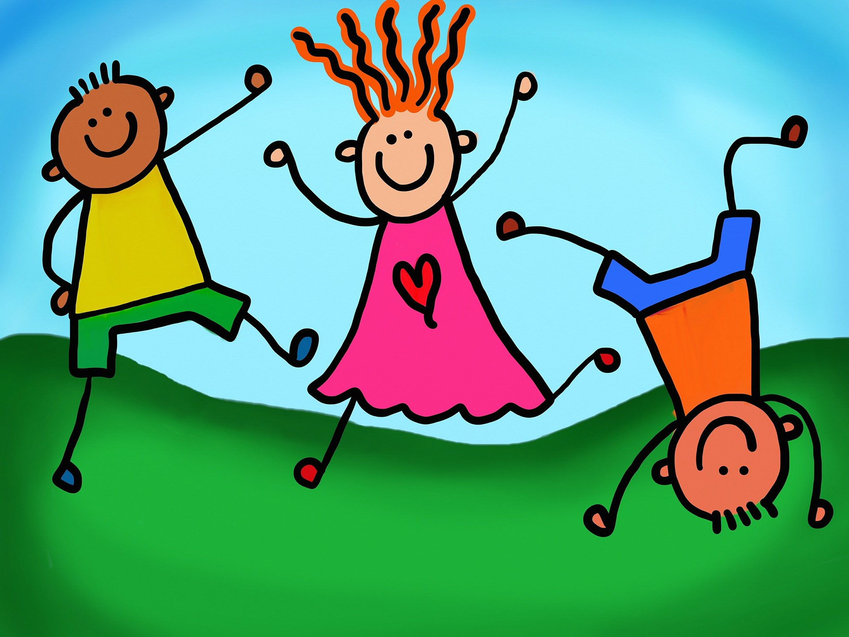
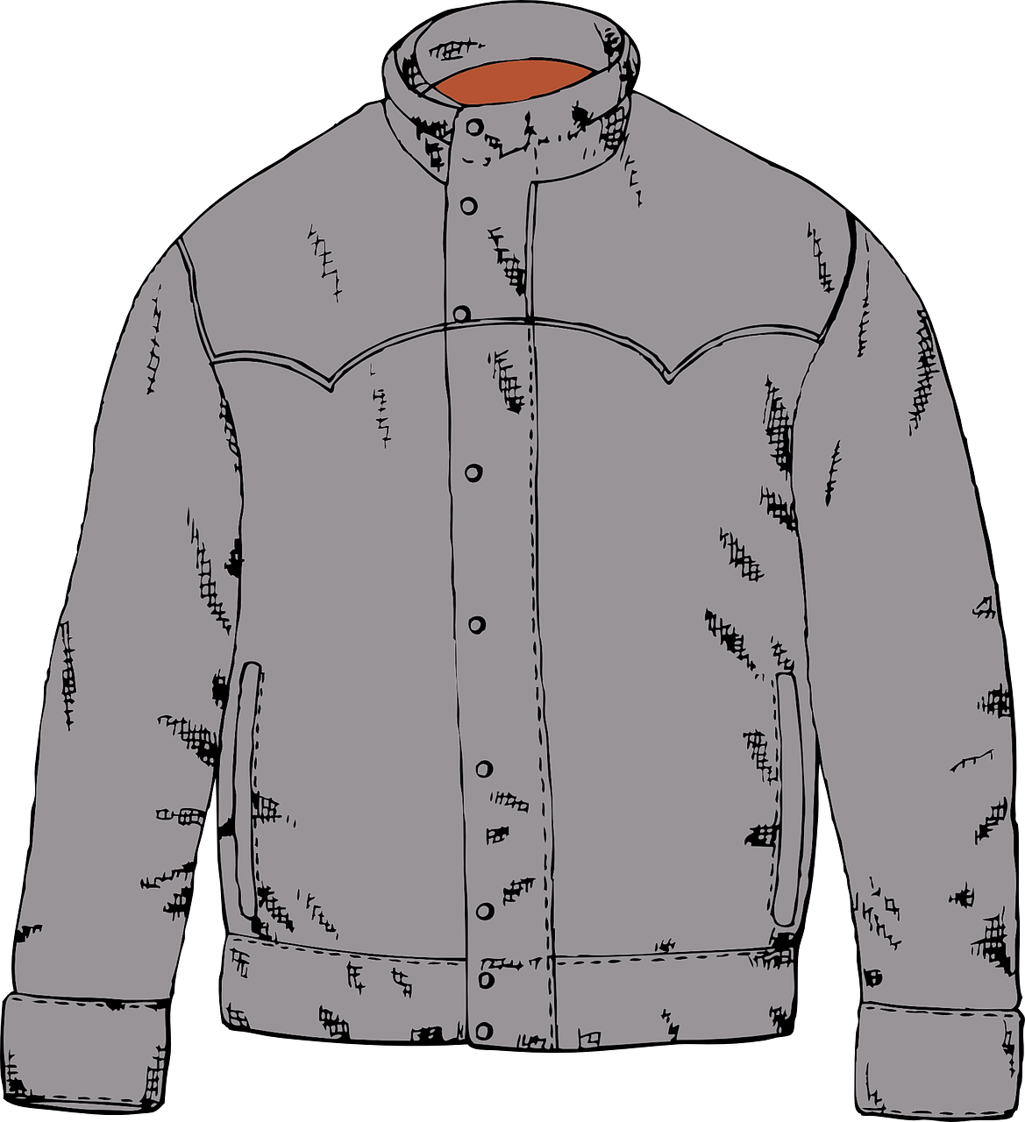
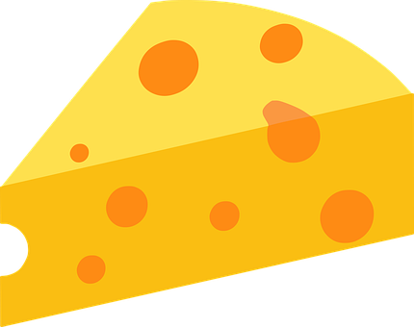
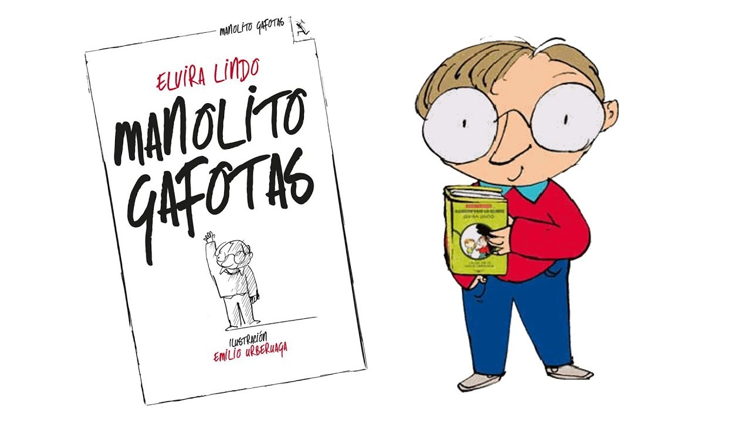
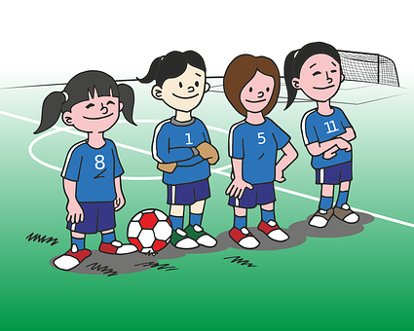
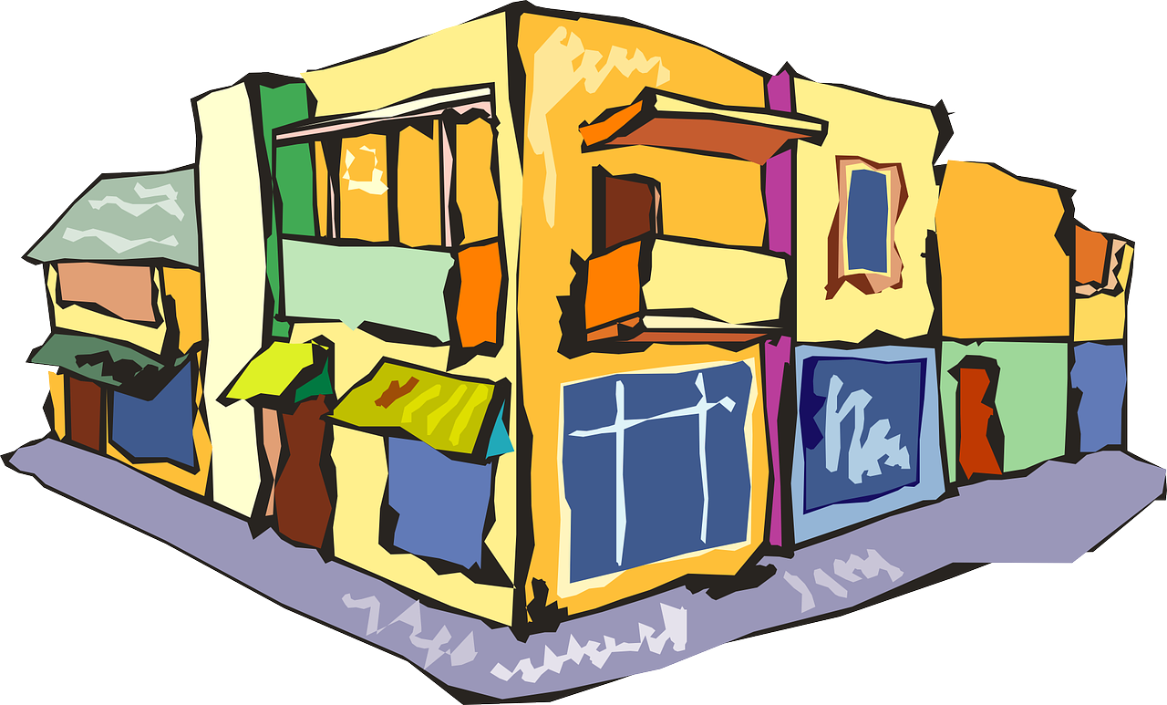
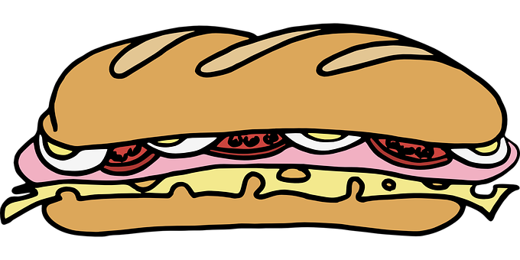
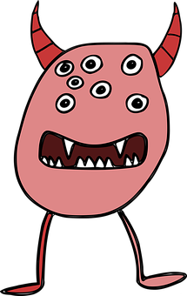
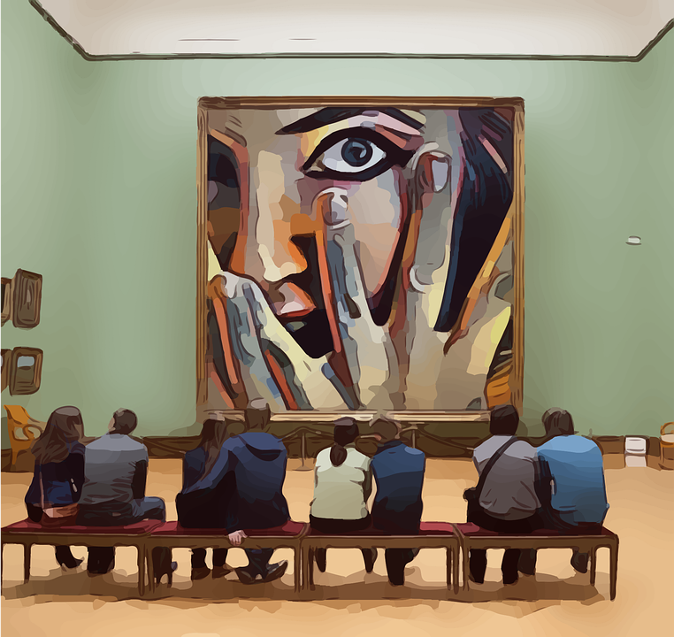
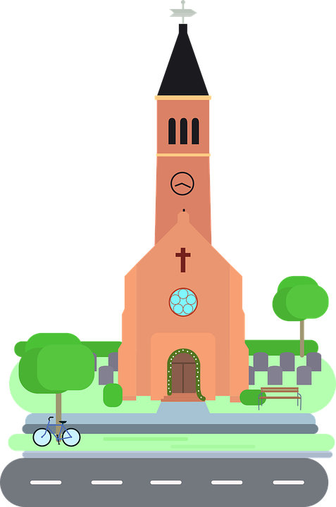
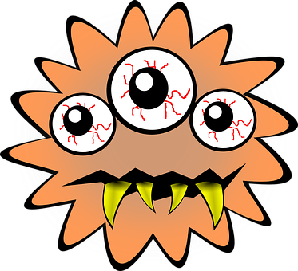
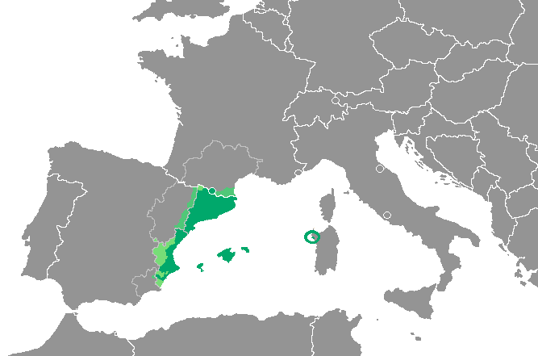
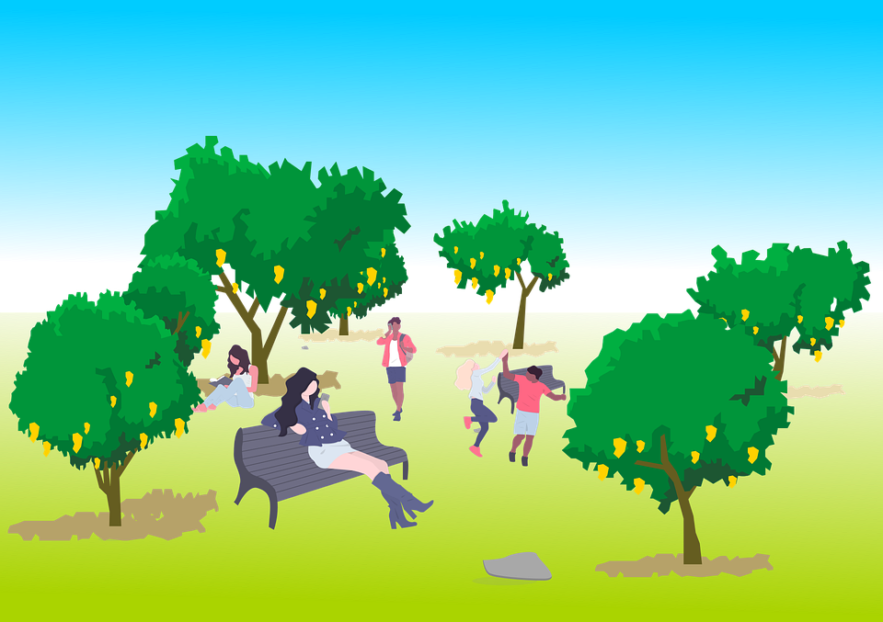
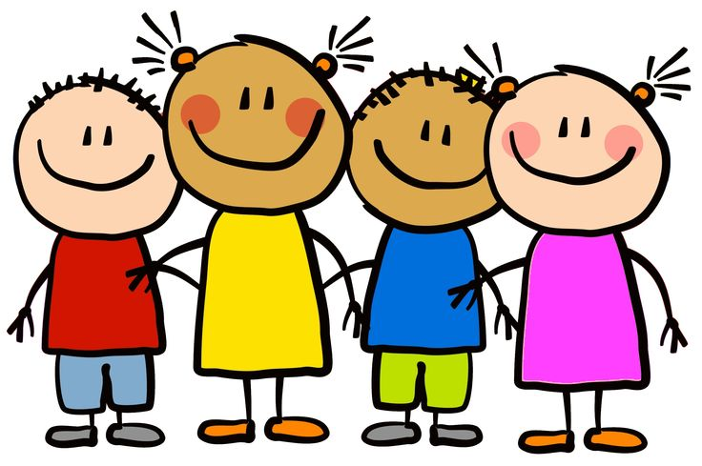
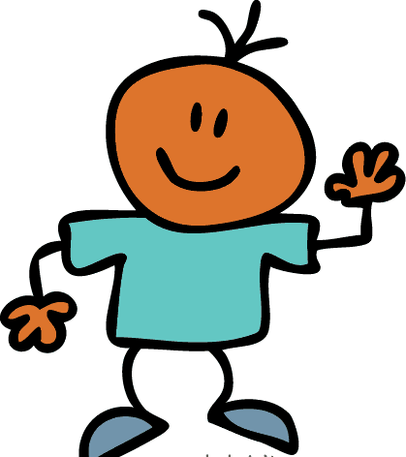
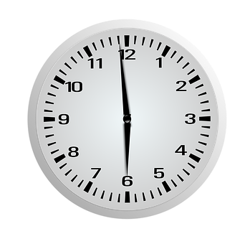
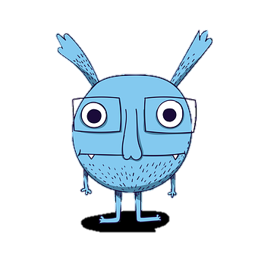
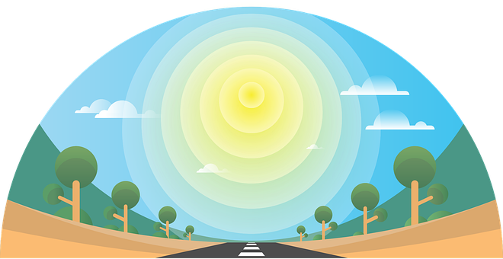
Amarillo Knowledge Organiser - Spring Term B
Los números
uno - one
dos – two
tres – three
cuatro – four
cinco – five
seis – six
siete – seven
ocho – eight
nueve – nine
diez – ten
once - eleven
doce – twelve
hay – there is, there are
cuántos – how many (mpl)
cuántas – how many (fpl)
unos – some (mpl)
unas – some (fpl)
El cuerpo (body)
boca (f) – mouth
cabeza (f) – head
dedo (m) - finger
ojo (m) - eye
oreja (f) - ear
pie (m) - foot
Phonics
jugar
[ga]
ganar
galleta
amiga
to play, playing
[go]
lago
domingo
Sun
gota
amigo
[gu]
gusano
segundo
canguro
laguna
Manolito Gafotas es un libro famoso* en España.
[que]
paquete
queso
bosque
chaqueta
esquina
[qui]
equipo
quince
aquí
corner
Indefinite articles – ‘some’ Remember: to mean a (or an) in Spanish use un before a masculine noun and una before a feminine noun. un museo una iglesia To mean some for a masculine noun, use unos, and use unas before a feminine noun: unos museos – some museums unas iglesias – some churches | Plural nouns Most nouns in Spanish add –s for plural: unos bocadillos – some sandwiches unas revistas – some magazines unos parques – some parks unas tardes – some afternoons | How many? To mean ‘how many’ before a masculine noun, use cuántos: ¿Cuántos ojos hay? How many eyes are there? To mean ‘how many’ before a feminine noun, use cuántas: ¿Cuántas bocas hay? How many mouths are there?
Catalan is an official language in Catalonia, Valencia, the Balearic islands and Andorra.
➜
In Valencia, the language is called ‘valenciano’.
Many of its words are similar to Spanish.
¡Bon dia!
¡Buenos días!
pm
¡Adéu!
¡Adiós!
pm

