Slide 1
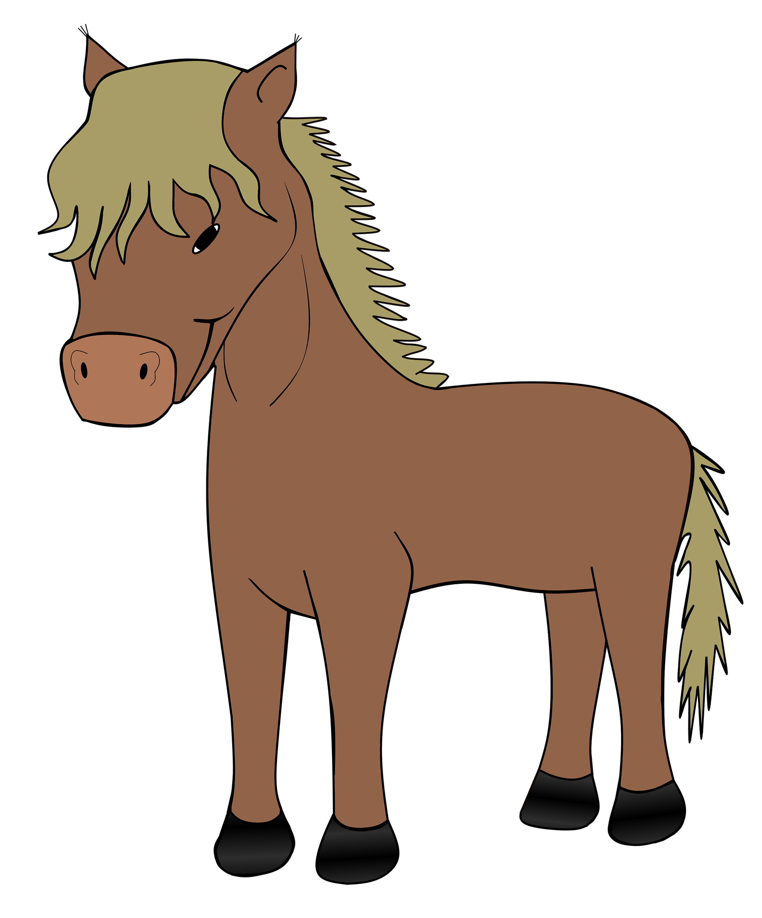
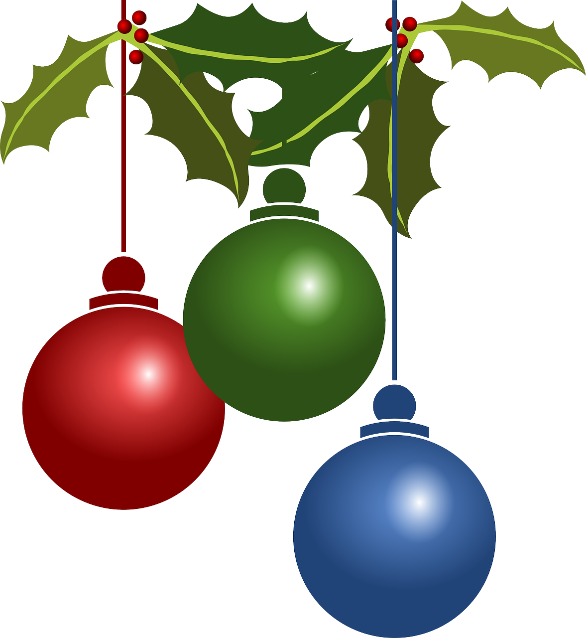
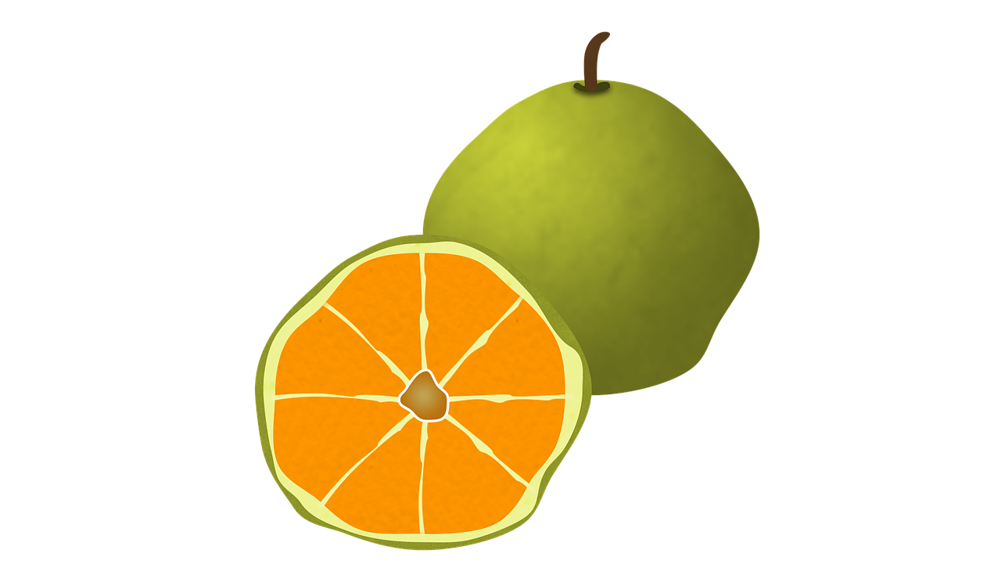
¡Feliz Navidad!
Pupil name: ___________________________________
Total score: _____ / 20
Listen and fill the gaps with the correct letter or letters.
 | Name | Present | SSC [sound-symbol correspondence] | p/ x
1 | Alan | abanico | a
2 | Esteban | establo | e
3 | Olivia | ornamento | co
4 | Ciro | címbalos | ce
5 | Isabel | imán | i
6 | Zoe | zorro | z
7 | Constanza | consola | o
8 | Celeste | cerdo | ci
9 | Úrsula | ugli | u
10 | Camilo | camisa | ca
 | Names
1 | __ lan
2 | __ steban
3 | __ livia
4 | __ __ ro
5 | __ sabel
6 | __ oe
7 | __ __nstanza
8 | __ __ leste
9 | __ rsula
10 | __ __ milo
abanico
establo
ornamento
címbalos
imán
zorro
consola
cerdo
Note: 1] Each item offers two opportunities to assess the same SSC, but only one SSC is assessed per item (e.g. ‘abanico’ only assesses for ‘a’, not for ‘i’ or ‘co’. 2] Teachers award one point for the SSC in each word (max. 2 points per item).
ugli
camisa
Read aloud the Spanish name and the Christmas present with the same initial sound. You have not learnt these words so use what you know about how to pronounce Spanish.

