Slide 1
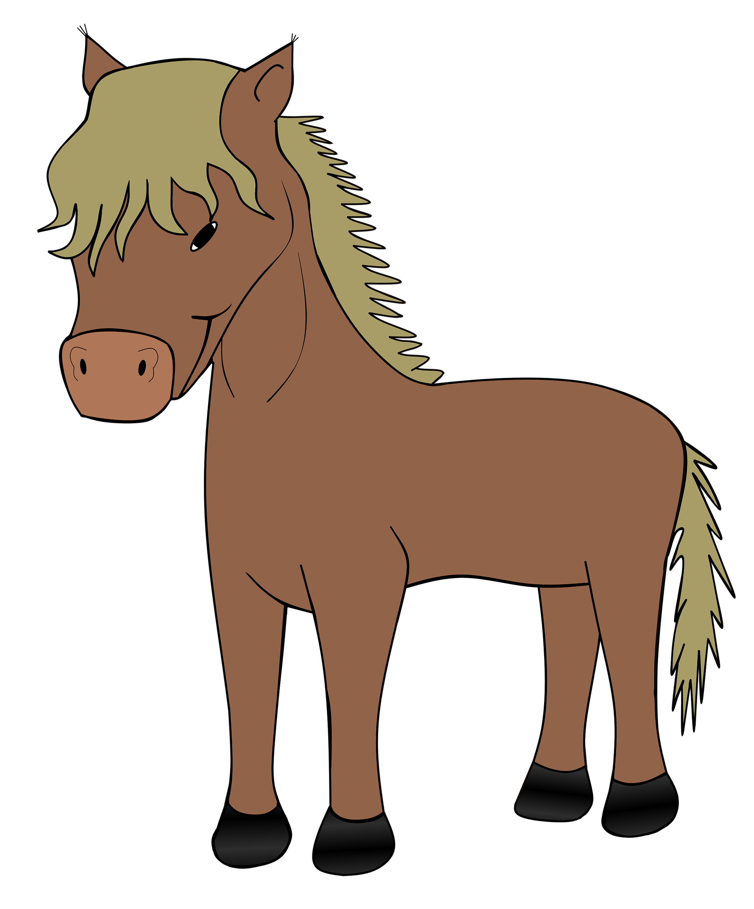
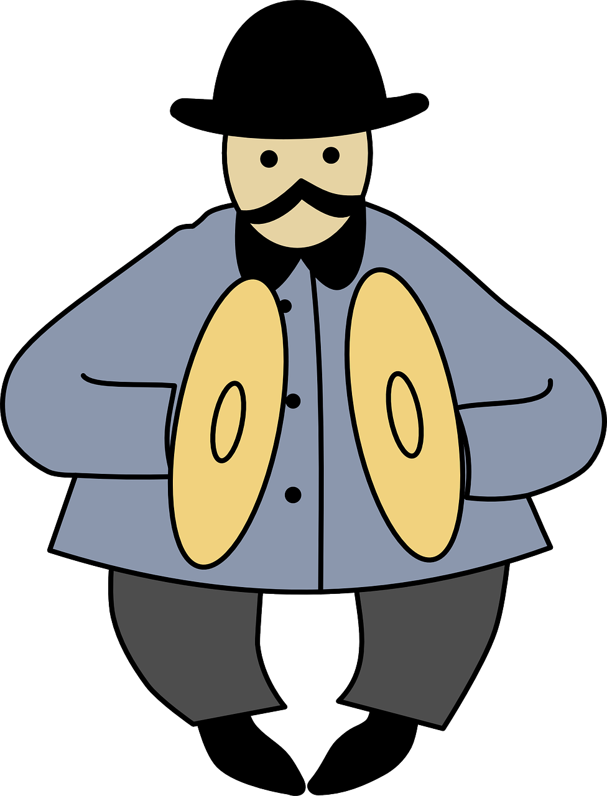
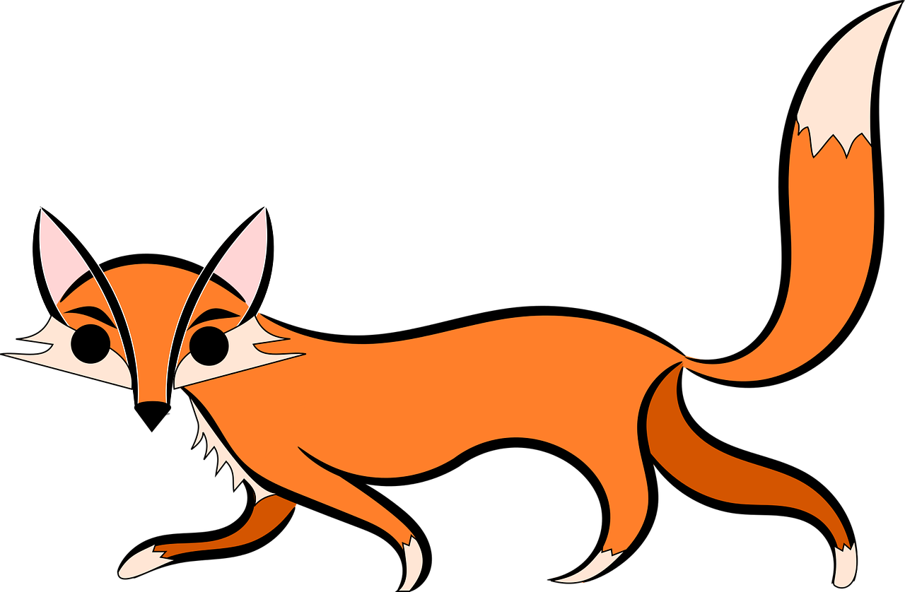
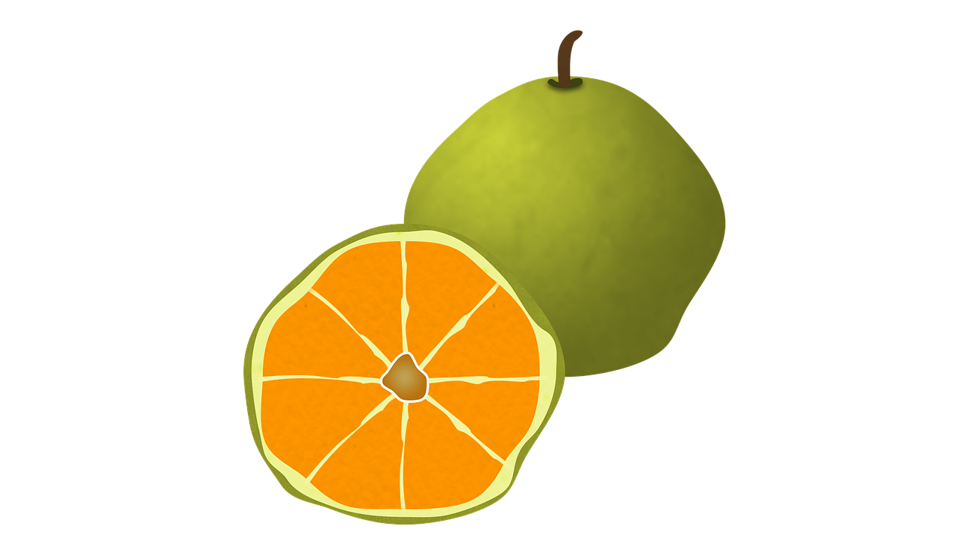
¡Feliz Navidad!
¡Feliz Navidad!
Listen and fill the gaps with the correct letter or letters.
Listen and fill the gaps with the correct letter or letters.
 | Names
1 | __ lan
2 | __ steban
3 | __ livia
4 | __ __ ro
5 | __ sabel
6 | __ oe
7 | __ __nstanza
8 | __ __ leste
9 | __ rsula
10 | __ __ milo
 | Names
1 | __ lan
2 | __ steban
3 | __ livia
4 | __ __ ro
5 | __ sabel
6 | __ oe
7 | __ __nstanza
8 | __ __ leste
9 | __ rsula
10 | __ __ milo
abanico
establo
abanico
establo
ornamento
címbalos
ornamento
címbalos
imán
zorro
imán
zorro
consola
cerdo
consola
cerdo
ugli
camisa
ugli
camisa
Read aloud the Spanish name and the Christmas present with the same initial sound. You have not learnt these words so use what you know about how to pronounce Spanish.
Read aloud the Spanish name and the Christmas present with the same initial sound. You have not learnt these words so use what you know about how to pronounce Spanish.

