Slide 1
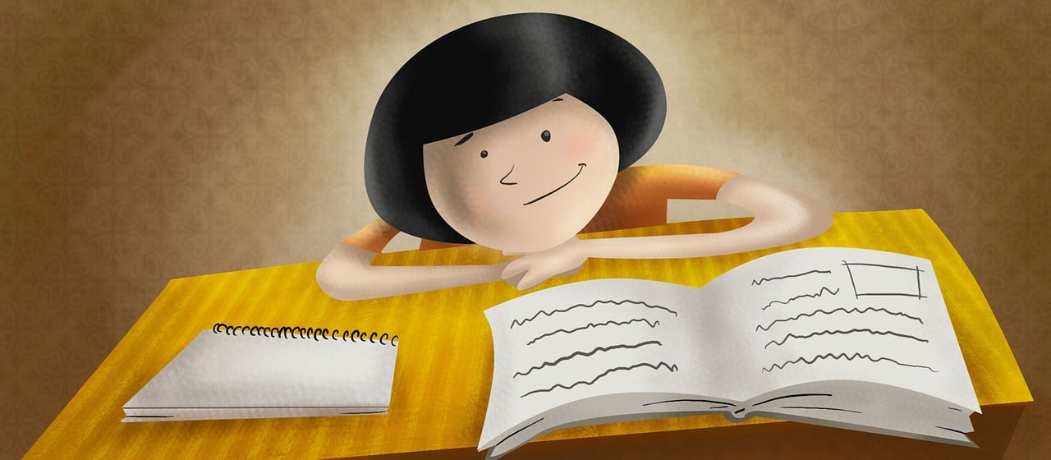
Expressing likes and saying what I and others do
Je révise !
vert
Follow ups 1-5
Notes:
Artwork by Steve Clarke. Pronoun pictures from NCELP (www.ncelp.org). All additional pictures selected from Pixabay and are available under a Creative Commons license, no
attribution required.
Phonics: Revisit SSC from this term and from previous learning: [-tion] [qu] [-s-] [h] [-ien] [j/g] [ç/c] [SFC] [u] [ou] [(a)in] open [eu] [ch] [(e)au]
Vocabulary: Revisit vocabulary (new words in bold) from this term and from previous learning.
Revisit 1: aimer [242] corde [3784] danse [2964] football [2602] guitare [>5000] piano [4967] sport [2011] tennis [3687]
amusant [4695] sympa [4164] intéressant [1244] parce que [NA] pourquoi [193]
Revisit 2: tu vas je vais [53] tu es je suis [5] à (meaning ‘at/in/to’) [4] café [1886] campagne [666] centre commercial [n/a] église [1782] ile [1245] magasin [1736] maison [325] marché [280] montagne [1732] plage [2693] pont [1889] port [1304]
Londsale, D., & Le Bras, Y. (2009). A Frequency Dictionary of French: Core vocabulary for learners London: Routledge.
The frequency rankings for words that occur in this PowerPoint which have been previously introduced in these resources are given in the SOW and in the resources that first
introduced and formally re-visited those words.
For any other words that occur incidentally in this PowerPoint, frequency rankings will be provided in the notes field wherever possible.

Slide 2
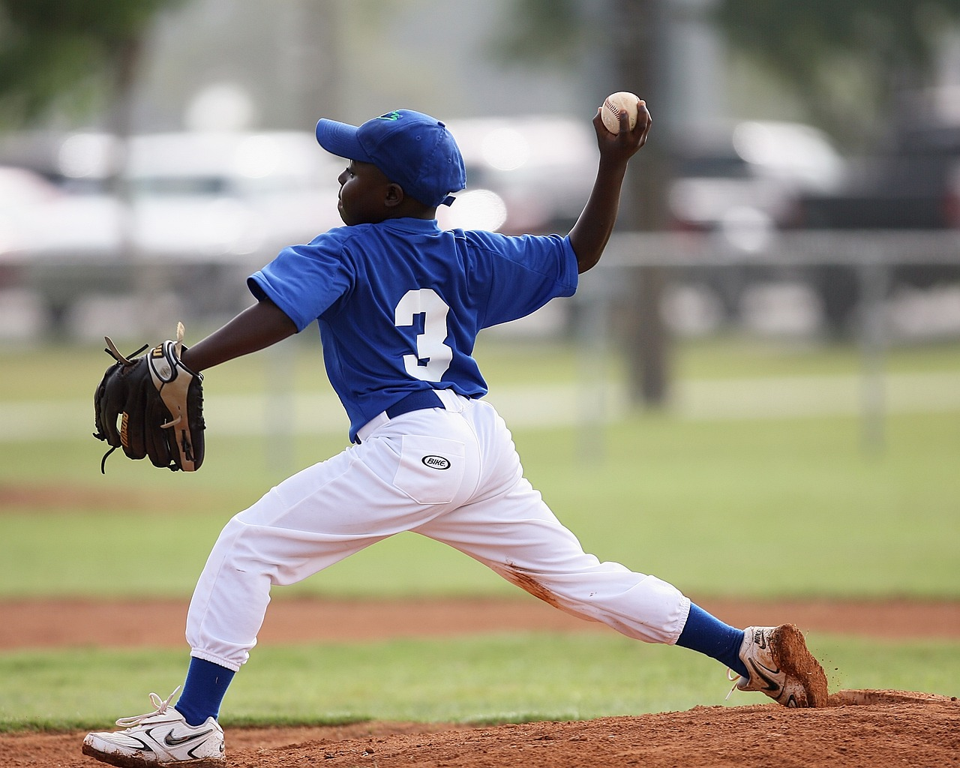
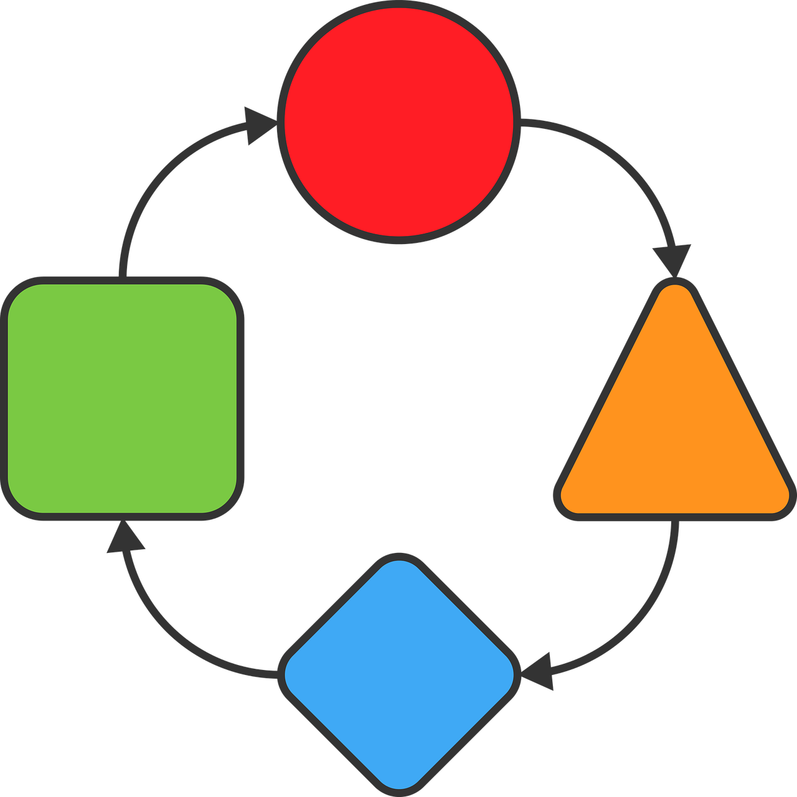
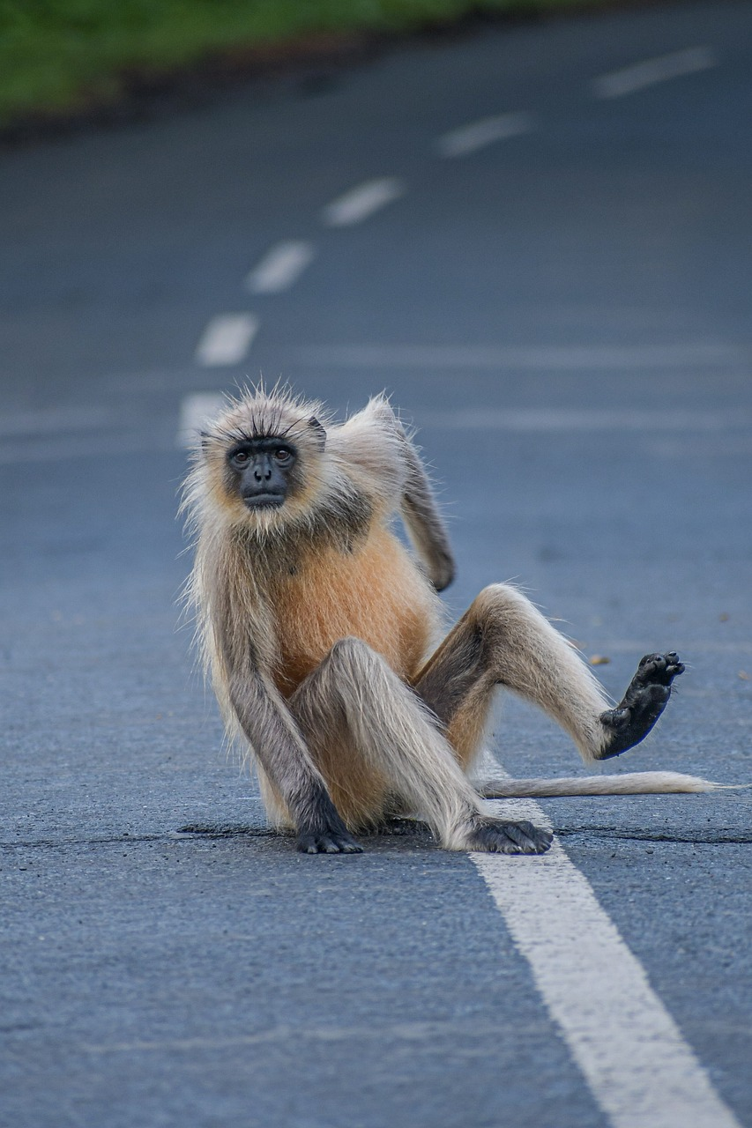
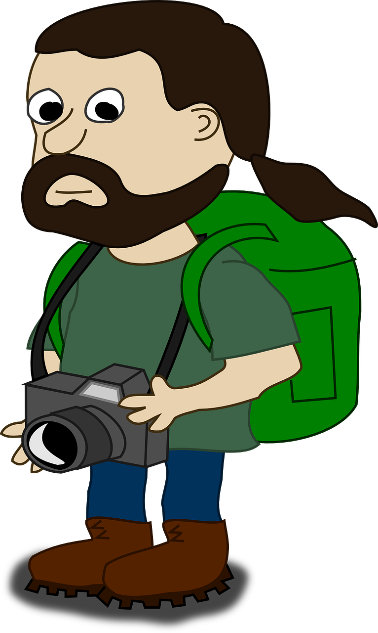
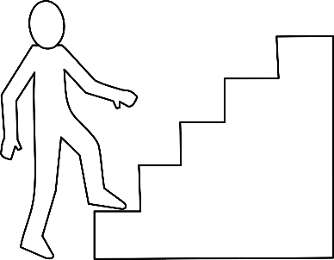
Follow up 1
Prononce les mots.
prononcer
correction
lancer [to throw]
projet [project]
toit [roof]
correction |  | lancer | projet | public |  | toit
équivalent |  | juger |  | coup |  | épaule
exploser | horaire | comédien |  | voyageur | point | marche
public
60
équivalent
juger [to judge]
coup
[knock, blow]
épaule [shoulder]
$$\frac{1}{10}$$
S
exploser
[explode]
horaire
[timetable]
comédien [comedian]
voyageur
[traveller]
point
[full stop]
marche [step]
0
START
Notes:
Timing: 5 minutes
Aim: to practise applying knowledge of several SSC to unknown words.
Procedure: 1. Start the timer. Pupil A tries to read aloud all of the words pronouncing n / ñ correctly, within the 60 seconds allowed.
2. Pupil B listens. If Pupil A mispronounces by mistake, Pupil B can direct him/her to start again from the beginning. 3. They swap roles and repeat the task.
4. Teacher then uses animations to elicit pronunciations chorally.
Note: in the audio version, you can click on the pictures to hear the words and also on the white shapes.
Word frequency of unknown words and cognates:
comédien [4253] correction [3005] coup [299] épaule [2495] équivalent [2476] exploser [2678] horaire [3192] juger [395] lancer [514] marche [906] point [n/a] projet [228] public [285] toit [2894] voyageur [2629]

Slide 3
Follow up 2
Écoute et écris la phrase en français. Puis, vérifie.
écouter
 | en anglais | en français
 | I want to do some sport. | Je veux faire du sport.
 | Do you like playing football? | Tu aimes jouer au foot ?
 | I would like to go to the park. | Je voudrais aller au parc.
 | You hate working in silence. | Tu détestes travailler en silence.
1
2
3
4
Notes:
Timing: 5 minutes Aim: to practise transcription of four short sentences made up of previously taught language.
Procedure:
Pupils listen to the French and can also look at the English.
They then try to write the short sentence in French – they can continue to see the English.
Play the full audio for each item again, and click to reveal the French.
Pupils correct their own work.
Continue for items 1-3.
Transcript:
1. Je veux faire du sport.
2. Tu aimes jouer au foot ?
3. Je voudrais aller au parc.
4. Tu détestes travailler en silence.

Slide 4
Follow up 3
Lis la phrase en anglais et écris les bonnes lettres.
Écoute et vérifie. (1-6).
lire
E aime
V sport
CC exercice
A | je/j’
B | tu
C | il
D | elle
L | faire
M | jouer
N | aller
O | être
P | au
Q | à la
R | à l’
S | du
T | de la
U | de l’
F aimes
W danse
DD plage
G détestes
X guitare
EE campagne
H déteste
Y piano
FF marché
I veut
Z foot
GG café
J veux
AA corde
HH stade
K voudrais
BB église
II maison
You like being at the stadium.
1
B
F
O
P
HH
Tu aimes être au stade.
Notes:
Timing: 6 minutes (six slides) Aim: to practise written comprehension of the 2-verb structures and use of articles from this term with a range of vocabulary, expressing wants, likes and dislikes of activities and locations.
Procedure:
Click to bring up the English phrase.
Give pupils a minute to write down the correct letters.
Count pupils down (3-3-1) and elicit the French phrase from them.
Click to listen to the phrase, bring up the correct letters and confirm the correct sentence in writing.
Continue to the next slides for items 2-6.
Transcript:
1. Tu aimes être au stade.

Slide 5
Follow up 3
lire
E aime
V sport
CC exercice
A | je/j’
B | tu
C | il
D | elle
L | faire
M | jouer
N | aller
O | être
P | au
Q | à la
R | à l’
S | du
T | de la
U | de l’
F aimes
W danse
DD plage
G détestes
X guitare
EE campagne
H déteste
Y piano
FF marché
I veut
Z foot
GG café
J veux
AA corde
HH stade
K voudrais
BB église
II maison
She wants to go to the country.
2
D
I
N
Q
EE
Elle veut aller à la campagne.
Notes:
[2/6]
Transcript:
2. Elle veut aller à la campagne.

Slide 6
Follow up 3
lire
E aime
V sport
CC exercice
A | je/j’
B | tu
C | il
D | elle
L | faire
M | jouer
N | aller
O | être
P | au
Q | à la
R | à l’
S | du
T | de la
U | de l’
F aimes
W danse
DD plage
G détestes
X guitare
EE campagne
H déteste
Y piano
FF marché
I veut
Z foot
GG café
J veux
AA corde
HH stade
K voudrais
BB église
II maison
I would like to do some exercise.
3
A
K
L
U
CC
Je voudrais faire de l’exercice.
Notes:
[3/6]
Transcript:
3. Je voudrais faire de l’exercice.

Slide 7
Follow up 3
lire
E aime
V sport
CC exercice
A | je/j’
B | tu
C | il
D | elle
L | faire
M | jouer
N | aller
O | être
P | au
Q | à la
R | à l’
S | du
T | de la
U | de l’
F aimes
W danse
DD plage
G détestes
X guitare
EE campagne
H déteste
Y piano
FF marché
I veut
Z foot
GG café
J veux
AA corde
HH stade
K voudrais
BB église
II maison
He hates playing (the) guitar.
4
C
H
M
T
X
Il déteste jouer de la guitare.
Notes:
[4/6]
Transcript:
4. Il déteste jouer de la guitare.

Slide 8
Follow up 3
lire
E aime
V sport
CC exercice
A | je/j’
B | tu
C | il
D | elle
L | faire
M | jouer
N | aller
O | être
P | au
Q | à la
R | à l’
S | du
T | de la
U | de l’
F aimes
W danse
DD plage
G détestes
X guitare
EE campagne
H déteste
Y piano
FF marché
I veut
Z foot
GG café
J veux
AA corde
HH stade
K voudrais
BB église
II maison
Does she want to play football?
5
D
I
M
P
Z
Elle veut jouer au foot ?
Notes:
[5/6]
Transcript:
5. Elle veut jouer au foot ?

Slide 9
Follow up 3
lire
E aime
V sport
CC exercice
A | je/j’
B | tu
C | il
D | elle
L | faire
M | jouer
N | aller
O | être
P | au
Q | à la
R | à l’
S | du
T | de la
U | de l’
F aimes
W danse
DD plage
G détestes
X guitare
EE campagne
H déteste
Y piano
FF marché
I veut
Z foot
GG café
J veux
AA corde
HH stade
K voudrais
BB église
II maison
Would you like to go to the church?
6
B
K
N
R
BB
Tu voudrais aller à l’église ?
Notes:
[6/6]
Transcript:
6. Tu voudrais aller à l’église ?

Slide 10
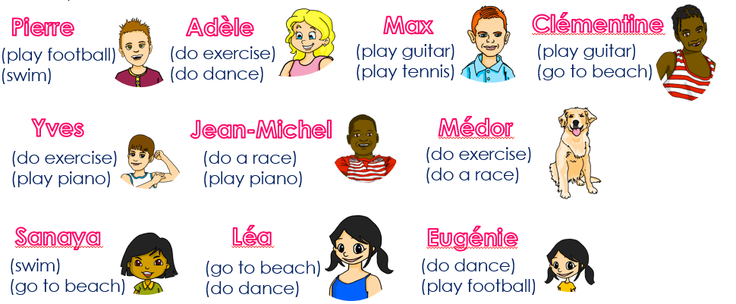
parler
Pose des questions. Ton/ta partenaire, c’est qui ?
A: Tu veux faire de l’exercice ?
A: Tu voudrais nager ?
B: Non.
B: Non.
A: Tu veux aller à la plage ?
B: Oui !
A: Tu voudrais jouer de la guitare ?
B: Oui !
Notes:
Time: 8-10 minutes
Aim: to practise spoken production of 2-verb structures to ask about plans/intentions using ‘veux’ and ‘voudrais’ with vocabulary from this term/year.
Tell pupils they are going to work in pairs. Partners take it in turns to ask yes/no questions to try to figure out the other player’s character. The partner guessing needs to use raised question intonation and the correct 2-verb (either tu veux or tu voudrais) in combination with an infinitive and other vocabulary to narrow down their options correctly!
Click x3 to bring the speech bubbles to make sure students are clear about what the exchange should look like (Tu veux faire de l’exercice ? No.) There is a callout to reminder them to use raised intonation.
Animation appears on click to allow teachers to narrow down the options together with the whole class. Who doesn’t want to swim? Click to bring up more crosses to eliminate more characters.
Keep going to arrive at Clémentine.
5. Give pupils 30 seconds to write down 4 names (mixture of male/female).
6. The aim is to work with your partner, to identify all 8 people as quickly as possible (without any cheating, of course – just using the power of their French communication!)
10

Slide 11
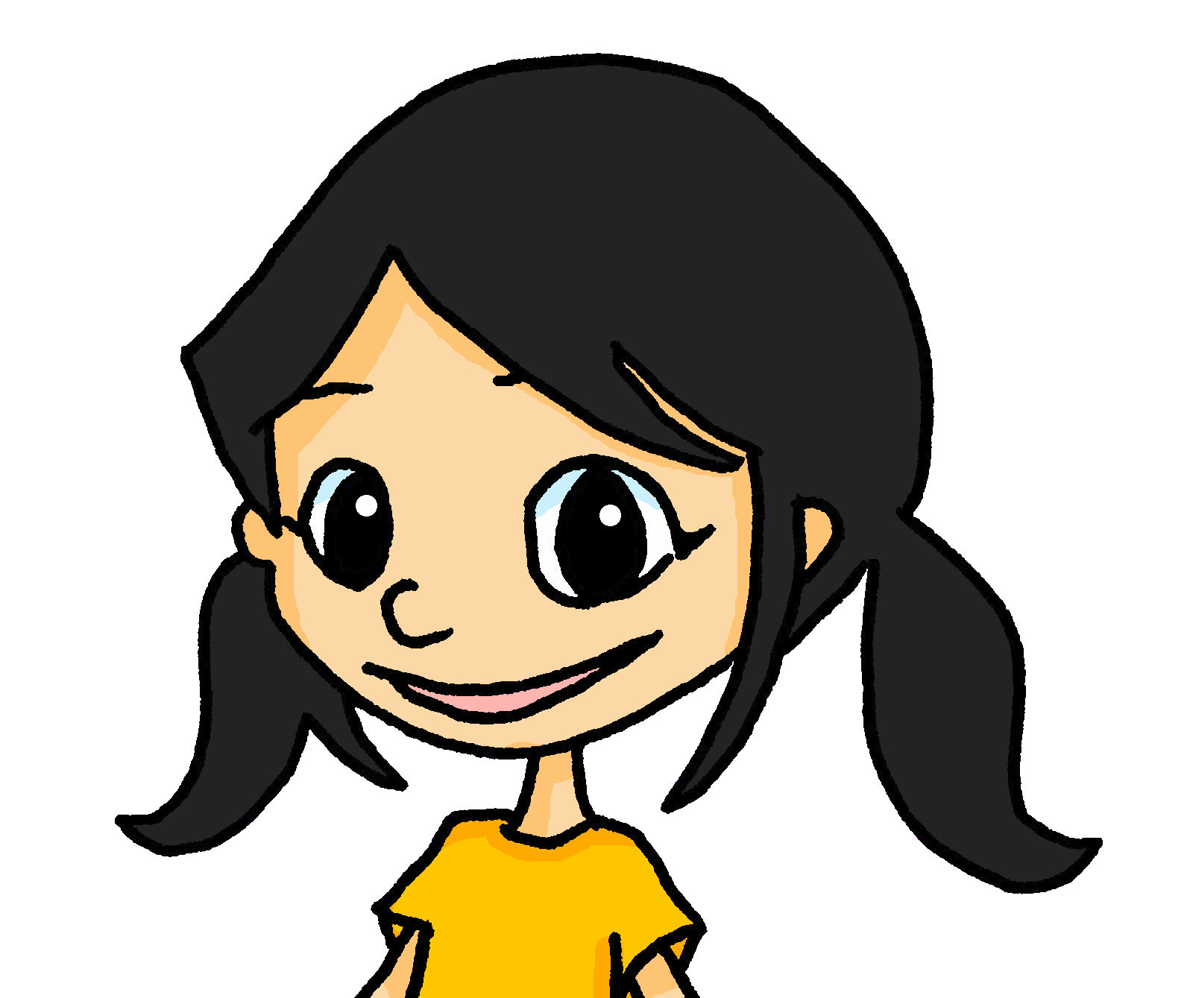
parler
Pose des questions. Ton/ta partenaire, c’est qui ?
Find out who your partner’s secret character is by asking ‘Do you want to…’ or
‘Would you like to…’.
Pierre
Adèle
Max
Clémentine
(play football)
(swim)
(do exercise)
(do dance)
(play guitar)
(play tennis)
(play guitar)
(go to beach)
Yves
Jean-Michel
Médor
(do exercise)
(play piano)
(do a race)
(play piano)
(do exercise)
(do a race)
exercice guitare
plage - beach course - race
nager – to swim
Sanaya
Léa
Eugénie
(swim)
(go to beach)
(go to beach)
(do dance)
(do dance)
(play football)
Notes:
Master slide for guess who game.
It may be helpful to print the template slide in A5 so that students can cross out as they play.
Alternatively, this is in the workbook, if pupils are using that, OR they could note just the names down first and cross those off, if photocopying is not permitted in school. Note that the additional vocabulary help is optional – if it is required, then click the support icon and it will appear.
11

Slide 12
Follow up 5
Parle en français.
Écris cinq phrases en anglais. Utilise les mots donnés.
Ton/ta partenaire dit tes phrases en français.
donnés - given
parler
Est-ce que/qu’ | je/j’ tu il elle | aime aimes veux veut voudrais voudrait | faire jouer manger boire aller rester trouver | un une du de la de l’ des au à la à l’
30
chocolat
exercice
eau
pont
guitare
course
piano
hôtel
S
tennis
jeu
sport
sandwich
plage
danse
maison
glace
0
DÉBUT
Notes:
Timing: 5-8 minutes
Aim: to practise spoken recall of key vocabulary and grammar, communication statements and questions about activities that I, you and others like, want or would like to do.
Procedure:
Both pupils write 5 sentences (in English) made up of words from the table.
They swap sentences.
Partner A tries to say all B’s sentences in French within 30 seconds.
Then Partner B tries to say all A’s sentences in French within 30 seconds.

Slide 13
vocabulaire
Follow up EXTRA - Écris en anglais : Can you get at least 15 points?
mots
 | je vais | je suis | tu fais
 | tu vas | elle fait | tu es
 | le soleil | pourquoi ? | mes
 | le parent | parce que | tes
 | le jus | vouloir | tu voudrais
 | l’eau | le fromage | tu veux
I go, am going
I am
you do, are doing
x3
you go, are going
she does, is doing
you are
(the) sun
why?
my (m/fpl)
x2
(the) parent
because
your (m/fpl)
(the) juice
to want, wanting
you would like
x1
(the) water
(the) cheese
you want
Notes:
Timing: 5-10 minutes
Aim: to practise written production of vocabulary from this week and two revisited weeks.
Procedure: 1. Give pupils a blank grid. They fill in the English meanings of any of the words they know, trying to reach 15 points in total. 2. Remind pupils that adjectives can refer to male or female persons and they should note this in their translations. E.g. pleased (f), short (m).
Note: The most recently learnt and practised words are pink, words from revisit 1 are green and those from revisit 2 are blue, thus more points are awarded for them, to recognise that memories fade and more effort (heavy lifting!) is needed to retrieve them.
13

Slide 14
vocabulaire
Follow up EXTRA - Écris en français : Can you get at least 15 points?
mots
 | I am | I go, am going | she does, is doing
 | you are | you go, are going | I do, am doing
 | my | why? | because
 | your (pl) | (the) parent | (the) sun
 | (the) cheese | (the) juice | (the) water
 | you want | to want, wanting | you would like
je suis
je vais
elle fait
x3
tu es
tu vas
je fais
mes
pourquoi ?
parce que
x2
tes
le parent
le soleil
le fromage
le jus
l’eau
x1
tu veux
vouloir
tu voudrais
Notes:
Timing: 5-10 minutes
Aim: to practise written comprehension of vocabulary from this week and previous weeks.
Procedure: Give pupils a blank grid. They fill in the French meanings of any of the words they know, trying to reach 15 points in total.
Note: The most recently learnt and practised words are pink, words from the previous week are green and those from earlier are blue, thus more points are awarded for them, to recognise that memories fade and more effort (heavy lifting!) is needed to retrieve them.
14

Slide 15
vocabulaire
Follow up EXTRA - Écris en anglais : Can you get at least 15 points?
mots
 | je vais | je suis | tu fais
 | tu vas | elle fait | tu es
 | le soleil | pourquoi ? | mes
 | le parent | parce que | tes
 | le jus | vouloir | tu voudrais
 | l’eau | le fromage | tu veux
x3
x2
x1
Notes:
HANDOUT
15

Slide 16
vocabulaire
Follow up EXTRA - Écris en français : Can you get at least 15 points?
mots
 | I am | I go, am going | she does, is doing
 | you are | you go, are going | I do, am doing
 | my | why? | because
 | your (pl) | (the) parent | (the) sun
 | (the) cheese | (the) juice | (the) water
 | you want | to want, wanting | you would like
x3
x2
x1
Notes:
HANDOUT
16

