Slide 1
Expressing likes and saying what I and others do
vert
vouloir: je veux, tu veux, il/elle veut
2-verb structures
SSC [j/soft g] hard [g]
Notes:
Artwork by Steve Clarke. Pronoun pictures from NCELP (www.ncelp.org). All additional pictures selected from Pixabay and are available under a Creative Commons license, no
attribution required.
Phonics: j (soft g) jour [78] j’ai [8 - avoir] génial [3872] gymnastique [>5000] déjà [58]
Vocabulary: vouloir [57] je veux, tu veux, il/elle veut [57]
Revisit 1: Il fait [25] Allemagne [n/a] Belgique [n/a] Canada [n/a] Grande-Bretagne [n/a] Espagne [n/a] France [n/a] Italie [n/a] Luxembourg [n/a] Suisse [n/a] chaud [1852] froid [1307] soleil [1713]
vent [1387]
quand [119] à [4] en [7]
Revisit 2: il y a un [3] deux [41] trois [115] quatre [253] cinq [288] six [450] sept [905] huit [877] neuf [787] dix [372] onze [2447] douze [1664] des [2] combien [800] treize [3285], quatorze [3359], quinze
[1472] seize [3285] dix-sept [3812] dix-huit [3592] dix-neuf [4851] vingt [1273] vingt-et-un [1273/6/3] vingt-deux, vingt-trois, vingt-quatre, vingt-cinq, vingt-six, vingt-sept, vingt-huit, vingt-neuf, trente
[1646]
Londsale, D., & Le Bras, Y. (2009). A Frequency Dictionary of French: Core vocabulary for learners London: Routledge.
The frequency rankings for words that occur in this PowerPoint which have been previously introduced in these resources are given in the SOW and in the resources that first
introduced and formally re-visited those words.
For any other words that occur incidentally in this PowerPoint, frequency rankings will be provided in the notes field wherever possible.
1

Slide 2
[j/soft g]
prononcer
jour
Notes:
Timing: 1 minute
Aim: To introduce SSC [j/soft g]
Procedure: 1. Present the letter(s) and say the [j/soft g] sound first, on its own. Students repeat it with you. 2. Bring up the word ”jour” on its own, say it, students repeat it, so that they have the opportunity to focus all of their attention on the connection between the written word and its sound.
3. Roll back the animations and work through 1-3 again, but this time, dropping your voice completely to listen carefully to the students saying the [j/soft g] sound, pronouncing ”jour” and, if using, doing the gesture.
Gesture suggestion:
https://www.signbsl.com/sign/day The sign is both palms facing inwards, towards each other, finger tips slightly overlapping – then pulled apart – the motion mimes the break of day with the sun rising.
Word frequency (1 is the most frequent word in French):
jour [78].
Source: Londsale, D., & Le Bras, Y. (2009). A Frequency Dictionary of French: Core vocabulary for learners London: Routledge.
2

Slide 3
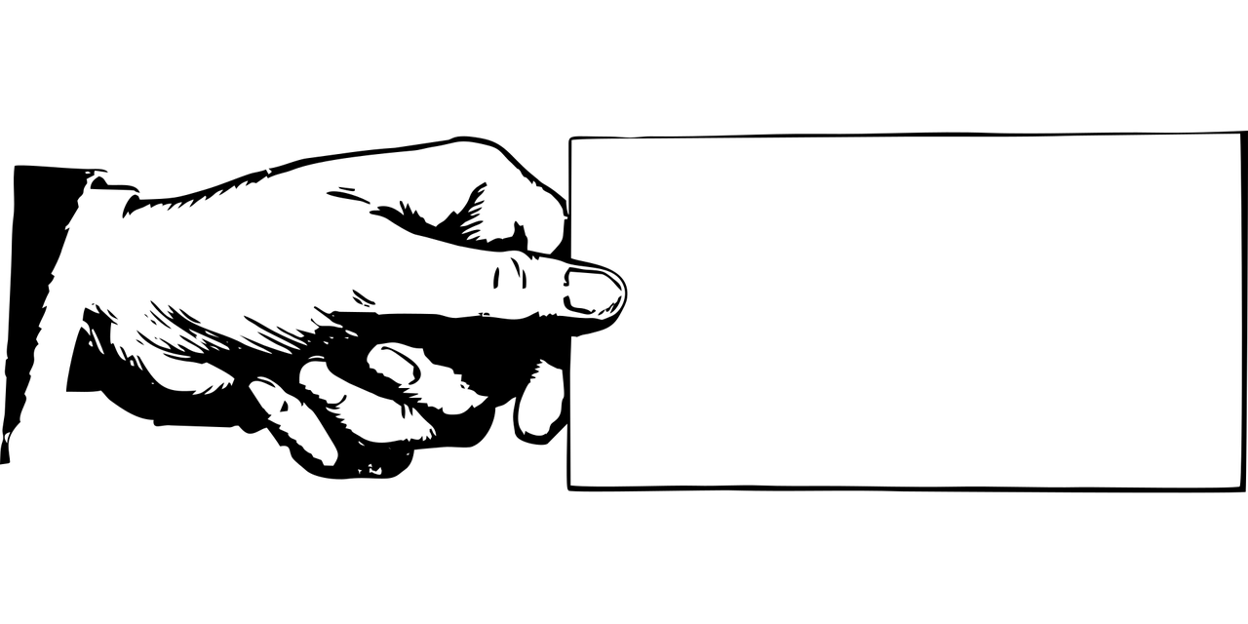
[j/soft g]
prononcer
I have
j’ai
génial
jour
déjà
gymnastique
Notes:
Timing: 2 minutes
Aim: To introduce SSC [j/soft g]
Procedure:
1. Introduce and elicit the pronunciation of the individual SSC [j/soft g] and then the source word again ‘jour’ (with gesture, if using). 2. Then present and elicit the pronunciation of the four cluster words.
The cluster words have been chosen for their high-frequency, from a range of word classes, with the SSC (where possible) positioned within a variety of syllables within the words (e.g. initial, 2nd, final etc.). Additionally, we have tried to use words that build cumulatively on previously taught SSCs (see the Phonics Teaching Sequence document) and do not include new SSCs. Where new SSCs are used, they are often consonants which have a similar symbol-sound correspondence in English.
Word frequency: jour [78] j’ai [8 - avoir] génial [3872] gymnastique [>5000] déjà [58]
Source: Londsale, D., & Le Bras, Y. (2009). A Frequency Dictionary of French: Core vocabulary for learners London: Routledge.
3

Slide 4
Tennis phonétique
.
Prononce le mot en anglais. Puis, prononce le mot en français.
prononcer
village
9
5
courage
1
voyage
8
biologie
6
intelligent
3
danger
2
magique
10
garage
4
orange
7
girafe
Notes:
Timing: 5 minutes
Aim: To raise awareness of the difference in pronunciation between English and French cognate words with SSC [j/soft g].
Procedure:
1. Students work in pairs and take turns to pronounce pairs of works.
2. Click to reveal a French word which lands on the English side of the tennis court. Pupil A says the English translation.
3. On a click, the word is ‘passed’ to the French side of the court. Pupil A says the French translation.
4. Check pronunciation by clicking on the loudspeaker icon beside the tennis ball.
5. Click to release a new word for Pupil B.
Transcript:
voyage
magique
danger
orange
courage
intelligent girafe
biologie
village
garage
Frequency of unknown words and cognates (1 is the most frequent word in French):
biologie [>5000] courage [1431] danger [932] garage [4881] girafe [>5000] magique [3530]
Source: Londsale, D., & Le Bras, Y. (2009). A Frequency Dictionary of French: Core vocabulary for learners London: Routledge.
4

Slide 5
vocabulaire
Un mur de mots
mots
.
Qu’est-ce que c’est en anglais ?
aller
regarder
nager
chanter
to watch, watching
to swim, swimming
to sing, singing
to go, going
une chanson
Allemagne
la campagne
la maison
the country(side)
the house (home)
a song
Germany
faire
un défilé
organiser
le magasin
a parade, procession
to organise, organising
to do, make
the shop
participer à
jouer
Suisse
rester
to take part in, taking part in
to play, playing
to stay, remain
Switzerland
monter
en
à
un spectacle
to ride, climb up, on, into
in, to
to, at, in, on
a show
Notes:
Timing: 5 minutes
Aim: this slide practises read aloud, meaning and spoken production of 20 revisited words that we will use this week with timed spoken comprehension.
Procedure: the activity is designed like a scratch card. On clicks, the English translation appears following the horizontal (left to right) order of the display.
Click to select a word (the word will change colour). Pupils read the word aloud.
Ask Qu’est-ce que c’est en anglais ? and click again to trigger a 6-second ‘scratch’ animation, which slowly reveals the English equivalent. Pupils turn to their partner and say the word meaning before it is revealed.
Ask Qu’est-ce que c’est en français ? to elicit the French meaning again.
When all English meanings are displayed, if time allows, ask Comment dit-on [to play, playing] en français ? etc. to elicit oral recall of a few of the French meanings again.
Frequency of unknown words and cognates: mur [1335]
Note: if pupils have done Bleu, then they will have been taught ‘mur’ already.
5

Slide 6
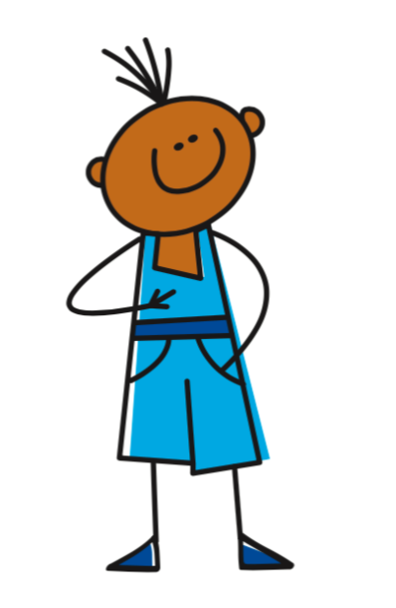
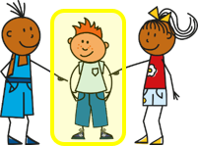
vouloir (to want to)
Vouloir is an irregular verb. To mean ‘I want’, use:
Je veux aller en Suisse.
I want to go to Switzerland.
The 2nd verb is an infinitive.
In English, we say ‘to go’ not ‘going’ after want.
Tu veux aller en Allemagne.
You want to go to Germany.
This is the same form as for je.
Veut sounds the same as veux.
Il veut jouer au tennis.
He wants to play tennis.
Elle veut jouer au football.
She wants to play football.
Notes:
Timing: 3 minutes
Aim: to recap two-verb structures with four previously-taught –ER verbs.
Procedure:
Click through the animations to present the information.
Elicit English translations for the French examples provided.

Slide 7
lire
Adèle rêve* et c’est bizarre !
.
C’est Adèle (je) ou Léa (elle) ?
Je veux aller en ville.
2
Elle veut écouter des chansons.
1
3
Je veux aller au centre commercial.
Elle veut regarder un film.
6
Elle veut rester à la maison.
4
Je veux lire un livre.
5
rêve – dreams, is dreaming
Notes:
Timing: 7 minutes
Aim: to practise written recognition of the 1st and 3rd person singular forms of vouloir and connect them to meaning; to understand a range of previously taught vocabulary.
Procedure:
Ensure that the context is clear. Adèle is dreaming about what she wants to do. The problem in the dream is that her best friend Lea doesn’t want to do the same things as her.
Pupils write 1-6, read the dream narrative, and write A (Adèle) and L (Léa) for each.
3. Then move to the next slide for the second comprehension task.
7

Slide 8
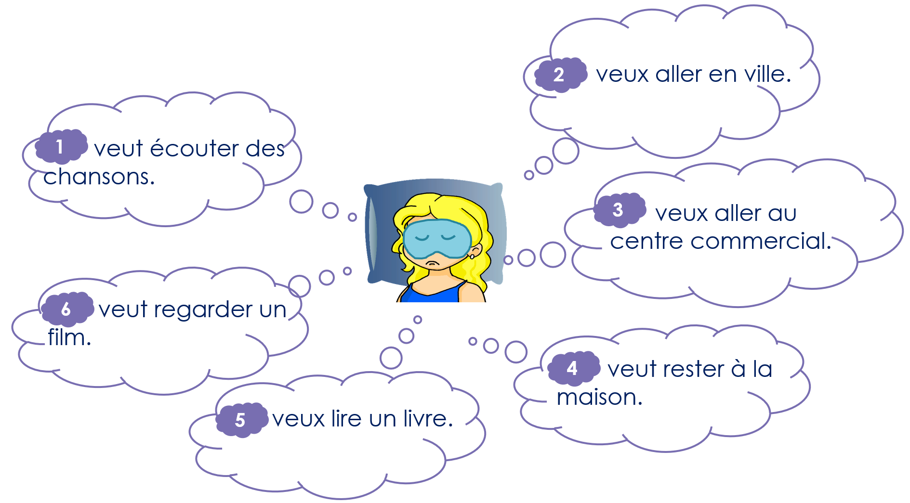
lire
Adèle rêve* et c’est bizarre ! [2/2]
Qui veut faire quoi ?
I want…
to go into town.
to go to the shopping centre.
to read a book.
She wants…
to listen to some songs.
to stay at home.
to watch a film.
Notes:
[2/2]
Procedure:
Elicit the answers from pupils and click to reveal them.
8

Slide 9
Two-verb structures
Remember! When a French sentence has two verbs, the 2nd verb is in infinitive form. The 1st verb has endings to match the subject, the person doing the action.
Remember how to use two verbs together in a sentence:
This is the 1st verb.
This is the 2nd verb.
J’aime aller à la campagne.
I like going to the countryside.
Tu détestes être dehors.
You hate being outside.
Il/Elle préfère rester à la maison.
S/he prefers staying at home.
Nous adorons nager dans la piscine.
We love swimming in the pool.
Vous aimez monter à vélo.
You (all) like going cycling.
Ils/Elles détestent chanter.
They hate singing.
Notes:
Timing: 3 minutes
Aim: to recap two-verb structures with four previously-taught –ER verbs.
Procedure:
Click through the animations to present the information.
Elicit English translations for the French examples provided.

Slide 10
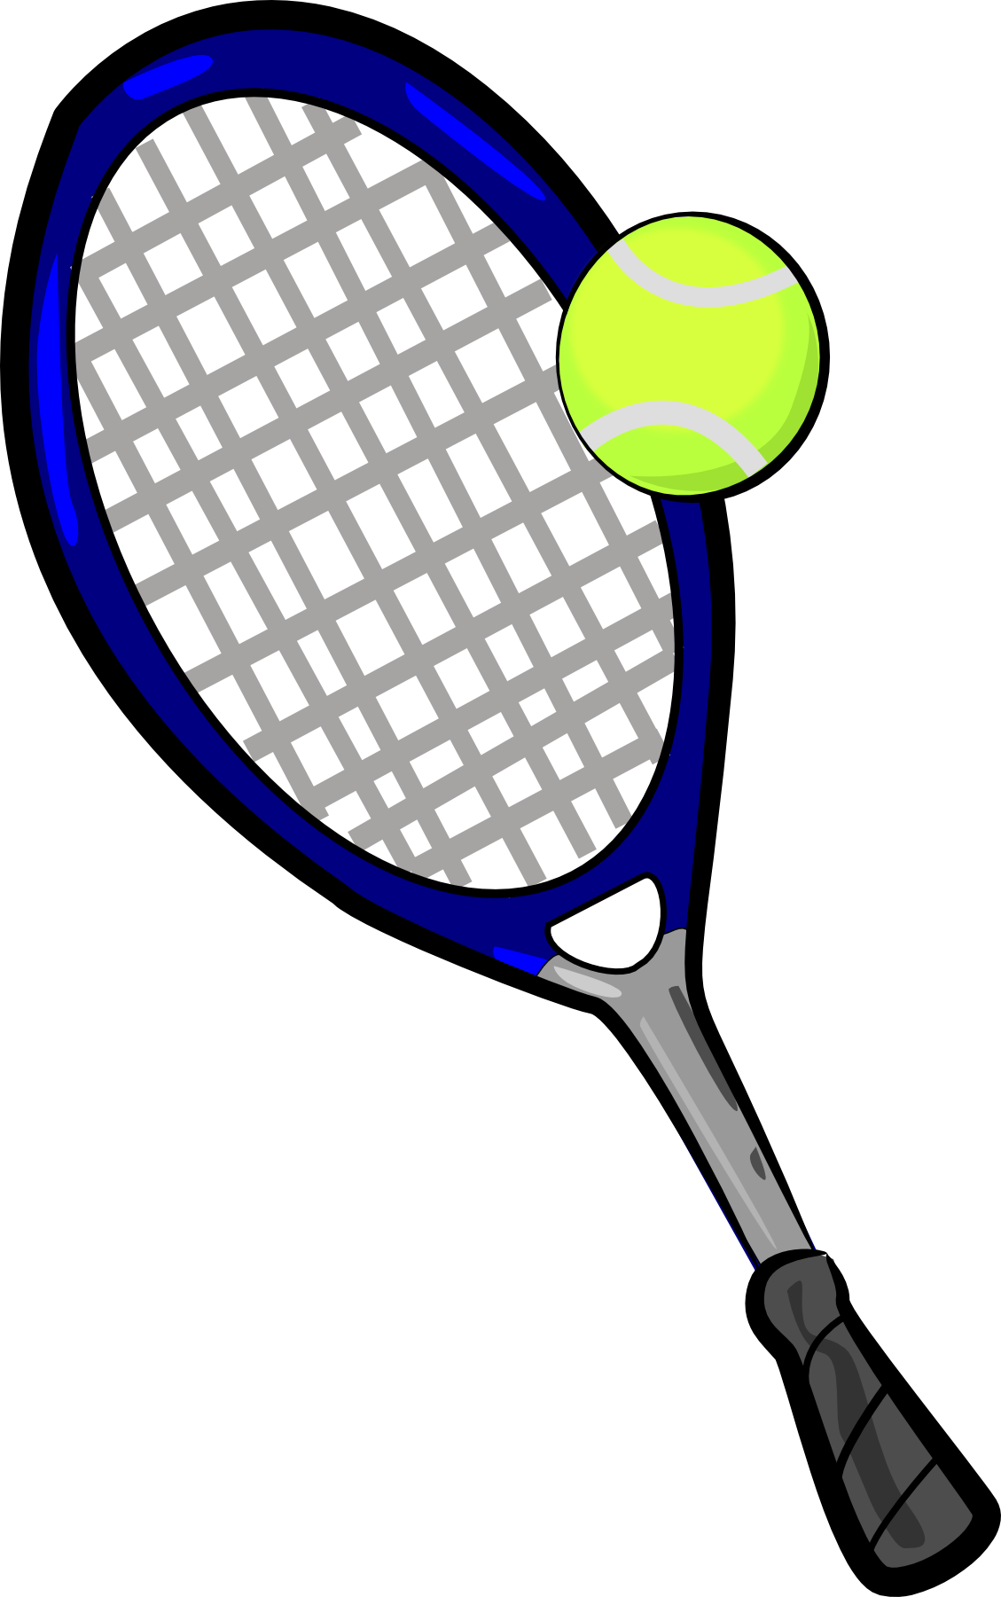
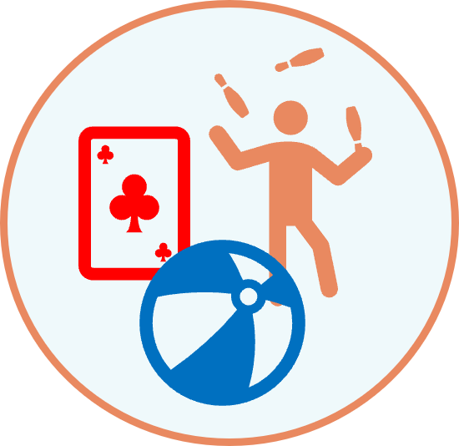
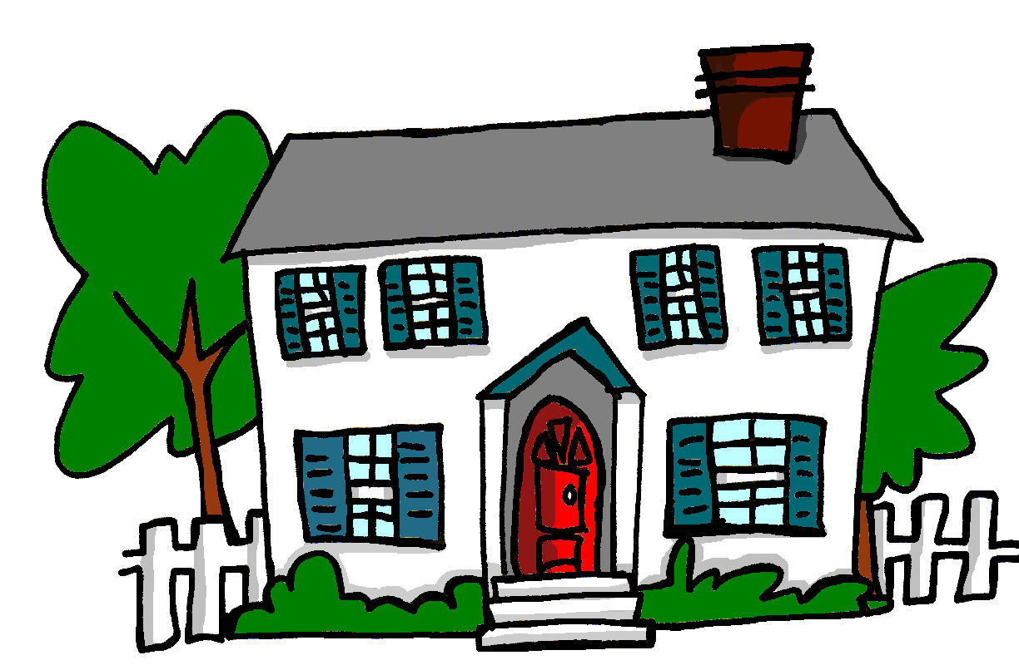
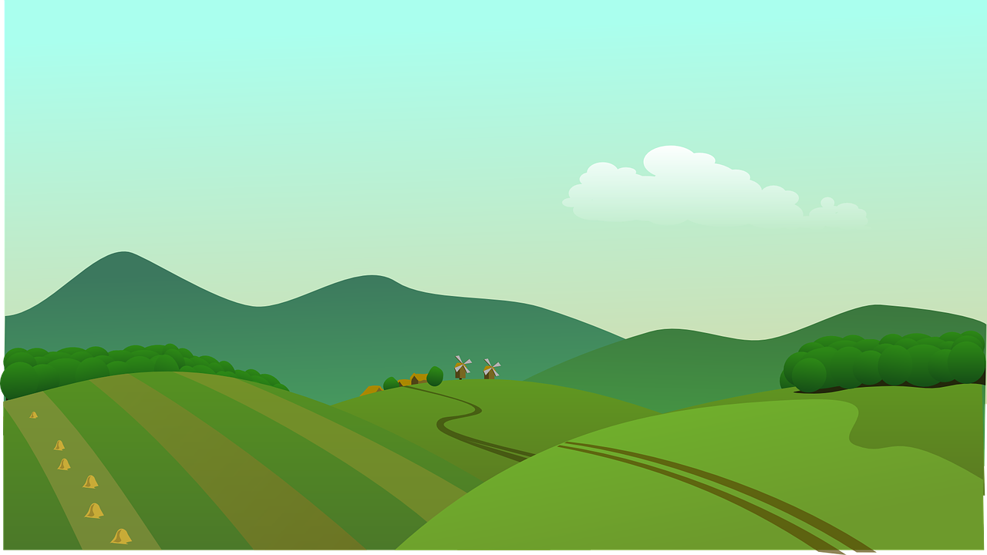
écouter
Léa et Adèle parlent du weekend.
Écoute. Qu’est-ce qu’elles décident ? Choisis les deux bonnes lettres.
1
2
?
?
?
?
A
B
A
B
C
D
C
D
3
4
?
?
?
?
A
B
A
B
Oui, je veux bien ➜ Yes, I do (want to).
C
D
C
D
Notes:
Timing: 8 minutes
Aim: to practise comprehension of short dialogues using a variety of 2-verb structures.
Procedure:
Ensure that the instructions are clear.
Do number 1 with pupils to model the task.
Click to listen. Pupils select the two letters that correspond to what they hear.
Elicit responses and click to confirm.
Complete steps 3-4 with items 2-4.
Transcript: 1. – Léa, est-ce que tu veux jouer au tennis le samedi ?
- Oui, je veux bien. J’adore jouer au tennis.
2. – Adèle, est-ce que tu veux regarder un film au cinéma ?
- Je veux regarder un film, mais je préfère rester à la maison.
3. – Léa, est-ce que tu veux faire du vélo ?
- Non, je déteste faire du vélo quand il fait du vent.
4. - Adèle, tu veux aller en ville ?
- Pourquoi ?
- Parce que je vais à un spectacle de danse au théâtre avec Maman.
- Oui, je veux bien.
10

Slide 11
Au revoir !
vert
Notes:
11

