Slide 1
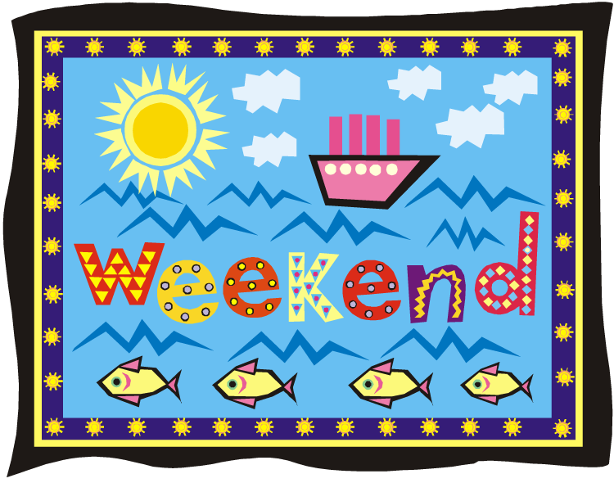
Saying what I and others do
vert
faire [to do, make] (je fais, il/elle fait)
SSC [ç] [soft c]
Notes:
Artwork by Steve Clarke. Pronoun pictures from NCELP (www.ncelp.org). All additional pictures selected from Pixabay and are available under a Creative Commons license, no
attribution required.
Phonics: ç (and soft -c) ici [167] français [251] garçon [1599] cinéma [1623] décider [165]
Vocabulary: faire [25] je fais il/elle fait activité [452] course à pied [n/a] chanson [2142] dessin [2624] film [848] gâteau [4845] matin [442] soir [397] spectacle [1687] ville
[360] visite [1072] weekend [2475] demain [871]
Revisit 1: aller [53] je vais il/elle va à (meaning ‘at/in/to’)[4] campagne [666] Île [1245] montagne [1732] plage [2693] port [1304]
Revisit 2: nager [n/a] chanter [1820] jouer [219] participer (à) [670] porter [105] animal [1002] cadeau [2298] chapeau [2908] château [3510] cheval [2220] course [1289]
défilé [>5000] feu d'artifice [n/a] gâteau [4845] glace² [2580] jeu [291] lieu [117] neige [1824] trâineau [n/a] Québec [n/a]
Londsale, D., & Le Bras, Y. (2009). A Frequency Dictionary of French: Core vocabulary for learners London: Routledge.
The frequency rankings for words that occur in this PowerPoint which have been previously introduced in these resources are given in the SOW and in the resources that first
introduced and formally re-visited those words.
For any other words that occur incidentally in this PowerPoint, frequency rankings will be provided in the notes field wherever possible.
1

Slide 2
[ç/c] soft ‘c’
prononcer
[here]
ici
Notes:
Timing: 1 minute
Aim: To consolidate SSC [ç/c]
Procedure: 1. Present the letter(s) and say the [ç/c] sound first, on its own. Pupils repeat it with you. 2. Bring up the word ”ici” on its own, say it, pupils repeat it, so that they have the opportunity to focus all of their attention on the connection between the written word and its sound.
3. A possible gesture for this would be to point to the spot on which one is standing / indicate the room in which the lesson is taking place with a sweeping motion of one’s index finger. 4. Roll back the animations and work through 1-3 again, but this time, dropping your voice completely to listen carefully to the pupils saying the [ç/c] sound, pronouncing ”ici” and, if using, doing the gesture.
2

Slide 3
[ç/c] soft ‘c’
prononcer
cinéma
décider
[here]
français
garçon
ici
Notes:
Timing: 2 minutes
Aim: to consolidate SSC [ç/c]
Procedure:
1. Introduce and elicit the pronunciation of the individual SSC [ç/c] and then the source word again ‘ici’ (with gesture, if using). 2. Then present and elicit the pronunciation of the five cluster words.
The cluster words have been chosen for their high-frequency, from a range of word classes, with the SSC (where possible) positioned within a variety of syllables within the words (e.g. initial, 2nd, final etc.). Additionally, we have tried to use words that build cumulatively on previously taught SSCs (see the Phonics Teaching Sequence document) and do not include new SSCs. Where new SSCs are used, they are often consonants which have a similar symbol-sound correspondence in English.
Word frequency (1 is the most frequent word in French): français [251] garçon [1599] cinéma [1623] décider [165] ici [167]. Source: Londsale, D., & Le Bras, Y. (2009). A Frequency Dictionary of French: Core vocabulary for learners London: Routledge.
3

Slide 4
[ç/c] soft ‘c’
prononcer
The letter ‘c’ is soft (sounds like ‘s’) before e or i:
c’est
cinq
However, ‘c’ is hard (sounds like ‘k’) before a, o or u:
carte
courses
cuisine
Some words have a cedilla (ç) before a, o or u to soften the ‘c’:
ça va ?
garçon
Notes:
Timing: 2 minutes
Aim: to explain the spelling rules governing the pronunciation of the letter ‘c’ before vowels and use of a cedilla.
Procedure:
1. Bring up the rules governing each category on clicks.
2. Teacher reads the words in each category out loud. Pupils repeat.
4

Slide 5
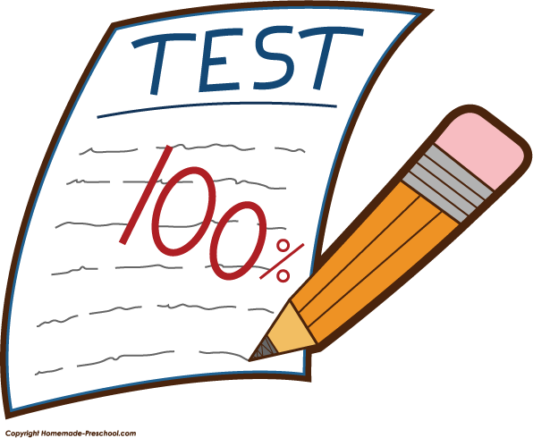
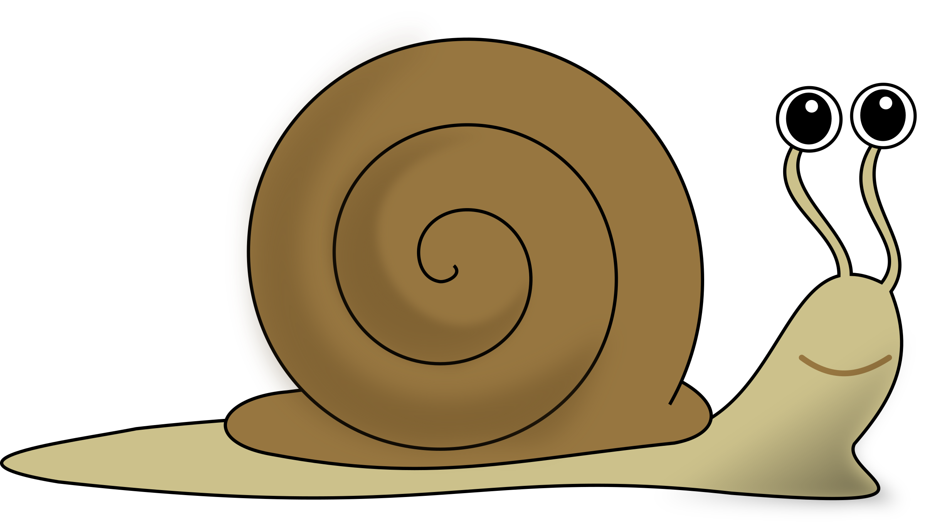
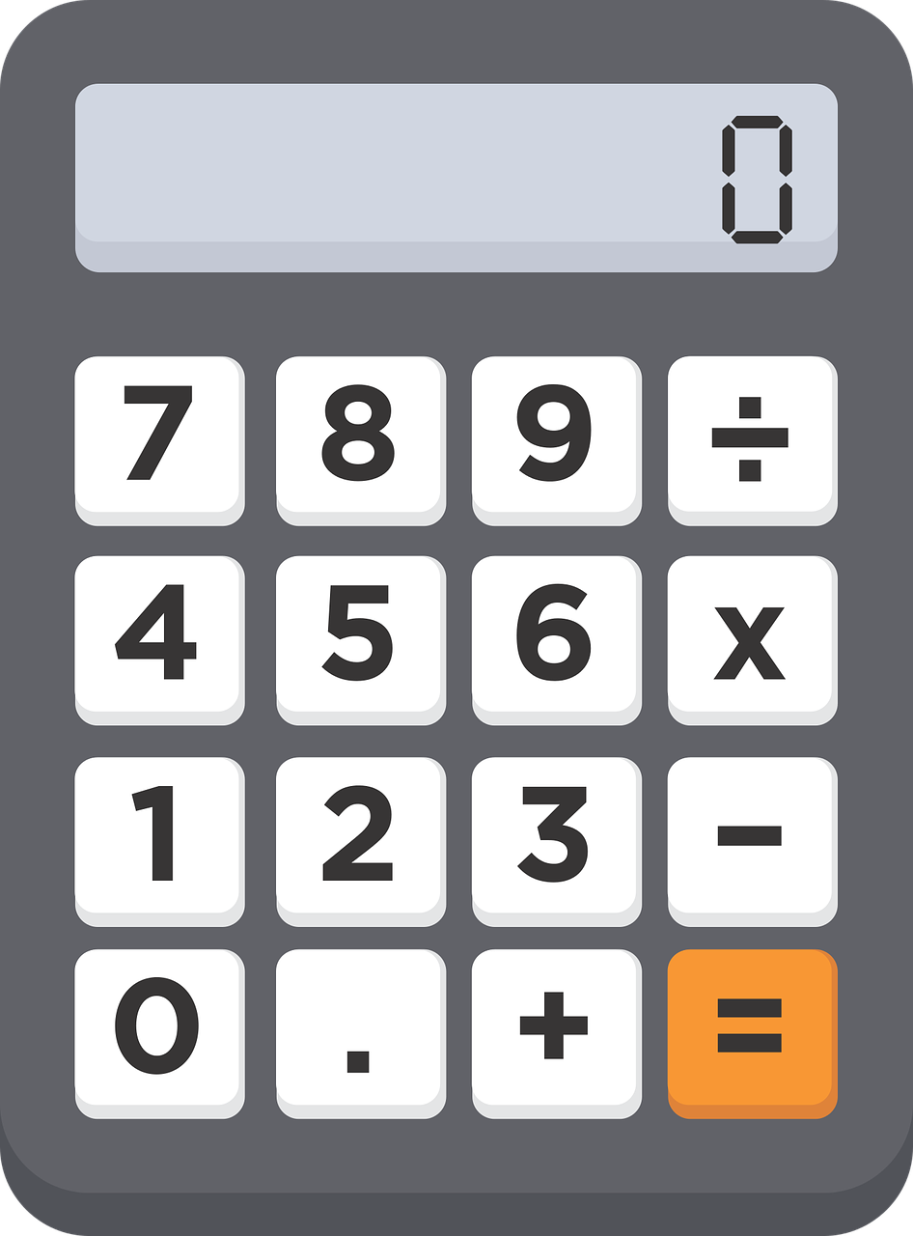
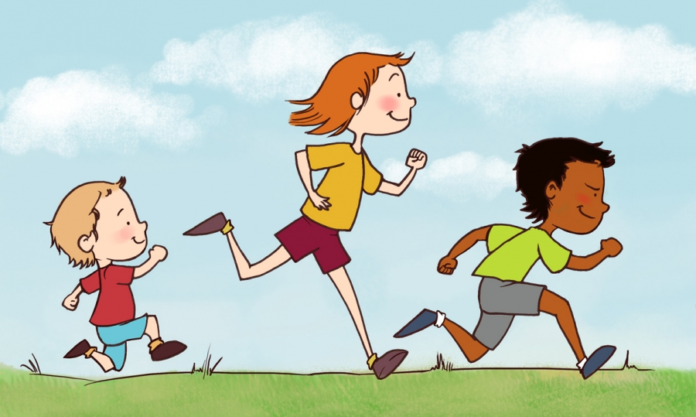
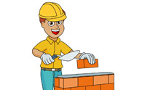
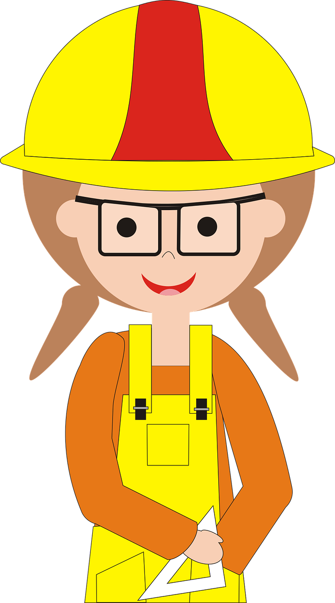
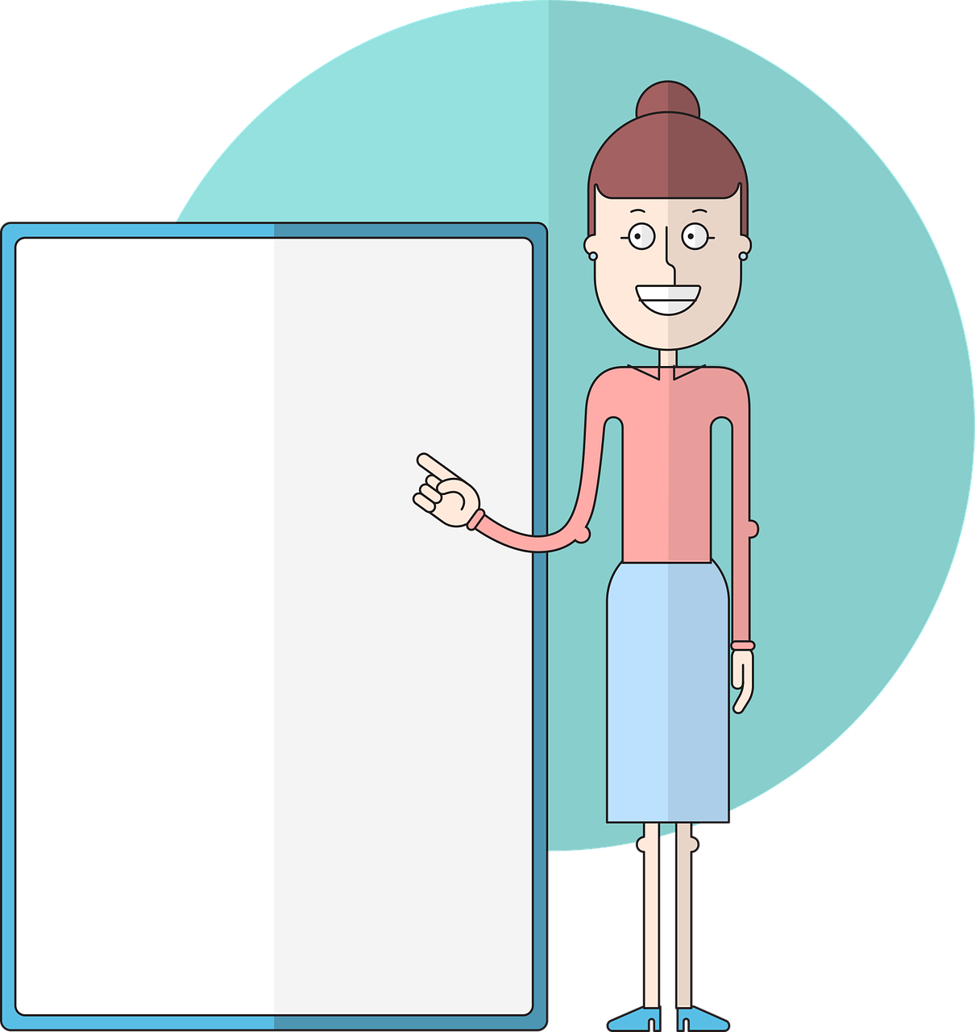
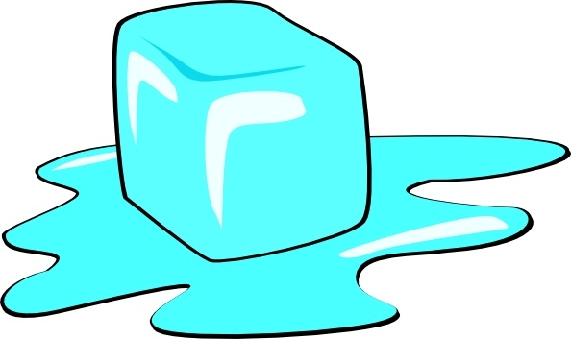
prononcer
Écoute. C’est avec ‘ç’ ou ‘c’ ?
Puis, prononce les mots.
c o n t r ô l e
c a l c u l e r
m a ç o n
l e ç o n
l i m a ç o n
c o u r s e à p i e d
c o n c o u r s
g l a ç o n
_
_
1
5
_
2
_
_
6
3
_
7
_
_
competition
4
8
_
_
Notes:
Timing: 5 minutes
Aim: to practise aural distinction between words with ç and c before a, o, u.
Procedure:
Read the instruction.
Do the first one with pupils. Remind them that if they hear the a soft ‘c’ sound, the spelling is ç. Otherwise it is ‘c’.
Elicit responses chorally and click to reveal the answers.
Transcript:
contrôle
calculer
maçon leçon limaçon course à pied concours glaçon
Frequency of unknown words and cognates: contrôle [662] calculer [2331] maçon [>5000] leçon [1300] limaçon [>5000] course [1289] concours [1375] glaçon [>5000] Londsale, D., & Le Bras, Y. (2009). A Frequency Dictionary of French: Core vocabulary for learners London: Routledge.

Slide 6
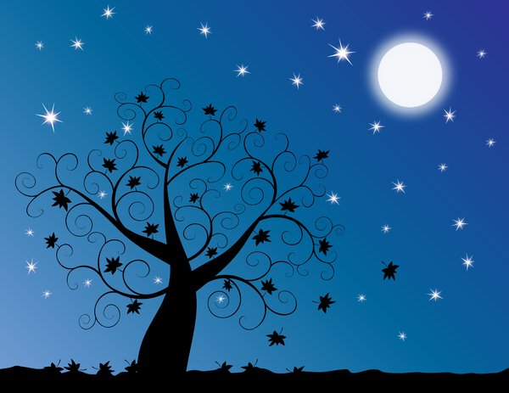
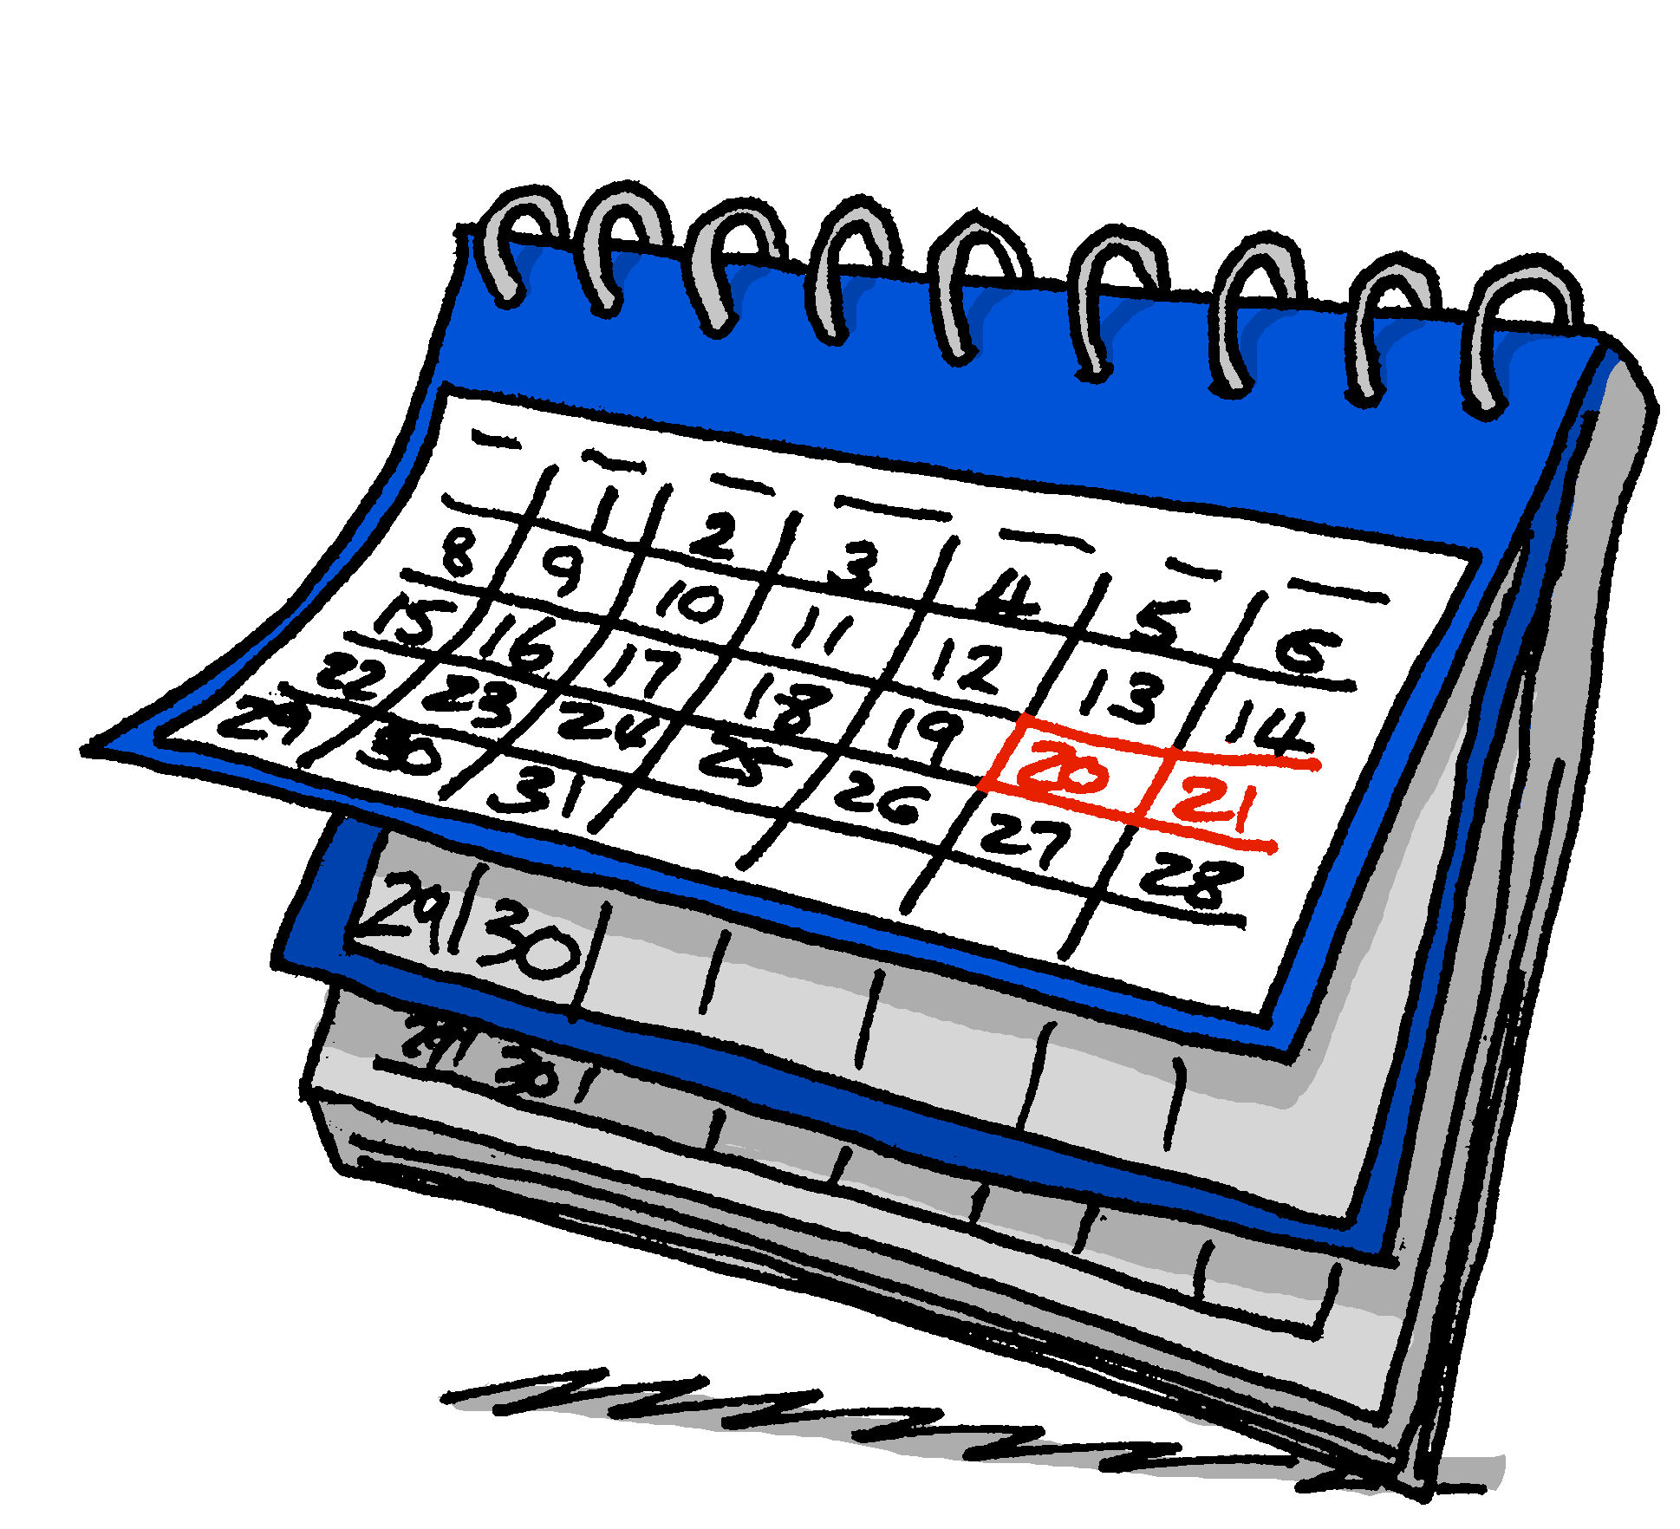
vocabulaire
Vocabulaire
mots
Comment dit-on ça en français ?
le matin
le soir
le weekend
demain
Notes:
Timing: 5 minutes
Aim: to present and practise written comprehension and read aloud of some revisited vocabulary for this week, and one new word, demain.
Procedure: 1. Click for a French word. Elicit pronunciation from pupils.
2. Click for the English meaning and picture prompt. Elicit the French word again.
3. Present all five words like this, in order.
4. Click for one English meaning to disappear. Elicit the English meaning from pupils. Continue with the remaining items.
5. Click for the French word to disappear. Elicit the French from pupils. Continue with the remaining items.
6

Slide 7
faire (to do and to make)
We use the verb faire to mean to do and to make.
⚠ The –s is a Silent Final Consonant (SFC).
je fais
I do|I make
⚠ The –t is a Silent Final Consonant (SFC).
il fait
he does | he makes
Elle fait
she does | she makes
Notes:
Timing: 2 minutes
Aim: to introduce two forms of the irregular verb faire.
Procedure:
Click through the animations to present the information.
Elicit English translations for the French examples provided.

Slide 8
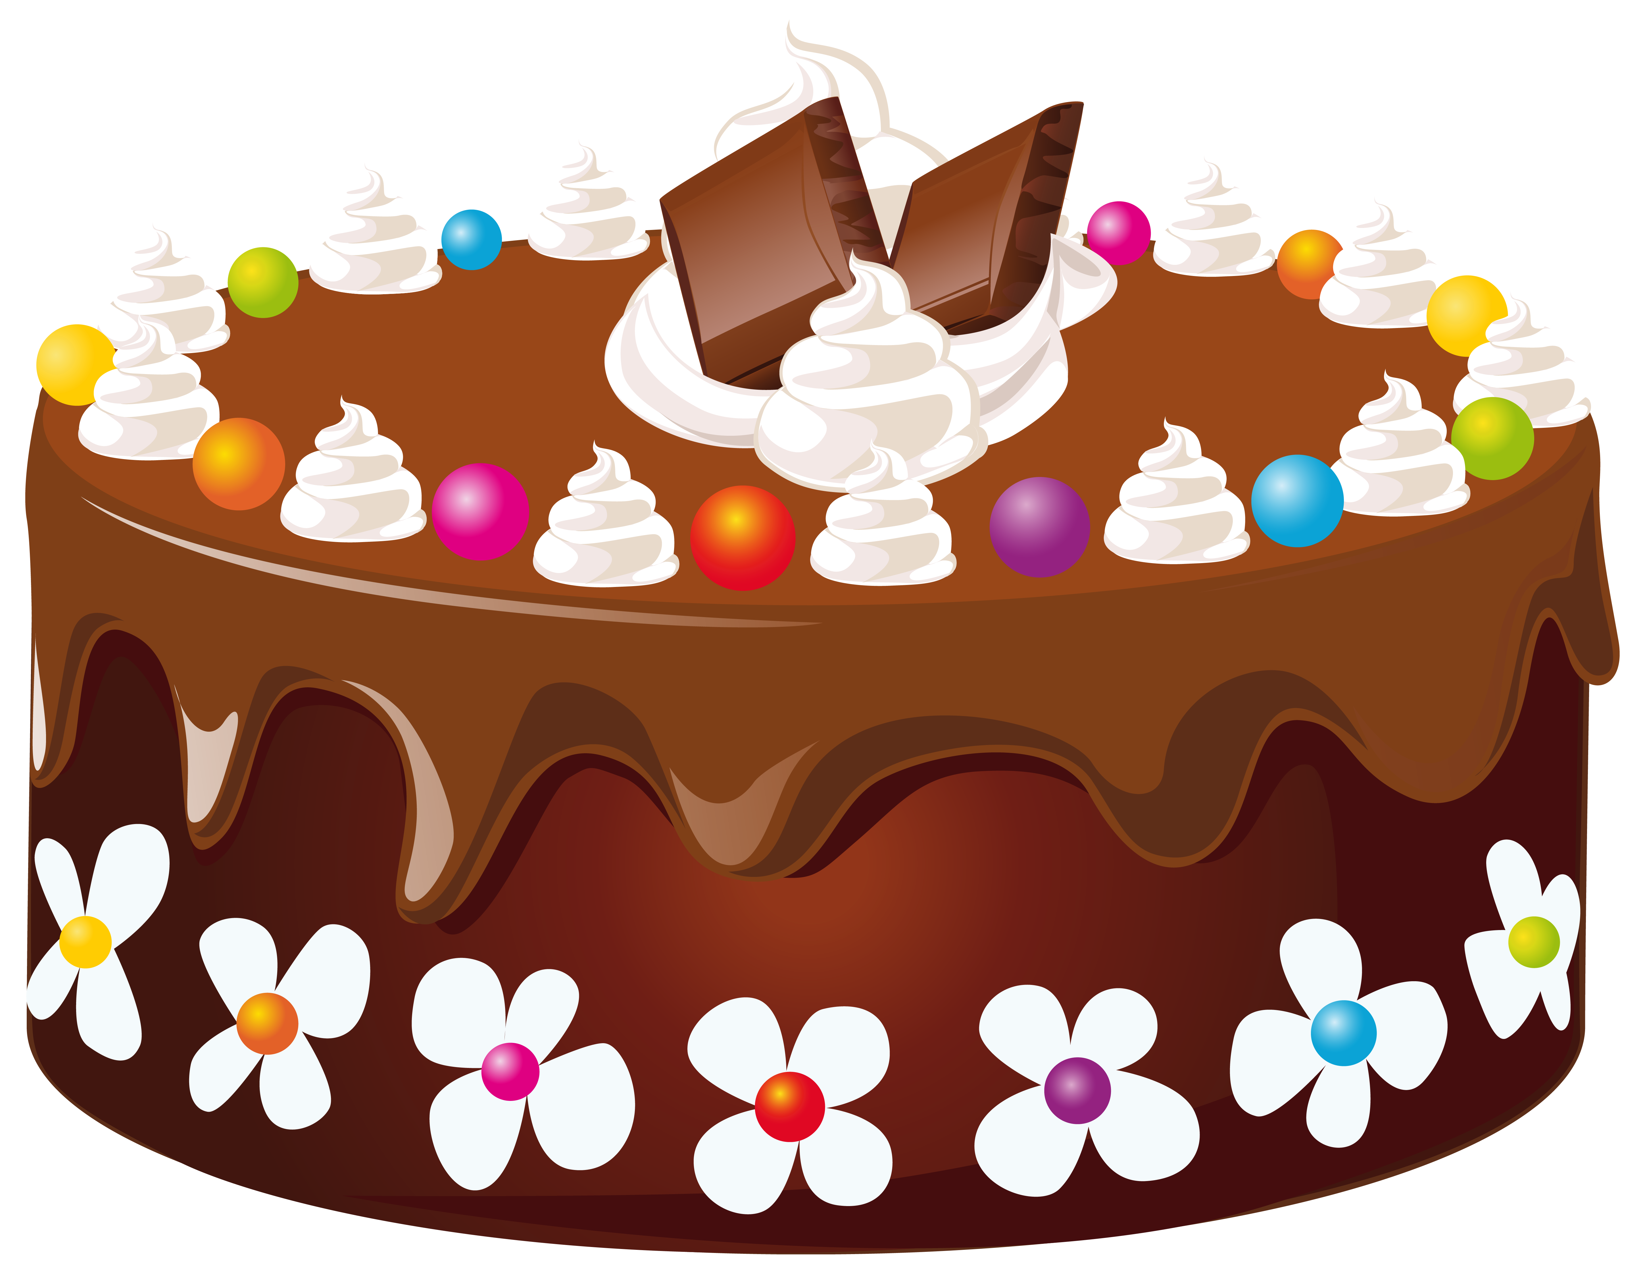
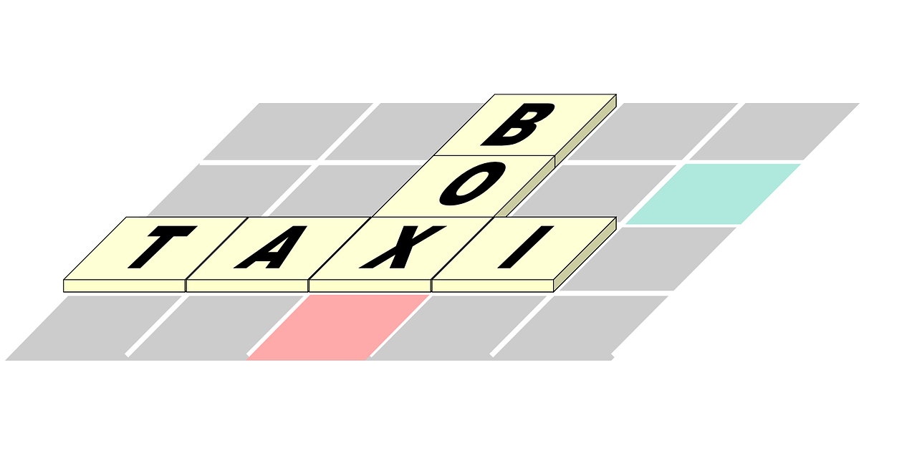
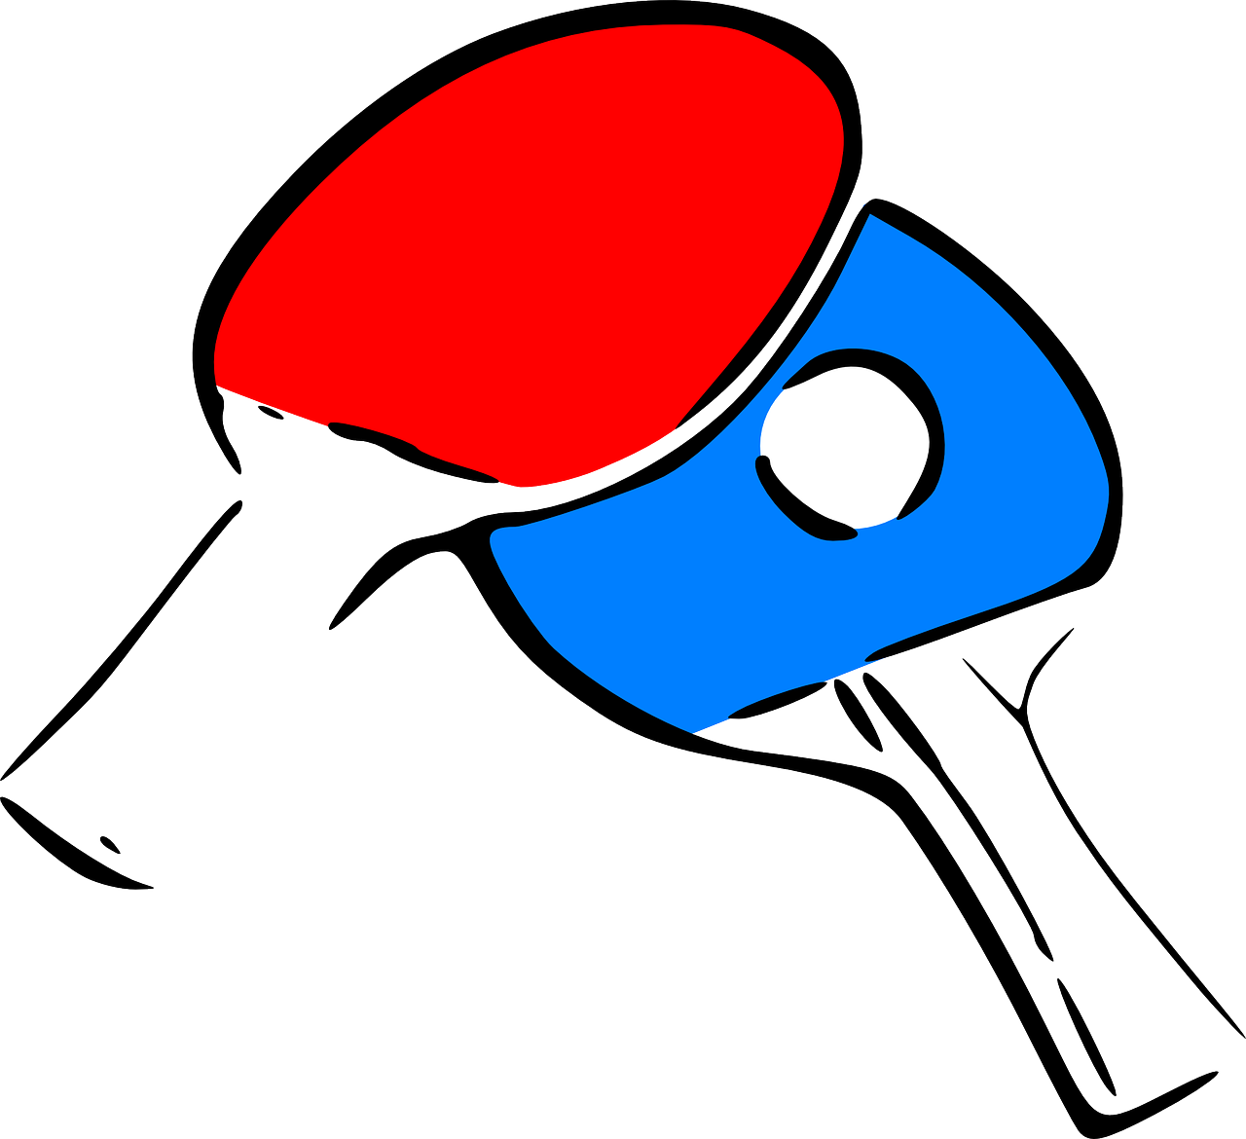
vocabulaire
Vocabulaire
mots
Comment dit-on ça en français ?
cake
test
drawing
activity
race
song
film
visit
faire une chanson
faire un gâteau
faire une visite
faire une activité
faire une course à pied
faire un test
faire un dessin
faire un film
Notes:
Timing: 5 minutes
Aim: to consolidate understanding and pronunciation of faire + complementary nouns.
Procedure:
Click for French prompt.
Elicit French, then English from pupils, paying attention to when it is it ‘to do’ and when ‘to make’.
Click to confirm.
Then click again to reveal each picture again and use the English to elicit the French for each phrase from pupils.
Note: with the exception of the cognate ‘test’, all words have been previously taught or presented this lesson.
Word frequency of unknown words or cognates used (1 is the most frequent word in French): test [1788]
Source: Londsale, D., & Le Bras, Y. (2009). A Frequency Dictionary of French: Core vocabulary for learners London: Routledge.
8

Slide 9
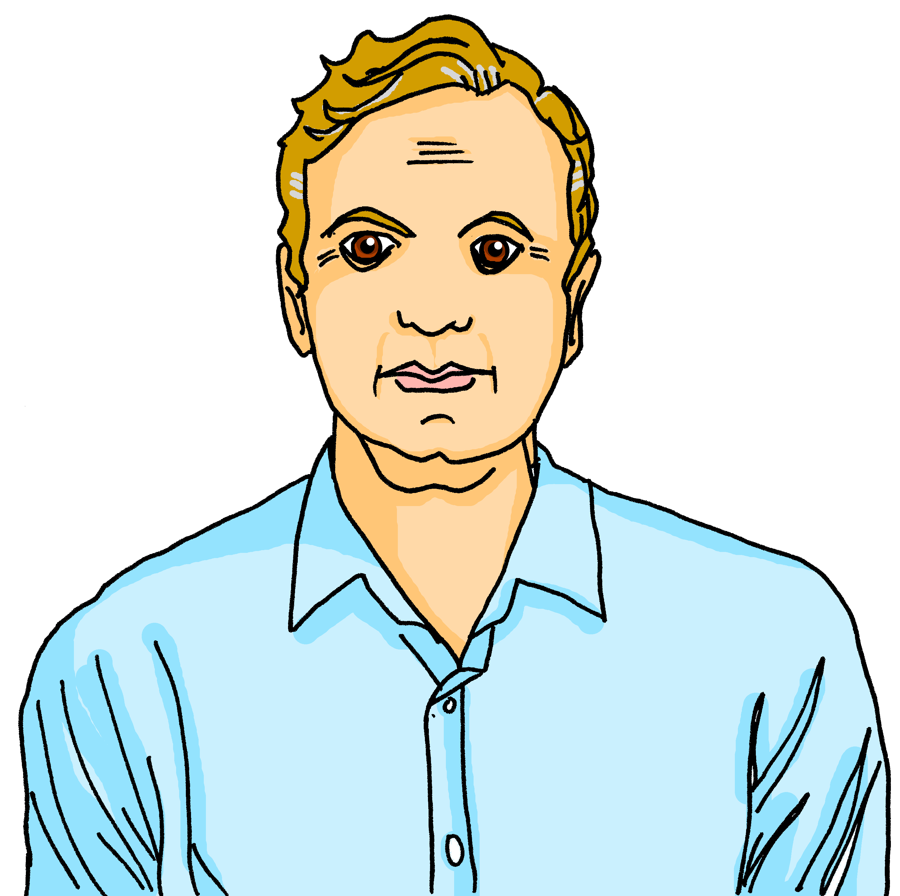
lire
C’est le weekend. Jean-Michel décrit ses* activités et les activités de son père.
Qui fait quoi ? C’est Jean-Michel (I...) ou son père Jacques (he...) ?
 | (je) | (il)
Je fais une chanson.
Je fais une visite.
Il fait un dessin.
Je fais un film.
 | (je) | (il)
Il fait un test de vocabulaire.
Il fait une activité.
Je fais un gâteau.
Il fait une course à pied.
1
5
2
6
3
7
4
8
*son, ses = his
Notes:
Timing: 5 minutes
Aim: to practise written recognition of the first and third person singular forms of ‘faire’ and connect these with meaning.
Procedure:
1. Pupils read the parts of sentences they can see and tick who they think it applies to. They should use their knowledge of verb forms to decide.
2. Answers revealed on clicks.
3. Optional – click the numbered buttons to hear the full sentences.
4. Ask additional questions to assess comprehension – e.g., who does the shopping? Who makes an effort?
5. Finally, ask pupils if any of the statements surprises them (e.g. Jean-Michel making a film, or his dad doing a vocabulary test) – ask them if they do the same things as J-M at home at the weekend. Do any of them do different things?

Slide 10
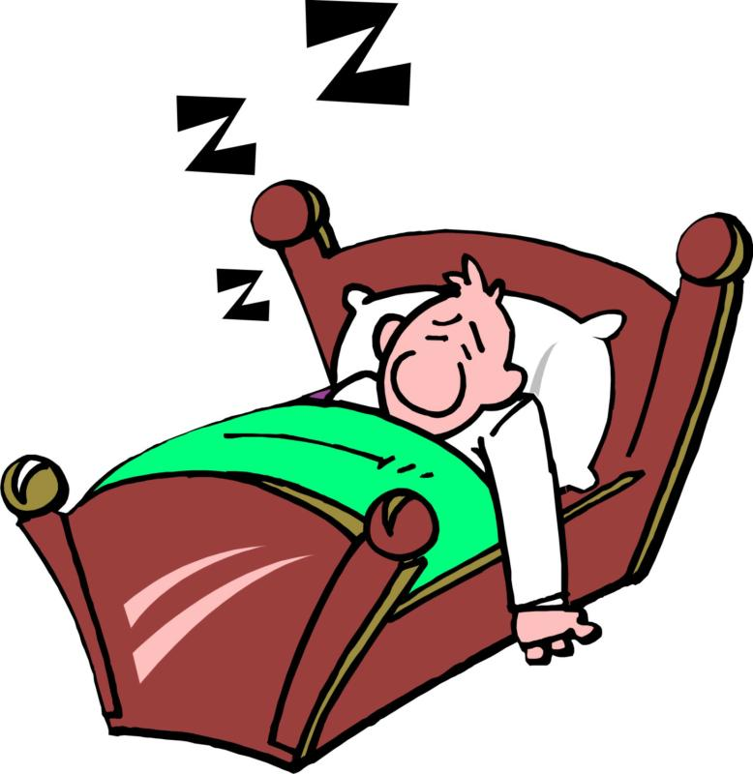
faire la grasse matinée
Faire la grasse matinée literally means ‘to do/make the fat morning’.
But French people say this to mean ‘to have a lie-in’.
La science trouve que faire la grasse matinée est bon pour la santé*. Mais il y a des opinions différentes ! Une autre recommendation est de rester au lit entre 7 et 8 heures chaque nuit pour rester en bonne santé.
Qu’est-ce que tu fais le weekend ?
Est-ce que tu fais la grasse matinée ?
la santé – health
Notes:
Timing: 2 minutes
Aim: to introduce an idiomatic expression with ‘faire’.
Procedure:
Click through the animations to present the information.
Ask pupils if they have a lie-in at the weekend?
Source:
https://www.noovomoi.ca/vivre/bien-etre/article.il-faut-faire-la-grasse-matinee-et-cest-la-science-qui-le-dit.1.9723116.html
https://actu.fr/insolite/fan-grasses-matinees-trop-dormir-est-dangereux-la-sante_18137277.html

Slide 11
écouter
Un weekend en famille
Écoute. Qui fait quoi ? Écris en anglais.
 | Activité | Extra info
on Saturday morning
is doing an activity
in town for mum
1
is doing a song
in the evening
Jean-Michel
for a school show
is going on a visit of Port-au-Prince
on Saturday
2
with a friend
Annick
on Sunday
is making a cake
for her (the friend)
is doing a lot of things
at the weekend
is making a film
on Saturday
3
with friends
for the show
is doing a race
on Sunday morning
Clémentine
in the park
Notes:
Timing: 5 minutes
Aim: to practise aural comprehension of this week’s vocabulary and use of 1st 2nd and 3rd persons of faire.
Procedure:
Pupils listen to each phrase.
Pupils note what each person does as well as any extra information they hear.
Click first to reveal what they do and then to reveal the extra information.
Transcript:
Le samedi matin je fais une activité en ville pour Maman. Le soir, je fais une chanson pour un spectacle de l’école.
Maman, le samedi tu fais une visite de Port-au-Prince avec ton amie. Et le dimanche ? Tu fais un gâteau pour elle, oui ?
Le weekend, Clémentine fait beaucoup de choses ! Le samedi, elle fait un film pour le spectacle avec des amis. Le Dimanche matin elle fait une course à pied dans le parc.
11

Slide 12
Au revoir !
vert
Notes:
12

