Slide 1
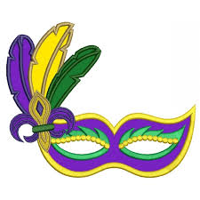
Describing me and others
M a r d i
g r a s
vert
Negation
Est-ce que questions
SSC [oi]
Notes:
Artwork by Steve Clarke. Pronoun pictures from NCELP (www.ncelp.org). All additional pictures selected from
Pixabay and are available under a Creative Commons license, no attribution required.
Frequency of new words:
Phonics: [oi] voir [69] avoir [8] au revoir [n/a] pourquoi ? [193] trois [115]
Vocabulary:
Revisit 1: nager [n/a] chanter [1820] jouer [219] participer (à) [670] porter [105] animal [1002] cadeau [2298]
chapeau [2908] château [3510] cheval [2220] course [1289] défilé [>5000] feu d'artifice [n/a] gâteau [4845]
glace² [2580] jeu [291] lieu [117] neige [1824] trâineau [n/a] Québec [n/a]
Revisit 2: cheveu [2296] acteur [1552] actrice [1552] nez [2661] œil, yeux [474] visage [1292] bleu [1216]
blond [4585] brun [>5000] court [545] crépu [>5000] gris [2769] long [202] noir [572] ovale [>5000] rond
[2268] roux [>5000] vert [1060]
Londsale, D., & Le Bras, Y. (2009). A Frequency Dictionary of French: Core vocabulary for learners London:
Routledge.
The frequency rankings for words that occur in this PowerPoint which have been previously introduced in these
resources are given in the SOW and in the resources that first introduced and formally re-visited those words.
For any other words that occur incidentally in this PowerPoint, frequency rankings will be provided in the notes
field wherever possible.
1

Slide 2
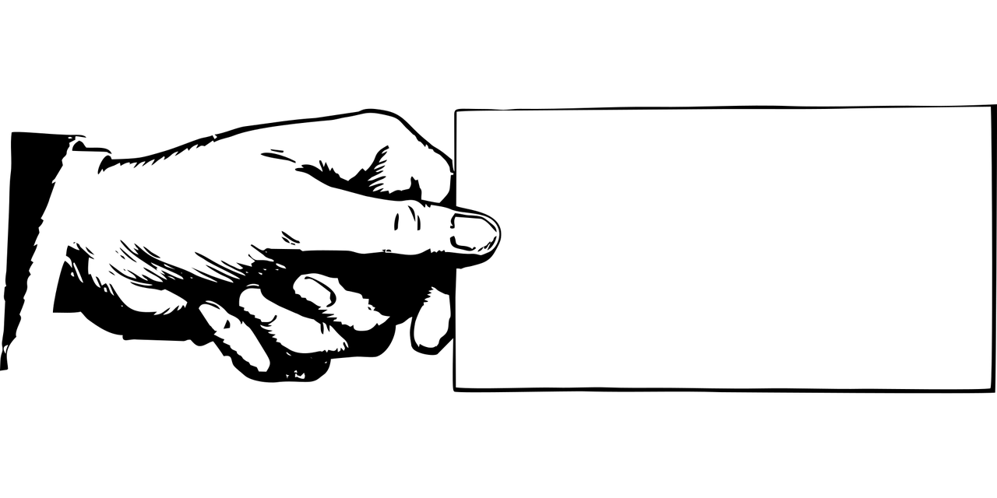
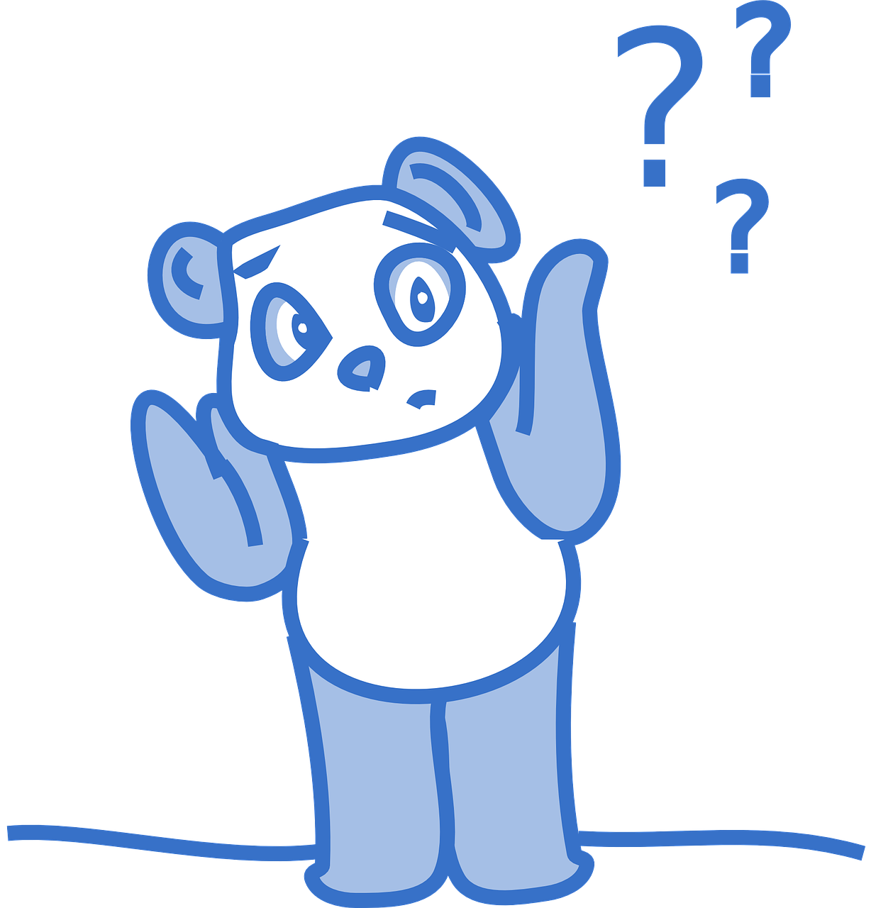
prononcer
[oi]
voir
to have, having
avoir
Au revoir !
[to see, seeing]
[why?]
trois
pourquoi ?
Notes:
Timing: 2 minutes
Aim: to recap SSC [oi].
Procedure:
Introduce and elicit the pronunciation of the individual SSC [oi] and the source word ‘voir’.
Click to bring on the picture and get students to repeat (with gesture, if using).
Present and practise the cluster words.
Gesture: gesture for voir – hand with thumb and two fingers pointing forwards doing a three downwards motions, one for each syllable of the word.
https://www.signbsl.com/sign/see (scroll down to the correct definition of ‘see’ and we recommend the 1st video of these three) – right index finger comes up to the eye and then points away from the body as if tracing the path of sight from the eyes towards an object in view.
2

Slide 3
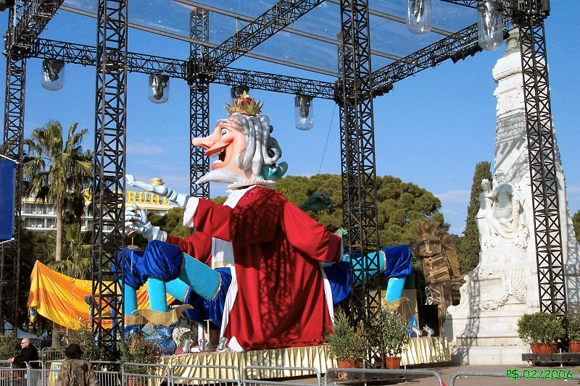
prononcer
Le Mardi gras
on voit = you/one see(s)
le roi = king il faut = you must
le fumier = manure
le navet = turnip
. Écoute les noms des animaux. C’est [ien] ou [(a)in]?
Écoute et note le son [oi].
Puis, prononce le texte.
//
/
/
//
///
//
[oi]
Février est un mois spécial. Pourquoi ?
M a r d i
g r a s
On voit les défilés du Mardi gras.
À Nice le vendredi soir…
on voit l’arrivée du roi du Carnaval.
Le dernier soir, on dit ‘Au revoir’ au roi.
Un proverbe, c’est : « Le soir du Mardi gras, il faut danser sur le fumier pour avoir des navets. »
Notes:
Timing: 8 minutes
Aim: to consolidate SSC [oi].
Procedure:
Make sure pupils understand the context, and the task. First, they need to tally the number of [oi] they hear in each sentence.
Pupils number 1 – 6 in their books. Click to hear number 1 and work through as an example.
Click to reveal the tally. Click to reveal the full sentence. Pupils pronounce the sentence.
Complete items 2-6.
Reveal the answers
Given pupils time to practise pronouncing each sentence in pairs.
Frequency of unknown words and cognates: arrivée [1075] dernier [87] falloir (il faut) [68] fumier [>5000] navet [>5000] proverbe [>5000] roi [1364] Source: Londsale, D., & Le Bras, Y. (2009). A Frequency Dictionary of French: Core vocabulary for learners London: Routledge.
Picture attribution: Roi du Carnaval: Patrice Semeria, Public domain, via Wikimedia Commons
3

Slide 4
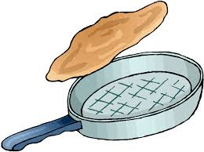
Making sentences negative
ne…pas
Remember, to make a sentence negative, add ne before the verb and pas after it.
Je prépare les crêpes !
Je ne prépare pas les crêpes !
I prepare the pancakes!
I don’t prepare the pancakes!
Tu prépares les crêpes !
Tu ne prépares pas les crêpes !
You prepare the pancakes!
You don’t prepare the pancakes!
⚠ Remember: Ne changes to n’ before a verb starting with a vowel (or a silent h).
For example: je n’aime pas [I don’t like]
Notes:
Timing: 2 minutes
Aim: Introduce ne…pas negation with single-verb structures and draw attention to differences between French and English negation structure
Procedure:
Click through the animations to present the information.
Elicit English translations for the French examples provided.

Slide 5
lire
Le Mardi gras
. Écoute les noms des animaux. C’est [ien] ou [(a)in]?
Lis et décide le reste de la phrase. C’est A ou B ?
la recette = recipe
1
Ma famille célèbre…
pas le Mardi gras.
le Mardi gras.
2
Je ne prépare…
pas les crêpes.
les crêpes.
3
Maman n’utilise…
la recette.
pas la recette.
4
J’ai…
pas faim.
faim.
5
J’aide…
pas Maman.
Maman.
6
Je ne trouve…
les œufs.
pas les œufs.
7
Maman n’est…
pas contente.
contente.
8
Elle demande…
pourquoi !
pas pourquoi !
M a r d i g r a s | M a r d i g r a s | M a r d i g r a s
Notes:
Timing: 8 minutes
Aim: to pay attention to the position of ne..pas and practise written distinction between simple positive and negative sentence structures.
Procedure:
Students write down 1-8.
Model number 1 with the class, so pupils are clear that they select the sentence ending based on the present or absence of ‘ne’ in the sentence beginnings.
Click to leave the correct sentence ending.
Elicit the English meaning from pupils.
Pupils complete 2 – 8.
Teacher clicks to correct and elicit the English for the remainder of the story. Ask pupils to tell you why Eugénie is not happy.
English meanings: 1. My family is celebrating Epiphany. 2. I don’t prepare the cake.
3. Mum hides the figurine.
4. I give some presents. 5. I am under the table. 6. I don’t find the figurine. 7. I am not the queen. 8. She is wearing the crown. 9. Now, I don’t eat the cake!

Slide 6
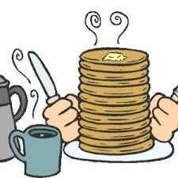
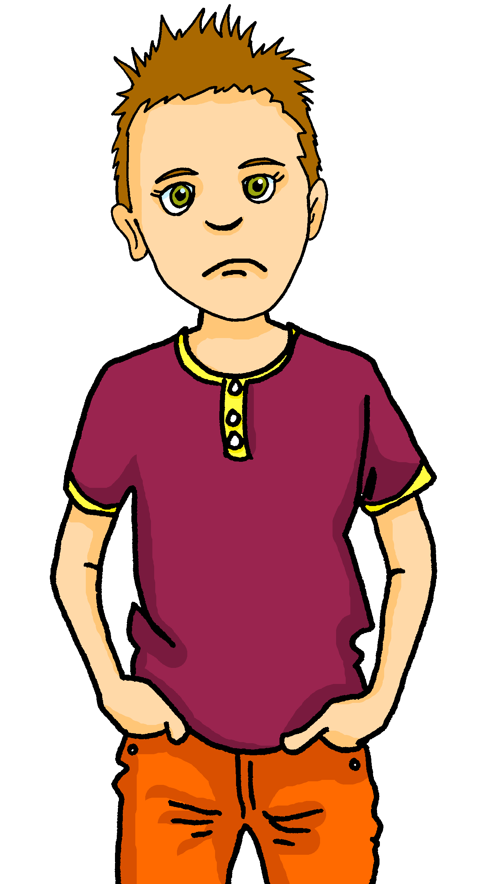
écouter
Écoute.
Pierre is not happy. Adèle suggests why. What does she say? She doesn’t finish her sentences, so you have to!
Écris 1-6 et A ou B.
 | A | B
 | … les crêpes. | … pas les crêpes.
 | … pas la recette. | … la recette.
 | … pas des œufs. | … des œufs.
 | … les œufs. | … pas les œufs.
 | … pas des crêpes. | … des crêpes.
 | … pas triste. | … triste.
1
1
2
2
3
3
4
4
5
5
6
6
Notes:
Timing: 7 minutes
Aim: to practise aural distinction of positive and negative sentences in the 2nd person present; to practise
comprehension of several previously taught verbs.
Procedure:
1. Ensure pupils are clear about the task.
2. Click to play the example. Ask pupils to select the correct sentence ending A or B. Click on the audio button
to listen to the full sentence and reveal the written answer on a mouse click.
3. Continue with items 2-6.
5. Listen and check the answers and click to reveal.
Transcript:
Tu ne prépares [pas les crêpes]. Maman ne trouve [pas la recette]. Tu cherches [les œufs]. Tu ne trouves [pas les œufs]. Aujourd’hui, tu ne manges [pas des crêpes]. Alors, tu es [triste].
6

Slide 7
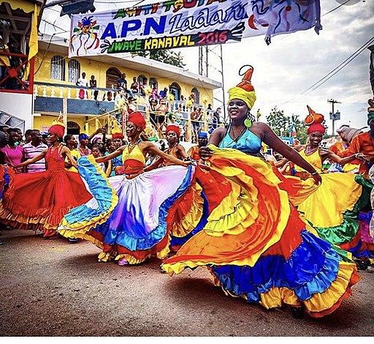
lire
Le Mardi gras à Haïti
la bataille = battle les vêtements – clothes on s’amuse bien ! – you have a good time!
.
Lis le texte.
Le Carnaval d’Haïti (“Mardi gras” ou “Kanaval” en créole haïtien) est une grande fête au mois de février.
Pendant la fête il y a des défilés, des batailles de confetti et beaucoup de musiques populaires (par exemple, le rara).
On chante, on danse, on joue des instruments, on porte des masques et des vêtements multicolores. On s’amuse bien !
M a r d i g r a s | M a r d i g r a s | M a r d i g r a s
Notes:
Timing: 8 minutes
Aim: to learn about Mardi gras in Haiti; to practise written comprehension of previously taught vocabulary and some cognates.
Procedure:
Click to hear each of the three sections of the text.
Ask pupils to tell you what they understand about Mardi gras in Haiti.
Ask pupils for their impressions – does this sound like something they would like to experience?
If time allows, listen to the video of rara music, and explain that it is a particular type of Haitian music used as festivals during parades and processions.
Picture attribution: (Ladies dancing) Bmcao2, CC BY-SA 4.0 <https://creativecommons.org/licenses/by-sa/4.0>, via Wikimedia Commons
Haitian folk music: https://www.youtube.com/watch?v=CpKiOJTXGDY Haitian rara music (a particular type of music typical in festival parades and processions): https://www.youtube.com/watch?v=-oAPqKZ7ZJ0
Frequency of unknown vocabulary and cognates: amuser [2538] bataille [1303] confetti [>5000] instrument [1650] masque [3856] multicolore [>5000] populaire [1349] vêtement [2383]

Slide 8
Au revoir !
vert
Notes:
8

