Slide 1
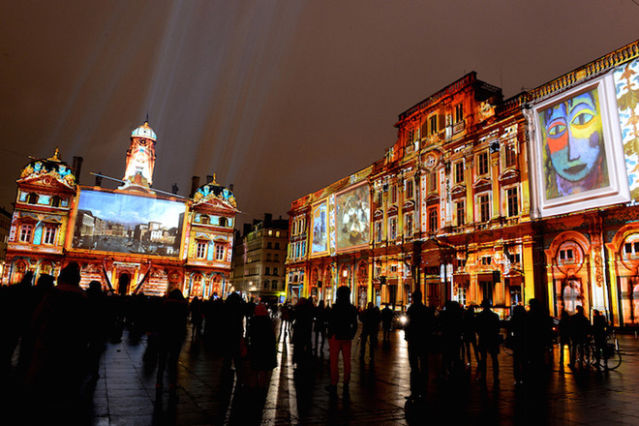
Describing me and others
La Fête des Lumières
Festival of lights
vert
Follow ups 1-5
Notes:
Artwork by Steve Clarke. Pronoun pictures from NCELP (www.ncelp.org). All additional pictures selected from Pixabay and are available under a Creative Commons license, no attribution required.
Frequency of new words:
Phonics: Revisit [é] and SfE
é(et, ez, er) répéter [630] écrire [382] bébé [2271] donner [46] parler [106] et [6] nez [2661]
SFE - timide [3835] monde [77] moderne [1239] centre [491] douze [1664]
Vocabulary: la lumière [1059] le soir [397]
Revisit 1: étudier [960] gagner [258] cacher [914] pratiquer [1268] présenter [209] prononcer [706] trouver [83] école [477] porte [696] pays [114] carte [955] dictionnaire [4094] prix [310] salle [812] sur [16] à (meaning ‘at’)[4]
Revisit 2: centre commercial [491/908] église [1782] magasin [1738] pont [1889] rue [598] excellent [1225] différent [350] idéal [1429] important [215] indépendant [954] moderne [1239] propre [237] sale [2906] des [de-2]
Londsale, D., & Le Bras, Y. (2009). A Frequency Dictionary of French: Core vocabulary for learners London: Routledge.
The frequency rankings for words that occur in this PowerPoint which have been previously introduced in these resources are given in the SOW and in the resources that first
introduced and formally re-visited those words.
For any other words that occur incidentally in this PowerPoint, frequency rankings will be provided in the notes field wherever possible.

Slide 2
prononcer
[é]
[er]
[et]
[ez]
Remember that [é], [er],[et] and [ez] sound the same.
répéter
[and]
écrire
parler
et
bébé
donner
nez
[to give]
Notes:
Timing: 2 minutes
Aim: to recap SSC [é] [er] [et] [ez], which are the same sound written differently.
Procedure:
Introduce and elicit the pronunciation of the individual SSC [é, et, et, ez] and the source word ‘répéter’, which has both spellings of the sound.
Click to bring on the picture and get students to repeat (with gesture, if using).
Present and practise the cluster words.
Gesture: gesture for répéter – hand with thumb and two fingers pointing forwards doing a three downwards motions, one for each syllable of the word.
https://www.signbsl.com/sign/repeat (the 2nd video marked again: repeat with the female signer)
2

Slide 3
prononcer
[SFe]
⚠ Remember: The Silent Final -e means you pronounce the final consonant.
monde
douze
timide
centre
[shy]
moderne
Notes:
Timing: 2 minutes
Aim: To introduce/consolidate SSC [SFe]
Procedure:
1. Practise the pronunciation of the individual SSC [SFe] and then the source word again ‘timide’ (with gesture, if using). 2. Then present and elicit the pronunciation of the four cluster words.
Frequency: monde [77] moderne [1239] centre [491] vie [132] douze [1664] timide [3835] Source: Londsale, D., & Le Bras, Y. (2009). A Frequency Dictionary of French: Core vocabulary for learners London: Routledge.
3

Slide 4
Follow up 1:
la porte
mots
la salle
room
door
préféré
Complète les dominos. 🗣
market
vocabulaire
clean
le défilé
la carte
favourite
le défilé
card
propre
l’église
dirty
idea
card
door
modern
le marché
church
parade
sale
la carte
l’idée
propre
préféré
market
moderne
modern
dirty
church
parade
clean
room
favourite
l’idée
le marché
la porte
idea
sale
la salle
moderne
l’église
Notes:
Timing: 5 minutes
Aim: to practise written comprehension and spoken pronunciation of previously taught vocabulary ending in either SFe or [é].
Procedure:
Starting from the play button, pupils work in pairs or chorally, led by the teacher, to complete the domino orally.
Note: they only need to pronounce the French word each time.
If working as a whole class the teacher can click to provide the answers at each turn.
4. The activity can be repeated to speed up recall.

Slide 5
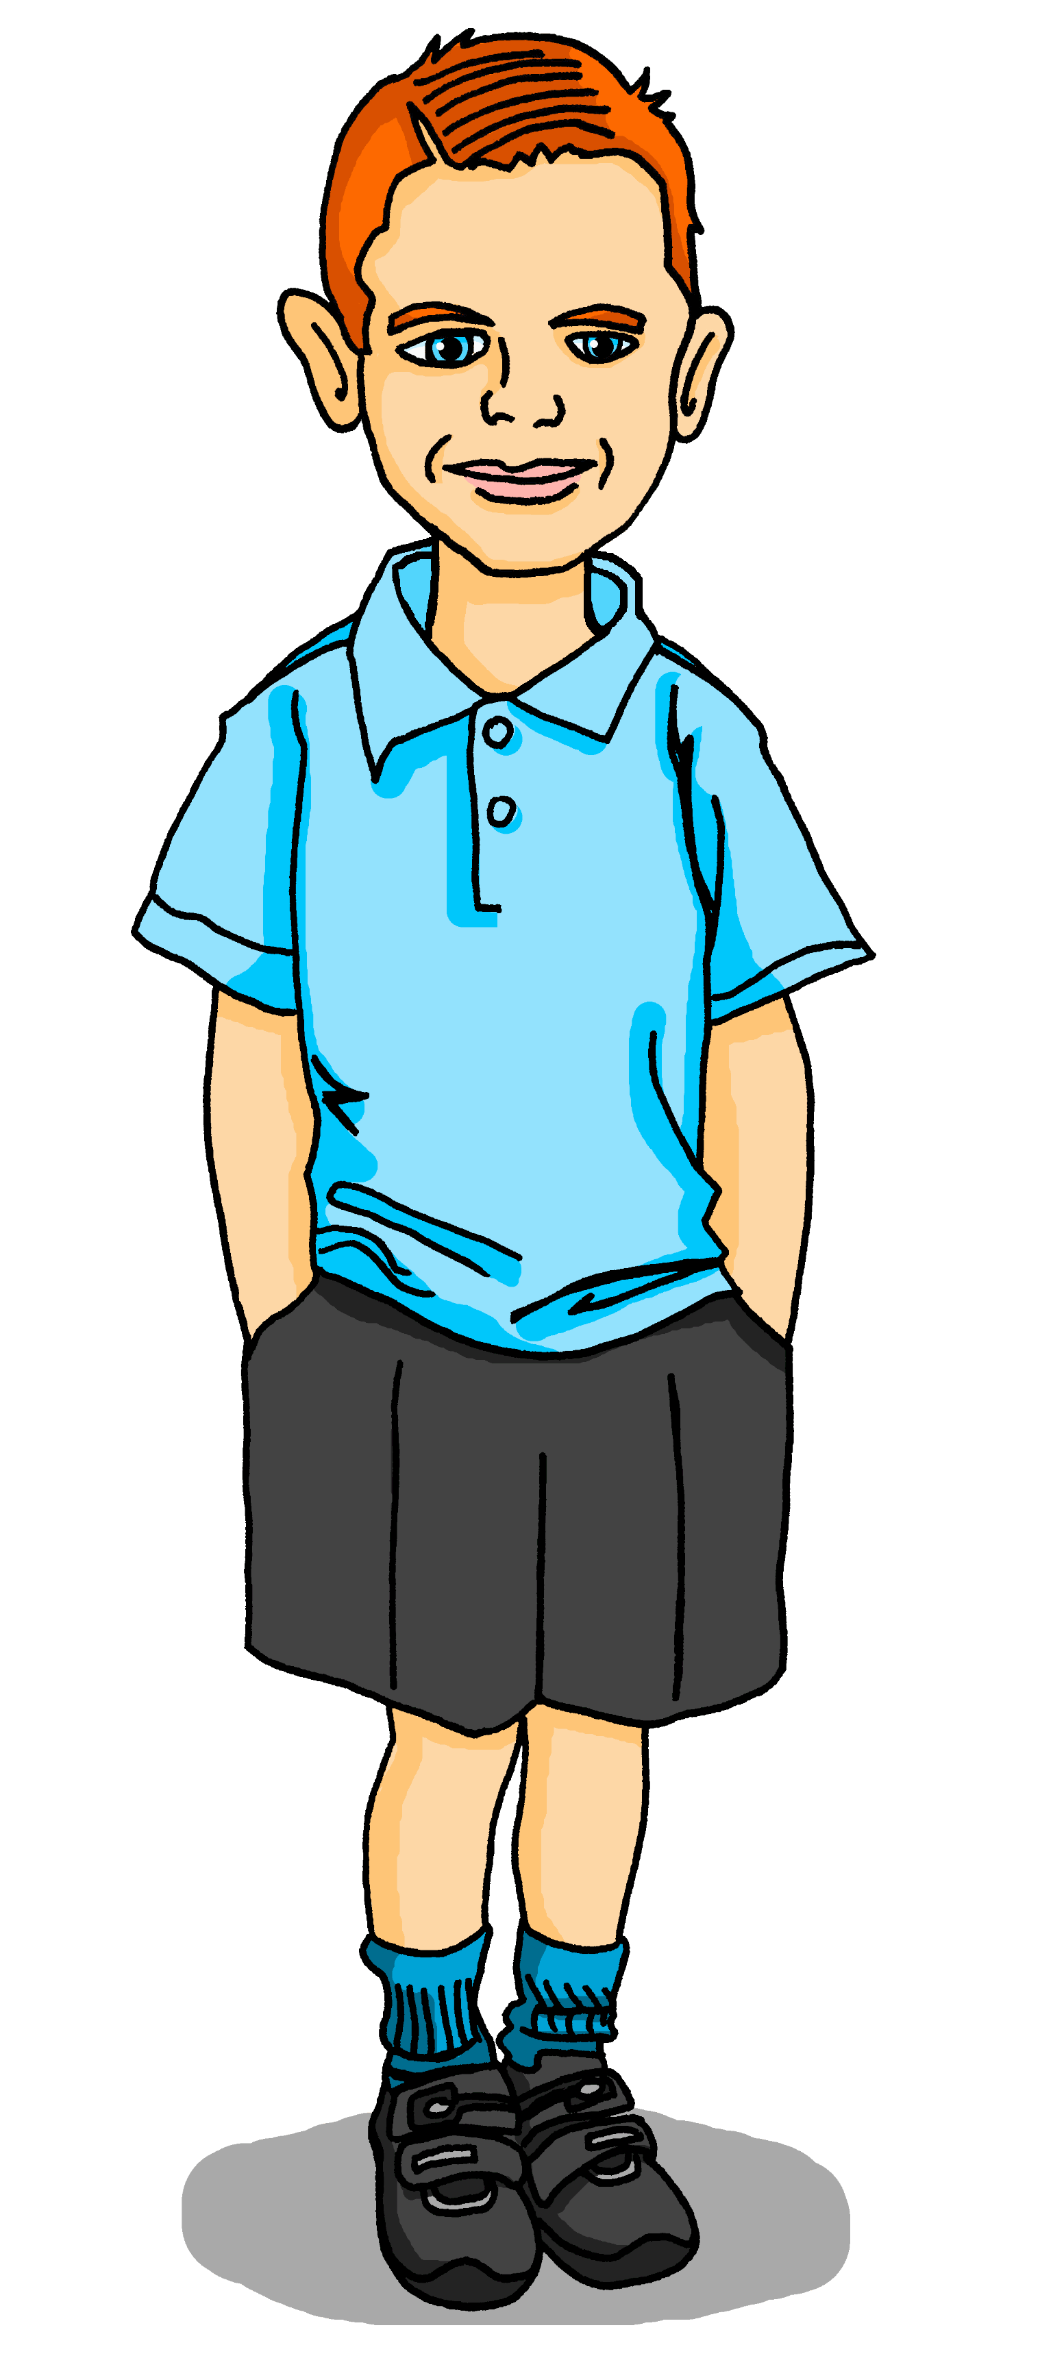
Follow up 2 [1/8]
Écoute. Max pose la question à Pierre ou a Hervé ?
. Écoute les noms des animaux. C’est [ien] ou [(a)in]?
La Fête des Lumières
écouter
1
Est-ce que tu aimes la Fête des Lumières ?
Notes:
Timing: 8 minutes (8 slides)
Aim: to practise aural comprehension of tu and vous forms of the verb in est-ce que questions, and their connection with meaning.
Procedure
Read the title and scenario and clarify the context and the activity with pupils. Remind pupils that the tu form means ‘you’ for one person you know well and vous form is ‘you’ in a formal context (e.g. to an adult you don’t call by their first name).
Pupils listen to each question and decide who it is addressed to, depending on the form of the verb they hear. The pronouns are beeped out to focus pupils’ attention on the verb form.
Click to highlight the answer and see the question in writing.
Elicit the English meaning of the question.
Transcript:
Est-ce que [tu] aimes la Fête des Lumières ?

Slide 6
Follow up 2 [2/8]
Écoute. Max pose la question à Pierre ou a Hervé ?
. Écoute les noms des animaux. C’est [ien] ou [(a)in]?
La Fête des Lumières
écouter
2
Est-ce que vous visitez l’église ?
Notes:
[2/8]
Transcript:
Est-ce que [vous] visitez l’église ?

Slide 7
Follow up 2 [3/8]
Écoute. Max pose la question à Pierre ou a Hervé ?
. Écoute les noms des animaux. C’est [ien] ou [(a)in]?
La Fête des Lumières
écouter
3
Est-ce que vous marchez dans les rues ?
Notes:
[3/8]
Transcript:
Est-ce que [vous] marchez dans les rues ?

Slide 8
Follow up 2 [4/8]
Écoute. Max pose la question à Pierre ou a Hervé ?
. Écoute les noms des animaux. C’est [ien] ou [(a)in]?
La Fête des Lumières
écouter
4
Est-ce que vous avez froid ?
Notes:
[4/8]
Transcript:
Est-ce que [vous] avez froid ?

Slide 9
Follow up 2 [5/8]
Écoute. Max pose la question à Pierre ou a Hervé ?
. Écoute les noms des animaux. C’est [ien] ou [(a)in]?
La Fête des Lumières
écouter
5
Est-ce que tu portes une écharpe et des gants ?
Notes:
[5/8]
Transcript:
Est-ce que [tu] portes une écharpe et des gants ?

Slide 10
Follow up 2 [6/8]
Écoute. Max pose la question à Pierre ou a Hervé ?
. Écoute les noms des animaux. C’est [ien] ou [(a)in]?
La Fête des Lumières
écouter
6
Est-ce que vous regardez un spectacle au château ?
Notes:
[6/8]
Transcript:
Est-ce que [vous] regardez un spectacle au château ?

Slide 11
Follow up 2 [7/8]
Écoute. Max pose la question à Pierre ou a Hervé ?
. Écoute les noms des animaux. C’est [ien] ou [(a)in]?
La Fête des Lumières
écouter
7
Est-ce que tu prépares des crêpes ?
Notes:
[7/8]
Transcript:
Est-ce que [tu] prépares des crêpes ?

Slide 12
Follow up 2 [8/8]
Écoute. Max pose la question à Pierre ou a Hervé ?
. Écoute les noms des animaux. C’est [ien] ou [(a)in]?
La Fête des Lumières
écouter
8
Est-ce que tu décores la maison avec des bougies ?
la bougie – candle
Notes:
[8/8]
Transcript:
Est-ce que [tu] décores la maison avec des bougies ?

Slide 13
Follow up 3:
Max organise les notes.
But he has mixed up the answers to his questions.
Can you help him sort them out?
lire
1) ……………………………………………
2) ……………………………………………
3) ……………………………………………
4) ……………………………………………
5) ……………………………………………
6) ……………………………………………
7)…………………………………………….
8)…………………………………………….
B
1
Est-ce que tu aimes la Fête des Lumières ?
F
A
Oui, mais je bois un chocolat chaud.
2
Est-ce que vous visitez l’église ?
B
Oui, c’est une très jolie fête.
Est-ce que vous marchez dans les rues ?
E
3
C
Oui, le château a un grand spectacle.
Est-ce que vous avez froid ?
A
4
H
D
Non, ça c’est le 2 février pour la Chandeleur.
5
Est-ce que tu portes une écharpe et des gants ?
E
Oui, marcher, c’est parfait pour voir les lumières le soir.
Est-ce que vous regardez un spectacle au château?
C
6
F
Oui, tout le monde regarde le spectacle de lumières à l’église.
D
7
Est-ce que tu prépares des crêpes ?
G
Oui, le soir. J’adore les bougies.
Est-ce que tu décores la maison avec des bougies ?
G
8
H
Oui, et je porte aussi mon nouveau chapeau.
Notes:
Timing: 5 minutes
Aim: to practise written comprehension of 2nd person singular formal and informal question and connect them to appropriate answers.
Procedure: 1. Pupils can number 1-8 to avoid copying the full text.
2. Pupils read the questions and identify their answers.
3. For feedback of answers and to practise read aloud, click to hear each question in full.
4. Pupils respond with their selected answer, reading it aloud.
5. Click to bring up the letter answer. Differentiation: In feedback, for more challenge, pupils could be divided into two halves. One half could read the question aloud and the other half could respond with the answer.

Slide 14
Follow up 4:
Parle avec ton/ta partenaire.
Personne A pose la question.
Personne B identifie l’image correspondante et écrit en anglais.
parler
Personne A
Ask:
[Are you (formal) listening to] la présentation ?
[M. Clarke]
[Jamie]

Est-ce que vous écoutez la présentation ?
listening to the presentation?
……………………………….
A
B
Notes:
Timing: 5-10 minutes
Aim: to practise receptive and productive knowledge of est-ce que questions in the present tense in tu and vous forms.
Procedure: 1. Use this slide to model the task.
2. Pupil A produces the est-ce que + pronoun + verb in French.
3. Pupil B identifies the correct picture – Monsieur Clarke or Jamie.
4. If able, pupil B writes down what pupil A is asking, too.
4. Complete items 1-5.
5. Then pupils swap roles and repeat the task. 6. See next slides for answers, and handouts at the end of the presentation.

Slide 15
parler
Round 1
parler
1
2
3
[Jamie]
[M. Clarke]
[Jamie]
[M. Clarke]
[Jamie]
[M. Clarke]



……………………………….
……………………………….
……………………………….
4
5
[Jamie]
[M. Clarke]
[Jamie]
[M. Clarke]


……………………………….
……………………………….
Notes:
Display during Round 1
Person B to use and decide Alex or Madame Smith each time, depending on the verb (and pronoun) used.
Note: There is no need to print this. Pupils write 1-5, the correct name and the meaning of the question in English.
15

Slide 16
parler
Round 2
parler
1
2
3
[M. Clarke]
[Jamie]
[M. Clarke]
[Jamie]
[M. Clarke]
[Jamie]



……………………………….
……………………………….
……………………………….
4
5
[M. Clarke]
[Jamie]
[M. Clarke]
[Jamie]


……………………………….
……………………………….
Notes:
Display during Round 2
Person A to use and decide Alex or Madame Smith each time, depending on the verb (and pronoun) used.
Note: There is no need to print this. Pupils write 1-5, the correct name and the meaning of the question in English.
16

Slide 17
parler
Round 1
parler
1
2
3
[Jamie]
[M. Clarke]
[Jamie]
[M. Clarke]
[Jamie]
[M. Clarke]



listening to the presentation?
……………………………….
……………………………….
preparing (some) questions?
presenting some pictures?
……………………………….
4
5
[Jamie]
[M. Clarke]
[Jamie]
[M. Clarke]


……………………………….
……………………………….
speaking to the class?
like/liking the presentation?
Notes:
Round 1 answers
Person B’s answers
17

Slide 18
parler
Round 2
parler
1
2
3
[M. Clarke]
[Jamie]
[M. Clarke]
[Jamie]
[M. Clarke]
[Jamie]



organising the chairs?
……………………………….
……………………………….
asking (some) questions?
presenting in French?
……………………………….
4
5
[M. Clarke]
[Jamie]
[M. Clarke]
[Jamie]


……………………………….
hiding the prize?
finding some important information?
……………………………….
Notes:
Round 2 answers
Person A’s answers
18

Slide 19
parler
Round 1
Round 2
parler
Personne A asks:
1) [Are you (formal) listening to] la présentation?
……………………………….
2) [Are you (formal) preparing] des questions ?
……………………………….
3) [Are you (informal) presentating] des images ?
……………………………….
4) [Are you (formal) speaking] à la classe ?
……………………………….
5) [Do you (informal) like] la présentation?
………………………………..
Personne B asks:
1) [Are you (informal) organising] les chaises ?
……………………………….
2) [Are you (formal) asking] des questions ?
……………………………….
3) [Are you (informal) presenting] en français ?
……………………………….
4) [Are you (informal) finding] des infos importantes ?
……………………………….
5) [Are you (formal) hiding] le prix ?
………………………………..
Est-ce que vous écoutez…
Est-ce que tu organises…
Est-ce que vous préparez…
Est-ce que vous posez…
Est-ce que tu présentes…
Est-ce que tu présentes…
Est-ce que vous parlez…
Est-ce que tu trouves…
Est-ce que tu aimes…
Est-ce que vous cachez…
Notes:
Questions for Rounds 1 & 2
19

Slide 20
vocabulaire
Follow up 5 - Écris en anglais : Can you get at least 15 points?
mots
 | sale | le centre commercial | le pont
 | des | propre | le magasin
 | l’école | la salle | la porte
 | la carte | le pays | à
 | étudier | pratiquer | trouver
 | gagner | prononcer | présenter
 | la lumière | le soir | gagner
dirty (m/f)
(the) shopping centre
(the) bridge
x3
some
clean (m/f)
(the) shop
(the) school
(the) room
(the) door
x2
(the) card
(the) country
to, at, in
to study, studying
to practise, practising
to find, finding
to win, winning
to pronounce
to present, presenting
x1
(the) light
(the) evening
to win, winning
Notes:
Timing: 5-10 minutes
Aim: to practise written production of vocabulary from this week and two revisited weeks.
Procedure: 1. Give pupils a blank grid. They fill in the English meanings of any of the words they know, trying to reach 15 points in total. 2. Remind pupils that adjectives can refer to male or female persons and they should note this in their translations. E.g. pleased (f), short (m).
Note: The most recently learnt and practised words are pink, words from revisit 1 are green and those from revisit 2 are blue, thus more points are awarded for them, to recognise that memories fade and more effort (heavy lifting!) is needed to retrieve them.
20

Slide 21
vocabulaire
Follow up 5 - Écris en français : Can you get at least 15 points?
mots
 | clean (m/f) | dirty (m/f) | some
 | (the) shop | (the) shopping centre | (the) bridge
 | (the) card | (the) room | to, at, in
 | (the) school | (the) door | (the) country
 | to present | to pronounce | to find, finding
 | to win, winning | to hide, hiding | to practise, practising
 | (the) light | (the) evening | to study, studying
propre
sale
des
x3
le magasin
le centre commercial
le pont
la carte
la salle
à
x2
l’école
la porte
le pays
présenter
prononcer
trouver
gagner
cacher
pratiquer
x1
la lumière
le soir
étudier
Notes:
Timing: 5-10 minutes
Aim: to practise written production of vocabulary from this week and two revisited weeks.
Procedure: 1. Give pupils a blank grid. They fill in the French meanings of any of the words they know, trying to reach 15 points in total. 2. Remind pupils that adjectives can refer to male or female persons and they should note this in their translations. E.g. pleased (f), short (m).
Note: The most recently learnt and practised words are pink, words from revisit 1 are green and those from revisit 2 are blue, thus more points are awarded for them, to recognise that memories fade and more effort (heavy lifting!) is needed to retrieve them.
21

Slide 22
parler
Round 1
Round 2
parler
Personne A asks:
1) [Are you (formal) listening to] la présentation ?
……………………………….
2) [Are you (formal) preparing] des questions ?
……………………………….
3) [Are you (informal) presentating] des images ?
……………………………….
4) [Are you (formal) speaking] à la classe ?
……………………………….
5) [Do you (informal) like] la présentation?
………………………………..
Personne B asks:
1) [Are you (informal) organising] les chaises ?
……………………………….
2) [Are you (formal) asking] des questions ?
……………………………….
3) [Are you (informal) presenting] en français ?
……………………………….
4) [Are you (informal) finding] des infos importantes ?
……………………………….
5) [Are you (formal) hiding] le prix ?
………………………………..
Notes:
Handouts Round 1 and 2
22

Slide 23
vocabulaire
Follow up 5 - Écris en anglais : Can you get at least 15 points?
mots
 | sale | le centre commercial | le pont
 | des | propre | le magasin
 | l’école | la salle | la porte
 | la carte | le pays | à
 | étudier | pratiquer | trouver
 | gagner | prononcer | présenter
 | la lumière | le soir | gagner
x3
x2
x1
Notes:
HANDOUT
23

Slide 24
vocabulaire
Follow up 5 - Écris en français : Can you get at least 15 points?
mots
 | clean (m/f) | dirty (m/f) | some
 | (the) shop | (the) shopping centre | (the) bridge
 | (the) card | (the) room | to, at, in
 | (the) school | (the) door | (the) country
 | to present | to pronounce | to find, finding
 | to win, winning | to hide, hiding | to practise, practising
 | (the) light | (the) evening | to study, studying
x3
x2
x1
Notes:
HANDOUT
24

