Slide 1
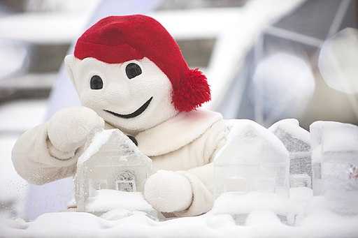
Saying what I and others do
vert
-ER verbs: they, s/he
cognates
SSC [è|ê]
Notes:
Artwork by Steve Clarke. Pronoun pictures from NCELP (www.ncelp.org). All additional pictures selected from Pixabay and are available under a Creative Commons license, no
attribution required.
Phonics: [è | ê] fête [1490] tête [343] frère [1043] être [5] problème [188]
Frequency of new words:
Vocabulary: aimer [242] apporter [339] arriver [174] organiser [701] porter [105] préparer [368] créer [332] marcher [1532] monter [853] quitter [507] puis [230]
Revisit 1: cheveu [2296] acteur [1552] actrice [1552] nez [2661] œil, yeux [474] visage [1292] bleu [1216] blond [4585] brun [>5000] court [545] crépu [>5000] gris [2769] long [202] noir [572] ovale [>5000] rond [2268] roux [>5000] vert
[1060]
Revisit 2: avoir [8] j’ai [8] quoi [297] un [3] une [3] café [1886] cinéma [1623] hôtel [1774] poste [489] école [477] très [66] utile [1003] différent [350] idéal [1429] important [215] indépendant [954] moderne [1239] propre [237] sale [2906]
Londsale, D., & Le Bras, Y. (2009). A Frequency Dictionary of French: Core vocabulary for learners London: Routledge.
The frequency rankings for words that occur in this PowerPoint which have been previously introduced in these resources are given in the SOW and in the resources that first
introduced and formally re-visited those words.
For any other words that occur incidentally in this PowerPoint, frequency rankings will be provided in the notes field wherever possible.
Image attribution:
Logo - Stagiairec, CC BY-SA 4.0 via Wikimedia Commons
Bonhomme Carnaval - Laserpdb, CC BY-SA 3.0 via Wikimedia Commons
Bonhomme Carnaval (2) - Stagiairec, CC BY-SA 4.0 via Wikimedia Commons
1

Slide 2
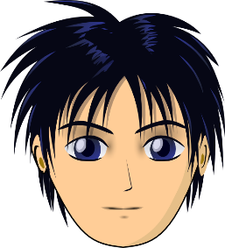
prononcer
[è|ê]
[è] and [ê] sound almost the same. [ê] is a little longer and deeper.
to be, being
fête
être
frère
(brother)
(party, celebration)
tête
problème
(head)
Notes:
Timing: 2 minutes
Aim: to recap SSC [è] and [ê] which are almost the same sound.
Procedure:
Introduce and elicit the pronunciation of the individual SSC [è] and the source word ‘xxx’, which has both spellings of the sound.
Click to bring on the picture and get students to repeat (with gesture, if using).
Present and practise the cluster words.
Gesture: gesture for fête: raise both hands in the air (middle three fingers facing down in a partial fist, with thumb and pinkie facing upwards) and move up and down alternate left and right to suggest a celebration-style dance.
Source: https://www.signbsl.com/sign/party (the 3rd video from the right is the best one, in my view)
2

Slide 3
prononcer
[è|ê]
Prononce les mots avec le son [è] [ê]. Écoute et vérifie.
1
2
3
4
5
6
cheveu
nez
tête
glace
neige
défilé
café
hôtel
cinéma
être
arriver
organiser
crépu
blond
vert
moderne
utile
très
Notes:
Timing: 3 minutes
Aim: to practise written recognition and spoken production of [è] and [ê] in individual words.
Procedure:
Ensure that pupils understand the instruction to pronounce only the words with the SSC [è] and [ê].
Give pupils 2 minutes to decide which words to pronounce and to practise pronouncing them.
Click to hear only the word or words from each row that contain the correct SSC.
Elicit from pupils the pronunciation of the other words, those with SSC [è].
Transcript: tête neige
hôtel
être
vert moderne, très
3

Slide 4
vocabulaire
Vocabulaire
Trouve la connexion.
mots
1
2
3
4
5
6
body parts
cheveu
nez
tête
glace
neige
défilé
Quebec Carnival
café
hôtel
buildings
cinéma
être
arriver
organiser
verbs
crépu
blond
vert
hair
moderne
utile
très
description
body parts
description
hair
Quebec Carnival
buildings
verbs
Notes:
Timing: 2 minutes
Aim: to practise written comprehension of previously taught words and (near) cognates by associating them with a broader theme; to practise pronunciation of words with SSC [è/ê] and [é].
Procedure: 1. Explain the task. Pupils can volunteer answers for any line in any order.
2. To volunteer a connection, pupils say the three French words followed by the English category word they suggest.
3. Teacher clicks on the English category – it will reappear next to the correct row of French words that it links to.
Note: row 2 links to our theme this week, the Quebec Carnival.
4

Slide 5
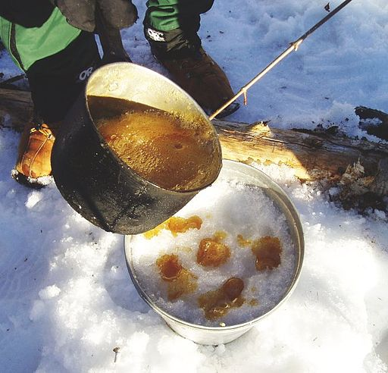
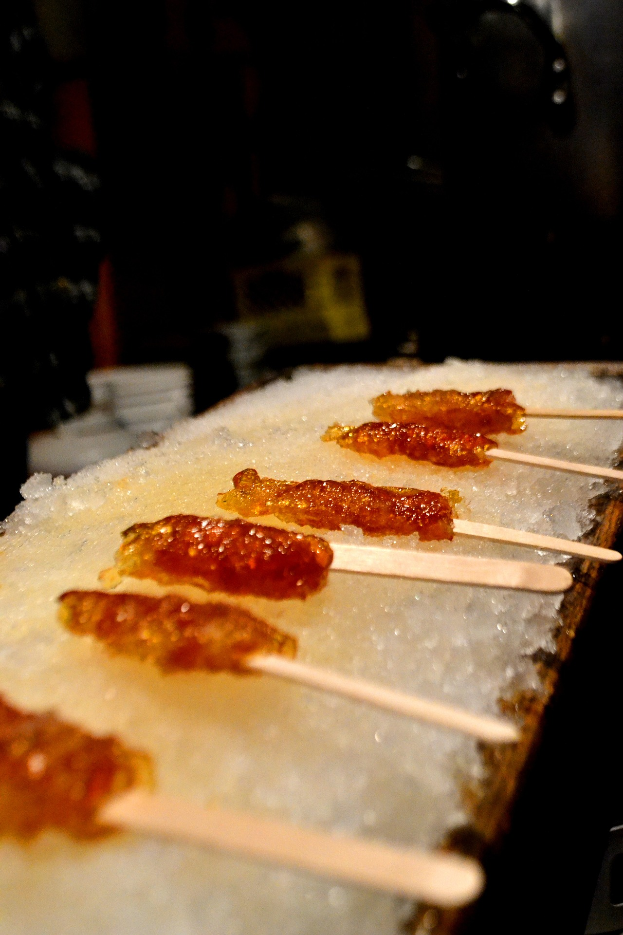
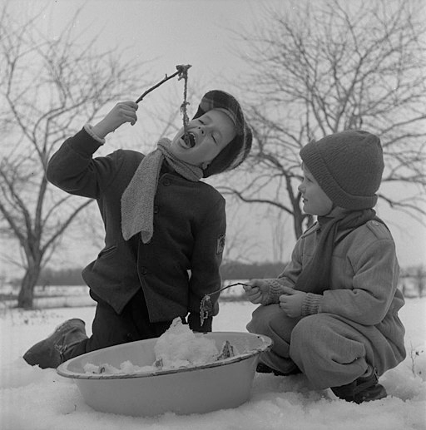
La tire* sur la neige
chauffer – to heat l’érable - maple
La tire sur la neige est une spécialité de Québec. On fait chauffer* du sirop d’érable* et puis, on verse le sirop sur de la neige pour créer des bonbons.
la tire = maple candy
C’est une tradition très ancienne !
The maple is the national tree of Canada and on Canada’s national flag.
Notes:
Timing: 4 minutes
Aim: to introduce pupils to a Québec tradition, maple candy (or maple taffy).
Picture attributions:
Tire sur la neige: The original uploader was SimonP at English Wikipedia., CC BY-SA 3.0 via Wikimedia Commons
1950s children eating Tire sur la neige in Québec: Chris Lund, Public domain, via Wikimedia Commons
Video showing Maple candy/toffee/taffy on snow (39 seconds): https://www.youtube.com/watch?v=9NniZSGxRHU
Procedure:
Read the title and bring up the callout with ‘la tire’.
Read (or click to listen to) the information about the candy.
Click to highlight five cognates and elicit the English meanings (spécialité – speciality, sirop – syrup, tradition- tradition, ancienne – old/ancient)
Elicit pupils’ understanding of the text.
A rough translation in English could be: Maple candy is a speciality in Quebec. You heat up maple syrup and then pour the syrup onto some snow to create sweets/candy. It’s a very old tradition.
If desired, visit YouTube to see the very short video of the candy being poured out onto snow and rolled up onto lolly sticks.
Finally, click to tell students that the maple is Canada’s national tree and on Canada’s flag.

Slide 6
vocabulaire
Vocabulaire
C’est quoi en français ?
mots
marcher
puis
monter
then
quitter
créer
to ride, climb up/on/into
to create, creating
to leave (somewhere)
to walk, walking
then
Notes:
Timing: 4 minutes
Aim: to present and practise written comprehension and read aloud of the new vocabulary for this week.
Procedure: 1. Click for an English prompt.
2. Elicit the French word from pupils where they can recognise and read it aloud. Or say the word for pupils to repeat.
3. Continue until all 8 items have been seen and heard.
6

Slide 7
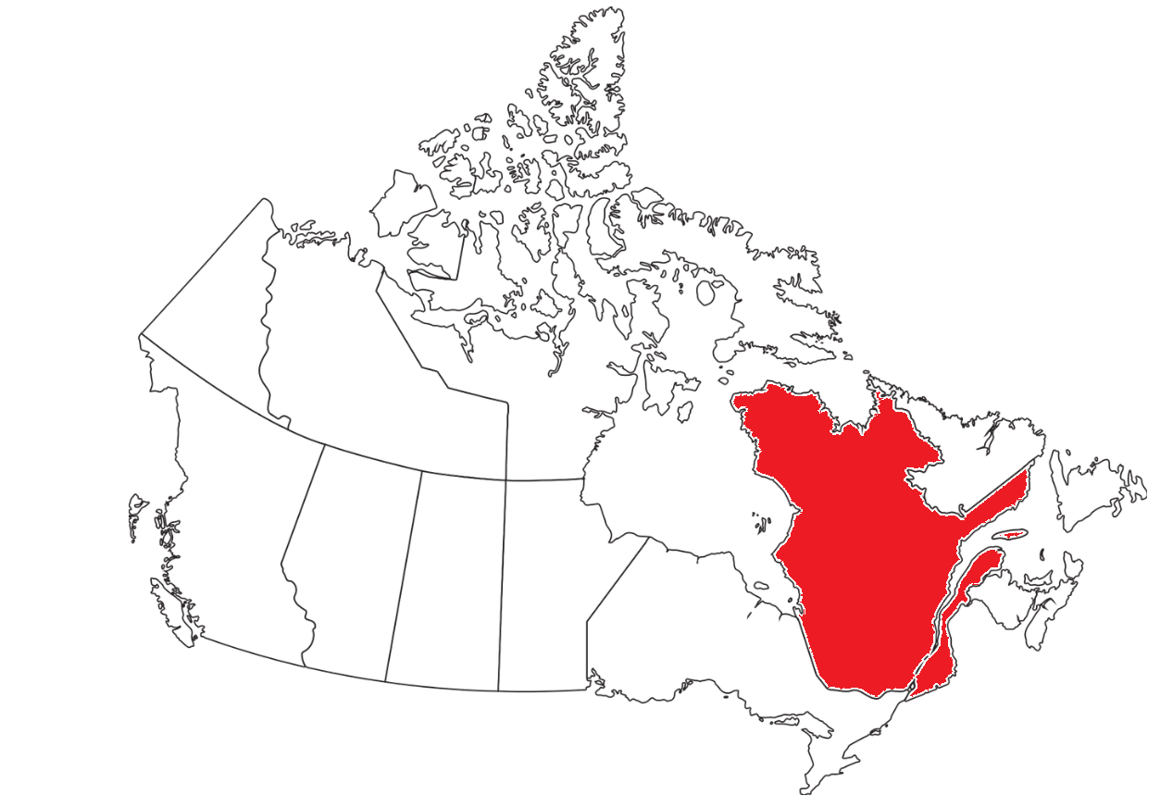
écouter
Le Carnaval de Québec
le traîneau = sled(ge)
. Écoute les noms des animaux. C’est [ien] ou [(a)in]?
Écoute. Écris en anglais.
 | en anglais ?
Ex
swim in the snow
1
create ice sculptures
2
watch the parade
3
visit the castle
H
4
ride on a sledge
5
walk in the snow
6
leave the hotel
Notes:
Timing: 1 minute
Aim: to practise aural comprehension of the new vocabulary for this week and from last week, in short phrases.
Procedure:
1. Click to listen.
2. Pupils write or say the English meaning.
3. Click to correct.
Transcript:
Exemple: nager dans la neige
créer des sculptures en glace
regarder le défilé
visiter le château
monter sur un traineau
marcher dans la neige
quitter l’hôtel
7

Slide 8
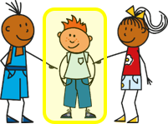
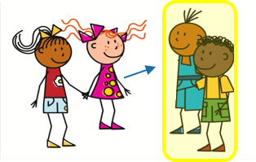
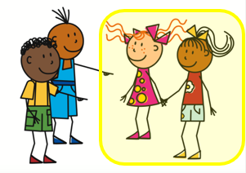
Knowing who does what
-ER verbs: they (ils, elles)
You know that to say s/he, it + -ER verb in French, the verb ends in –e.
ils is for either a group of boys or a mixed group.
To say they + -ER verb in French, the verb ends in –ent.
Il prépare des sandwichs.
Ils préparent des sandwichs.
He prepares sandwiches.
They prepare sandwiches.
Elle organise le sac.
Elles organisent le sac.
Elles organisent le sac.
She organises the bag.
They organise the bag.
The endings are silent so –e and –ent sound the same!
Remember the liaison –s before verbs starting with a vowel.
Notes:
Timing: 2 minutes
Aim: to introduce the 3rd person plural of –ER verbs and contrast it with the 3rd person singular.
Procedure:
Click through the animations to present the information.
Elicit English translations for the French examples provided.

Slide 9
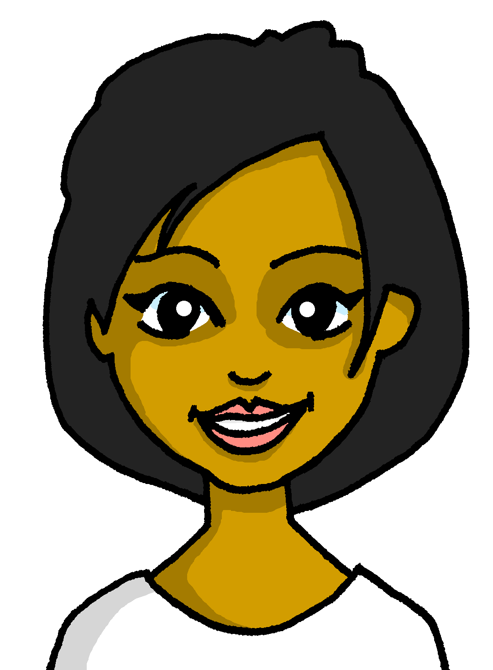
lire
Le Carnaval de Québec
vers = towards
Renée et Cécile sont à Québec pour le carnaval.
C’est qui ? Renée ou Renée et Cécile ?
Everyone in Québec loves the Carnival. But what does Renée do on her own, and what do Renée and Cécile do together? |  | elles (they) | elle (she)
1 | …. prépare des sandwichs.
2 | …. organise le sac.
3 | …. quittent l’hôtel.
4 | …. marchent vers le centre.
5 | …. apportent une bouteille d’eau.
6 | …. porte un bikini.
7 | … cherchent des informations.
8 | … aiment le Carnaval.
1
2
3
4
5
6
7
8
Notes:
Timing: 5 minutes
Aim: to practise written recognition of singular and plural –ER verb endings, and their connection with meaning.
Procedure:
1. Students write 1-8 and elles (they) or elle (she) according to whether the verb is singular or plural.
2. Answers are revealed on a mouse click.
3. Move on to the next slide for a comprehension task based on the same text.

Slide 10
lire
Le Carnaval de Québec
vers = towards
Renée et Cécile sont à Québec pour le carnaval.
C’est quoi en anglais ? Écris des phrases.
Everyone in Québec loves the Carnival. But what does Renée do on her own, and what do Renée and Cécile do together?
1 | …. prépare des sandwichs.
2 | …. organise le sac.
3 | …. quittent l’hôtel.
4 | …. marchent vers le centre.
5 | …. apportent une bouteille d’eau.
6 | …. porte un bikini.
7 | … cherchent des informations.
8 | … aiment le Carnaval.
1
She prepares sandwiches.
2
She organises the bag.
3
They leave the hotel.
4
They walk towards the centre.
5
They bring/carry a bottle of water.
6
She wears a bikini.
7
They look for information.
8
They like the carnival.
Notes:
Timing: 5 minutes
Aim: to practise written comprehension or a range of singular and plural –ER verbs and vocabulary associated with the Québec Carnival.
Procedure:
Pupils volunteer English meanings of each sentence.
Teacher clicks to reveal written answers.
If desired, click the buttons to play full sentence audio.
Encourage pupils to identify French words that remind them of English words, and volunteer their meaning (e.g. sandwichs, prépare, organise, centre, bikini, informations, carnaval). Tell pupils these are called cognates (or near-cognates, when there are minor differences), that there are many such words between French and English, but that usually the pronunciation will be different. Encourage them to pronounce them in English and French in pairs.

Slide 11
Au revoir !
vert
Notes:
11

