Slide 1
Interactions
Échange en ligne
vert
Follow ups 1-5
Notes:
Artwork by Steve Clarke. Pronoun pictures from NCELP (www.ncelp.org). All additional pictures selected from Pixabay and are available under a Creative Commons license, no attribution required.
Artwork by Steve Clarke. Pronoun pictures from NCELP (www.ncelp.org). All additional pictures selected from Pixabay and are available under a Creative
Commons license, no attribution required.
Phonics: revisit au/eau/o: gauche [607] faux [555] eau [475] photo [1412] aussi [44]
Vocabulary: centre commercial [491/908] église [1782] magasin [1738] pont [1889] rue [598] excellent [1225] différent [350] idéal [1429] important [215]
indépendant [954] moderne [1239] propre [237] sale [2906] des [de-2]
Revisit 1: sont [5] ils [13] elles [38] dangereux [713] ennuyeux [>5000] heureux [764] sérieux [412] travailleur [1341] aussi [44] et [6] mais [30]
Londsale, D., & Le Bras, Y. (2009). A Frequency Dictionary of French: Core vocabulary for learners London: Routledge.
The frequency rankings for words that occur in this PowerPoint which have been previously introduced in these resources are given in the SOW and in the
resources that first introduced and formally re-visited those words.
For any other words that occur incidentally in this PowerPoint, frequency rankings will be provided in the notes field wherever possible.
Londsale, D., & Le Bras, Y. (2009). A Frequency Dictionary of French: Core vocabulary for learners London: Routledge.
The frequency rankings for words that occur in this PowerPoint which have been previously introduced in these resources are given in the SOW and in the resources that first introduced and formally re-visited those words.
For any other words that occur incidentally in this PowerPoint, frequency rankings will be provided in the notes field wherever possible.

Slide 2
Follow up 1:
[au]
[au / eau / o]
gauche
prononcer
faux
eau
photo
aussi
[also]
Notes:
Timing: 2 minutes
Aim: to recap SSC [au]
Procedure:
1. Introduce and elicit the pronunciation of the individual SSC [au] and then the source word again ‘gauche’ (with gesture, if using). 2. Then present and elicit the pronunciation of the five cluster words.
Frequency:
gauche [607] faux [555] eau [475] photo [1412] aussi [44]
Londsale, D., & Le Bras, Y. (2009). A Frequency Dictionary of French: Core vocabulary for learners London: Routledge.

Slide 3
parler
Parle avec ton/ta partenaire.
Trouve les mots avec le son [(e)au].
fou
dos
bout
nous
beau
trop
tôt
mou
houx
sous
chaud
faux
tout
nos
trou
ou
seau
peau
pot
mot
vaut
chou
Notes:
Timing: 5 minutes
Aim: to practise applying knowledge of [ie] to previously taught words.
Procedure: 1. Start the timer. Pupil A tries to read aloud all of the words with the SSC [(e)au, o], within the 30 seconds allowed.
2. Pupil B listens. If Pupil A says one of the other words by mistake, Pupil B can direct him/her to start again from the beginning.
Note that all of the distractors have the SSC [ou]. Pupils need to aim to avoid these. 3. They swap roles and repeat the task.
Note that there is a handout so that pupils can cross off the words said by their partner.
3

Slide 4
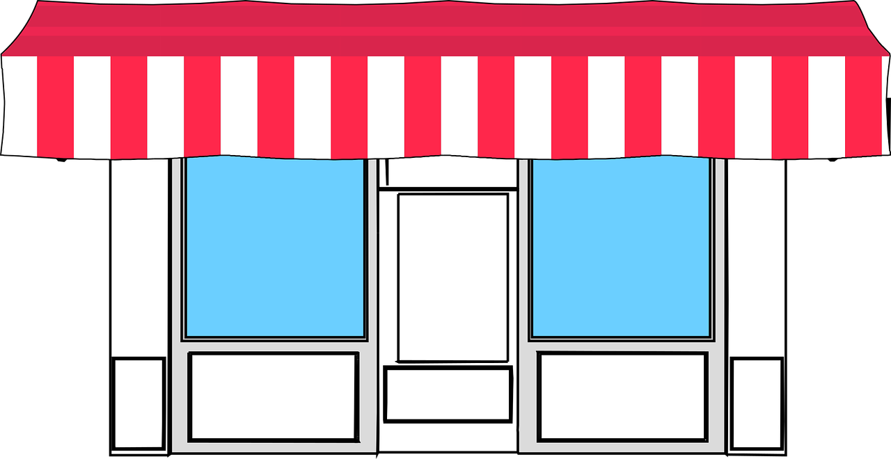
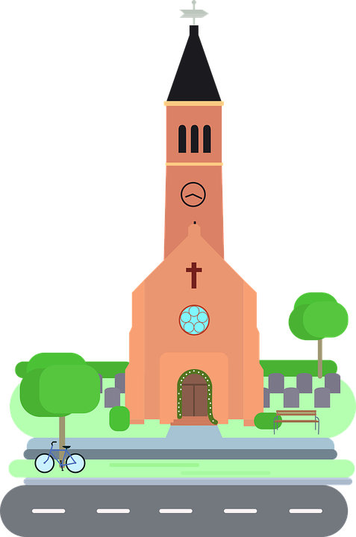
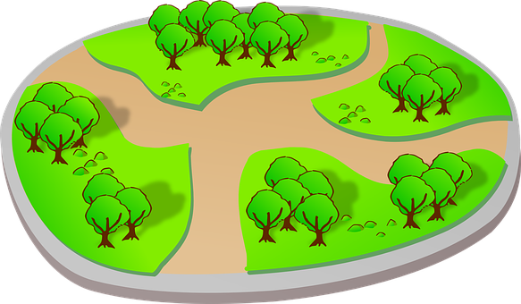
Follow up 2:
Écoute. C’est A ou B ? L’objet, c’est comment ?
A
B
?
modern
1
A
B
?
useful
2
A
B
?
different
3
A
B
?
important
4
A
B
?
green
5
A
B
?
dirty
6
Notes:
Timing: 5 minutes
Aim: to differentiate aurally between singular and plural nouns/adjectives, based on the indefinite article; to practise aural comprehension of several adjectives.
Procedure:
Click on the number to hear the audio.
Pupils select the correct picture, based on the singular or plural article, and then write the adjective.
Click to reveal the answers.
Differentiation: i. for greater challenge (without additional preparation) encourage pupils to turn away from the board and write the full English sentence meanings instead.
Transcript:
Il y a des rues modernes. Il y a des magasins utiles. Il y a un cinéma different. Il y a des églises importantes. Il y a un parc vert. Il y a un centre commercial sale.

Slide 5
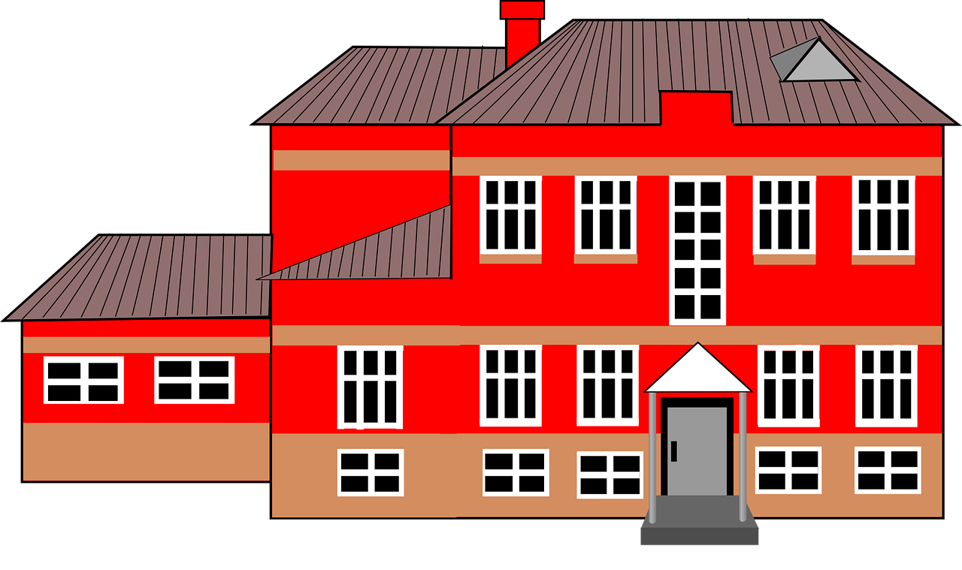
There are | These are
il y a
Remember! To say ‘there are’, use __________.
ce sont
To say ‘these are’, use __________.
⚠ This is the plural of c’est (it is).
Il y a des magasins sales.
Ce sont des magasins sales.
There are some dirty shops.
These are (some) dirty shops.
Il y a des écoles importantes.
Ce sont des écoles importantes.
There are important schools.
These are important schools.
⚠ In English we can miss out ‘some’ but we always need des in French.
⚠ In English, there are (il y a) and these are (ce sont) look and sound a bit similar.
Notes:
Use this slide as the preparation for Follow up 3.
Timing: 5 minutes (two slides)
Aim: to revisit the meaning of il y a and contrast it with ce sont. These are very similar in English (there are – these are).
Procedure:
Click through the animations to present the information.
Elicit English translations for the French examples provided.

Slide 6
Follow up 3: Parle en anglais.
Translate the sentences on sight.
lire
1
Il y a des postes utiles.
There are (some) useful post offices.
2
Ce sont des églises propres.
These are (some) clean churches.
3
Ce sont des cinémas importants.
These are (some) important cinemas.
4
Il y a des écoles modernes.
There are (some) modern schools.
5
Ce sont des magasins différents.
These are (some) different shops.
Notes:
Aim: to practise sight interpreting from French into English of sentences with il y a and ce sont.
Procedure:
Click to bring up the first French sentence.
Pupils translate it on sight chorally into English.
Click to bring up the English translation.
Repeat 1-3 with the remaining four sentences.
Differentiation / Alternative task: Pupils could practise aural interpreting instead. Click to hear the sentence (before clicking to bring up the writing version). On hearing it, pupils translate the sentence into English orally.

Slide 7
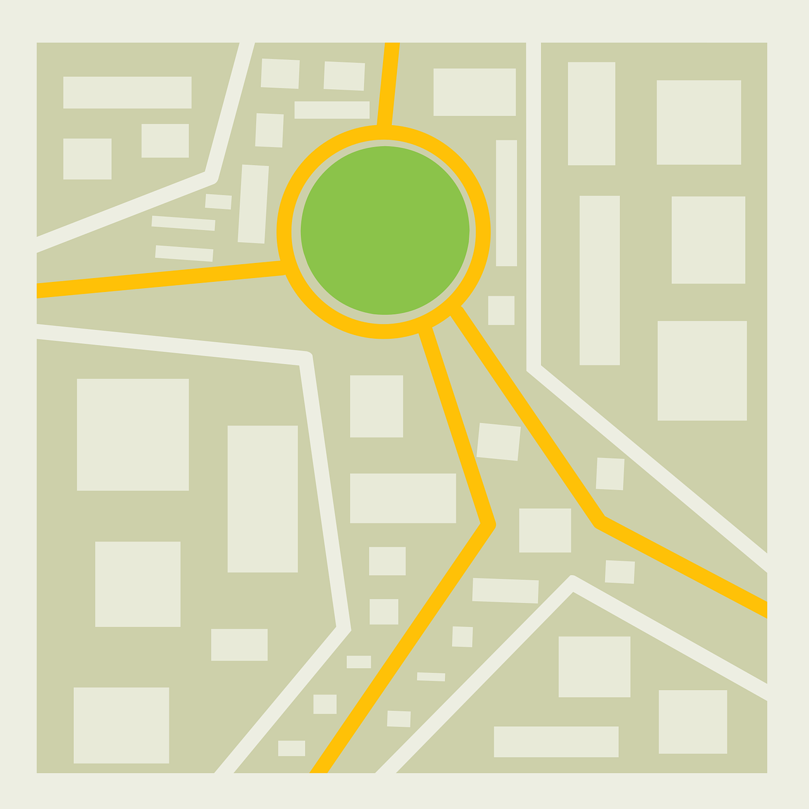
Follow up 4:
Écris les phrases en français.
Il y a un centre commercial important.
There is an important shopping centre.
écrire
There are some different bridges.
Il y a des ponts différents.
There is an ideal church.
Il y a une église idéale.
There is a useful post office.
Il y a une poste utile.
There are some clean shops.
Il y a des magasins propres.
There are some important streets.
Il y a des rues importantes.
Notes:
Timing: 10 minutes
Aim: to practise written productions of sentences using singular and plural indefinite articles, nouns and adjectives.
Procedure: 1. Pupils write the sentences in French. Note: they can do this on mini whiteboards or on their arms or in their books. 2. Click on each answer bubble to hear the phrase pronounced. Differentiation / Alternative tasks: i. for a lower level of challenge provide the first letter of every word. ii. for more scaffolding still, focus only on the articles, or on the articles and nouns (prompting with English), providing the rest of the sentence. iii. for a transcription task, blank the screen and listen to the audio first, transcribing the sentences. (Note: the animations can be altered using a disappear affect on the answers to reveal the English meanings underneath, if desired.)

Slide 8
vocabulaire
Follow up 5 - Écris en français : Can you get at least 15 points?
mots
 | also | and | but
 | serious (mpl) | hard-working (m) | ideal (m)
 | dangerous (mpl) | boring (mpl) | happy (m)
 | they (m, m/f) | they (f) | are
 | clean (mfpl) | some | dirty (m/f)
 | (the) bridge | (the) street | excellent (m)
 | _{(the)} shopping centre | (the) church | (the) shop
aussi
et
mais
x3
sérieux
travailleur
idéal
dangereux
ennuyeux
heureux
x2
ils
elles
sont
propres
des
sale
le pont
la rue
excellent
x1
le centre commercial
l’église
le magasin
Notes:
Timing: 5-10 minutes
Aim: to practise written production of vocabulary from this week and two revisited weeks.
Procedure: 1. Give pupils a blank grid. They fill in the French meanings of any of the words they know, trying to reach 15 points in total. 2. Remind pupils that adjectives can refer to male or female persons and they should note this in their translations. E.g. pleased (f), short (m).
Note: The most recently learnt and practised words are pink, words from revisit 1 are green and those from revisit 2 are blue, thus more points are awarded for them, to recognise that memories fade and more effort (heavy lifting!) is needed to retrieve them.
8

Slide 9
parler
Follow up 1
fou
dos
bout
nous
beau
trop
tôt
mou
houx
sous
chaud
faux
tout
nos
trou
ou
seau
peau
pot
mot
vaut
chou
Notes:
HANDOUT 1
9

Slide 10
vocabulaire
Follow up 5 - Écris en français : Can you get at least 15 points?
mots
 | also | and | but
 | serious (mpl) | hard-working (m) | ideal (m)
 | dangerous (mpl) | boring (mpl) | happy (m)
 | they (m, m/f) | they (f) | are
 | clean (mfpl) | some | dirty (m/f)
 | (the) bridge | (the) street | excellent (m)
 | _{(the)} shopping centre | (the) church | (the) shop
x3
x2
x1
Notes:
HANDOUT
10

