Slide 1
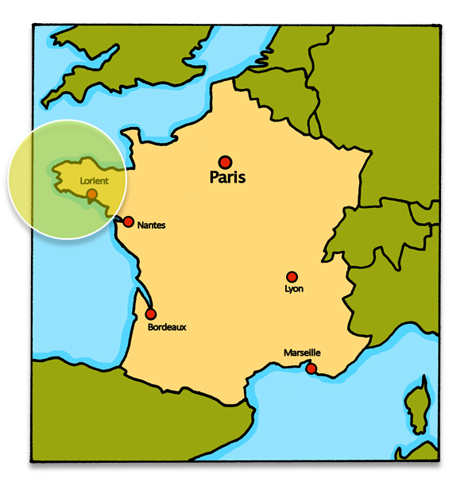
Describing me and others
vert
Follow ups 1-5
Notes:
Artwork by Steve Clarke. Pronoun pictures from NCELP (www.ncelp.org). All additional pictures selected from Pixabay and are available under a Creative Commons license, no attribution required.
Frequency of new vocabulary and phonics:
Phonics: [XXX] source word: Vocabulary: word X [frequency]
Londsale, D., & Le Bras, Y. (2009). A Frequency Dictionary of French: Core vocabulary for learners London: Routledge.
The frequency rankings for words that occur in this PowerPoint which have been previously introduced in these resources are given in the SOW and in the resources that first introduced and formally re-visited those words.
For any other words that occur incidentally in this PowerPoint, frequency rankings will be provided in the notes field wherever possible.

Slide 2
Follow up 1:
[SFe]
prononcer
monde
timide
douze
[shy]
centre
moderne
Notes:
Timing: 1 minute (+ 5 minutes for following 8 slides)
Aim: To introduce/consolidate SSC [SFe]
Procedure:
1. Practise the pronunciation of the individual SSC [SFe] and then the source word again ‘timide’ (with gesture, if using). 2. Then present and elicit the pronunciation of the four cluster words.
Frequency: monde [77] moderne [1239] centre [491] vie [132] douze [1664] timide [3835] Source: Londsale, D., & Le Bras, Y. (2009). A Frequency Dictionary of French: Core vocabulary for learners London: Routledge.

Slide 3
écouter
[Sfe]
Écoute. C’est avec ‘e’ ou sans ‘e’ ?
anglaise
1
?
Notes:
Timing: 5 minutes (8 slides)
Aim: to practise aural recognition of the presence of SFe contrasted with SFC (Silent Final Consonant) when there is no ‘e’.
Procedure:
Click to listen to the word.
Pupils respond ‘avec ‘e’’ if they decide there is a SFe and ‘sans ‘e’’ if they decided there is no ‘e’.
Click to remove the rectangle to see the presence or absence of ‘e’.
Click again to bring up the corresponding image, and elicit the French phrase from pupils – i.e., une école française.
If needed, click on the picture to hear the full phrase.
Repeat steps 1-4 for the next 7 slides.
Transcript:
anglaise une école anglaise
3

Slide 4
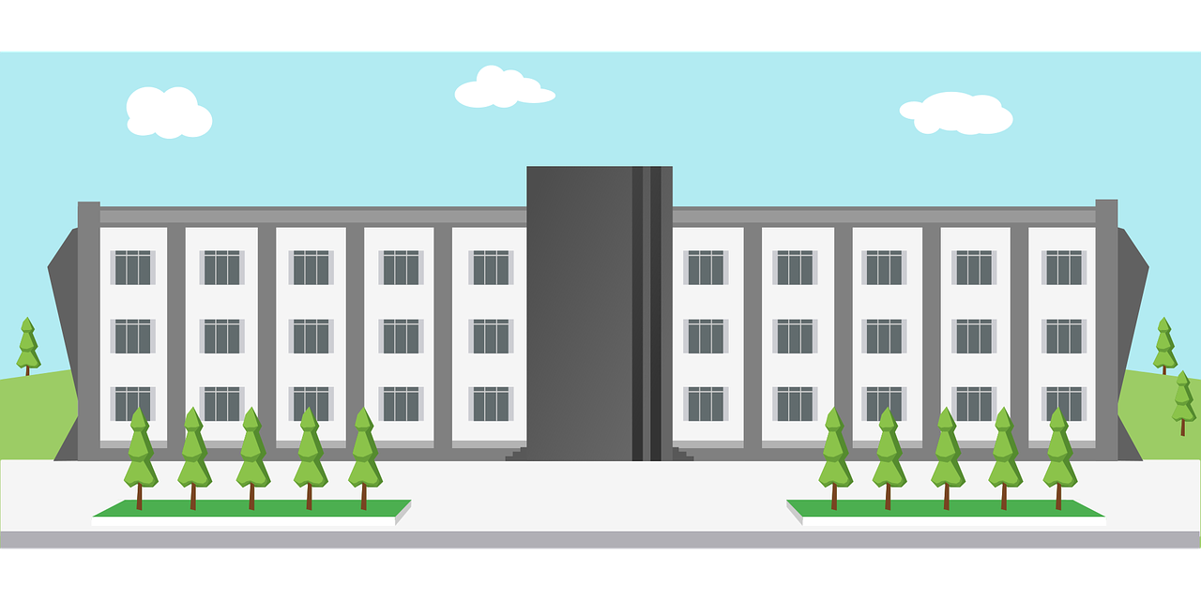
écouter
[Sfe]
Écoute. C’est avec ‘e’ ou sans ‘e’ ?
parfaite
2
?
Notes:
[2/8]
Transcript:
parfaite
une université parfaite
4

Slide 5
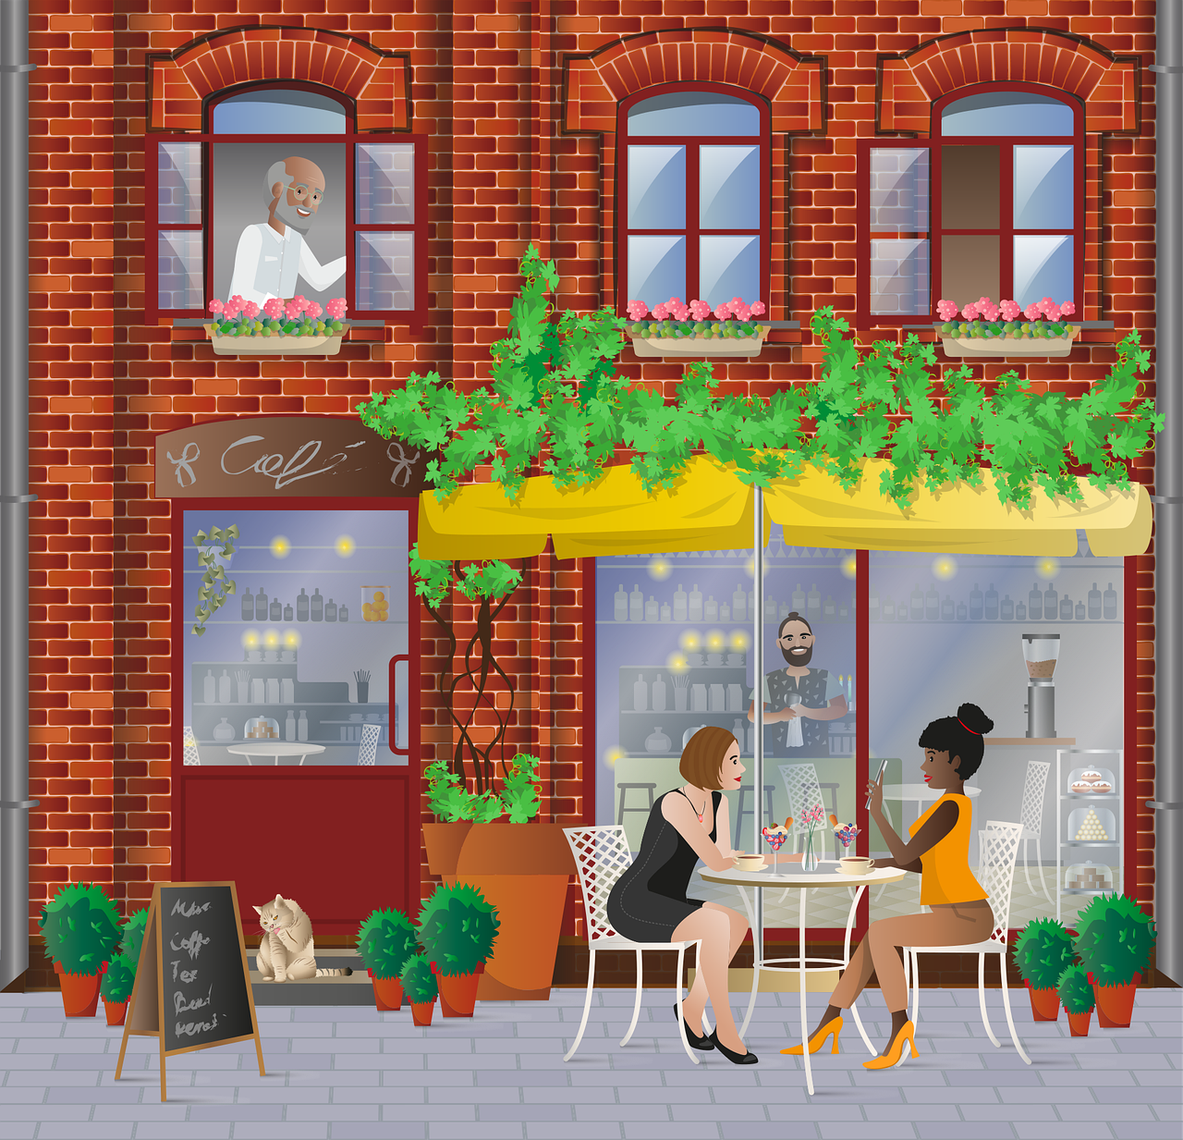
écouter
[Sfe]
Écoute. C’est avec ‘e’ ou sans ‘e’ ?
intéressant
3
?
Notes:
[3/8]
Transcript:
intéressant
un café intéressant
5

Slide 6
écouter
[Sfe]
Écoute. C’est avec ‘e’ ou sans ‘e’ ?
gris
4
?
Notes:
[4/8]
Transcript:
gris un musée gris
6

Slide 7
écouter
[Sfe]
Écoute. C’est avec ‘e’ ou sans ‘e’ ?
différent
5
?
Notes:
[5/8]
Transcript:
différent
un cinéma différent
7

Slide 8
écouter
[Sfe]
Écoute. C’est avec ‘e’ ou sans ‘e’ ?
importante
6
?
Notes:
[6/8]
Transcript:
importante une poste importante
8

Slide 9
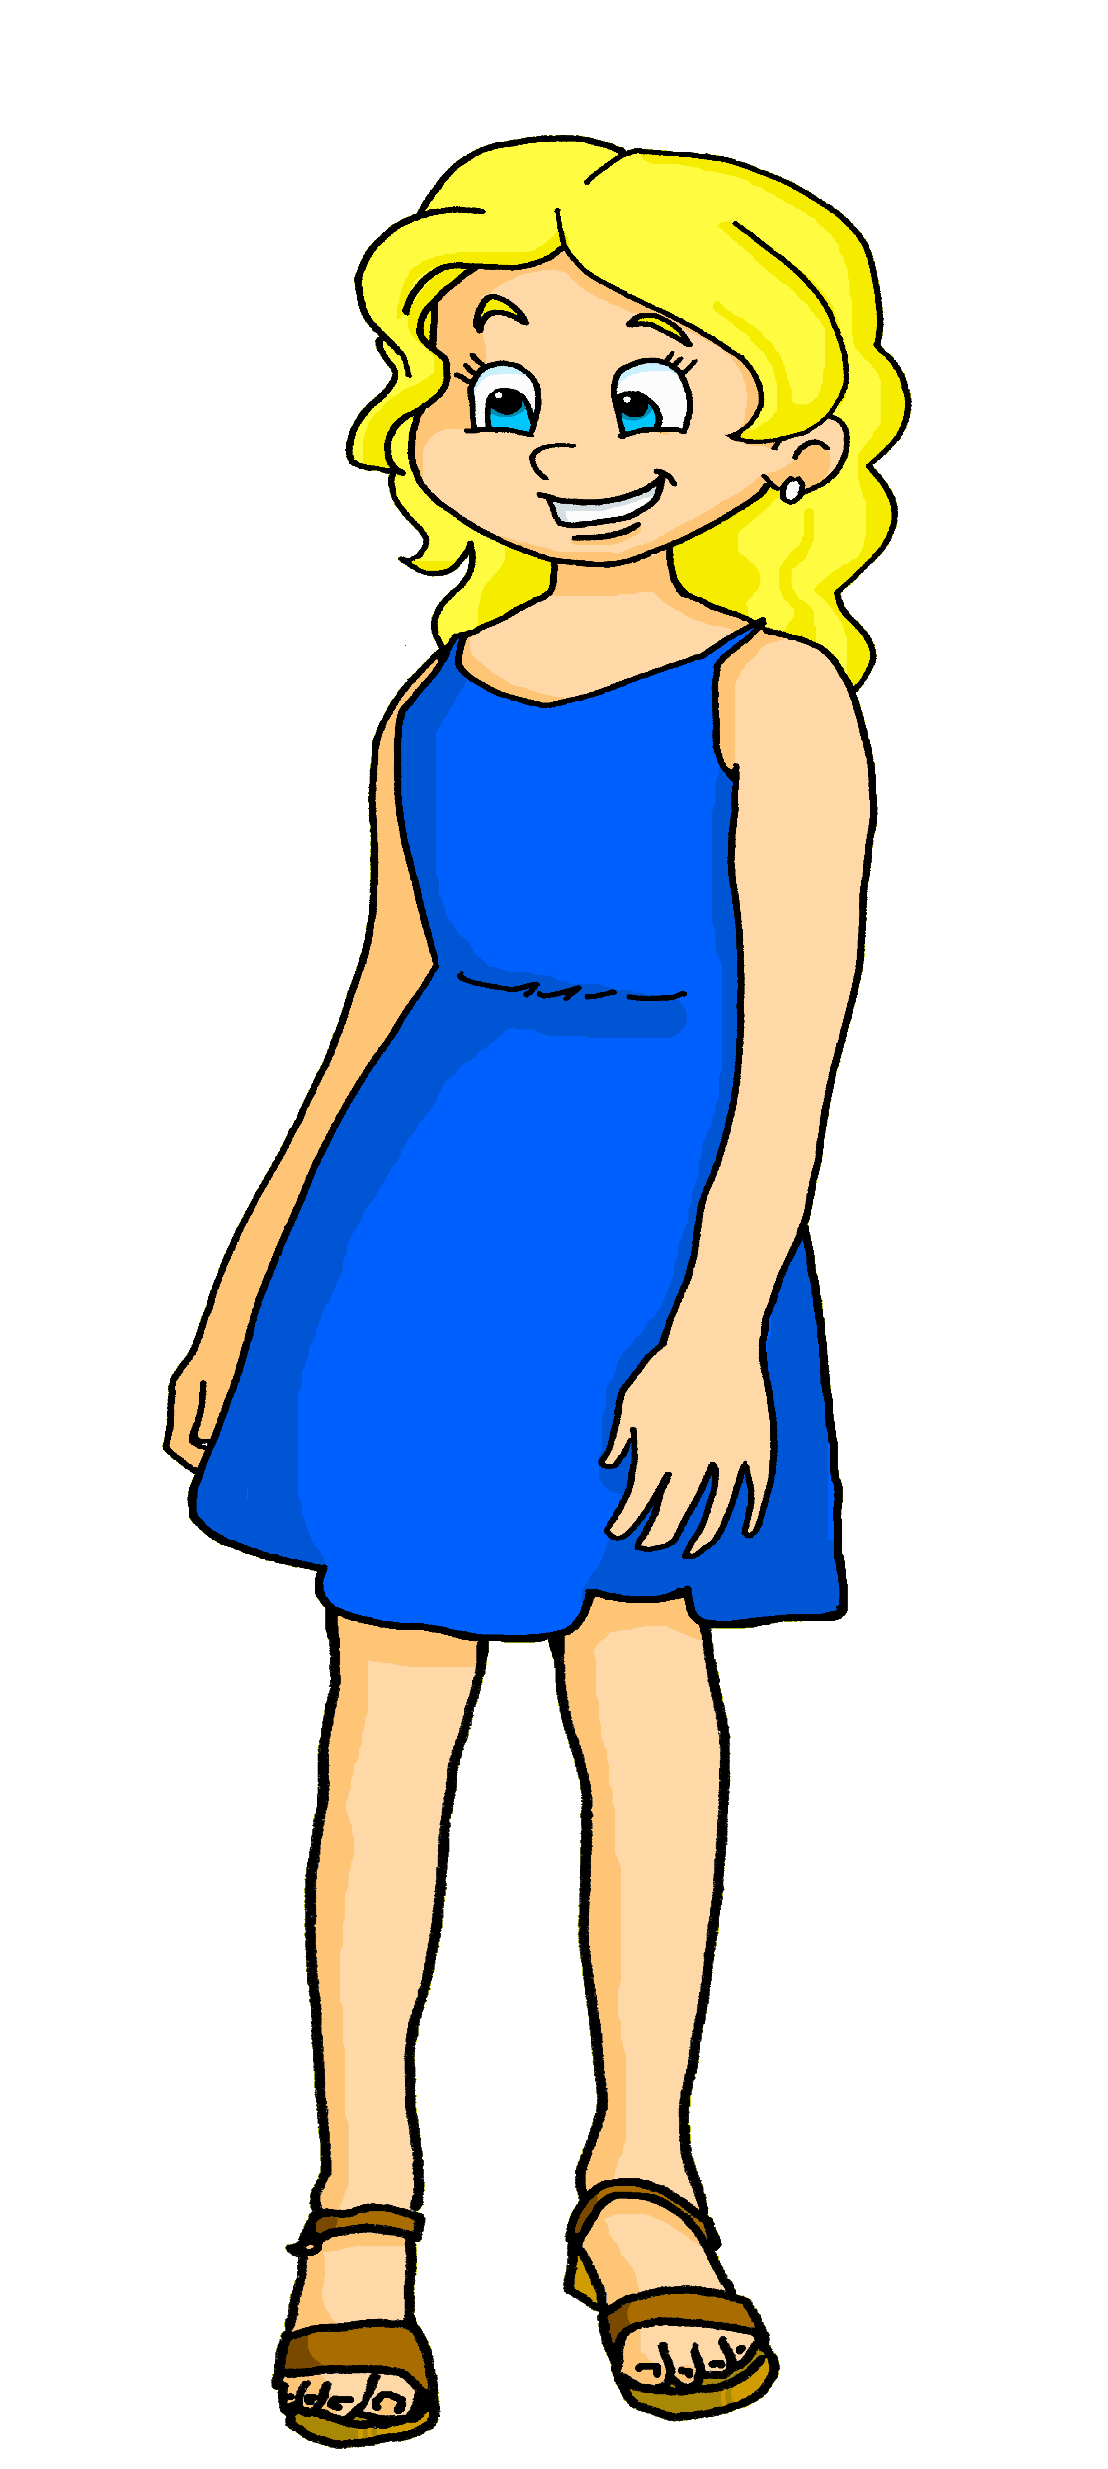
écouter
[Sfe]
Écoute. C’est avec ‘e’ ou sans ‘e’ ?
française
7
?
Notes:
[7/8]
Transcript:
française
une amie française
9

Slide 10
écouter
[Sfe]
Écoute. C’est avec ‘e’ ou sans ‘e’ ?
indépendant
8
?
Notes:
[8/8]
Transcript:
indépendant
un garçon indépendant
10

Slide 11
Follow up 2a
Listen carefully, then practise saying these words:
écouter
1
tu as [you have]
2
tu es [you are]
3
Il a [he has]
4
il est [he is]
5
elle a [she has]
6
elle est [she is]
Notes:
Timing: 1 minute (as preparation for the listening task that follows)
Aim: to differentiate between the [a] or [ê/è] sounds
Procedure:
Click on the numbers to hear the native speaker, then pupils repeat.
Transcript:
Tu as
Tu es
Il a
Il est
Elle a
Elle est

Slide 12
Follow up 2b
Écoute. C’est a(s) ou es(t) ?
C’est quoi ?
.
écouter
lire
Il | est | a
Tu | es | as
Tu | as | es
Elle | est | a
Elle | a | est
Il | est |a
1
1
indépendant. | un café indépendant.
2
un musée intéressant. | intéressant.
2
3
propre. | un hôtel propre.
3
4
importante. | un cinéma important.
4
5
un parc sale. | sale.
5
6
utile. | une poste utile.
6
Notes:
Timing: 5 minutes
Aim: to practise aural recognition of a(s) and es(t) and to connect these with meaning in a written comprehension.
Procedure:
1. Click each number to listen. The end of the sentence is beeped out to focus all attention initially on the difference between a(s) and es(t) sounds. 2. Pupils select (a)s or es(t) verb forms.
3. Click to reveal the verb answers. 4. Pupils then decide how the sentence ends, based on the meaning of the verb (have/has or are/is).
5. Click to reveal answers and check understanding of the whole sentences by eliciting English meanings. 6. If desired, click to bring up a 2nd set of audio buttons (green, over the top of the 1st set) to hear the full sentences.
Transcript:
1. Il est [indépendant]. 2. Tu es [intéressant]. 3. Tu as [un hôtel propre].
4. Elle est [importante]. 5. Elle a [un parc sale].
6. Il a [une poste utile].
Transcript 2:
1. Il est indépendant. 2. Tu es intéressant. 3. Tu as un hôtel propre.
4. Elle est importante. 5. Elle a un parc sale.
6. Il a une poste utile.

Slide 13
Follow up 3
Chouchou mange la lettre de Sanaya !
Comment dit-on ‘useful’ ?
Comment dit-on ‘you have’ ?
Comment dit-on ‘clean’ ?
Comment dit-on ‘school’ ?
Miam, miam !
. Écoute les noms des animaux. C’est [ien] ou [(a)in]?
Lis. C’est Sanaya ? Adèle ? ou toutes les deux ?
lire
Complète le diagramme de Venn en anglais.
as un professeur différent.
ai un chien idéal.
.
ai un café utile.
as un hôtel propre.
les deux
ai une école moderne.
useful café
Adèle
Sanaya
different teacher
ideal dog
as un cinéma moderne.
modern school
clean hotel
as und chien idéal.
interesting teacher
modern cinema
ai un professeur intéressant.
Notes:
Timing: 5 minutes
Aim: To practise written understanding of ‘ai’ and ‘as’ and nouns and adjectives from this week.
Procedure:
Read the task title in French & click to bring further instruction.
Click x1 to bring Venn diagram and instruction, then draw pupils attention to the sentences. Was Sanaya writing about herself or Adèle? Are there any things they both have? (I have +you have).
3. Ask pupils to draw the diagram (or a table) and write down the English for the French words in the correct part of the diagram.
4. Go through answers together, answers are animated in groups (first Sanaya, then Adèle, and lastly ‘les deux’).
Part 2
Click to bring up the question to prompt for French for the new vocabulary this lesson. Elicit French from pupils.

Slide 14
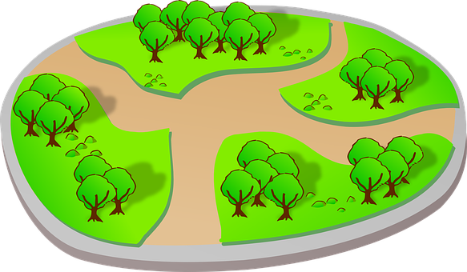
Follow up 4:
Parle avec ton / ta partenaire.
Écoute. C’est a (has) ou est (is) ?
Numéro 1 a un parc.
parler
A
1. Number 1 has a park.
B
1
Notes:
Timing: 5 minutes
Aim: to practise spoken production of sentences to describe a picture using the correct verb ‘a’ or ‘est’ plus correct noun.
Procedure: 1. Model the task using this slide, clicking through the animations.
2. Move onto the next slide for part 1 of the task.
Note: It’s important for pupils to know that they are differentiating between Item number 1 IS XXX, and Person number 1 HAS XXX. The ‘hinge’ is ‘est’ or ‘a’ for each item.
Procedure:
1. Give out the handout to partner Bs and ask them to turn away from the board.
2. Click to reveal English prompts. Partner As need to say the correct sentence in French. 3. Pupil B decides if his/her picture matches the description, and puts a tick or cross. 4. Then s/he turns back to the board to check. 5. Swap roles and move on to the next slide.

Slide 15
Handout
Round 1
B
1
2
3
4
5
1
parler
A
1. Numéro un a un cinéma.
1. Numéro un has a cinema.
2
2. Numéro deux est une université.
2. Numéro deux is a university.
3
3. Numéro trois est un musée.
3. Numéro trois is a museum.
4. Numéro quatre has a hotel.
4. Numéro quatre a un hôtel.
4
5. Numéro cinq has a post office.
5. Numéro cinq a une poste.
5
Notes:
ANSWERS Round 1
15

Slide 16
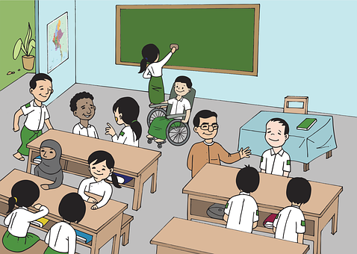
Handout
Round 2
1
2
3
4
5
A
1
parler
B
1. Numéro un a un café.
1. Numéro un has a café.
2
2. Numéro un is a post office.
2. Numéro deux est une poste.
3
3. Numéro un is a hotel.
3. Numéro trois est un hôtel.
4. Numéro quatre a un musée.
4. Numéro un has a museum.
4
5. Numéro cinq a une école.
5. Numéro un has a school.
5
Notes:
ANSWERS Round 2
16

Slide 17
vocabulaire
Follow up 5 - Écris en français : Can you get at least 15 points?
mots
 | (the) school | ideal (f) | clean (m/f)
 | dirty (m/f) | independent (m) | for
 | very | to have, having | useful
 | I have | (the) café | (the) hotel
 | she has | (the) cinema | (the) post office
l’école
idéale
propre
x2
sale
indépendant
pour
très
avoir
utile
j’ai
le café
l’hôtel
x1
elle a
le cinéma
la poste
Notes:
Timing: 5-10 minutes
Aim: to practise written production of vocabulary from this week and two revisited weeks.
Procedure: 1. Give pupils a blank grid. They fill in the French meanings of any of the words they know, trying to reach 15 points in total. 2. Remind pupils that adjectives can refer to male or female persons and they should note this in their translations. E.g. pleased (f), short (m).
Note: The most recently learnt and practised words are pink, words from revisit 1 are green and those from revisit 2 are blue, thus more points are awarded for them, to recognise that memories fade and more effort (heavy lifting!) is needed to retrieve them.
17

Slide 18
Handout
A
Round 2
AB
1
2
3
4
5
parler
1
Round 1
1. Numéro un has a cinema.
2
2. Numéro deux is a university.
3
3. Numéro trois is a museum.
4. Numéro quatre has a hotel.
4
5. Numéro cinq has a post office.
5
Notes:
HANDOUT A
18

Slide 19
Handout
B
Round 1
B
1
2
3
4
5
1
parler
Round 2
2
1. Numéro un has a café.
2. Numéro un is a post office.
3
3. Numéro un is a hotel.
4. Numéro un has a museum.
4
5. Numéro un has a school.
Notes:
HANDOUT B
19

Slide 20
vocabulaire
Follow up 5 - Écris en français : Can you get at least 15 points?
mots
 | (the) school | ideal (f) | clean (m/f)
 | dirty (m/f) | independent (m) | for
 | very | to have, having | useful
 | I have | (the) café | (the) hotel
 | she has | (the) cinema | (the) post office
x2
x1
Notes:
HANDOUT
20

