Slide 1
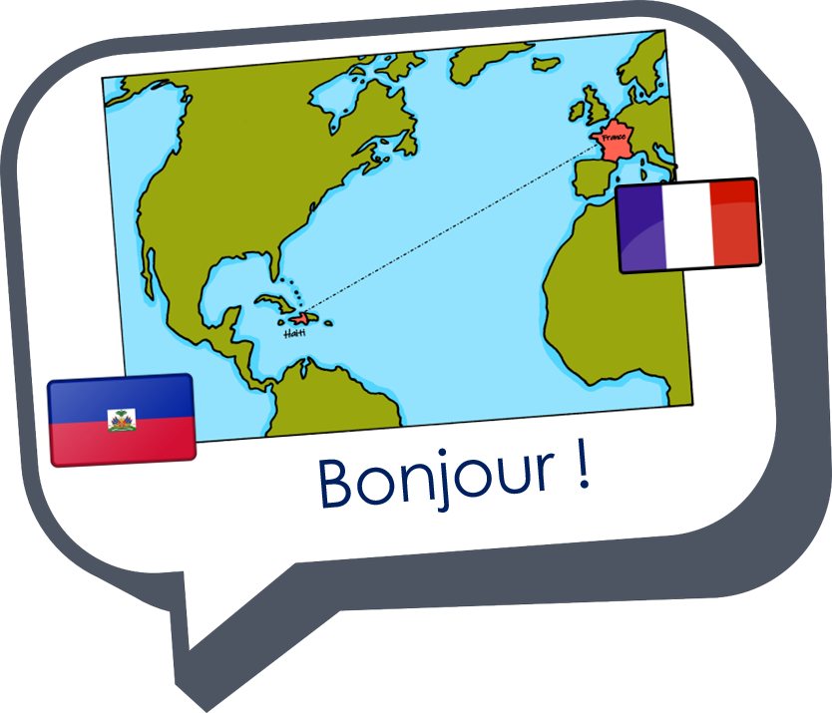
Interactions
Échange en ligne
vert
Follow ups 1-5
Notes:
Artwork by Steve Clarke. Pronoun pictures from NCELP (www.ncelp.org). All additional pictures selected from Pixabay and are available under a Creative Commons license, no attribution required.
Phonics: revisit closed [eu(t,x,s)] un peu [91] vs open [eu(r,l,f,ne,ve)] peur [755] fleur [2305] jeune [152] neuf [787] acteur [1552] seul [102]
Vocabulary: activité [452] chaise [3419] chanson [2142] garçon [1599] fille [629] jeu [291] langue [712] règle2 [488] spectacle [1687]
Revisit 1: sommes [5] nous [31] quel, quelle [146] date [660] jour [78] semaine [245] saison [1667] lundi [1091], mardi [1044] mercredi [1168] jeudi [1112] vendredi [1086] samedi [1356] dimanche [1235] aujourd’hui [233]
Revisit 2: -
Londsale, D., & Le Bras, Y. (2009). A Frequency Dictionary of French: Core vocabulary for learners London: Routledge.
The frequency rankings for words that occur in this PowerPoint which have been previously introduced in these resources are given in the SOW and in the resources that first introduced and formally re-visited those words.
For any other words that occur incidentally in this PowerPoint, frequency rankings will be provided in the notes field wherever possible.

Slide 2
Follow up 1:
prononcer
Mathieu le merveilleux
Mathieu a deux yeux bleus Il n’a plus de cheveux Mais il est merveilleux Mathieu est courageux Il n’est pas malheureux Mais il est très curieux Mathieu joue à un jeu Avec son vieux neveu Le jeudi quand il pleut Et au millieu d’un feu Tous deux font cuire des œufs Puis ça va beaucoup mieux
Marie-Odile Guillou
Notes:
Link to video: https://www.youtube.com/watch?v=03F-BxFi3y0
Timing: 5 minutes
Aim: to practise aural recognition and production of closed [eu]
Procedure:
1. Blank the screen and play the audio for the poem without showing the words. 2. Pupils respond with a gesture (could be hands up and immediately down) each time they hear the SSC closed [eu]. 3. Click to bring up the poem text.
5. Pupils then practise reading the poem aloud.
6. Play the video and pupils read along to practise producing the words in time with the audio.
Note that whilst a fair few words are unknown, several of these will be taught in subsequent weeks (cheveu, il pleut, vieux)
Frequency of unknown words and cognates (1 is the most frequent word in French): merveilleux [2209] malheureux [2372] vieux [671] neveu [>5000] il pleut [n/a] millieu [479] feu [786] cuire [4963] mieux [217]
Source: Londsale, D., & Le Bras, Y. (2009). A Frequency Dictionary of French: Core vocabulary for learners London: Routledge.
Rough translation: Mathieu has two blue eyes He has no hair (he no longer has hair) But he is wonderful Mathieu is brave He is not unhappy But he is very curious Mathieu plays a game With his old nephew On Thursdays when it rains And in the middle of a fire Both of them cook eggs Then it gets much better

Slide 3
Follow up 2:
. Écoute les noms des animaux. C’est [ien] ou [(a)in]?
Écoute. Trouve la phrase correspondante.
écouter
1
C
A
Jean-Michel et sa sœur
2
B
B
jeudi et vendredi
3
F
C
Cirque du soleil
4
D
D
Monopoly
5
E
E
l’allemand et l’espagnol
F
le tennis et le foot
6
A
Notes:
Timing: 5 minutes
Aim: to practise aural comprehension of vocabulary that we are revisiting this week.
Procedure:
1. Click each number to listen. 2. Pupils write down the letter of the sentence whose meaning matches the aural clue.
3. Click to reveal the answers.
Transcript:
1. C’est un spectacle.
2. Ce sont des jours de la semaine. 3. Ce sont des sports.
4. C’est un jeu.
5 Ce sont des langues.
6. C’est un garçon et une fille.

Slide 4
Follow up 3: Parle en français.
I like sports. They are important.
parler
1
J’aime les sports. Ils sont importants.
I hate Thursdays. They are boring.
2
Je déteste les jeudis. Ils sont ennuyeux.
I like shows. They are creative.
3
J’aime les spectacles. Ils sont créatifs.
I like languages. They are interesting.
4
J’aime les langues. Elles sont intéressantes.
I like games. They are fun.
5
J’aime les jeux. Ils sont amusants.
I hate rules but they are important.
6
Je déteste les règles mais elles sont importantes.
Notes:
Less challenging version with full sentence prompts in English.
Timing: 5 minutes
Aim: to practise structured production of sentences using 3rd person plural subject pronouns; to describe a picture in sentences.
Procedure:
Click to reveal the first English sentences.
Pupils say the French out loud.
Click to reveal the French answer.
Continue with items 2-6.
Transcript: J’aime les sports. Ils sont importants. Je déteste les jeudis. Ils sont ennuyeux. J’aime les spectacles. Ils sont créatifs. J’aime les langues. Elles sont intéressantes. J’aime les jeux. Ils sont amusants. Je déteste les règles mais elles sont importantes.

Slide 5
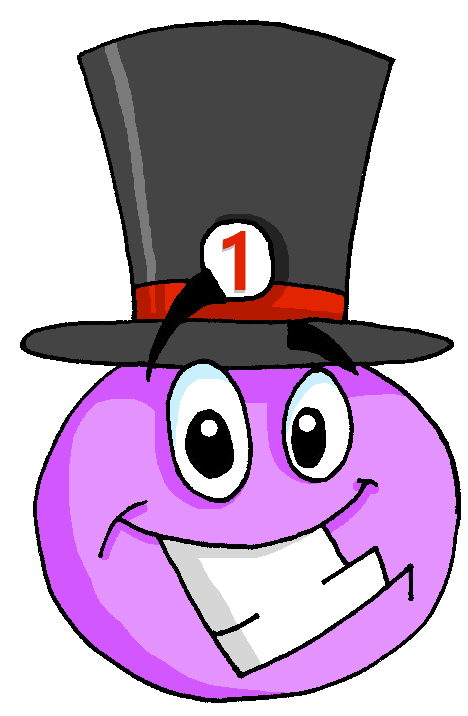
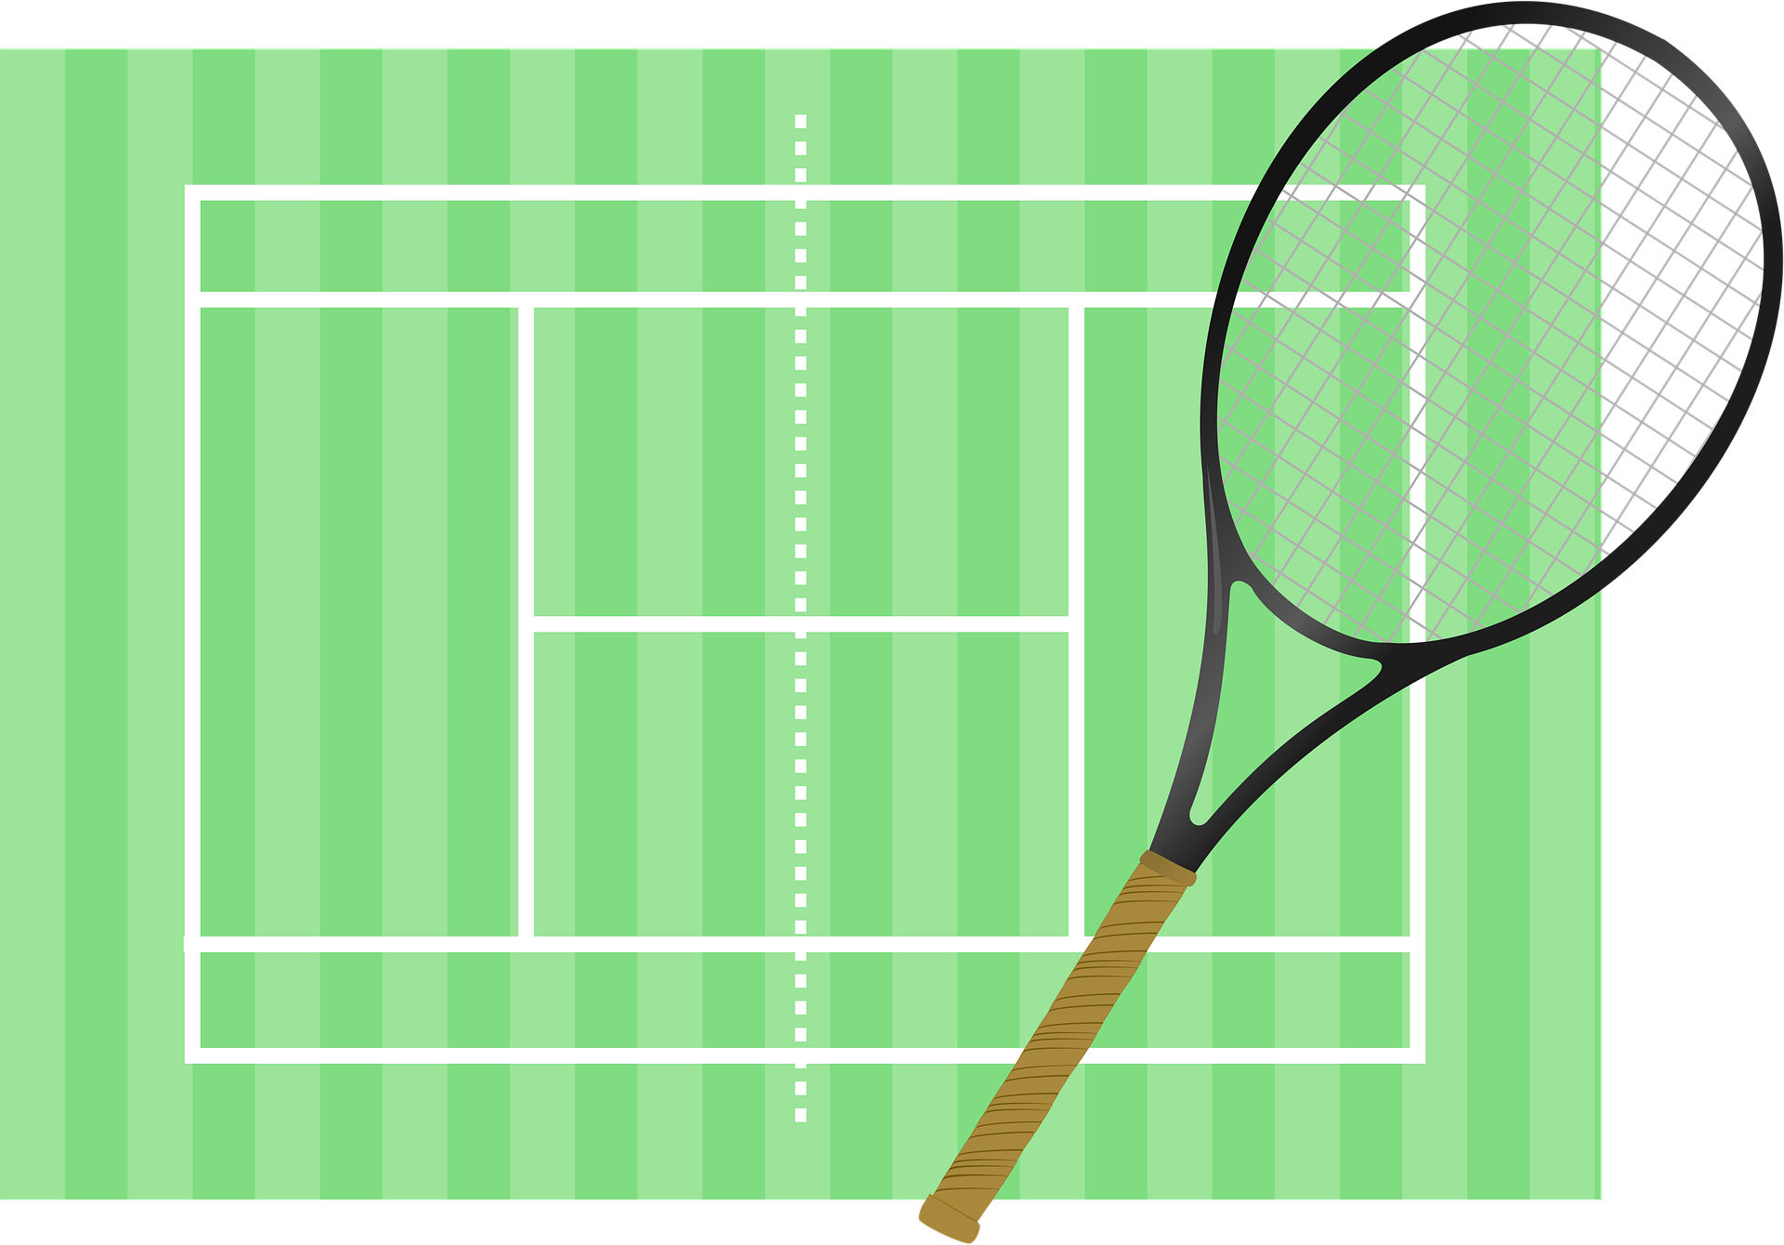
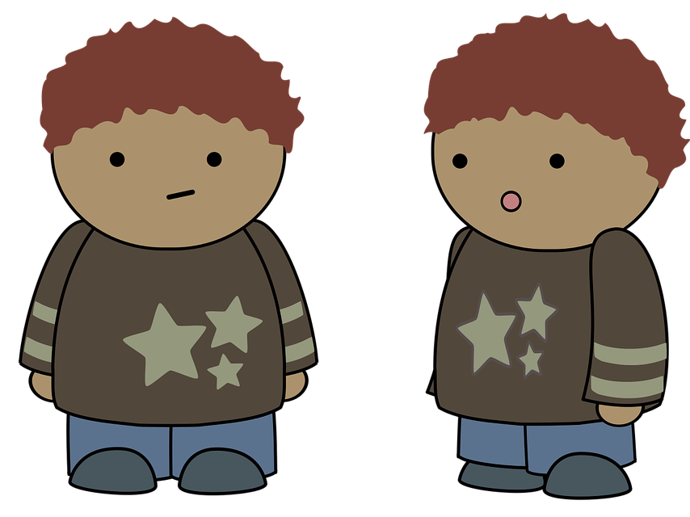
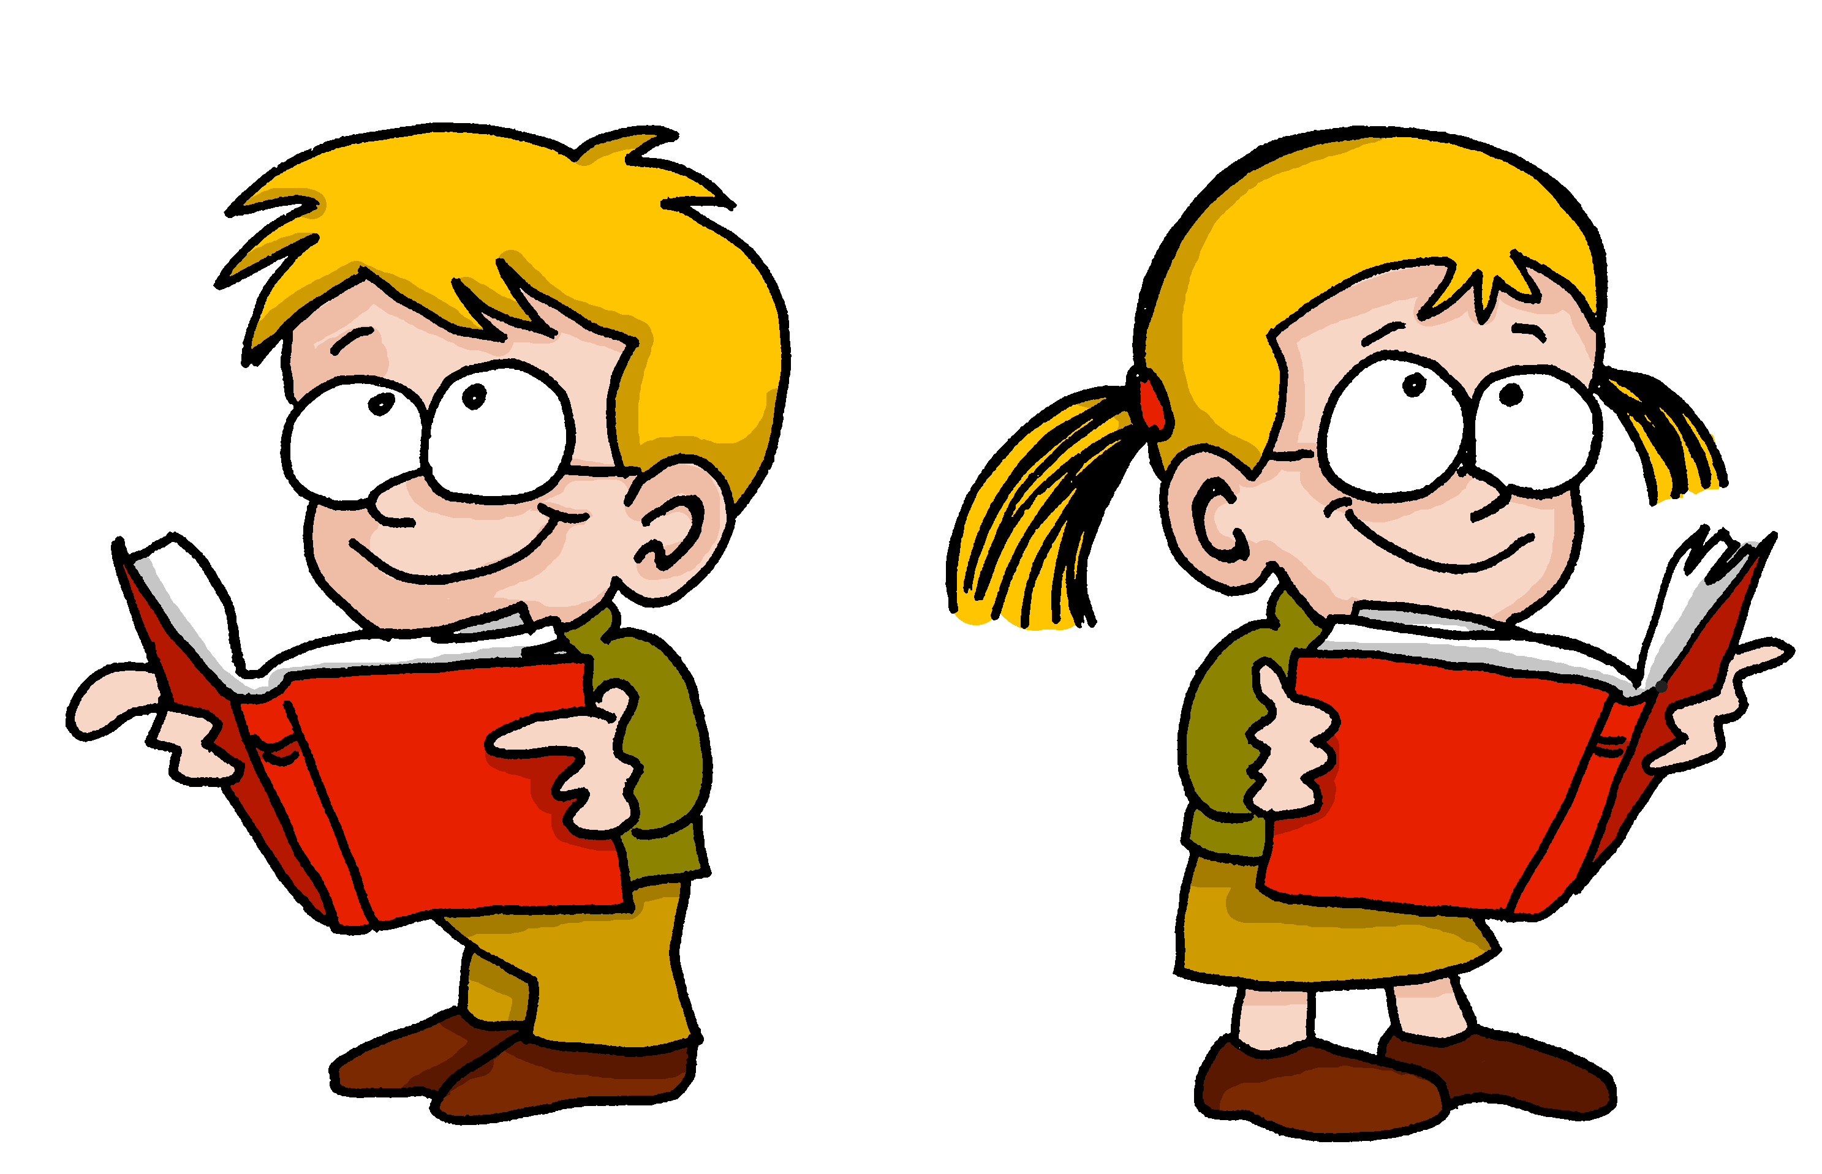
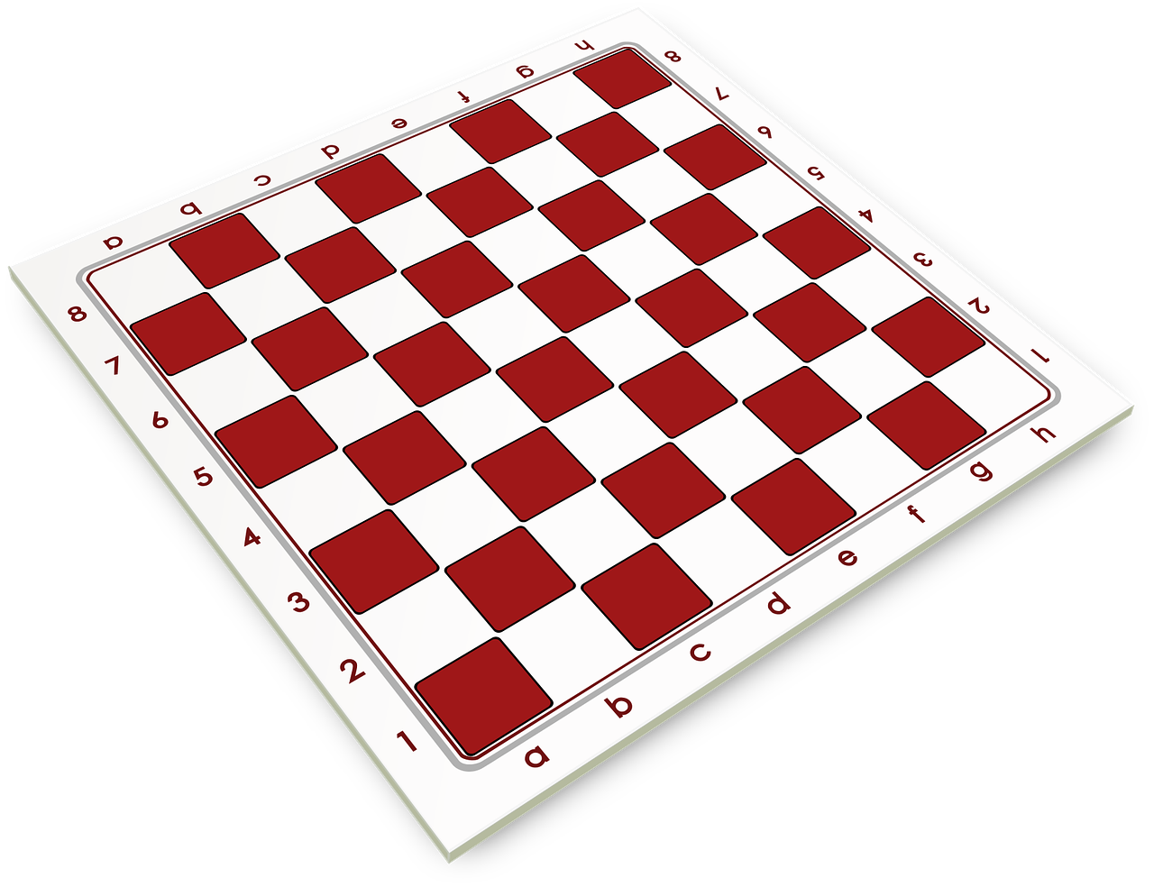
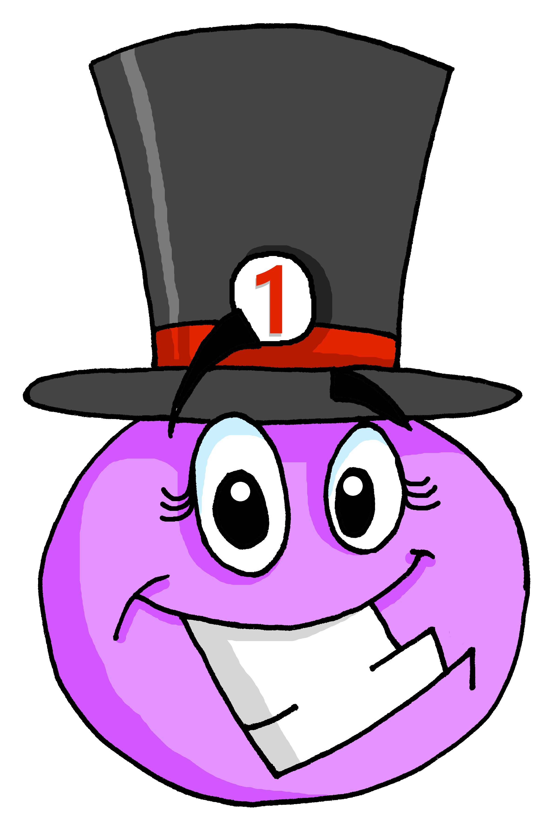
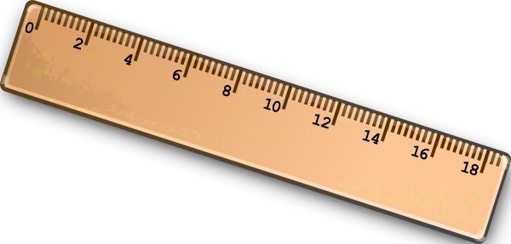
Follow up 3: Parle en français.
parler
1
J’aime les sports. Ils sont importants.
2
Thu
Je déteste les jeudis. Ils sont ennuyeux.
3
J’aime les spectacles. Ils sont créatifs.
4
J’aime les langues. Elles sont intéressantes.
5
J’aime les jeux. Ils sont amusants.
6
Je déteste les règles mais elles sont importantes.
Notes:
More challenging version with picture prompts. Timing: 5 minutes
Aim: to practise structured production of sentences using 3rd person plural subject pronouns; to describe a picture in sentences.
Procedure:
Click to reveal the first English sentences.
Pupils say the French out loud.
Click to reveal the French answer.
Continue with items 2-6.
Transcript: J’aime les sports. Ils sont importants. Je déteste les jeudis. Ils sont ennuyeux. J’aime les spectacles. Ils sont créatifs. J’aime les langues. Elles sont intéressantes. J’aime les jeux. Ils sont amusants. Je déteste les règles mais elles sont importantes.

Slide 6
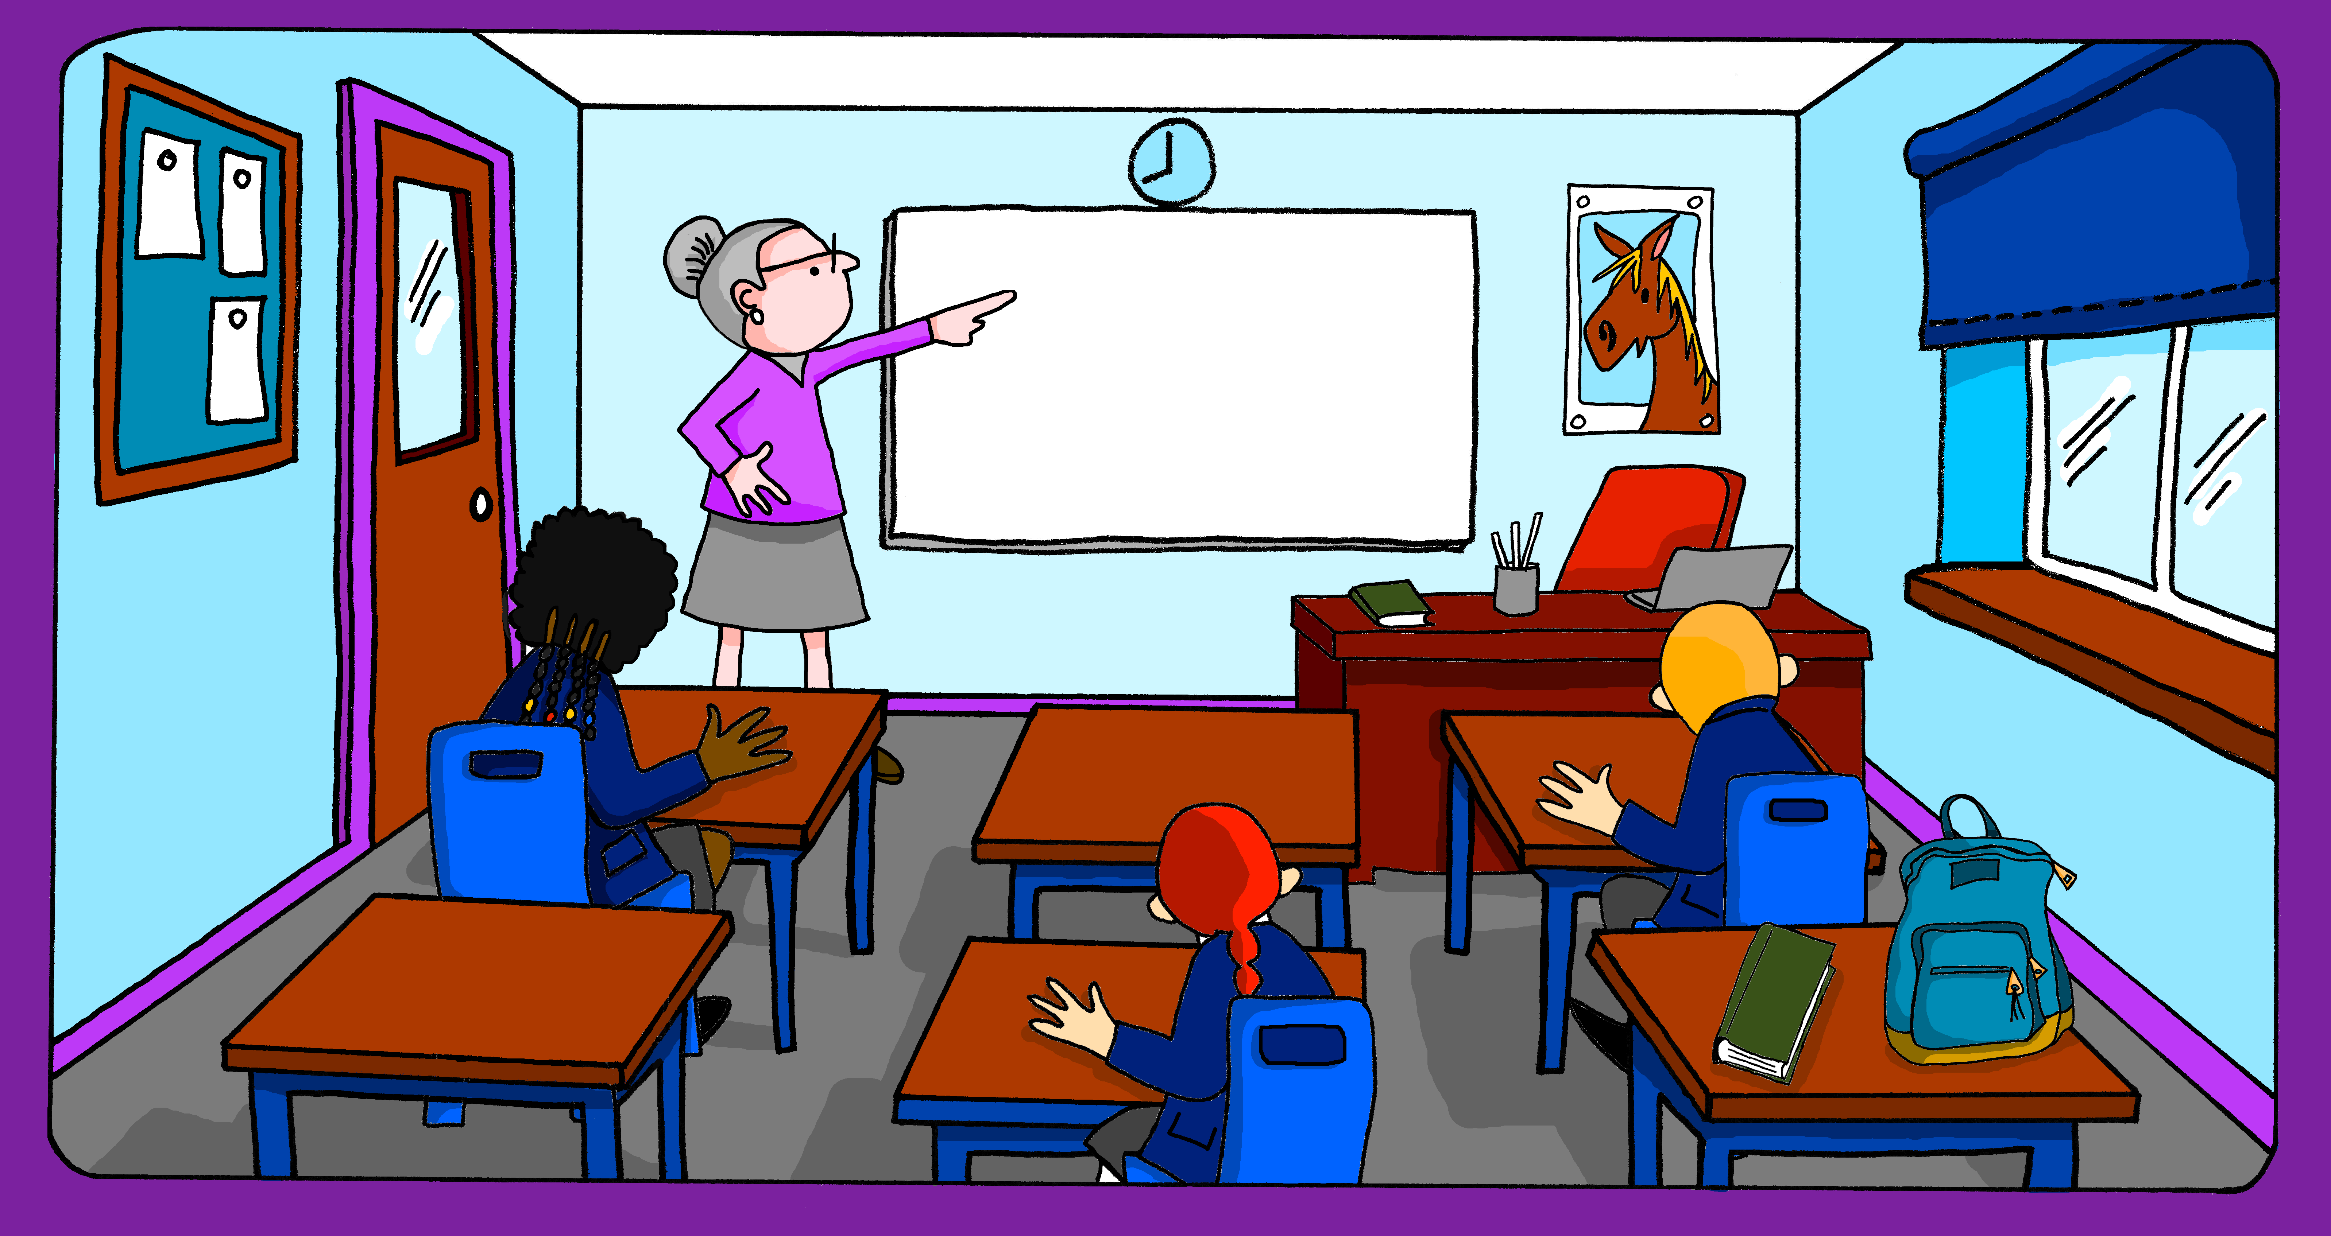
Follow up 4:
Décris ton école. Écris des phrases en français.
écrire
les spectacles
créatif
les langues
parfait
important
positif
les sports
les activités
sérieux
intéressant
les règles
les jeux
difficile
les garçons
ennuyeux
négatif
les profs
facile
les chansons
amusant
Notes:
Timing: 5-10 minutes
Aim: to practise written production of sentences in a more open-ended task.
Procedure: 1. Pupils write three sentences of their choice to describe things at their school.
2. Teacher circulates to support pupils, as needed.

Slide 7
vocabulaire
Follow up 5 - Écris en anglais : Can you get at least 15 points?
mots
 | le vendredi | le jeudi | le dimanche
 | le mardi | aujourd’hui | le samedi
 | quel ? | nous sommes | quelle ?
 | la semaine | la saison | le jour
 | la règle | le jeu | la fille
 | la langue | la chanson | l’activité
 | le garçon | le spectacle | la chaise
(the) Friday
(the) Thursday
(the) Sunday
x3
(the) Tuesday
today
(the) Saturday
which? (m)
we are
which? (f)
x2
(the) week
(the) season
(the) day
(the) rule
(the) game
(the) girl
(the) language
(the) song
(the) activity
x1
(the) boy
(the) show
(the) chair
Notes:
Timing: 5 minutes
Aim: to practise written comprehension of vocabulary from this week and two revisited weeks.
Procedure: 1. Give pupils a blank grid. They fill in the English meanings of any of the words they know, trying to reach 15 points in total. 2. Remind pupils that adjectives can refer to male or female persons and they should note this in their translations. E.g. pleased (f), short (m).
Note: The most recently learnt and practised words are pink, words from revisit 1 are green and those from revisit 2 are blue, thus more points are awarded for them, to recognise that memories fade and more effort (heavy lifting!) is needed to retrieve them.
7

Slide 8
vocabulaire
Follow up 5 - Écris en français : Can you get at least 15 points?
mots
 | (the) Tuesday | (the) Thursday | (the) Saturday
 | today | (the) Friday | (the) Sunday
 | (the) week | (the) season | (the) day
 | we are | which? (m) | which? (f)
 | (the) language | (the) rule, ruler | (the) show
 | (the) boy | (the) girl | (the) game
 | (the) activity | (the) chair | (the) song
le mardi
le jeudi
le samedi
x3
aujourd’hui
le vendredi
le dimanche
la semaine
la saison
le jour
x2
nous sommes
quel ?
quelle ?
la langue
la règle
le spectacle
le garçon
la fille
le jeu
x1
l’activité
la chaise
la chanson
Notes:
Timing: 5 minutes
Aim: to practise written comprehension of vocabulary from this week and two revisited weeks.
Procedure: 1. Give pupils a blank grid. They fill in the English meanings of any of the words they know, trying to reach 15 points in total. 2. Remind pupils that adjectives can refer to male or female persons and they should note this in their translations. E.g. pleased (f), short (m).
Note: The most recently learnt and practised words are pink, words from revisit 1 are green and those from revisit 2 are blue, thus more points are awarded for them, to recognise that memories fade and more effort (heavy lifting!) is needed to retrieve them.
8

Slide 9
vocabulaire
Follow up 5 - Écris en anglais : Can you get at least 15 points?
mots
 | le vendredi | le jeudi | le dimanche
 | le mardi | aujourd’hui | le samedi
 | quel ? | nous sommes | quelle ?
 | la semaine | la saison | le jour
 | la règle | le jeu | la fille
 | la langue | la chanson | l’activité
 | le garçon | le spectacle | la chaise
x3
x2
x1
Notes:
HANDOUT
9

Slide 10
vocabulaire
Follow up 5 - Écris en français : Can you get at least 15 points?
mots
 | (the) Tuesday | (the) Thursday | (the) Saturday
 | today | (the) Friday | (the) Sunday
 | (the) week | (the) season | (the) day
 | we are | which? (m) | which? (f)
 | (the) language | (the) rule, ruler | (the) show
 | (the) boy | (the) girl | (the) game
 | (the) activity | (the) chair | (the) song
x3
x2
x1
Notes:
Timing: 5 minutes
Aim: to practise written comprehension of vocabulary from this week and two revisited weeks.
Procedure: 1. Give pupils a blank grid. They fill in the English meanings of any of the words they know, trying to reach 15 points in total. 2. Remind pupils that adjectives can refer to male or female persons and they should note this in their translations. E.g. pleased (f), short (m).
Note: The most recently learnt and practised words are pink, words from revisit 1 are green and those from revisit 2 are blue, thus more points are awarded for them, to recognise that memories fade and more effort (heavy lifting!) is needed to retrieve them.
10

