Slide 1
Interactions
Échange en ligne
vert
Asking and giving dates
Using quel/quelle
[an|en] and [am|em]
Notes:
Artwork by Steve Clarke. Pronoun pictures from NCELP (www.ncelp.org). All additional pictures selected from Pixabay and are available under a Creative Commons license, no
attribution required.
Phonics: revisit SSC [an|en] enfant [138] and introduce [am|em] temps [64]
Vocabulary (new words in bold): sommes [5] nous [31] quel, quelle [146] date [660] jour [78] mois [179] saison [1667] semaine [245] lundi [1091], mardi [1044] mercredi [1168] jeudi [1112] vendredi [1086] samedi [1356] dimanche [1235] aujourd’hui [233]
Revisit 1: être [5] suis, est, es [5] je [22] tu [112] il [13] elle [38] qui ? [14] ami(e) [467] école [477] monsieur [79] madame [294] professeur(e) [110] absent [2016] actif [1219] anglais [784] content [1841] créatif [>5000] grand [59] français [251] indépendant [954] intelligent [2509] négatif [1520] petit [138] positif [949] présent [216] sportif [2670] triste [1843] bien [47] mal [277] Salut ! [2205] Ça va ? [54/53] Oui [284] Non [75] Bonjour ! [1972] Au revoir [n/a] Revisit 2: chaud [1852] froid [1307] peur [755] mal [277]
The frequency rankings for words that occur in this PowerPoint which have been previously introduced in these resources are given in the SOW and in the resources that first
introduced and formally re-visited those words.
For any other words that occur incidentally in this PowerPoint, frequency rankings will be provided in the notes field wherever possible.
1

Slide 2
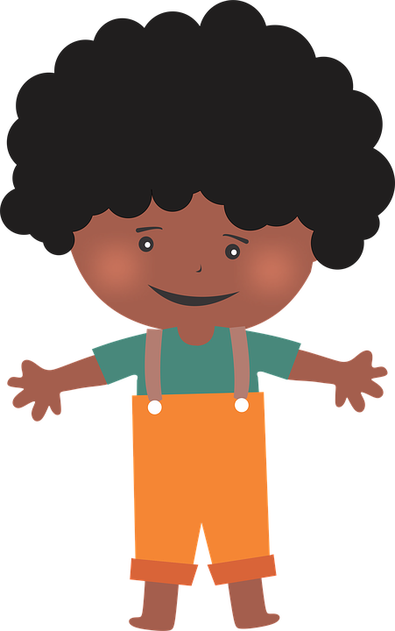
[an|en]
prononciation
enfant
French vowels are either nasal like [an|en] or
non-nasal (oral) like [e] and [a].
When you say a nasal vowel, air passes through your nose as well as your mouth.
Notes:
Timing: 1 minute
Aim: to revisit SSC [an|en] and remind pupils that this sound has two spellings. Note: in the follow ups this week, we will also introduce pupils to [am|em].
Procedure:
Introduce and elicit the pronunciation of the individual SSC [an|en]. Practise saying it several times.
Click to bring up the information about nasal and oral vowel sounds. Practise saying [a] then [an|en] several times.
Click to bring up the source word ‘enfant’ (with gesture, if using). Say the word several times.
Click to bring up the picture and get pupils to repeat the words (with gesture, if using).
Bring up the 2nd callout reminding pupils that [an] and [en] sounds the same and that they need to think carefully about how to write accurately words that they have already learnt. (The next activity practises transcription of eight such words).

Slide 3
[an|en]
. Écoute les noms des animaux. C’est [ien] ou [(a)in]?
Écoute et écris les mots. C’est [an] ou [en] ?
écrire
 | c o n t e n t
 | a n g l a i s e
 | a b s e n t e
 | g r a n d
 | i n t e l l i g e n t
 | p r é s e n t e
 | f r a n ç a i s
 | i n d é p e n d a n t
_ _ _ _ _ _ _
_ _ _ _ _ _ _ _ _ _ _
_ _ _ _ _ _ _ _
_ _ _ _ _ _ _ _
_ _ _ _ _ _ _
_ _ _ _ _ _ _ _
_ _ _ _ _
_ _ _ _ _ _ _ _ _ _ _
⚠ In English, independent has no ‘a’!
Notes:
Timing: 5 minutes
Aim: to revisit SSC [an|en] and practise accurate transcription of [an] and [en] with known words.
Procedure:
Click to listen to each word. Pupils transcribe the word, paying attention to the spelling of the [an|en] sound.
Click to reveal the answers.
Ensure pupils are clear about the meanings as these words are part of this week’s revisiting sets.
Transcript: content anglaise absente grand intelligent présente français indépendant

Slide 4
écouter
. Écoute les noms des animaux. C’est [ien] ou [(a)in]?
Écoute et écris les numéros dans le bon ordre.
Notes:
Timing: 3 minutes
Aim: to practise aural comprehension and spoken production of numbers 11-30.
Procedure:
Teacher reads instruction in French.
Ask pupils to write the number (not the word) – here we focus on the link between sound and meaning.
Click on the speaker icon to play the recording. The 13 numbers are said with a gap of 3 seconds between each one.
Click to make all numbers disappear and elicit numbers in French from pupils, in the order they were mentioned (each number appears on an individual click).
4

Slide 5
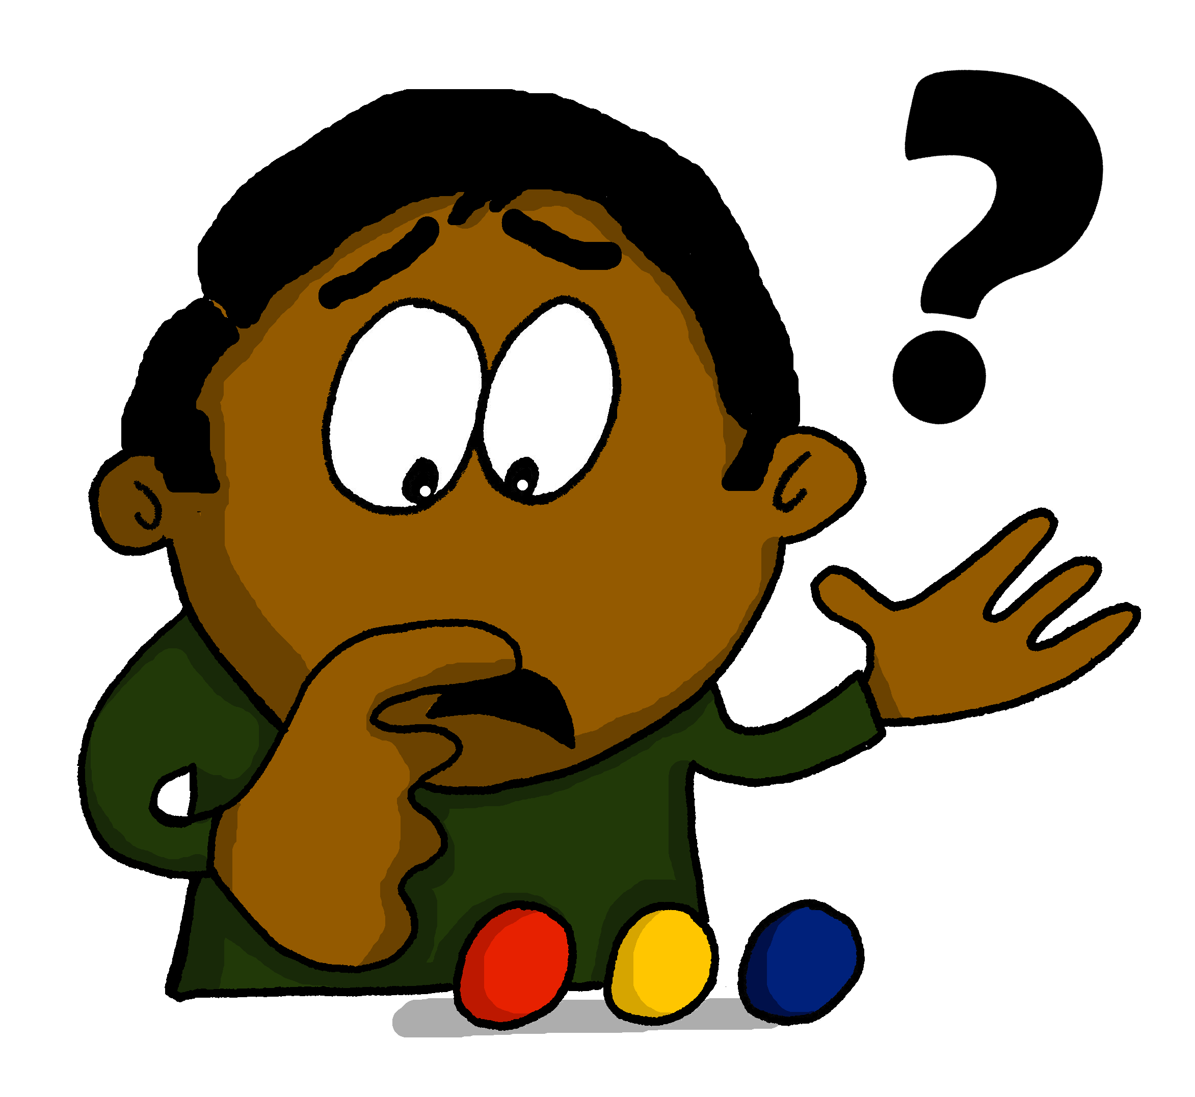
prononcer
quel ?
⚠In English, we often say what day is it? in French, we often use ‘quel’ (which) and nous sommes (we are).
Which?
Le concert, c’est quel jour ?
[The concert, it’s which day?] What day is the concert?
Rachel Hawkes / Emma Marsden
Notes:
Timing: 2 minutes (two slides)
Aim: to introduce question word quel ? and quelle ?
Procedure:
Pupils listen and repeat the key question word (include gesture if possible).
Display the word and get them to repeat one more time.
Elicit English meaning.
Reveal the sentence and elicit English translation from pupils.
Continue with the next slide.

Slide 6
prononcer
quelle ?
⚠quel is which for singular masculine nouns, quelle for singular feminine nouns. They sound almost the same.
Which?
Le spectacle, c’est quelle date ?
[The show, it’s which date?] What date is the show?
Rachel Hawkes / Emma Marsden
Notes:
Procedure:
Pupils listen and repeat the key question word (include gesture if possible).
Display the word and get them to repeat one more time.
Elicit English meaning.
Reveal the sentence and elicit English translation from pupils.

Slide 7
quel ? | quelle ? |
[which (m), which (f)]
We can ask questions with ‘quel’ and ‘quelle’ like this:
⚠ jour and mois are masculine; date, semaine, saison are feminine.
La fête, c’est quel jour ?
Which day is the party?
Le spectacle, c’est en quel mois ?
In which month is the show?
Le concert, c’est quelle date ?
Which date is the concert?
We can ask what day or date it is today like this:
Nous sommes quel jour ?
What day is it?
(Literally, we are which day?
Nous sommes quelle date ?
What date is it?
(Literally, we are which date?
Nous sommes en quelle semaine ?
Which week are we in?
Nous sommes en quelle saison ?
Which season are we in?
Notes:
Time: 2 minutes Aim: to recap the way to refer to the date with and without days; to recap the use of quel/quelle in questions about dates, ahead of the next activity.
Procedure: 1. Teachers present the new information. It is animated to allow for a paced, interactive delivery. 2. Elicit the English translation from the examples.
Notes: i) it is correct to pronounce the –x on 10 novembre and also not to pronounce it (i.e. di novembre).
ii) we pronounce it here as pupils have learnt this pronunciation so it avoids overloading them with too many new things.
iii) to read more: https://www.yumpu.com/fr/document/read/10919945/prononciation-et-liaison-des-chiffres-5-6-7-8-9-10-

Slide 8
lire
Jean-Michel’s class gets messages from France.
What are people asking?
. Écoute
Écris de1à 5 le bon mot en anglais.
1
À: tout le monde*
Le jour de l’Indépendance, c’est en quel mois
season
month
tout le monde – everyone
… ?
2
À: tout le monde*
Le Jour de l’Université, c’est quelle date
4
À: tout le monde*
La fête des Mères, c’est en quel mois
day
season
… ?
date
… ?
month
3
À: tout le monde*
La fête du Travail*, c’est en quel mois
5
À: tout le monde*
La fête du Mardi gras, c’est en quelle saison ?
month
season
… ?
week
… ?
month
le travail – work
Notes:
Timing: 5 minutes
Aim: to practise written recognition of the forms of quel/quelle and their connection to meaning.
Procedure:
Pupils write 1-5 and the correct French word and English meaning from the two options given.
Click to reveal answers.
If desired, click the numbered buttons to listen and check the full sentences.
8

Slide 9
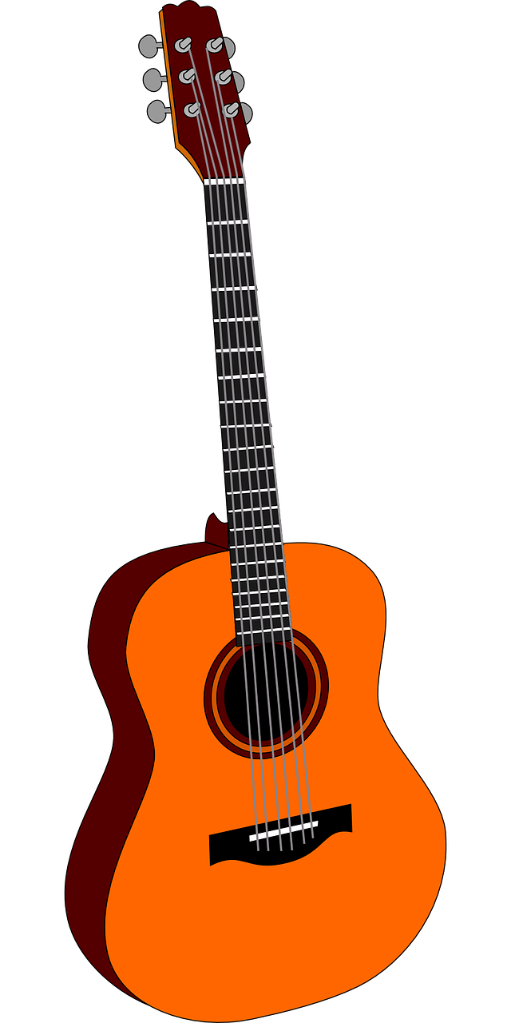
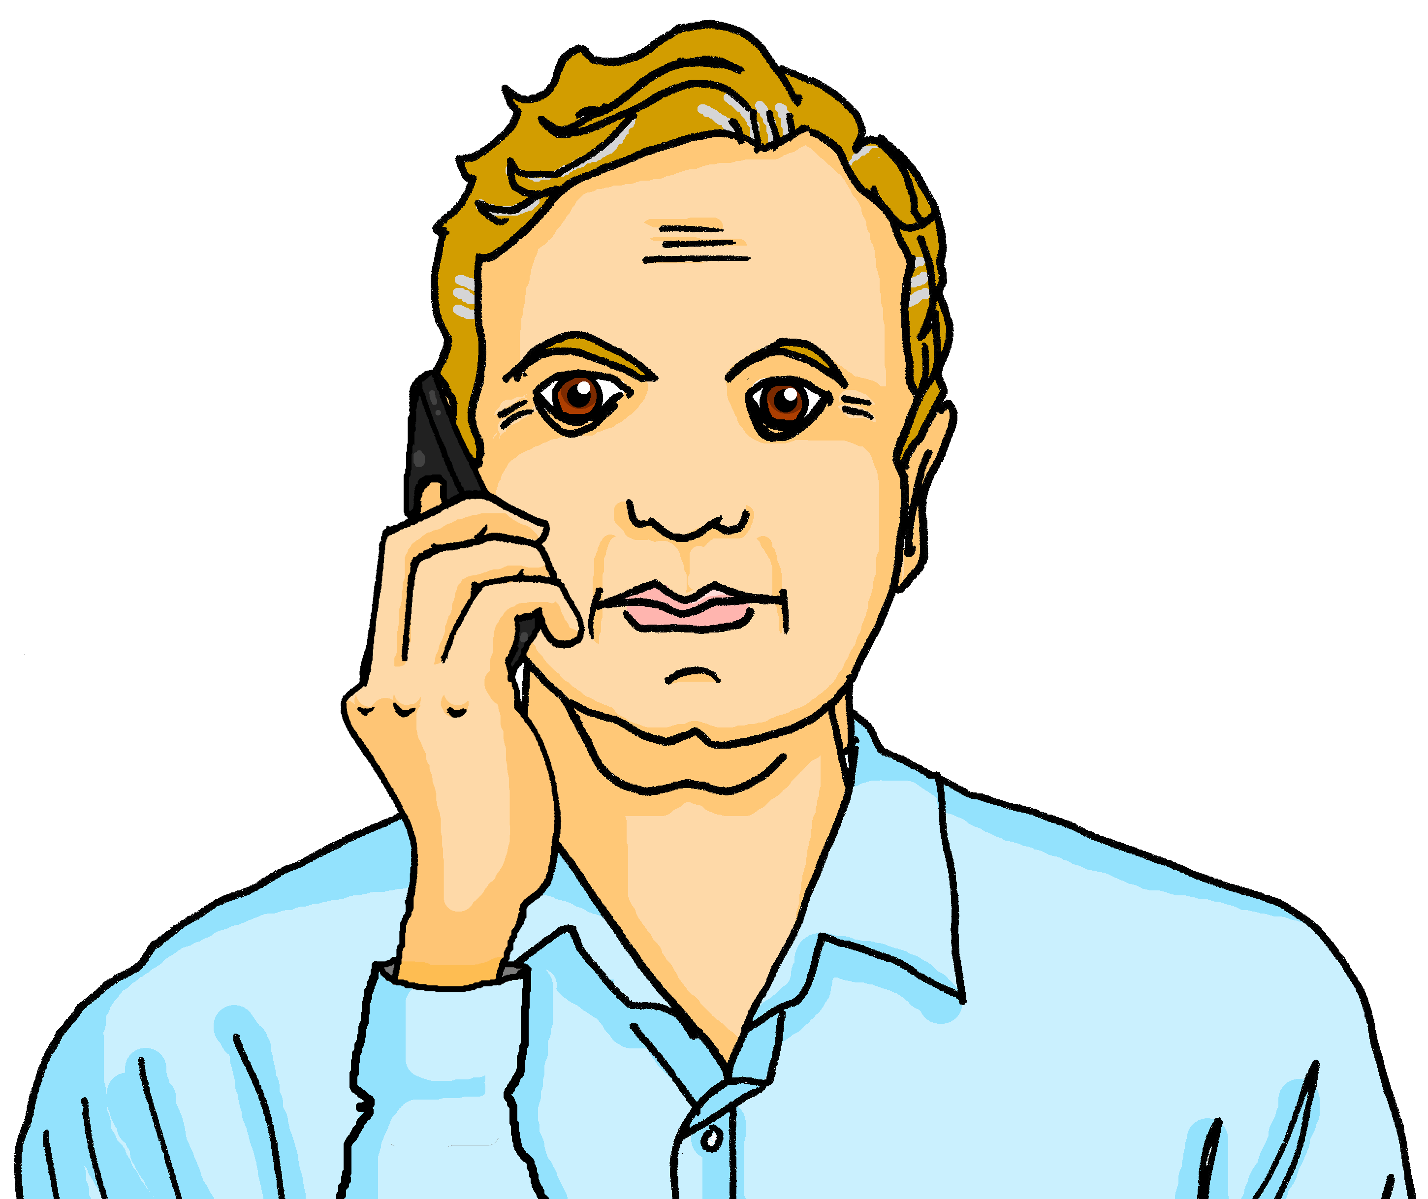
écouter
Quel ? Quelle ?
Jacques est prof de guitarre.
Les étudiants demandent quoi ?
.
écrire
Écris quel ou quelle.
1
4
Le concert est en quel mois ? En aout ?
Nous sommes en quelle semaine ?
Cherche la réponse correspondante.
______
______
B
E
A | Nous sommes mardi 15 octobre.
B | Non, c’est le mois de mai.
C | En automne.
D | Aujourd’hui, c’est mardi.
E | En semaine 7.
F | La fête est samedi.
2
5
Nous sommes quel jour, aujourd’hui ?
Nous sommes quelle date ?
______
______
D
A
Monsieur Kergosien, nous sommes en quelle saison maintenant ?
3
6
La fête de famille est quel jour ?
C
F
______
______
Notes:
Time: 10 minutes Aim: to practise written differentiation in production of the two forms quel ? and quelle ? based on knowledge of noun gender and recognition in listening. Procedure: 1. Click the message icon to hear the question. (Note: this could simply be done as a reading task, but the audio reinforces the fact that the two forms sound the same. For greater challenge, pupils could listen ‘blind’ – simply cover the whole statement with a text box during listening.)
2. Pupils decide which question word is missing based on the gender of the word that follows.
3. Click to reveal the answers. 4. Click again to bring up a table of possible responses to these questions.
5. Pupils read and match questions and answers. They will need to read very carefully paying close attention to the detail.
Transcript: 1. Le concert est quel mois ? Aout ?
2. Nous sommes quel jour, aujourd’hui ?
3. Monsieur Kergosien, nous sommes en quelle saison maintenant ?
4. Nous sommes en quelle semaine ?
5. Nous sommes quelle date ?
6. La fête de famille est quel jour ?
9

Slide 10
Les jours de la semaine
parler
Monday
Tuesday
Thursday
lundi
mardi
Wednesday
jeudi
mercredi
Friday
Saturday
Sunday
vendredi
samedi
dimanche
Notes:
Time: 2 minutes Aim: to practise spoken recall of the days of the week.
Procedure: 1. Click to elicit pupils’ oral translation of the days of the week in a jumbled order.
2. Pupils try to say the word before the animation is finished. The French word appears after each animation.
3. Finally, click to reveal the English again. Elicit all of the days in French one more time.

Slide 11
Au revoir !
vert
Notes:
11

