Slide 1
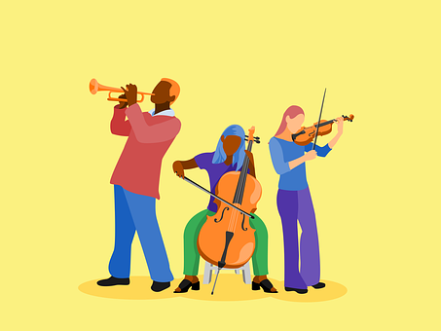
Interactions
Échange en ligne
vert
Follow ups 1-5
Term 1 Week 3
Notes:
Artwork by Steve Clarke. Pronoun pictures from NCELP (www.ncelp.org). All additional pictures selected from Pixabay and are available under a Creative Commons license, no attribution required.
Phonics: petit [138]
Vocabulary (new words in bold): anniversaire [2043] mois [179] janvier [939] février [1139] mars [868] avril [1022] mai [943] juin [931] juillet [1326] aout [1445] séptembre [944] octobre [826] novembre [982] décembre [891] quand [119] treize [3285] quatorze [3359] quinze [1472] seize [3285] dix-sept [3812] dix-huit [3592] dix-neuf [4851] vingt [1273] vingt et un [1273/6/3] vingt-deux, vingt-trois vingt-quatre vingt-cinq vingt-six vingt-sept vingt-huit vingt-neuf trente [1646] concert [1697] fête [1490] spectacle [1687]
Londsale, D., & Le Bras, Y. (2009). A Frequency Dictionary of French: Core vocabulary for learners London: Routledge.
The frequency rankings for words that occur in this PowerPoint which have been previously introduced in these resources are given in the SOW and in the resources that first introduced and formally re-visited those words.
For any other words that occur incidentally in this PowerPoint, frequency rankings will be provided in the notes field wherever possible.

Slide 2
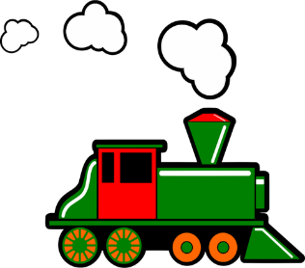
prononcer
Follow up 1:
[(a)in]
train
Notes:
Timing: 6 minutes (three slides)
Aim: to revisit SSC [(a)in]
Procedure:
Introduce and elicit the pronunciation of the individual SSC [(a)in] and then the source word ‘train’ (with gesture, if using).
Click to bring on the picture and get students to repeat (with gesture, if using).
Click to bring on four cluster words for further practice.
Note: gesture for train – arms at your sides with hands facing forwards do several circular motions recalling the action of train wheels.
2

Slide 3
prononcer
Follow up 1:
[(a)in]
train
vingt
fin
main
lapin
Notes:
Timing: 6 minutes (three slides)
Aim: to revisit SSC [(a)in]
Procedure:
Introduce and elicit the pronunciation of the individual SSC [(a)in] and then the source word ‘train’ (with gesture, if using).
Click to bring on the picture and get students to repeat (with gesture, if using).
Click to bring on four cluster words for further practice.
Note: gesture for train – arms at your sides with hands facing forwards do several circular motions recalling the action of train wheels.
3

Slide 4
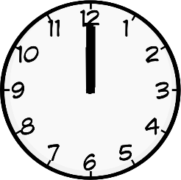
prononcer
Follow up 1:
[i]
[(a)in]
And [i] is an oral vowel.
midi
train
Remember! [(a)in] is a nasal vowel.
Notes:
Aim: to recap the SSC [i] and source word midi, alongside [(a)in] and train as preparation for the activity that follows.
Procedure:
Introduce and elicit the pronunciation of the individual SSC [i] and [(a)in] and then the source words ‘midi’ and ‘train’ (with gestures, if using).
Click to bring on the picture and get students to repeat the words (with gesture, if using).
Note: gesture for midday – raise both arms above your head, palms touching to mime 12 o’clock.
4

Slide 5
Follow up 1
[i]
midi
[(a)in]
train
. Écoute les noms des animaux. C’est [ien] ou [(a)in]?
Écoute. L’intrus, c’est quoi ?
écouter
1
2
3
4
5
A | B | C
intéressant | petit | timide
cinéma | cousine | cinq
quinze | vingt-cinq | dix-sept
dessin | dessiner | cousin
février | vingt-trois | six
[(a)im] is the same sound as [(a)in]. When this sound is before a ‘p’ or ‘b’ it is spelt ‘im’.
Notes:
Aim: to practise aural distinction between the SSC [i] and [(a)in].
Procedure:
Click on each audio symbol to listen to the set of three words.
Click to reveal all of the options.
Click to elicit the odd one out from pupils and click to highlight it.
Clarify word meanings – unknown words are mostly cognates (exception: pain which is a false friend)
Elicit choral pronunciations of all words once more time.
Transcript a) intéressant b) petit c) timide a) cinéma b) cousine c) cinq a) quinze b) vingt-cinq c) dix-sept a) dessin b) dessiner c) cousin a) février b) vingt-trois c) six
Frequency of unknown words and cognates: cinéma [1623] timide [3835]
Londsale, D., & Le Bras, Y. (2009). A Frequency Dictionary of French: Core vocabulary for learners London: Routledge.

Slide 6
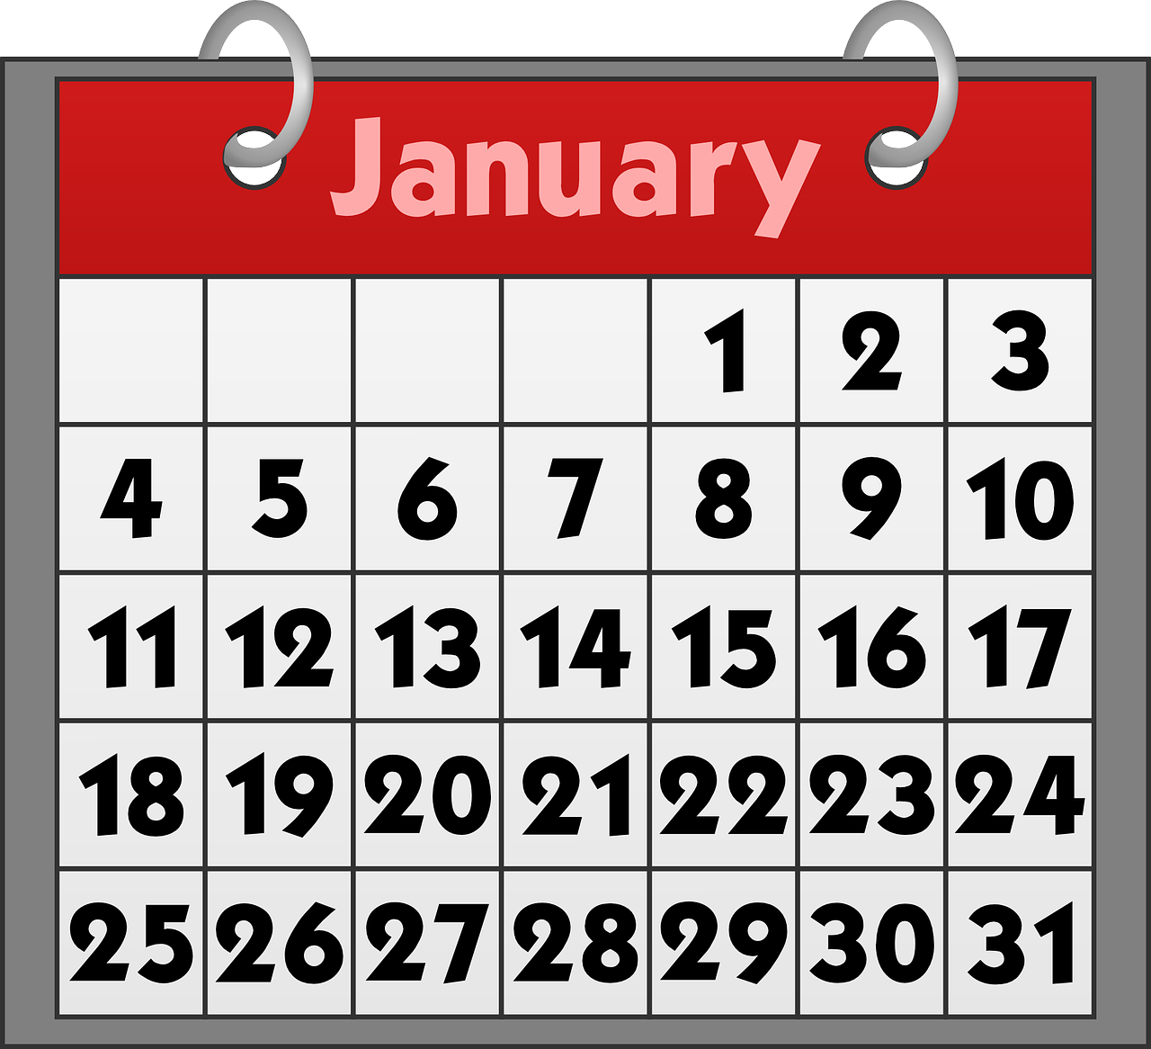
Follow up 2: Using ‘le’ with dates
[on the]
We use the definite article ‘le’ with dates to mean ‘the’ or ‘on the’.
Exemple:
Le concert est le 19 aout.
The concert is (on) the 19th of August.
To say dates with days don’t use ‘le’:
Le spectacle est dimanche 24 janvier.
The show is (on) Sunday 24th of January (i.e., this year).
Notes:
Time: 6-8 minutes (two slides) Aim: to learn the use of ‘le’ with the meaning of (on) the with dates and omission of ‘le’ for dates with days of the week.
Procedure: 1. Teachers present the new information. It is animated to allow for a paced, interactive delivery. 2. Elicit the English translation from the examples.

Slide 7
Follow up 2:
C’est quand ?
Do people mention a day or just the number and month?
. Écoute les noms des animaux. C’est [ien] ou [(a)in]?
écouter
Écoute et décide. Puis, écris la date et le mois en anglais.
jour | date | mois
19
April
E
E
1
1
23
November
2
2
12
February
3
3
15
August
4
4
13
July
5
5
18
March
6
6
11
June
Notes:
Aim: to practise aural distinction of number only dates with ‘le’ and dates with days without ‘le’.
Procedure: 1. Explain to pupils that they will most of the sentence, but that there will be a beep which will either obscure a day of the week or nothing. If pupils hear ‘le’ with the date they know there is no day, and put a cross.
2. Click to listen to the example. Pupils either tick or cross.
3. Pupils listen again and write the date in digits and the month in English.
4. Click to reveal the example answers.
5. Complete steps 2 – 4 with items 1-6. 6. Click to bring up a further set of audio buttons. Click to hear the full sentences without beeps. Elicit the meaning of the three days that feature in the sentences, too. We will revisit days in next week’s lesson.
Transcript: EJ. Le concert est [beep] le 19 avril.
1. Le spectacle est [samedi] 23 novembre.
2. Le concert est [jeudi] 12 février.
3. La fête est [beep] le 15 aout.
4. Le concert est [lundi] 13 juillet.
5. Le spectacle est [beep] le 18 mars.
6. La fête est [beep] le 11 juin.
Transcript 2: EJ. Le concert est le 19 avril.
1. Le spectacle est samedi 23 novembre.
2. Le concert est jeudi 12 février.
3. La fête est le 15 aout.
4. Le concert est lundi 13 juillet.
5. Le spectacle est le 18 mars.
6. La fête est le 11 juin.

Slide 8
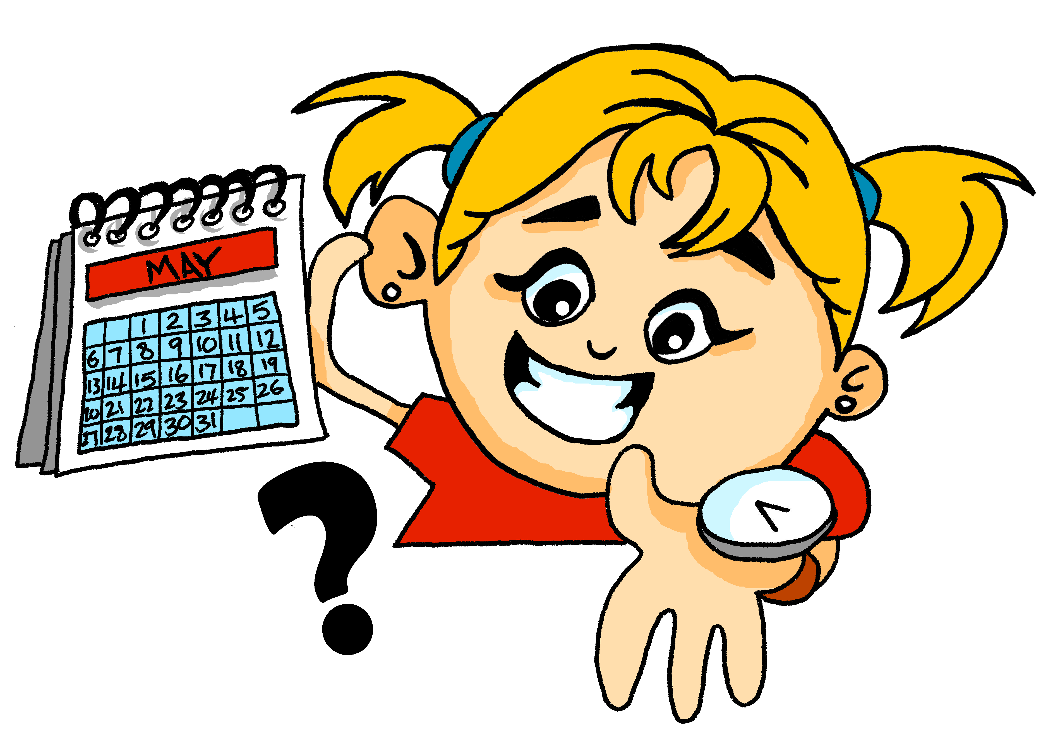
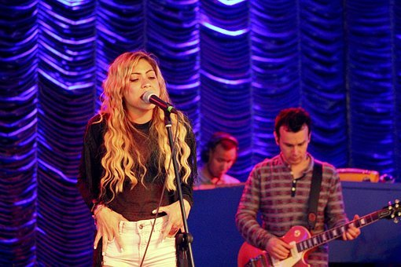
Follow up 3:
[1/8]
Le concert, c’est quand ?
. Écoute les noms des animaux. C’est [ien] ou [(a)in]?
parler
. Écoute les noms des animaux. C’est [ien] ou [(a)in]?
Le concert est le 28 avril.
Le concert est le [__] [____].
Notes:
Time: 5 minutes (6 slides) Aim: to ask and answer about dates of concerts, shows and parties in oral production.
Ask the question “Le concert, c’est quand ? and encourage pupils to answer in French using the prompts.
Round 2 (next slide). Click to remove support and display clues for each word in the question and answer.

Slide 9
Follow up 3:
[2/8]
L. c......, c’... q.... ?
. Écoute les noms des animaux. C’est [ien] ou [(a)in]?
parler
. Écoute les noms des animaux. C’est [ien] ou [(a)in]?
L. c.….. e.. l. [_____] [______]
Le concert est le 28 avril.
Notes:
[2/8]

Slide 10
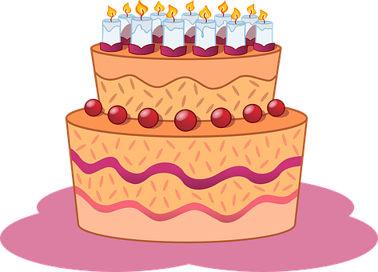
Follow up 3:
[3/8]
La fête, c’est quand ?
. Écoute les noms des animaux. C’est [ien] ou [(a)in]?
parler
. Écoute les noms des animaux. C’est [ien] ou [(a)in]?
La fête est le [__] [____].
La fête est le 17 janvier.
January
17
Notes:
[3/8]

Slide 11
Follow up 3:
[4/8]
L. f..., c’... q.... ?
. Écoute les noms des animaux. C’est [ien] ou [(a)in]?
parler
. Écoute les noms des animaux. C’est [ien] ou [(a)in]?
L. f… e.. l. [_____] [______]
La fête est le 17 janvier.
January
17
Notes:
[4/8]

Slide 12
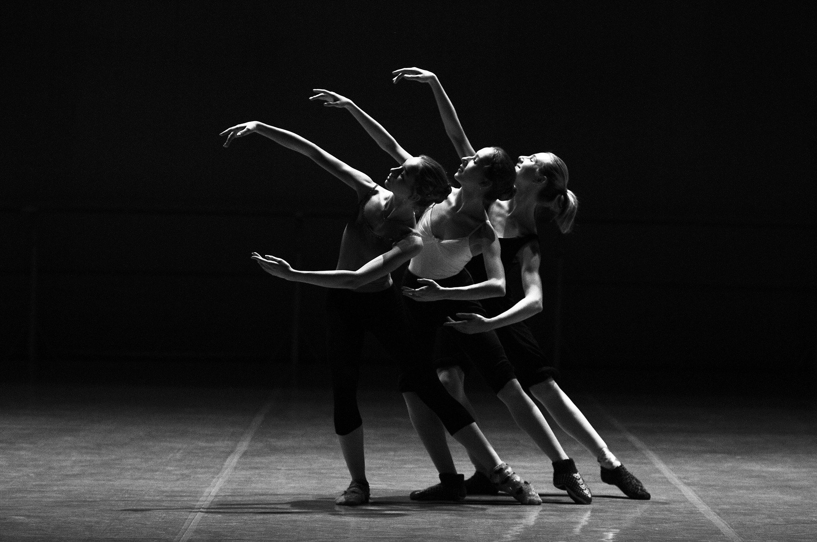
Follow up 3:
[5/8]
Le spectacle, c’est quand ?
. Écoute les noms des animaux. C’est [ien] ou [(a)in]?
parler
. Écoute les noms des animaux. C’est [ien] ou [(a)in]?
Le spectacle est le [__] [____].
Le spectacle est le 21 septembre.
September
21
Notes:
[5/8]
Procedure:
Ask the question “Le spectacle, c’est quand? and encourage pupils to answer in French using the prompts.
Round 2 (next slide). Click to remove support and display clues for each word in the question and answer.

Slide 13
Follow up 3:
[6/8]
. Écoute les noms des animaux. C’est [ien] ou [(a)in]?
L. s........, c’... q.... ?
parler
. Écoute les noms des animaux. C’est [ien] ou [(a)in]?
L. s.……. e.. l. [_____] [______]
Le spectacle est le 21 septembre.
September
21
Notes:
[6/8]
Procedure:
Ask the question “Le spectacle, c’est quand? and encourage pupils to answer in French using the prompts.
Round 2 (next slide). Click to remove support and display clues for each word in the question and answer.

Slide 14
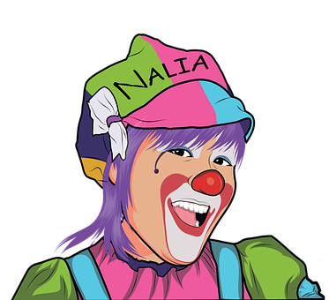
Follow up 3:
[7/8]
La fête, c’est quand ?
. Écoute les noms des animaux. C’est [ien] ou [(a)in]?
parler
. Écoute les noms des animaux. C’est [ien] ou [(a)in]?
La fête est le [__] [____].
La fête est le 25 février.
February
25
Notes:
[7/8]

Slide 15
Follow up 3:
[8/8]
L. f..., c’... q.... ?
. Écoute les noms des animaux. C’est [ien] ou [(a)in]?
parler
. Écoute les noms des animaux. C’est [ien] ou [(a)in]?
L. f… e.. l. [_____] [______]
La fête est le 25 février.
February
25
Notes:
[8/8]

Slide 16
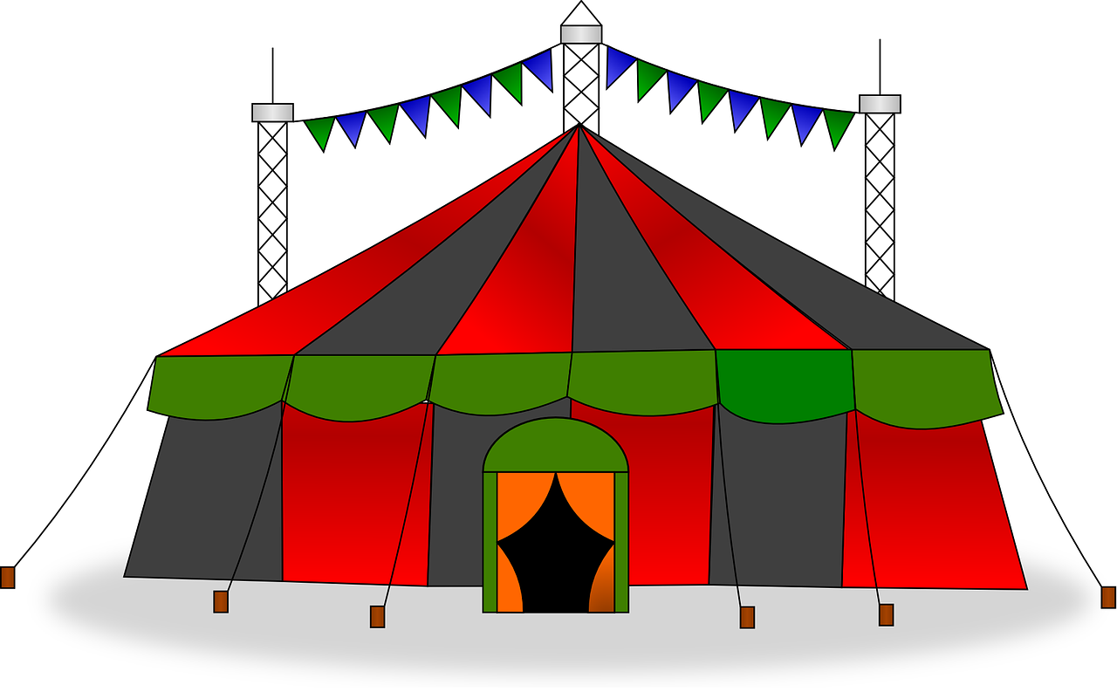
Follow up 4:

s noms des animaux. C’est [ien] ou [(a)in]?
Écris les phrases.
⚠Remember that we don’t use capital letters with months in French.
écrire
The concert is on the 14th July.
Le concert est le 14 juillet.
The party is on the 19th May.
La fête est le 19 mai.
The show is on the 30th November.
Le spectacle est le 30 novembre.
The show is on the 24th March.
Le spectacle est le 24 mars.
Notes:
Timing: 6-8 minutes
Aim: to practise written production of dates (numbers and months) and use of ‘le’ with dates with numbers (and no days).
Procedure:
1. Pupils write the four sentences in French. 2. Click to bring up written answers. 3. Pupils to check their sentences carefully.

Slide 17
vocabulaire
Follow up 5 - Écris en français : Can you get at least 15 points?
mots
 | July | February | May
 | twenty-eight | October | August
 | June | thirty-one | March
 | fourteen | January | twenty-four
 | thirteen | sixteen | fifteen
 | it is, it’s | (the) month | (the) party
 | (the) show | (the) concert | when?
juillet
février
mai
x3
vingt-huit
octobre
aout
juin
trente-et-un
mars
x2
quatorze
janvier
vingt-quatre
treize
seize
quinze
c’est
le mois
la fête
x1
le spectacle
le concert
quand ?
Notes:
Timing: 5 minutes
Aim: to practise written production of vocabulary from this week.
Procedure: 1. Give pupils a blank grid. They fill in the French meanings of any of the words they know, trying to reach 15 points in total.
17

Slide 18
vocabulaire
Follow up 5 - Écris en français : Can you get at least 15 points?
mots
 | July | February | May
 | twenty-eight | October | August
 | June | thirty-one | March
 | fourteen | January | twenty-four
 | thirteen | sixteen | fifteen
 | it is, it’s | (the) month | (the) party
 | (the) show | (the) concert | when?
x3
x2
x1
Notes:
HANDOUT
18

