Slide 1
Interactions
Échange en ligne
« être » nous sommes (we are)
adjective agreement (plural)
Revisit [a] and [an|en]
vert
Term 1 Week 2
Notes:
Artwork by Steve Clarke. Pronoun pictures from NCELP (www.ncelp.org). All additional pictures selected from Pixabay and are available under a Creative Commons license, no attribution required.
Phonics: revisit [a] and [an|en] banane [>5000] enfant [126] maman [2168]
Vocabulary (new words in bold): sommes [5] nous [31] allemand [844] espagnol [1666] amusant [4695] calme [1731] différent [350] difficile [296] facile [822] important [215] indépendant [954] jeune [152]
malade [1066] méchant [3184] prudent [1529] seul [102] Revisit 1: -- Revisit 2: elle2 [38] il2 [13] actif [1219] massif [1760] propre [237] sale [2906] sportif [2670] idéal [1429]
Londsale, D., & Le Bras, Y. (2009). A Frequency Dictionary of French: Core vocabulary for learners London: Routledge.
The frequency rankings for words that occur in this PowerPoint which have been previously introduced in these resources are given in the SOW and in the resources that first introduced and formally re-visited those words.
For any other words that occur incidentally in this PowerPoint, frequency rankings will be provided in the notes field wherever possible.
1

Slide 2
Vokabeln
L’amitié*
l’amitié- friendship
Learning languages is about making friends.
You show kindness when you learn even a few words in another language.
Let’s remember some of the friendship sentences we have learnt already!
Salut !
Bonjour !
_ _ _ _ _ !
_ _ _ _ ?
_ _ _ _ _ _ _ !
Ça va ?
Can you say other kind things?
Are you pleased?
Tu es content(e) ?
C’est parfait !
Tu es mon ami(e).
It’s perfect!
You are my friend.
I like your bag!
J’aime ton sac !
You are nice!
Tu es sympa !
Notes:
Timing: 3 minutes
Aim: to introduce the idea that learning other languages opens the door to new friendships, and that a few kind words go a long way; to revisit some previously-taught language from this term that fits our category of ‘friendship sentences’. This is an idea we will return to now and then during the course.
Procedure:
Click to present the information on the slide.
Elicit the French from pupils for the English greetings and friendly statements.
Allow pupils a few moments to turn to those around them and greet them and say something kind about their work or about them themselves.
Remind pupils that we all need to hear kind words every day, in whatever language!
2

Slide 3
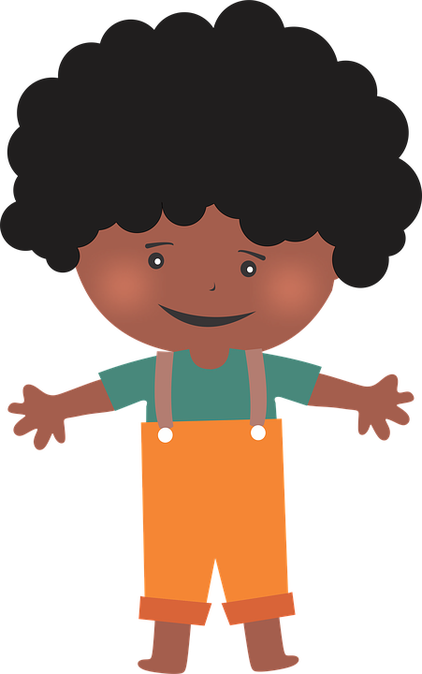
[an|en]
prononciation
enfant
French vowels are either nasal like [an|en] or
non-nasal (oral) like [e] and [a].
When you say a nasal vowel, air passes through your nose as well as your mouth.
Notes:
Timing: 1 minute
Aim: to re-introduce SSC [an|en], which pupils met last week.
Procedure:
Introduce and elicit the pronunciation of the individual SSC [an|en]. Practise saying it several times.
Click to bring up the information about nasal and oral vowel sounds. Practise saying [a] then [an|en] several times.
Click to bring up the source word ‘enfant’ (with gesture, if using). Say the word several times.
Click to bring up the picture and get pupils to repeat the words (with gesture, if using).
Pupils can also practise in pairs.

Slide 4
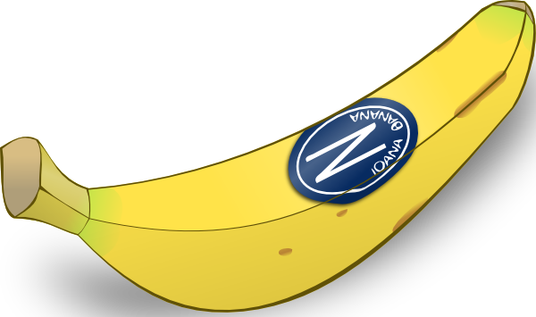
[a]
banane
prononciation
[a] is an oral vowel.
Notes:
Timing: 1 minute
Aim: to remind pupils of SSC [a]
Procedure:
Elicit the pronunciation of the individual SSC [a] and then the source word ‘banane’ (with gesture, if using).
Click to bring on the picture and get students to repeat (with gesture, if using).
Note: a gesture for ‘banana’ – we suggest making the shape of a banana with both hands – start with finger tips together in the middle, pull them apart and upwards to trace the shape of a banana (like the shape of a smile).
4

Slide 5
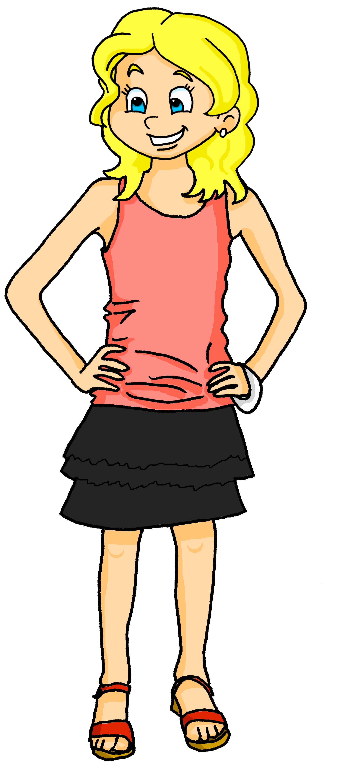
[a]
[an]
prononciation
This common French word has both an oral vowel and a nasal vowel.
Maman
oral vowel
nasal vowel
Voici Claudine, la maman de Pierre et Adèle.
Notes:
Timing: 1 minute
Aim: to focus further on the difference in sound between [a] and [an|en].
Procedure:
Click to bring up the two SSC [a] and [an|en].
Click to bring up the cluster word ‘maman’. Say the word several times.
Click to bring up the call out and labels for [a] and [an|en].
Click to introduce Claudine, Pierre and Adèle’s mum.
5

Slide 6
Écoute et écris les mots.
. Écoute les no
1
[a]
banane
[an|en]
enfant
écouter
2
3
sale
blanc
4
massif
indépendant
5
active
amusant
intéressant
6
allemand
idéal
blanche
7
8
9
10
Notes:
Timing: 5 minutes
Aim: to practise aural comprehension and written production of previously taught vocabulary containing the SSC [a] and [an|en]
Procedure:
Ensure that pupils understand the task. They listen out for the vowel sounds [a] and [an|en] and write the French words. Words go into the overlap if they contain both sounds.
Click to listen to each word.
Pupils transcribe the word into the appropriate part of the Venn diagram.
Click to reveal each word in order.
Elicit the English meanings as these are words that pupils learnt in Y3/4, with the exception of allemand (German), which is a new word for this week, and appears with a visual prompt.
Transcript sale massif
active
blanc
indépendant
idéal
amusant intéressant blanche allemand

Slide 7
Être
[to be | being]
Remember, the last letter of all these verb forms is a
Silent Final Consonant!
You already know these parts of the verb être (to be):
être
Je suis présent. | I (a boy) am present.
Tu es grande. | You (a girl) are tall.
Il est petit. | He is short.
Elle est absente. | She is absent.
___ _______ _______.
___ _______ _______.
___ _______ _______.
Elle est absente.
___ _______ _______.
Except when followed by a vowel!
To say ‘we’ + être:
Nous sommes contents.
We are pleased.
Notes:
Timing: 2 minutes
Aim: to revise the persons of être already met and to present the 1st person plural nous sommes.
Procedure:
Elicit the four French sentences from pupils.
Click to present nous sommes and elicit the English meaning.
Click to remind pupils about SFC and liaison.
7

Slide 8
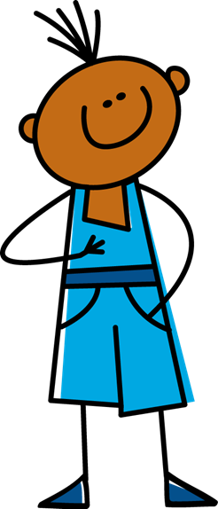
écouter
Je ou nous ?
1
fun
Notes:
Timing: 6 minutes (9 slides)
Aim: to practise distinguishing aurally between the first person singular and first person plural forms of ‘être’.
Procedure:
1. Click the button to play audio with the pronoun obscured.
2. Students should note whether the first word of each sentence must be ‘je’ or ‘nous’.
3. They then write the English meaning of the adjective used in each sentence (to force vocabulary recall).
4. Answers appear upon clicking the mouse. Note: a full version of the sentence audio plays when the green tick appears.
Transcript:
[…] sommes amusants.
8

Slide 9
écouter
Je ou nous ?
2
positive
Notes:
Transcript:
[…] sommes positifs.
9

Slide 10
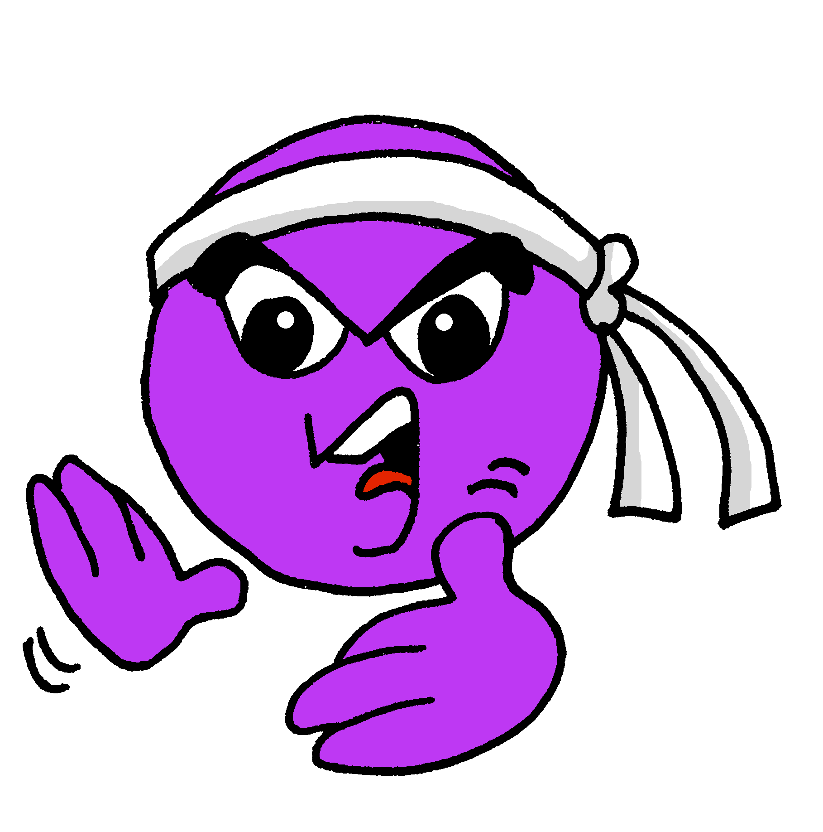
écouter
Je ou nous ?
3
active
Notes:
Transcript:
[…] suis actif.
10

Slide 11
écouter
Je ou nous ?
4
German
Notes:
Transcript:
[…] sommes allemands.
11

Slide 12
écouter
Je ou nous ?
5
Spanish
Notes:
Transcript:
[…] suis espagnol.
12

Slide 13
écouter
Je ou nous ?
6
creative
Notes:
Transcript:
[…] suis créatif.
13

Slide 14
écouter
Je ou nous ?
7
funny
Notes:
Transcript:
[…] sommes drôles.
14

Slide 15
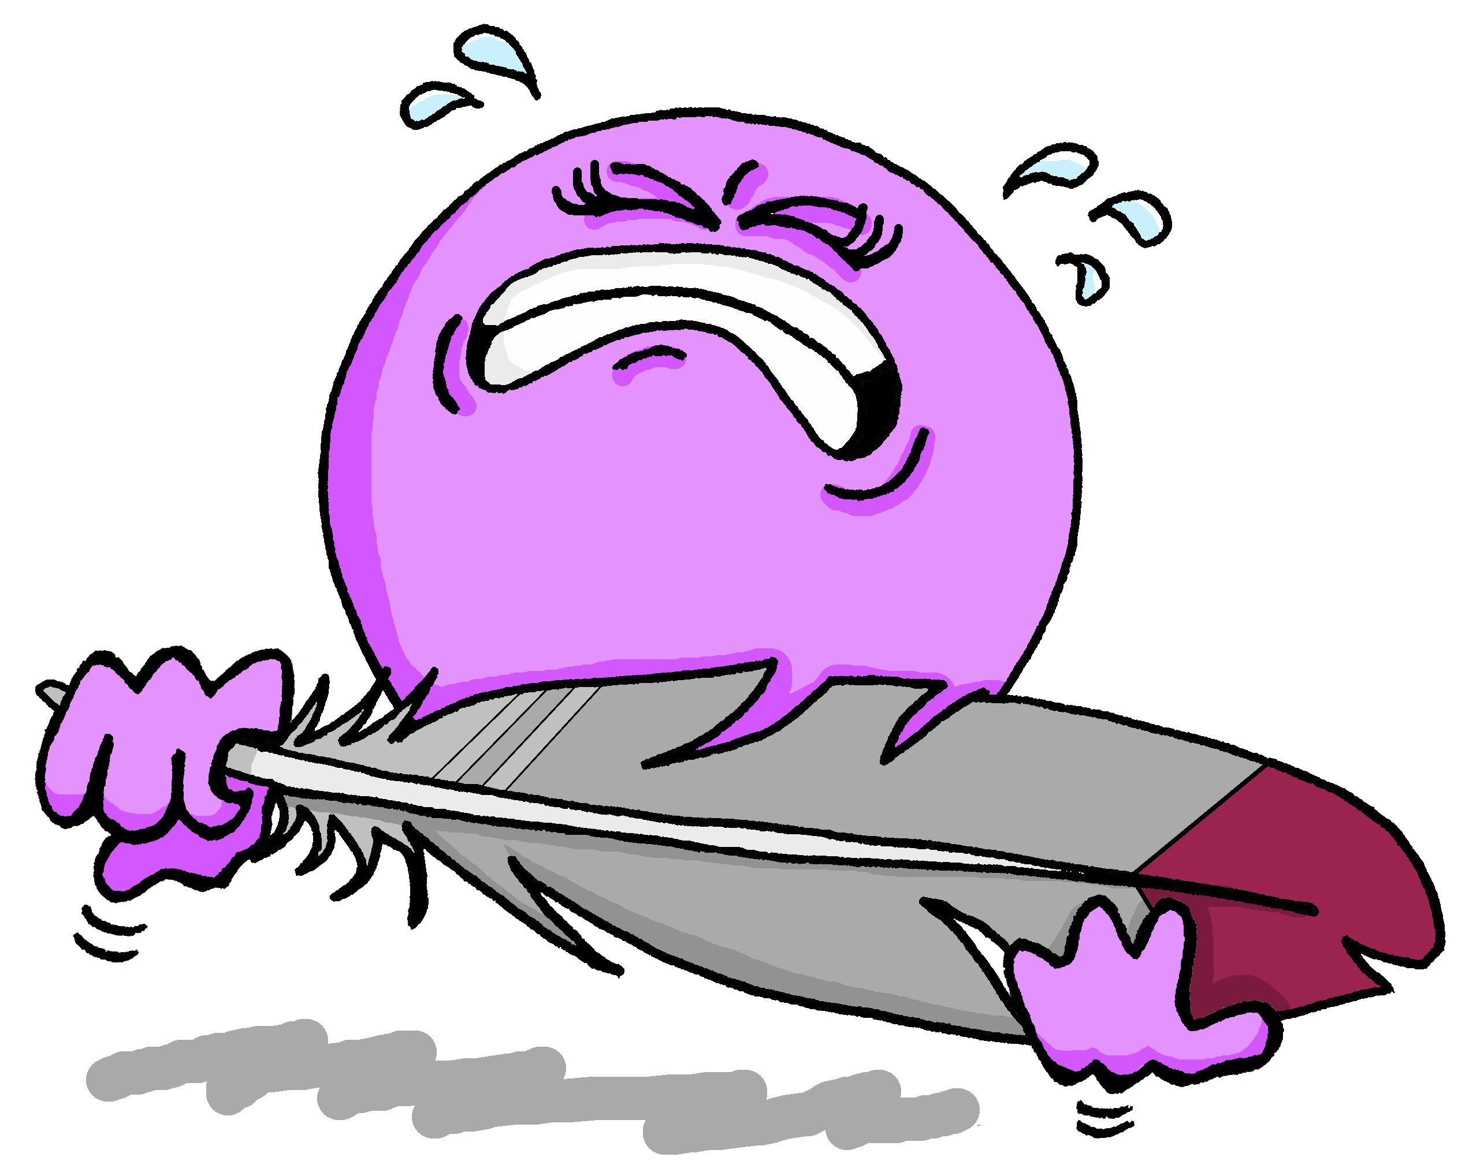
écouter
Je ou nous ?
8
weak
Notes:
Transcript:
[…] suis faible.
15

Slide 16
écouter
Je ou nous ?
9
pleased
Notes:
Transcript:
[…] sommes contents.
16

Slide 17
Describing more than one [1/2]
“Nous” (we) is a plural pronoun – it refers to more than one person.
Remember: There must be agreement between the adjective and noun!
So, adjectives describing “nous” need to be in a plural form:
Nous sommes contents.
We are pleased.
Don’t forget! The -s on the end of ‘sommes’ and the adjective are Silent Final Consonants.
Don’t forget! The -s on the end of ‘sommes’ and the adjective are Silent Final Consonants.
Notes:
Timing: 2 minutes
Aim: to introduce plural adjective agreement.
Procedure:
Click to present the information.
Elicit the English sentence meaning.
Click to remind pupils about SFC.
Note: First we will practise recognising the difference between masculine singular and masculine plural adjectives. Then we will bring in feminine plural agreement.
17

Slide 18
Échange en ligne*
l’échange – exchange en ligne - online
Jean-Michel organise un échange en ligne avec la classe de Pierre.
Notes:
Timing: 1 minute
Aim: to introduce the idea of the online exchange.
Procedure:
Click to listen to the title and explanation and ensure pupils’ understanding.
If needed, remind students that Jean-Michel lives in Haiti and Pierre lives in France and they are cousins.

Slide 19
lire
Aïe ! Il y a un problème avec le micro ! Jean-Michel utilise le tchat.
Mais il a aussi un problème avec le tchat!
Is Jean-Michel messaging about himself or himself AND his classmates?
Je ou nous ? Écris les adjectifs en anglais.
. Écoute les noms des animaux. C’est [ien] ou [(a)in]?
À: tout le monde
… … actifs.
 |  | nous (we) | je (I)
1
2
3
4
5
6
7
8
1
À: tout le monde
… … forts.
5
1
active
À: tout le monde
… … amusants.
2
fun
2
À: tout le monde
… … prudent.
6
3
creative
4
independent
À: tout le monde
… … créatif.
3
À: tout le monde
… … sportif.
7
5
strong
6
careful
À: tout le monde
… … indépendants.
4
À: tout le monde
… … intéressants.
sporty
8
7
8
interesting
Notes:
Timing: 7 minutes
Aim: to practise written recognition of singular and plural adjective agreement and connect these to 1st person singular and plural pronouns and parts of être (which are omitted to focus pupils’ attention on the adjective form.
Procedure:
Explain the task.
Complete number one with pupils. They write noun / je and the adjective meaning in English.
Explain that this difference between plural and singular adjectives can only be detected in writing, because of the SFC.
Pupils complete items 2-8.
Click to correct.
Optional – elicit full sentences from pupils as additional practice. E.g. Comment dit-on ‘we are intelligent’ en français? and click on the dark blue numbers in the table to hear the full sentences.
19

Slide 20
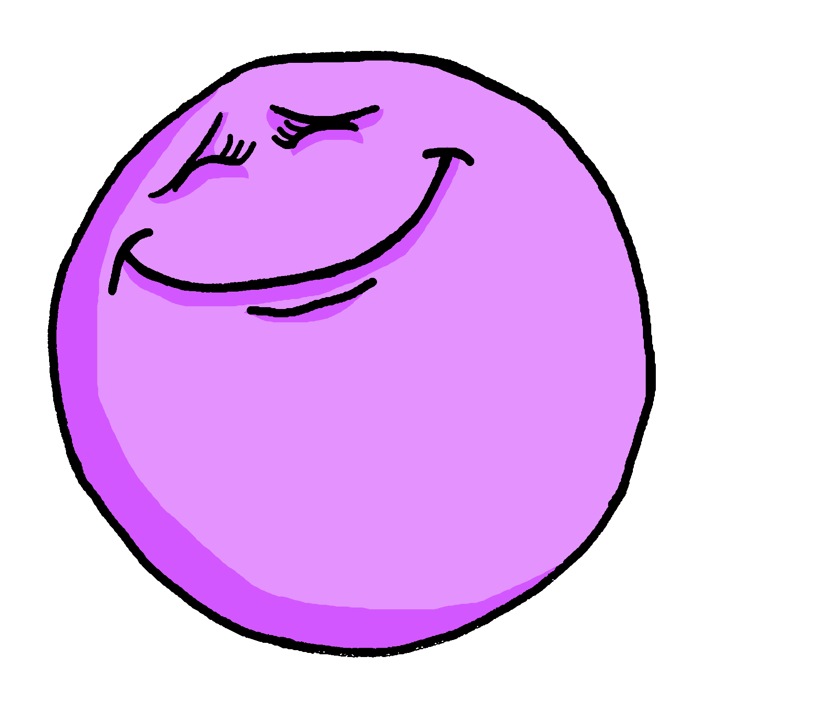
Describing more than one [2/2]
You know that many adjectives add -e to describe a feminine noun.
Je suis contente.
I (a girl) am pleased.
You also know this pattern: -if → -ive
The -s on the end is silent but the –e makes you pronounce the –t.
Je suis active.
I (a girl) am active.
When the feminine noun is plural, add -s to the singular adjective:
Nous sommes contentes.
We (girls) are pleased.
Nous sommes actives.
We (girls) are active.
If there is a mix of male and female people in the group, we use the masculine plural adjective.
Nous sommes contents.
We (boys|boys & girls) are pleased.
Nous sommes actifs.
We (boys|boys & girls) are active.
Notes:
Timing: 2 minutes
Aim: to introduce feminine plural adjective agreement.
Procedure:
Click to present the information.
Elicit the English sentence meanings.
Click to remind pupils about SFC.
Explain that masculine endings are used when the group described is all boys or a mixture of boys and girls.
20

Slide 21
lire
Le micro fonctionne à nouveau*.
à nouveau – again
Je ou nous ? Organise les adjectifs.
. Écoute les noms des animaux. C’est [ien] ou [(a)in]?
… … positif
… … créatifs
je
nous
… … petit
… … actifs
… … amusante
… … petit
… … positif
… … intéressantes
… … intelligente
… … actifs
… … sportives
… … créatifs
Jean-Michel
Jean-Michel et des amis
… … sportives
… … amusante
je
nous
… … intelligente
… … intéressantes
Clémentine
Clémentine et des amies
Notes:
Timing: 5 minutes
Aim: to practise written recognition of singular and plural adjective agreement (masculine and feminine) and connect these to 1st person singular and plural pronouns and parts of être (which are omitted to focus pupils’ attention on the verb and adjective forms.
Procedure:
Explain the task.
Complete number one with pupils. They say the full French sentence, then say the correct name or names.
Teacher elicits the meaning of the adjective.
A further click places the callout in the appropriate category.
Teacher guides pupils to complete items 2-8 chorally, providing feedback after each item.
If desired, click on the white speech bubbles to hear the full sentences.
21

Slide 22
Au revoir !
vert
Notes:
22

