Slide 1
Interactions
vert
Échange en ligne
« avoir » nous avons / vous avez
adjective agreement (plural)
liaison
Notes:
Artwork by Steve Clarke. Pronoun pictures from NCELP (www.ncelp.org). All additional pictures selected from Pixabay and are available under a Creative Commons license, no attribution required.
Phonics: liaison
Vocabulary: avons [8] avez [8] nous [31] vous [50] bâtiment [1952] derrière [805] devant [198] entre [55] où [48] dans [11] sur [16] sous [122] ici [167]
Revisit 1: activité [452] chaise [3419] chanson [2142] garçon [1599] fille [629] jeu [291] langue [712] règle² [488] spectacle [1687]
Revisit 2: être [5] suis, est, es [5] je [22] tu [112] il [13] elle [38] qui ? [14] ami(e) [467] école [477] monsieur [79] madame [294] professeur(e) [110] absent [2016] actif [1219] anglais [784] content [1841] créatif [>5000] grand [59] français [251] indépendant [954] intelligent [2509] négatif [1520] petit [138] positif [949] présent [216] sportif [2670] triste [1843] bien [47] mal [277] Salut ! [2205] Ça va ? [54/53] Oui [284] Non [75] Bonjour ! [1972] Au revoir [n/a]
Londsale, D., & Le Bras, Y. (2009). A Frequency Dictionary of French: Core vocabulary for learners London: Routledge.
The frequency rankings for words that occur in this PowerPoint which have been previously introduced in these resources are given in the SOW and in the resources that first introduced and formally re-visited those words.
For any other words that occur incidentally in this PowerPoint, frequency rankings will be provided in the notes field wherever possible.
1

Slide 2
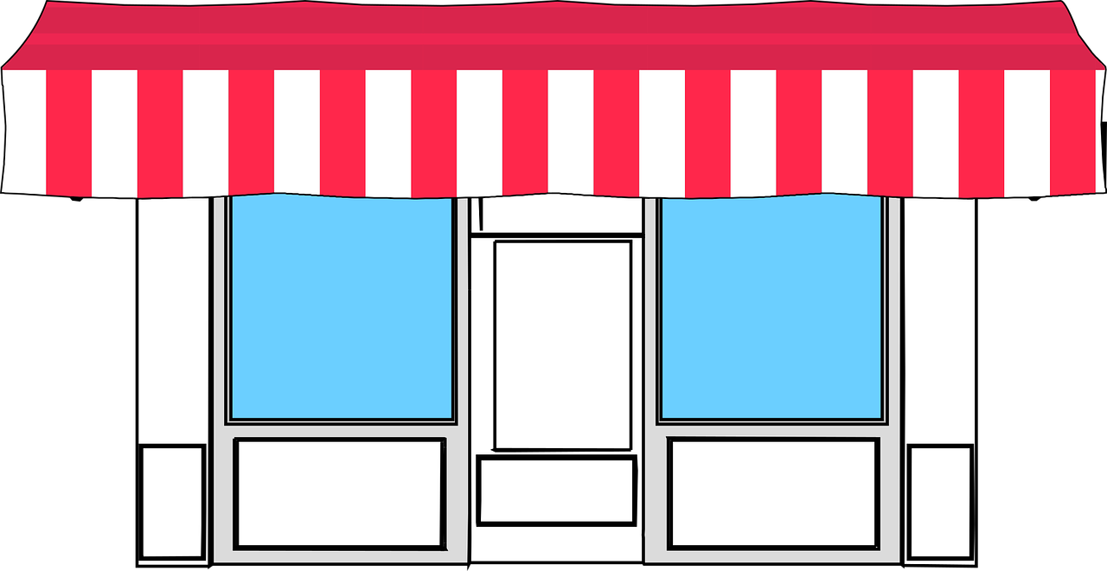
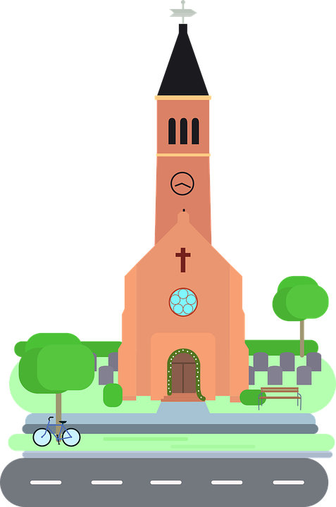
La liaison
You know that ‘s’ is usually a Silent Final Consonant.
Il y a des magasins.
There are some shops.
But…
The ‘s’ here sounds like a ‘z’.
Il y a des églises.
There are some churches.
Because the ‘s’ is followed by a vowel you pronounce it.
Remember that this is called liaison.
Notes:
Timing: 2 minutes
Aim: to introduce s-liaison with between des and nouns starting with a vowel.
Procedure:
Click to present the new information about liaison.
2. Elicit the English for the French examples.

Slide 3
prononcer
Liaison
Il y a quoi ? Il y a …
40
des parcs
des amis
des musées
des cafés
Fin
des amis
des cinémas
des universités
S
des activités
des universités
des activités
des rues
des hôtels
des hôtels
Début
des ponts
des magasins
des églises
des postes
des églises
0
DÉBUT
Notes:
Timing: 2 minutes
Aim: to practise liaison following ‘s’ and a vowel and no liaison after ‘s’ plus a consonant.
Procedure:
Pupils take it in turns trying to say all of the sentences (with il y a each time) within the 40 second time-limit.
Partners listen carefully and they can make their partner re-start if s/he liaises or doesn’t liaise appropriately.
The time element is to speed up processing in a low stakes way. This is at least the 4th time pupils have practised liaison explicitly.
3

Slide 4
Avoir
[to have | having]
You already know some parts of avoir:
J’ ai
I have
__
Tu as
you have
__
Il a
he has
__
You hear the ‘s’ (like ‘z’) on ‘nous’ because of the vowel that follows. This liaison is always made.
Elle a
she has
__
You hear the ‘s’ (like ‘z’) on ‘vous’ because of the vowel that follows. This liaison is always made.
To say ‘we’ and ‘you (plural)’ + avoir:
(z)
(z)
Nous avons des églises.
Nous avons des église.
We have some churches.
(z)
Vous avez des ponts.
You (all) have some bridges
Vous avez des ponts.
Notes:
Timing: 3 minutes
Aim: To present the 1st and 2nd person plural forms of avoir.
Procedure:
Teacher to remind students of the meaning of the forms of avoir that they already know, eliciting the pronouns from pupils
Teacher to present the two new forms of avoir.
Teacher to use animations to continue the focus on liaison.
4

Slide 5
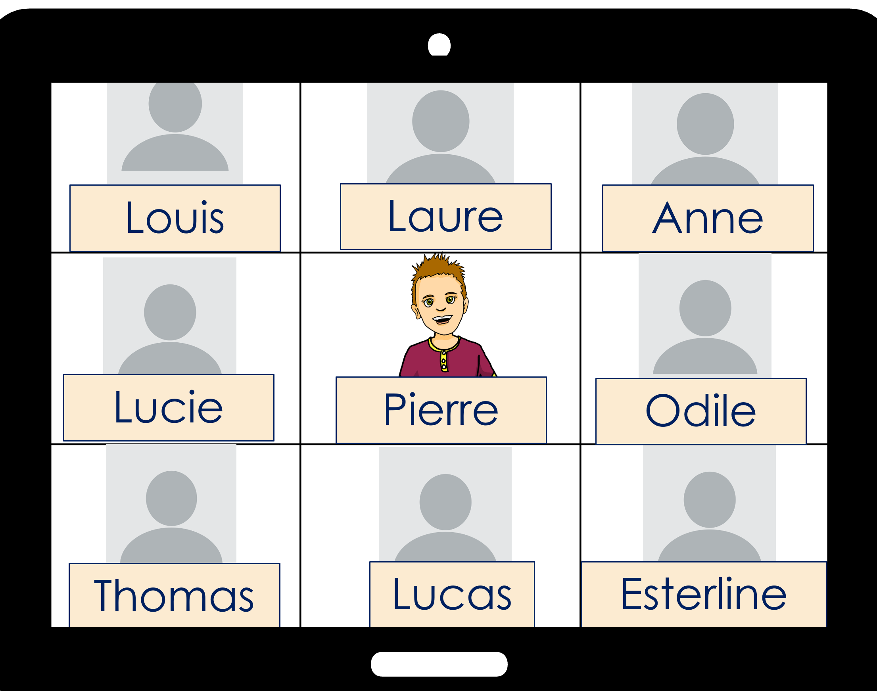
Pierre compare Lorient à Port- au-Prince.
. Écoute les noms des animaux. C’est [ien] ou [(a)in]?
Pierre compare Lorient, en France, à Port-au-Prince, à Haïti.
.
Nous avons…….. Vous avez…….
Notes:
Timing: 1 minute
Aim: to introduce the context for the next activity.
Procedure:
Read the scenario.

Slide 6
vocabulaire
Écoute et répète.
mots
nous avons
we have
Notes:
Timing: 6 minutes (six slides)
Aim: to practise SFC ‘s’ before a consonant and s-liaison before a vowel in sentences with nous avons, vous avez and plural indefinite articles.
Procedure:
Click to bring up the sentence.
Click the audio button to hear the sentence.
Pupils repeat.
Elicit English meaning and click to reveal English and picture.
Continue with the next five slides.
Transcript: nous avons
6

Slide 7
vocabulaire
Écoute et répète.
mots
vous avez
you (all) have
Notes:
[2/6]
Transcript: vous avez
7

Slide 8
vocabulaire
Écoute et répète.
mots
Vous avez des postes.
You (all) have some post offices.
Notes:
[4/6]
Transcript: Vous avez des postes.
8

Slide 9
vocabulaire
Écoute et répète.
mots
Nous avons des magasins.
We have some shops.
Notes:
[3/6]
Transcript: Nous avons des magasins.
9

Slide 10
vocabulaire
Écoute et répète.
mots
Vous avez des écoles.
You (all) have some schools.
Notes:
[6/6]
Transcript: Vous avez des écoles.
10

Slide 11
vocabulaire
Écoute et répète.
mots
Vous avez des églises.
You (all) have some churches.
Notes:
[6/6]
Transcript: Vous avez des églises.
11

Slide 12
vocabulaire
Écoute et répète.
mots
le bâtiment
le marché
[building]
[market]
entre
devant
derrière
[between]
[in front of]
[behind]
Notes:
Timing: 4 minutes
Aim: to introduce the new vocabulary for this week.
Procedure:
Click to bring up the picture, French word and English translation.
Pupils repeat.
Continue with the next four words.
12

Slide 13
écouter
Écoute.
le lieu - place
Pierre compare Lorient à Port-au-Prince.
Écris 1 – 6, ‘you (all)’ ou ‘we’ et le lieu* en anglais.
Salut, Pierre ! Ça va ?
 | you have (all) | we have
place
a market
(some) churches
a shopping centre
(some) parks
(some) modern buildings
(some) museums
1
1
v
2
2
v
3
3
v
4
4
v
5
5
v
6
6
v
Notes:
Timing: 5 minutes
Aim: to practise aural comprehension of avons and avez, and previously taught nouns.
Procedure
Pupils listen to the short sentences and decide if they hear the verb form for ‘we have’ or ‘you (plural) have’.
Click to check.
Pupils listen again and note in English the noun.
Click to reveal answers.
Transcript:
[Vous] avez un marché. [Vous] avez des églises.
[Nous] avons un centre commercial.
[Vous] avez des parcs.
[Nous] avons des bâtiments modernes.
[Nous] avons des musées.
Transcript 2: Vous avez un marché. Vous avez des églises.
Nous avons un centre commercial.
Vous avez des parcs.
Nous avons des bâtiments modernes.
Nous avons des musées.
13

Slide 14
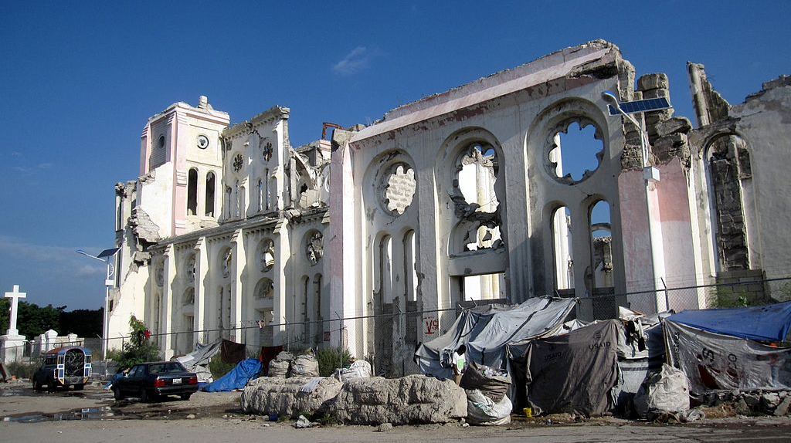
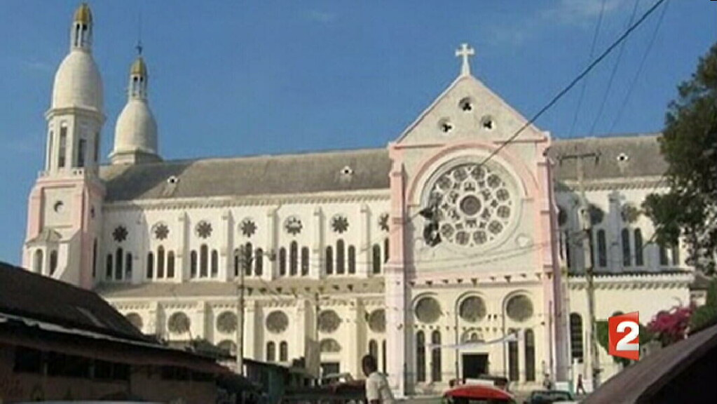
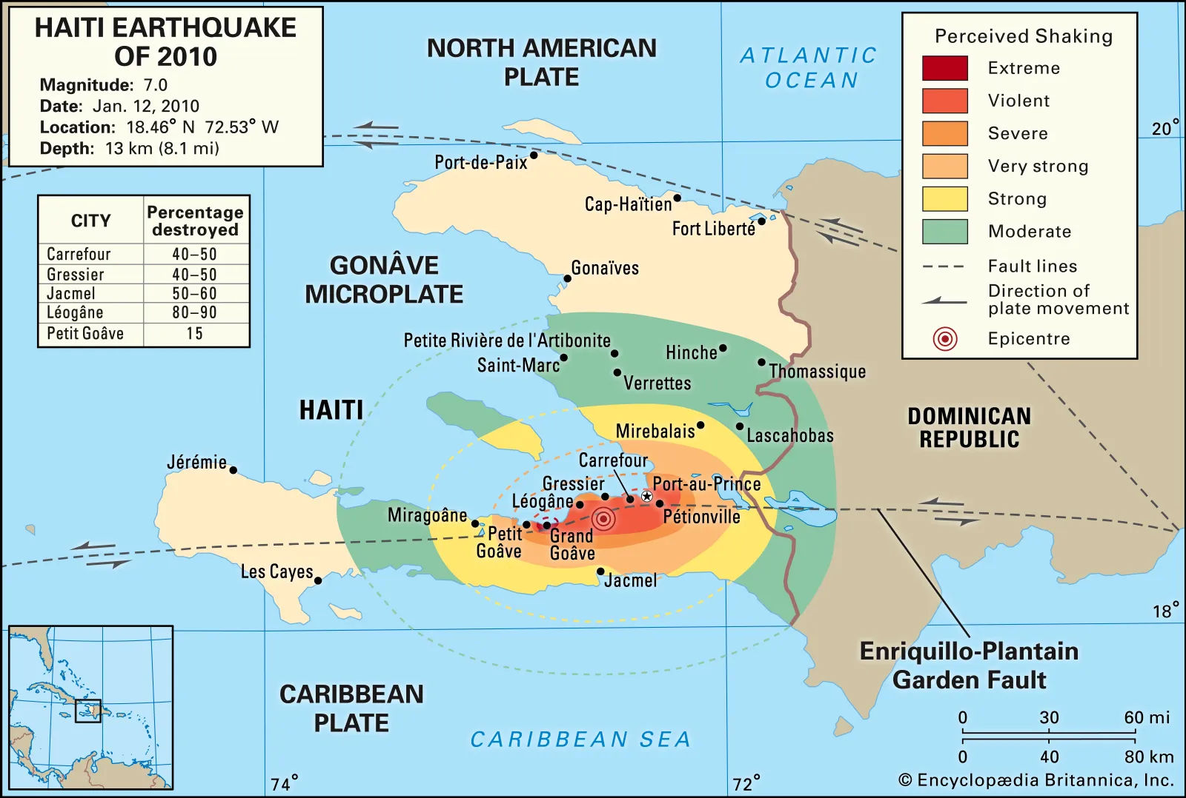
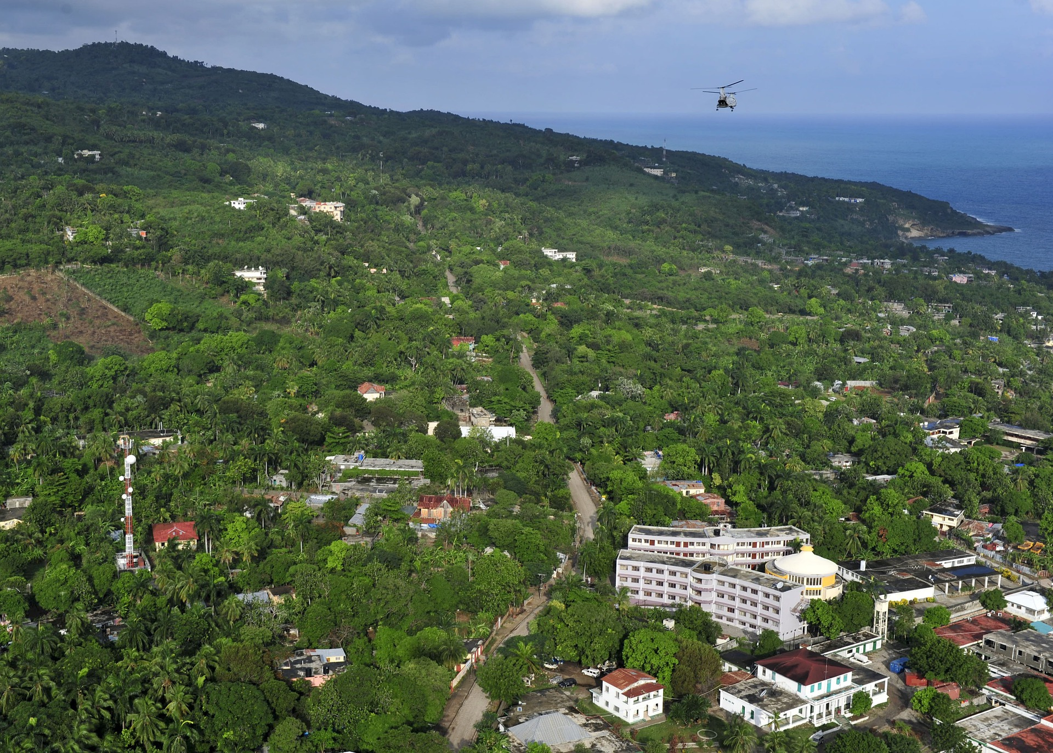
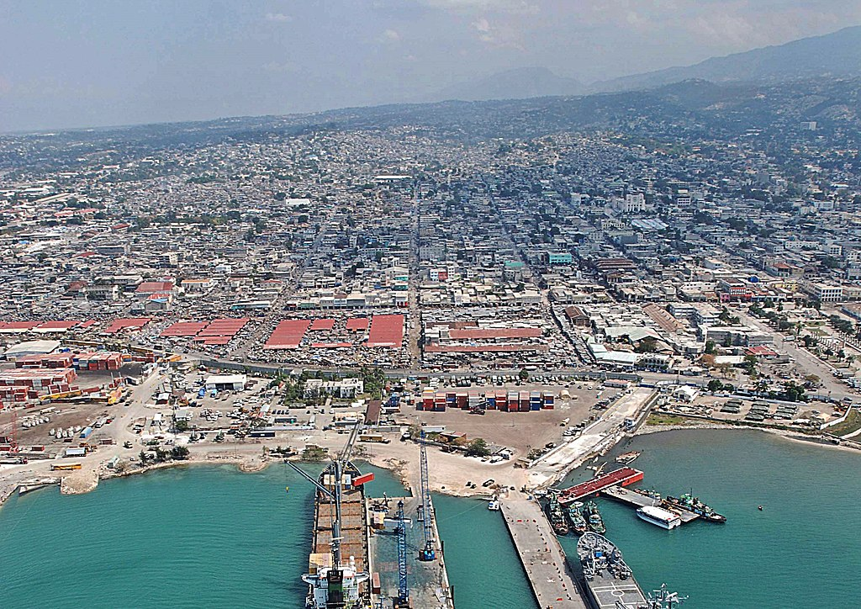
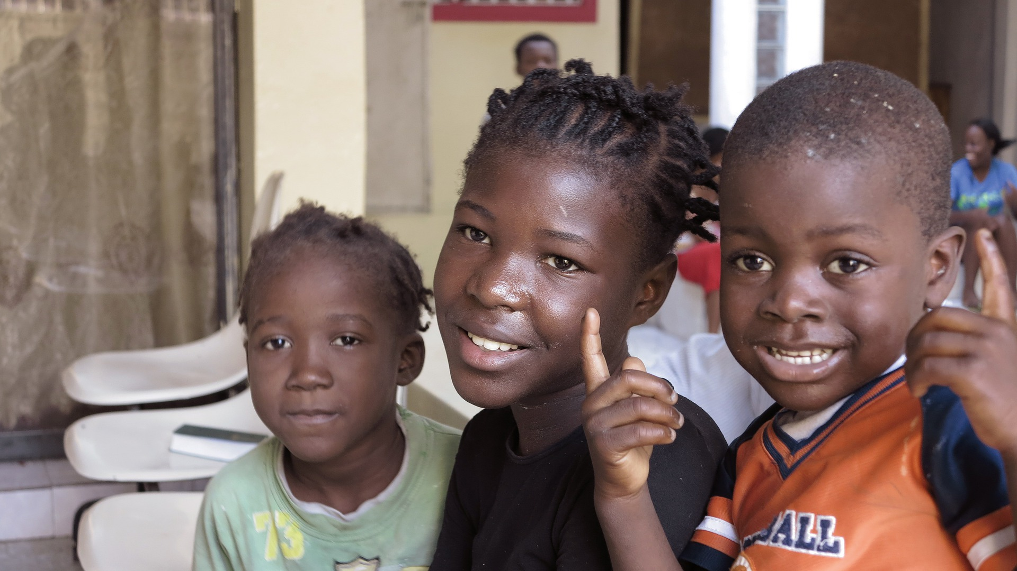
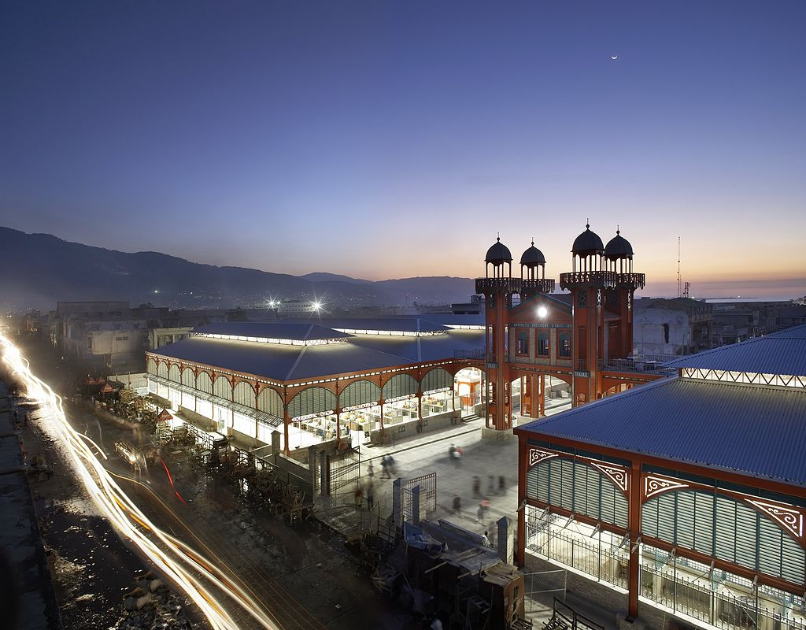
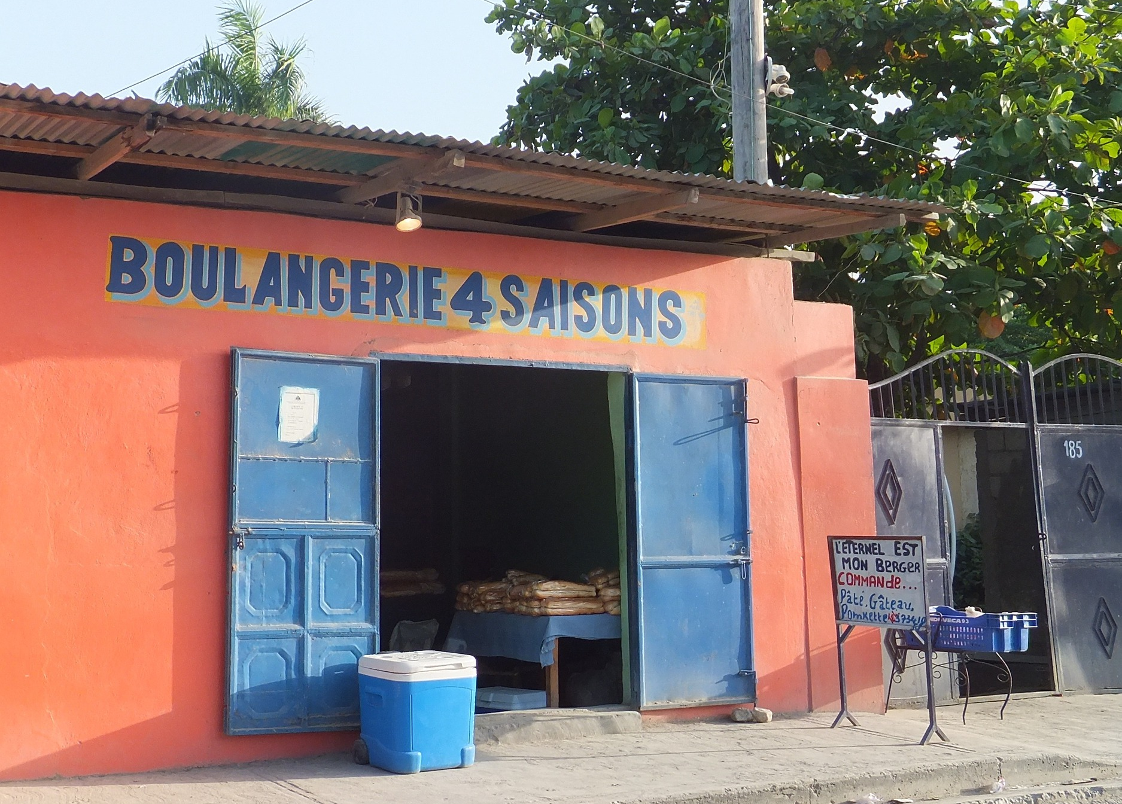
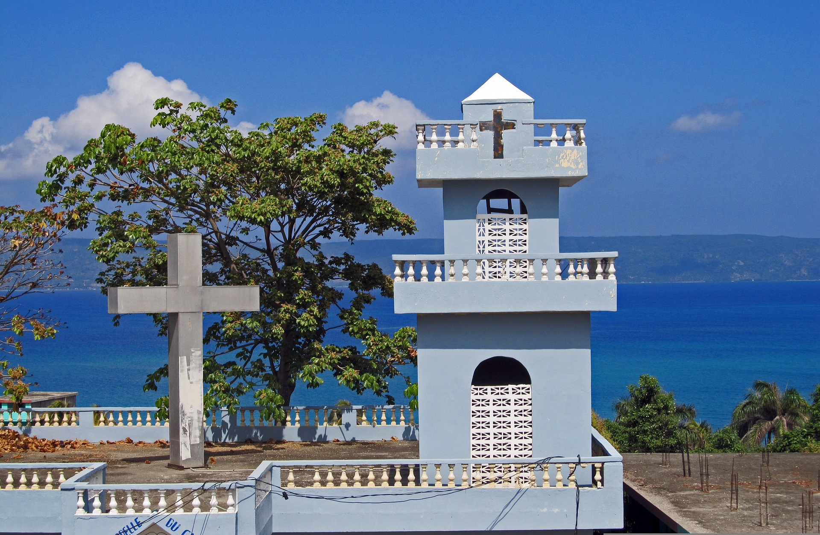
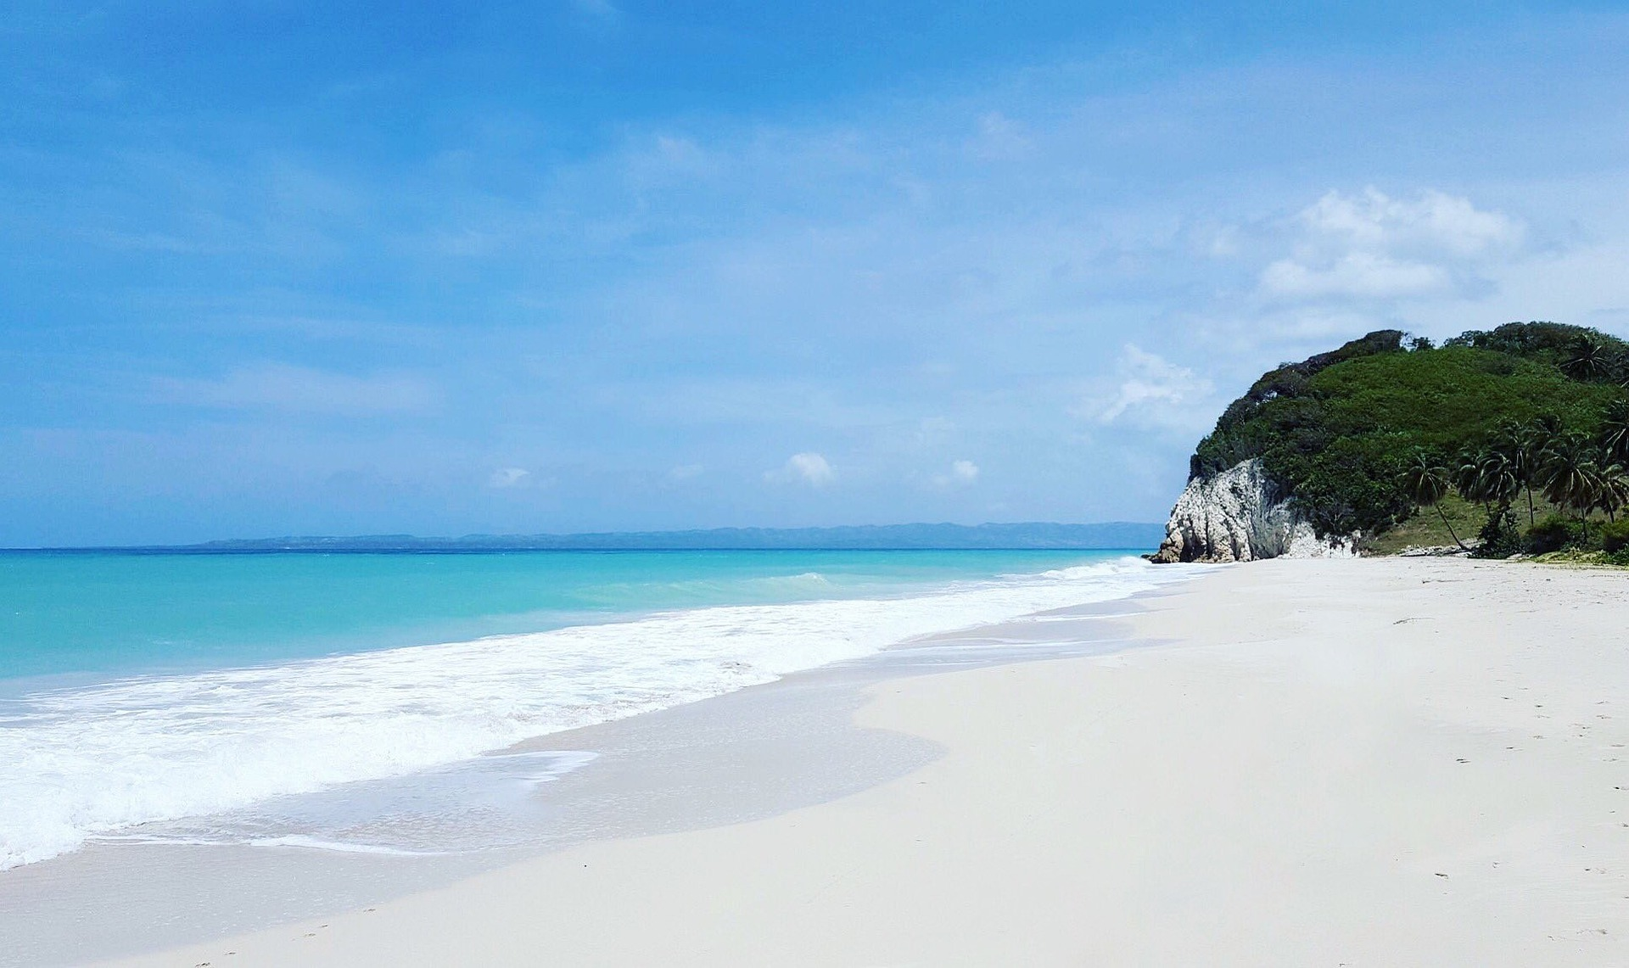
Port-au-Prince est la capitale d’Haïti.
Port-au-Prince
environ - approximately
Port-au-Prince est la capitale d’Haïti.
Elle a une population d’environ* 1.000.000 de personnes.
Nous avons un marché, des magasins, des églises…
Notes:
Timing: 2 minutes (two slides)
Aim: to introduce some information about Port-au-Prince, the capital of Haïti.
Procedure:
Click to hear the title ‘Port-au-Prince’.
Read and listen to the information with pupils.
Check for understanding.
Image attribution: Marché de Fer - Hufton and Crow, CC BY-SA 4.0 via Wikimedia Commons
U.S. Navy photo by Mass Communication Specialist 2nd Class Meranda Keller, Public domain, via Wikimedia Commons
Information: https://en.wikipedia.org/wiki/Port-au-Prince
https://www.britannica.com

Slide 15
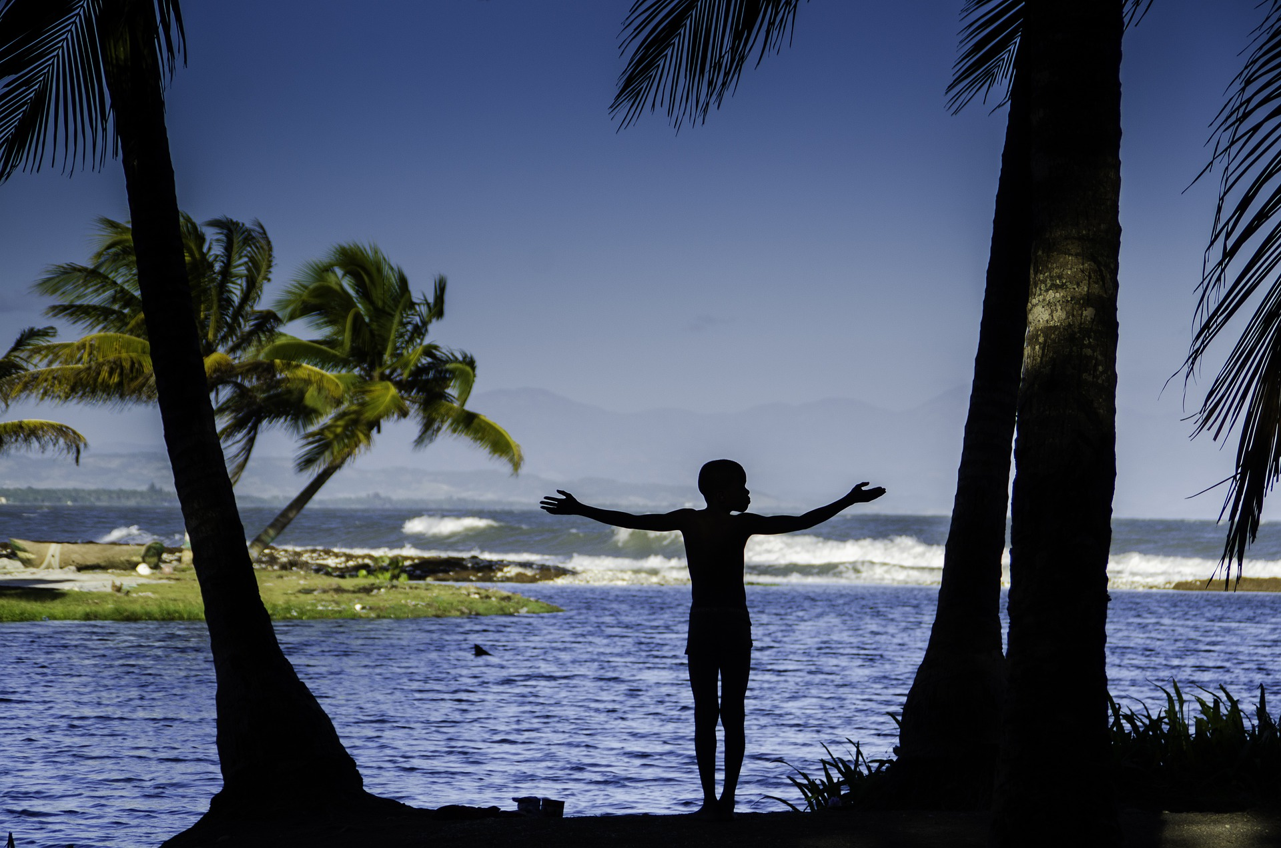
Port-au-Prince
… le 12 janvier 2010 il y a eu un terrible tremblement de terre.
Voici la cathédrale en 2009…
C’est très joli mais…
…et aujourd’hui.
Notes:
[2/2]
Procedure:
Read and listen to the information with pupils.
Check for understanding.
Note: tremblement de terre is not glossed because there is effectively a definition given with the image.
3. Pupils may ask questions about the earthquake in which an estimated 230, 000 people died, and large numbers of buildings were damaged or destroyed. This event devastated the lives of many Haitians. Today the majority of the country’s population lives in poverty, and over a third of the population is aged 15 years or younger.
Image attribution: Notre Dame Cathedral - Stefan Krasowski from New York, NY, USA, CC BY 2.0 via Wikimedia Commons
Notre Dame Cathedral – Mariesophie Bock Digne CC BY 2.0 https://www.flickr.com/photos/planetevivante/4272703276
Haiti earthquake of 2010, Encyclopaedia Britannica - https://www.britannica.com/place/Haiti#/media/1/251961/138132
Information: https://en.wikipedia.org/wiki/Port-au-Prince
https://www.britannica.com

Slide 16
lire
Jean-Michel décrit. C’est où exactement ?
Lis les phrases. C’est quelle image ? Écris 1-6 et la bonne lettre A-H.
1
Le marché est devant l’église.
G
A
B
C
2
Le bâtiment est derrière la parc.
B
3
Le musée est entre la poste et l’école.
H
D
E
4
Le marché est derrière l’école.
F
5
Le bâtiment est devant la poste et l’école.
E
F
G
H
6
Le musée est derrière la poste et l’école.
A
Notes:
Time: 8 minutes
Aim: to practise written comprehension of a range of previously taught and our five new vocabulary items.
Procedure:
Read the context and clarify meaning.
Do number 1 together with pupils to model the task.
Pupils complete 2 – 6.
Click each number to listen to full sentences, if desired. Click to provide correct answers.
Elicit the French for the two unused phrases (click on the letters to hear them) – C. Le marché est derrière l’église. D. Le bâtiment est devant le parc.
Transcript: 1. Le marché est devant l’église.
2. Le bâtiment est derrière la parc.
3. Le musée est entre la poste et l’école.
4. Le marché est derrière l’école.
5. Le bâtiment est devant la poste et l’école.
6. Le musée est derrière la poste et l’école.

Slide 17
Au revoir !
vert
Notes:
17

