Slide 1
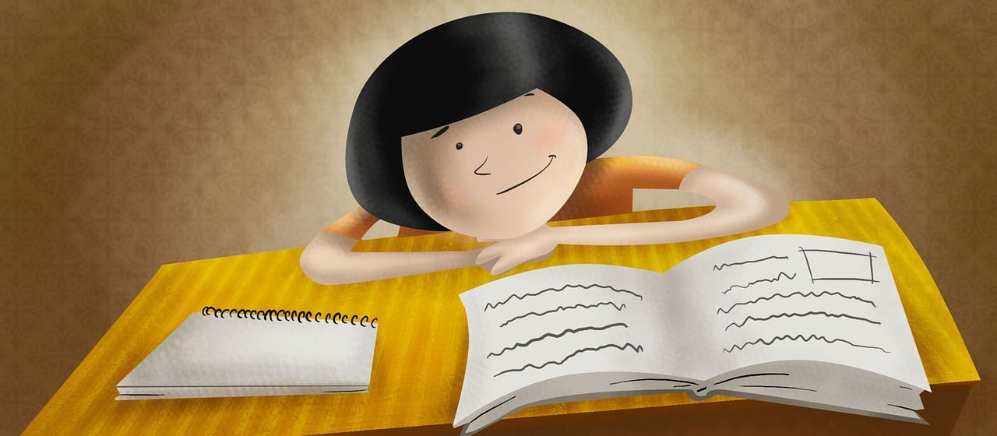
Expressing likes and saying what I and others do
Je révise !
bleu
Révision
Notes:
Artwork by Steve Clarke. Pronoun pictures from NCELP (www.ncelp.org). All additional pictures selected from Pixabay and are available under a Creative Commons license, no
attribution required.
Phonics: Revisit SSC from this term and from previous learning: [-tion] [qu] [-s-] [h] [-ien] [j/g] [ç/c] [SFC] [u] [ou] [(a)in] open [eu] [ch] [(e)au]
Vocabulary: Revisit vocabulary (new words in bold) from this term and from previous learning:
Revisit 1: cyclisme [>5000] exercice [1290] gymnastique [>5000] natation [>5000] ski [4751] sport [2011]
Revisit 2: tu vas je vais [53] tu es je suis [5] à (meaning ‘at/in/to’)[4] marché [280] piscine [>5000]
Londsale, D., & Le Bras, Y. (2009). A Frequency Dictionary of French: Core vocabulary for learners London: Routledge.
The frequency rankings for words that occur in this PowerPoint which have been previously introduced in these resources are given in the SOW and in the resources that first
introduced and formally re-visited those words.
For any other words that occur incidentally in this PowerPoint, frequency rankings will be provided in the notes field wherever possible.
1

Slide 2
prononcer
Je révise
Prononce les mots.
[-tion]
prononcer
la compétition
Notes:
Timing: 5 minutes
Aim: To practise pronunciation of words with a variety of previously taught SSC. This set of 14 unknown words is set out as for the upcoming phonics quiz, to provide pupils with familiarity of the task as part of their revision.
Procedure:
The teacher explains that this is a revisit of 14 different SSC, and that the format is the same as a quiz they will be having next week.
Then s/he clicks through the 7 slides, with two words on each slide, eliciting pronunciation of both the SSC and the unknown word.
3. Click on the word to hear it pronounced. Note: in the quiz itself pupils are not required to produce the SSC but this step is included in the revision, here.
Word frequency of unknown words and cognates:
competition [2651]
2

Slide 3
prononcer
[-tion]
[qu]
prononcer
Congratulations!
[to risk]
Félicitations !
risquer
Notes:
félicitation [4589] risquer [322]
3

Slide 4
prononcer
[-s-]
[h]
prononcer
[tcrisis]
crise
harmonie
Notes:
crise [765] harmonie [4584]
4

Slide 5
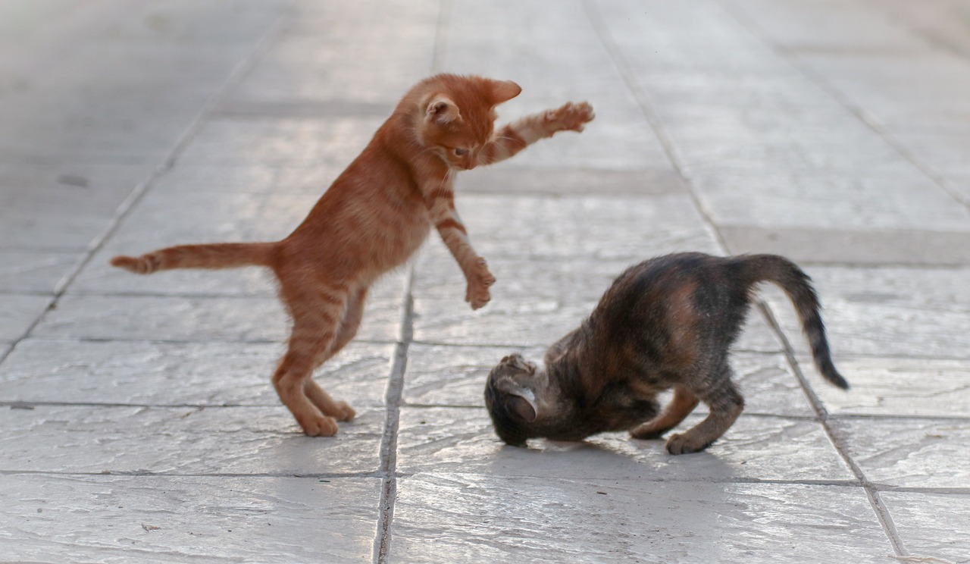
prononcer
[-ien]
[j/g]
prononcer
[to move]
politicien
bouger
Notes:
bouger [1893] politician [3371]
5

Slide 6
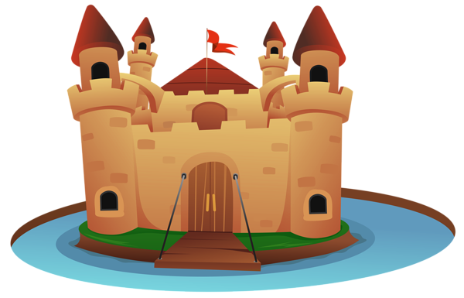
prononcer
[ç/c]
[SFC]
prononcer
[refusal]
[to surround]
cerner
refus
Notes:
cerner [3435] refus [1615]
6

Slide 7
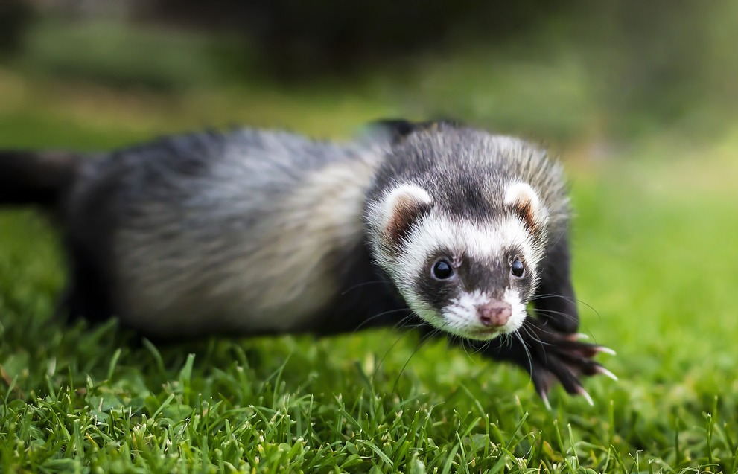
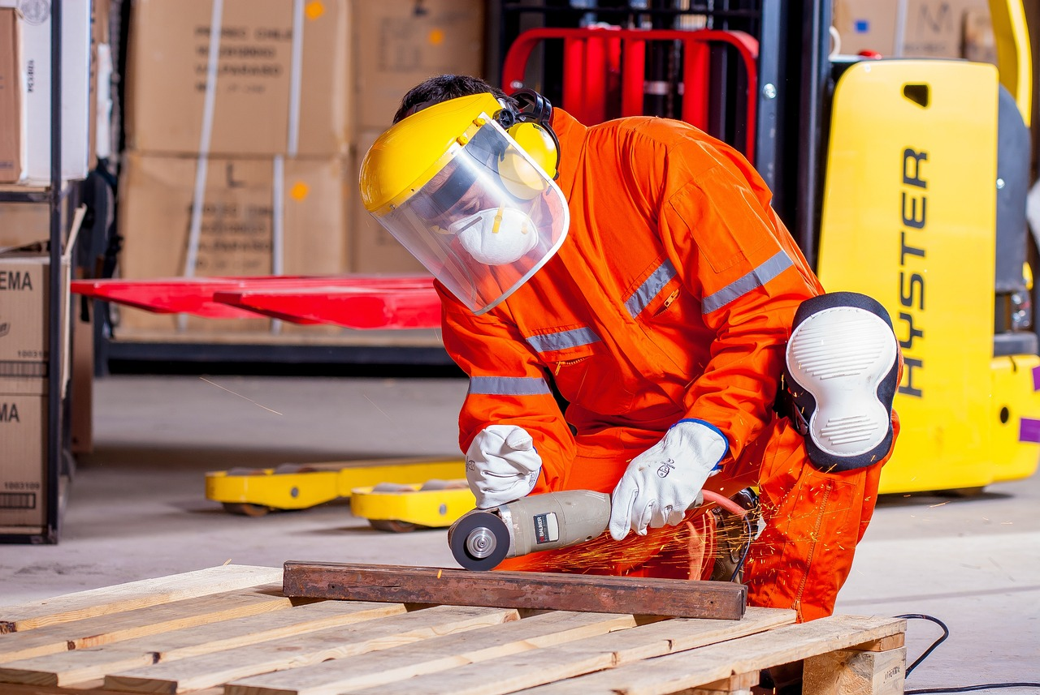
prononcer
[u]
[ou]
prononcer
[ferret]
[worker]
furet
ouvrier
Notes:
furet [>5000] ouvrier [1861]
7

Slide 8
prononcer
open
[(a)in]
[eu]
prononcer
africain
pasteur
Notes:
africain [>5000] Pasteur [4071]
8

Slide 9
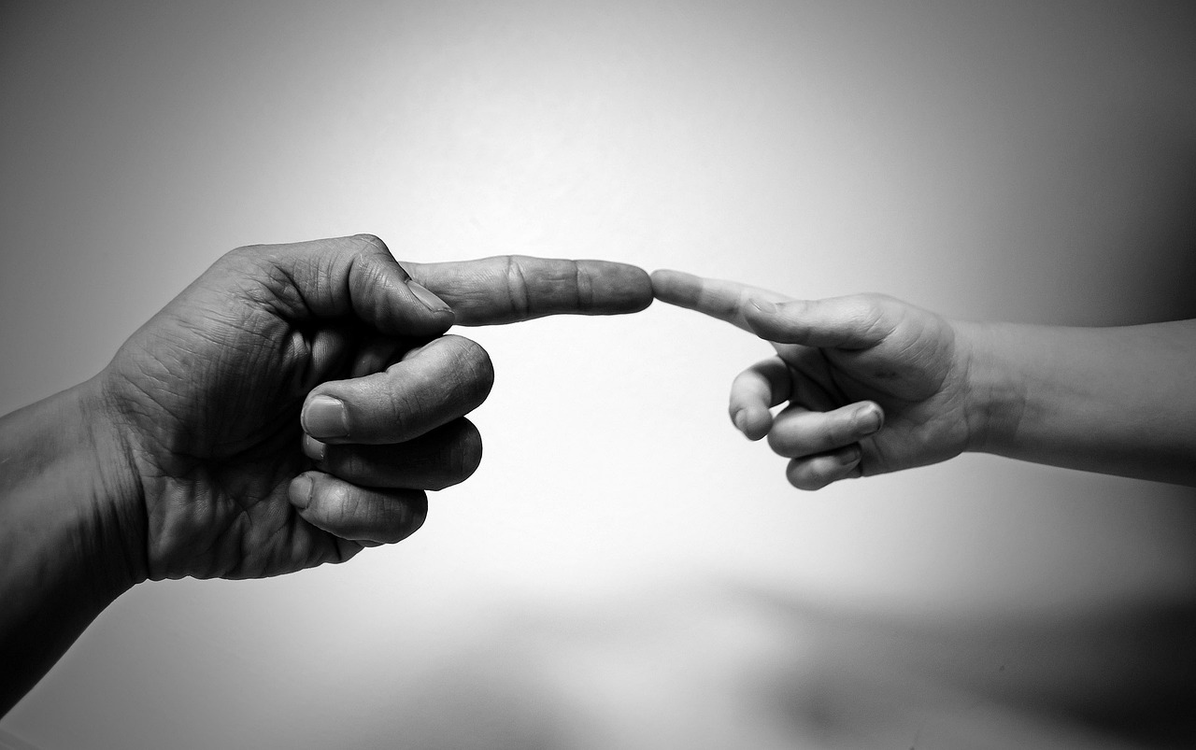
prononcer
[ch]
[(e)au]
prononcer
[brain]
toucher
cerveau
Notes:
cerveau [1990] toucher [231]
9

Slide 10
écrire
Écris un mot correspondant.
lire
 | Catégorie
le ski | la gymnastique | le cyclisme | | sport
le bus | le vélo | le cheval | | transport
le nord | l’ouest | le sud | | directions
le printemps | l’automne | l’été | | saisons
le café | la glace | le poisson | | manger/boire
la fleur | le fruit | le ballon | | dehors
1
la natation
2
la voiture
3
l’est
4
l’hiver
5
l’eau
6
le jardin
car | east | garden | winter | water | swimming
de l’aide
Notes:
Timing: 6 minutes
Aim: to practise written recognition and production of vocabulary.
Procedure:
Pupils try to write one or two words that could plausibly belong to the 9 categories.
Option: decide if to click on the ‘help’ image to bring up a jumbled list of English suggestions to prompt pupils with ideas.
Click to provide possible suggested answers. Note that some of the categories have many possible answers.
4. Option: click to play the optional answers, together with the original words.
10

Slide 11
vocabulaire
Il fait mauvais !
Écris en anglais. Parle en français.
mots
souhaiter
célébrer
échanger
fabriquer
laver
ranger
5
aller
corriger
fermer
4
acheter
boire
3
expliquer
2
détester
faire
aimer
1
Notes:
Timing: 5 minutes (two slides)
Aim: to practise written comprehension of a range of infinitive verbs.
Procedure:
Tell pupils to be ready to write the English meanings of verbs they have been learning and practising in their course. There will be 15 altogether and they should prepare to work from the bottom of the slide, left to right.
Explain the scenario – it’s raining and the raindrops will splash down and cover the words. They need to write the meanings before the verbs get covered. Tell them they will have 5 seconds to get a headstart on the rain.
Click to start number animation.
Click once more to start raindrops. The timing has been carefully set! Don’t click again or all the raindrops will appear at once.
When finished move to the next slide to check answers.
11

Slide 12
vocabulaire
Il fait mauvais !
Écris en anglais. Parle en français.
mots
souhaiter
célébrer
échanger
to wish, wishing
to celebrate, celebrating
to exchange, exchanging
fabriquer
laver
ranger
to create, make
to wash, washing
to tidy, put away
aller
corriger
fermer
to go, going
to correct, correcting
to shut, shutting
acheter
boire
expliquer
to buy, buying
to drink, drinking
to explain, explaining
détester
faire
aimer
to hate, hating
to do, doing
to like, liking
Notes:
Aim: to practise spoken production of 15 previously taught verbs.
Procedure:
Click to bring up all the English answers for pupils to check their work.
Click to disappear the French verbs individually and elicit the French from pupils, orally.
(The verbs disappear in a random order).
12

Slide 13
faire de (do) and jouer à (play) with sports
Remember! To say ‘do’ with sports, use faire de:
Je fais du sport.
⚠ This use of ‘de’ + article is called the partitive.
I do (some) sport.
⚠ de + le → du
Tu fais de la danse.
You do (some) dance/dancing.
Use jouer + à + le/la to say what sport you play:
Je joue au football.
I play football.
⚠ à + le → au
Elle joue à la corde.
She plays skipping.
Notes:
Timing: 2 minutes
Aim: to revisit the partitive article ‘de’ with sports and contrast it with faire + un/une + nouns.
Procedure:
Click through the animations.
Elicit English from pupils following the ?.
Note: in weeks 8 and 9 pupils will also learn to use the partitive with other nouns (food and drink).

Slide 14
The partitive article
We use it in French for an ‘unspecified amount or ‘part’.
du, de la, de l’, des
You have also used the partitive article to mean ‘some’ with food and drink:
the
a/an
some
le
un
du poisson
some fish
la
une
de la glace
some ice cream
Remember: l’ = the for any noun that starts with a vowel or silent ‘h’.
l’
une
de l’ eau
some water
Notes:
Timing: 2 minutes
Aim: to revisit the definite, indefinite and partitive articles.
Procedure:
Click through the animations to present the information.
Elicit English translations for the French examples provided.

Slide 15
lire
Jean-Michel écrit un message à Pierre.
Il y a un problème avec l’ordinateur ! Lis le message et écris les bons articles (1-8).
Salut Pierre ! Ça va ? J’aime bien l’ été ! Ici, il fait beau tous les jours. À l’école, j’aime faire du sport. Il n’y a pas de piscine mais nous allons à la plage et nous faisons de la natation. Nous aimons aussi jouer au volley. Quand je suis à la maison, j’aime faire la cuisine dans le jardin– un barbecue, bien sûr ! Nous mangeons du poisson et de la salade - c’est super ! Et toi ? Qu’est-ce que tu aimes faire en été ?


Activité | J-M (I) | J-M + (we)






Notes:
Timing: 10 minutes
Aim: written comprehension of key vocabulary and grammar from Term 3.
Procedure:
Teacher to read the context and ensure this is clear.
Pupils to read the message aloud in pairs.
First, they need to write all the articles that are missing.
Then they look at the activities pictured and decide if just J-M does them or if he does them with others (we).
Elicit answers from pupils and click to bring up answers.
Note: in the audio version, click on the message to hear it in full.

Slide 16
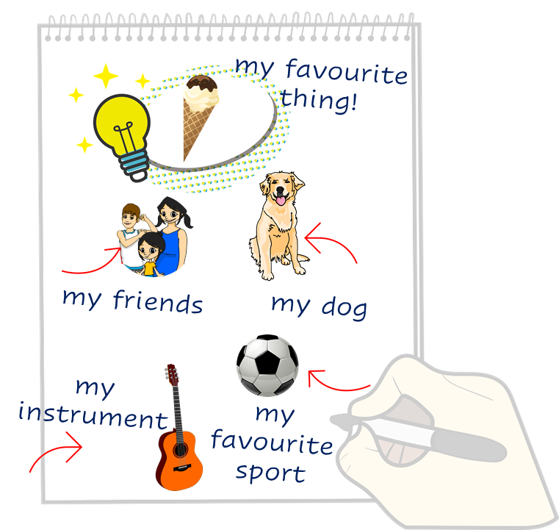
écrire
Lis le texte. Écris des mots en français.
Just have a go! Write any of these English words in French. You can add different words, too.
Pierre writes to Max in English. Max wants to reply in French. Can you help him?
lire
Hello! How are you?
I like writing in English!
I love the summer. It’s hot today.
I like swimming. I go to the pool with my friends.
But I hate doing homework in June!
Do you like going to the beach? What do you play?
Notes:
Timing: 6 minutes
Aim: to practise written production of vocabulary and structures.
Aim: to practise written production of this term’s vocabulary and to practise written production of short sentences.
Note: This is a less challenging version of the activity, where pupils are encouraged to write any word and/or phrases they can in French.
Procedure:
Pupils read the message from Pierre in the green text box.
Pupils use Pierre’s message and the words and pictures on the notebook to the right as inspiration. They use the lines on the left and the empty notepad to write any words or sentences in French that they could use to reply to Pierre.
16

Slide 17
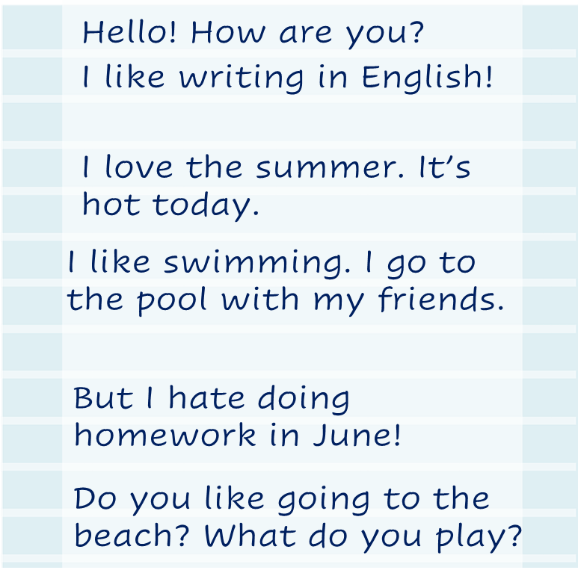
écrire
Écris en français.
Write a message to Pierre in French. Write anything you like. You can write short sentences or words or a mixture, like Pierre.
Pierre writes to Max in English. Max wants to reply in French. Can you help?
lire
Notes:
Timing: 8 minutes
Aim: to practise written production of this term’s vocabulary and to practise written production of short sentences.
Note: This is a more challenging version of the activity, where pupils are encouraged to write a mixture of sentences and words. A more straightforward version of the activity can be found on the previous slide, where pupils are asked to write individual words.
Procedure:
Pupils read the message from Pierre in the green text box.
Pupils use Pierre’s message and the words and pictures on the notebook to the right as inspiration. They use the lines on the left and the empty notepad to write any words or sentences in French that they could use to reply to Pierre.
17

Slide 18
Au revoir !
bleu
Notes:
18

