Slide 1
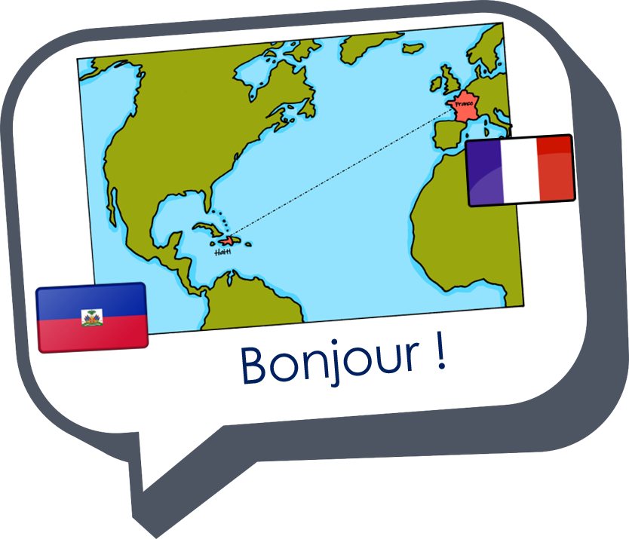
Saying what I and others do
bleu
Follow ups 1-5
Notes:
Artwork by Steve Clarke. Pronoun pictures from NCELP (www.ncelp.org). All additional pictures selected from Pixabay and are available under a Creative Commons license, no attribution required.
Phonics: Revisit SSC [-qu-] question[144] quatre[283] musique [1139] expliquer [252] unique [402]
Vocabulary (new words in bold): cyclisme [>5000] exercice [1290] gymnastique [>5000] natation [>5000] ski [4751] sport [2011]
Revisit 1: Il fait [25] automne [1503] été [623] printemps [1288] hiver [1586] beau [393] mauvais [274] chaud [1852] froid [1307] quand [119]
Revisit 2: cacher [914] maintenant [192] normalement [2018]
Londsale, D., & Le Bras, Y. (2009). A Frequency Dictionary of French: Core vocabulary for learners London: Routledge.
The frequency rankings for words that occur in this PowerPoint which have been previously introduced in these resources are given in the SOW and in the resources that first
introduced and formally re-visited those words.
For any other words that occur incidentally in this PowerPoint, frequency rankings will be provided in the notes field wherever possible.

Slide 2
[qu]
prononcer
question
Notes:
Timing: 1 minute
Aim: To introduce SSC [qu]
Procedure: 1. Present the letter(s) and say the [qu] sound first, on its own. Students repeat it with you. 2. Bring up the word ”question” on its own, say it, students repeat it, so that they have the opportunity to focus all of their attention on the connection between the written word and its sound.
3. Say the word and do the gesture, if using.
4. Roll back the animations and work through 1-3 again, but this time, dropping your voice completely to listen carefully to the students saying the [qu] sound, pronouncing ”question” and, if using, doing the gesture.
Gesture: https://www.signbsl.com/sign/question
The 2nd video from the left – trace the shape of a question mark in the air
Word frequency (1 is the most frequent word in French):
question [144]
Source: Londsale, D., & Le Bras, Y. (2009). A Frequency Dictionary of French: Core vocabulary for learners London: Routledge.
2

Slide 3
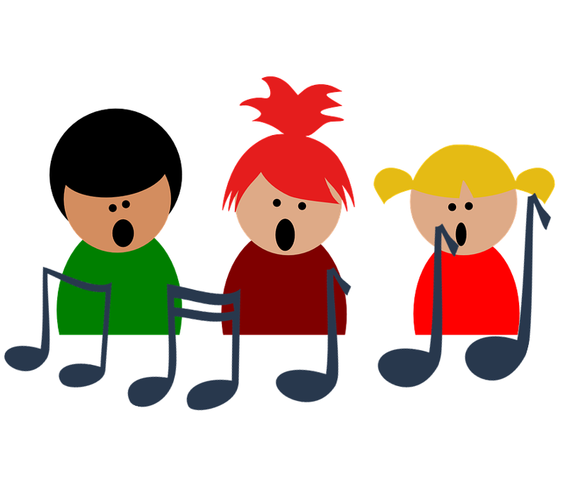
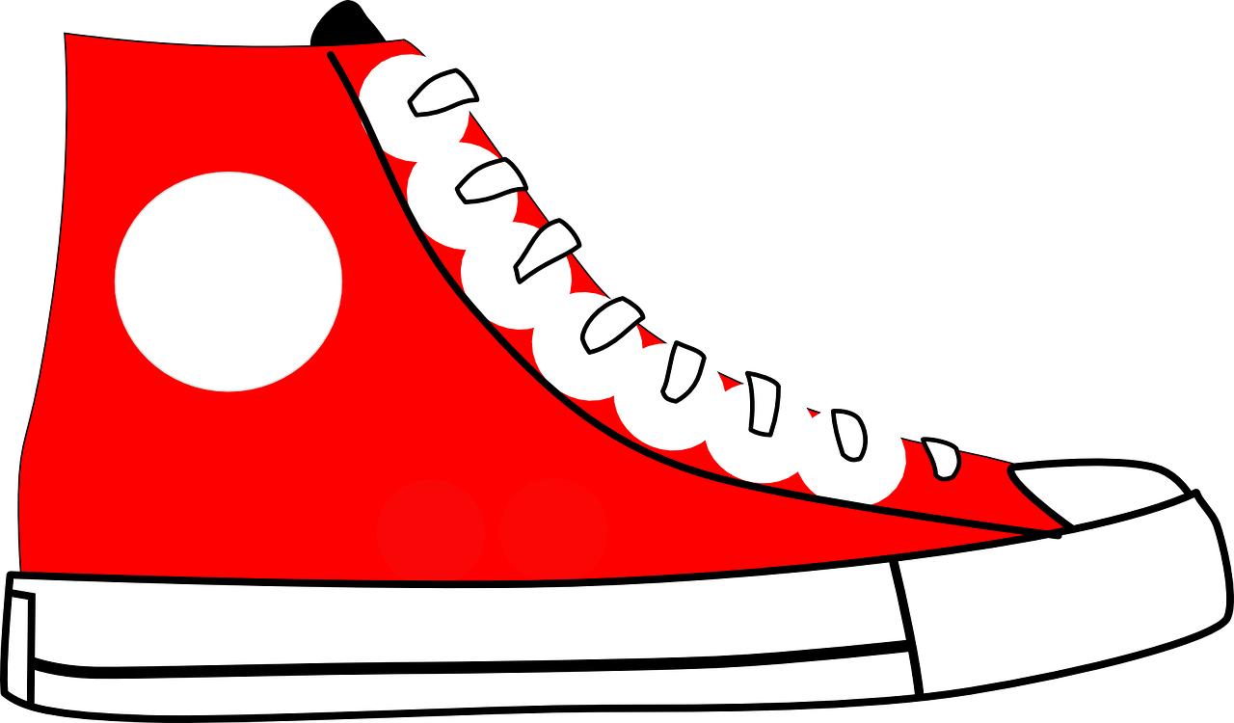
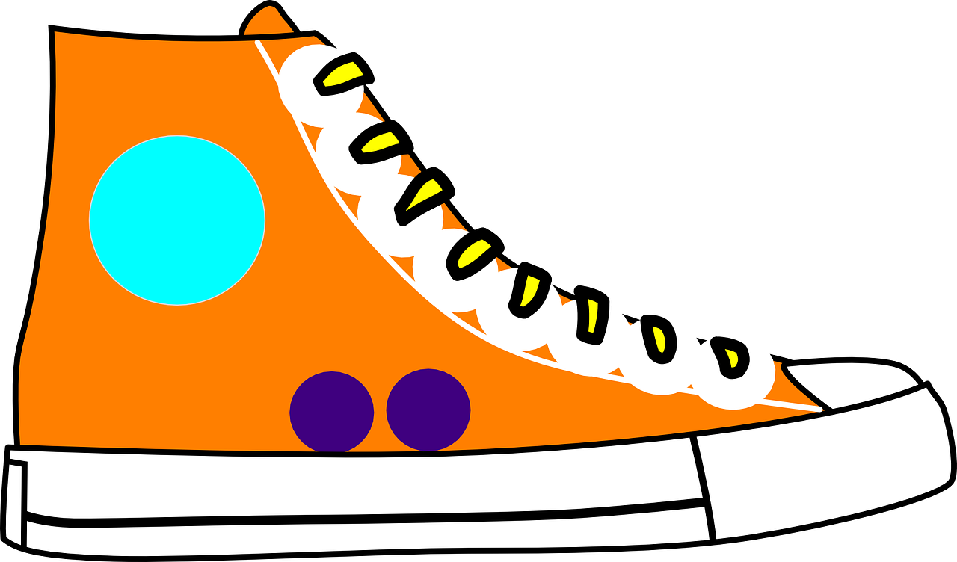
[qu]
prononcer
to explain
quatre
expliquer
question
musique
unique
Notes:
Timing: 2 minutes
Aim: To introduce SSC [qu]
Procedure:
1. Introduce and elicit the pronunciation of the individual SSC [qu] and then the source word again ‘question’ (with gesture, if using). 2. Then present and elicit the pronunciation of the four cluster words.
The cluster words have been chosen for their high-frequency, from a range of word classes, with the SSC (where possible) positioned within a variety of syllables within the words (e.g. initial, 2nd, final etc.). Additionally, we have tried to use words that build cumulatively on previously taught SSCs (see the Phonics Teaching Sequence document) and do not include new SSCs. Where new SSCs are used, they are often consonants which have a similar symbol-sound correspondence in English.
Word frequency: quatre [283] musique [1139] expliquer [252] unique [402] question [144] Source: Londsale, D., & Le Bras, Y. (2009). A Frequency Dictionary of French: Core vocabulary for learners London: Routledge.
3

Slide 4
prononcer
Follow up 1
Prononce les sports. C’est un sport olympique ?
l’équitation
le ski nautique
l’escalade
la gymnastique
la pétanque
le karaté
le canoë-kayak
le skateboard
le tir à l’arc
le patinage artistique
les courses de ballons
la canne de combat
Notes:
Timing: 5 minutes
Aim: to practise oral production of [-qu-] and [c]/[k] in sports, most of which are unknown words, but cognates.
Procedure:
Ensure that pupils know these are all French words that are similar to English words, but may not sound the same.
Pupils pronounce all the words with a partner.
Elicit pupils’ pronunciations, chorally.
Click on each word to hear the audio, if desired.
Note that this activity can also be the game in which one pupil selects 3 of the sports, and the other has 30 seconds to try to discover his/her partner’s choices by naming the correct 3 sports.
Information – Olympic sports: https://olympics.com/en/sports/ Sports come in and out of the Olympics but there is a good link here with pictograms of the sports. Those not included appear to be: pétanque, courses de ballons, escalade. I think many pupils will spot these are not Olympic sports.
Picture attribution: Fencing/Canne de combat - Thadius856, Public domain, via Wikimedia Commons Waterskiing – Thadius856, Public domain, via Wikimedia Commons
4

Slide 5
Follow up 2:
Tu fais quel sport ? Tu fais quelle activité ?
Exemple :
parler
Personne A lit la phrase.
Personne B complète la phrase avec le bon mot.
Tu fais de la…
…gymnastique.
gymnastique
1
1 | Tu fais de la ……..
Listen out for the article – if you hear du, de la, de l’ you know the sentence finishes with a sport.
Notes:
Timing: 5 minutes (three slides)
Aim: to practise oral production of t-liaison (or silent final consonant –t) with c’est before vowels and consonants.
Procedure: 1. Model the task using the example. Click to demonstrate each step.
2. Give out the handouts (at the end of this PPT). 2. Pupil As start by saying the first half of the sentence (this is a read aloud element).
3. Pupil Bs listen and finish their partner’s sentence correctly. (this is a listening element, paying attention to the article, but also a speaking element, as they need to produce the correct noun from memory).
4. Pupil As complete the English sentence meanings appropriately, writing down the word. (this is a transcription element).
5. After Round 1, pupils swap roles.
6. Use the next two slides to elicit feedback; note that this part of the activity could be completed the next day, too.

Slide 6
Follow up 2: Réponses [Round 1]
A
B
1 | Tu fais de la ……………
2 | Tu fais du….……………
3 | Tu fais un ….……………
4 | Tu fais une. ……………
5 | Tu fais de l’ ……………
gymnastique
1
2
3
4
5
sport
gâteau
visite
exercice
Notes:
ANSWERS [1] – DO NOT DISPLAY DURING THE SPEAKING ACTIVITY
Procedure: Elicit the answers from pupils orally (as a whole class) and click to reveal the spelling of the nouns.

Slide 7
Follow up 2: Réponses [Round 2]
B
A
1
2
3
4
5
1 | Tu fais du………………
2 | Tu fais la….……………
3 | Tu fais les ….……………
4 | Tu fais du….……………
5 | Tu fais de la ……………
cyclisme
cuisine
courses
ski
natation
= activity
Notes:
ANSWERS [2] – DO NOT DISPLAY DURING THE SPEAKING ACTIVITY
Procedure: Elicit the answers from pupils orally (as a whole class) and click to reveal the spelling of the nouns.

Slide 8
Follow up 3:
Adèle écrit un email à Sanaya.
Lis. Choisis la bonne image. Écris les détails en anglais.
lire
Salut Sanaya ! Qu’est-ce que je fais normalement ?
Alors, quand il fait froid, je fais des activités chez moi. Par exemple, je fais la cuisine avec mon père ou j’écoute de la musique dans ma chambre. Parfois, je fais le ménage pour aider Maman. Quand il fait beau, je joue dans le jardin et le samedi, je fais de la natation avec ma sœur. Et toi ? Tu fais quoi maintenant ?
activities | weather | extra info?
does activities
cooks
listens to music
does housework
plays
swims
at home
with dad
in her room
to help mum
in garden
with sister
Is there a detail that seems wrong in this email?
Yes! Adèle has a brother, not a sister!
Notes:
Timing: 10 minutes [version 1]
Aim: written comprehension of key vocabulary and hacer for weather.
Procedure:
Teacher to read the context and ensure this is clear.
Pupils to read the message aloud in pairs. Looking at the activities listed, they need to decide when Adèle does them (when it’s cold or hot) and note down an extra detail. [Next slide offers a more challenging version of this task]
Elicit answers from pupils and click to bring up answers. Ask pupils how they knew and elicit French from them (does gardening → the text says ‘je fais des activités’).
Note: in the audio version, click on the message to hear it in full.

Slide 9
Follow up 3:
Adèle écrit un email à Sanaya.
Lis. Choisis la bonne image. Écris les détails en anglais.
lire
Salut Sanaya ! Qu’est-ce que je fais normalement ?
Alors, quand il fait froid, je fais des activités chez moi. Par exemple, je fais la cuisine avec mon père ou j’écoute de la musique dans ma chambre. Parfois, je fais le ménage pour aider Maman. Quand il fait beau, je joue dans le jardin et le samedi, je fais de la natation avec ma sœur. Et toi ? Tu fais quoi maintenant ?
activities | weather | extra info?
does activities
at home
cooks
with dad
listens to music
in her room
does housework
to help mum
plays
in garden
swims
with sister
Is there a detail that seems wrong in this email?
Yes! Adèle has a brother, not a sister!
Notes:
Timing: 10 minutes [version 2]
Aim: written comprehension of key vocabulary and revisit faire for weather.
Procedure:
Teacher to read the context and ensure this is clear.
Pupils to read the message aloud in pairs.
3. Pupils to find the 7 activities mentioned by Adèle, when he does them and any extra information.
Note: in the audio version, click on the message to hear it in full.

Slide 10
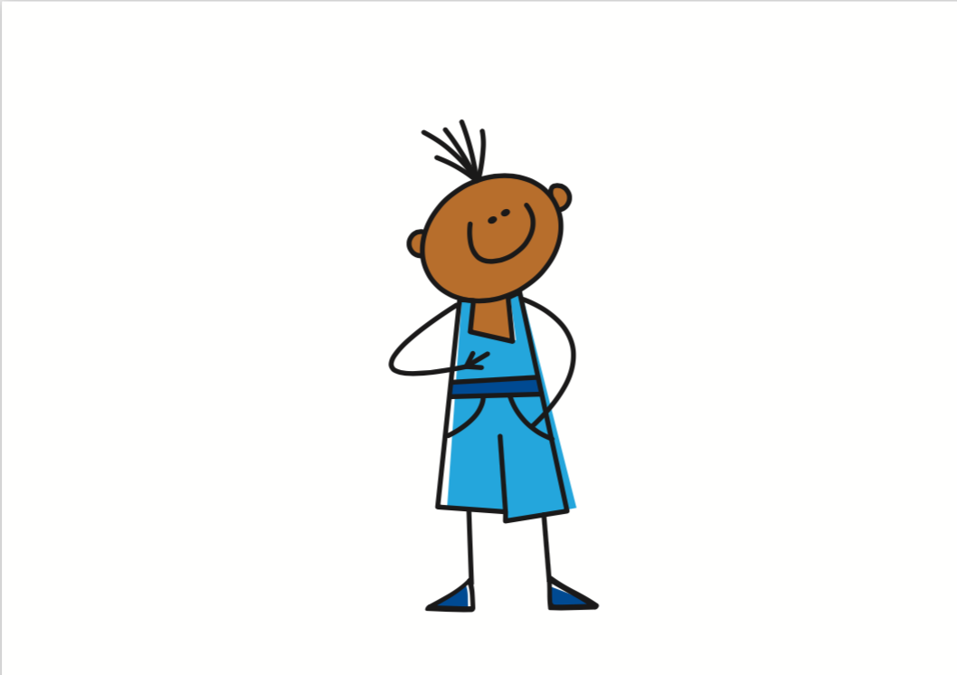
Follow up 4
⚠ Remember, to say ‘it’s hot weather’ use ‘il fait + heat’.
Écris les phrases en français.
heat
écrire
En été, quand il fait chaud, je fais de la natation.
1
In
summer
when
it’s hot
Au printemps, il fait beau et je joue à la corde dans le jardin.
2
In
it’s
and
in
the
spring
fine/good
En automne, il fait souvent mauvais et je fais de l’exercice à la maison.
autumn
it’s
often
bad
and
at
the
3
In
En hiver, il fait froid et je regarde la télévision avec ma famille.
4
In
it’s
and
with
my
winter
cold
Notes:
Timing: 5-10 minutes
Aim: to practise written production of language and structures from this week.
Procedure:
Do the first item together with pupils.
Pupils complete 2-4.
Elicit answers orally, and click to confirm.
Note that in the audio version, you can click on the numbered buttons to hear the full sentences pronounced.

Slide 11
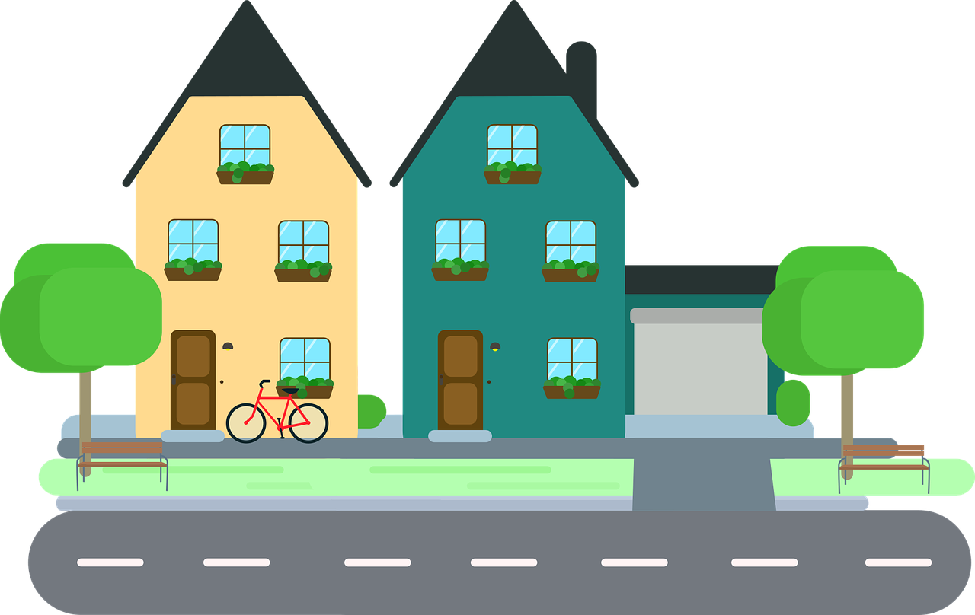
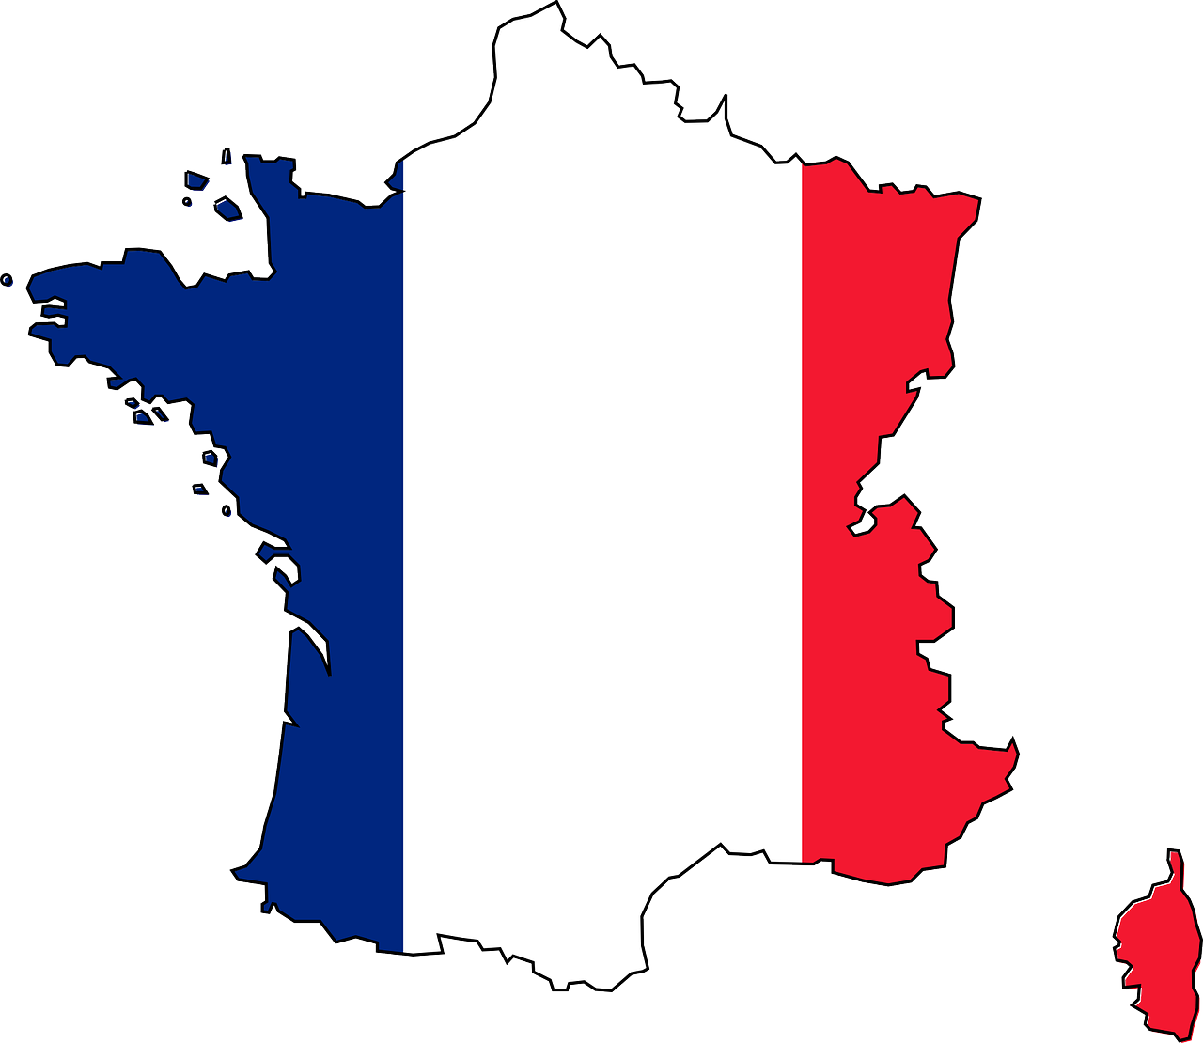
Follow up 5a
Écoute bien. C’est quelles images ?
A | B | C
D | E | F
G | H | I
écouter
1
C, B, F
summer
2
G, A, H
3
E, I, D
winter
Notes:
Timing: 5 minutes
Aim: to practise aural comprehension of longer sentences with familiar language.
Procedure:
Teacher clarifies pupils need to work out which three images match to each listening passage.
Pupils can be encouraged to make notes in English to help them.
When pupils have suggested their answers, click to reveal.
Transcript:
Le tour de France est une course cycliste en juillet en France.
En hiver au Canada tout le monde joue au hockey sur glace. À Haïti les enfants jouent au football dans la rue.

Slide 12
vocabulaire
Follow up 5a - Écris en anglais : Can you get at least 15 points?
mots
 | cacher | maintenant | normalement
 | mauvais | chaud | froid
 | le printemps | l’hiver | beau
 | Il fait | l’automne | l’été
 | le ski | je fais | quand
 | le cyclisme | la gymnastique | la natation
to hide, hiding
now
normally
x3
bad
heat
cold
(the) spring
(the) winter
fine/good
x2
he does/makes
(the) autumn
(the) summer
(the) skiing
I do/make
quand
x1
(the) cycling
(the) gymnastics
(the) swimming
Notes:
Timing: 5-10 minutes
Aim: to practise written production of vocabulary from this week and two revisited weeks.
Procedure: 1. Give pupils a blank grid. They fill in the English meanings of any of the words they know, trying to reach 15 points in total. 2. Remind pupils that adjectives can refer to male or female persons and they should note this in their translations. E.g. pleased (f), short (m).
Note: The most recently learnt and practised words are pink, words from revisit 1 are green and those from revisit 2 are blue, thus more points are awarded for them, to recognise that memories fade and more effort (heavy lifting!) is needed to retrieve them.
12

Slide 13
vocabulaire
Follow up 5b - Écris en français : Can you get at least 15 points?
mots
 | to hide, hiding | now | normally
 | bad | heat | cold
 | (the) spring | (the) winter | fine/good
 | he does/makes | (the) autumn | (the) summer
 | (the) skiing | I do/make | when
 | (the) cycling | (the) gymnastics | (the) swimming
cacher
maintenant
normalement
x3
mauvais
chaud
froid
le printemps
l’hiver
beau
x2
il fait
l’automne
l’été
le ski
je fais
quand
x1
le cyclisme
la gymnastique
la natation
Notes:
Timing: 5-10 minutes
Aim: to practise written comprehension of vocabulary from this week and previous weeks.
Procedure: Give pupils a blank grid. They fill in the French meanings of any of the words they know, trying to reach 15 points in total.
Note: The most recently learnt and practised words are pink, words from the previous week are green and those from earlier are blue, thus more points are awarded for them, to recognise that memories fade and more effort (heavy lifting!) is needed to retrieve them.
13

Slide 14
Follow up 2: Handout A
Read aloud the start to each sentence. Listen to how your partner finishes it and write in the final word.
Listen. Do you hear ‘de’ (du, de la, de l’)? If so, choose and say the sentence ending which is a sport / the correct sport.
1 | Tu fais de la ……………
2 | Tu fais du….……………
3 | Tu fais un ….……………
4 | Tu fais une. ……………
5 | Tu fais de l’ ……………
1
2
3
4
5
= activity
Notes:
HANDOUT

Slide 15
Follow up 2: Handout B
Now read aloud the start to each sentence. Listen to how your partner finishes it and write in the final word.
Listen. Do you hear ‘de’ (du, de la, de l’)? If so, choose and say the sentence ending which is a sport / the correct sport.
1
2
3
4
5
1 | Tu fais du………………
2 | Tu fais la….……………
3 | Tu fais les ….……………
4 | Tu fais du….……………
5 | Tu fais de la ……………
Notes:
HANDOUT

Slide 16
vocabulaire
Follow up 5a - Écris en anglais : Can you get at least 15 points?
mots
 | cacher | maintenant | normalement
 | mauvais | chaud | froid
 | le printemps | l’hiver | beau
 | Il fait | l’automne | l’été
 | le ski | je fais | quand
 | le cyclisme | la gymnastique | la natation
x3
x2
x1
Notes:
HANDOUT
16

Slide 17
vocabulaire
Follow up 5b - Écris en français : Can you get at least 15 points?
mots
 | to hide, hiding | now | normally
 | bad | heat | cold
 | (the) spring | (the) winter | fine/good
 | he does/makes | (the) autumn | (the) summer
 | (the) skiing | I do/make | when
 | (the) cycling | (the) gymnastics | (the) swimming
x3
x2
x1
Notes:
HANDOUT
17

