Slide 1
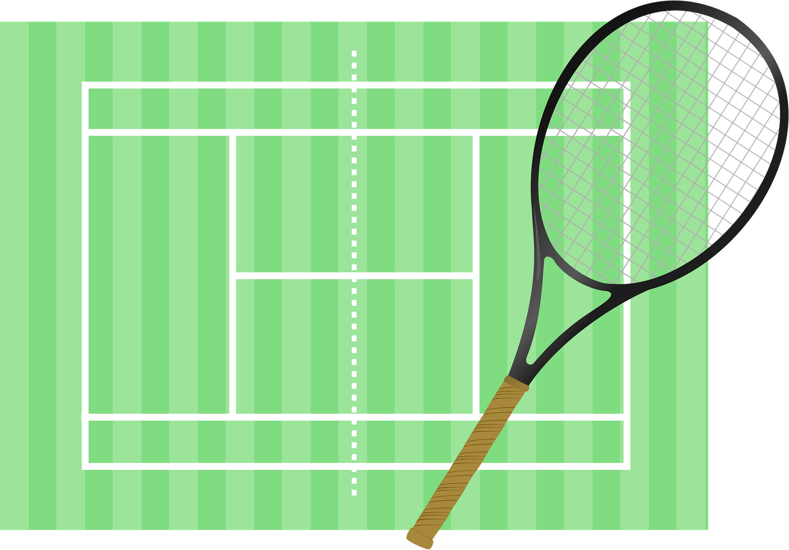
Saying what I and others do
bleu
Follow ups 1-5
Notes:
Artwork by Steve Clarke. Pronoun pictures from NCELP (www.ncelp.org). All additional pictures selected from Pixabay and are available under a Creative Commons license, no
attribution required.
Phonics: Revisit SSC [-ien] ancien [392] bien [47] bientôt [1208] chien [1744] combien? [800] Vocabulary (new words in bold): football [2602] tennis [3687] quand [119]
Revisit 1: faire [25] je fais, il/elle fait activité [452] cuisine [2618] courses [1289] ménage [2326]
Revisit 2: corriger [1639] expliquer [252] fermer [757] demander [80] écouter [49] regarder [425] poser [218] aide [457] classe [778] devoirs [39] idée [239] question [144] phrase [2074] porte [696] professeur/professeure [110] réponse [456] solution [608]
Londsale, D., & Le Bras, Y. (2009). A Frequency Dictionary of French: Core vocabulary for learners London: Routledge.
The frequency rankings for words that occur in this PowerPoint which have been previously introduced in these resources are given in the SOW and in the resources that first
introduced and formally re-visited those words.
For any other words that occur incidentally in this PowerPoint, frequency rankings will be provided in the notes field wherever possible.

Slide 2
[ien]
prononcer
good, well
bien
Notes:
Timing: 1 minute
Aim: to recap SSC [ien]
Procedure: 1. Present the letter(s) and say the [ien] sound first, on its own. Students repeat it with you. 2. Bring up the word ”bien” on its own, say it, students repeat it, so that they have the opportunity to focus all of their attention on the connection between the written word and its sound.
3. A possible gesture for this would be to give a thumbs up sign. 4. Roll back the animations and work through 1-3 again, but this time, dropping your voice completely to listen carefully to the students saying the [ien] sound, pronouncing ”bien” and, if using, doing the gesture.
Word frequency (1 is the most frequent word in French):
bien [47]
Source: Londsale, D., & Le Bras, Y. (2009). A Frequency Dictionary of French: Core vocabulary for learners London: Routledge.
2

Slide 3
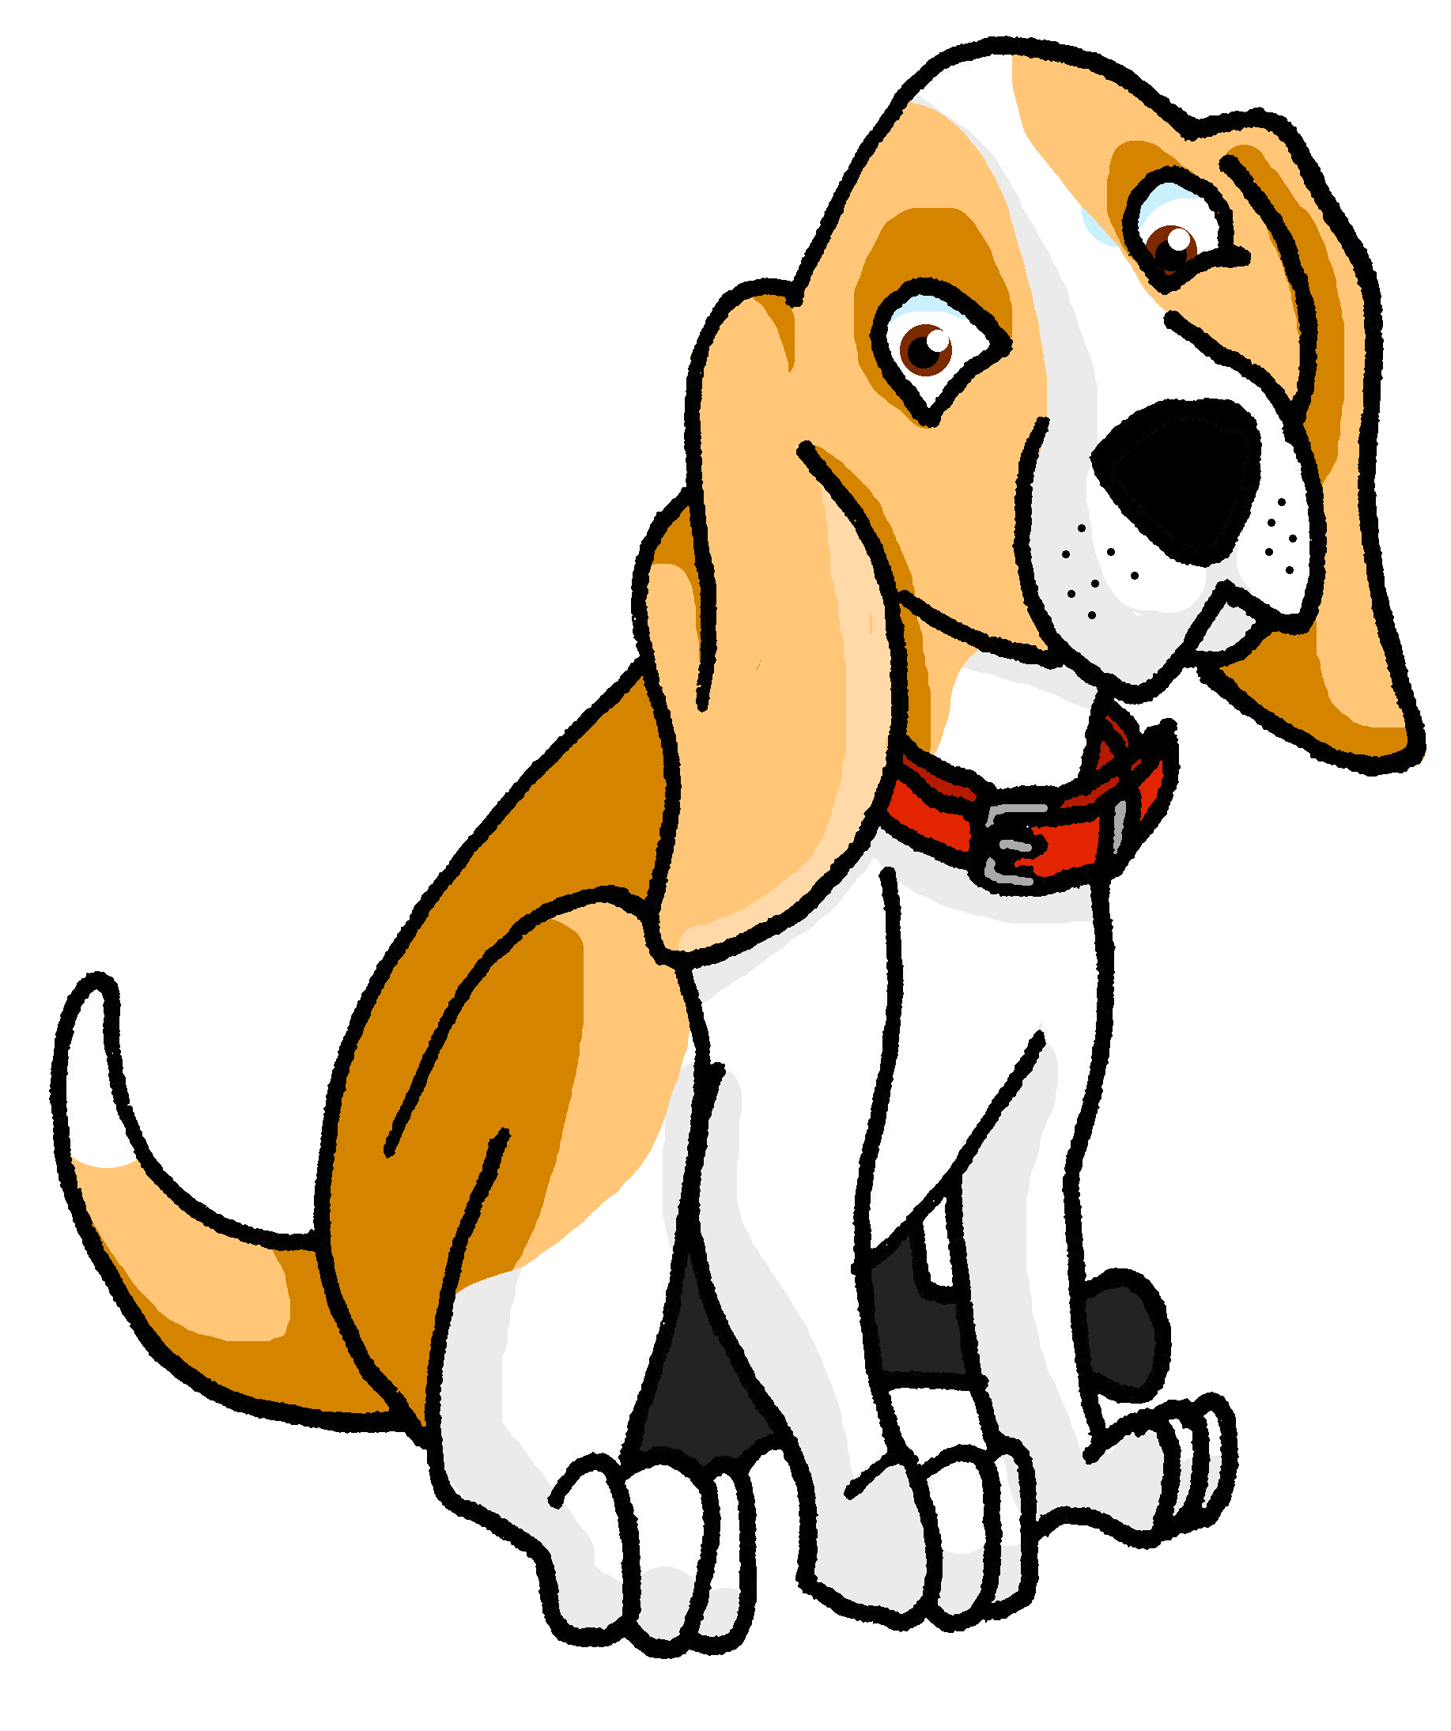
[ien]
prononcer
chien
ancien
bien
€ ?
bientôt
combien
Notes:
Timing: 2 minutes
Aim: to revisit SSC [ien]
Procedure:
1. Introduce and elicit the pronunciation of the individual SSC [ien] and then the source word again ‘bien’ (with gesture, if using). 2. Then present and elicit the pronunciation of the five cluster words.
The cluster words have been chosen for their high-frequency, from a range of word classes, with the SSC (where possible) positioned within a variety of syllables within the words (e.g. initial, 2nd, final etc.). Additionally, we have tried to use words that build cumulatively Word frequency (1 is the most frequent word in French): ancien [392] bien [47] bientôt [1208] chien [1744] combien? [800] Source: Londsale, D., & Le Bras, Y. (2009). A Frequency Dictionary of French: Core vocabulary for learners London: Routledge.
3

Slide 4
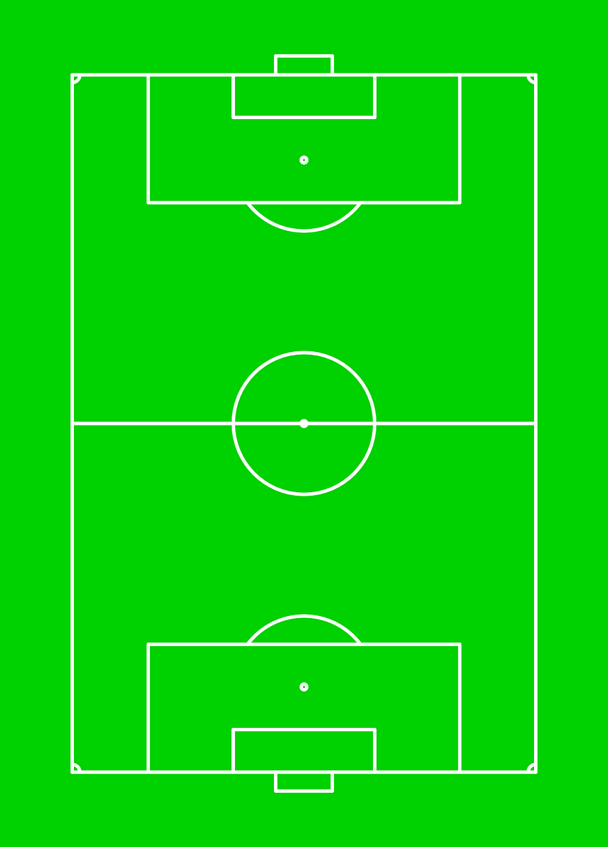
prononcer
Follow up 1: L’équipe de Jean-Michel
Prononce les prénoms* dans le match de foot.
Lucien
Jocelyn
Julien
Jean-Michel
Adrien
Martin
Valentin
Sébastien
Fabien
Benjamin
Aurélien
Notes:
Timing: 5 minutes
Aim: to practise oral production of [-ien] and [-(a)in]. Both SSCs contain the same nasal sound at the end.
Procedure:
Click to pass the ball to a player.
Pupils commentate on the match by saying the name of the player who has the ball.
Click on the player’s shirt to listen and check the pronunciation.
Pupils repeat.
Click to pass the ball to the next player.
Note: in next week’s lesson there will be information about sports and games children generally play in Haïti. It is not common for children to have access to sports facilities, so whilst football is the most popular team sport, it is most often played in the street.
Transcript
1. Martin
2. Benjamin
3. Fabien
4. Adrien
5. Julien
6. Sébastien
7. Aurélien
8. Lucien
9. Valentin
10. Jocelyn
4

Slide 5
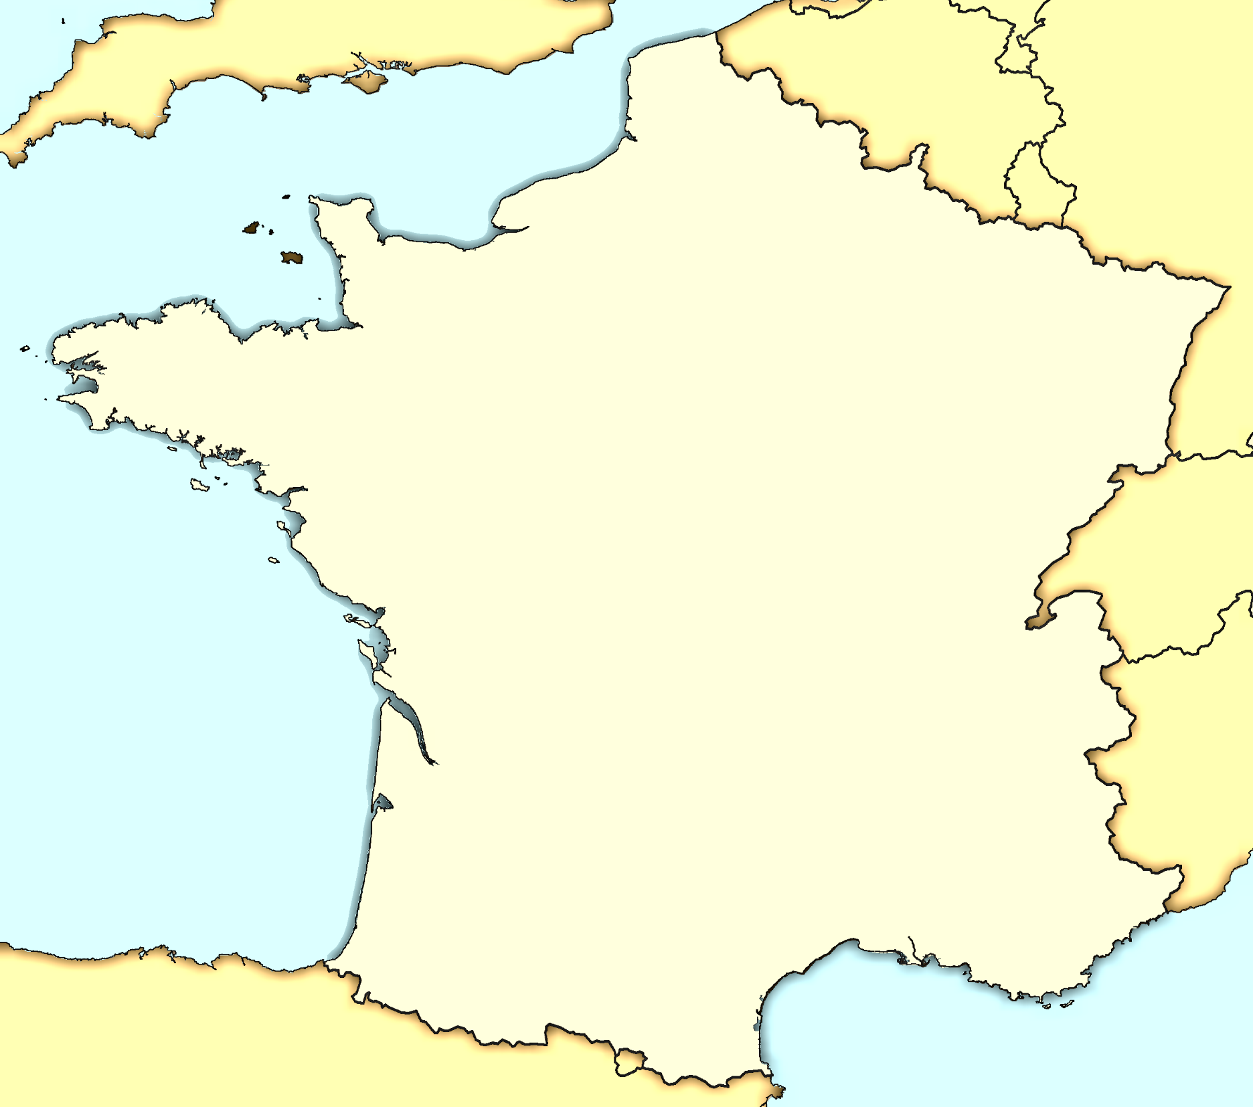
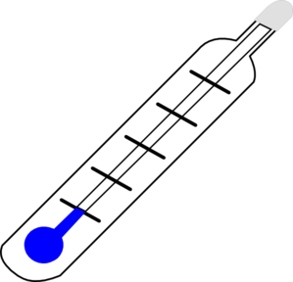
Follow up 2
Parle en français et décris le temps*
le temps - weather
1
À Calais il fait mauvais.
Calais
Liège
parler
2
À Bordeaux il fait chaud.
Rouen
Saint-Malo
3
À Blois il fait froid.
Blois
Rieux
4
À Saint Malo il fait beau.
5
À Rouen il fait du vent.
6
À Rieux il pleut.
Bordeaux
7
À Marseille il fait du soleil.
Marseille
Marseille est un nom très commun à Haïti.
8
À Liège il neige.
Notes:
Timing: 5 minutes
Aim: to practise read aloud of several SSC, noting how different letter strings are pronounced with the same SSC in French. (e.g. -eaux and –aud).
Procedure:
Teacher clarifies that the weather expressions rhyme with the place names in this task.
Pupils practise pronouncing each phrase (out loud, but individually at their own pace).
Teacher elicits a repetition of each phrase, chorally and clicks for a listen and check of each one.
Note: pupils have learnt the first four weather expressions. The remaining four are included here for pronunciation only, but some pupils may be interested enough to learn them incidentally.

Slide 6
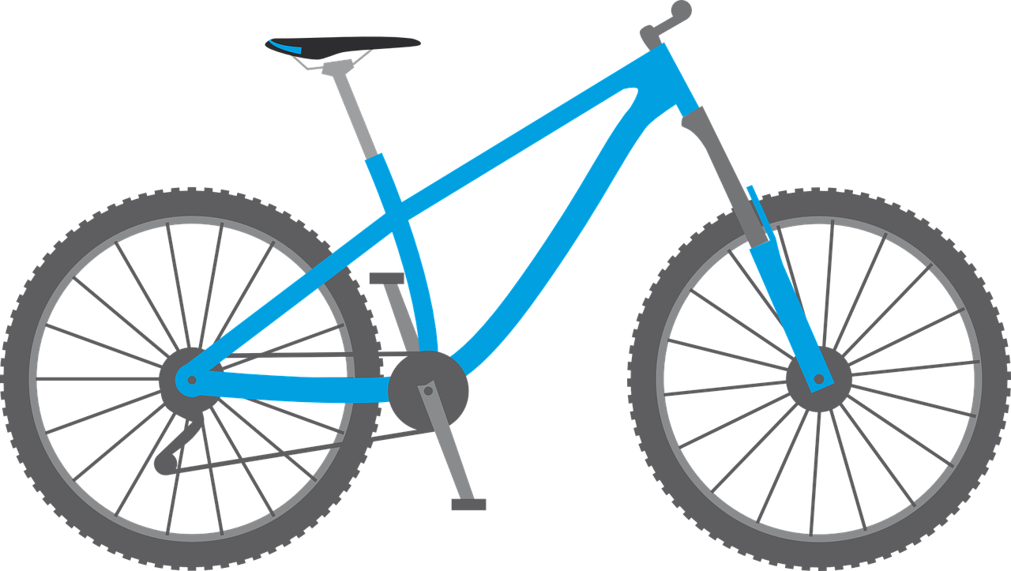
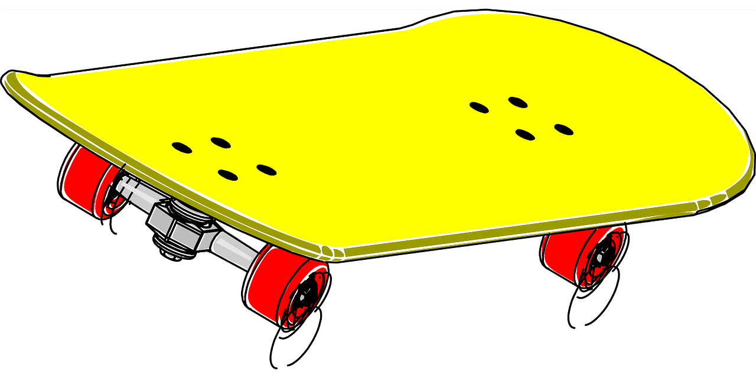
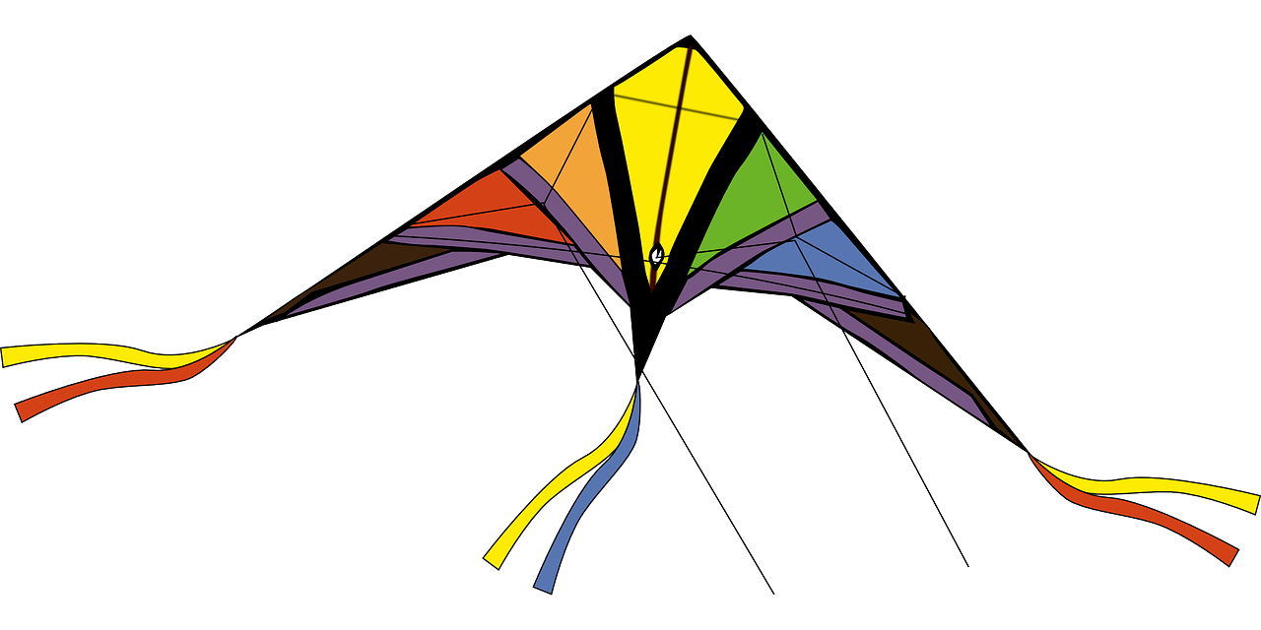
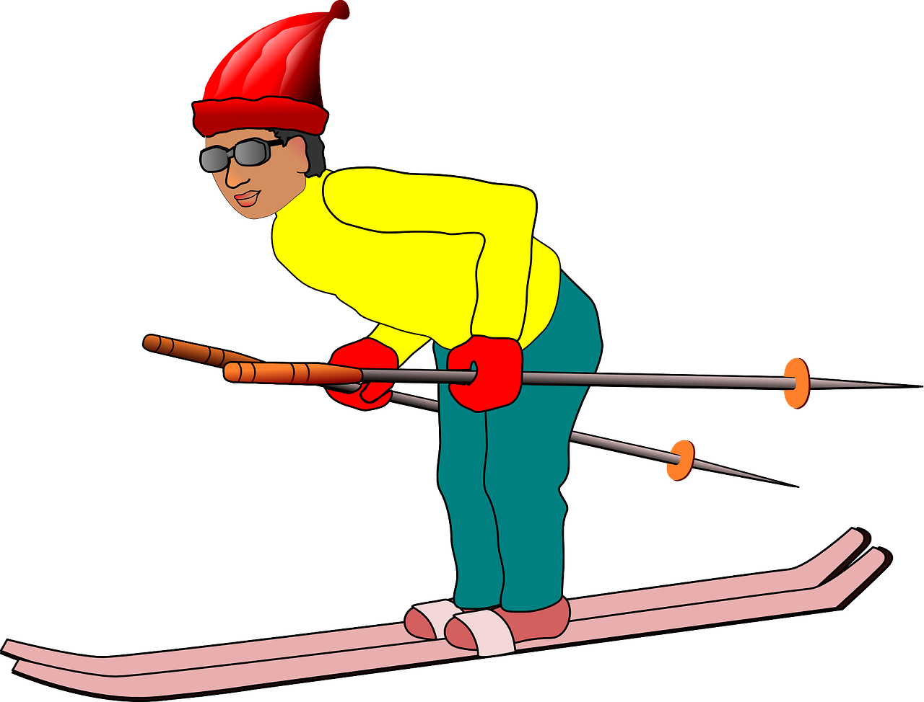
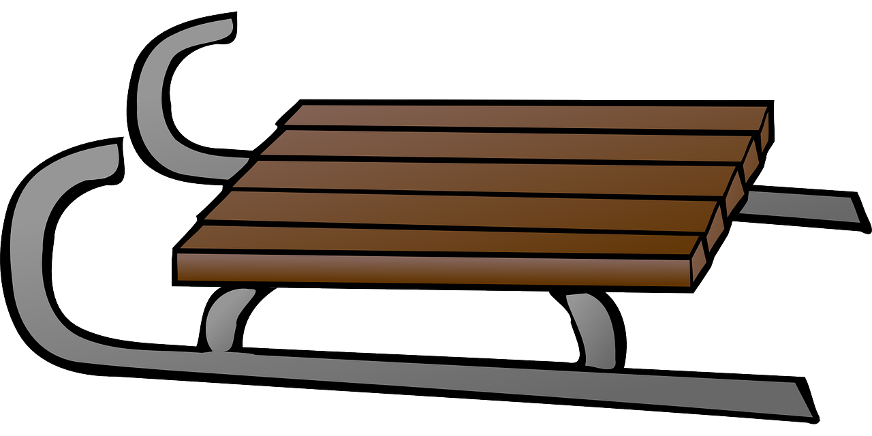
Follow up 3
Les saisons
écouter
Les saisons changent quatre fois
quatre fois quatre fois
Les saisons changent quatre fois
quatre fois quatre fois
parler
Au printemps au printemps
On sort nos bicyclettes, nos planches à roulettes
et nos cerfs-volants
au printemps
Au automne au automne
On regarde les feuilles changer
les oiseaux s’envoler
La ville est belle en automne
En été en éte
on aime quand il fait beau
nager quand il fait chaud
et on aime flotter en éte
En hiver en hiver
on aime aller patiner
faire du ski et glisser
faire les sports populaires
en hiver
Notes:
Timing: 5 minutes (two slides)
Aim: to listen to and join in with a Canadian song about the seasons.
Procedure:
Tell pupils that this is a song they are going to listen to and join in with.
Tell them they know quite a few of the words in it.
Click to listen to the lyrics of the chorus (Les saisons…)
Elicit the meaning from pupils.
Play each verse.
After each one, ask pupils to tell you briefly what they understand about the activities of each season. The pictures support understanding, here.
Go to the next slide to play the song.
Source: https://www.youtube.com/watch?v=PWhLSc_FpCM

Slide 7
Follow up 3
Écoute et chante aussi.
écouter
parler
Notes:
Procedure:
Play the song.
Source: https://www.youtube.com/watch?v=PWhLSc_FpCM

Slide 8
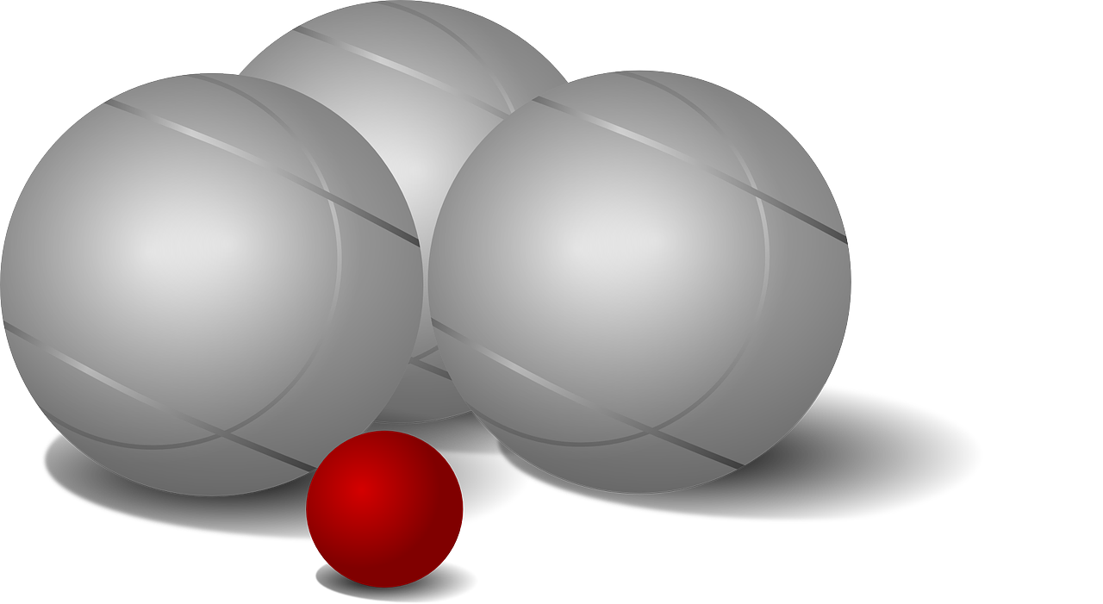
Follow up 4
⚠ Note that final –-s and –t are pronounced with these sports – they are not SFC!
Écoute et prononce les sports.
parler
écouter
le football
le tennis
le hockey
le volleyball
le basketball
le foot
le volley
le basket
le rugby
le handball
le badminton
le cricket
la pétanque
Notes:
Timing: 10 minutes (this practice slide, the speaking task modelling slide, and the task itself)
Aim: to practise pronunciation of the sports in French; they are cognates but their pronunciation needs practice, not least because pupils need to recognise that the –t and –s at the end are not silent final consonants.
Procedure:
Click on each word to hear it pronounced.
Click to bring up the callout alerting pupils to the lack of SFC on French sports.
Move to the next slide for the speaking task.

Slide 9
Follow up 4: Tu joues au foot(ball) ? Tu aimes le tennis ?
Parle avec ton ou ta partenaire.
parler
Exemple :
…au rugby ?
Just say this part of the question. Your partner will know if you’re asking about playing if you say ‘au’ + sport and liking if you say ‘le’.
Personne A pose des questions :
1. (Tu joues) au rugby ?
Personne B donne la réponse correspondante :
Listen carefully to the question. ‘au’ or ‘le’? Choose the appropriate answer to tell your partner.
like | play
Oui, à l’école.
1. J’adore ça. Oui, à l’école.
Personne A écrit la réponse en anglais :
Yes, at school.
Notes:
Aim: to model the speaking task.
Procedure:
Click through the animations carefully to model the task.
Give out the handout (see end of this presentation).

Slide 10
Follow up 4
Personne B
Personne A
Round 1
Round 1
like | play
1. (Tu aimes) le badminton ?
I love it.
J’adore ça.
Parfois.
parler
2. (Tu joues) au handball ?
No.
Non, c’est difficile.
Non.
3. (Tu joues) au basket ?
Yes, often.
Oui, c’est super.
Oui, souvent.
4. (Tu aimes) le football ?
I like it a lot.
J’aime bien ça.
Oui, avec mon père.
5. (Tu joues) à la corde ?
Yes, with my friend.
Oui, c’est amusant.
Oui, avec mon ami(e).
Round 2
Round 2
like | play
C’est mon sport préféré.
Oui, le samedi.
1. (Tu joues) au tennis ?
Yes, on Saturdays.
Oui, c’est amusant.
Une fois par semaine.
2. (Tu aimes) le volley de plage ?
Yes, it’s fun.
Quand il fait froid.
Non, c’est nul.
3. (Tu aimes) le ping-pong ?
I like it a lot.
Oui, je déteste ça.
Oui, à l’école.
4. (Tu joues) au hockey ?
Yes, at school.
C’est trop difficile.
Oui, en hiver.
5. (Tu joues) au rugby ?
Yes, in winter.
Notes:
ANSWERS – DO NOT DISPLAY DURING THE TASK
Procedure:
Click on A’s question to hear it. The teacher can also elicit the full question from pupils, chorally, for additional pronunciation practice.
Click to bring up B’s answer, with audio.
Click to reveal A’s written English translation of that answer.
Repeat with all the utterances.
5. Further practice could be done using full versions of the questions and allowing pupils to answer freely.

Slide 11
vocabulaire
Follow up 5a - Écris en anglais : Can you get at least 15 points?
mots
 | l’aide | expliquer | fermer
 | les devoirs | corriger | la réponse
 | la cuisine | il fait | je fais
 | les courses | le ménage | faire
 | une fois | tu joues | elle aime
 | le football | le tennis | la corde
(the) year
(the) people
to wear, carry
x3
(the) health
(the) item of clothing
(the) history
I go, am going
you are
heat, (hot)
x2
I am
at, to, in
cold
(the) winter
fine/good
(the) spring
x1
(the) summer
bad
(the) autumn
Notes:
Timing: 5-10 minutes
Aim: to practise written production of vocabulary from this week and two revisited weeks.
Procedure: 1. Give pupils a blank grid. They fill in the English meanings of any of the words they know, trying to reach 15 points in total. 2. Remind pupils that adjectives can refer to male or female persons and they should note this in their translations. E.g. pleased (f), short (m).
Note: The most recently learnt and practised words are pink, words from revisit 1 are green and those from revisit 2 are blue, thus more points are awarded for them, to recognise that memories fade and more effort (heavy lifting!) is needed to retrieve them.
11

Slide 12
vocabulaire
Follow up 5b - Écris en français : Can you get at least 15 points?
mots
 | help | homework | reply
 | to correct | to explain | to close, shut
 | to do, make | I do, make | he does, makes
 | cooking | shopping | housework
 | a/one time | you play | she likes
 | (the) football | (the) tennis | (the) rope
l’aide
les devoirs
la réponse
x3
corriger
expliquer
fermer
faire
je fais
il fait
x2
la cuisine
les courses
le ménage
une fois
tu joues
elle aime
x1
le football
le tennis
la corde
Notes:
Timing: 5-10 minutes
Aim: to practise written comprehension of vocabulary from this week and previous weeks.
Procedure: Give pupils a blank grid. They fill in the French meanings of any of the words they know, trying to reach 15 points in total.
Note: The most recently learnt and practised words are pink, words from the previous week are green and those from earlier are blue, thus more points are awarded for them, to recognise that memories fade and more effort (heavy lifting!) is needed to retrieve them.
12

Slide 13
Follow up 4: Personne A
Follow up 4: Personne B
Round 1
Round 1
like | play
1. (Tu aimes) le badminton ?
J’adore ça.
Parfois.
2. (Tu joues) au handball ?
Non, c’est difficile.
Non.
3. (Tu joues) au basket ?
Oui, c’est super.
Oui, souvent.
4. (Tu aimes) le football ?
J’aime bien ça.
Oui, avec mon père.
5. (Tu joues) à la corde ?
Oui, c’est amusant.
Oui, avec mon ami(e).
Round 2
Round 2
like | play
C’est mon sport préféré.
Oui, le samedi.
1. (Tu joues) au tennis ?
Oui, c’est amusant.
Une fois par semaine.
2. (Tu aimes) le volley de plage ?
J’aime bien ça.
Quand il fait froid.
3. (Tu aimes) le ping-pong ?
Oui, je déteste ça.
Oui, à l’école.
4. (Tu joues) au hockey ?
C’est trop difficile.
Oui, en hiver.
5. (Tu joues) au rugby ?
Notes:
HANDOUT
Photocopy and cut into 2 x A5 handouts, one for A and one for B.

Slide 14
vocabulaire
Follow up 5a - Écris en anglais : Can you get at least 15 points?
mots
 | l’aide | expliquer | fermer
 | les devoirs | corriger | la réponse
 | la cuisine | il fait | je fais
 | les courses | le ménage | faire
 | une fois | tu joues | elle aime
 | le football | le tennis | la corde
x3
x2
x1
Notes:
HANDOUT
14

Slide 15
vocabulaire
Follow up 5b - Écris en français : Can you get at least 15 points?
mots
 | help | homework | reply
 | to correct | to explain | to close, shut
 | to do, make | I do, make | he does, makes
 | cooking | shopping | housework
 | a/one time | you play | she likes
 | (the) football | (the) tennis | (the) rope
x3
x2
x1
Notes:
HANDOUT
15

