Slide 1
Saying what I and others do
bleu
faire (tu fais)
SSC [ç/c]
Notes:
Artwork by Steve Clarke. Pronoun pictures from NCELP (www.ncelp.org). All additional pictures selected from Pixabay and are available under a Creative Commons license, no
attribution required.
Phonics: Revisit SSC [ç/c] (soft -c) ici [167] français [251] garçon [1599] cinéma [1623] décider [165]
Vocabulary (new words in bold): tu fais [25] effort [388] voyage [904] carte [955] gâteau [4845] liste [924]
Revisit 1: aller [53] je vais il/elle va à (meaning ‘at/in/to’)[4] Canada [N/A] France [N/A] nord [1090] sud [1242] est [4603] ouest [1690]
Revisit 2: aimer [242] avoir [8] vous2 [50] animal [1002] cadeau [2298] chapeau [2908] cheval [2220] fanal [>5000] gâteau [4845] feu [786] jeu [291] vœu [2103]
Londsale, D., & Le Bras, Y. (2009). A Frequency Dictionary of French: Core vocabulary for learners London: Routledge.
The frequency rankings for words that occur in this PowerPoint which have been previously introduced in these resources are given in the SOW
and in the resources that first introduced and formally re-visited those words.
For any other words that occur incidentally in this PowerPoint, frequency rankings will be provided in the notes field wherever possible.
1

Slide 2
[ç/c] soft ‘c’
prononcer
[here]
ici
Notes:
Timing: 1 minute
Aim: To consolidate SSC [ç/c]
Procedure: 1. Present the letter(s) and say the [ç/c] sound first, on its own. Pupils repeat it with you. 2. Bring up the word ”ici” on its own, say it, pupils repeat it, so that they have the opportunity to focus all of their attention on the connection between the written word and its sound.
3. A possible gesture for this would be to point to the spot on which one is standing / indicate the room in which the lesson is taking place with a sweeping motion of one’s index finger. 4. Roll back the animations and work through 1-3 again, but this time, dropping your voice completely to listen carefully to the pupils saying the [ç/c] sound, pronouncing ”ici” and, if using, doing the gesture.
2

Slide 3
[ç/c] soft ‘c’
prononcer
cinéma
décider
[here]
français
garçon
ici
Notes:
Timing: 2 minutes
Aim: to consolidate SSC [ç/c]
Procedure:
1. Introduce and elicit the pronunciation of the individual SSC [ç/c] and then the source word again ‘ici’ (with gesture, if using). 2. Then present and elicit the pronunciation of the five cluster words.
The cluster words have been chosen for their high-frequency, from a range of word classes, with the SSC (where possible) positioned within a variety of syllables within the words (e.g. initial, 2nd, final etc.). Additionally, we have tried to use words that build cumulatively on previously taught SSCs (see the Phonics Teaching Sequence document) and do not include new SSCs. Where new SSCs are used, they are often consonants which have a similar symbol-sound correspondence in English.
Word frequency (1 is the most frequent word in French): français [251] garçon [1599] cinéma [1623] décider [165] ici [167]. Source: Londsale, D., & Le Bras, Y. (2009). A Frequency Dictionary of French: Core vocabulary for learners London: Routledge.
3

Slide 4
[ç/c] soft ‘c’
prononcer
The letter ‘c’ is soft (sounds like ‘s’) before e or i:
c’est
cinq
However, ‘c’ is hard (sounds like ‘k’) before a, o or u:
carte
courses
cuisine
Some words have a cedilla (ç) before a, o or u to soften the ‘c’:
ça va ?
garçon
Notes:
Timing: 2 minutes
Aim: to explain the spelling rules governing the pronunciation of the letter ‘c’ before vowels and use of a cedilla.
Procedure:
1. Bring up the rules governing each category on clicks.
2. Teacher reads the words in each category out loud. Pupils repeat.
4

Slide 5
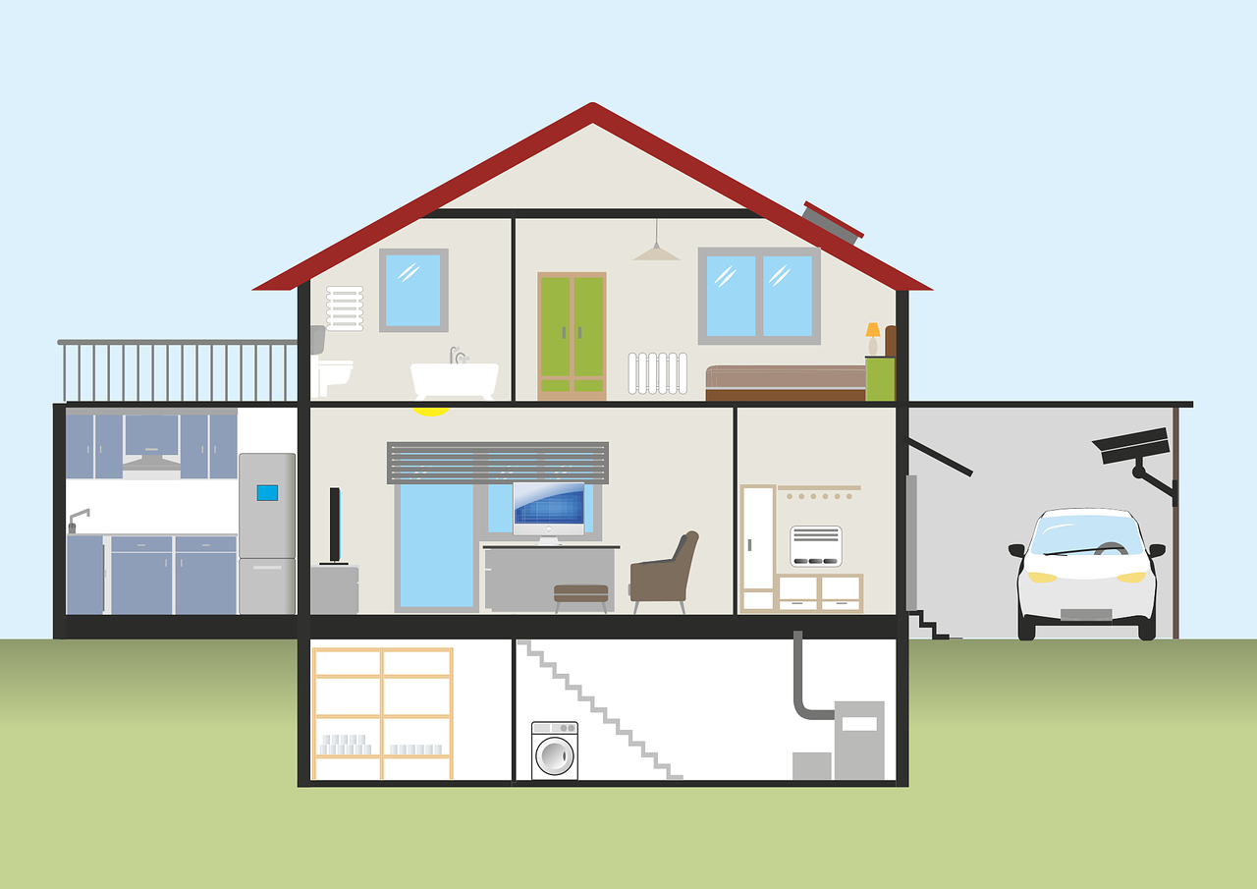
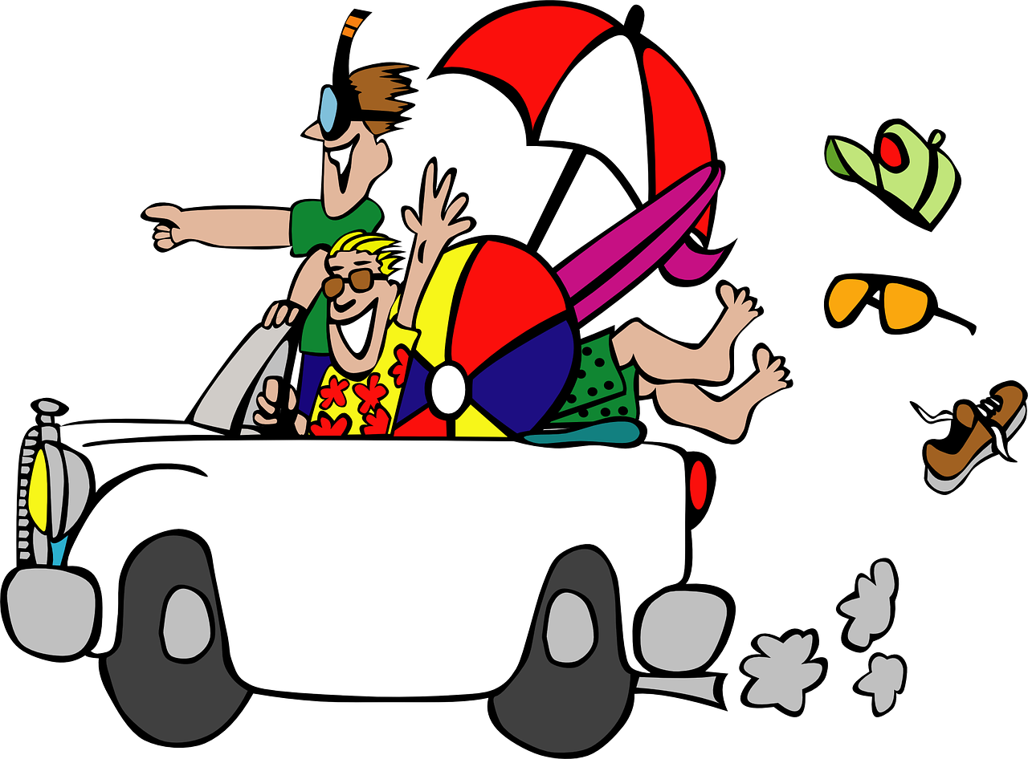
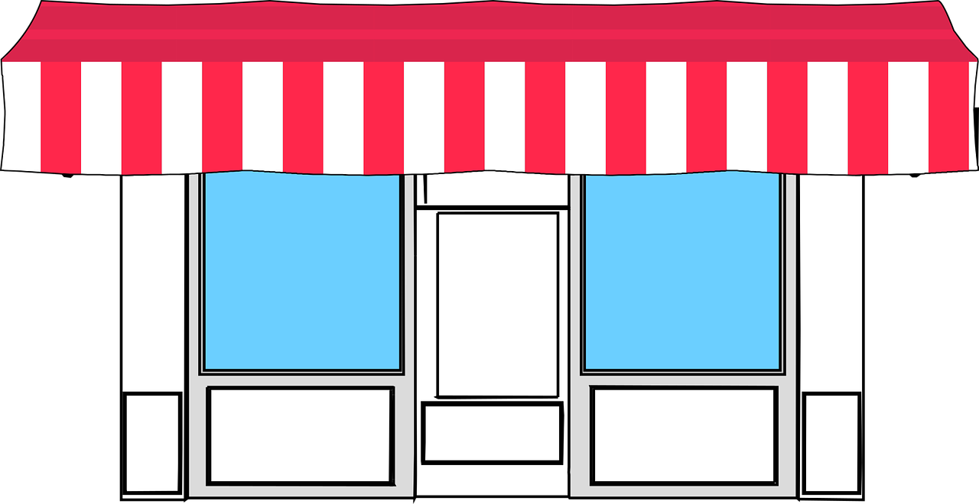
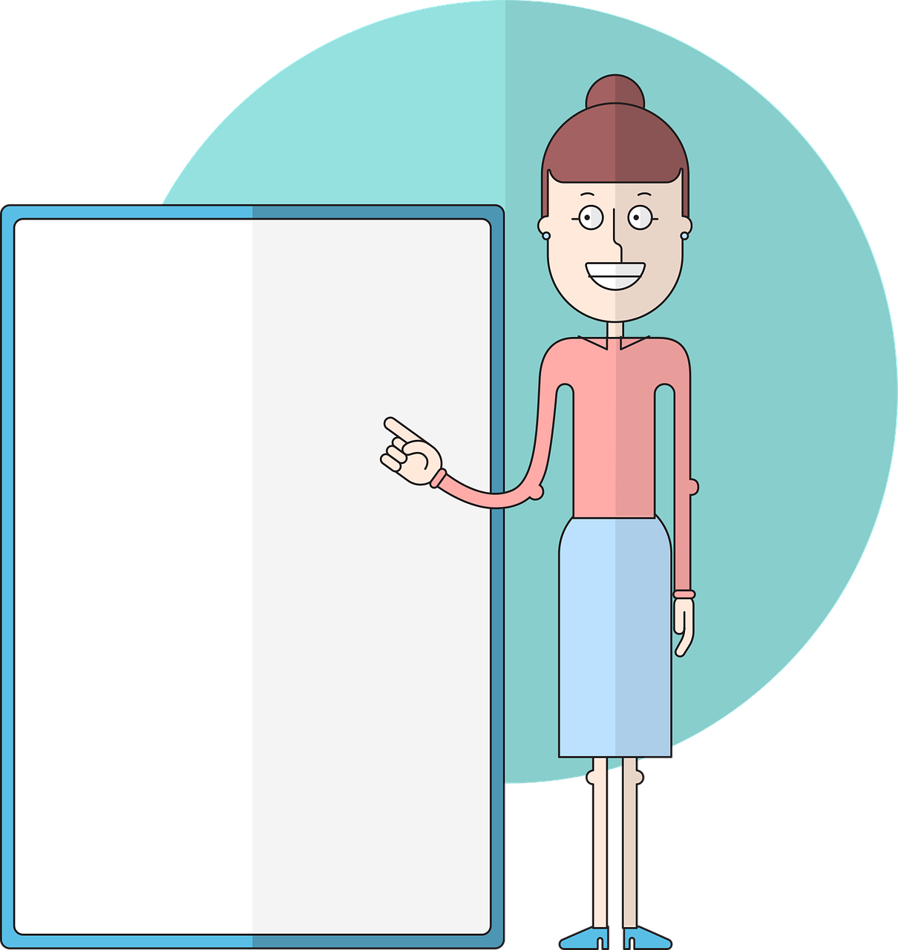
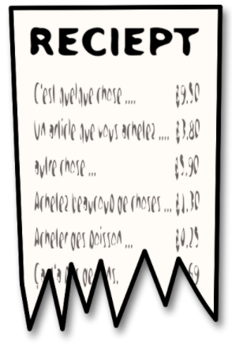
prononcer
Écoute. C’est avec ‘ç’ ou ‘c’ ?
Puis, prononce les mots.
c a v e
v a c a n c e
f a ç a d e
l e ç o n
c o m m e r ç a n t
c a l c u l
c a m i o n
r e ç u
1
_
5
_
2
_
6
_
_
3
_
7
_
4
8
_
_
Notes:
Timing: 5 minutes
Aim: to practise aural distinction between words with ç and c before a, o, u.
Procedure:
Read the instruction.
Do the first one with pupils. Remind them that if they hear the a soft ‘c’ sound, the spelling is ç. Otherwise it is ‘c’.
Elicit responses chorally and click to reveal the answers.
Transcript:
cave vacance façade leçon commerçant calcul camion reçu
Frequency of unknown words and cognates: cave[4870] vacance [1726] façade [4029] leçon [1300] commerçant [4167] calcul [1624] camion [2542] reçu [4226] Londsale, D., & Le Bras, Y. (2009). A Frequency Dictionary of French: Core vocabulary for learners London: Routledge.

Slide 6
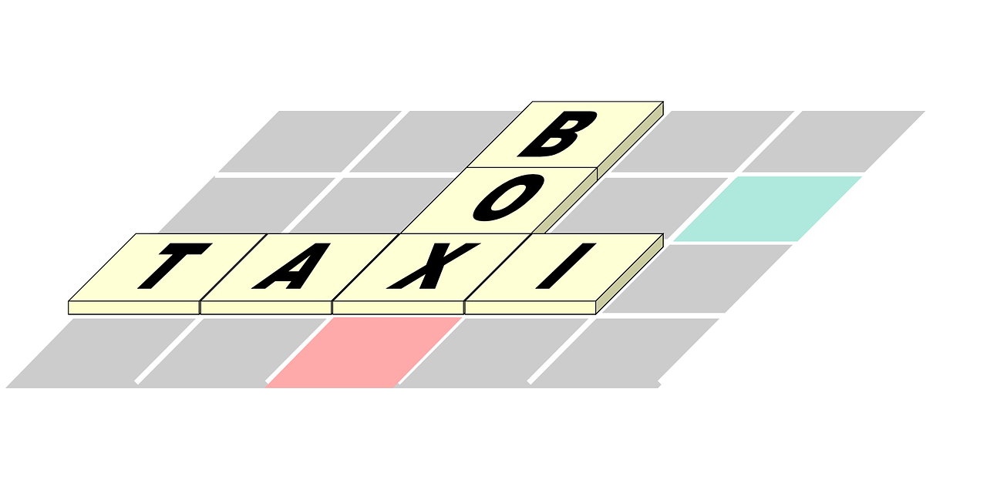
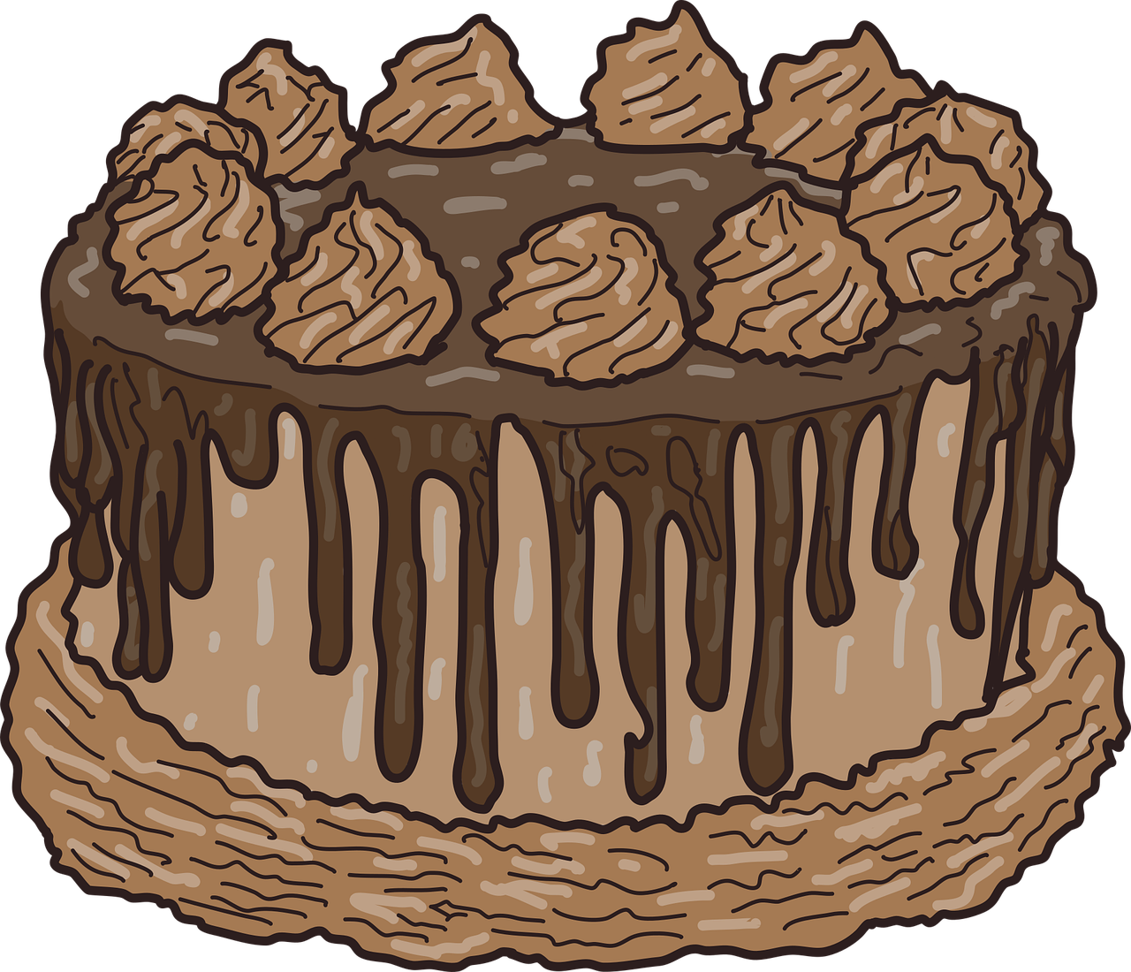
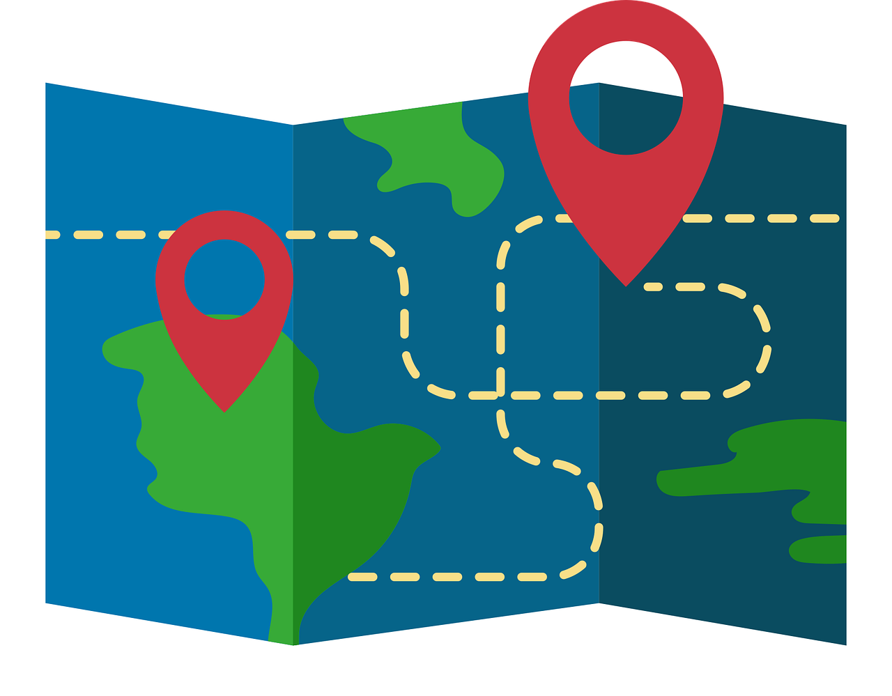
vocabulaire
Vocabulaire
mots
Comment dit-on ça en français ?
le ménage
les courses
la cuisine
un effort
to do the housework
to make a present
to make a list
to do/go on a journey
to do the cooking
to do homework
to do the shopping
to make a cake
une liste
to do an activity
une activité
to make a cake
to do the cooking
to do homework
to make a present
to make an effort
to do an activity
to do the housework
to do/go on a trip
to make a list
to make an effort
to do the shopping
un gâteau
les devoirs
un voyage
un cadeau
Notes:
Timing: 5 minutes
Aim: to present and practise written comprehension and read aloud of previously taught vocabulary and two new words for this week.
Procedure: 1. Click for an English item. Elicit pronunciation of the French from pupils, the full phrase, i.e., faire un cadeau.
2. Click to cover the French word with a picture.
3. Continue with the remaining items.
4. Elicit the French from pupils, (English prompts reappear on each mouse click) this time without written French support.
6

Slide 7
faire (to do and to make)
We use the verb faire to mean to do and to make.
⚠ Note that this is the same form as ‘I do|make’ → je fais. You need the pronoun to know who is doing the action.
tu fais
⚠ The –s is a Silent Final Consonant (SFC).
you do|you make
Il fait
he does|he makes
elle fait
she does|she makes
Notes:
Timing: 2 minutes
Aim: to recap il / elle fait and introduce tu fais.
Procedure:
Click through the animations to present the information.
Elicit English translations for the French examples provided.

Slide 8
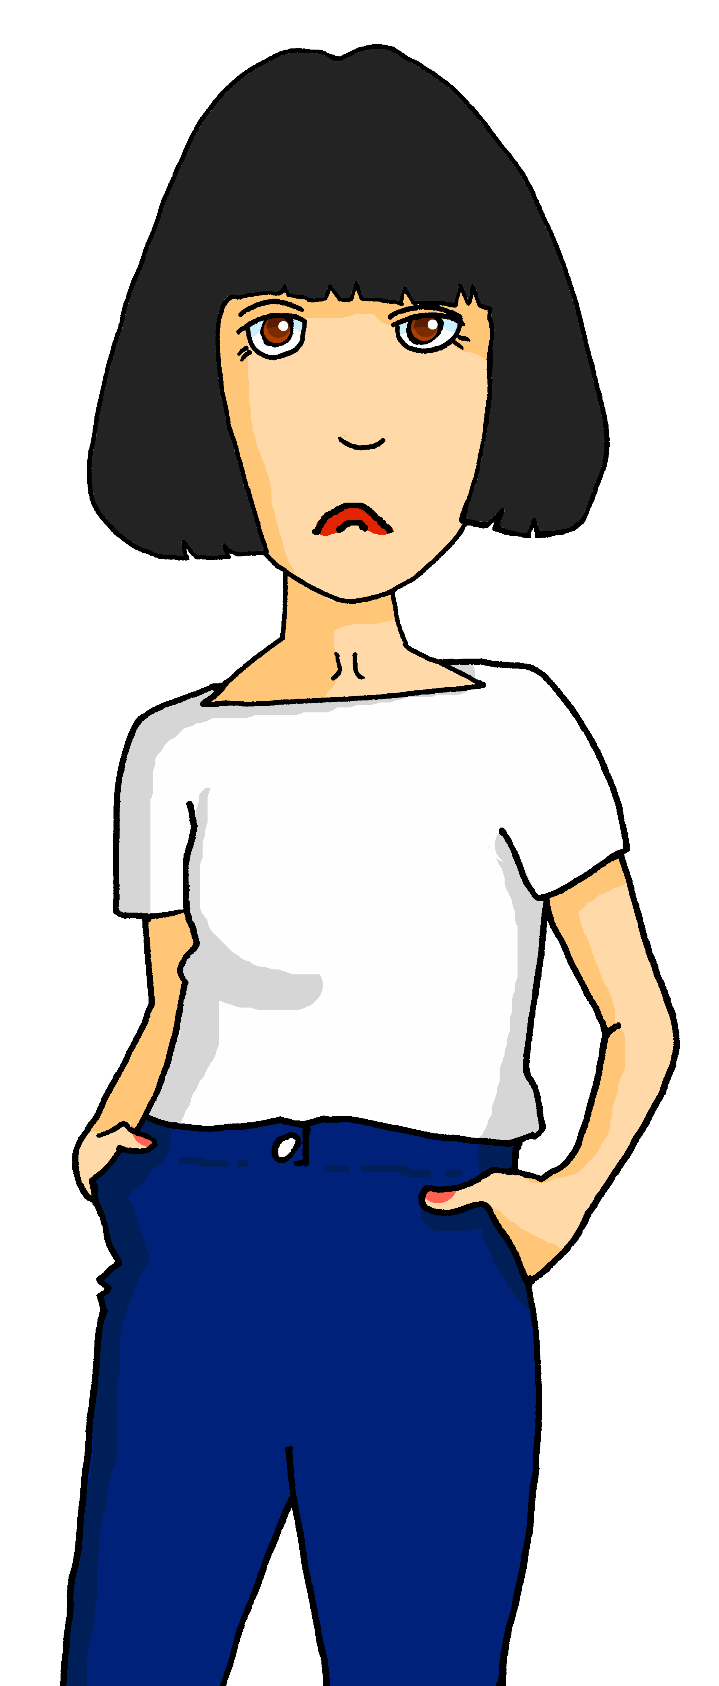
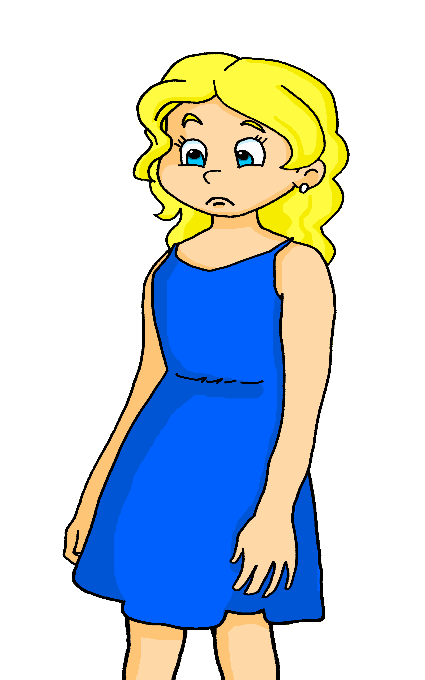
lire
Samedi, c’est l’anniversaire de Léa ! Adèle organise une fête improvisée .
Claudine écrit une liste des activités pour Hervé et Adèle. Mais Médor mange la liste !
Qui fait quoi ? C’est Hervé (you...) ou Adèle (she) ?
3
fait le gâteau.
1
fais la cuisine.
2
fais le lit.
tu (you)
elle (she)
4
fais la carte.
1
2
3
4
5
6
7
8
5
fait le ménage.
6
fait le cadeau.
7
fais les courses.
8
fait une activité avec Médor !
Notes:
Timing: 6 minutes
Aim: to practise written recognition of the second and third person singular forms of ‘faire’ and connect these with meaning.
Procedure:
1. Read the rubric and ensure that pupils understand the context.
2. Pupils read the parts of sentences they can see and tick who they think it applies to. They should use their knowledge of verb forms to decide.
3. Answers revealed on clicks.
4. Optional – click the numbered buttons to hear the full sentences.
5. Ask additional questions to assess comprehension – e.g., who is doing the shopping? Who is making the present? Alternatively (or additionally) teachers could say that Hervé and Adèle don’t look too happy about what they have to do. They each have 4 x things to do, but which has the harder/easier jobs to do? Who would you rather be in this situation?

Slide 9
écouter
Hervé needs to check with Adèle that he understands the to-do list.
Écoute. C’est une question ? Écris les détails en anglais.
⚠
Three activities are not mentioned!
(you), activity with dog, statement
1
2
3
4
5
6
I, shopping, ?
you, present, ?
I, cooking, statement
1
2
3
4
5
6
you, housework, statement
you, cake, ?
Notes:
Timing: 6 minutes
Aim: to practise aural differentiation of statements and intonation questions, and to recognise vocabulary aurally.
Procedure:
Pupils listen to each phrase.
Pupils note: 1. cooking. ? i.e. the person (I or you), what each person does as well as if it is a question or a statement. They may need to listen more than once to get all the information.
Click to reveal the answers.
Transcript:
Tu fais une activité avec le chien. Je fais les courses ?
Tu fais le cadeau ?
Je fais la cuisine. Tu fais le ménage. Tu fais le gâteau ?
9

Slide 10
Au revoir !
bleu
Notes:
10

