Slide 1
Saying what I and others do
bleu
Follow ups 1-5
Notes:
Artwork by Steve Clarke. Pronoun pictures from NCELP (www.ncelp.org). All additional pictures selected from Pixabay and are available under a Creative Commons license, no
attribution required.
Phonics: Revisit SSC [SFe] - vrai [292] maison [325] aider [413] raison [72] aimer [242] semaine [245]
Vocabulary (new words in bold): faire, je fais, il/elle fait [25] activité [452] cuisine [2618] courses [1289] ménage [2326]
Revisit 1: il y a un [3] deux [41], trois [115], quatre [253], cinq [288], six [450], sept [905], huit [877], neuf [787], dix [372], onze [2447], douze [1664] des [2] combien [800] treize [3285], quatorze [3359], quinze [1472], seize [3285], dix-sept [3812], dix-huit [3592], dix-neuf [4851], vingt [1273], vingt et un [1273/6/3], vingt-deux, vingt-trois, vingt-quatre, vingt-cinq, vingt-six, vingt-sept, vingt-huit, vingt-neuf, trente [1646]
Revisit 2: célébrer [2170] échanger [1452] fabriquer [1231] souhaiter [403] feu d'artifice [>5000] rue [598] tout le monde [n/a]
Londsale, D., & Le Bras, Y. (2009). A Frequency Dictionary of French: Core vocabulary for learners London: Routledge.
The frequency rankings for words that occur in this PowerPoint which have been previously introduced in these resources are given in the SOW and in the resources that first
introduced and formally re-visited those words.
For any other words that occur incidentally in this PowerPoint, frequency rankings will be provided in the notes field wherever possible.

Slide 2
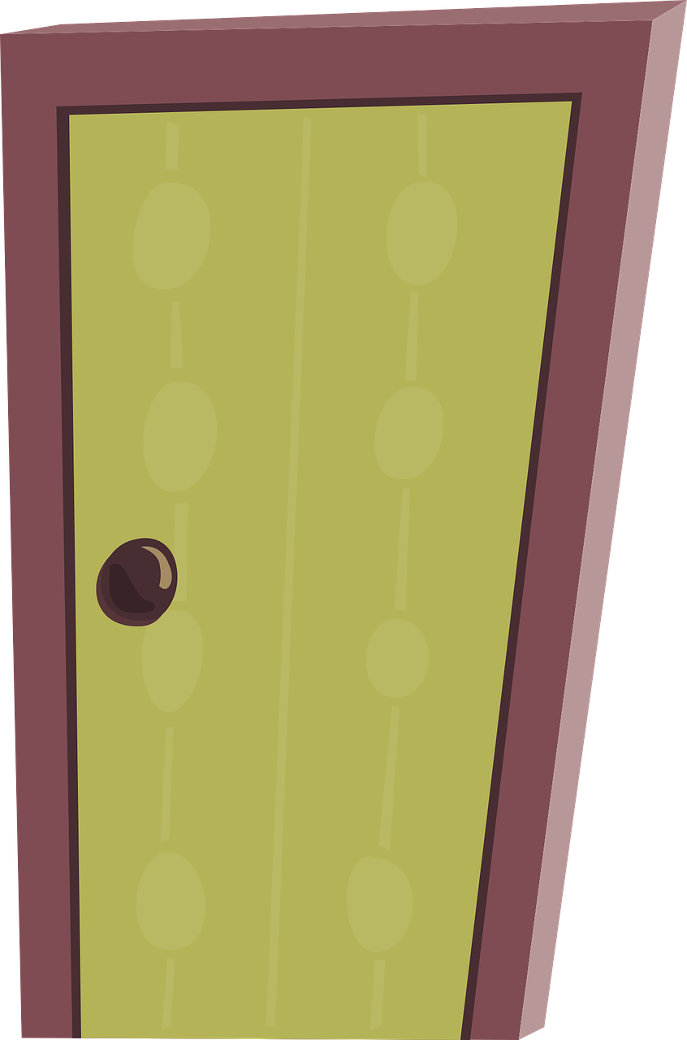
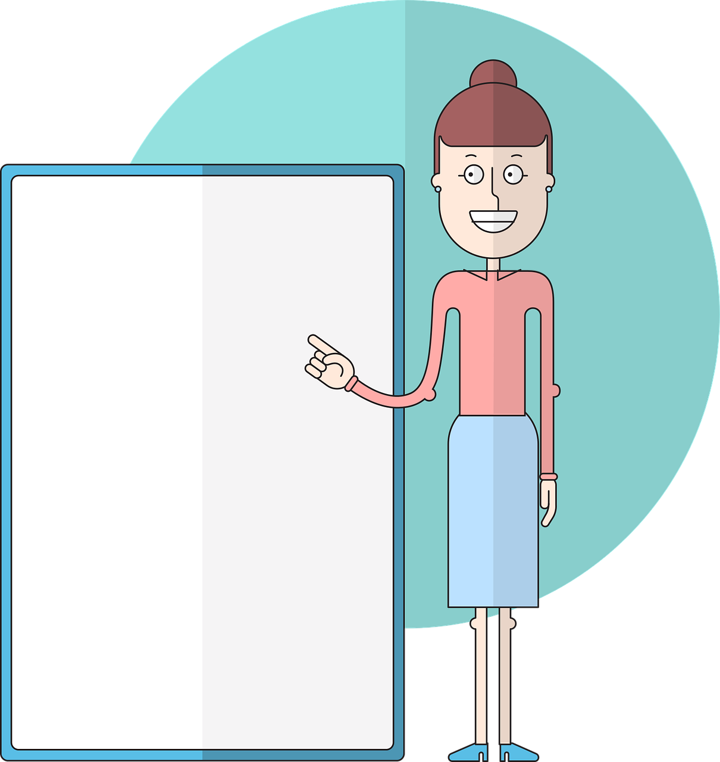
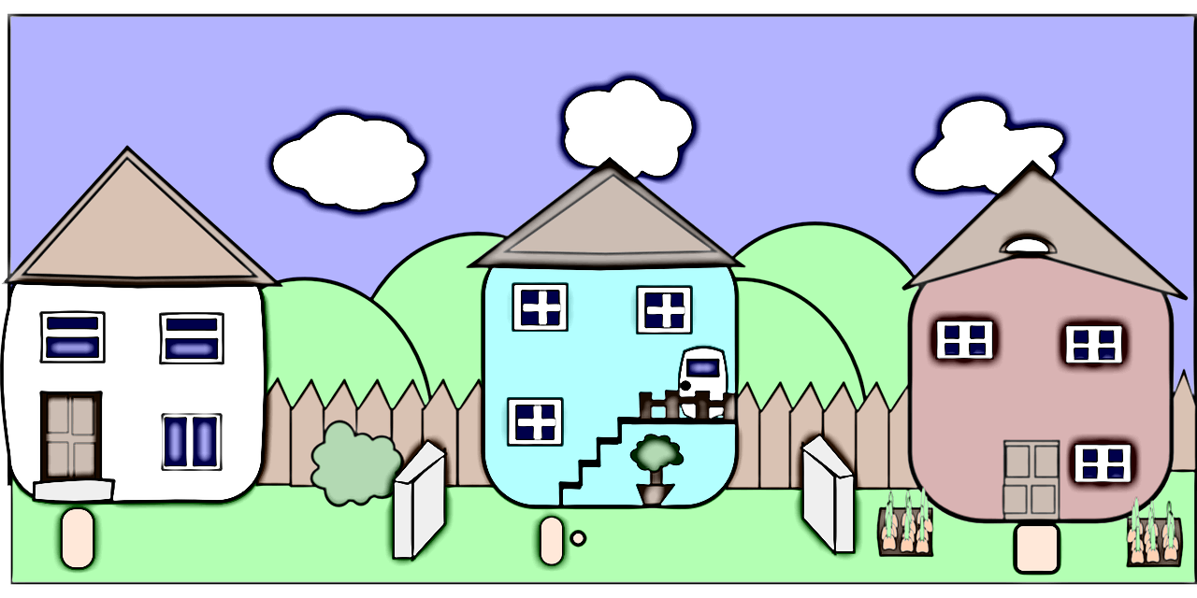
prononcer
Follow up 1
Prononce bien les mots dans l’ordre alphabétique.
porte
effort
pot
crêpe
cours
voisin
copine
pont
part
cuisine
drap
courses
Notes:
Timing: 5 minutes (two slides)
Aim: to correctly pronounce unknown words containing [SFC] in decreasing amounts of time, helping automatisation of SSC production.
Procedure:
1. Pupils pair up.
2. Both pupils speak together and try to say the words in alphabetical order.
3. If they say a different word, they need to pause, work out where they went wrong, and start from the beginning.
4. Make it clear that this is teamwork and there is no time limit – it is the ‘training’ before the game on the next slide.
5. Click on the pictures to hear the words pronounced. Pupils repeat.
6. Move onto the next slide.
Frequency of unknown words and cognates: copin [>5000] crêpe [>5000] drap [>5000] effort [388] part [86] pont [1889] pot [3648] voisin [979] Londsale, D., & Le Bras, Y. (2009). A Frequency Dictionary of French: Core vocabulary for learners London: Routledge.
2

Slide 3
prononcer
Follow up 1
Prononce les mots vite mais bien.
porte
effort
pot
20
crêpe
cours
voisin
S
copine
pont
part
cuisine
drap
courses
0
DÉBUT
Notes:
Timing: 5 minutes
Aim: to correctly pronounce unknown words containing [SFC] in decreasing amounts of time, helping automatisation of SSC production.
Procedure:
1. Teacher starts 20 second timer.
2. Pupil A tries to say the words without pronouncing the [SFC].
3. Pupil B makes speaker pause for 3 seconds every time an [SFC] is pronounced.
4. Complete before 20 seconds runs out.
6. Swap roles and play the game again.
Frequency of unknown words and cognates: copin [>5000] crêpe [>5000] drap [>5000] effort [388] part [86] pont [1889] pot [3648] voisin [979] Londsale, D., & Le Bras, Y. (2009). A Frequency Dictionary of French: Core vocabulary for learners London: Routledge.
3

Slide 4
vocabulaire
Follow up 2a - Écris en anglais : Can you get at least 15 points?
mots
 | tout le monde | souhaiter | célébrer
 | échanger | fabriquer | la rue
 | vingt-et-un | trois | douze
 | dix-sept | vingt-cinq | trente-quatre
 | il fait | la cuisine | faire
 | je fais | le ménage | les courses
everyone
to wish, wishing
to celebrate
x3
to exchange
to create, creating
(the) road, street
x2
21
3
12
17
25
34
he does, he makes
(the) cooking
to do, to make
x1
I do, I make
(the) housework
(the) shopping
Notes:
Timing: 5-10 minutes
Aim: to practise written production of vocabulary from this week and two revisited weeks.
Procedure: 1. Give pupils a blank grid. They fill in the English meanings of any of the words they know, trying to reach 15 points in total. 2. Remind pupils that adjectives can refer to male or female persons and they should note this in their translations. E.g. pleased (f), short (m).
Note: The most recently learnt and practised words are pink, words from revisit 1 are green and those from revisit 2 are blue, thus more points are awarded for them, to recognise that memories fade and more effort (heavy lifting!) is needed to retrieve them.
4

Slide 5
vocabulaire
Follow up 2b - Écris en français : Can you get at least 15 points?
mots
 | to wish | (the) road, street | everyone
 | to celebrate | to exchange | to create, make
 | 16 | 28 | 39
 | 13 | 14 | 15
 | (the) cooking | (the) shopping | (the) housework
 | to do, to make | I do, I make | she does, makes
souhaiter
la rue
tout le monde
x3
célébrer
échanger
fabriquer
x2
seize
vingt-huit
trente-neuf
treize
quatorze
quinze
la cuisine
les courses
le ménage
x1
faire
je fais
elle fait
Notes:
Timing: 5-10 minutes
Aim: to practise written comprehension of vocabulary from this week and previous weeks.
Procedure: Give pupils a blank grid. They fill in the French meanings of any of the words they know, trying to reach 15 points in total.
Note: The most recently learnt and practised words are pink, words from the previous week are green and those from earlier are blue, thus more points are awarded for them, to recognise that memories fade and more effort (heavy lifting!) is needed to retrieve them.
5

Slide 6
Making sentences negative
ne…pas
⚠
Remember that in English…
However, in French…
I make the bed.
I don’t make the bed.
Je fais le lit.
Je ne fais pas le lit.
…add don’t before the verb to make the sentence negative.
…add ne before the verb and pas after the verb to make the sentence negative.
Notes:
Timing: 1 minute
Aim: Recap ne…pas negation with single-verb structures and draw attention to differences between French and English negation structure. (Pupils were introduced to this last term – T2 Week 5).
Procedure:
Click through the animations to present the information.
Elicit English translations for the French examples provided.

Slide 7
Follow up 3:
What do Clémentine and Jean-Michel do to help at home?
Lis et coche* la liste.
Write ? if the activity isn’t mentioned.
lire
1) …………………………………
2) …………………………………
3) …………………………………
4) …………………………………
5) …………………………………
6) …………………………………
7)………………………………….
8)………………………………….
Parfois, il fait le ménage.
?
cooking
homework
shopping
garden activities
housework
bed
Elle fait la cuisine tous les weekends.
Il fait toujours les devoirs.
?
Elle ne fait pas le ménage.
?
?
Il ne fait pas le lit.
Elle fait le lit tous les jours.
Elle fait aussi les devoirs.
Il ne fait pas les courses.
cocher – to tick
Notes:
Timing: 5 minutes
Aim: to practise written comprehension of ne…pas and vocabulary from this and previous weeks.
Note: the answers are not in the order of the text.
Procedure: 1. Pupils can write the six categories and Cl | JM as two column headers.
2. Pupils read the sentences and tick if either or both characters do the activity, cross if they don’t and put ? if there is no mention of the activity for one or both of them.
3. For feedback of answers click to to complete the table and to highlight the answer in the text itself.

Slide 8
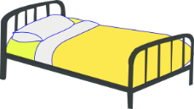
Follow up 4
Tu es Adèle et tu organises une fête improvisée pour Léa.
Tu écris des messages à ta mère. Écris cinq phrases avec
‘je’ (Adèle) ou ‘il’ (Hervé/papa).
écrire
4
2
5
1
3
1
Je fais le lit.
2
Il fait les courses.
3
Je fais la cuisine.
4
Je fais le cadeau.
5
Il fait le ménage.
Notes:
Timing: 5 minutes
Aim: to practise written production of vocabulary and the first and third person singular forms of faire.
Procedure:
Check understanding of the rubric, given in French. Pupils know these words from previous learning.
Use stressed intonation and strategic pointing (i.e. at Adèle or her dad) to ensure that the instruction for the task is fully understood.
Do the first one together as an example, ensuring pupilsfocus on the verb ending as well as the pronoun, when feedback on the first answer is given.
Then give students time to do questions 2-5, before checking them together.
8

Slide 9
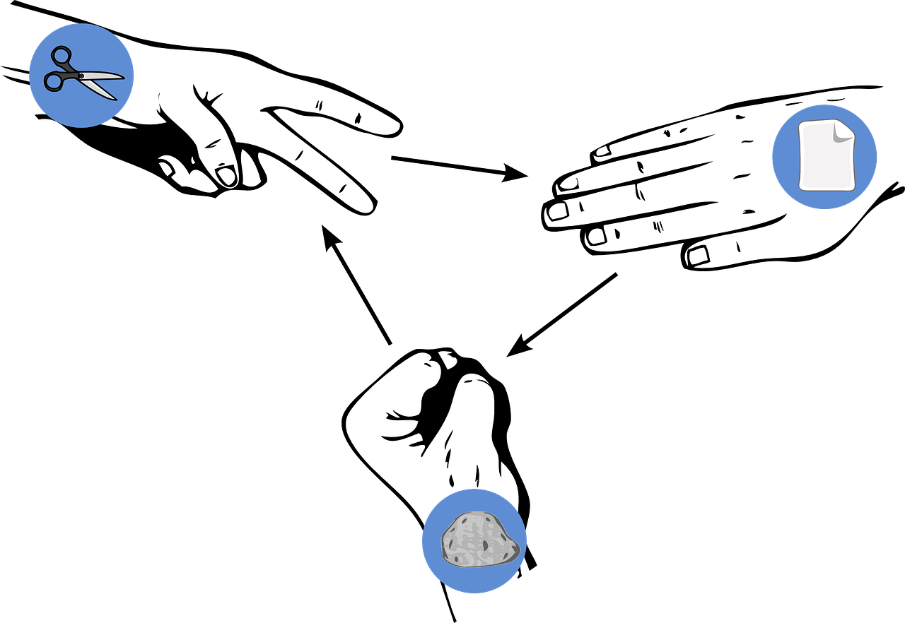
Follow up 5
Pierre-papier-ciseaux*
Choose four activities and write four sentences in French saying what you do OR don’t do: ‘I do…’ / ‘I don’t…’
écrire
parler
Read your sentences. If your partner has exactly the same sentence as you, play rock-paper-scissors. The loser must write/say a different sentence. Play until you have successfully said all your sentences.
Exemple:
Je ne fais pas le lit.
Je ne fais pas le lit !
Je fais le ménage.
Partenaire A
Partenaire B
*Rock-paper-scissors
Notes:
Timing: 5-10 minutes (two rounds of speaking activity)
Aim: to practise oral production and comprehension of negative sentences with 1st person of faire, and vocabulary from this week.
Note: This slide shows how the speaking task is intended to work. The stages are animated to support the teacher in modelling the task.
Procedure:
After modelling this example, display the next slide with 6 item choices (which gives 12 possible sentences, as each one can also be negative).
Partner As read first and Bs answer.
Then swap roles for Round 2.

Slide 10
Follow up 5
Pierre-papier-ciseaux*
Remember you can make your sentences negative, too.
écrire
parler
[the cooking]
[a list]
[the housework]
[(the) bed]
[a present]
[the shopping]
*rock-paper-scissors
Notes:
DISPLAY THIS SLIDE FOR PUPILS DURING THE TASK.
Note: if desired, click on the pictures to hear the French phrases (as affirmative statements).

Slide 11
vocabulaire
Follow up 2a - Écris en anglais : Can you get at least 15 points?
mots
 | tout le monde | souhaiter | célébrer
 | échanger | fabriquer | la rue
 | vingt-et-un | trois | douze
 | dix-sept | vingt-cinq | trente-quatre
 | il fait | la cuisine | faire
 | je fais | le ménage | les courses
x3
x2
x1
Notes:
HANDOUT
11

Slide 12
vocabulaire
Follow up 2b - Écris en français : Can you get at least 15 points?
mots
 | to wish | (the) road, street | everyone
 | to celebrate | to exchange | to create, make
 | 16 | 28 | 39
 | 13 | 14 | 15
 | (the) cooking | (the) shopping | (the) housework
 | to do, to make | I do, I make | she does, makes
x3
x2
x1
Notes:
HANDOUT
12

