Slide 1
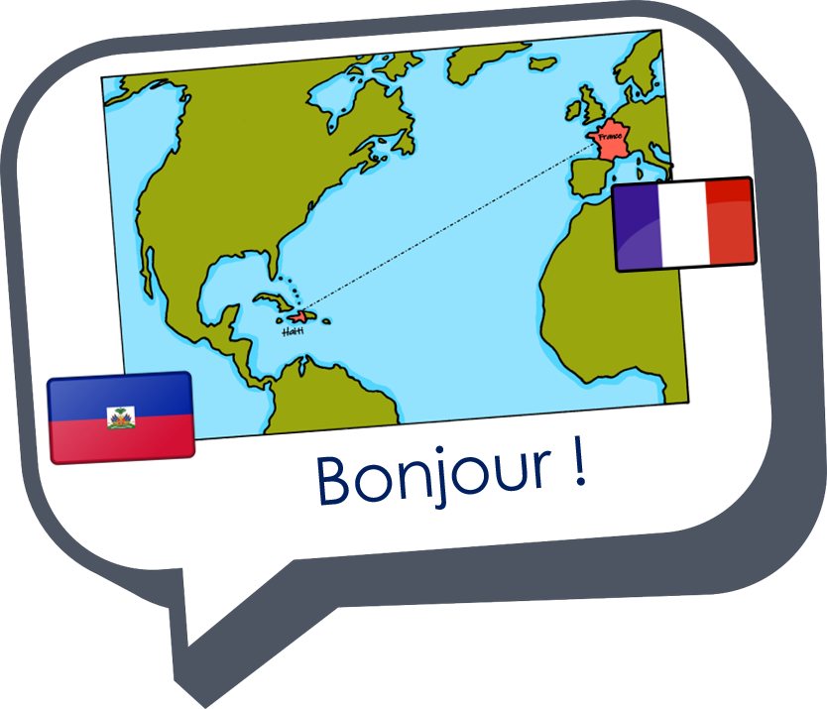
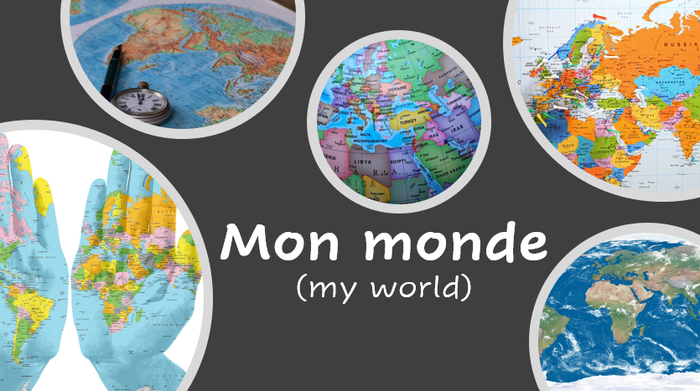
Describing me and others
bleu
Follow ups 1-5
Term 3 Week 13
Notes:
Artwork by Steve Clarke. Pronoun pictures from NCELP (www.ncelp.org). All additional pictures selected from Pixabay and are available under a Creative Commons license, no
attribution required.
Phonics: Revisit
Vocabulary: Revisit
Revisit 1: acheter [636] boire [1879] café [1886] eau [475] glace [2580] pain [2802] poisson [1616] manger [1338] partager [527] fruit [896]
Revisit 2: tu fais [25] effort [388] voyage [904] carte [955] gâteau [4845] liste [924]
Londsale, D., & Le Bras, Y. (2009). A Frequency Dictionary of French: Core vocabulary for learners London: Routledge.
The frequency rankings for words that occur in this PowerPoint which have been previously introduced in these resources are given in the SOW and in the resources that first
introduced and formally re-visited those words.
For any other words that occur incidentally in this PowerPoint, frequency rankings will be provided in the notes field wherever possible.

Slide 2
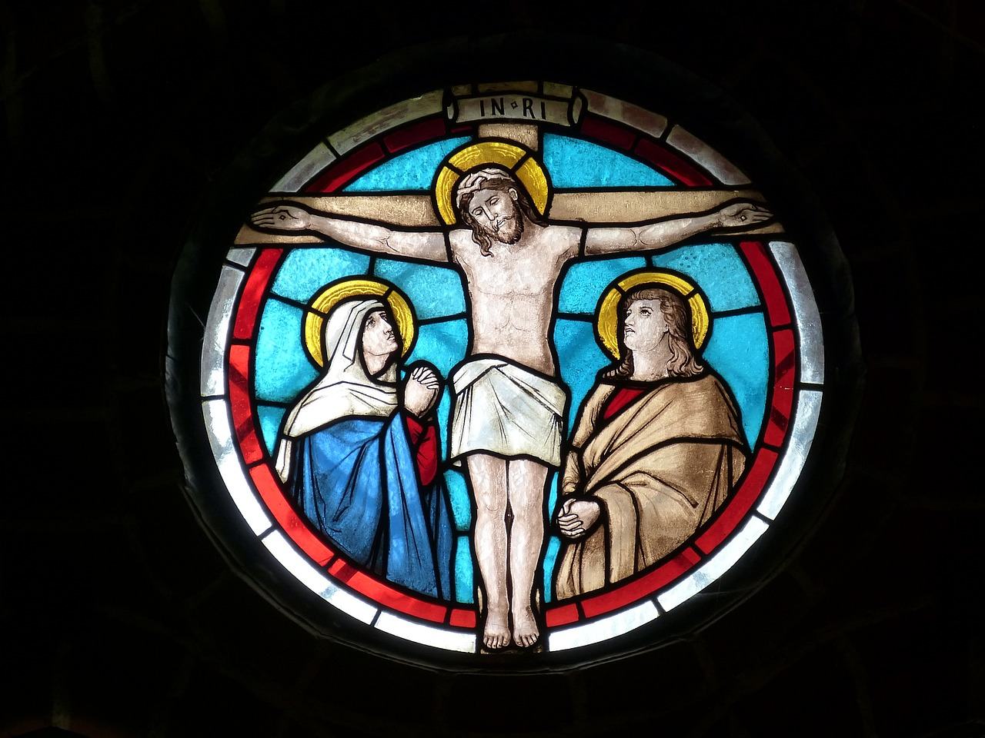
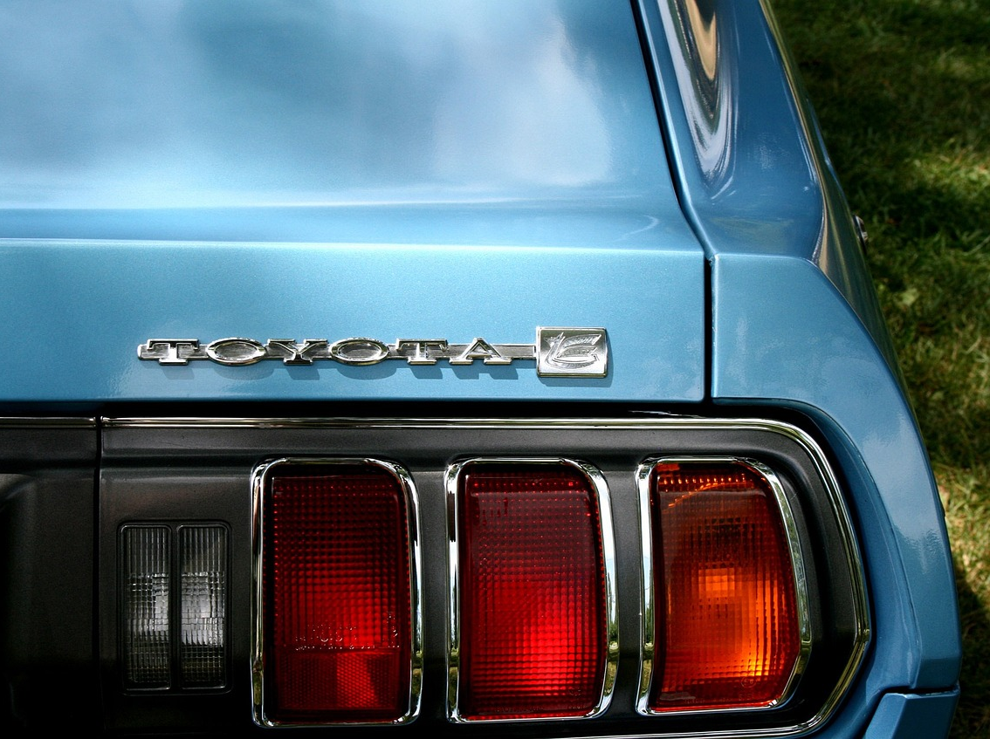
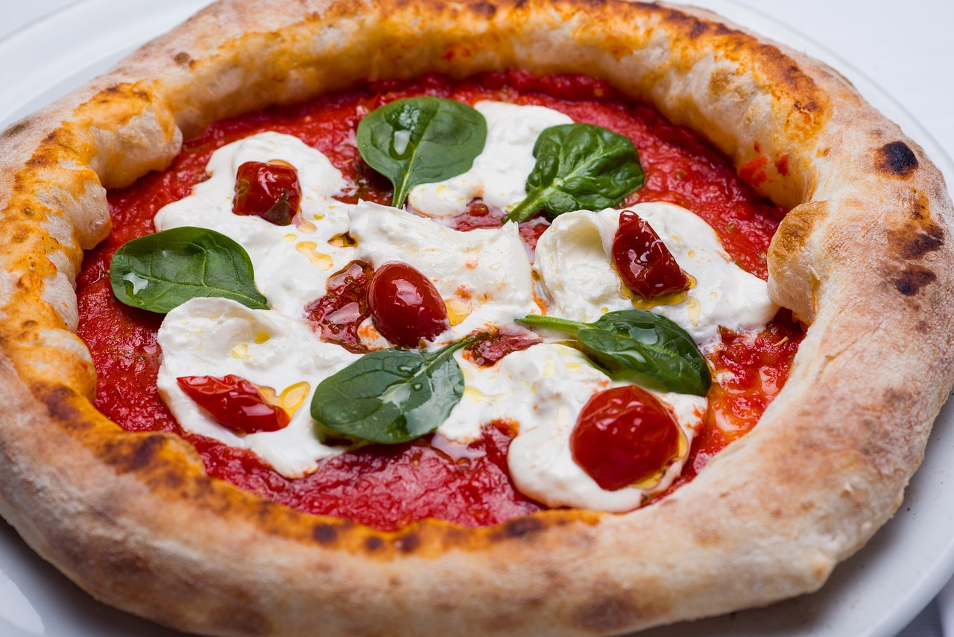
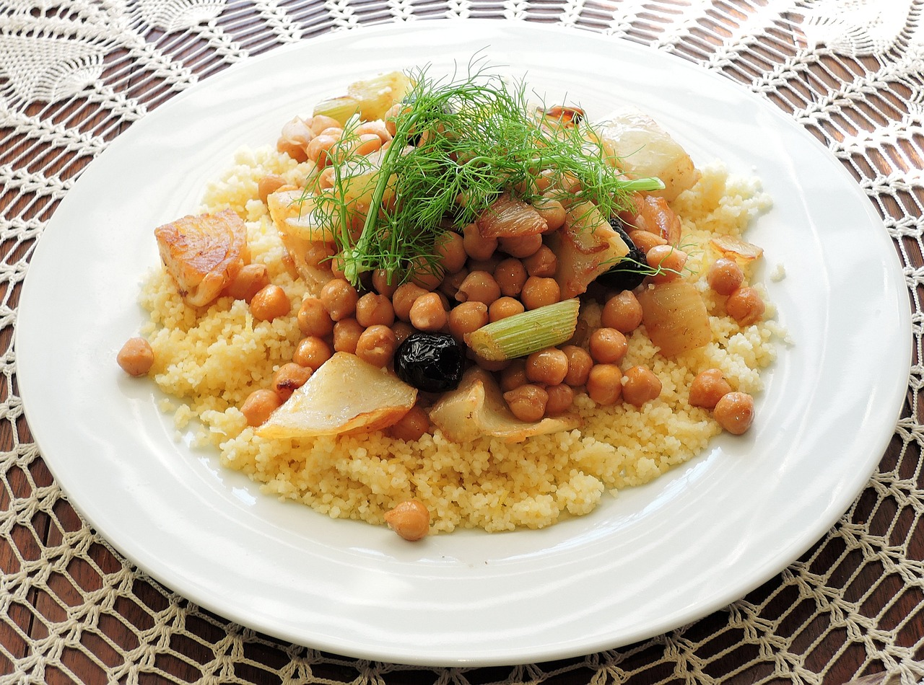
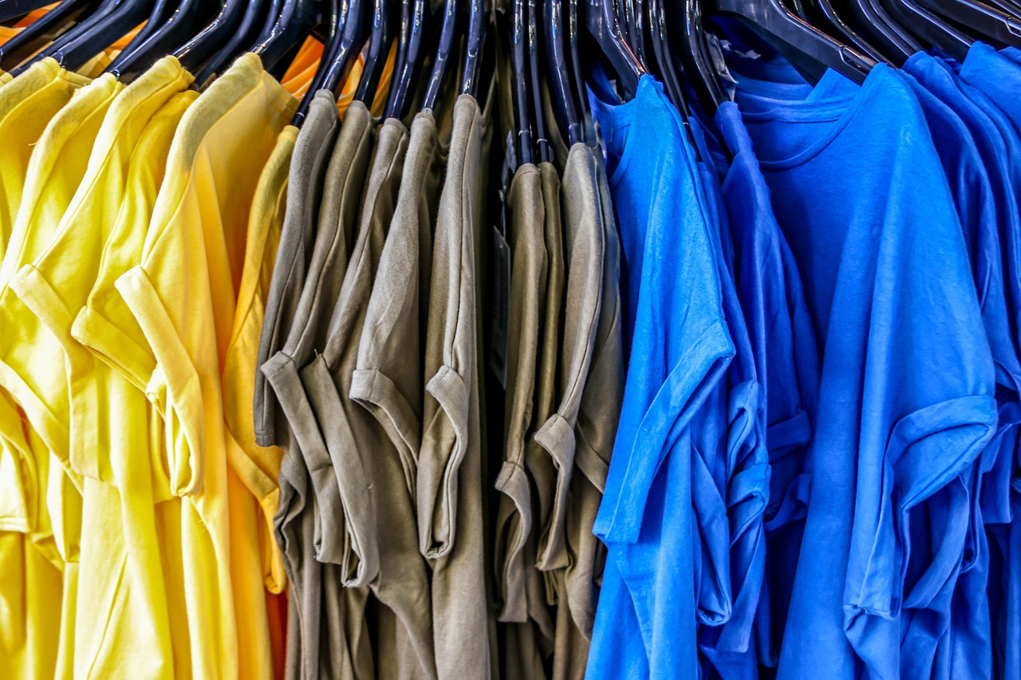
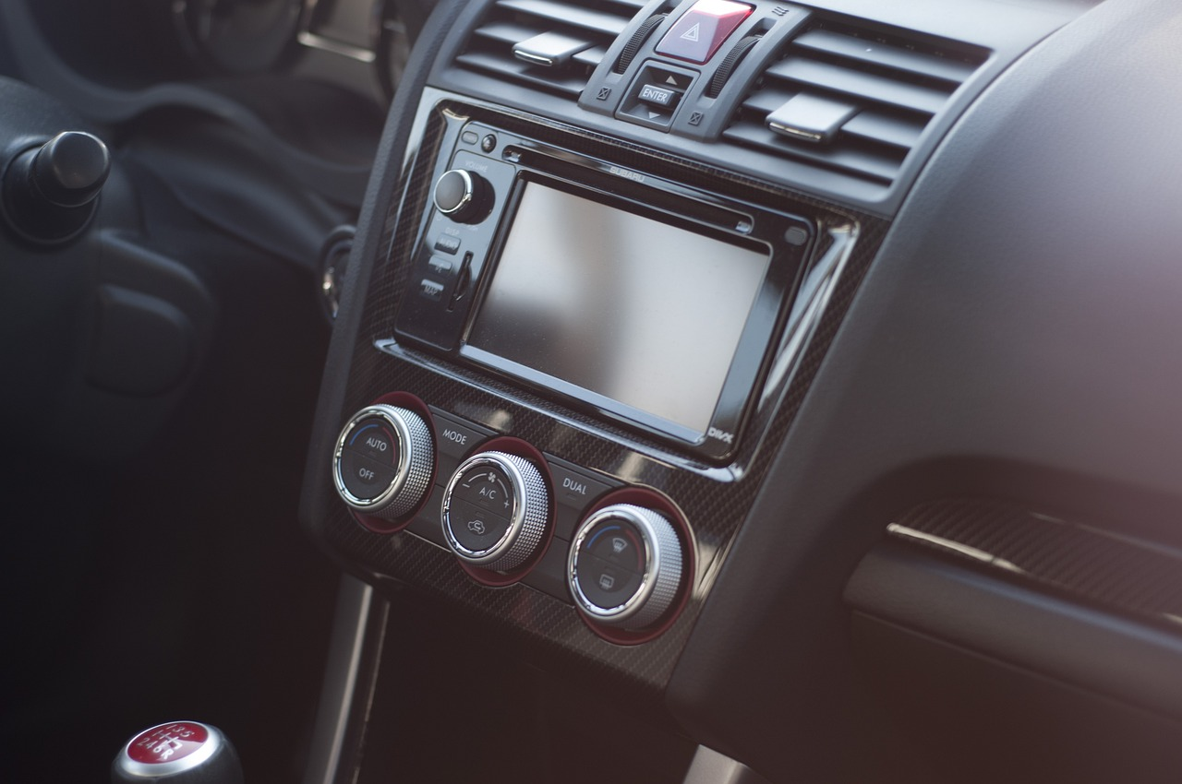
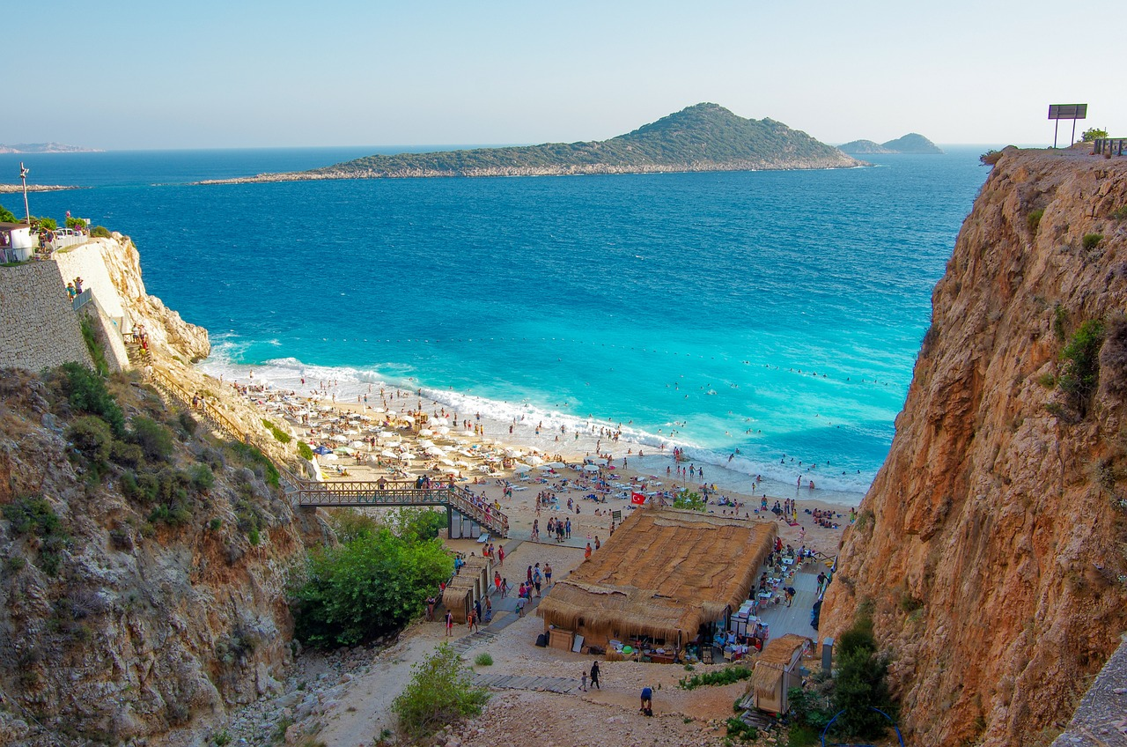
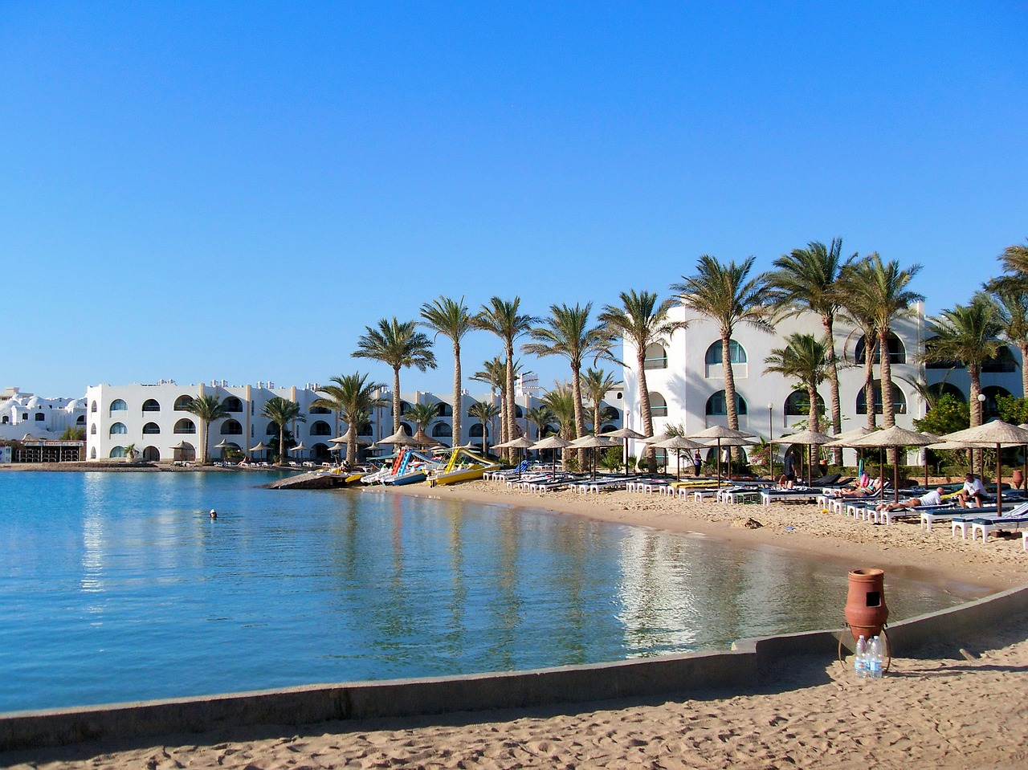
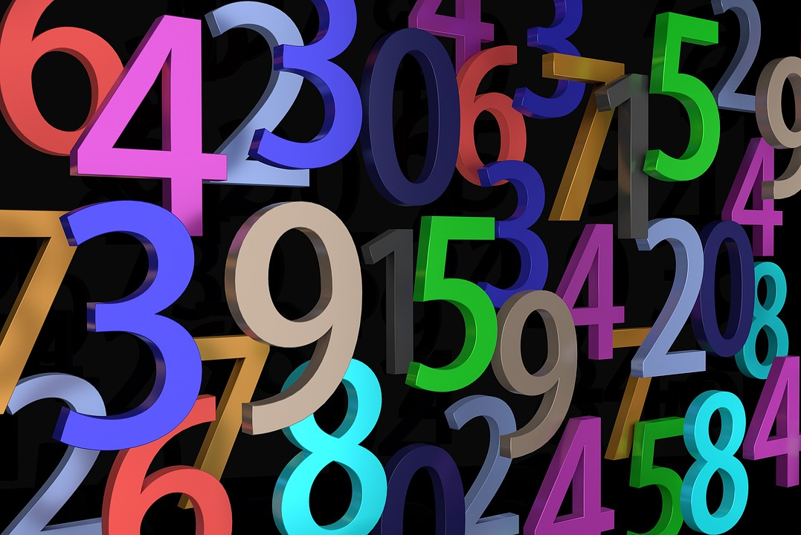
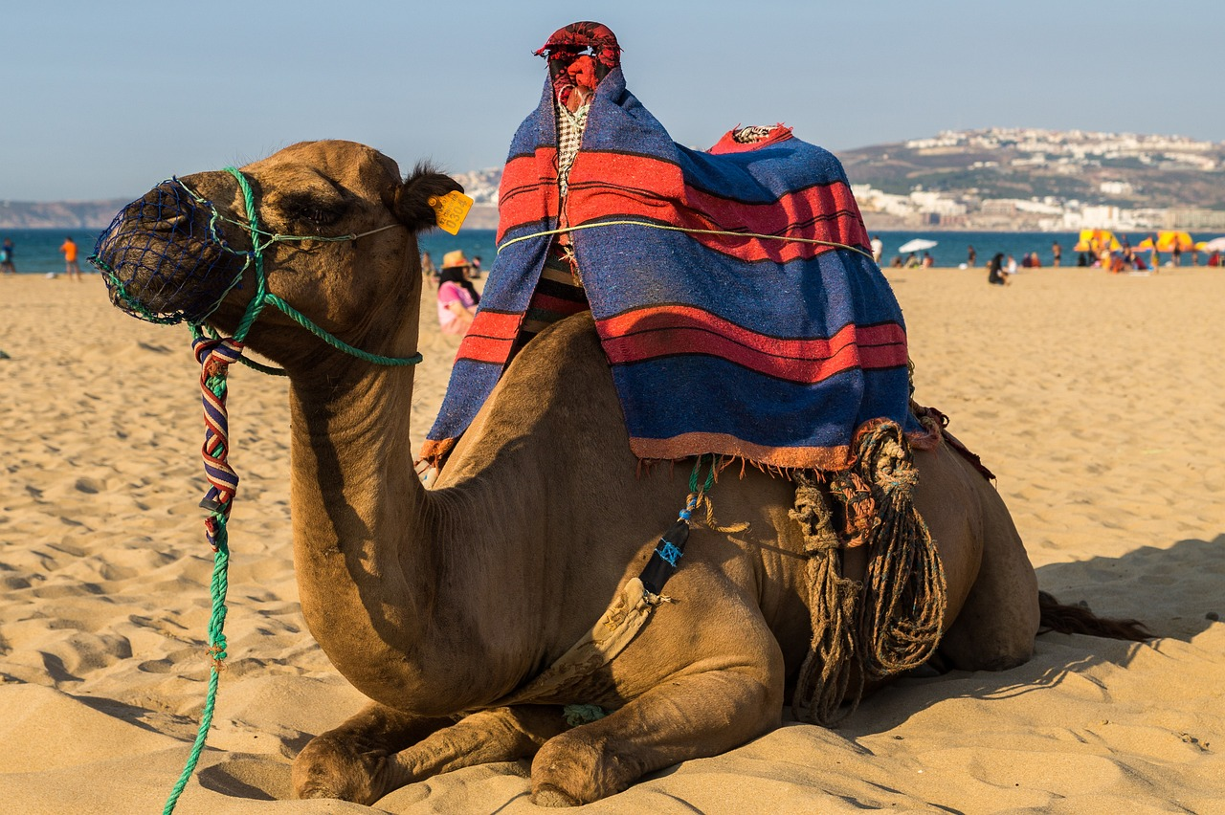
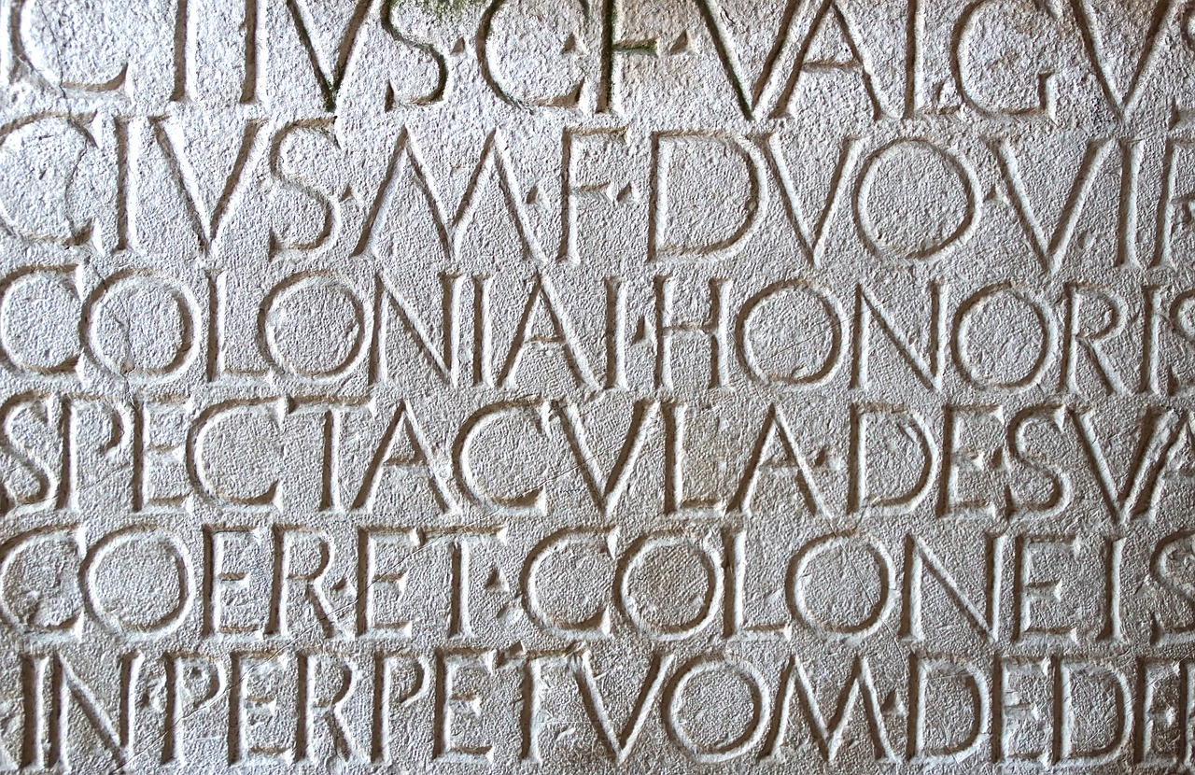
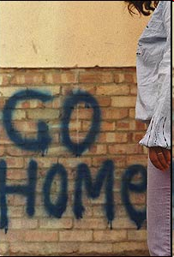
Follow ups
Remember! mon | ma | mes = my mon = masculine nouns, and nouns beginning with a vowel or silent ‘h’. ma = feminine nouns mes = all plural nouns.
Écris un poème.
Ton Christ est juif,
lire
Ta voiture est japonaise,
lire
Ta pizza est italienne et ton coucous algérien,
Ta démocratie est grecque,
Ton café est brésilien,
Ta montre est suisse, ta chemise est indienne,
Ta radio est coréenne,
Tes vacances sont turques, tunisiennes ou marocaines,
Tes chiffres sont arabes, ton écriture est latine,
?????????????????????????????????????
Et…Tu reproches à ton voisin d’être étranger.
Et…Tu reproches à ton voisin d’être étranger.c
Notes:
Timing: flexible during the week
Aim: to continue work pupils’ adaptations of this poem text, illustrated poster work.
Procedure:
Teacher directs pupils to work appropriately for their own context.

Slide 3
vocabulaire

Follow up 5
Écris en anglais. Can you get at least 15 points?
mots
 | le gâteau | l’effort | tu fais
 | la carte | le voyage | la liste
 | boire | la glace | l’eau
 | le café | le pain | le poisson
 | l’été | l’équipe | acheter
 | il fait mauvais | l’hiver | il fait beau
(the) cake
(the) effort
you do, make
x3
(the) card
(the) journey, trip
(the) list
to drink, drinking
(the) ice cream
(the) water
x2
(the) coffee
(the) bread
(the) fish
(the) team
to buy, buying
(the) summer
x1
it’s bad weather
(the) winter
it’s good weather
Notes:
Timing: 5 minutes
Aim: to practise written comprehension of vocabulary.
Procedure: 1. Give pupils a blank grid. They fill in the English meanings of any of the words they know, trying to reach 15 points in total. 2. Remind pupils that adjectives can refer to male or female persons and they should note this in their translations. E.g. pleased (f), short (m).
Note: The most recently learnt and practised words are pink, words from the previous week are green and those from week 1 are blue, thus more points are awarded for them, to recognise that memories fade and more effort (heavy lifting!) is needed to retrieve them.
3

Slide 4
vocabulaire

Follow up 5
Écris en français. Can you get at least 15 points?
mots
 | (the) card | (the) cake | (the) list
 | you do, make | (the) effort | (the) journey, trip
 | (the) ice cream | (the) bread | (the) fish
 | to drink, drinking | (the) coffee | (the) water
 | it’s bad weather | (the) summer | to buy, buying
 | (the) team | (the) winter | it’s good weather
la carte
le gâteau
la liste
x3
tu fais
l’effort
le voyage
la glace
le pain
le poisson
x2
boire
le café
l’eau
il fait mauvais
l’été
acheter
x1
l’équipe
l’hiver
il fait beau
Notes:
Timing: 5 minutes
Aim: to practise written comprehension of vocabulary from week 1, last week and this week.
Procedure: 1. Give pupils a blank grid. They fill in the English meanings of any of the words they know, trying to reach 15 points in total. 2. Remind pupils that adjectives can refer to male or female persons and they should note this in their translations. E.g. pleased (f), short (m).
Note: The most recently learnt and practised words are pink, words from the previous week are green and those from week 1 are blue, thus more points are awarded for them, to recognise that memories fade and more effort (heavy lifting!) is needed to retrieve them.
4

Slide 5
vocabulaire

Follow up 5
Écris en anglais. Can you get at least 15 points?
mots
 | le gâteau | l’effort | tu fais
 | la carte | le voyage | la liste
 | boire | la glace | l’eau
 | le café | le pain | le poisson
 | l’été | l’équipe | acheter
 | il fait mauvais | l’hiver | il fait beau
x3
x2
x1
Notes:
HANDOUT
5

Slide 6
vocabulaire

Follow up 5
Écris en français. Can you get at least 15 points?
mots
 | (the) card | (the) cake | (the) list
 | you do, make | (the) effort | (the) journey, trip
 | (the) ice cream | (the) bread | (the) fish
 | to drink, drinking | (the) coffee | (the) water
 | it’s bad weather | (the) summer | to buy, buying
 | (the) team | (the) winter | it’s good weather
x3
x2
x1
Notes:
HANDOUT
6

