Slide 1
Saying what I and others do
La Galette des Rois
bleu
Follow ups 1-5
Notes:
Artwork by Steve Clarke. Pronoun pictures from NCELP (www.ncelp.org). All additional pictures selected from Pixabay and are available under a Creative Commons license, no
attribution required.
Phonics: Revisit SSC [é|er|ez|et] and [è|ê] - répéter [630] écrire [382] bébé [2271] donner [46] parler [106] et [6] nez [2661] fête [1490] tête [343] frère [1043] être [5] problème [188]
Vocabulary (new words in bold): étudier [960] partager [527] parfois [410]
Revisit 1: aimer [242] arriver [174] célébrer [2170] organiser [701] porter [105] préparer [368] année [102] fête [1490] gens [236] histoire [262] santé [641] vêtement [2383]
Revisit 2: avons [8] avez [8] nous [31] vous [50] exercice [1290] chaise [3419] cours [169] enfant [126] où [48] sur [16] ici [167] là [109]
Londsale, D., & Le Bras, Y. (2009). A Frequency Dictionary of French: Core vocabulary for learners London: Routledge.
The frequency rankings for words that occur in this PowerPoint which have been previously introduced in these resources are given in the SOW and in the resources that first
introduced and formally re-visited those words.
For any other words that occur incidentally in this PowerPoint, frequency rankings will be provided in the notes field wherever possible.

Slide 2
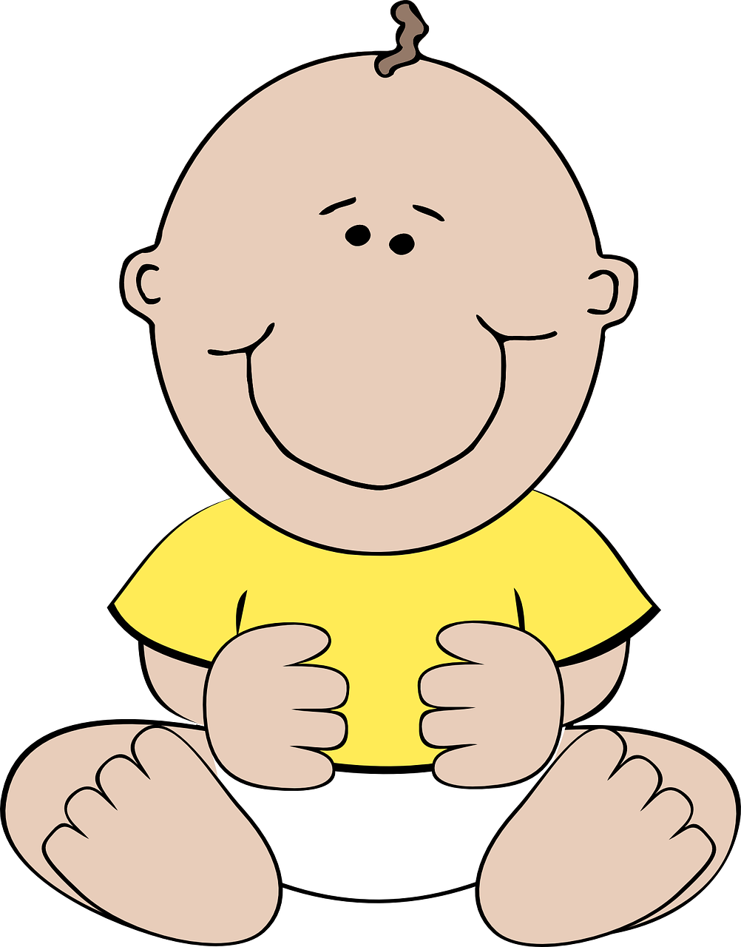
prononcer
[é]
[er]
[et]
[ez]
Remember that [é], [er],[et] and [ez] sound the same.
répéter
[and]
écrire
parler
et
bébé
donner
nez
[to give]
Notes:
Timing: 2 minutes
Aim: to recap SSC [é] [er] [et] [ez], which are the same sound written differently.
Procedure:
Introduce and elicit the pronunciation of the individual SSC [é, et, et, ez] and the source word ‘répéter’, which has both spellings of the sound.
Click to bring on the picture and get students to repeat (with gesture, if using).
Present and practise the cluster words.
Gesture: gesture for répéter – hand with thumb and two fingers pointing forwards doing a three downwards motions, one for each syllable of the word.
https://www.signbsl.com/sign/repeat (the 2nd video marked again: repeat with the female signer)
2

Slide 3
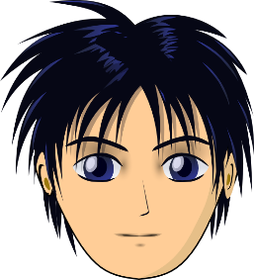
prononcer
[è|ê]
[è] and [ê] sound almost the same. [ê] is a little longer and deeper.
to be, being
fête
être
frère
(brother)
(party, celebration)
tête
problème
(head)
Notes:
Timing: 2 minutes
Aim: to recap SSC [è] and [ê] which are the same sound written differently.
Procedure:
Introduce and elicit the pronunciation of the individual SSC [è] and the source word ‘xxx’, which has both spellings of the sound.
Click to bring on the picture and get students to repeat (with gesture, if using).
Present and practise the cluster words.
Gesture: gesture for fête: raise both hands in the air (middle three fingers facing down in a partial fist, with thumb and pinkie facing upwards) and move up and down alternate left and right to suggest a celebration-style dance.
Source: https://www.signbsl.com/sign/party (the 3rd video from the right is the best one, in my view)
3

Slide 4
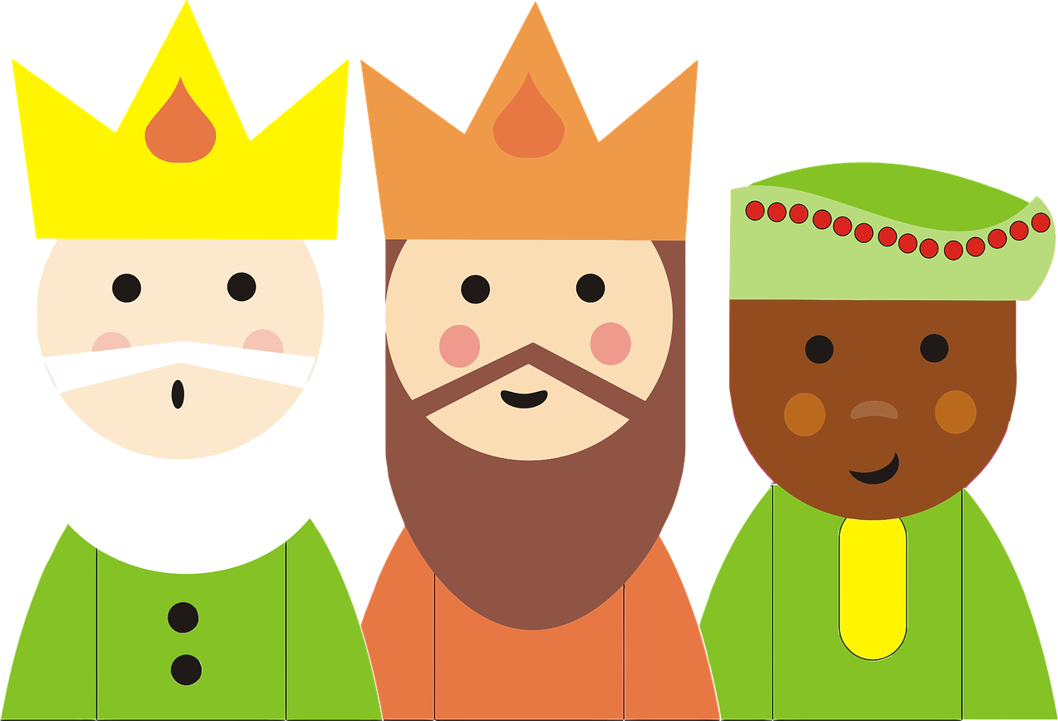
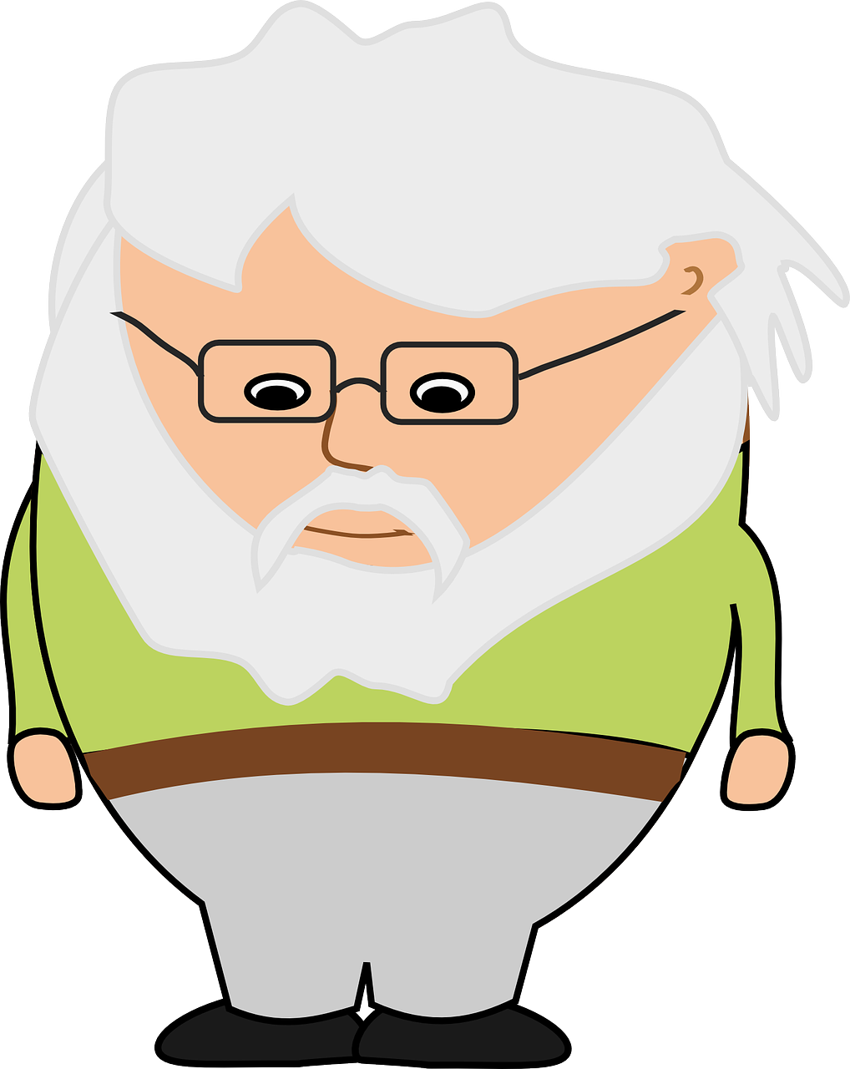
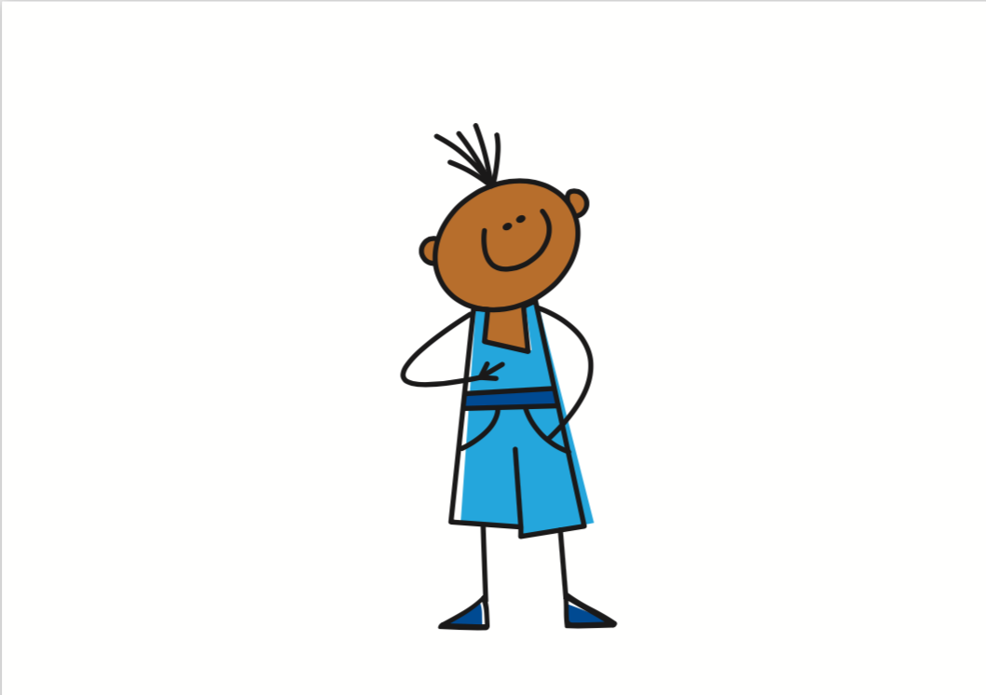
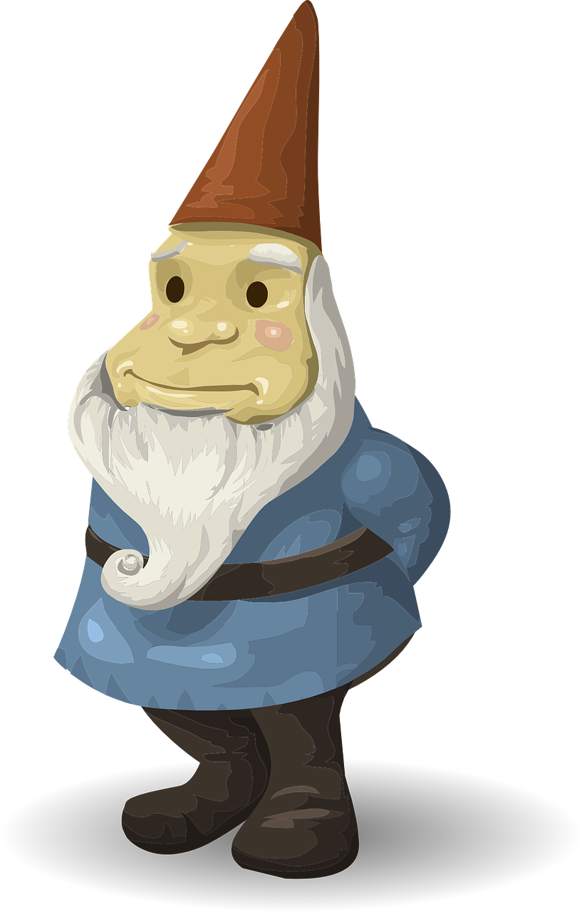
Follow up 1:
Prononce la chanson.🗣
C'est la jolie fête
La fête des Rois
On mange la galette
Chez mon oncle Éloi
Si maman est reine
Papa sera roi
Mais si j'ai la fève
La couronne pour moi.
C'est la jolie fête
La fête des Rois
On mange la galette
Chez mon oncle Éloi
Si maman est reine
Papa sera roi
Mais si j'ai la fève
La couronne pour moi.
C'est la jolie fête
La fête des Rois
On mange la galette
Chez mon oncle Éloi
Si maman est reine
Papa sera roi
Mais si j'ai la fève
La couronne pour moi.
C'est la jolie fête
La fête des Rois
On mange la galette
Chez mon oncle Éloi
Si maman est reine
Papa sera roi
Mais si j'ai la fève
La couronne pour moi.
It’s the pretty festival.
prononcer
The festival of the Kings (Epiphany)
All these sound the same, though remember [ê] is a little longer and deeper.
When you sing French, you often pronounce the Silent Final e!
You know that [ez] sounds the same as [é], too.
We eat the (Epiphany) cake
At my uncle Éloi’s house.
If mum is the queen
dad will be the king.
But if I have the fève (figurine)
l’oncle = uncle
si = if sera = (s/he) will be
the crown for me.
Notes:
Timing: 5 minutes
Aim: to practise pronunciation of different sounds represented by the letter ‘e’; to find out about the SFe in sung French; to practise read aloud with some known and some unfamiliar words.
Procedure:
Pupils work in pairs to pronounce the song first of all (without hearing the sung version).
Click to highlight all the different ‘e’ sounds.
Click to listen to the song.
Draw pupils attention to the SFe, which is pronounced when French in sung, particularly at the end of lines.
Play the song again and encourage pupils to sing along.
Pupils know many of these words. If time allows, teachers can elicit an oral translation. Click to reveal the English meanings.
Source: https://www.mamalisa.com/?t=es&p=3006 (Sing to tune of Au clair de la lune)
Frequency: couronne [>5000] fève [>5000] galette [>5000] roi [1364] Source: Londsale, D., & Le Bras, Y. (2009). A Frequency Dictionary of French: Core vocabulary for learners London: Routledge.

Slide 5
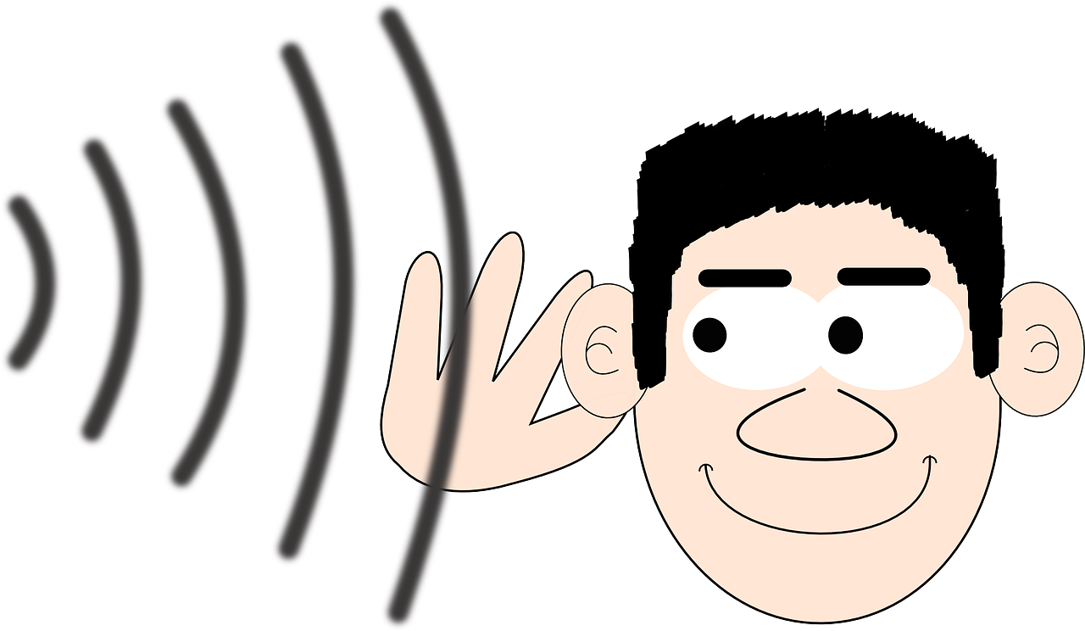
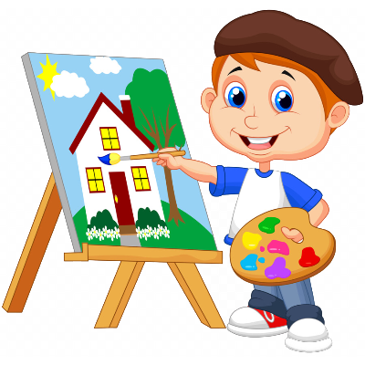
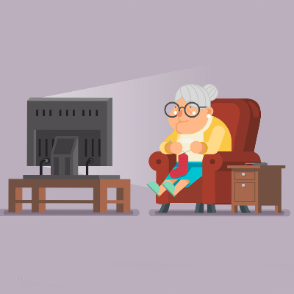
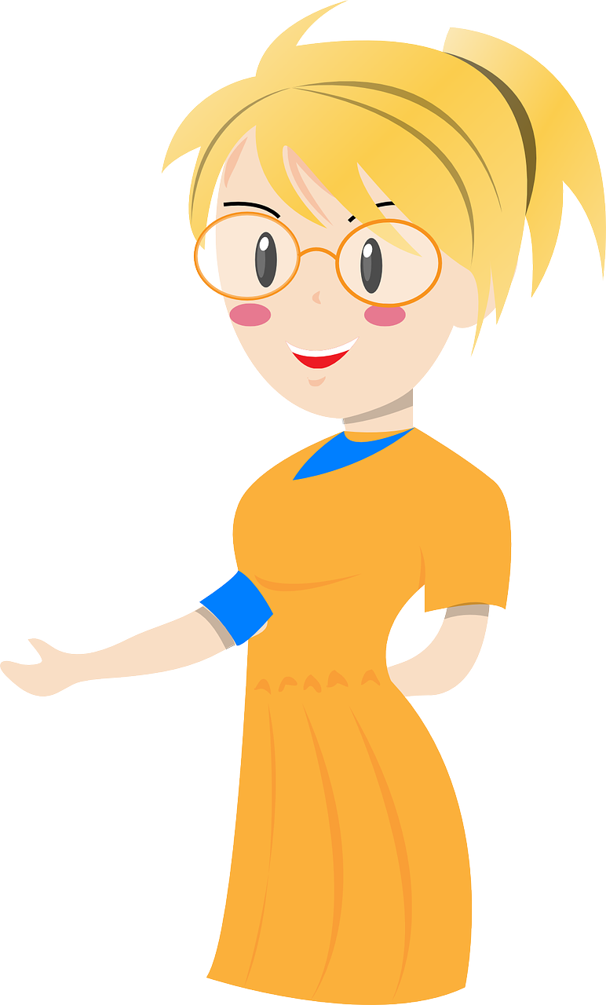
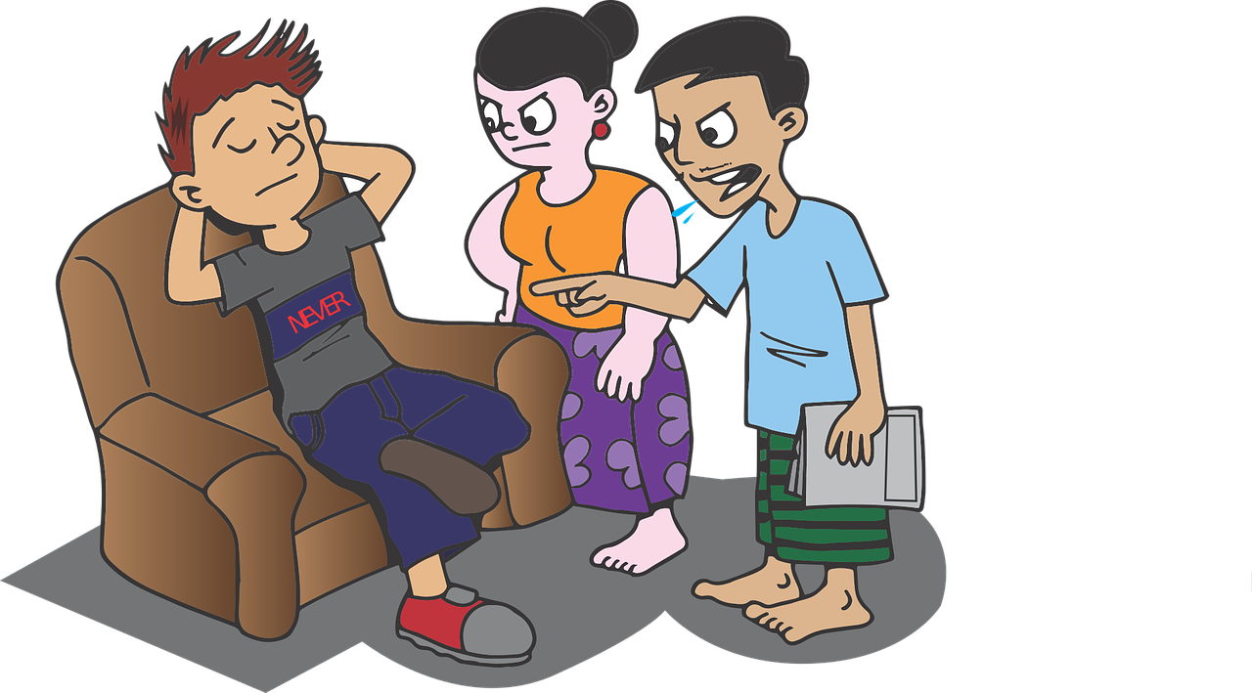
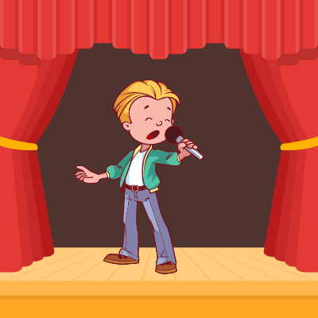
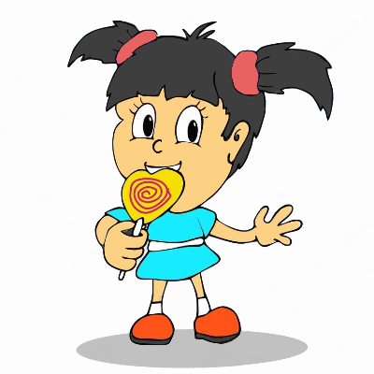
Follow up 2
C’est vrai ?
Écris cinq phrases négatives en français.
écrire
1
Il écoute.
C’est vrai !
5
Il parle.
Ce n’est pas vrai !
Il ne parle pas.
Elle ne danse pas.
Ce n’est pas vrai !
2
Elle danse.
6
Elle regarde.
C’est vrai !
Ce n’est pas vrai !
Ce n’est pas vrai !
Il étudie.
Il n’ étudie pas.
3
Elle mange.
Elle ne mange pas.
7
Ce n’est pas vrai !
8
Elle travaille.
Elle ne travaille pas.
4
Il chante.
C’est vrai !
Notes:
Timing: 5 minutes
Aim: to practise written production of simple negative sentences.
Note: The reading and speaking elements of this task were done in the lesson. Pupils will hopefully recognise that they responded ‘ce n’est pas vrai’ to five of the statements. Those are the focus for this writing task.
Procedure:
Pupils write negative sentences for the five incorrect statements.
Elicit answers orally from pupils and click to reveal written answers.

Slide 6
Knowing who does what [1/2]
It is also the form of a verb you see in a dictionary.
[–er verbs: ‘we’ and ‘you (plural)’]
We know the infinitive verb tells us the general meaning:
célébrer
to celebrate, celebrating
Remember: to mean ‘we’ with a verb, remove –er and add –ons:
Nous célébrons la fête des Rois.
Nous aimons la galette des Rois !
We celebrate Epiphany.
And to mean ‘you (plural)’ with a verb:
Vous célébrez, aussi.
You celebrate, too.
Notes:
Complete before Follow up 3
[1/2]
Timing: 2 minutes (two slides)
Aim: to introduce 1st and 2nd persons plural for –er verbs.
Procedure:
Click through the animations to present the new information.
Elicit English translations for the French examples provided.

Slide 7
Knowing who does what [2/2]
[–er verbs: ‘we’ and ‘you (plural)’]
partager
to share, sharing
Remember: verbs with stems ending in –g need an ‘e’ in the nous form.
Nous partageons la galette des Rois.
We share the epiphany cake.
And to mean ‘you (plural)’ with a verb:
Vous partagez des vœux, aussi.
You (all) share best wishes, too.
Notes:
[2/2]
Procedure:
Click through the animations to present the new information.
Elicit English translations for the French examples provided.

Slide 8
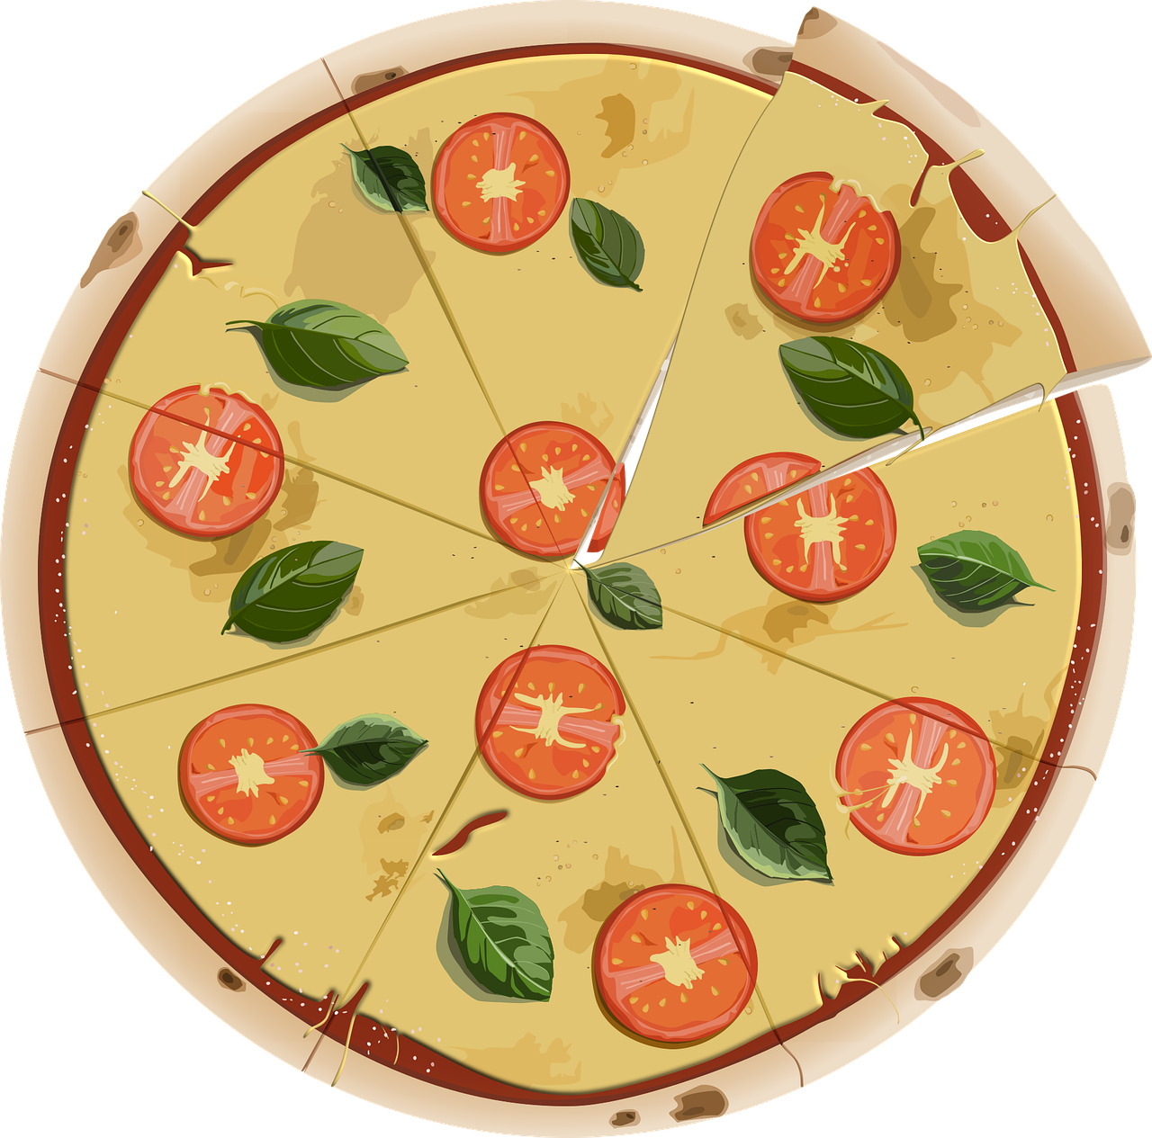
Follow up 3 Pratique les verbes : nous et vous
organiser
parler
partager
porter
[to organise, organising]
[to wear, wearing]
[to share, sharing]
étudier
célébrer
[to study, studying]
[to celebrate, celebrating]
Notes:
Timing: 3 minutes (three slides)
Aim: to reinforce the specific production and pronunciation of 1st and 2nd persons plural, along with the subject pronouns nous and vous.
Procedure:
Click to bring up each infinitive on its own and elicit the pronunciation from pupils.
Elicit choral responses of the infinitive form from students by clicking to disappear the five verbs at random.
Note: audio is not part of the animation, as we want to elicit the pronunciation from pupils. However, if needed, teachers can click on the verbs to listen and check.

Slide 9
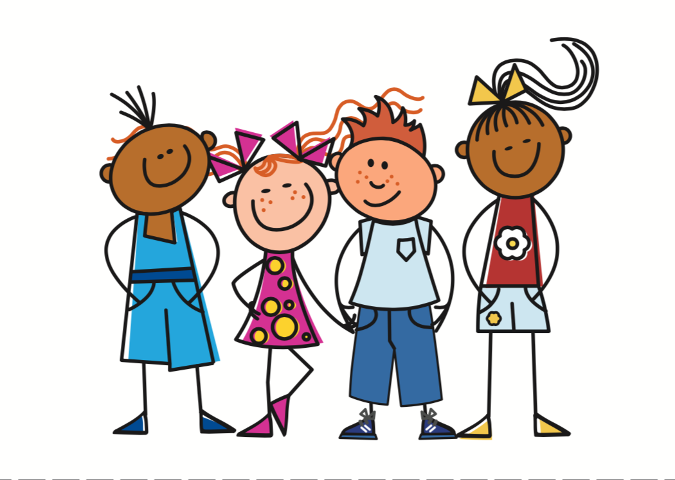
Follow up 3 Pratique les verbes : nous et vous
organiser
==
parler
partager
==
porter
==
nous
étudier
célébrer
==
==
Remember the liaison –s before verbs starting with vowels.
Notes:
Procedure:
Click to bring up the nous pronoun.
Click again to trigger nous and a verb stem to disappear (slow animation of 3 seconds). Pupils need to give the nous form of the verb before the verb disappears e.g. nous portons.
Continue until all 6 verbs have disappeared.
This time, the audio answer is heard when the nous re-appears, so that pupil elicitation happens first.

Slide 10
Follow up 3 Pratique les verbes : nous et vous
organiser
Remember the liaison –s before verbs starting with vowels.
==
parler
partager
==
porter
==
vous
étudier
célébrer
==
==
Notes:
Audio with pronouns being added.
Procedure:
Click to bring up the nous pronoun.
Click again to trigger nous and a verb stem to disappear (slow animation of 3 seconds). Pupils need to give the nous form of the verb before the verb disappears e.g. nous portons.
Continue until all 6 verbs have disappeared.
This time, the audio answer is heard when the nous re-appears, so that pupil elicitation happens first.

Slide 11
Follow up 4 [1/7]
Écoute la question. Donne une réponse en français.
parler
1
Oui, il chante.
Notes:
[1/7]
Timing: 5 minutes (7 slides)
Aim: to practise aural comprehension of est-ce que questions and respond with affirmative or negative sentences.
Procedure:
Teacher says (or clicks for the audio of) the question.
Pupils respond, chorally, with a short sentence.
Click to bring up a written and audio version of the response, for listen and check.
Transcript: Est-ce qu’ il chante ?

Slide 12
Follow up 4 [2/7]
Écoute la question. Donne une réponse en français.
parler
2
Non, elle ne parle pas.
Notes:
[2/7]
Transcript: Est-ce qu’elle parle ?

Slide 13
Follow up 4 [3/7]
Écoute la question. Donne une réponse en français.
parler
3
Oui, elle regarde.
Notes:
[3/7]
Transcript: Est-ce qu’elle regarde ?

Slide 14
Follow up 4 [4/7]
Écoute la question. Donne une réponse en français.
parler
4
Oui, il dessine.
Notes:
[4/7]
Transcript: Est-ce qu’il dessine ?

Slide 15
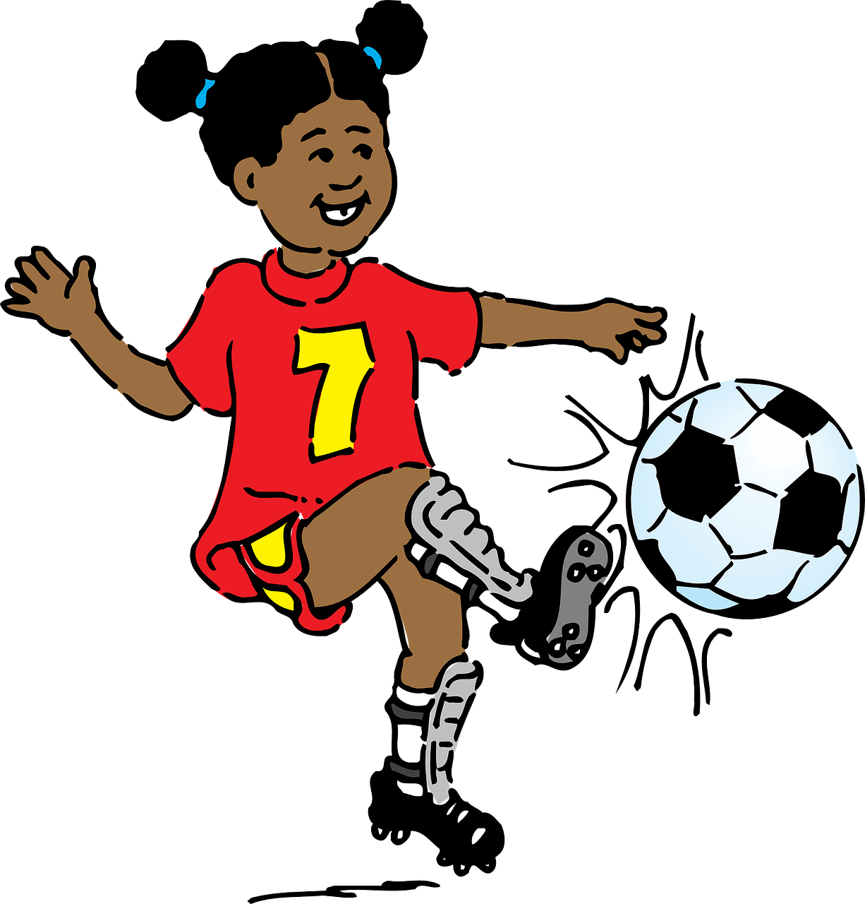
Follow up 4 [5/7]
Écoute la question. Donne une réponse en français.
parler
5
Non, elle n’étudie pas.
Notes:
[5/7]
Transcript: Est-ce qu’elle étudie ?

Slide 16
Follow up 4 [6/7]
Écoute la question. Donne une réponse en français.
parler
6
Non, il n’explique pas.
Notes:
[6/7]
Transcript: Est-ce qu’il explique ?

Slide 17
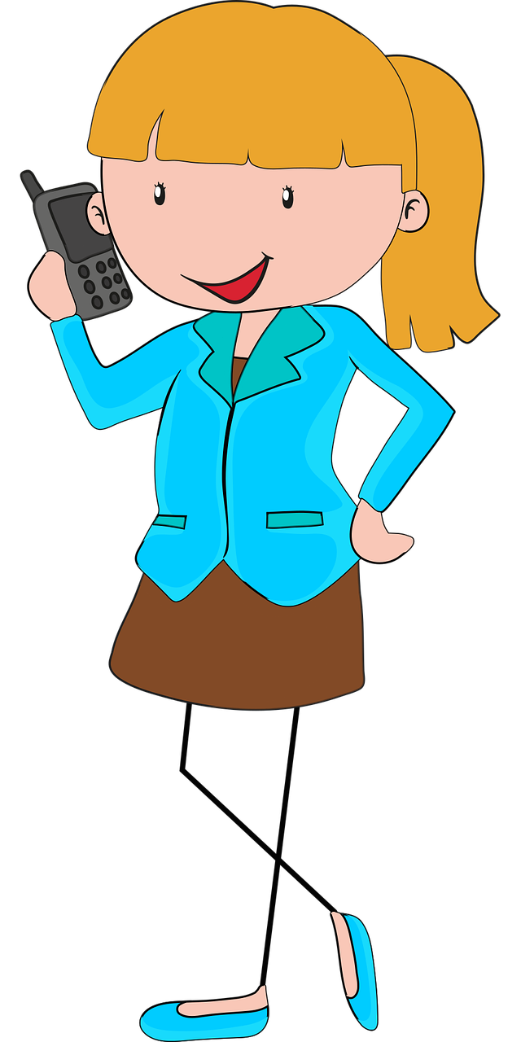
Follow up 4 [7/7]
Écoute la question. Donne une réponse en français.
parler
7
Non, elle ne mange pas.
Notes:
[7/7]
Transcript: Est-ce qu’elle mange ?

Slide 18
vocabulaire
Follow up 5 - Écris en anglais : Can you get at least 15 points?
mots
 | le cours | nous partageons | vous étudiez
 | nous avons | vous avez | l’exercice
 | l’histoire | la santé | le vêtement
 | l’année | la fête | les gens
 | étudier | partager | parfois
lesson, course
we share
you (pl) study
x3
we have
you (pl) have
exercise
(the) (item of) clothing
(the) history
(the) healthy
x2
(the) party, celebration, festival
(the) year
(the) people
x1
to study, studying
to share, sharing
sometimes
Notes:
Timing: 5-10 minutes
Aim: to practise written production of vocabulary from this week and two revisited weeks.
Procedure: 1. Give pupils a blank grid. They fill in the English meanings of any of the words they know, trying to reach 15 points in total. 2. Remind pupils that adjectives can refer to male or female persons and they should note this in their translations. E.g. pleased (f), short (m).
Note: The most recently learnt and practised words are pink, words from revisit 1 are green and those from revisit 2 are blue, thus more points are awarded for them, to recognise that memories fade and more effort (heavy lifting!) is needed to retrieve them.
18

Slide 19
vocabulaire
Follow up 5 - Écris en anglais : Can you get at least 15 points?
mots
 | le cours | nous partageons | vous étudiez
 | nous avons | vous avez | l’exercice
 | l’histoire | la santé | le vêtement
 | l’année | la fête | les gens
 | étudier | partager | parfois
x3
x2
x1
Notes:
HANDOUT
19

Slide 20
vocabulaire
Follow up 5 - Écris en français : Can you get at least 15 points?
mots
 | (the) lesson, course | we share | you (pl) study
 | we have | you (pl) have | exercise
 | (the) history | (the) health | (the) item of clothing
 | (the) year | (the) party, celebration, festival | (the) people
 | to study, studying | to share, sharing | sometimes
le cours
nous partageons
vous étudiez
x3
nous avons
vous avez
l’exercice
l’histoire
la santé
le vêtement
x2
l’année
la fête
les gens
x1
étudier
partager
parfois
Notes:
Timing: 5-10 minutes
Aim: to practise written production of vocabulary from this week and two revisited weeks.
Procedure: 1. Give pupils a blank grid. They fill in the French meanings of any of the words they know, trying to reach 15 points in total. 2. Remind pupils that adjectives can refer to male or female persons and they should note this in their translations. E.g. pleased (f), short (m).
Note: The most recently learnt and practised words are pink, words from revisit 1 are green and those from revisit 2 are blue, thus more points are awarded for them, to recognise that memories fade and more effort (heavy lifting!) is needed to retrieve them.
20

Slide 21
vocabulaire
Follow up 5 - Écris en français : Can you get at least 15 points?
mots
 | (the) lesson, course | we share | you (pl) study
 | we have | you (pl) have | exercise
 | (the) history | (the) health | (the) item of clothing
 | (the) year | (the) party, celebration, festival | (the) people
 | to study, studying | to share, sharing | sometimes
x3
x2
x1
Notes:
HANDOUT
21

