Slide 1
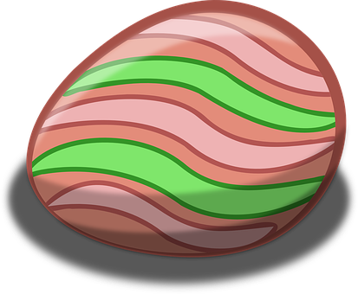
Saying where you are going and what there is there
bleu
Vocabulary & Grammar Quiz
Notes:
Artwork by Steve Clarke. Pronoun pictures from NCELP (www.ncelp.org). All additional pictures selected from Pixabay and are
available under a Creative Commons license, no attribution required.
This lesson contains vocabulary and grammar assessments to check progress in the words and structures introduced and practised in the first 23 weeks of this year’s course, as well as those from the previous two years. The ratio of old to new language in the quiz is very approximately 50:50.
1

Slide 2
écouter
Vouvol is from another planet. They like earth and speaking French but often forget word meanings, spellings and things like gender and verb forms. Help Vouvol by answering the questions in this quiz.
A For each question, put a cross (x) under the English meaning that matches what you hear.
You will hear each French word twice. Choose one correct answer only.
 | A | B | C | D
1. | east | west | he is | it is
 | ☐ | ☐ | ☐ | ☐
2. | 21 | 31 | 11 | 1
 | ☐ | ☐ | ☐ | ☐
3. | new | gift/present | hair | bad
 | ☐ | ☐ | ☐ | ☐
4. | health | history | homework | year
 | ☐ | ☐ | ☐ | ☐
1
2
3
4
Notes:
Timing: 20-25 minutes (all assessment slides)
Aim: to practise aural comprehension of vocabulary taught in weeks 1-12 of the course.
Procedure:
1. Click the audio buttons to play each item. (The words are recorded twice with a pause to allow pupils to process the information).
2. Pupils can either write 1C, etc.. or if they have the assessment on a print out they can put a X in the correct box.
3. After items 1-4, continue to the next slide to complete the remainder of the task.
Transcript:
1. l’ouest….. l’ouest
2. trente-et-un...... trente-et-un
3. Nouveau…..nouveau
4. la santé…..la santé
5. la fleur…..la fleur
6. tout le monde.....tout le monde
7. regarder.....regarder
8. cacher.....cacher
2

Slide 3
écouter
 | A | B | C | D
5. | nine | sister | flower | brother
 | ☐ | ☐ | ☐ | ☐
6. | everyday | everyone | each, every | people
 | ☐ | ☐ | ☐ | ☐
7. | to share | to create | to watch | to study
 | ☐ | ☐ | ☐ | ☐
 | to sing | to correct | to hide | to explain
 | ☐ | ☐ | ☐ | ☐
5
6
7
8
Notes:
[2/2]
Transcript:
1. l’ouest….. l’ouest
2. trente-et-un...... trente-et-un
3. Nouveau…..nouveau
4. la santé…..la santé
5. la fleur…..la fleur
6. tout le monde.....tout le monde
7. regarder.....regarder
8. cacher.....cacher
3

Slide 4
écouter
B For each question, put a cross (x) under the type of word you hear. You will hear each French word twice. Choose one correct answer only.
This word is a good example of …
 | A | B | C | D
1. | a direction ☐ | a country ☐ | a building ☐ | an object ☐
2. | an object ☐ | a person ☐ | a number ☐ | a time adverb ☐
3. | a person ☐ | a greeting ☐ | a building ☐ | a direction ☐
4. | a building ☐ | an object ☐ | a person ☐ | an activity ☐
1
2
3
4
Notes:
Procedure:
1. Click the audio buttons to play each item. (The words are recorded twice with a pause to allow pupils to process the information).
2. Pupils can either write 1C, etc.. or if they have the assessment on a print out they can put a X in the correct box.
4. When complete, continue to the next slide to do items 5-8.
Transcript:
le nord…..le nord
le frère….. le frère
l’école…..l’école
fabriquer…..fabriquer
la piscine…..la piscine
inquiet…..inquiet
maintenant…..maintenant
le cours…..le cours
4

Slide 5
écouter
B For each question, put a cross (x) under the type of word you hear. You will hear each French word twice. Choose one correct answer only.
This word is a good example of …
 | A | B | C | D
1. | a place in town ☐ | a country ☐ | something you do ☐ | an object ☐
2. | a direction ☐ | a mood ☐ | a description ☐ | a number ☐
3. | a time adverb ☐ | a building ☐ | a person ☐ | an object ☐
4. | a mood ☐ | something you do ☐ | an object ☐ | a place in town ☐
5
6
7
8
Notes:
Procedure:
1. Click the audio buttons to play each item. (The words are recorded twice with a pause to allow pupils to process the information).
2. Pupils can either write 1C, etc.. or if they have the assessment on a print out they can put a X in the correct box.
3. When complete, continue to the reading.
Transcript:
le nord…..le nord
le frère….. le frère
l’école…..l’école
fabriquer…..fabriquer
la piscine…..la piscine
inquiet…..inquiet
maintenant…..maintenant
le cours…..le cours
5

Slide 6
lire
C Help Vouvol to translate the underlined French word(s) to complete each English sentence.
1. Le feu est grand. _____ ________ is big.
2. Dimanche, je reste chez moi. On Sunday I’m staying ____ ___________.
3. Tu as les cheveux roux. You have ___________ ___________ .
4. Il y a vingt-cinq feux d’artifice ? Are there ________ ___________________?
5. C’est amusant d’aller à l’école. It’s fun ____________ to school.
6. Elle est toujours très heureuse. She is ____________ __________ ___________ .
7. Il donne de l’aide ? Is he giving _____________?.
8. Ils ont des vêtements. They have _______ ______________ .
9. C’est un vieux marché. It is an ___________ _______________.
10. Monsieur Pau enseigne bien. Mr Pau is ______________ well.
Notes:
One mark per item for this task
Aim: to practise written recall of previously taught vocabulary.
Procedure:
Ensure that the task is clear.
Pupils could write 1 – 10 and the individual English word meanings (or they could fill in if they have printed assessment sheets).
6

Slide 7
écrire
D Translate the underlined English words to complete the French sentence.
1. Does she usually hide the fève? _____________, elle cache la fève ? (write one word)
2. He goes to the east. Il va _______ __ ___________. (write three words)
3. Who is lost? _______ est perdu ? (write one word)
4. He has fourteen days. Il a _____________ _______. (write two words)
5. Natalie is ready. Natalie est _______________. (write one word)
6. I have a ruler for you. J’ai une règle ________ _______. (write two words)
7. He wears a beautiful hat. Il porte un _______ ____________. (write two words)
8. He has short hair. . Il a _____ cheveux __________. (write two words)
9. It’s easy to read. C’est facile de ____________. (write one word)
10. We have a ball! ________________ un ballon ! (write two words)
Total marks available (Vocabulary): 43
Notes:
One mark per word for this task
Aim: to practise written production of previously taught vocabulary.
Procedure:
Ensure that the task is clear.
Pupils could write 1 – 10 and the individual English word meanings (or they could fill in if they have printed assessment sheets).
7

Slide 8
lire
Grammar
A [1/3] Put a (X) next to the person the sentence is about.
1 | ☐ I or he/she ☐ you _{[singular]} ☐ we ☐ you _{[plural]} ☐ they | …habite à Cambridge. |  | 3 | ☐ I or he/she ☐ you _{[singular]} ☐ we ☐ you _{[plural]} ☐ they | …écoutent la radio.
2 | ☐ I or he/she ☐ you _{[singular]} ☐ we ☐ you _{[plural]} ☐ they | …parlons bien. |  | 4 | ☐ I or he/she ☐ you _{[singular]} ☐ we ☐ you _{[plural]} ☐ they | … répétez la phrase.
Notes:
Aim: to practise written understanding of previously taught grammar features.
Procedure:
Ensure that the task is clear.
Pupils could write 1 – 8 and the correct English pronoun (or they could fill in if they have printed assessment sheets).
8

Slide 9
lire
Grammar
A [2/3] Put a (X) next to the person the sentence is about.
5 | ☐ I or he/she ☐ you _{[singular]} ☐ we ☐ you _{[plural]} ☐ they | …sont intelligents. |  | 7 | ☐ I or he/she ☐ you _{[singular]} ☐ we ☐ you _{[plural]} ☐ they | …utilises un crayon.
6 | ☐ I or he/she ☐ you _{[singular]} ☐ we ☐ you _{[plural]} ☐ they | …avez une gomme ? |  | 8 | ☐ I or he/she ☐ you _{[singular]} ☐ we ☐ you _{[plural]} ☐ they | … êtes courageux.
Notes:
[2/3]
9

Slide 10
lire
Grammar
A [3/3] Put a (X) next to the person the sentence is about.
9 | ☐ I ☐ you _{[singular]} ☐ he/she | …vas en train.
10 | ☐ I ☐ you _{[singular]} ☐ he/she | …vais seul.
Notes:
[3/3]
10

Slide 11
lire
Grammar
B Put a (X) next to the verb meaning that best fits each sentence.
1 | Parfois, elle explique. | ☐ She explains ☐ She is explaining
2 | Aujourd’hui, j’étudie. | ☐ I am studying ☐ I study
C Negation
Put a cross (x) next to the words that complete the sentence.
1. Sur le bureau, _____________ des livres. ☐ il y a ☐ il n’y a pas
2. À l’école ______________ de chaises. ☐ il y a ☐ il n’y a pas
D Put a cross (x) next to the names that start the sentence.
1 | __________,vous fermez la porte. | ☐ Emilie ☐ Monsieur Marchand
2 | __________, tu corriges les devoirs. | ☐ Madame Annecy ☐ Louis
Notes:
Aim: to practise written understanding of previously taught grammar features.
Procedure:
Ensure that the task is clear.
Pupils could write the answers only (or they could fill in if they have printed assessment sheets).
11

Slide 12
lire
Grammar
E Put a cross (x) by the noun that completes the sentence.
1. Il va au … ☐ Canada ☐ France ☐ Paris
2. Elle va en … ☐ York ☐ l’ouest ☐ France
3. Puis, elle va dans … ☐ Paris ☐ le sud ☐ Québec
F Write the words in each box in the correct order to create questions.
1. | va est-ce qu’ il où | Correct order:_________________________________________
2. | les célèbrent gens | Correct order:_________________________________________
3. | elle est-ce qu’ l’histoire aime | Correct order:_________________________________________
Notes:
Aim: to practise written understanding of previously taught grammar features.
Procedure:
Ensure that the task is clear.
Pupils could write the answers only (or they could fill in if they have printed assessment sheets).
12

Slide 13
lire
Grammar
G Write the plural forms of these nouns.
 | singular | plural
1 | fête
2 | gâteau
3 | vœu
4 | animal
5 | rue
écrire
H Write the French for the English given in brackets. Use the clues to help you.
1. | Elle ___________ le chien. (finds) | to find = trouver
2. | Je ___________ une semaine ici. (am spending) | to spend = passer
3. | Nous ______________ “Joyeux Noël.” (wish) | to wish = souhaiter
4. | Tu ___________ le déjeuner. (are eating) | to eat = manger
5. | Elles _________________ des cadeaux. (exchange) | to exchange = échanger
Notes:
Aim: to practise written understanding of previously taught grammar features.
Procedure:
Ensure that the task is clear.
Pupils could write the answers only (or they could fill in if they have printed assessment sheets).
13

Slide 14
lire
Grammar
écrire
I Rewrite each French sentence in the negative.
1. | Tu partages. (You share.) | Negative: Tu _________________________. (do not share.)
2. | Nous sommes calmes. (We are calm.) | Negative: Nous ____________________________ calmes. (are not)
Total marks available (Grammar): 34
Notes:
Aim: to practise written understanding of previously taught grammar features.
Procedure:
Ensure that the task is clear.
Pupils could write the answers only (or they could fill in if they have printed assessment sheets).
14

Slide 15
Au revoir !
bleu
Notes:
15

Slide 16
écouter
Vouvol is from another planet. They like earth and speaking French but often forget word meanings, spellings and things like gender and verb forms. Help Vouvol by answering the questions in this quiz.
A For each question, put a cross (x) under the English meaning that matches what you hear.
You will hear each French word twice. Choose one correct answer only.
 | A | B | C | D
1. | east | west | he is | it is
 | ☐ | ☐ | ☐ | ☐
2. | 21 | 31 | 11 | 1
 | ☐ | ☐ | ☐ | ☐
3. | new | gift/present | hair | bad
 | ☐ | ☐ | ☐ | ☐
4. | health | history | homework | year
 | ☐ | ☐ | ☐ | ☐
1
2
3
4
Notes:
Timing: 20-25 minutes (all assessment slides)
Aim: to practise aural comprehension of vocabulary taught in weeks 1-12 of the course.
Procedure:
1. Click the audio buttons to play each item. (The words are recorded twice with a pause to allow pupils to process the information).
2. Pupils can either write 1C, etc.. or if they have the assessment on a print out they can put a X in the correct box.
3. After items 1-4, continue to the next slide to complete the remainder of the task.
Transcript:
1. l’ouest….. l’ouest
2. trente-et-un...... trente-et-un
3. Nouveau…..nouveau
4. la santé…..la santé
5. la fleur…..la fleur
6. tout le monde.....tout le monde
7. regarder.....regarder
8. cacher.....cacher
16

Slide 17
écouter
 | A | B | C | D
5. | nine | sister | flower | brother
 | ☐ | ☐ | ☐ | ☐
6. | everyday | everyone | each, ever | people
 | ☐ | ☐ | ☐ | ☐
7. | to share | to create | to watch | to study
 | ☐ | ☐ | ☐ | ☐
 | to sing | to correct | to hide | to explain
 | ☐ | ☐ | ☐ | ☐
5
6
7
8
Notes:
[2/2]
Transcript:
1. l’ouest….. l’ouest
2. trente-et-un...... trente-et-un
3. Nouveau…..nouveau
4. la santé…..la santé
5. la fleur…..la fleur
6. tout le monde.....tout le monde
7. regarder.....regarder
8. cacher.....cacher
17

Slide 18
écouter
B For each question, put a cross (x) under the type of word you hear. You will hear each French word twice. Choose one correct answer only.
This word is a good example of …
 | A | B | C | D
1. | a direction ☐ | a country ☐ | a building ☐ | an object ☐
2. | an object ☐ | a person ☐ | a number ☐ | a time adverb ☐
3. | a person ☐ | a greeting ☐ | a building ☐ | a direction ☐
4. | a building ☐ | an object ☐ | a person ☐ | an activity ☐
1
2
3
4
Notes:
Procedure:
1. Click the audio buttons to play each item. (The words are recorded twice with a pause to allow pupils to process the information).
2. Pupils can either write 1C, etc.. or if they have the assessment on a print out they can put a X in the correct box.
4. When complete, continue to the next slide to do items 5-8.
Transcript:
le nord…..le nord
le frère….. le frère
l’école…..l’école
fabriquer…..fabriquer
la piscine…..la piscine
inquiet…..inquiet
maintenant…..maintenant
le cours…..le cours
18

Slide 19
écouter
B For each question, put a cross (x) under the type of word you hear. You will hear each French word twice. Choose one correct answer only.
This word is a good example of …
 | A | B | C | D
1. | a place in town ☐ | a country ☐ | something you do ☐ | an object ☐
2. | a direction ☐ | a mood ☐ | a description ☐ | a number ☐
3. | a time adverb ☐ | a building ☐ | a person ☐ | an object ☐
4. | a mood ☐ | something you do ☐ | an object ☐ | a place in town ☐
5
6
7
8
Notes:
Procedure:
1. Click the audio buttons to play each item. (The words are recorded twice with a pause to allow pupils to process the information).
2. Pupils can either write 1C, etc.. or if they have the assessment on a print out they can put a X in the correct box.
3. When complete, continue to the reading.
Transcript:
le nord…..le nord
le frère….. le frère
l’école…..l’école
fabriquer…..fabriquer
la piscine…..la piscine
inquiet…..inquiet
maintenant…..maintenant
le cours…..le cours
19

Slide 20
lire
C Help Vouvol to translate the underlined French word(s) to complete each English sentence.
1. Le feu est grand. _____ ________ is big.
2. Dimanche, je reste chez moi. On Sunday I’m staying ____ ___________.
3. Tu as les cheveux roux. You have ___________ ___________ .
4. Il y a vingt-cinq feux d’artifice ? Are there ________ ___________________?
5. C’est amusant d’aller à l’école. It’s fun ____________ to school.
6. Elle est toujours très heureuse. She is ____________ __________ ___________ .
7. Il donne de l’aide ? Is he giving _____________?.
8. Ils ont des vêtements. They have _______ ______________ .
9. C’est un vieux marché. It is a/an ___________ _______________.
10. Monsieur Pau enseigne bien. Mr Pau is ______________ well.
The fire
at my house
at home
red/ginger hair
25 fireworks
going
always very happy
help
some clothes
old market
teaches
Notes:
One mark per item for this task
Aim: to practise written recall of previously taught vocabulary.
Procedure:
Ensure that the task is clear.
Pupils could write 1 – 10 and the individual English word meanings (or they could fill in if they have printed assessment sheets).
20

Slide 21
écrire
D Translate the underlined English words to complete the French sentence.
1. Does she usually hide the fève? _____________, elle cache la fève ? (write one word)
2. He goes to the east. Il va _______ __ ___________. (write three words)
3. Who is lost? _______ est perdu ? (write one word)
4. He has fourteen days. Il a _____________ _______. (write two words)
5. Natalie is ready. Natalie est _______________. (write one word)
6. I have a ruler for you. J’ai une règle ________ _______. (write two words)
7. He wears a beautiful hat. Il porte un _______ ____________. (write two words)
8. He has short hair. . Il a _____ cheveux __________. (write two words)
9. It’s easy to read. C’est facile de ____________. (write one word)
10. We have a ball! ________________ un ballon ! (write two words)
Normalement
dans l’ est
Qui
quatorze jours
prête
pour toi
beau chapeau
les
courts
lire
Nous avons
Total marks available (Vocabulary): 43
Notes:
One mark per word for this task
Aim: to practise written production of previously taught vocabulary.
Procedure:
Ensure that the task is clear.
Pupils could write 1 – 10 and the individual English word meanings (or they could fill in if they have printed assessment sheets).
21

Slide 22
lire
Grammar
A [1/3] Put a (X) next to the person the sentence is about.
1 | ☐ I or he/she ☐ you _{[singular]} ☐ we ☐ you _{[plural]} ☐ they | …habite à Cambridge. |  | 3 | ☐ I or he/she ☐ you _{[singular]} ☐ we ☐ you _{[plural]} ☐ they | …écoutent la radio.
2 | ☐ I or he/she ☐ you _{[singular]} ☐ we ☐ you _{[plural]} ☐ they | …parlons bien. |  | 4 | ☐ I or he/she ☐ you _{[singular]} ☐ we ☐ you _{[plural]} ☐ they | … répétez la phrase.
Notes:
Aim: to practise written understanding of previously taught grammar features.
Procedure:
Ensure that the task is clear.
Pupils could write 1 – 8 and the correct English pronoun (or they could fill in if they have printed assessment sheets).
22

Slide 23
lire
Grammar
A [2/3] Put a (X) next to the person the sentence is about.
5 | ☐ I or he/she ☐ you _{[singular]} ☐ we ☐ you _{[plural]} ☐ they | …sont intelligents. |  | 7 | ☐ I or he/she ☐ you _{[singular]} ☐ we ☐ you _{[plural]} ☐ they | …utilises un crayon.
6 | ☐ I or he/she ☐ you _{[singular]} ☐ we ☐ you _{[plural]} ☐ they | …avez une gomme ? |  | 8 | ☐ I or he/she ☐ you _{[singular]} ☐ we ☐ you _{[plural]} ☐ they | … êtes courageux.
Notes:
[2/3]
23

Slide 24
lire
Grammar
A [3/3] Put a (X) next to the person the sentence is about.
9 | ☐ I ☐ you _{[singular]} ☐ he/she | …vas en train.
10 | ☐ I ☐ you _{[singular]} ☐ he/she | …vais seul.
Notes:
[3/3]
24

Slide 25
lire
Grammar
B Put a (X) next to the verb meaning that best fits each sentence.
1 | Parfois, elle explique. | ☐ She explains ☐ She is explaining
2 | Aujourd’hui, j’étudie. | ☐ I am studying ☐ I study
C Negation
Put a cross (x) next to the words that complete the sentence.
1. Sur le bureau, _____________ des livres. ☐ il y a ☐ il n’y a pas
2. À l’école ______________ de chaises. ☐ il y a ☐ il n’y a pas
D Put a cross (x) next to the names that start the sentence.
1 | __________,vous fermez la porte. | ☐ Emilie ☐ Monsieur Marchand
2 | __________, tu corriges les devoirs. | ☐ Madame Annecy ☐ Louis
Notes:
Aim: to practise written understanding of previously taught grammar features.
Procedure:
Ensure that the task is clear.
Pupils could write the answers only (or they could fill in if they have printed assessment sheets).
25

Slide 26
lire
Grammar
E Put a cross (x) by the noun that completes the sentence.
1. Il va au … ☐ Canada ☐ France ☐ Paris
2. Elle va en … ☐ York ☐ l’ouest ☐ France
3. Puis, elle va dans … ☐ Paris ☐ le sud ☐ Québec
F Write the words in each box in the correct order to create questions.
1. | va est-ce qu’ il où | Correct order:_________________________________________
2. | les célèbrent gens | Correct order:_________________________________________
3. | elle est-ce qu’ l’histoire aime | Correct order:_________________________________________
Où est-ce qu’il va ?
Les gens célèbrent ?
Est-ce qu’elle aime l’histoire ?
Notes:
Aim: to practise written understanding of previously taught grammar features.
Procedure:
Ensure that the task is clear.
Pupils could write the answers only (or they could fill in if they have printed assessment sheets).
26

Slide 27
lire
Grammar
G Write the plural forms of these nouns.
 | singular | plural
1 | fête
2 | gâteau
3 | vœu
4 | animal
5 | rue
fêtes
gâteaux
vœux
animaux
rues
écrire
H Write the French for the English given in brackets. Use the clues to help you.
1. | Elle ___________ le chien. (finds) | to find = trouver
2. | Je ___________ une semaine ici. (am spending) | to spend = passer
3. | Nous ______________ “Joyeux Noël.” (wish) | to wish = souhaiter
4. | Tu ___________ le déjeuner. (are eating) | to eat = manger
5. | Elles _________________ des cadeaux. (exchange) | to exchange = échanger
trouve
passe
souhaitons
manges
échangent
Notes:
Aim: to practise written understanding of previously taught grammar features.
Procedure:
Ensure that the task is clear.
Pupils could write the answers only (or they could fill in if they have printed assessment sheets).
27

Slide 28
lire
Grammar
écrire
I Rewrite each French sentence in the negative.
ne partages pas
1. | Tu partages. (You share.) | Negative: Tu _________________________. (do not share.)
2. | Nous sommes calmes. (We are calm.) | Negative: Nous ____________________________ calmes. (are not)
ne sommes pas
Total marks available (Grammar): 34
Notes:
Aim: to practise written understanding of previously taught grammar features.
Procedure:
Ensure that the task is clear.
Pupils could write the answers only (or they could fill in if they have printed assessment sheets).
28

Slide 29
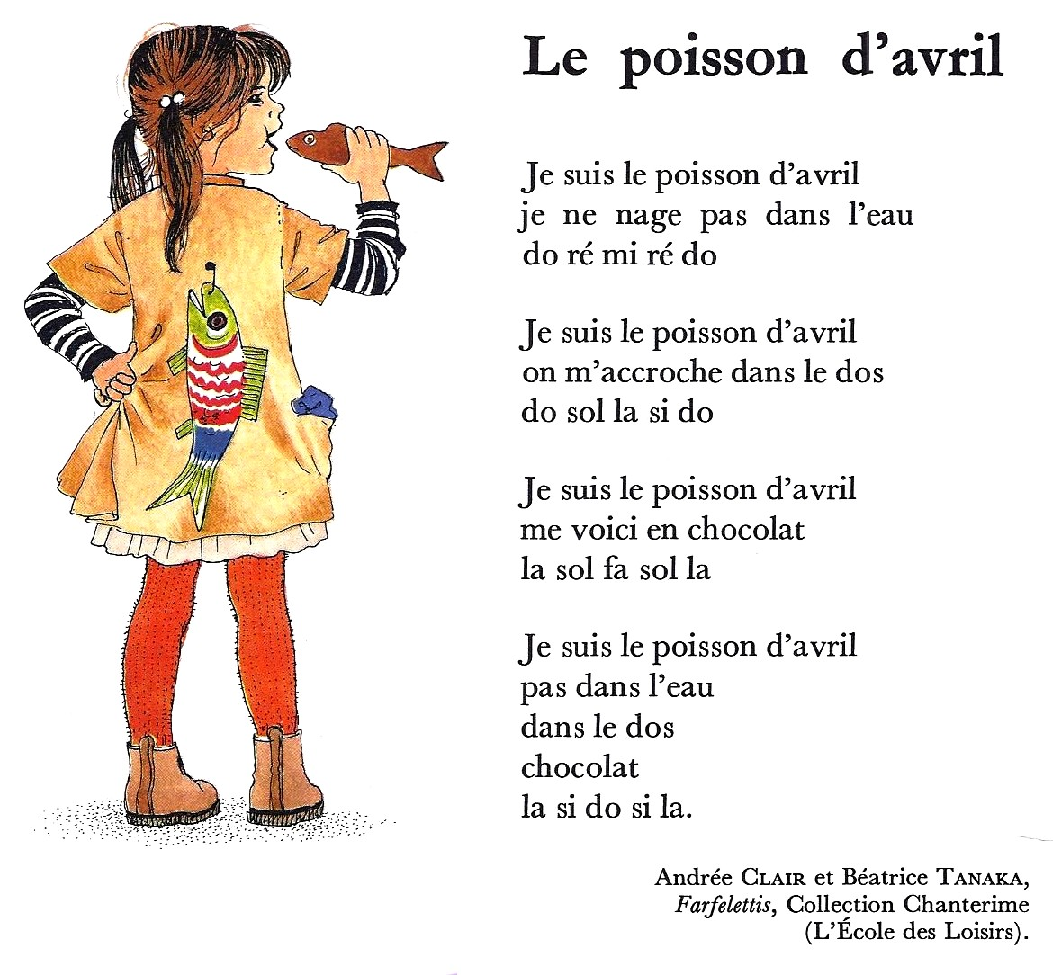
Poisson d’avril !
In France, until 1564, the first of April used to be New Year’s Day. Then, King Charles IX decided to change the calendar and put the beginning of the year in January…
When the day changed, people kept on giving presents (les étrennes) in April, but because it wasn’t the real beginning of the year anymore, they decided to give fake presents and do tricks! They use fish (le poisson) as it was a common present given in the old days during lent when it was prohibited to eat meat (Catholic religion).
Read the poem “Le poisson d’avril”:
Notes:
Timing: flexible
Note: the majority of this lesson will be taken up with the vocabulary and grammar parts of the assessment. However, this French poem can fit in either at the end of this week’s lesson or in the follow up time this week. There are no other follow up materials this week, as we anticipate schools will be busy at this time of term. The poem would make a good addition to an Easter assembly.
Aim: to enjoy a French poem; to learn about a French tradition for April Fools’ day..
Procedure: 1. Click to bring up the information about the origin of Poisson d’avril.
2. Show the poem ‘The April fish (Poisson d’avril) and move to the next slide to listen and read it.
29

Slide 30
écouter
Un poème : Le poisson d’avril
B Puis, lis et récite.
A Écoute.
1. Je suis le poisson d’avril
je ne nage pas dans l’eau
do ré mi ré do
2. Je suis le poisson d’avril
on m’accroche dans le dos
do sol la si do
3. Je suis le poisson d’avril
me voici en chocolat
la sol fa sol la
4. Je suis le poisson d’avril
pas dans l’eau
dans le dos
chocolat
la si do si la
Did you know that for Easter, in France, it is also common to find chocolate fish, as well as Easter chocolate eggs, bells, hens and rabbits too.
le poisson – fish
on m’accroche – you stick me le dos - back
Notes:
Procedure: 1. Pupils listen to the poem reading along with the words. 2. Teacher can ask pupils if they can spot the negation phrases in the poem.
3. Ensure that pupils realise the final line is sol-fa (names for musical notes) not French! 4. Read the poem aloud in pairs.
30

