Slide 1
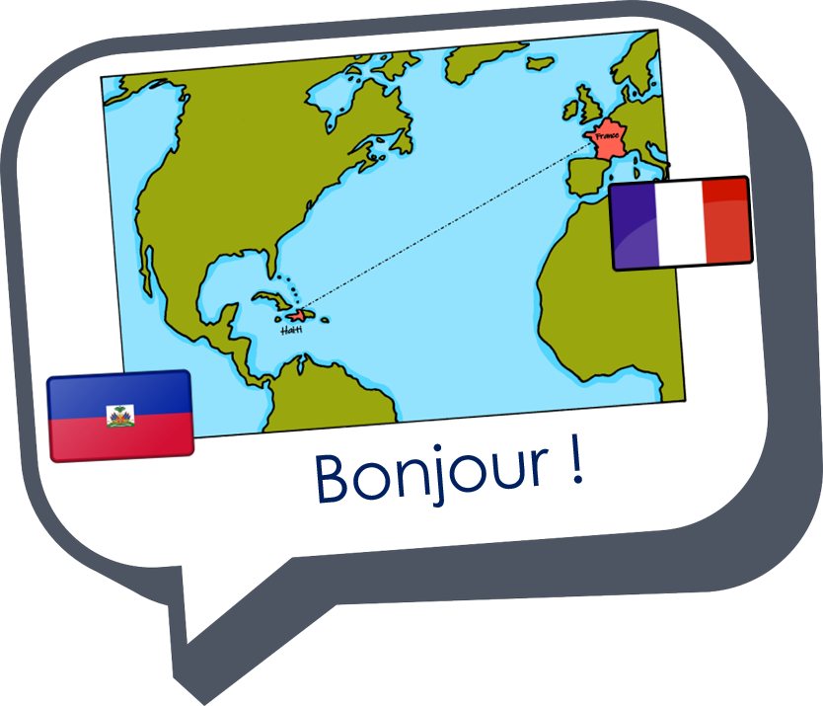
Saying what I and others have
une semaine horrible
bleu
« avoir » j’ai, il a, elle a
adjective agreement (singular)
SSC silent final [e]
Term 1 Week 8
Notes:
Artwork by Steve Clarke. Pronoun pictures from NCELP (www.ncelp.org). All additional pictures selected from Pixabay and are available under a Creative Commons license, no
attribution required.
Phonics: revisit Sfe (Silent Final [e])
Vocabulary (new words in bold): avoir [8] j’ai [8] il a [8] elle a [8]un [3] une [3] animal [1002] chambre [633] livre [358] maison [325] professeur/ professeure [110] problème [188] tâche [887] amusant [4695] différent [350] idéal [1429] important [215] indépendant [854] lent [2572] lourd [1026] parfait [1600] sage [2643] strict [1859] très [66]
Revisit 1: êtes [5] vous [50] ensemble [124] maintenant [192] toujours [103] rarement [2535] souvent [287] Revisit 2: revisit chanter [1820] écouter [429] regarder [425] chercher [336] parler [106] passer [90] rester [100]
Londsale, D., & Le Bras, Y. (2009). A Frequency Dictionary of French: Core vocabulary for learners London: Routledge.
The frequency rankings for words that occur in this PowerPoint which have been previously introduced in these resources are given in the SOW and in the resources that first
introduced and formally re-visited those words.
For any other words that occur incidentally in this PowerPoint, frequency rankings will be provided in the notes field wherever possible.
1

Slide 2
prononcer
[SFe]
Silent final -e
timide
⚠ Remember: The Silent Final -e means you pronounce the final consonant.
[shy]
Notes:
Timing: 1 minute
Aim: to present and practise SSC Silent Final –e.
Procedure:
Introduce and elicit the pronunciation of the individual SSC [SFe] the source word ‘timide’ with gesture, if using.
Click to bring on the picture and get pupils to repeat (with gesture, if using).
Move to the next slide to present and practise the cluster words.
Suggested gesture: Bring up the palm of one hand in a gesture of covering / hiding the face. This is like the 4th video on the BSL site, here: https://www.signbsl.com/sign/shy
2

Slide 3
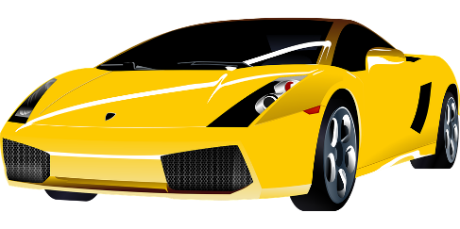
prononcer
[SFe]
monde
timide
douze
[shy]
centre
moderne
Notes:
Timing: 2 minutes
Aim: To introduce/consolidate SSC [SFe]
Procedure:
1. Practise the pronunciation of the individual SSC [SFe] and then the source word again ‘timide’ (with gesture, if using). 2. Then present and elicit the pronunciation of the four cluster words.
Frequency: monde [77] moderne [1239] centre [491] vie [132] douze [1664] timide [3835] Source: Londsale, D., & Le Bras, Y. (2009). A Frequency Dictionary of French: Core vocabulary for learners London: Routledge.
3

Slide 4
Avoir: I have | s/he, it has
[to have, having]
to have
In French the verb avoir means ___________.
Remember that it is an irregular verb:
J’ai une question.
Elle a un ordinateur.
I have a question.
She has a computer.
⚠ une tâche is a task you might do at home, e.g., tidy, make your bed.
Il a une tâche.
organiser ma chambre
He has a task.
Notes:
Timing: 1 minute
Aim: to revisit 1st and 3rd person singular of ‘avoir’.
Procedure:
Click to present the information.
Elicit English translations for the Spanish examples provided.

Slide 5
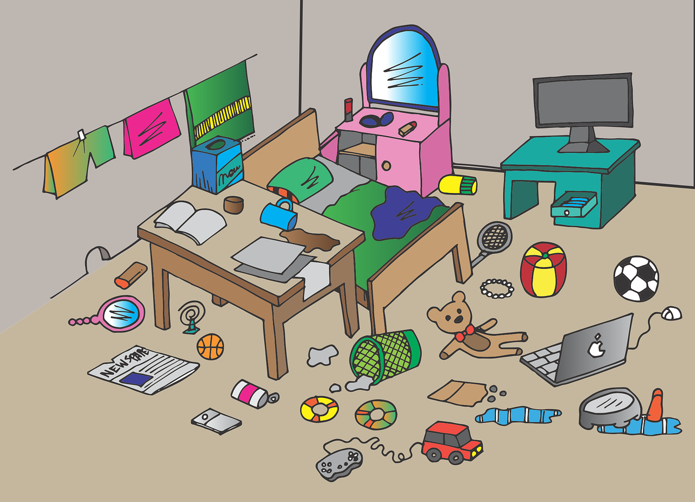
Adjectives following the noun
In French, most adjectives follow the noun:
In English the adjective comes before the noun.
J’ai une question importante.
I have an important question.
⚠ Remember: Adjectives that end in -e stay the same to describe all singular nouns.
Elle a un ordinateur rapide.
She has a fast computer.
Il a une tâche indépendante.
He has an independent task.
Notes:
Timing: 2 minutes
Aim: to revisit postnominal adjective agreement.
Procedure:
Click through the animations to present the information.
Elicit English translations for the French examples provided.
Callout 1 highlights the difference between English and French.
Callout 2 reminds pupils about gender agreement of adjectives ending in –e.

Slide 6
lire
Natalie a tout !
Natalie arrive à l’école d’Adèle. Elle a tout !
Adèle écrit une liste. Natalie a quoi ?
1
Elle a un sac | une chemise élégante.
2
Elle a une amie | un professeur intelligente.
3
Elle a un livre | une gomme intéressant.
4
⚠ Remember: Adjectives that end in -e stay the same to describe all singular nouns.
Elle a un animal | une sœur amusant.
5
Elle a un ordinateur | une maison moderne.
Notes:
Timing: 5 minutes
Aim: to practise written recognition of masculine and feminine adjectives and their connection to masculine and feminine nouns.
Procedure:
Read the title and instructions and ensure the task scenario is understood. (Natalie is a new girl in Adèle’s class who seems to have everything).
Pupils write the correct noun for items 1-5.
Click to reveal answers and elicit English meanings of the phrases.
6

Slide 7
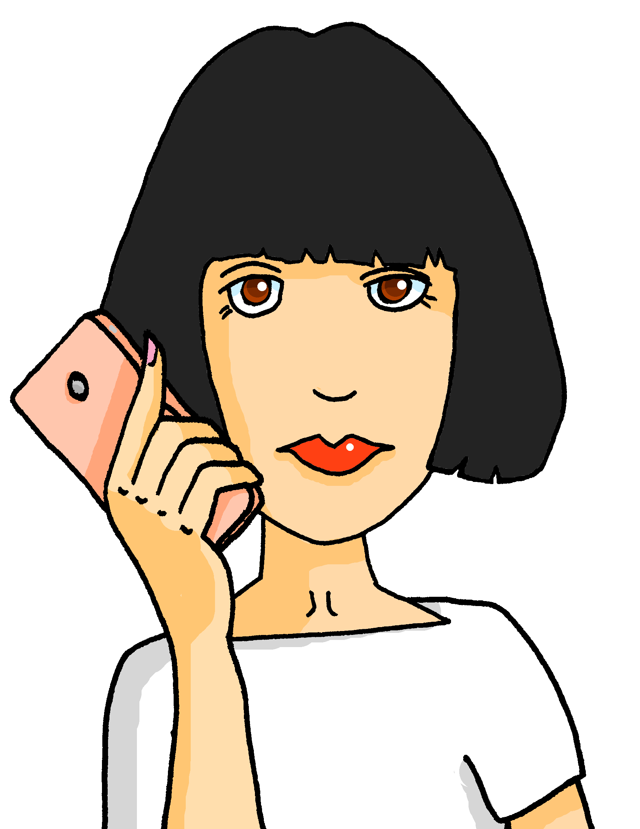
écouter
Une semaine horrible pour Adèle et Pierre à l’école
Écoute. La maman d’Adèle et de Pierre parle. Qui a quoi ?
 | Adèle (she) | Pierre (he) | description | object
1
heavy
bag
2
strict
teacher
3
serious
problem
4
very intelligent
friend (f)
5
worried
friend (m)
Notes:
Timing: 5 minutes
Aim: to practise aural recognition of ‘elle’ and ‘il’ and their connection with meaning; to practise aural comprehension of postnominal adjectives and several nouns.
Procedure:
Read the instructions in French.
Ask pupils to write 1-5 in their books.
Tell them that they will hear Claudine (Adèle and Pierre’s mum) telling a friend about the terrible week her children are having at school. Tell pupils they need to pay attention to whether they hear “elle a” or “il a”. They can write A or P.
Click to listen to each item once. The first time they listen, pupils should identify whether mum is talking about Adèle or Pierre and write A or P.
Feed back the answers.
Pupils listen again. The second time they listen, they need to write down the adjective in English and object in English.
Click to correct answers.
Transcript:
1. Il a un sac lourd. 2. Il a une professeure stricte. 3. Elle a un problème sérieux. 4. Elle a une amie très inteligente. 5. Il a un ami inquiet.
7

Slide 8
lire
Une semaine horrible pour Adèle et Pierre à la maison
Claudine écrit des messages à Hervé (le père d’Adèle et de Pierre).
Qui a quoi ?
Adèle
1
Elle a une chambre sale.
a dirty bedroom
an important task
2
Elle a une tâche importante.
a slow computer
3
Il a un chien méchant.
Pierre
4
Il a un livre difficile.
a naughty dog
a difficult book
5
Elle a un ordinateur lent.
Notes:
Timing: 5 minutes
Aim: to practise written comprehension of full sentences with postnominal adjectives.
Procedure:
Read the title and instructions and ensure the task scenario is understood. (Adèle and Pierre’s horrible week continues at home, too).
Pupils write two headings A (Adèle) and P (Pierre) and what each has (noun and adjective).
Click to elicit English meanings of the phrases and reveal answers.
If desired, click on the numbers to hear the sentences.
8

Slide 9
vocabulaire
Écris en anglais : Can you get at least 15 points?
mots
 | intéressant | méchante | sage
 | souvent | passer | inquiète
 | maintenant | toujours | rarement
 | vous | êtes | ensemble
 | tu as | lourde | elle a
 | j’ai | il a | très
 | avoir | intelligente | lourd
interesting (m)
naughty (f)
well-behaved
x3
often
to spend (time)
worried (f)
now
always
rarely
x2
you (all) (pl)
are (you, pl)
together
you have
heavy (f)
she has
I have
he has
very
x1
to have | having
intelligent (f)
heavy (m)
Notes:
Timing: 6 minutes
Aim: to practise written comprehension of vocabulary from this week and two revisited weeks.
Procedure: 1. Give pupils a blank grid. They fill in the English meanings of any of the words they know, trying to reach 15 points in total. 2. Remind pupils that adjectives can refer to male or female persons and they should note this in their translations. E.g. pleased (f), short (m).
Note: The most recently learnt and practised words are pink, words from revisit 1 are green and those from revisit 2 are blue, thus more points are awarded for them, to recognise that memories fade and more effort (heavy lifting!) is needed to retrieve them.
9

Slide 10
vocabulaire
Handout - Écris en anglais : Can you get at least 15 points?
mots
 | intéressant | méchante | sage
 | souvent | passer | inquiète
 | maintenant | toujours | rarement
 | vous | êtes | ensemble
 | tu as | lourde | elle a
 | j’ai | il a | très
 | avoir | intelligente | lourd
x3
x2
Notes:
HANDOUT
10

Slide 11
Au revoir !
bleu
Notes:
11

