Slide 1
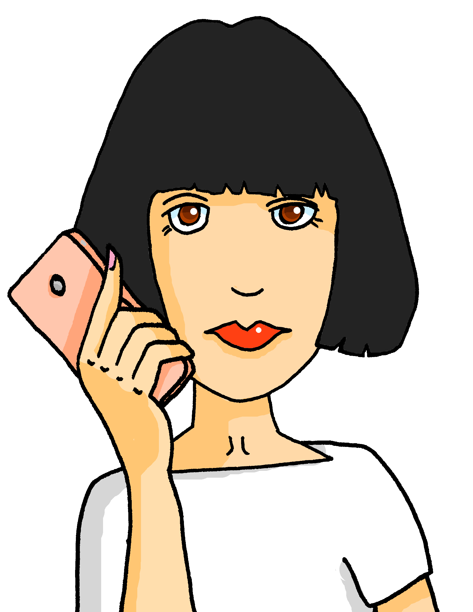
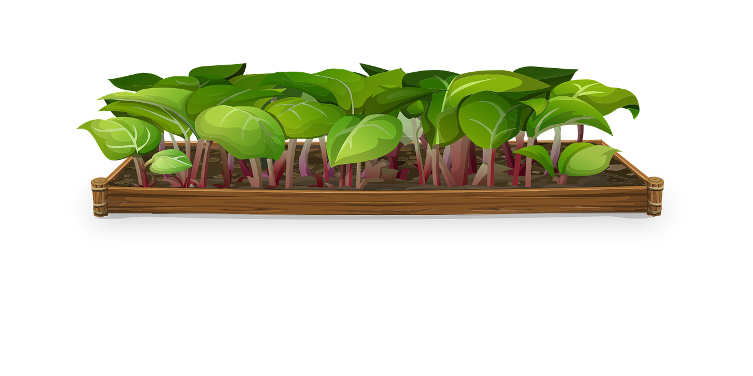
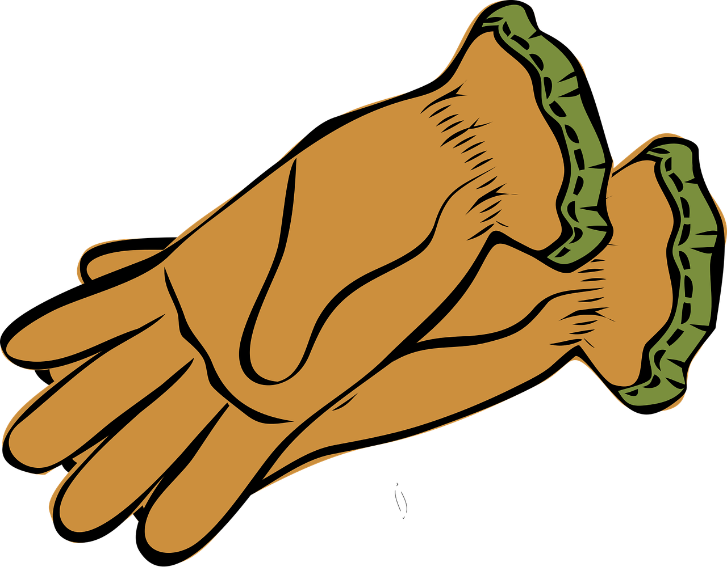
Describing me and others
Miam miam !
Maman est contente
« être » ils / elles sont (they are)
adjective agreement (plural)
SSC [on] and [om]
bleu
Term 1 Week 6
Notes:
Artwork by Steve Clarke. Pronoun pictures from NCELP (www.ncelp.org). All additional pictures selected from Pixabay and are available under a Creative Commons license, no
attribution required.
Phonics: revisit [on] and introduce [om] - non ! [72] crayon [>5000] onze [2447] monde [77] pont [1889] nom [171] combat [1062] tomber [547]
Vocabulary (new words in bold): sont [5] ils [13] elles [38] sérieux [412], heureux [764] curieux [2424] courageux [2198] aussi [44] et [6] mais [30], vrai [292] faux [555]
Revisit 1: anniversaire [2043] mois [179] janvier [939] février [1139] mars [868] avril [1022] mai [943] juin [931] juillet [1326] aout [1445] septembre [944] octobre [826] novembre [982] décembre [891] quand [119] treize [3285] quatorze [3359] quinze [1472] seize [3285] dix-sept [3812] dix-huit [3592] dix-neuf [4851] vingt [1273] vingt-et-un [1273/6/3] vingt-deux, vingt-trois vingt-quatre vingt-cinq vingt-six vingt-sept vingt-huit vingt-neuf trente [1646]
Revisit 2: les [1] pomme [2847] merci [1070] s'il te plaît/s'il vous plaît [n/a]
Londsale, D., & Le Bras, Y. (2009). A Frequency Dictionary of French: Core vocabulary for learners London: Routledge.
The frequency rankings for words that occur in this PowerPoint which have been previously introduced in these resources are given in the SOW and in the resources that first
introduced and formally re-visited those words.
For any other words that occur incidentally in this PowerPoint, frequency rankings will be provided in the notes field wherever possible.
1

Slide 2
prononcer
[on]
non !
crayon
monde
pont
onze
Notes:
Timing: 1 minute
Aim: to present and practise SSC [on]
Procedure:
Introduce and elicit the pronunciation of the individual SSC [on] the source word ‘Non !’ with gesture, if using.
Click to bring on the picture and get pupils to repeat (with gesture, if using).
Click again to bring up four cluster words to practise the sound. Repeat the words several times.
Note: gesture for Non ! – moving your index finger in a ‘wagging’ motion left to right in an exaggerated way.
2

Slide 3
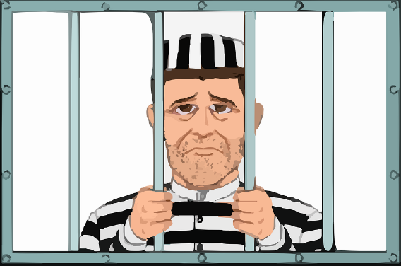
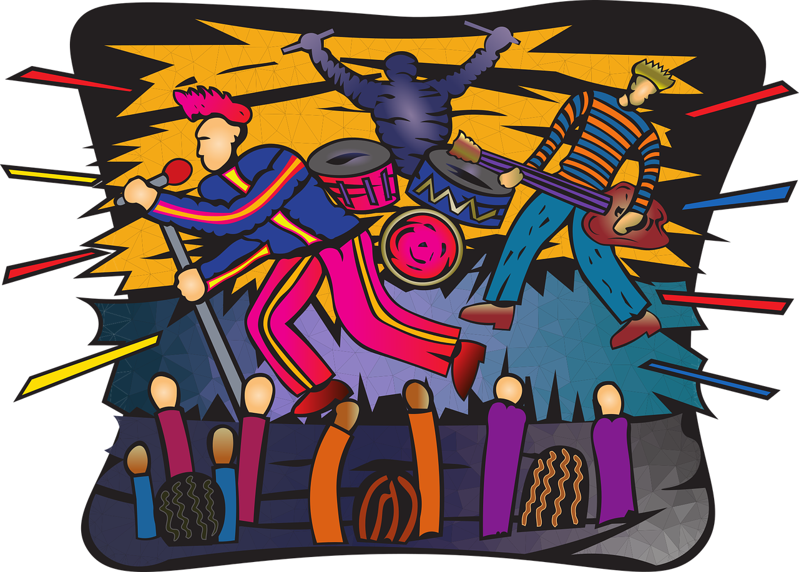
[on]
Prononce les mots. [1/3]
prononcer
These words look like English but have SSC [on] in French. How do they sound?
30
prison
blond
contact
opinion
S
révision
0
coton
concert
salon
DÉBUT
Notes:
Timing: 3 minutes (three slides)
Aim: to correctly pronounce cognates and near-cognates containing [on] in decreasing amounts of time, helping automatisation of SSC production; to raise awareness of the difference in the English and French pronunciation of this SSC.
Procedure:
Pupils pair up and take turns trying to say all the words in 30 seconds (run the timer twice).
Click on the pictures to hear the words pronounced by a native speaker. Pupils repeat.
Move on to the next slide, where the timer is at 20 seconds, and again to the third slide where the timer is at 15 seconds.
Frequency of unknown words and cognates: prison [1010] blond [4585] contact [894] opinion [777] coton [4516] concert [1697] salon [2729] révision [2748]
Source: Londsale, D., & Le Bras, Y. (2009). A Frequency Dictionary of French:], Core vocabulary for learners London: Routledge.
3

Slide 4
[on]
Prononce les mots. [2/3]
prononcer
These words look like English, but have SSC [on] in French. How do they sound?
20
prison
blond
contact
opinion
S
révision
0
coton
concert
salon
DÉBUT
Notes:
[2/3]
4

Slide 5
[on]
Prononce les mots. [3/3]
prononcer
These words look like English, but have SSC [on] in French. How do they sound?
15
prison
blond
contact
opinion
S
révision
0
coton
concert
salon
DÉBUT
Notes:
[3/3]
5

Slide 6
prononcer
[om]
nom
Pierre
tomber
combat
[to fall]
[name]
Notes:
Timing: 2 minutes (two slides)
Aim: to present and practise SSC [om]
Procedure:
Introduce and elicit the pronunciation of the individual SSC [om] the source word ‘nom’ with gesture, if using.
Click to bring on the picture and get pupils to repeat (with gesture, if using).
Click again to bring up two cluster words to practise the sound. Repeat the words several times.
Note: gesture for nom – tap the top of your head.
6

Slide 7
prononciation
[on]
[om]
[on] and [om] sound exactly the same!
non !
nom
When this nasal vowel appears in front of ‘p’ or ‘b’ it is spelt [om] instead of [on].
Pierre
[name]
Notes:
Aim: to recap SSC [on] and [om] making clear that they are exactly the same sound.
Procedure:
Introduce and elicit the pronunciation of the individual SSC [on] and [om] the source words ‘Non !’ and nom with gestures, if using.
Click to bring on the picture and get pupils to repeat (with gestures, if using).
Click to bring up the information about these two SSC.
Repeat the words several times.
Note: i) gesture for Non ! – moving your index finger in a ‘wagging’ motion left to right in an exaggerated way. ii) gesture for nom – tap the top of your head.
7

Slide 8
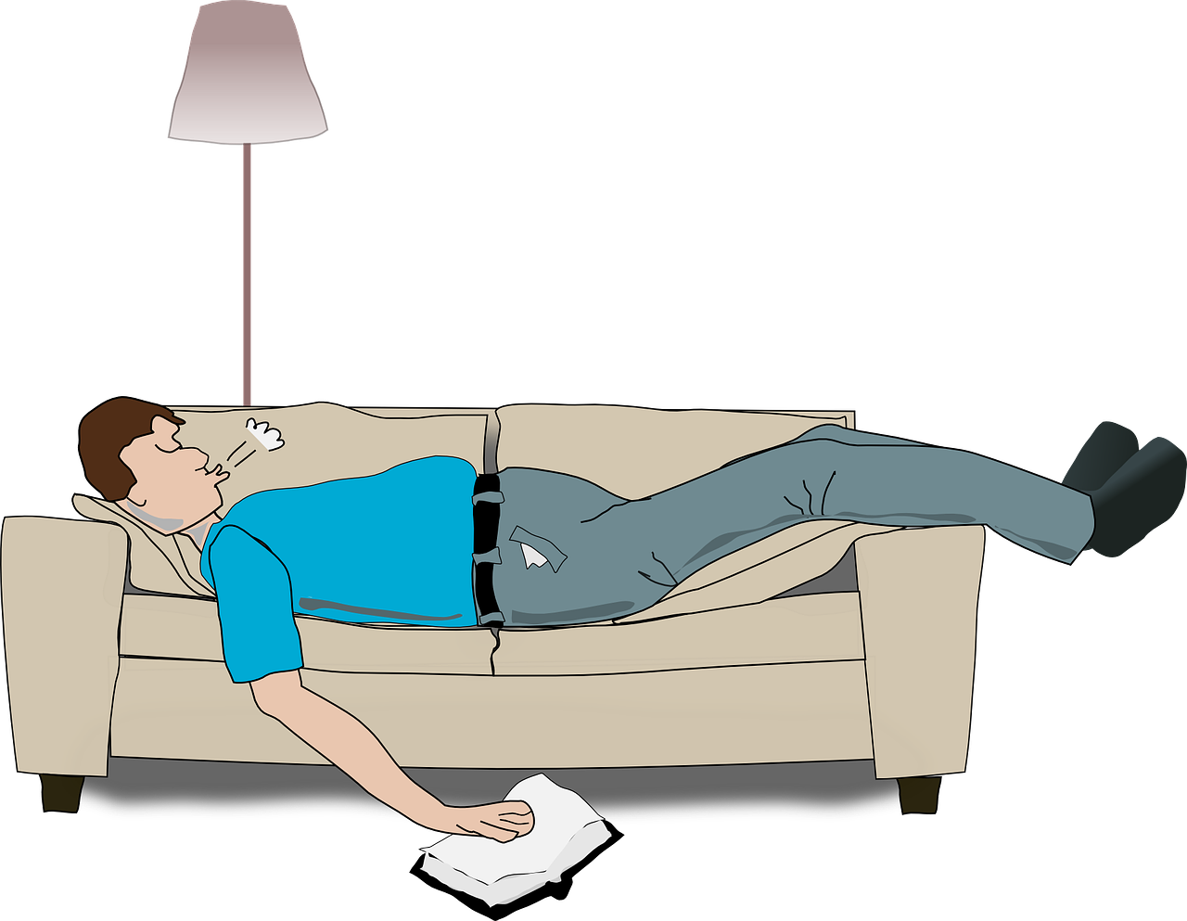
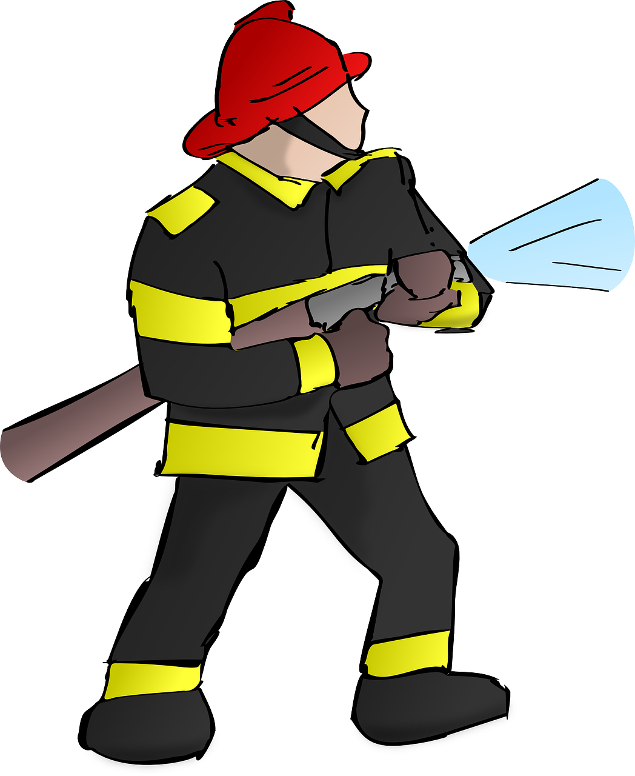
écouter
[on] and [om] sound exactly the same.
. Écoute les noms des animaux. C’est [ien] ou [(a)in]?
Écoute. Comment ça s'écrit ? Avec [on] ou [om] ? Complète et prononce les mots !
 | c o m p t e r
 | o m b r e
 | c o n f o r t a b l e
 | c o m p a r a i s o n
 | c o n c o m b r e
 | p o m p i e r
[on] | [om]
Ex
_ _
1
_ _
2
_ _
3
_ _
_ _
4
_ _
_ _
5
_ _
Notes:
Timing: 4 minutes
Aim: to apply knowledge of the spelling rules governing SSCs [on] and [om] and production of these two SSCs.
Procedure
Student read the words and decide based on the presence of absence of a ‘p’ or ‘b’ after the gap when [on] or [om] is needed.
Click to check.
Now, pupils are challenged to say all six words and pronounce the SSCs in the same way each time. It will be tempting for pupils to add an ‘n’ or ‘m’ after the vowel! Pupils should work in pairs and monitor each other for this.
Pupils try to say the words out loud. Teacher corrects.
Transcript:
Exemple: compter
ombre
confortable
comparaison
concombre
pompier
Frequency of unknown words and cognates: compter [140] comparaison [2244] concombre [>5000] confortable [3964] ombre [2001] pompier [3295]
Source: Londsale, D., & Le Bras, Y. (2009). A Frequency Dictionary of French: Core vocabulary for learners London: Routledge.
8

Slide 9
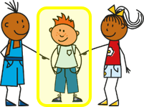
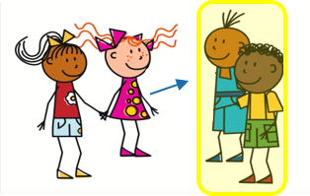
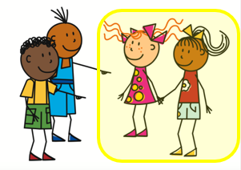
Être
Describing others – they are
The ‘e’ makes you pronounce the ‘t’.
[to be | being]
You know how to describe one other person:
Il est content.
Elle est contente.
He is pleased.
A plural noun needs a plural adjective.
She is pleased.
To say ‘they are’:
Pronounce the ‘t’ but the ‘s’ is a SFC.
Ils sont contents.
Elles sont contentes.
They (m) are pleased.
They (f) are pleased.
To say ‘they’ for mixed groups use ‘ils’.
Notes:
Timing: 2 minutes
Aim: to recap 3rd person singular of être (he is / she is) and to present the 3rd person plural (they are).
Procedure:
Click to present the information about être.
Make sure pupils are clear about the they pictures as these will come up in future lessons.
Elicit English translation for the French examples provided.
9

Slide 10
lire
Chouchou mange le journal de Pierre !
Miam miam !
Lis les phrases. Pierre décrit une personne ou deux ?
Écris de1 à 6 il/elle ou ils/elles.
. Écoute les noms des animaux. C’est [ien] ou [(a)in]?
Exemple:
… est sage.
 | il / elle (he/she) | ils / elles (they)
Ex.
1
2
3
4
5
6
1
4
… sont drôles.
… est malade.
2
5
… sont rapides.
… sont jeunes.
3
6
… est triste.
… sont calmes.
Notes:
Timing: 5 minutes
Aim: to practise written comprehension of 3rd person singular and plural of être (and written recognition of singular and plural adjectives).
Procedure:
Read the title and instructions and ensure the task scenario is understood.
Complete the example with the class.
Pupils write il/elle or ils/elles for items 1-6.
Click to reveal answers and elicit English meanings of the phrases.
Note: Here pupils focus only on the singular / plural distinction using adjectives that are the same for both genders.
10

Slide 11
Plural adjectives
Singular and plural adjectives sound the same.
As you know many adjectives add -s for plural:
Il est petit.
Elle est petite.
Ils sont petits.
Elles sont petites.
Masculine adjectives ending in -eux don’t change for plural:
But add –s to -euse for feminine plural:
Ils sont heureux.
Elles sont heureuses.
You don’t hear the difference between singular and plural adjectives because of SFC, so you need to listen out for the verb.
Notes:
Timing: 2 minutes
Aim: to present patterns of plural adjective agreement; to establish that you can often hear gender difference with adjectives but not number difference, so the verb form is very important.
Procedure:
Click to present the information.
Elicit English translation for the French examples provided.
11

Slide 12
écouter
Il ou ils ?
1
curious
Notes:
Timing: 6 minutes (8 slides)
Aim: to practise distinguishing aurally between the third person singular and third person plural forms of ‘être’.
Procedure:
1. Click the button to play audio with the pronoun obscured.
2. Students should note whether the first word of each sentence must be ‘il’ or ‘ils’.
3. They then write the English meaning of the adjective used in each sentence (to force vocabulary recall).
4. Answers appearing upon clicking the mouse.
Transcript:
[…] est curieux.
12

Slide 13
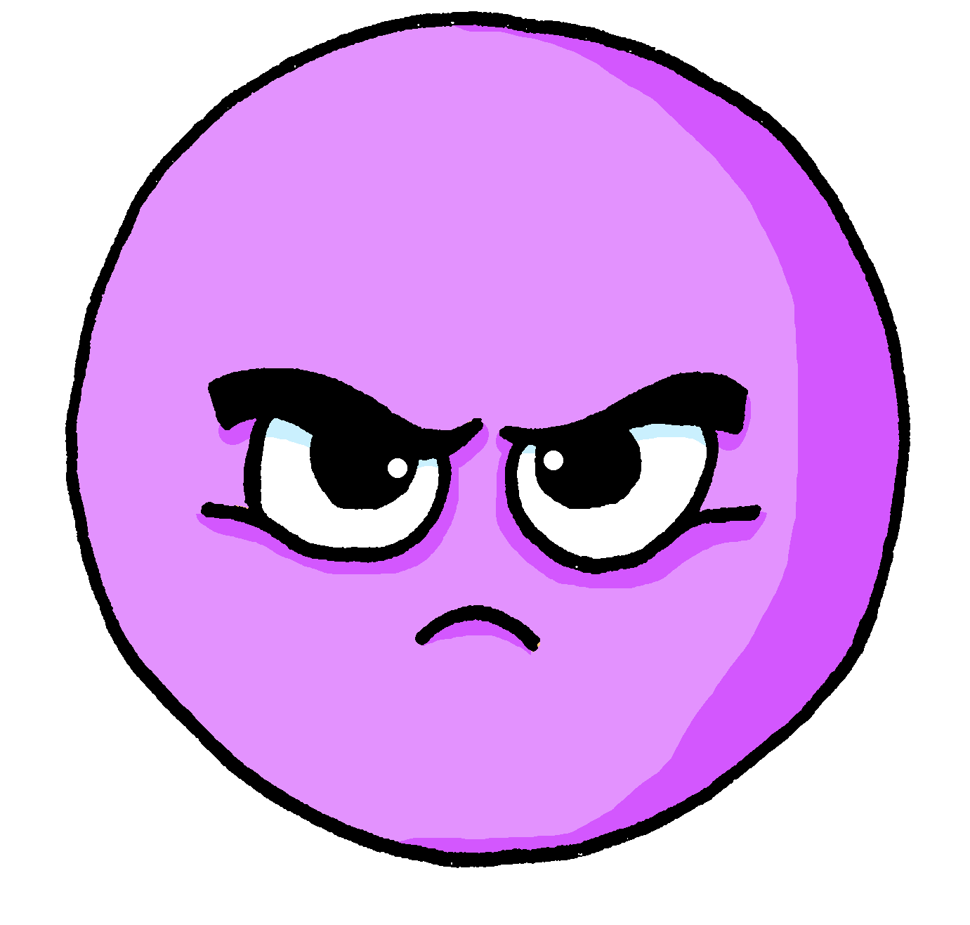
écouter
Il ou ils ?
2
serious
Notes:
[2/8]
Transcript:
[…] sont sérieux.
13

Slide 14
écouter
Il ou ils ?
3
difficult
Notes:
[3/8]
Transcript:
[…] sont difficiles.
14

Slide 15
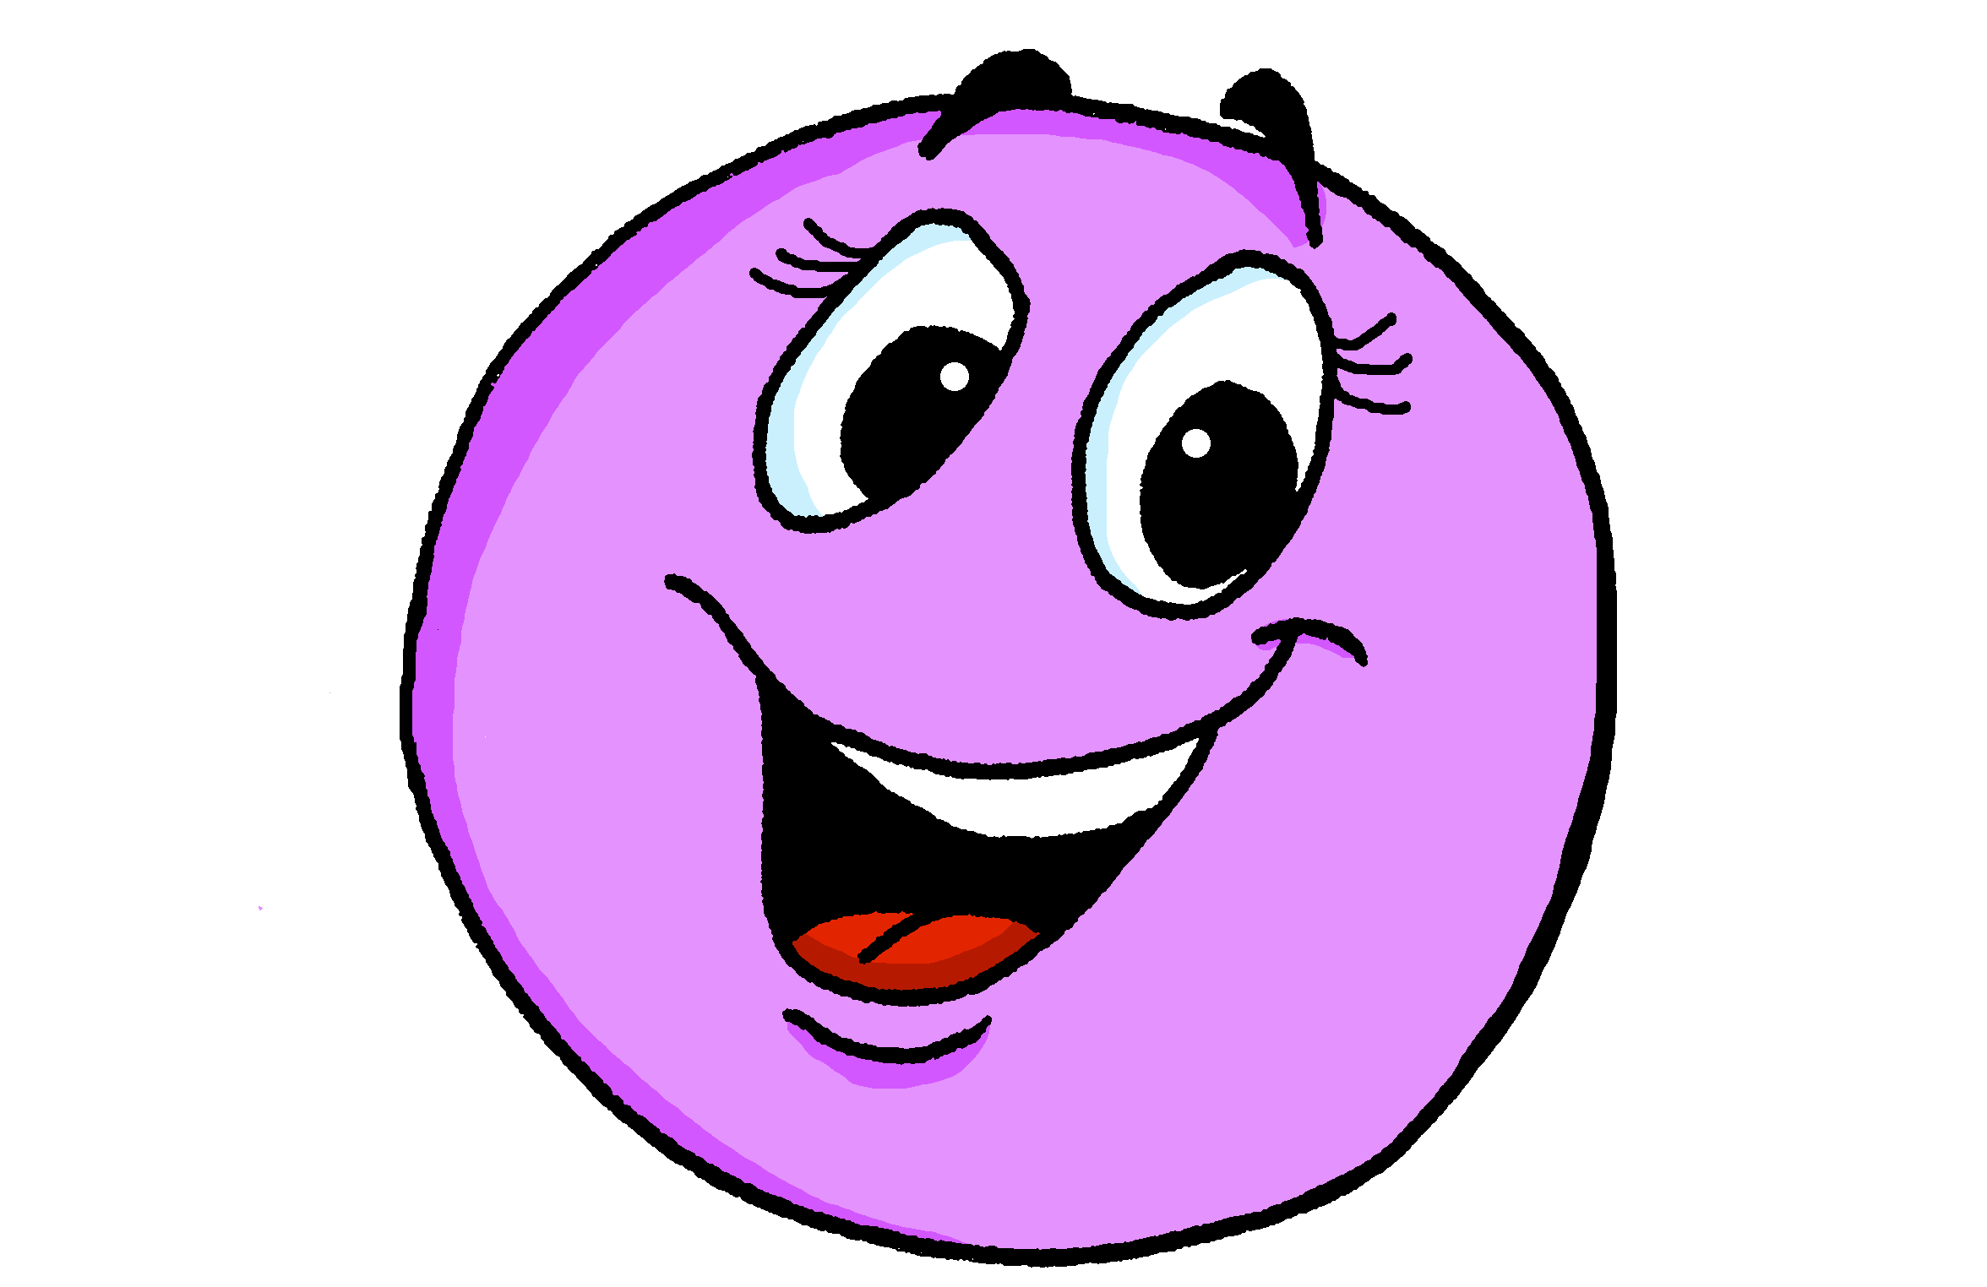
écouter
elle ou elles ?
4
happy
Notes:
[4/8]
Transcript:
[…] sont heureuses.
15

Slide 16
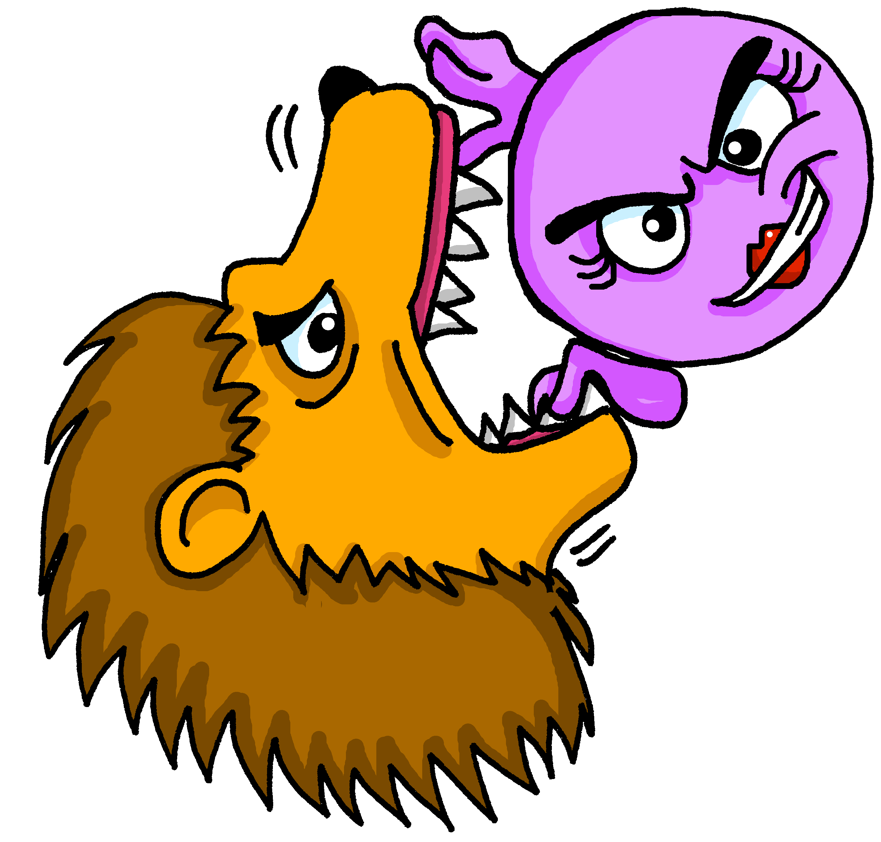
écouter
elle ou elles ?
5
brave
Notes:
[5/8]
Transcript:
[…] est courageuse.
16

Slide 17
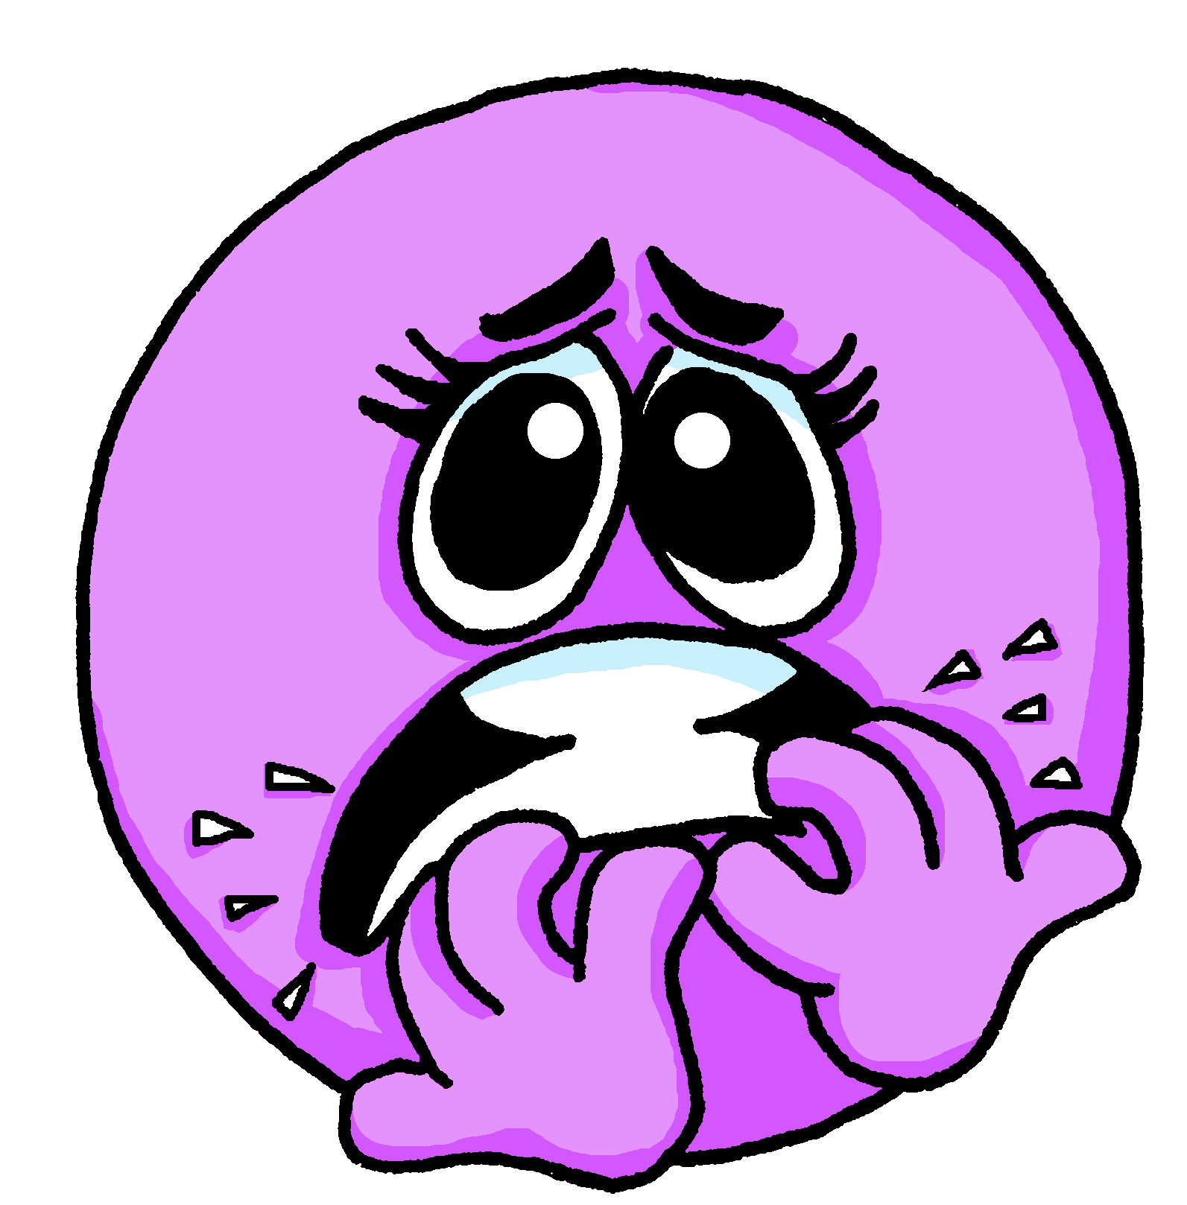
écouter
elle ou elles ?
6
worried
Notes:
[6/8]
Transcript:
[…] sont inquiètes.
17

Slide 18
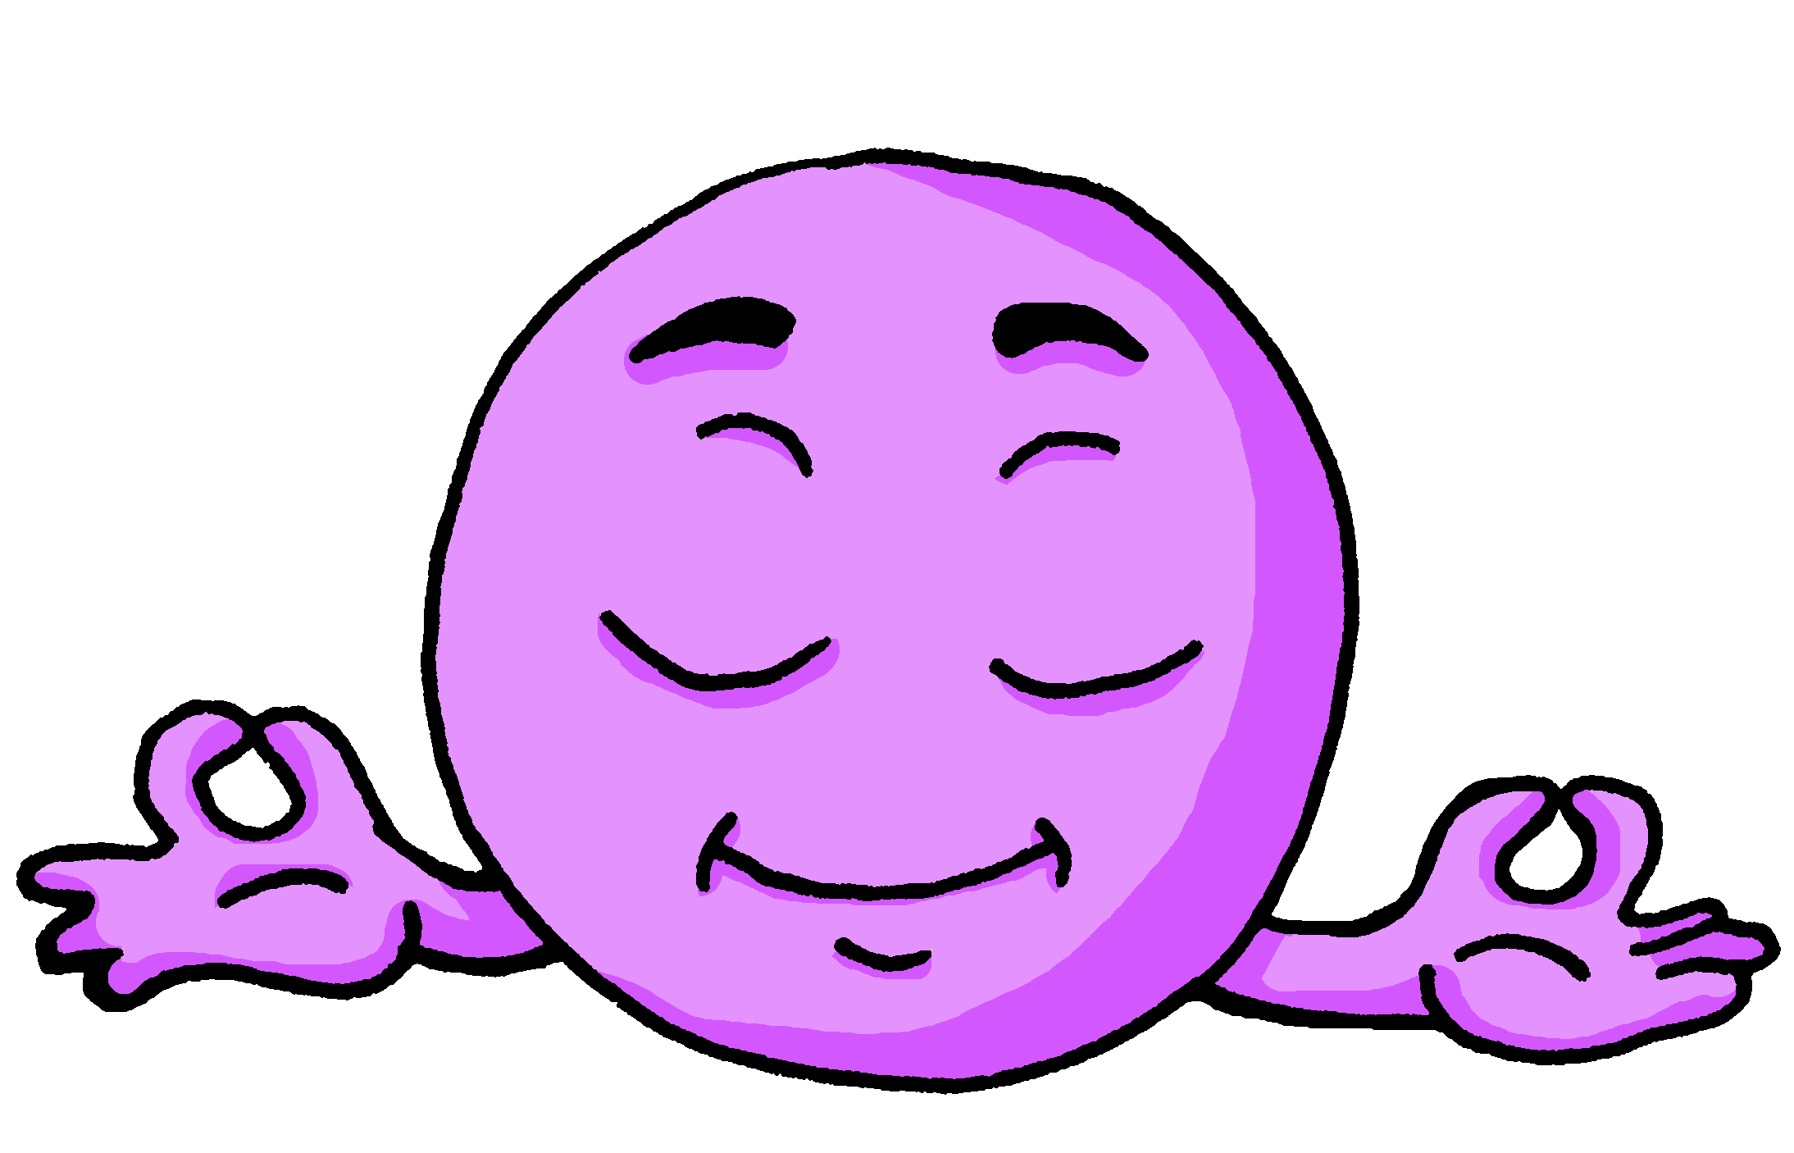
écouter
Il ou ils ?
7
calm
Notes:
[7/8]
Transcript:
[…] est calme.
18

Slide 19
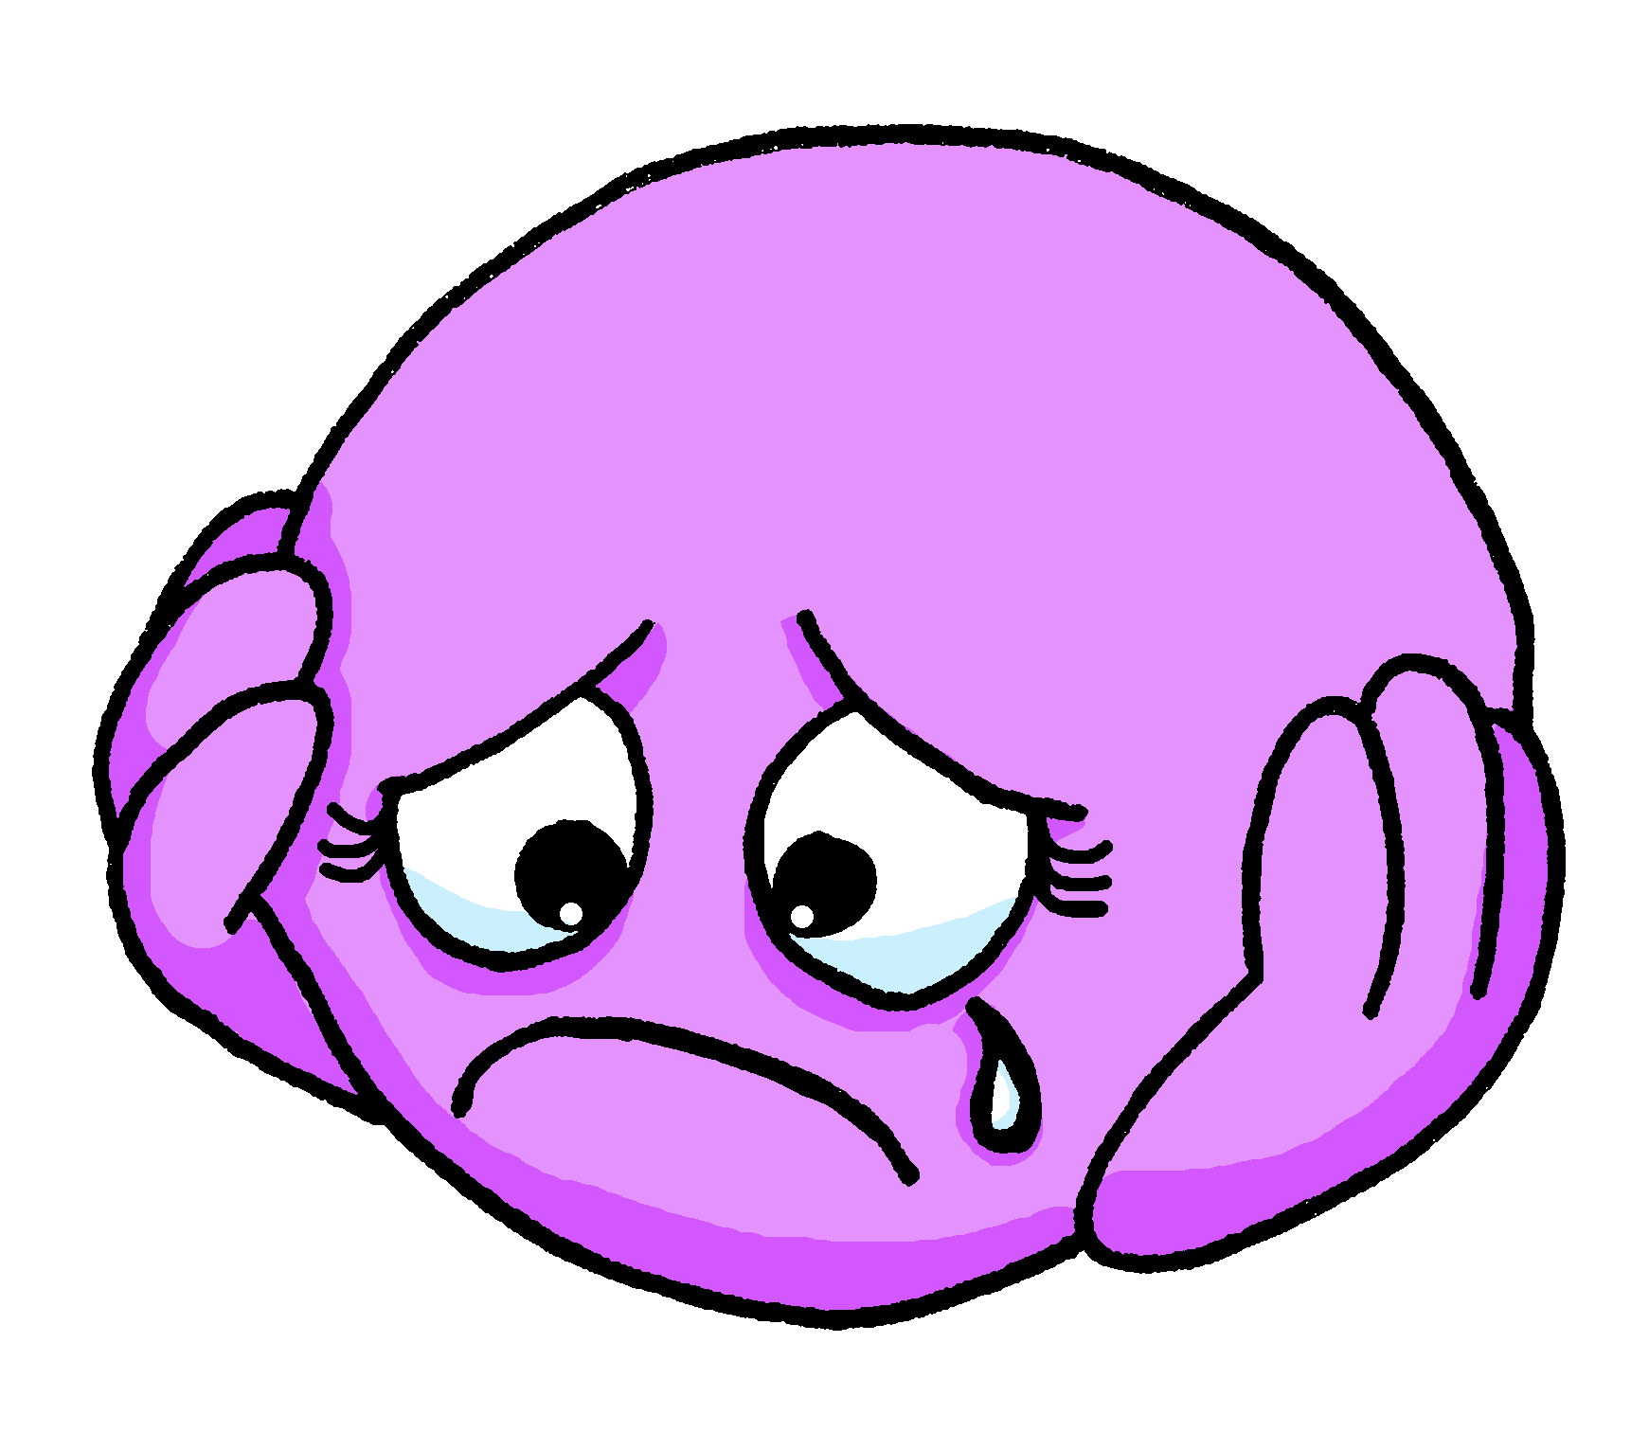
écouter
elle ou elles ?
8
sad
Notes:
[8/8]
Transcript:
[…] sont tristes.
19

Slide 20
lire
La maman d’Adèle et de Pierre est très contente.
Lis les messages. Choisis m ou f pour chaque mot de 1 à 6 .
Le jardin est très joli. Il y a aussi beaucoup de fruits. ☺
lire
1
masc.
Les pommes sont prêtes. ☺
fem.
2
4
fem.
masc.
Les fraises sont grandes !
Les prunes sont délicieuses.
fem.
masc.
3
5
masc.
fem.
Les petits pois sont verts.
Les jours sont très longs.
masc.
fem.
Notes:
Timing: 8 minutes
Aim: to practise written comprehension of plural adjective endings and their connection to noun gender; to revisit some of the vocabulary for this week.
Procedure:
Explain that Claudine, (Adèle and Pierre’s mum) is very pleased with her garden this year and sends messages to family and friends with the news.
Pupils read the messages and decide the gender of each noun based on the form of the adjective in the message.
Click to correct.
Question the class orally to assess understanding of the messages – what are delicious ? (big, green, long, ready)
Note: pupils may remember the genders of some of the nouns but they haven’t seen any of these words for a considerable time and we know that genders are easily forgotten. Applying the knowledge of adjective agreement
Frequency of unknown words and cognates: délicieux [>5000] long [202] petit pois [>5000] Londsale, D., & Le Bras, Y. (2009). A Frequency Dictionary of French: Core vocabulary for learners London: Routledge.
20

Slide 21
Au revoir !
bleu
Notes:
21

