Slide 1
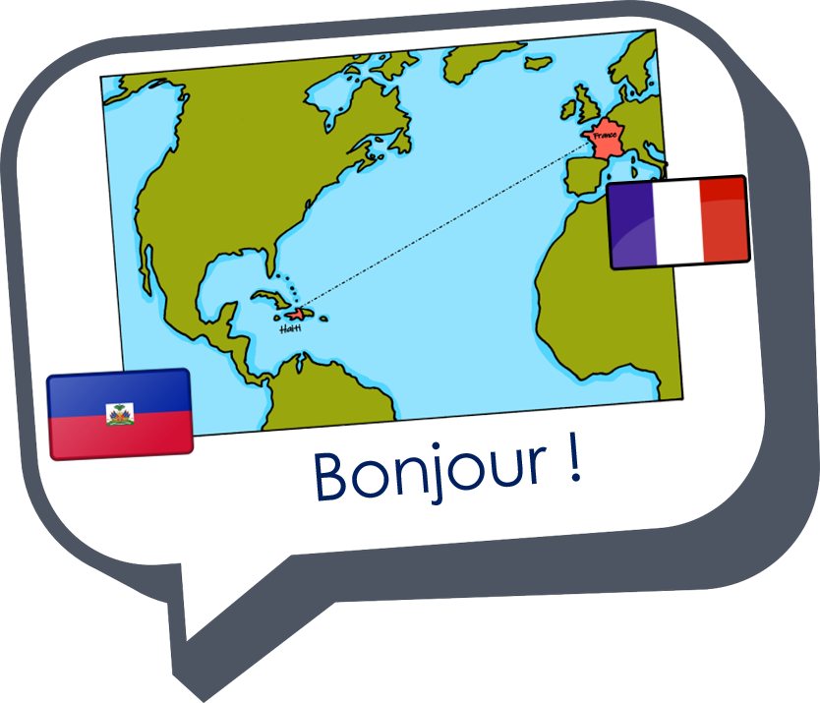
Describing me and others
bleu
Follow ups 1-5
Term 1 Week 5
Notes:
Artwork by Steve Clarke. Pronoun pictures from NCELP (www.ncelp.org). All additional pictures selected from Pixabay and are available under a Creative Commons license, no attribution required.
Phonics: revisit [u] and [ou] - tu [12] nous [31]
Vocabulary (new words in bold): êtes [5] vous [50] ensemble [124] maintenant [192] toujours [103] rarement [2535] souvent [287], known adjectives
Revisit 1: sommes [5] nous [31] absent [2016] amusant [4695] calme [1731] content [1841] différent [350] difficile [296] drôle [2166] fort [107] grand [59] jeune [152] lent [2572] malade [1066] méchant [3184] intelligent [2509] indépendant [954] important [215] petit [138] présent [216] prudent [1529] seul [102] rapide [672] strict [1859] sage [2643] triste [1843]
Revisit 2: détester [2898] jouer [219] travailler [290] silence [1281] en retard [n/a]
Londsale, D., & Le Bras, Y. (2009). A Frequency Dictionary of French: Core vocabulary for learners London: Routledge.
The frequency rankings for words that occur in this PowerPoint which have been previously introduced in these resources are given in the SOW and in the resources that first introduced and formally re-visited those words.
For any other words that occur incidentally in this PowerPoint, frequency rankings will be provided in the notes field wherever possible.

Slide 2
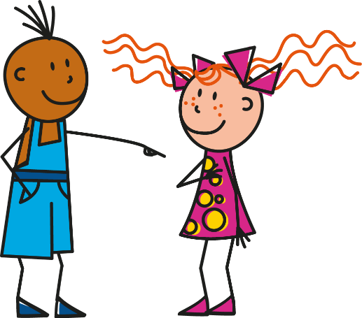
[u]
[ou]
prononcer
tu
nous
Notes:
Timing: 1 minute
Aim: to recap SSC [u] and [ou]
Procedure:
Introduce and elicit the pronunciation of the individual SSC [u] and [ou] and then the source words ‘tu’ and ‘nous’(with gestures, if using).
Click to bring on the picture and get students to repeat (with gesture, if using).
Note: i) gesture for tu – pointing away to an imaginary person in front of you.
ii) gesture for nous – spreading arms out in front palms down, do a sweeping motion (similar to a breastroke in swimming), motioning inclusivity ‘we’.
2

Slide 3
Follow up 1:
. Écoute les noms des animaux. C’est [ien] ou [(a)in]?
Écoute et écris. C’est [u] ou [ou] ?
1
2
3
4
5
6
7
8
9
écouter
[u]
[ou]
Notes:
Timing: 5 minutes
Aim: to practise aural distinction between the SSC [u] and [ou]; to provide the additional opportunity to practise written transcription of whole words.
Procedure:
Click on each number to listen to the word.
Write [u] or [ou] (and / or the full word).
After all items 1-9 have been heard, elicit the response from pupils (i.e. they say [u] or [ou] and/or the full word).
Click to reveal the written word.
Click again for it to disappear into the corresponding pacperson’s mouth.
Transcript 1. soupe 2. couleur 3. culture 4. souvenir 5. urgent 6. aventure 7. publicité 8. groupe
9. calculer
Frequency of unknown words and cognates:
aventure [209] calculer [2331] couleur [1211] culture [913] groupe [187] publicité [2110] soupe [4563] souvenir [616] urgent [2179]
Source: Londsale, D., & Le Bras, Y. (2009). A Frequency Dictionary of French: Core vocabulary for learners London: Routledge.

Slide 4
Follow up 2:
Parle en français.
You do not need all of the words!
toujours
parler
êtes
nous
15
Vous êtes souvent malades.
You (all) are often ill.
sages
sommes
S
malades
vous
0
souvent
DÉBUT
Notes:
Timing: 5 minutes (6 slides)
Aim: to practise oral sentence building, deciding between the target features of nous sommes and vous êtes and different vocabulary from this week.
Procedure:
1. Click for English sentence and French prompt words. 2. Click Début to start the timer.
3. Pupils select from the words given to create and say the sentence out loud before the time elapses. 4. Click for the French sentence to appear. Answer: Vous êtes souvent malades.

Slide 5
Follow up 2:
contents
parler
êtes
nous
15
Nous sommes maintenant contents.
We are now pleased.
souvent
sommes
S
maintenant
vous
0
calmes
DÉBUT
Notes:
[2/6] Answer: Nous sommes maintenant contents.

Slide 6
Follow up 2:
toujours
parler
tu
vous
15
Vous êtes rarement prudents.
You (all) are rarely careful!
prudents
êtes
S
prêts
es
0
rarement
DÉBUT
Notes:
[3/6] Answer: Vous êtes rarement prudents !

Slide 7
Follow up 2:
petits
parler
nous
vous
15
Nous sommes petits mais vous êtes grands.
We are short but you (all) are tall.
grands
êtes
S
sommes
et
0
mais
DÉBUT
Notes:
[4/6] Answer: Nous sommes petits mais vous êtes grands.

Slide 8
Follow up 2:
lent
parler
tu
vous
15
Tu es lent mais tu es fort aussi.
You are slow but you are also strong.
fort
êtes
S
aussi
es
0
mais
DÉBUT
Notes:
[5/6] Answer: Tu es lent mais tu es fort aussi.

Slide 9
Follow up 2:
jeunes
tu
parler
vous
15
You (all) are young and often funny.
Vous êtes jeunes et souvent amusants.
êtes
amusants
S
et
souvent
es
0
toujours
DÉBUT
Notes:
[6/6] Answer: Vous êtes jeunes et souvent amusants.

Slide 10
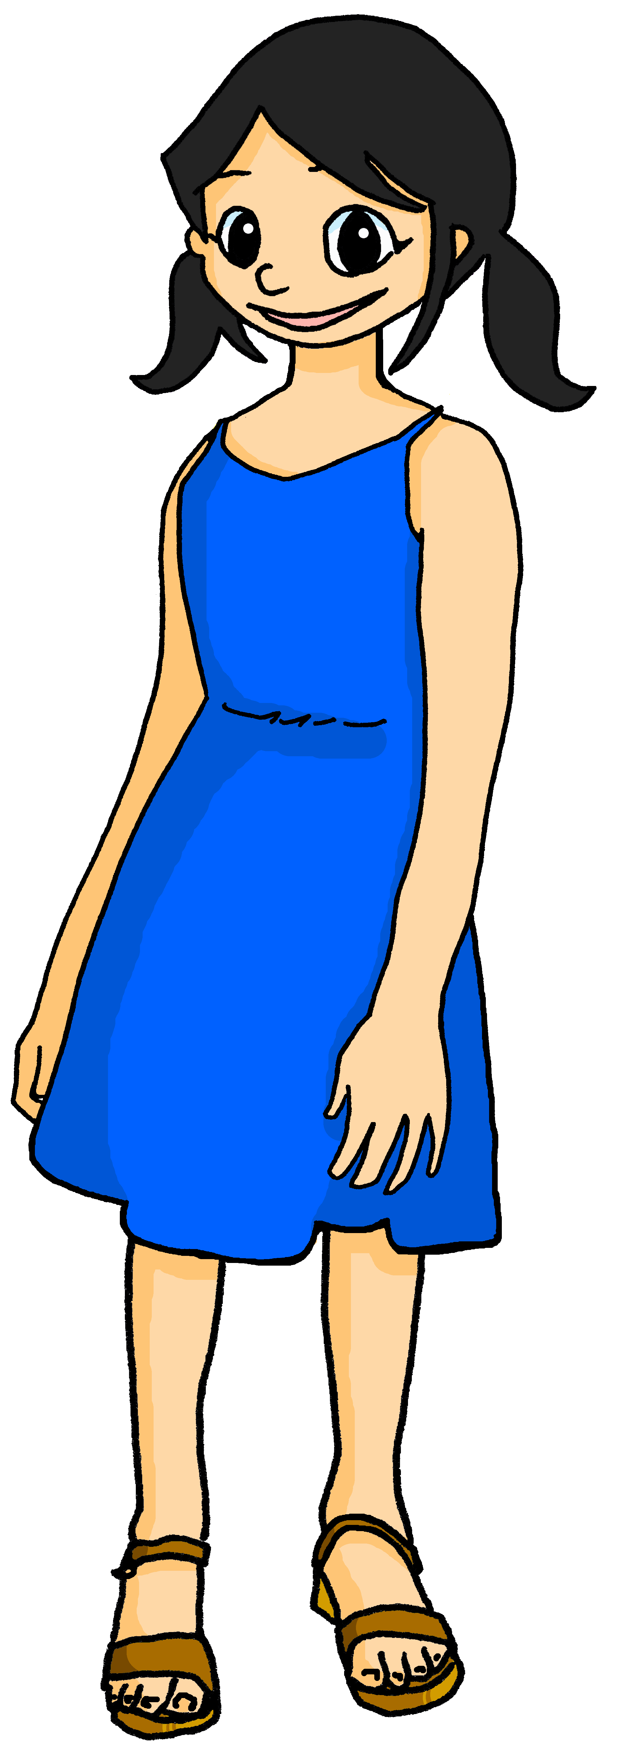
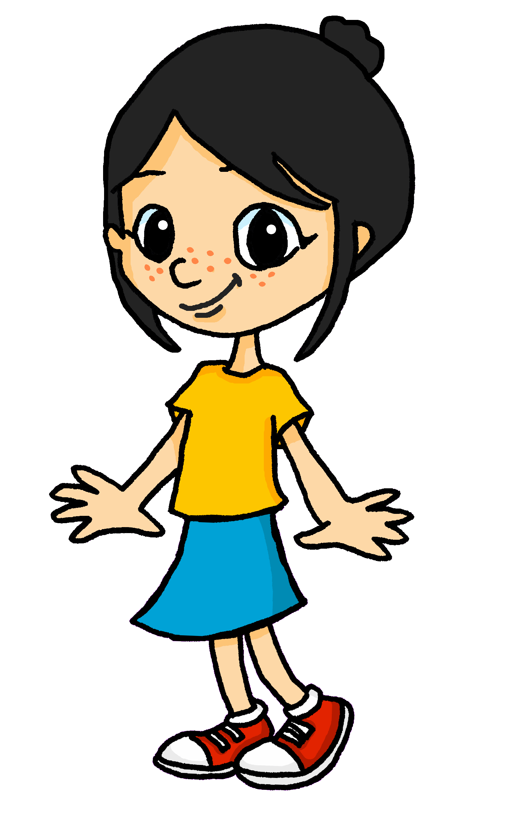
Follow up 3:
Parle en français.
Léa is playing a word game with her sister, Eugénie. What does Eugénie have to say?
parler
Nous sommes tristes.
Tu es jeune.
Vous êtes prudents.
Je suis méchant | méchante.
Elle est amusante | drôle.
Il est rapide.
1 | I am
2 | you are
3 | she is
4 | he is
5 | we are
6 | you (all) are
1 | fast
2 | young
3 | naughty
4 | sad
5 | funny
6 | careful
Notes:
Timing: 5 minutes
Aim: to practise oral production of parts of the verb to be and different adjectives.
Procedure: 1. Click to ‘roll’ the dice.
2. Pupils observe the forms and adjective whose numbers correspond to the respective dice, then translate them to make a short sentence. (For ‘je’, they should make the adjective agree for them). They say the answer chorally.
3. Click to reveal the correct sentence.
4. Repeat until all combinations have been tried.

Slide 11
Describing more than one
You know that many adjectives add -e to describe a feminine noun.
Je suis contente.
I (a girl) am pleased.
The -s on the end is silent but the –e makes you pronounce the –t.
When the feminine noun is plural, add -e and -s to the adjective:
Vous êtes contentes.
You (girls) are pleased.
If there is a mix of male and female people in the group, we use the masculine plural adjective.
Vous êtes contents.
You (boys|boys & girls) are pleased.
Notes:
Use this recap slides before Follow up 4.
Timing: 2 minutes
Aim: to recap feminine plural adjective agreement which was introduced in week 2.
Procedure:
Click to present the information.
Elicit the English sentence meanings.
Click to remind pupils about SFC.
Remind pupils that masculine endings are used when the group described is all boys or a mixture of boys and girls.
11

Slide 12
Follow up 4:

.
Écris en français.
écrire
1 | I am calm.
2 | You (a boy) are independent.
3 | She is strong.
4 | Are we well-behaved?
5 | You (girls) are important.
Je suis calme.
Tu es indépendant.
Elle est forte.
Nous sommes sages ?
Vous êtes importantes.
Notes:
Timing: 5-10 minutes
Aim: to practise written production of parts of être and adjective agreement.
Procedure:
Pupils write the sentences in French.
Elicit responses orally from the class.
Click to reveal written versions.

Slide 13
vocabulaire
Follow up 5 - Écris en anglais : Can you get at least 15 points?
mots
 | en silence | jouer | en retard
 | le silence | travailler | détester
 | drôles | méchantes | seule
 | strictes | jeune | malades
 | souvent | sommes | nous
 | êtes | ensemble | rarement
 | toujours | maintenant | vous
in silence
to play, playing
late
x3
(the) silence
to work, working
to hate, hating
funny (m/f, pl.)
naughty (f, pl.)
alone (f)
x2
strict (f, pl.)
young (m/f)
ill (m/f, pl.)
often
are (we)
we
are (you, pl.)
together
rarely
x1
always
now
you (plural)
Notes:
Timing: 5 minutes
Aim: to practise written comprehension of vocabulary from this week and two revisited weeks.
Procedure: 1. Give pupils a blank grid. They fill in the English meanings of any of the words they know, trying to reach 15 points in total. 2. Remind pupils that adjectives can refer to male or female persons and they should note this in their translations. E.g. pleased (f), short (m).
Note: The most recently learnt and practised words are pink, words from revisit 1 are green and those from revisit 2 are blue, thus more points are awarded for them, to recognise that memories fade and more effort (heavy lifting!) is needed to retrieve them.
13

Slide 14
vocabulaire
Follow up 5 - Écris en anglais : Can you get at least 15 points?
mots
 | en silence | jouer | en retard
 | le silence | travailler | détester
 | drôles | méchantes | seule
 | strictes | jeune | malades
 | souvent | sommes | nous
 | êtes | ensemble | rarement
 | toujours | maintenant | vous
x3
x2
x1
Notes:
HANDOUT
14

