Slide 1
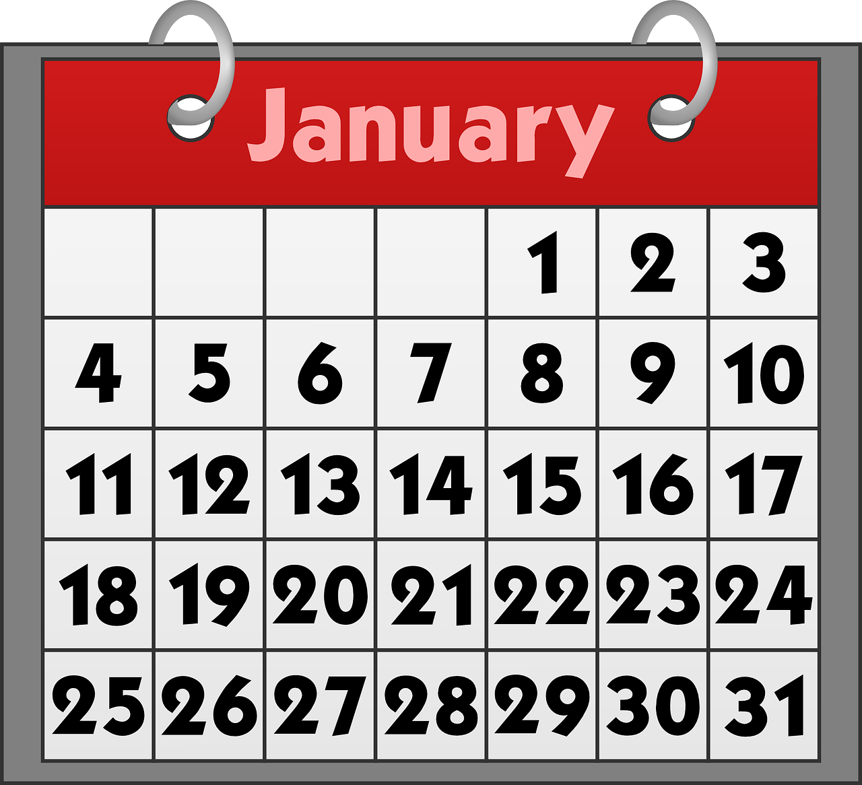
Describing me and others
bleu
Asking and giving dates
Using quel/quelle
[an|en] and [am|em]
Term 1 Week 4
Notes:
Artwork by Steve Clarke. Pronoun pictures from NCELP (www.ncelp.org). All additional pictures selected from Pixabay and are available under a Creative Commons license, no
attribution required.
Phonics: revisit SSC [an|en] enfant [138] and introduce [am|em] temps [64]
Vocabulary (new words in bold): sommes [5] nous [31] quel, quelle [146] date [660] jour [78] mois [179] saison [1667] semaine [245] lundi [1091], mardi [1044] mercredi [1168] jeudi [1112] vendredi [1086] samedi [1356] dimanche [1235] aujourd’hui [233]
Revisit 1: être [5] suis, est, es [5] je [22] tu [112] il [13] elle [38] qui ? [14] ami(e) [467] école [477] monsieur [79] madame [294] professeur(e) [110] anglais [784] français [251] calme [1731] amusant [4695] heureux [764] important [215] inquiet [1392] intelligent [2509] perdu [2264] prêt [422] sérieux [412] bien [47] mal [277] comment ? [234] Salut ! [2205] Ça va ? [54/53] Oui [284] Non [75] Bonjour ! [1972] Au revoir [4/1274] Revisit 2: an [76] faim [1986] raison [72] soif [4659] tort [1652] Londsale, D., & Le Bras, Y. (2009). A Frequency Dictionary of French: Core vocabulary for learners London: Routledge.
The frequency rankings for words that occur in this PowerPoint which have been previously introduced in these resources are given in the SOW and in the resources that first
introduced and formally re-visited those words.
For any other words that occur incidentally in this PowerPoint, frequency rankings will be provided in the notes field wherever possible.
1

Slide 2
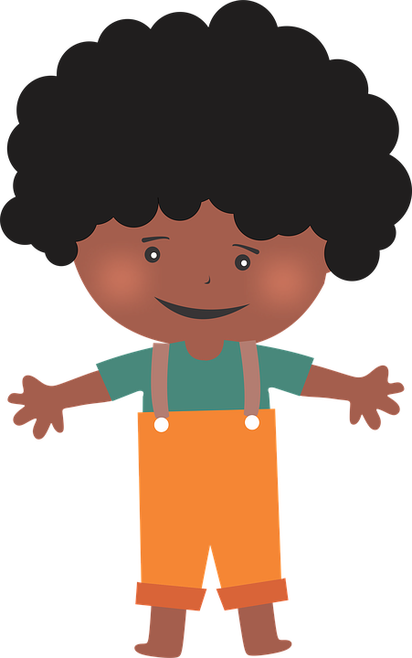
[an|en]
prononciation
enfant
French vowels are either nasal like [an|en] or
non-nasal (oral) like [e] and [a].
When you say a nasal vowel, air passes through your nose as well as your mouth.
Notes:
Timing: 1 minute
Aim: to revisit SSC [an|en] and remind pupils that this sound has two spellings. Note: in the follow ups this week, we will also introduce pupils to [am|em].
Procedure:
Introduce and elicit the pronunciation of the individual SSC [an|en]. Practise saying it several times.
Click to bring up the information about nasal and oral vowel sounds. Practise saying [a] then [an|en] several times.
Click to bring up the source word ‘enfant’ (with gesture, if using). Say the word several times.
Click to bring up the picture and get pupils to repeat the words (with gesture, if using).
Bring up the 2nd callout reminding pupils that [an] and [en] sounds the same and that they need to think carefully about how to write accurately words that they have already learnt. (The next activity practises transcription of eight such words).

Slide 3
[an|en]
. Écoute les noms des animaux. C’est [ien] ou [(a)in]?
Écoute et écris les mots. C’est [an] ou [en] ?
écrire
 | d i f f é r e n t
 | c o m m e n t ?
 | i m p o r t a n t
 | d i m a n c h e
 | a n g l a i s
 | a m u s a n t
 | f r a n ç a i s
 | v e n d r e d i
_ _ _ _ _ _ _ _ _
_ _ _ _ _ _ _
_ _ _ _ _ _ _
_ _ _ _ _ _ _
_ _ _ _ _ _ _ _ _
_ _ _ _ _ _ _ _
_ _ _ _ _ _ _ _
_ _ _ _ _ _ _ _
Notes:
Timing: 5 minutes
Aim: to revisit SSC [an|en] and practise accurate transcription of [an] and [en] with known words.
Procedure:
Click to listen to each word. Pupils transcribe the word, paying attention to the spelling of the [an|en] sound.
Click to reveal the answers.
Ensure pupils are clear about the meanings as these words are part of this week’s revisiting sets.
Transcript: différent comment ? important dimanche anglais amusant français vendredi

Slide 4
écouter
Écoute et écris les numéros dans le bon ordre.
. Écoute les noms des animaux. C’est [ien] ou [(a)in]?
Notes:
Timing: 3 minutes
Aim: to practise aural comprehension and spoken production of numbers 11-30.
Procedure:
Teacher reads instruction in French.
Ask pupils to write the number (not the word) – here we focus on the link between sound and meaning.
Click on the speaker icon to play the recording. The 13 numbers are said with a gap of 3 seconds between each one.
Click to make all numbers disappear and elicit numbers in French from pupils, in the order they were mentioned (each number appears on an individual click).
4

Slide 5
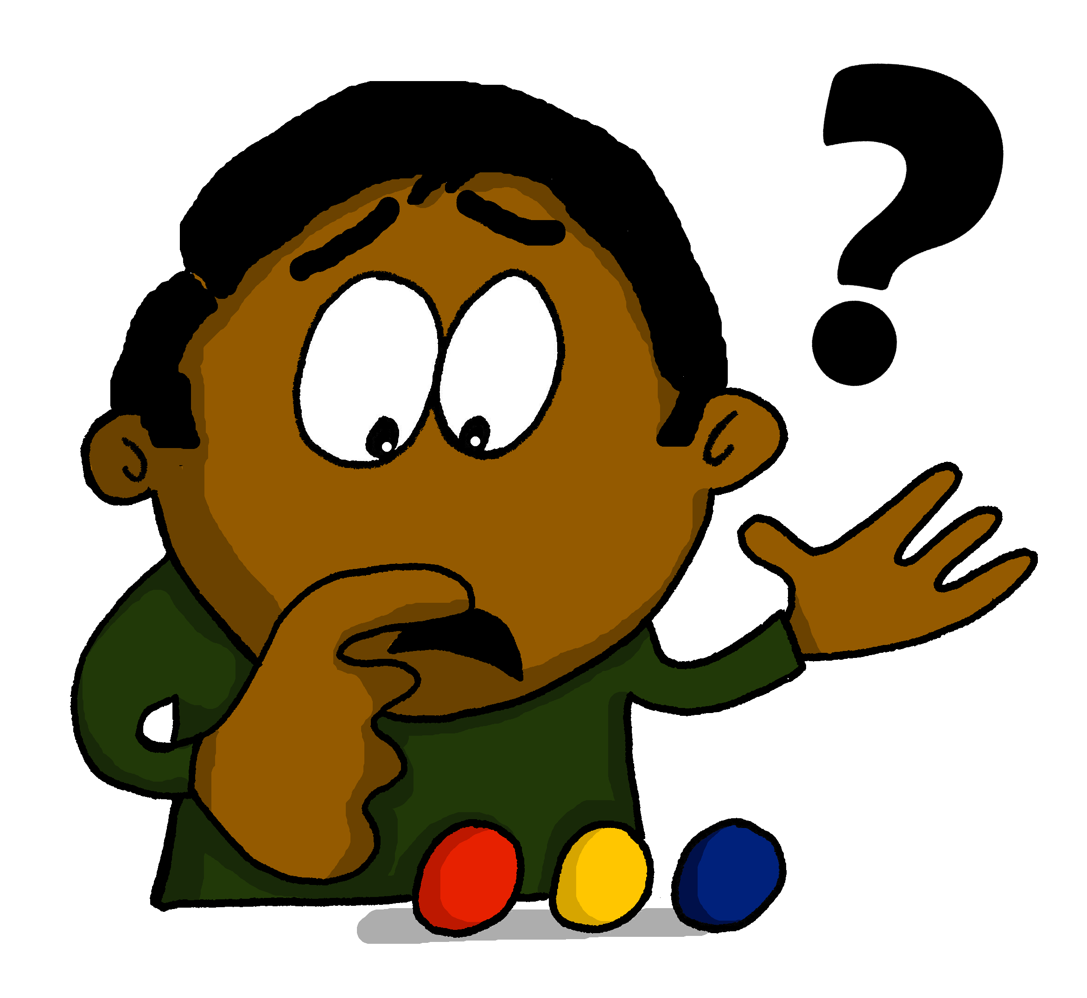
prononcer
quel ?
⚠In English, we often say what day is it? in French, we often use ‘quel’ (which) and nous sommes (we are).
Which?
Nous sommes quel jour ?
[We are which day?] What day is it?
Rachel Hawkes / Emma Marsden
Notes:
Timing: 2 minutes (two slides)
Aim: to introduce question word quel ? and quelle ?
Procedure:
Pupils listen and repeat the key question word (include gesture if possible).
Display the word and get them to repeat one more time.
Elicit English meaning.
Reveal the sentence and elicit English translation from pupils.
Continue with the next slide.

Slide 6
prononcer
quelle ?
⚠quel is which for singular masculine nouns, quelle for singular feminine nouns. They sound almost the same.
Which?
Nous sommes quelle date ?
[We are which date?] What date is it?
Rachel Hawkes / Emma Marsden
Notes:
Procedure:
Pupils listen and repeat the key question word (include gesture if possible).
Display the word and get them to repeat one more time.
Elicit English meaning.
Reveal the sentence and elicit English translation from pupils.

Slide 7
quel ? | quelle ? |
⚠Note that in French we use cardinal numbers for dates (no ^{st} or ^{th})
[which (m), which (f)]
⚠Remember! When you say the day you don’t use ‘le’
Here are two ways to say today’s date:
Compare:
Nous sommes le 10 novembre.
It’s the 10th November.
Nous sommes mercredi 10 novembre.
It’s Wednesday 10th November.
⚠ jour and mois are masculine; date, semaine, saison are feminine.
We can ask questions about dates like this:
Nous sommes quel jour ?
What day is it?
Nous sommes quel mois ?
What month is it?
Nous sommes quelle date ?
What date is it?
Nous sommes en quelle semaine ?
Which week are we in?
Nous sommes en quelle saison ?
Which season are we in?
Notes:
Time: 2 minutes Aim: to recap the way to refer to the date with and without days; to recap the use of quel/quelle in questions about dates, ahead of the next activity.
Procedure: 1. Teachers present the new information. It is animated to allow for a paced, interactive delivery. 2. Elicit the English translation from the examples.
Notes: i) it is correct to pronounce the –x on 10 novembre and also not to pronounce it (i.e. di novembre).
ii) we pronounce it here as pupils have learnt this pronunciation so it avoids overloading them with too many new things.
iii) to read more: https://www.yumpu.com/fr/document/read/10919945/prononciation-et-liaison-des-chiffres-5-6-7-8-9-10-

Slide 8
lire
Adèle gets lots of messages.
What are people asking her?
. Écoute
Choisis le mot correct en français et en anglais de 1 à 5.
1
Nous sommes quelle jour | date ?
day
date
2
4
Mercredi. Mais nous sommes quelle mois | date ?
month
date
Nous sommes quel date | mois ?
month
date
3
5
day
Avril ? Nous sommes quel date |jour ?
date
Aujourd’hui, nous sommes quel jour |date ?
day
date
Notes:
Timing: 5 minutes
Aim: to practise written recognition of the forms of quel/quelle and their connection to meaning.
Procedure:
Pupils write 1-5 and the correct French word and English meaning from the two options given.
Click to reveal answers.
8

Slide 9
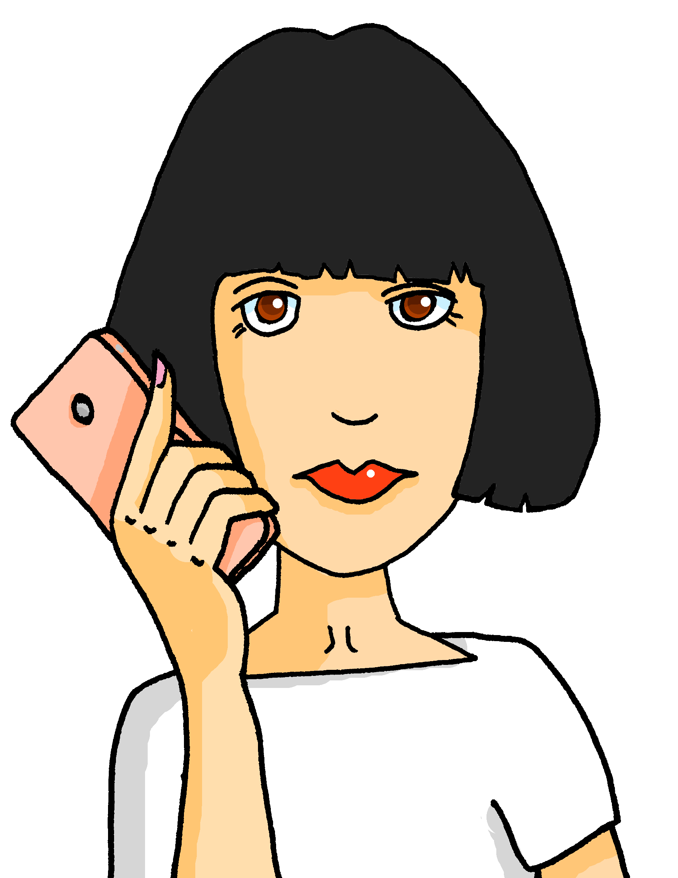
écouter
Quel ? Quelle ?
Claudine écoute des messages.
.
Ils demandent quoi ?
Écris quel ou quelle.
écrire
1
4
Nous sommes quel mois ? Juillet ?
Nous sommes en quelle semaine ?
Cherche la réponse correspondante.
______
______
B
E
A | Nous sommes jeudi 25 septembre.
B | Non, nous sommes le mois de décembre.
C | En automne.
D | Aujourd’hui, c’est lundi.
E | En semaine 3.
F | Mon anniversaire est mercredi.
2
5
Nous sommes quel jour, aujourd’hui ?
Nous sommes quelle date ?
______
______
D
A
3
Claudine, nous sommes en quelle saison maintenant ?
6
Ton anniversaire est quel jour, Claudine ?
C
F
______
______
Notes:
Time: 10 minutes Aim: to practise written differentiation in production of the two forms quel ? and quelle ? based on knowledge of noun gender and recognition in listening. Procedure: 1. Click the message icon to hear the question. (Note: this could simply be done as a reading task, but the audio reinforces the fact that the two forms sound the same. For greater challenge, pupils could listen ‘blind’ – simply cover the whole statement with a text box during listening.)
2. Pupils decide which question word is missing based on the gender of the word that follows.
3. Click to reveal the answers. 4. Click again to bring up a table of possible responses to these questions.
5. Pupils read and match questions and answers. They will need to read very carefully paying close attention to the detail.
Transcript: 1. Nous sommes quel mois ? Juillet ?
2. Nous sommes quel jour, aujourd’hui ?
3. Claudine, nous sommes en quelle saison maintenant ?
4. Nous sommes en quelle semaine ?
5. Nous sommes quelle date ?
6. Ton anniversaire est quel jour, Claudine ?
9

Slide 10
Les jours de la semaine
parler
Monday
Tuesday
Thursday
lundi
mardi
Wednesday
jeudi
mercredi
Friday
Saturday
Sunday
vendredi
samedi
dimanche
Notes:
Time: 2 minutes Aim: to practise spoken recall of the days of the week.
Procedure: 1. Click to elicit pupils’ oral translation of the days of the week in a jumbled order.
2. Pupils try to say the word before the animation is finished. The French word appears after each animation.
3. Finally, click to reveal the English again. Elicit all of the days in French one more time.

Slide 11
Au revoir !
bleu
Notes:
11

