Slide 1
Describing me and others
C’est quand, ton anniversaire ?
bleu
Numbers 13 - 31
Revisit months
Birthdays
SSC [i] [(a)in|im]
Term 1 Week 3
Notes:
Artwork by Steve Clarke. Pronoun pictures from NCELP (www.ncelp.org). All additional pictures selected from Pixabay and are available under a Creative Commons license, no
attribution required.
Phonics: revisit SSC (Sound-Spelling Correspondence) [i] [(a)in] and introduce [im] midi [2483] train [232] simple [212]
Vocabulary (new words in bold): mois [179] janvier [939] février [1139] mars [868] avril [1022] mai [943] juin [931] juillet [1326] aout [1445] septembre [944] octobre [826] novembre [982] décembre [891] quand [119] anniversaire [2043] treize [3285] quatorze [3359] quinze [1472] seize [3285] dix-sept [3812] dix-huit [3592] dix-neuf [4851] vingt [1273] vingt-et-un [1273/6/3] vingt-deux, vingt-trois vingt-quatre vingt-cinq vingt-six vingt-sept vingt-huit vingt-neuf trente [1646] Revisit 1: -- Revisit 2: cousin, cousine [3387] femme [154] homme [136] bleu [1216] rouge [987]
Londsale, D., & Le Bras, Y. (2009). A Frequency Dictionary of French: Core vocabulary for learners London: Routledge.
The frequency rankings for words that occur in this PowerPoint which have been previously introduced in these resources are given in the SOW and in the resources that first
introduced and formally re-visited those words.
For any other words that occur incidentally in this PowerPoint, frequency rankings will be provided in the notes field wherever possible.
1

Slide 2
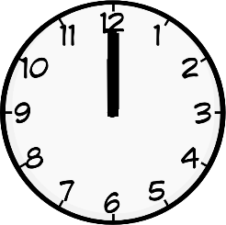
prononcer
[i]
midi
Notes:
Timing: 1 minute
Aim: to revisit SSC [i]
Procedure:
Introduce and elicit the pronunciation of the individual SSC [i] and then the source word ‘midi’ (with gesture, if using).
Click to bring on the picture and get Pupils to repeat (with gesture, if using).
Note: gesture for midday – raise both arms above your head, palms touching to mime 12 o’clock.
2

Slide 3
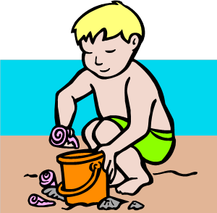
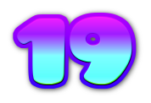
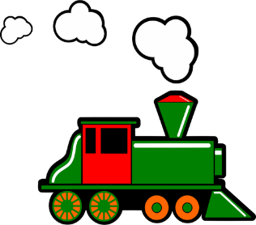
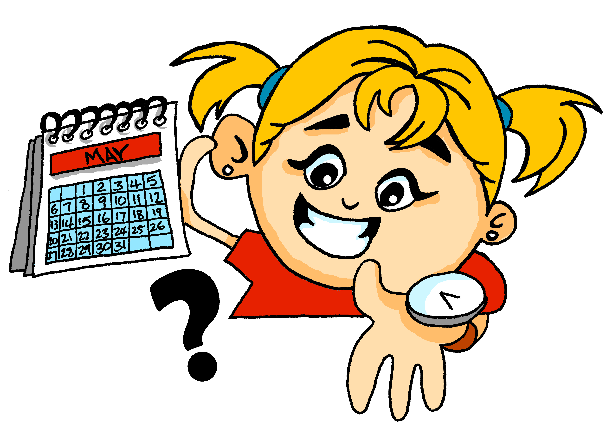
écouter
. Écoute les noms des animaux. C’est [ien] ou [(a)in]?
Écoute. Quel mot a le son [i] ? Écris A, B ou C.
 | A | B | C
1
idée
2
juillet
3
dix-neuf
4
ici
5
qui ?
Notes:
Timing: 6 minutes (two slides)
Aim: to practise aural recognition of SSC [i]
Procedure:
1. Click the numbers to play the audio. Tell pupils they are going to hear the letters ‘a’, ‘b’ and ‘c’ said in French.
2. Write 1-5 and choose if ‘a’, ‘b’ or ‘c’ is a word containing the SSC [i].
3. Click to reveal the answers.
Transcript:
a) idée b) vert c) anglais
a) mars b) juin c) juillet
a) treize b) dix-neuf c) quinze
a) train b) ici c) là
a) quand ? b) comment ? c) qui ?
Note: pupils have either met these words before or will meet them this lesson. Here the focus is simply on recognising the SSC [i] rather than on word meaning.
3

Slide 4
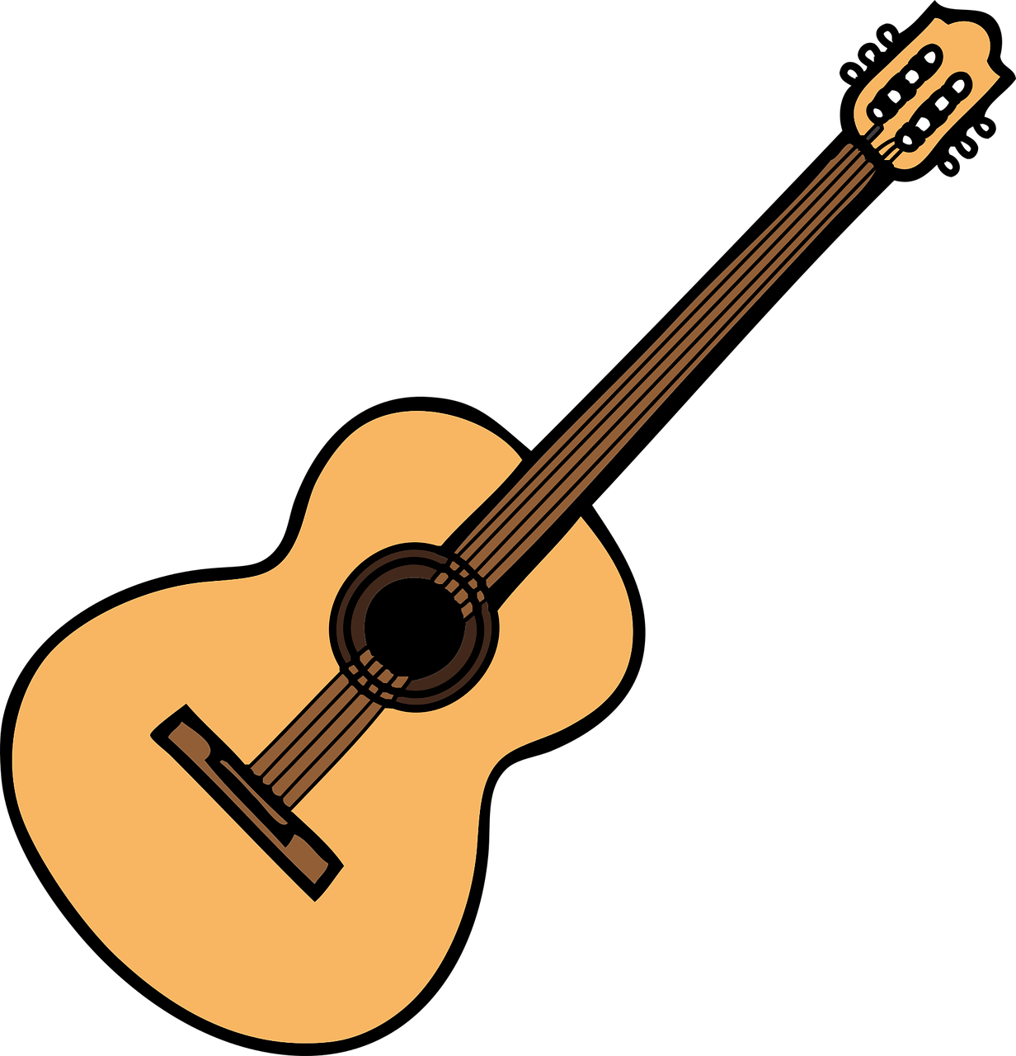
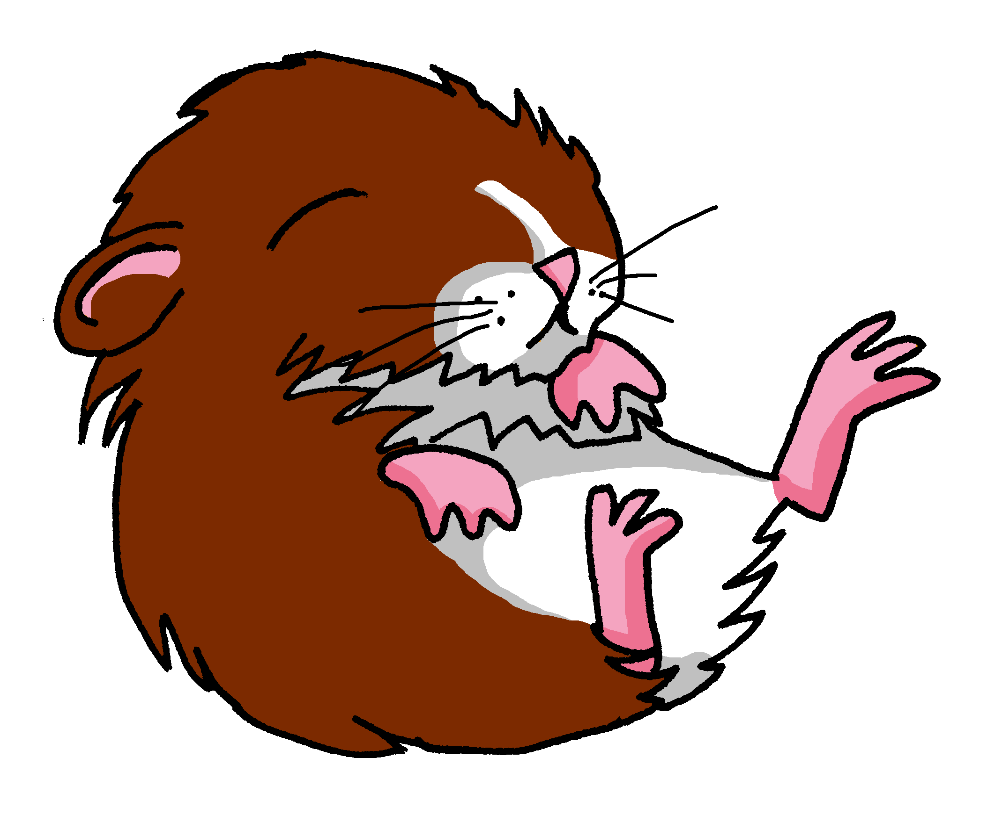
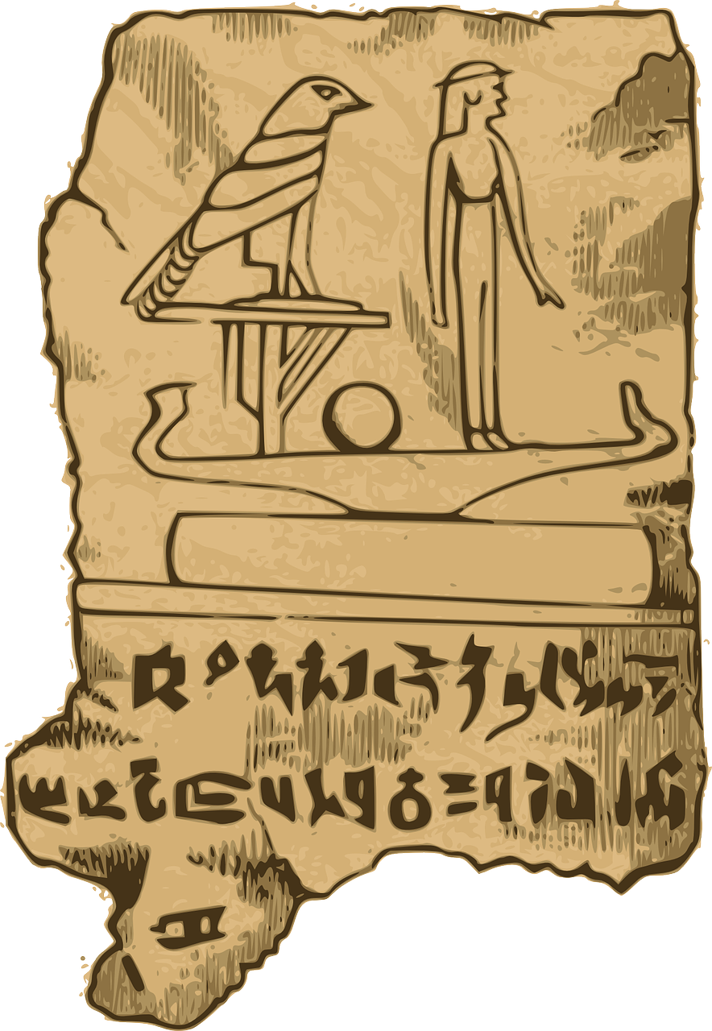
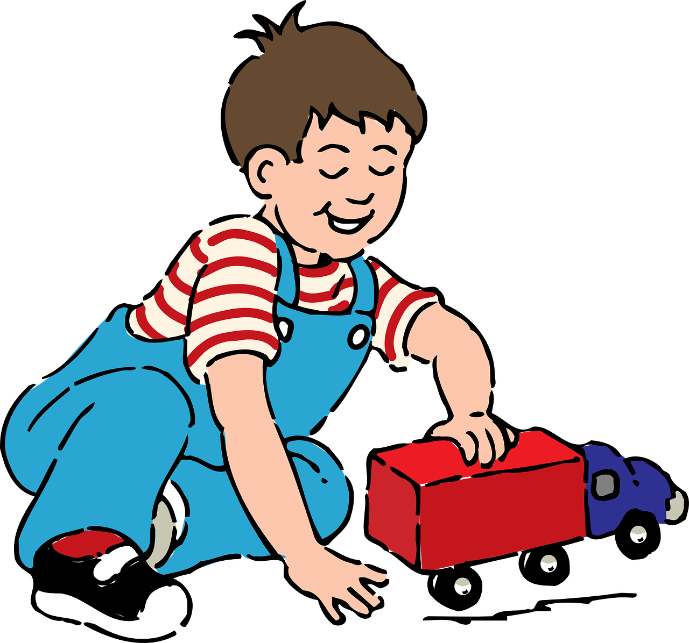
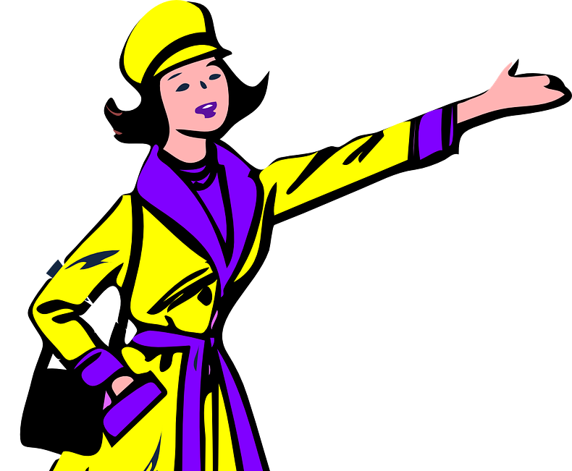
parler
Prononce les mots.
.
guitare
machine
20
animal
S
histoire
rapide
idée
activité
0
guide
DÉBUT
Notes:
Aim: to practise oral production of SSC [i] in a read aloud task.
Procedure:
Start the timer.
Pupils tried to say as many words as they can correctly in twenty seconds.
Pupil B listens carefully and stops his/her partner for a count of 3 every time s/he pronounces a word with the English [i] sound.
Pupils swap roles and the timer is restarted.
The person who has pronounced the greatest number of words correctly wins. If there is a tie, the student with the greatest amount of time remaining wins.
Click on the words to hear them said by a native speaker. Pupils repeat.
Go over the meaning of the words. These are all cognates or near-cognates, purposefully chosen for unlearning the connection between the SSC and the English sound.
Frequency of unknown words and cognates: activité [452] animal [1002] guide [2392] guitare [>5000] histoire [263] idée [239] machine [1294] Paris [n/a] rapide [672]
Source: Londsale, D., & Le Bras, Y. (2009). A Frequency Dictionary of French: Core vocabulary for learners London: Routledge.
4

Slide 5
Les nombres de 13 à 16
French numbers 13 – 16 are as follows:
treize
thirteen
quatorze
fourteen
quinze
fifteen
seize
sixteen
Notes:
Time: 3 minutes (two slides) Aim: to present the key knowledge needed for the formation of numbers 13 - 19. Procedure: 1. Teachers present the new information. It is animated to allow for a paced, interactive delivery. 2. Elicit the French for numbers 13 – 16 again. Audio has been added to these numbers (digits) to allow for listen and check.
Transcript:
treize quatorze quinze seize

Slide 6
Les nombres de 17 à 19
French numbers 17-19 are made with a combination of numbers.
17 →
dix-sept
⚠ Add a hyphen between the numbers.
18 →
dix-huit
⚠ In French, any number below 100 composed of more than one number is hyphenated.
19 →
dix-neuf
Notes:
Procedure: 1. Teachers present the new information. It is animated to allow for a paced, interactive delivery. 2. Elicit the French for numbers 16 – 19 when the digits appear. Audio has been added to these numbers to allow for a click, listen and check.
Transcript:
dix-sept dix-huit dix-neuf
Notes: Here are some further sources of information about number spelling in French since 2016: i) https://www.orthographe-recommandee.info/enseignement/regles.pdf
ii) https://www.projet-voltaire.fr/culture-generale/reforme-orthographe-expliquee-10-points/
French has three words for number, two of which are easily confused: nombre and numéro. Nombre is for when the number is a variable. It's an indefinite number and can change. For example, height is ‘un nombre’.
Numéro is when the number has been assigned. It no longer varies. E.g. the number of someone’s house or someone’s telephone number.
A teacher in the classroom might say. I’m going to give you a number (un nombre) – this number is a variable and not yet defined. Your number is 22 (ton numéro) – this number has been designated and will no longer vary.
The third word is ‘chiffre’. This equates to ‘digit’ in English.
https://yolainebodin.com/the-language-nook/french/understanding-the-difference-between-nombre-chiffre-and-numero#:~:text=Un%20nombre%20is%20made%20of,to%20identify%20things%20or%20people

Slide 7
écouter
C’est quel numéro ?
. Écoute les noms des animaux. C’est [ien] ou [(a)in]?
Écoute et écris le numéro et le mot.
E
12
douze
5
16
seize
1
18
dix-huit
6
14
quatorze
2
13
treize
7
10
dix
3
17
dix-sept
8
15
quinze
4
19
dix-neuf
9
11
onze
Notes:
Time: 5 minutes Aim: to practise understanding and transcribing cardinal numbers (10 -19)
Procedure: 1. Do the example with pupils. Click E to listen. Pupils write the number in digits and letters. Click to check the answer.
2. Complete items 1-9, then click to check. 3. In feedback, teachers can ask for the number in French. This has been included in the answers to provide pupils with support when giving the number.
Transcript: Ex. douze 1. dix-huit 2. treize 3. dix-sept 4. dix-neuf 5. seize 6. quatorze 7. dix 8. quinze 9. onze
7

Slide 8
Les nombres de 21 à 31
The numbers from 21 to 29 are also a combination:
⚠ Add et before un.
20 →
vingt
21 →
vingt-et-un
23 →
vingt-trois
25 →
vingt-cinq
22 →
vingt-deux
24 →
vingt-quatre
26 →
vingt-six
⚠ We also add a hyphen between these numbers.
For numbers from 31 to 39, use trente + a number 1-9.
30 →
trente
31 →
trente-et-un
32 →
trente-deux
33 →
trente-trois
Notes:
Time: 3 minutes Aim: to present the key knowledge needed for the formation of numbers 20-31. Procedure: 1. Teachers present the new information. It is animated to allow for a paced, interactive delivery. 2. Elicit the French for numbers 21- 26.
3. Continue with 30-33. Note: the 1990 spelling reforms introduced hyphens in 21 and 31 (to make them consistent with the other numbers).

Slide 9
écouter
C’est quel numéro ?
.
B : Lis le numéro.
A : Lis le numéro.
A :
Écoute et écris le numéro.
B:
1
vingt-deux
22
6
vingt-cinq
25
prononcer
2
trente
30
7
trente-et-un
31
3
vingt-quatre
24
8
vingt-neuf
29
4
vingt-sept
27
9
vingt-six
26
5
vingt-trois
23
10
vingt-huit
28
Notes:
Time: 5 minutes Aim: to practise reading aloud, understanding and transcribing cardinal numbers (22 -31).
Procedure: 1. Explain the task to pupils, using the French instructions.
2. Pupil B turns away from the board with a pen and something to write on. They will just write the digits this time.
3. Click to bring up the first set of numbers. Pupil A reads the numbers slowly and carefully, one by one, repeating as necessary. 4. Pupil B writes down the 5 numbers (in digits only – we are not practising spelling at this stage), then turns back to face the board.
5. Teacher elicits numbers in French from pupils chorally for additional read aloud practice, and clicks to reveal the number answers.
6. Pupils swap roles. 7. Repeat steps 2 – 5 with the 2nd set of numbers. 8. If required, teachers can click the number buttons to hear the numbers said by a native speaker.
Transcript: 1. vingt-deux 2. trente 3. vingt-quatre 4. vingt-sept 5. vingt-trois 6. vingt-cinq 7. trente-et-un 8. vingt-neuf 9. vingt-six 10. vingt-huit
9

Slide 10
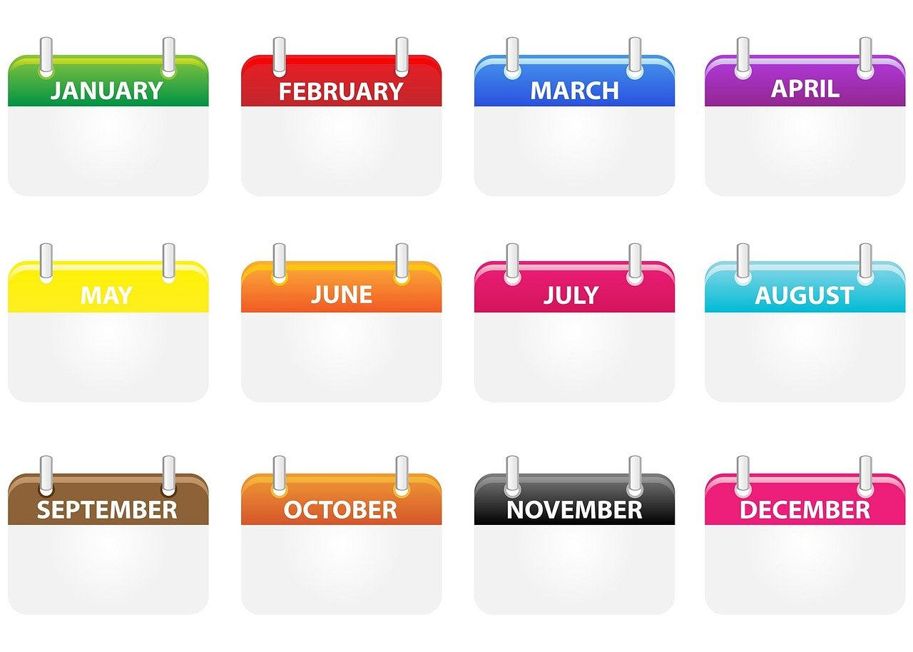
parler
Les mois
Prononce les mois vite mais bien.
. Écoute les noms des animaux. C’est [ien] ou [(a)in]?
12
janvier
février
mars
avril
S
mai
juin
juillet
aout
0
septembre
octobre
novembre
décembre
DÉBUT
Notes:
Time: 5 minutes (two slides) Aim: to revisit months of the year.
Procedure: 1. In pairs and alternating, pupils need to say the months in chronological order as quickly as possible and before the 12 seconds elapse.
2. They should have 2-3 attempts, to improve their spoken performance each time. 3. Pupil A then secretly selects 3 months (making a note that s/he can show his partner). Pupil B needs to try to say his/her partner’s 3 months correctly, within the 12 second time limit. S/he will need to say as many months as s/he can, but will naturally opt to say them out of order to try to match his/her partner’s choices.
4. Pupils then swap roles to play again. 5. If needed, click on the words to hear each of the months pronounced by a native speaker.
10

Slide 11
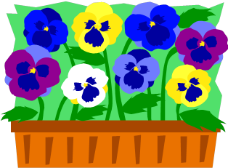
écrire
Les mois
. Écoute
Écris les mois.
60
j _ _ v _ _ r
_ é _ r _ e _
m _ r _
_ _ r _ l
_ a _
j a n v i e r
f é v r i e r
m a r s
a v r i l
m a i
_ _ i _
_ u _ l l _ _
j u i n
j u i l l e t
a _ _ t
_ _ p _ e m b _ _
a o u t
s e p t e m b r e
0
o _ t _ b _ _
n o v e m b r e
d é c e m b r e
o c t o b r e
_ o _ e m b _ _
d _ c _ m b _ _
DÉBUT
Notes:
Aim: to revisit months of the year.
Procedure: 1. Pupils need to write the months in order, filling in the missing letters, within the 60 second time limit.
2. Teacher starts the timer.
3. Click to show the full words for pupils to check their answers.
11

Slide 12
prononcer
quand ?
when?
C’est quand, ton anniversaire ?
[When is your birthday?]
Rachel Hawkes / Emma Marsden
Notes:
Timing: 1 minute
Aim: to recap the question word quand ?
Procedure:
Pupils listen and repeat the key question word (include gesture if possible)
Display the word and get pupils to repeat one more time.
Elicit English meaning.
Reveal the sentence and elicit English translation from pupils.
Gesture: turn to look at left wrist where a watch might be worn and tap it once in time with the syllable quand ?

Slide 13
écouter
Jean-Michel pose la question.
. Écoute les noms des animaux. C’est [ien] ou [(a)in]?
Écoute et écris. C’est quand, ton anniversaire ?
Yves
Pierre
Madame Vidal
le 22 octobre
le 25 juin
le 31 janvier
____
____
___
Use le before the number to mean ‘(on) the’ with dates.
Léa
Adèle
le 16 mai
le 15 aout
____
__
Mon anniversaire est le 27 novembre, aussi !
Eugénie
Clémentine
le 13 avril
le 27 novembre
___
___
Notes:
Note: This final activity makes this lesson 35 minutes. If this is not possible, then use this activity as one of the follow ups during the week. ☺
Time: 6 minutes Aim: to practise understanding cardinal numbers in birthday dates.
Procedure: 1. Click on each set of balloons to hear the audio.
2. Pupils listen to the date given for each person’s birthday, and write down the number. 2. In feedback, teachers can ask: ‘Qui dit “mon anniversaire est le X X ?”’ to elicit the names from pupils, and allow them another opportunity to hear and understand the dates one more time. Note: these are all characters in our narrative. Transcript: [Yves] Mon anniversaire est le 22 octobre [Pierre] Mon anniversaire est le 25 juin. [Madame Vidal] Mon anniversaire est le 31 janvier. [Léa ] Mon anniversaire est le 16 mai.
[Adèle] Mon anniversaire est le 15 aout. [Eugénie] Mon anniversaire est le 13 avril.
[Clémentine] Mon anniversaire est le 27 novembre. [Jean-Michel] Mon anniversaire est le 27 novembre, aussi !
13

Slide 14
Au revoir !
bleu
Notes:
14

