Slide 1
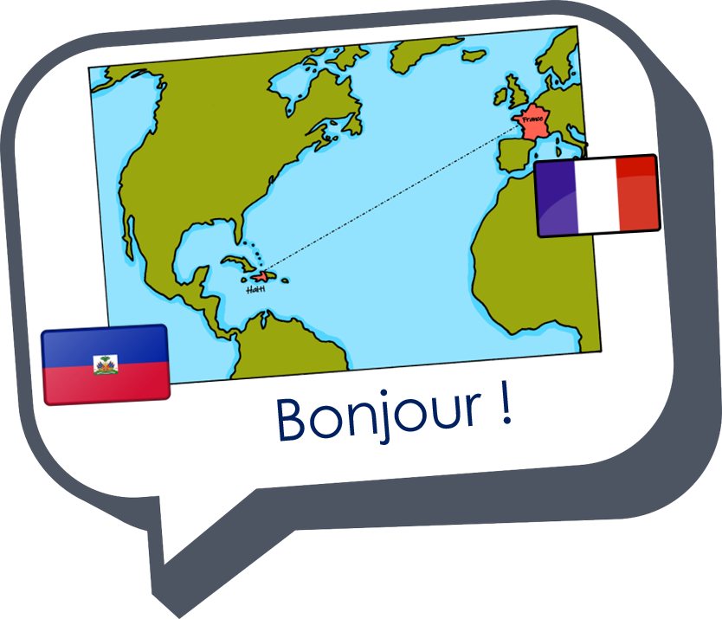
Describing me and others
les professeurs
bleu
Follow ups 1-5
Term 1 Week 2
Notes:
Artwork by Steve Clarke. Pronoun pictures from NCELP (www.ncelp.org). All additional pictures selected from Pixabay and are available under a Creative Commons license, no attribution required.
Phonics: revisit [a] and [an|en] banane [>5000] enfant [126] maman [2168]
Vocabulary (new words in bold): sommes [5] nous [31] absent [2016] amusant [4695] calme [1731] content [1841] différent [350] difficile [296] drôle [2166] fort [107] grand [59] jeune [152] lent [2572] malade [1066] méchant [3184] intelligent [2509] indépendant [954] important [215] petit [138] présent [216] prudent [1529] rapide [672] strict [1859] sage [2643] triste [1843]
Revisit 1: -- Revisit 2: trop [195] pour [10] moi [131] puis [230] idéal [1429]
Londsale, D., & Le Bras, Y. (2009). A Frequency Dictionary of French: Core vocabulary for learners London: Routledge.
The frequency rankings for words that occur in this PowerPoint which have been previously introduced in these resources are given in the SOW and in the resources that first introduced and formally re-visited those words.
For any other words that occur incidentally in this PowerPoint, frequency rankings will be provided in the notes field wherever possible.

Slide 2
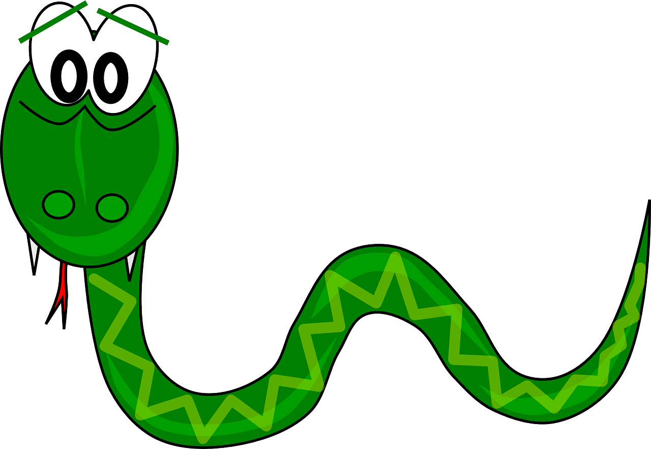
Follow up 1: [an|en]
Complète la phrase.
prononciation
Personne A
Personne B
Roman est un…
Il est lent…
Il chante et…
Il habite …
3
… il danse souvent.
… à Rouen.
… éléphant indépendant.
… mais intelligent.
1
4
2
Personne B
Personne A
Il habite...
Il est différent et...
Il mange souvent...
Laurent est un...
3
… serpent blanc.
… en France.
… des oranges.
… méchant.
2
3
2
Notes:
Timing: 4 minutes
Aim: to practise spoken production of the SSC [an|en] and aural comprehension of previously taught vocabulary and structures.
Note: this is the ANSWER SLIDE. Don’t click until after pupils have completed the task.
Procedure:
Give out the handout (see final slide).
Pupil A reads his/her sentence beginnings and Pupil B finishes the sentence with the appropriate ending.
They read the sentences again and between them tally the number of [an|en] sounds in each sentence.
Then they swap roles and repeat with the 2nd text.
Click this slide to show the full sentences, the number of [an|en] sounds and click the audio buttons to hear the lines read by a native speaker.
Transcript 1: Roman est un éléphant indépendant. Il est lent mais intelligent. Il chante et il danse souvent. Il habite à Rouen.
Transcript 2: Il habite en France. Il est different et méchant. Il mange souvent des oranges. Laurent est un serpent blanc.

Slide 3
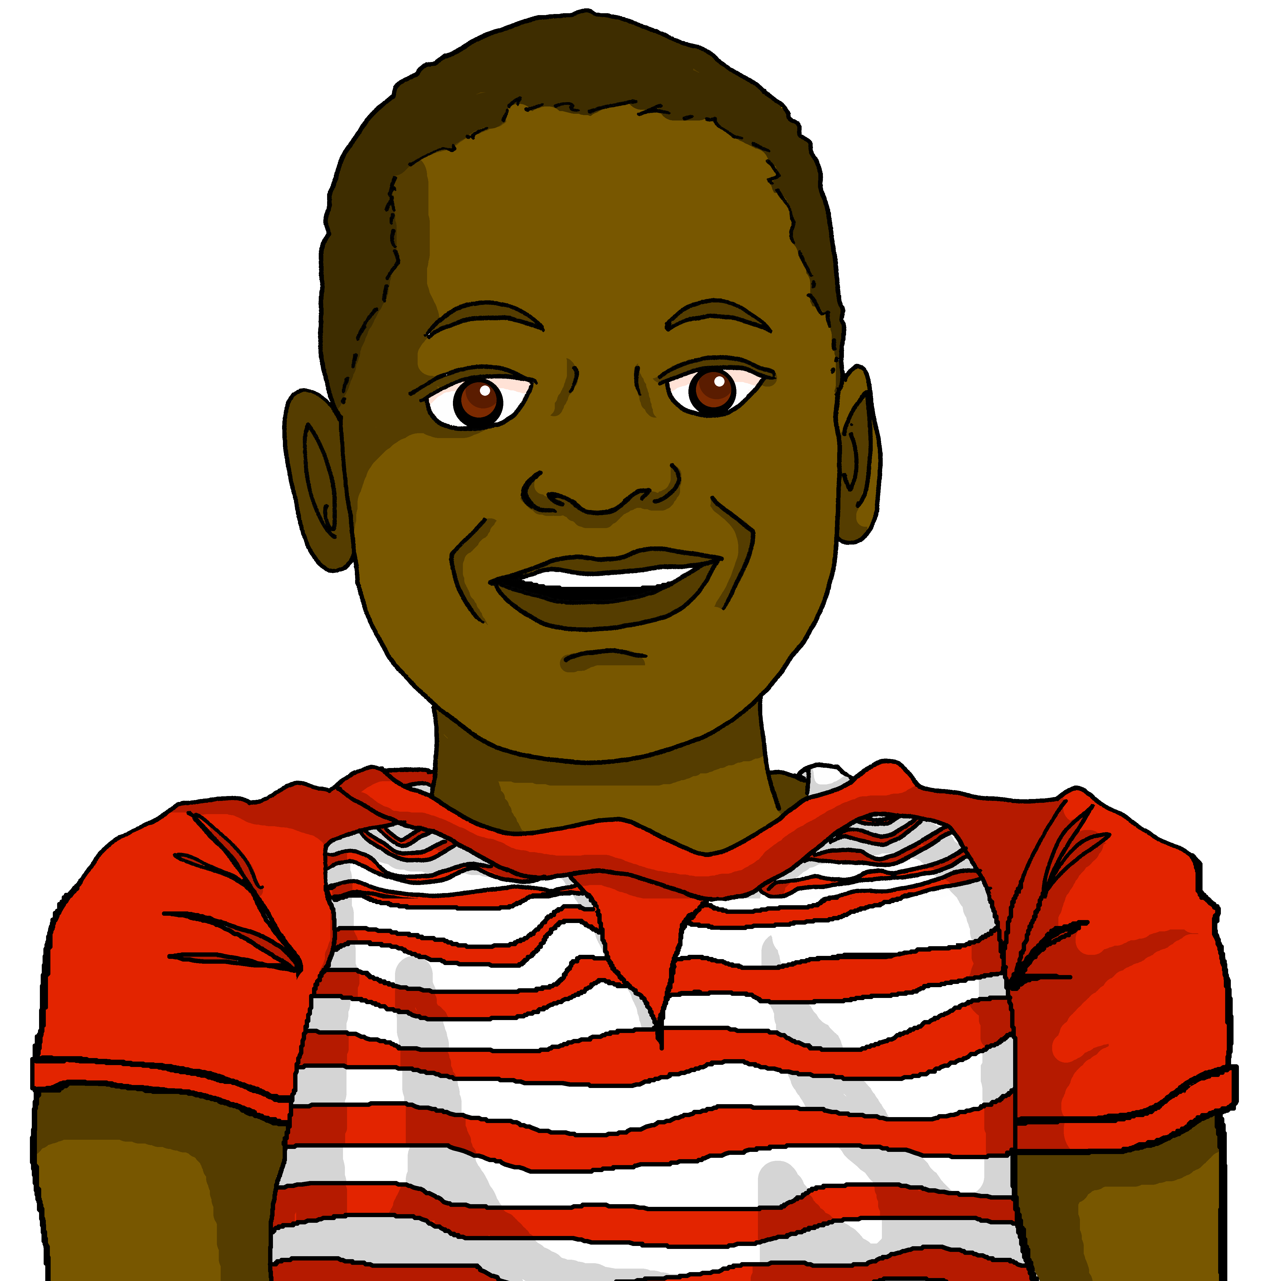
Follow up 2:
Écoute les phrases. Qui parle ?
. Écoute les noms des animaux. C’est [ien] ou [(a)in]?
 | nous | nous | en anglais
écouter
1
naughty
2
absent
short
3
different
4
5
careful
6
independent
strong
7
8
important
Notes:
Timing: 5 minutes
Aim: to practise aural recognition of the distinction between masculine and feminine plural adjectives.
Procedure:
Click to listen.
Remind pupils that a masculine plural ending also applies to a mixed group, and a feminine ending only to an all-female group.
Pupils note nous (f) or nous (m, m/f) and the English meaning of the adjective.
Transcript: 1. Nous sommes méchantes. 2. Nous sommes absents. 3. Nous sommes petits.
4. Nous sommes différentes. 5. Nous sommes prudentes. 6. Nous sommes indépendants. 7. Nous sommes fortes. 8. Nous sommes importants.

Slide 4
Follow up 3:
Lis les phrases. L’adjectif, c’est quoi ?
lire
Je suis Léa et je suis......
1 |  | intelligente | intelligentes
2 |  | content | contents
3 |  | drôle | drôles
4 |  | petit | petits
5 |  | sage | sages
6 |  | calme | calmes
7 |  | méchant | méchants
8 |  | amusant | amusants
Il est ......
Elle est ......
Nous sommes ......
Adèle ! Tu es ......
Nous sommes ......
Il est ......
Nous sommes ......
Notes:
Timing: 5 minutes
Aim: to practise recognition of the different forms of être, and adjectives with number agreement.
Procedure:
1. In this second reading activity, pupils are required to attend to the subject pronoun and verb form to determine singular or plural.
2. Then select the correct form of the adjective.
3. Answers revealed on clicks.

Slide 5
Follow up 4:
Parle avec ton/ta partenaire.
. Écoute les noms des animaux. C’est [ien] ou [(a)in]?
Choose four adjectives. Say four sentences to describe yourself and your friends (we).
parler
20
different
ill, sick
fast
tall
pleased
naughty
S
funny
careful
short
well-behaved
intelligent
0
calm
DÉBUT
Notes:
Timing: 5 minutes
Aim: to practise oral production of the newly-introduced ‘nous’ form of ‘être’ and known vocabulary.
Procedure:
1. Pupils split into pairs.
2. Teacher clicks to start the timer.
3. Pupils take turns to say sentences (two each) in the nous form, taking care not to pronounce the –s on the adjective. Pupils should use each adjective only once. They should repeat the task a couple of times to improve their confidence and speed in production.

Slide 6
Follow up 5:

Écris quatre phrases.

1 _____________________________
écrire
….
Here you are talking about yourself.
(You are ____________).


2 _____________________________
…
4 _____________________________
…
(I am ____________).
(We are ____________).

3 _____________________________
….
(She is ____________).
Notes:
Timing: 10 minutes
Aim: to practise free written production of the four known parts of être and adjectives.
Procedure:
Tell pupils to complete the English sentences first, with their own choice of adjectives.
Then write the four sentences in French.
Teacher circulates to offer support, as needed.

Slide 7
vocabulaire
Follow up 5 - Écris en anglais : Can you get at least 15 points?
mots
 | trop | il | elle
 | difficile | préféré(e) | jaune
 | rapide | triste | différentes
 | lents | jeune | fort
 | fortes | malade | drôles
 | méchantes | prudents | stricte
 | nous | sommes | sages
too
he, it
she, it
x3
difficult
favourite
yellow
fast (m/f)
sad (m/f)
different (f, pl.)
x2
slow (m, pl.)
young (m/f)
strong (m)
strong (f, pl.)
ill, sick
funny (m/f, pl.)
naughty (f, pl.)
careful (m, pl.)
strict (f)
x1
we
are (we)
well-behaved (m/f, pl.)
Notes:
Timing: 5 minutes
Aim: to practise written comprehension of vocabulary from this week and the revisited set.
Procedure: 1. Give pupils a blank grid. They fill in the English meanings of any of the words they know, trying to reach 15 points in total. 2. Remind pupils that adjectives can refer to male or female persons and they should note this in their translations. E.g. pleased (f), short (m).
Note: The most recently learnt and practised words are pink, words from revisited set 1 are green and those from revisited set 2 are blue, thus more points are awarded for them, to recognise that memories fade and more effort (heavy lifting!) is needed to retrieve them.
7

Slide 8
handout
Personne A
Personne B
Roman est un…
Il est lent…
Il chante et…
Il habite …
… il danse souvent.
… à Rouen.
… éléphant indépendant.
… mais intelligent.
… serpent blanc.
… en France.
… des oranges.
… méchant.
Il habite...
Il est différent et...
Il mange souvent...
Laurent est un...
Notes:
HANDOUT (editable)
8

Slide 9
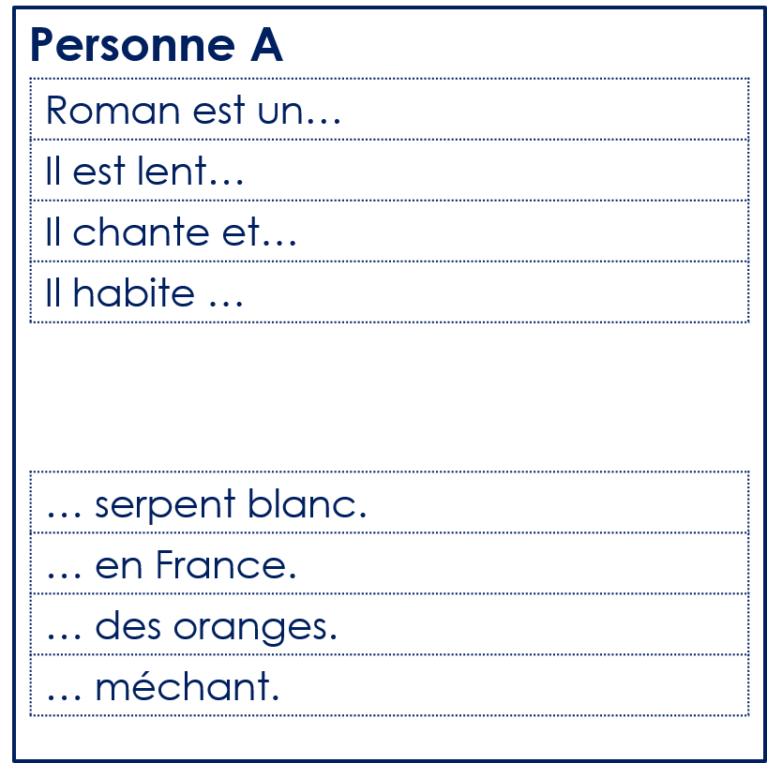
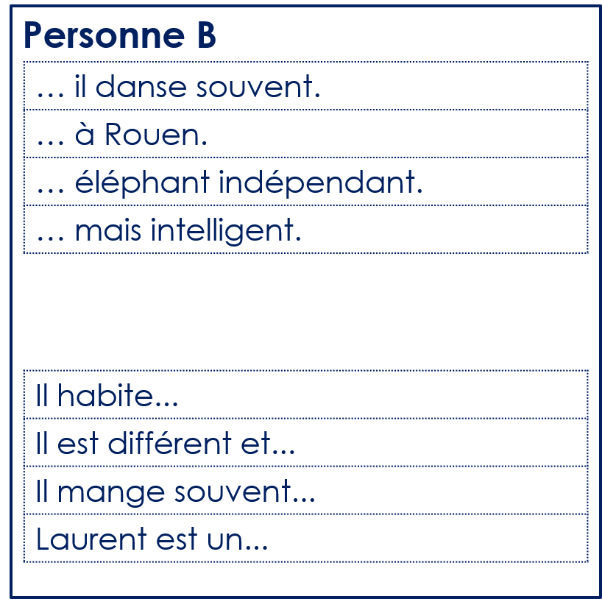
handout
handout
Notes:
HANDOUT (for printing)
9

Slide 10
vocabulaire
Follow up 5 - Écris en anglais : Can you get at least 15 points?
mots
 | trop | il | elle
 | difficile | préféré(e) | jaune
 | rapide | triste | différentes
 | lents | jeune | fort
 | fortes | malade | drôles
 | méchantes | prudents | stricte
 | nous | sommes | sages
Notes:
Timing: 5 minutes
Aim: to practise written comprehension of vocabulary from this week and the revisited set.
Procedure: 1. Give pupils a blank grid. They fill in the English meanings of any of the words they know, trying to reach 15 points in total. 2. Remind pupils that adjectives can refer to male or female persons and they should note this in their translations. E.g. pleased (f), short (m).
Note: The most recently learnt and practised words are pink, words from revisited set 1 are green and those from revisited set 2 are blue, thus more points are awarded for them, to recognise that memories fade and more effort (heavy lifting!) is needed to retrieve them.
10

