Slide 1
Saying what I and others have
bleu
Vocabulary & Grammar Quiz
Haitian folk song
Notes:
Artwork by Steve Clarke. Pronoun pictures from NCELP (www.ncelp.org). All additional pictures selected from Pixabay and are
available under a Creative Commons license, no attribution required.
This lesson contains vocabulary and grammar assessments to check progress in the words and structures introduced and practised in the first 12 weeks of this year’s course, as well as those from the previous two years. The ratio of old to new language in the quiz is very approximately 50:50.
1

Slide 2
écouter
Vouvol is from another planet. It likes earth and speaking French but often forgets word meanings, spellings and things like gender and verb forms. Help Vouvol by answering the questions in this quiz.
A For each question, put a cross (x) under the English meaning that matches what you hear.
You will hear each French word twice. Choose one correct answer only.
 | A | B | C | D
1. | 14 | 15 | 12 | 13
 | ☐ | ☐ | ☐ | ☐
2. | to look for | to find | to play | to sing
 | ☐ | ☐ | ☐ | ☐
3. | we | I | they | you (plural)
 | ☐ | ☐ | ☐ | ☐
4. | which | what | when | who
 | ☐ | ☐ | ☐ | ☐
1
2
3
4
Notes:
Timing: 20-25 minutes (all assessment slides)
Aim: to practise aural comprehension of vocabulary taught in weeks 1-12 of the course.
Procedure:
1. Click the audio buttons to play each item. (The words are recorded twice with a pause to allow pupils to process the information).
2. Pupils can either write 1C, etc.. or if they have the assessment on a print out they can put a X in the correct box.
3. After items 1-4, continue to the next slide to complete the remainder of the task.
Transcript:
1. quinze
2. chercher
3. ils
4. qui
2

Slide 3
écouter
 | A | B | C | D
5. | ready | lost | worried | heavy
 | ☐ | ☐ | ☐ | ☐
6. | naughty | funny | careful | slow
 | ☐ | ☐ | ☐ | ☐
7. | to prefer | to think | to wear | to pronounce
 | ☐ | ☐ | ☐ | ☐
 | simple | special | alone | serious
 | ☐ | ☐ | ☐ | ☐
5
6
7
8
Notes:
[2/2]
Transcript:
5. prêt
6. prudent
7. prononcer
8. seul
3

Slide 4
écouter
B For each question, put a cross (x) under the type of word you hear. You will hear each French word twice. Choose one correct answer only.
This word is a good example of …
 | A | B | C | D
1. | an object ☐ | a person ☐ | a month ☐ | a greeting ☐
2. | a day ☐ | a number ☐ | a question word ☐ | a part of the body ☐
3. | an animal ☐ | furniture ☐ | a person ☐ | personality ☐
4. | a part of the body ☐ | a question word ☐ | an animal ☐ | a number ☐
1
2
3
4
Notes:
Procedure:
1. Click the audio buttons to play each item. (The words are recorded twice with a pause to allow pupils to process the information).
2. Pupils can either write 1C, etc.. or if they have the assessment on a print out they can put a X in the correct box.
4. When complete, continue to the next slide to do items 5-8.
Transcript:
1. mars
2. quand
3. un bureau
4. le nez
4

Slide 5
écouter
B For each question, put a cross (x) under the type of word you hear. You will hear each French word twice. Choose one correct answer only.
This word is a good example of …
 | A | B | C | D
1. | a person ☐ | an object ☐ | furniture ☐ | a month ☐
2. | a day ☐ | a greeting ☐ | personality ☐ | an animal ☐
3. | a number ☐ | a part of the body ☐ | a month ☐ | a day ☐
4. | furniture ☐ | an object ☐ | a person ☐ | a greeting ☐
5
6
7
8
Notes:
Procedure:
1. Click the audio buttons to play each item. (The words are recorded twice with a pause to allow pupils to process the information).
2. Pupils can either write 1C, etc.. or if they have the assessment on a print out they can put a X in the correct box.
3. When complete, continue to the reading.
Transcript:
5. un ordinateur
6. dimanche
7. seize
8. la mère
5

Slide 6
lire
C Help Vouvol to translate the underlined French word(s) to complete each English sentence.
1. Il a les cheveux crépus. He has _____________ hair.
2. La professeure a une nouvelle idée. The teacher has a ________ idea.
3. Tu as un nez rond. You have a ___________ ___________ .
4. Il y a treize cahiers ? Are there ________ ___________________?
5. Décembre, c’est un beau mois. December is a ____________ ___________.
6. Elle est toujours très sérieuse. She is ____________ __________ ___________ .
7. Il a beaucoup de stylos ? Does he have ________________________?.
8. Il y a des crayons. There are _______ ______________ .
9. C’est une vieille fenêtre. It is an ___________ _______________.
10. Monsieur Dupont est rarement strict. Mr Pau is __________ ________________ .
Notes:
Aim: to practise written recall of previously taught vocabulary.
Procedure:
Ensure that the task is clear.
Pupils could write 1 – 10 and the individual English word meanings (or they could fill in if they have printed assessment sheets).
6

Slide 7
écrire
D Translate the underlined English words to complete the French sentence.
1. He has an oval face. Il a _____ __________ ovale. (write two words)
2. It is a small space. C’est ___ petit _____________. (write two words)
3. The doctor (f) is good. La médecin est ____________. (write one word)
4. He has a green bedroom. Il a une __________ _______. (write two words)
5. Madame Pau is brave. Mrs Pau is _______________. (write one word)
6. I’m doing a difficult task. Je fais une ________ ___________. (write two words)
7. The doctor (m) is old. Le médecin est ___________. (write one word)
8. He has blue eyes. . Il a _____ yeux __________. (write two words)
9. Today it’s Monday. __________, c’est____________. (write two words)
10. No, he speaks French! ____, il parle ____________ ! (write two words)
Notes:
Aim: to practise written production of previously taught vocabulary.
Procedure:
Ensure that the task is clear.
Pupils could write 1 – 10 and the individual English word meanings (or they could fill in if they have printed assessment sheets).
7

Slide 8
lire
Grammar
A Put a (X) next to the person the sentence is about.
1 | ☐ I ☐ you _{[singular]} ☐ s/he ☐ we ☐ you _{[plural]} ☐ they | …est drôle. |  | 4 | ☐ I ☐ you _{[singular]} ☐ s/he ☐ we ☐ you _{[plural]} ☐ they | …avons une chaise.
2 | ☐ I ☐ you _{[singular]} ☐ s/he ☐ we ☐ you _{[plural]} ☐ they | …sont inquiètes. |  | 5 | ☐ I ☐ you _{[singular]} ☐ s/he ☐ we ☐ you _{[plural]} ☐ they | … êtes ensemble.
3 | ☐ I ☐ you _{[singular]} ☐ s/he ☐ we ☐ you _{[plural]} ☐ they | …suis triste. |  | 6 | ☐ I ☐ you _{[singular]} ☐ s/he ☐ we ☐ you _{[plural]} ☐ they | …as un exercice.
Notes:
Aim: to practise written understanding of previously taught grammar features.
Procedure:
Ensure that the task is clear.
Pupils could write 1 – 6 and the correct English pronoun (or they could fill in if they have printed assessment sheets).
8

Slide 9
lire
Grammar
B Put a (X) next to the correct start of each sentence.
1. | ☐ Ils … ☐ Elles … | sont heureuses.
2. | ☐ Ils … ☐ Elles … | sont perdus.
C Write the words in each box in the correct order.
1. | livre amusant un | Correct order:_________________________________________
2. | belles les tortues | Correct order:_________________________________________
Notes:
Aim: to practise written understanding of previously taught grammar features.
Procedure:
Ensure that the task is clear.
Pupils could write the answers only (or they could fill in if they have printed assessment sheets).
9

Slide 10
lire
Grammar
D Write the words in each box in the correct order to make a question.
1. | a quoi il | Correct order:_________________________________________
2. | elle qui est | Correct order:_________________________________________
écrire
E Write the French for the English given in brackets. Use the clues to help you.
1. | Tu ___________ là. (are) | to be = être
2. | J’ ___________ un chapeau. (have) | to have = avoir
3. | Elles ___________ un problème. (have) | to have = avoir
4. | Nous _______________ le 11 juillet. | to be = être
5. | Elle _________ un cheval. | to have = avoir
6. | Vous __________ des chats? | to have = avoir
Clues
Notes:
Aim: to practise written understanding of previously taught grammar features.
Procedure:
Ensure that the task is clear.
Pupils could write the answers only (or they could fill in if they have printed assessment sheets).
10

Slide 11
écrire
Grammar
Grammar
F Write the French article ‘the’. The gender (and number) of the noun is provided.
1. | _____ mur (m) gris.
2. | _____ chiens (mpl) noirs.
3. | _____ tête (f) ovale.
G Write the French article ‘a’ or ‘some’. The gender (and number) of the noun is provided.
1. | Il a _______ maison. (f)
2. | Il y a ________ fraises. (fpl)
3. | C’est ________ village. (m)
H Write ‘quel’ or ‘quelle’. The gender of the noun is provided.
1. | Vous êtes en ____________ saison (f) ?
2. | C’est __________ jour (m) ?
Notes:
Aim: to practise written production of previously taught grammar features.
Procedure:
Ensure that the task is clear.
Pupils could write the answers only (or they could fill in if they have printed assessment sheets).
11

Slide 12
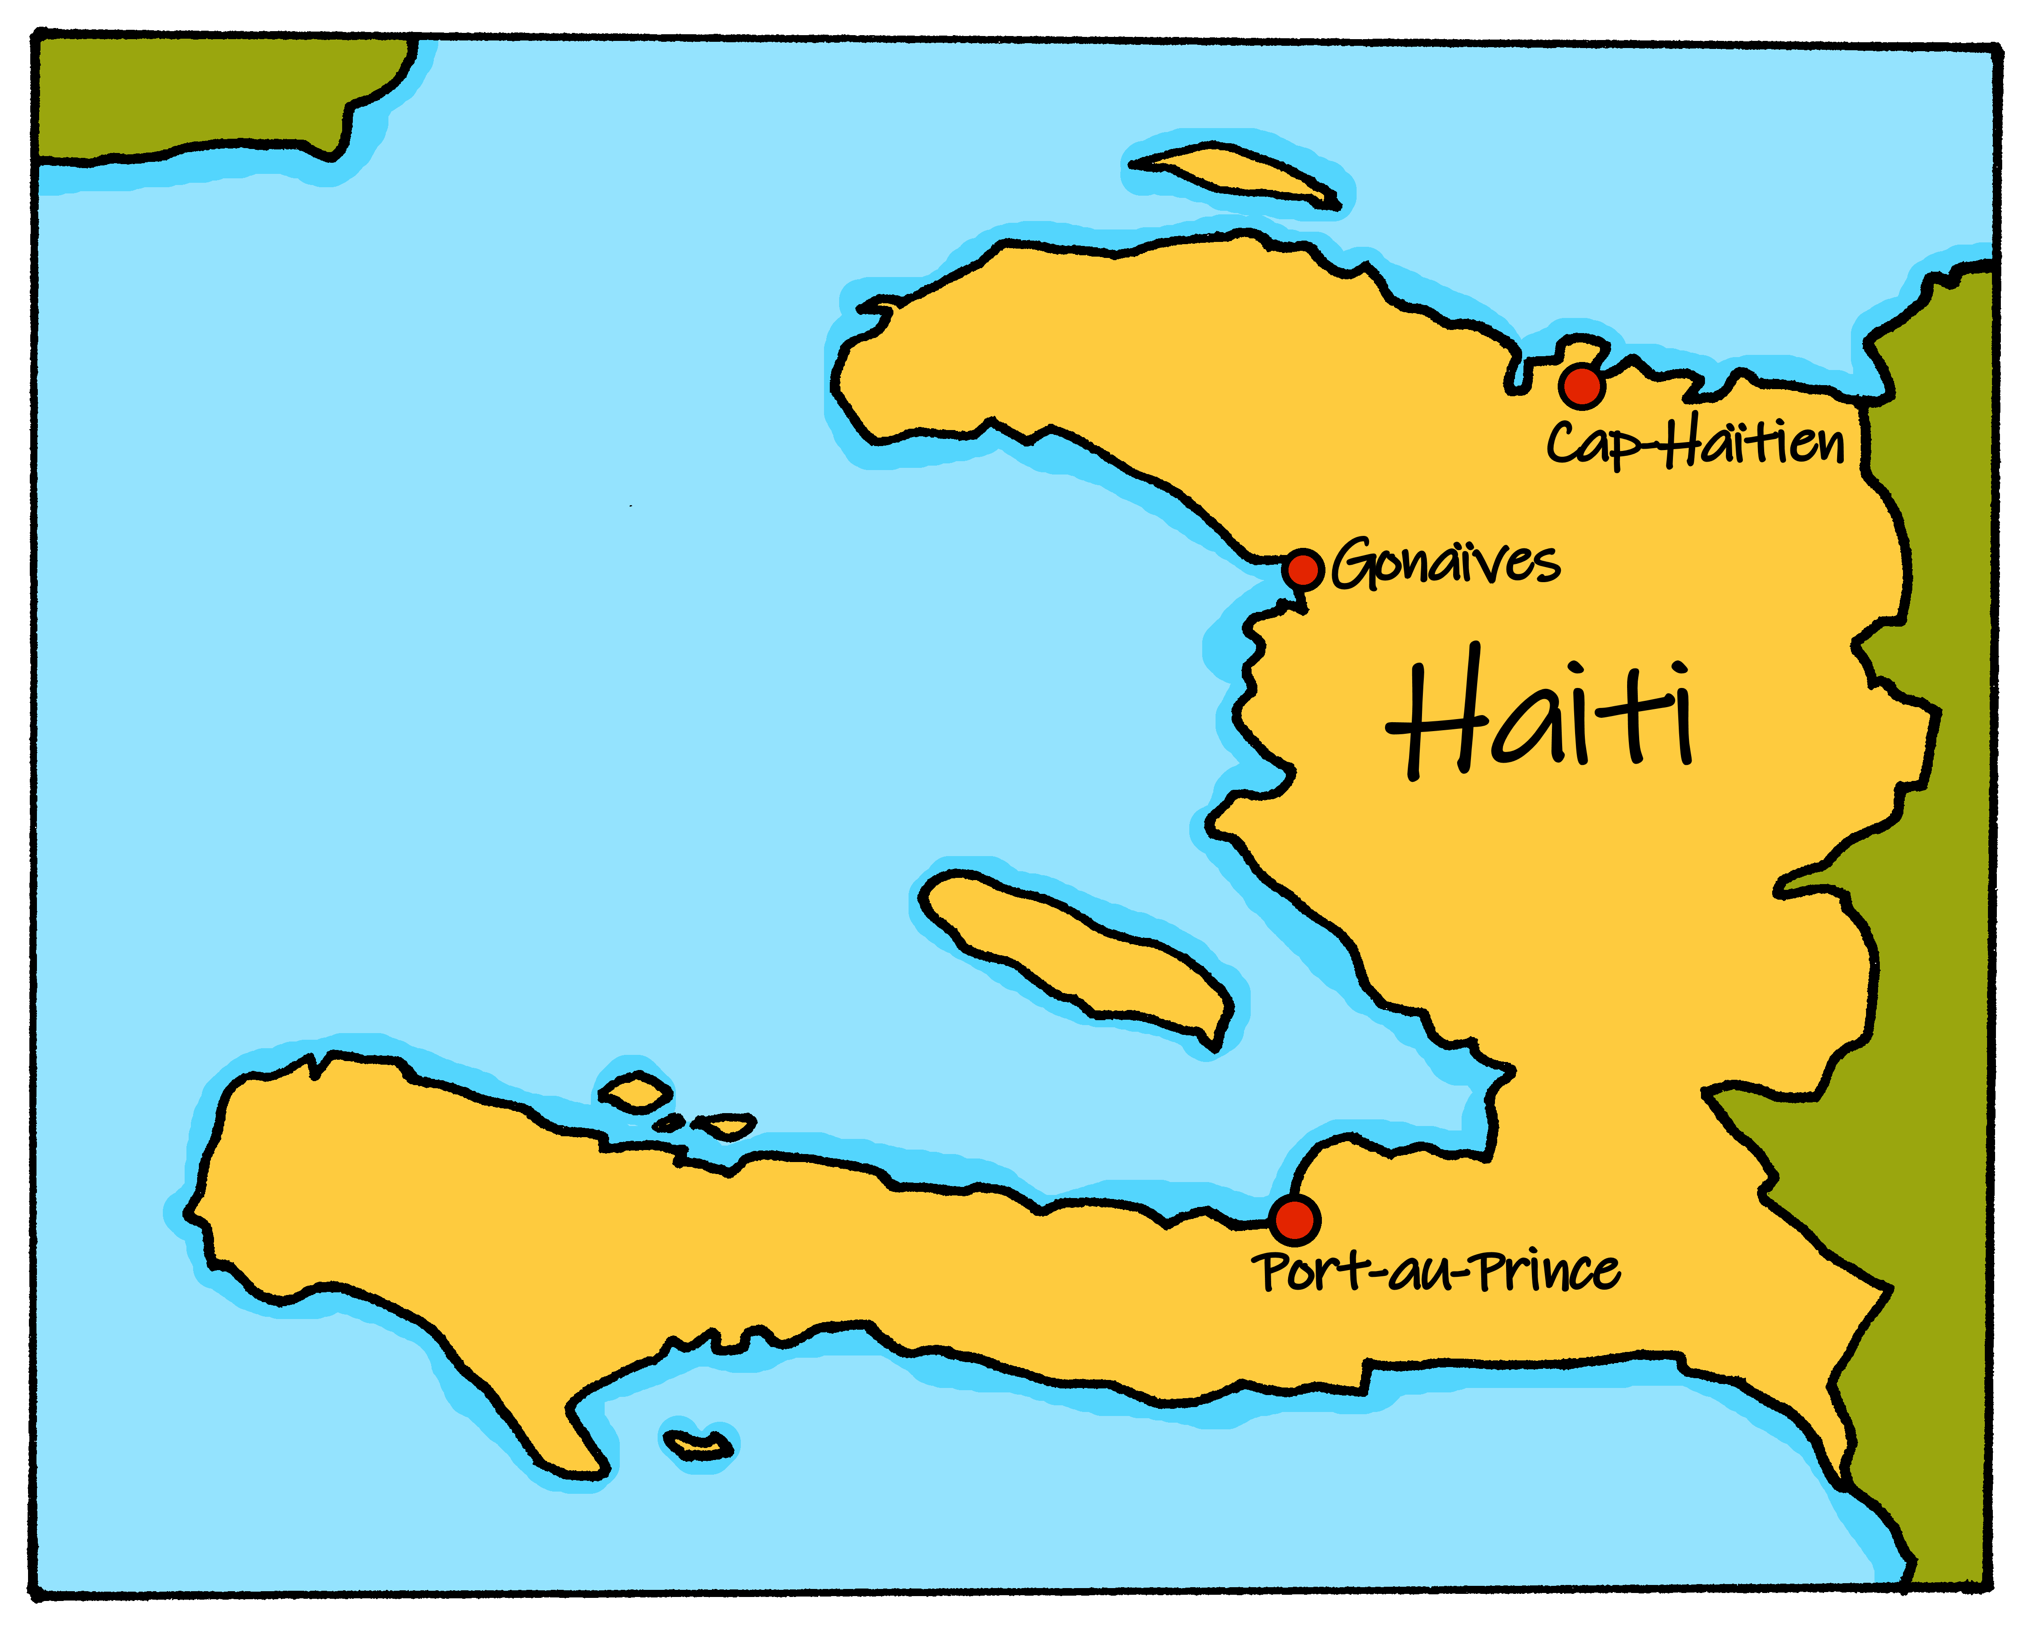
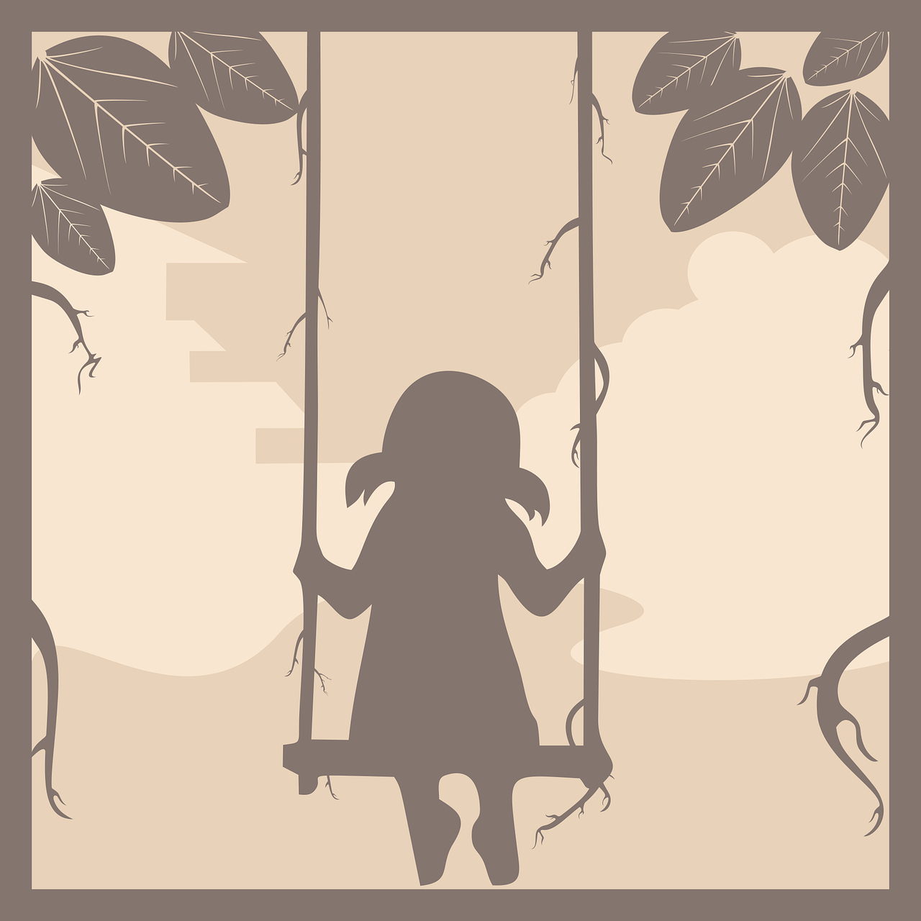
écouter
Une chanson folk: Balance Yaya
The two official languages of Haiti are French and Haitian Creole. Haitian Creole is spoken by almost everyone in Haiti, French by around half.
The vocabulary in Haitian Creole is 90% derived from French, but its grammar is more like some West African languages.
Look at the words in the first part of the song Balance Yaya.
Jezi, Marie, Joseph Rat la mange pijon mwen Rat pase,
sourit pase,
zanzolit pase.
Jesus, Mary, Joseph A rat ate my pigeon, A rat went by,
a mouse went by,
a lizard went by.
Yaya is a girl’s name. Balance means ‘swing’ or ‘balance’. This song, ‘Swing, Yaya’ is a very well-known folk song in Haiti.
Notes:
Timing: flexible
Note: the majority of this lesson will be taken up with the vocabulary and grammar parts of the assessment. However, this catchy Haitian folk song can fit in either at the end of this week’s lesson or in the follow up time this week. There are no other follow up materials this week, as we anticipate schools will be busy at this time of term. The song would make a good addition to a Christmas assembly. Note that there will be more activities in Week 14 to learn about Haitian Christmas traditions.
Aim: to enjoy a Haitian folk song; to learn more about Haiti.
Procedure: 1. Click to bring up the information about Haiti’s two official languages.
2. Click to bring up the introduction to the folk song. This part of the song is not repeated and is not obviously connected to the other part of the song. We use this part to introduce pupils to Haitian Creole. 3. Pupils will be able to pick out the obvious cognate (rat) but they may also remember ‘souris’. They will also probably be able to spot the other two animals, from similar letters (pijon/pigeon) and from the syntax (zanzolit/lizard). See if they also remember ‘mange’ from Y3/4.
4. Reinforce the point that many of words in Haitian Creole come from French, but that the spelling is usually different.
5. Click to bring up an explanation of the poem’s title, Balance Yaya.
Lovely version with live singing, minus the introduction: https://www.youtube.com/watch?v=jK7vtzClNSc This one is the best for joining in.
Alternative version, recording: https://www.youtube.com/watch?v=CpMi3H8CXz0 This version has the full song, including the introductory verse.
12

Slide 13
écouter
Une chanson folk: Balance Yaya
A Écoute.
B Puis, lis et chante.
1. Balance Yaya, Yaya o Yaya madan mango
Balance Yaya mwen fe priyè mwen, se pou Yaya
2. Balance Yaya, Yaya o Yaya madan mango
Balance Yaya, men ti poulet sa-a se pou Yaya
3. Balance Yaya, Yaya o Yaya madan mango
Balance Yaya men ti chapo pay sa se pou Yaya
4. Balance Yaya Yaya o Yaya madan mango
Balance Yaya talón kikit sa se pou Yaya
Swing,Yaya, Yaya o Yaya, Madame Mango
Swings Yaya all my prayers are for Yaya
Swing,Yaya, Yaya o Yaya, Madame Mango
Swings Yaya, the chicken is for Yaya
Swing,Yaya, Yaya o Yaya, Madame Mango
Swings Yaya, the straw hat is for Yaya
Swing,Yaya, Yaya o Yaya, Madame Mango
Swings Yaya, the high heels are for Yaya
sa – ça | se – c’est, sont pou – pour | mwen – mon, ma madan – Madame | chapo - chapeau
Notes:
Lovely version with live singing, minus the introduction: https://www.youtube.com/watch?v=jK7vtzClNSc This one is the best for joining in, though a couple of the verses have a different noun in the verse.
Alternative version, recording: https://www.youtube.com/watch?v=CpMi3H8CXz0 This version has the full song, including the introductory verse.
Procedure: 1. Pupils listen to the song reading along with the words, and the English translation. 2. Teacher can remind pupils that most Haitian Creole words are related to French, but may have different spellings.
3. See if pupils can come up with the French for the three words that are hidden. 4. Play the song again and join in.
13

Slide 14
Au revoir !
bleu
Notes:
14

Slide 15
écouter
Vouvol is from another planet. It likes earth and speaking French but often forgets word meanings, spellings and things like gender and verb forms. Help Vouvol by answering the questions in this quiz.
A For each question, put a cross (x) under the English meaning that matches what you hear.
You will hear each French word twice. Choose one correct answer only.
 | A | B | C | D
1. | 14 | 15 | 12 | 13
 | ☐ | ☐ | ☐ | ☐
2. | to look for | to find | to play | to sing
 | ☐ | ☐ | ☐ | ☐
3. | we | I | they | you (plural)
 | ☐ | ☐ | ☐ | ☐
4. | which | what | when | who
 | ☐ | ☐ | ☐ | ☐
1
2
3
4
Notes:
ANSWERS
Transcript:
1. quinze
2. chercher
3. ils
4. qui
15

Slide 16
écouter
 | A | B | C | D
5. | ready | lost | worried | heavy
 | ☐ | ☐ | ☐ | ☐
6. | naughty | funny | careful | slow
 | ☐ | ☐ | ☐ | ☐
7. | to prefer | to think | to wear | to pronounce
 | ☐ | ☐ | ☐ | ☐
 | simple | special | alone | serious
 | ☐ | ☐ | ☐ | ☐
5
6
7
8
Notes:
ANSWERS [2/2]
Transcript:
5. prêt
6. prudent
7. prononcer
8. seul
16

Slide 17
écouter
B For each question, put a cross (x) under the type of word you hear. You will hear each French word twice. Choose one correct answer only.
This word is a good example of …
 | A | B | C | D
1. | an object ☐ | a person ☐ | a month ☐ | a greeting ☐
2. | a day ☐ | a number ☐ | a question word ☐ | a part of the body ☐
3. | an animal ☐ | furniture ☐ | a person ☐ | personality ☐
4. | a part of the body ☐ | a question word ☐ | an animal ☐ | a number ☐
1
2
3
4
Notes:
ANSWERS
Transcript:
1. mars
2. quand
3. un bureau
4. le nez
17

Slide 18
écouter
B For each question, put a cross (x) under the type of word you hear. You will hear each French word twice. Choose one correct answer only.
This word is a good example of …
 | A | B | C | D
1. | a person ☐ | an object ☐ | furniture ☐ | a month ☐
2. | a day ☐ | a greeting ☐ | personality ☐ | an animal ☐
3. | a number ☐ | a part of the body ☐ | a month ☐ | a day ☐
4. | furniture ☐ | an object ☐ | a person ☐ | a greeting ☐
5
6
7
8
Notes:
ANSWERS
Transcript:
5. un ordinateur
6. dimanche
7. seize
8. la mère
18

Slide 19
lire
C Help Vouvol to translate the underlined French word(s) to complete each English sentence.
1. Il a les cheveux crépus. He has _____________ hair.
2. La professeure a une nouvelle idée. The teacher has a ________ idea.
3. Tu as un nez rond. You have a ___________ ___________ .
4. Il y a treize cahiers ? Are there ________ ___________________?
5. Décembre, c’est un beau mois. December is a ____________ ___________.
6. Elle est toujours très sérieuse. She is ____________ __________ ___________ .
7. Il a beaucoup de stylos ? Does he have _____________ pens?.
8. Il y a des crayons. There are _______ ______________ .
9. C’est une vieille fenêtre. It is an ___________ window.
10. Monsieur Dupont est rarement strict. Mr Pau is __________ ________________ .
frizzy
new
round
nose
13
exercise books
beautiful
month
always
very
serious
lots of
some
pencils
old
rarely
strict
Notes:
ANSWERS
19

Slide 20
écrire
D Translate the underlined English words to complete the French sentence.
1. He has an oval face. Il a _____ __________ ovale. (write two words)
2. It is a small space. C’est ___ petit _____________. (write two words)
3. The doctor (f) is good. La médecin est ____________. (write one word)
4. He has a green bedroom. Il a une __________ _______. (write two words)
5. Madame Pau is brave. Mrs Pau is _______________. (write one word)
6. I’m doing a difficult task. Je fais une ________ ___________. (write two words)
7. The doctor (m) is old. Le médecin est ___________. (write one word)
8. He has blue eyes. . Il a _____ yeux __________. (write two words)
9. Today it’s Monday. __________, c’est____________. (write two words)
10. No, he speaks French! ____, il parle ____________ ! (write two words)
un
visage
un
espace
bon
chambre
vert
courageuse
tâche
difficile
vieux
les
bleus
Aujourd’hui
lundi
Non
français
Notes:
ANSWERS
20

Slide 21
lire
Grammar
A Put a (X) next to the person the sentence is about.
1 | ☐ I ☐ you _{[singular]} ☐ s/he ☐ we ☐ you _{[plural]} ☐ they | …est drôle. |  | 4 | ☐ I ☐ you _{[singular]} ☐ s/he ☐ we ☐ you _{[plural]} ☐ they | …avons une chaise.
2 | ☐ I ☐ you _{[singular]} ☐ s/he ☐ we ☐ you _{[plural]} ☐ they | …sont inquiètes. |  | 5 | ☐ I ☐ you _{[singular]} ☐ s/he ☐ we ☐ you _{[plural]} ☐ they | … êtes ensemble.
3 | ☐ I ☐ you _{[singular]} ☐ s/he ☐ we ☐ you _{[plural]} ☐ they | …suis triste. |  | 6 | ☐ I ☐ you _{[singular]} ☐ s/he ☐ we ☐ you _{[plural]} ☐ they | …as un exercice.
Notes:
ANSWERS
21

Slide 22
lire
Grammar
B Put a (X) next to the correct start of each sentence.
1. | ☐ Ils … ☐ Elles … | sont heureuses.
2. | ☐ Ils … ☐ Elles … | sont perdus.
C Write the words in each box in the correct order.
1. | livre amusant un | Correct order:_________________________________________
2. | belles les tortues | Correct order:_________________________________________
un livre amusant
les belles tortues
Notes:
ANSWERS
22

Slide 23
lire
Grammar
D Write the words in each box in the correct order to make a question.
1. | a quoi il | Correct order:_________________________________________
2. | elle qui est | Correct order:_________________________________________
il a quoi ?
Elle est qui ?
écrire
E Write the French for the English given in brackets. Use the clues to help you.
1. | Tu ___________ là. (are) | to be = être
2. | J’ ___________ un chapeau. (have) | to have = avoir
3. | Elles ___________ un problème. (have) | to have = avoir
4. | Nous _______________ le 11 juillet. | to be = être
5. | Elle _________ un cheval. | to have = avoir
6. | Vous __________ des chats? | to have = avoir
Clues
es
ai
ont
sommes
a
avez
Notes:
ANSWERS
23

Slide 24
écrire
Grammar
Grammar
F Write the French article ‘the’. The gender (and number) of the noun is provided.
le
1. | _____ mur (m) gris.
2. | _____ chiens (mpl) noirs.
3. | _____ tête (f) ovale.
les
la
G Write the French article ‘a’ or ‘some’. The gender (and number) of the noun is provided.
une
1. | Il a _______ maison. (f)
2. | Il y a ________ fraises. (fpl)
3. | C’est ________ village. (m)
des
un
H Write ‘quel’ or ‘quelle’. The gender of the noun is provided.
quelle
1. | Vous êtes en ____________ saison (f) ?
2. | C’est __________ jour (m) ?
quel
Notes:
ANSWERS
24

