Slide 1
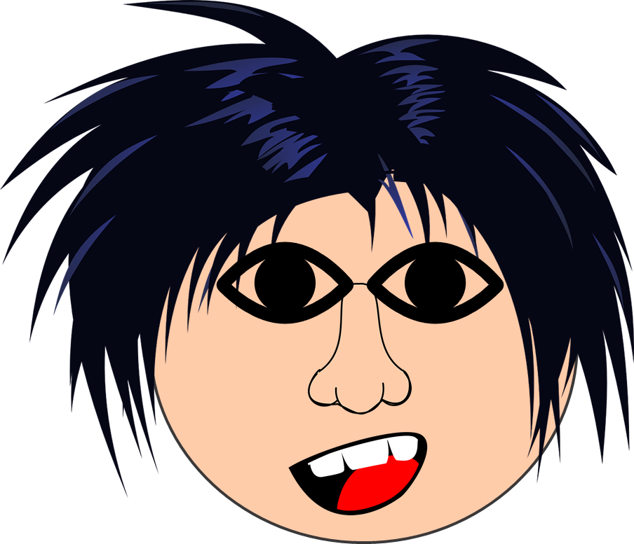
Saying what I and others have
bleu
physical description
singular and plural adjective agreement
SSC [ch]
Term 1 Week 12
Notes:
Artwork by Steve Clarke. Pronoun pictures from NCELP (www.ncelp.org). All additional pictures selected from Pixabay and are available under a Creative Commons license, no
attribution required.
Phonics: revisit [ch] - dimanche [1235] marché [280] chercher [336] chat [3138] bouche [1838]
Vocabulary (new words in bold): bouche [1938] cheveu [2296] médecin [827] nez [2661] œil, yeux [474] visage [1292] bleu [1216] blond [4585] brun [>5000] court [545] crépu [>5000] gris [2769] long [202] marron [>5000] noir [572] ovale >5000] rond [2268] roux [-] vert [1060]
Revisit 1: as [8] a [8] donner [46] organiser [791] parler [106] poser [218] préparer [368] trouver [83] utiliser [345] livre [358] question [144] phrase [2074] problème [188] sac [2343] réponse [456] solution [608] court [545] simple [212] spécial [726] vrai [292] faux [555] des [de-2] calme [1731] difficile [296] facile [822] important [215] indépendant [854] intéressant [1244] rapide [672] utile [1003]
Revisit 2: anniversaire [2043] mois [179] janvier [939] février [1139] mars [868] avril [1022] mai [943] juin [931] juillet [1326] aout [1445] septembre [944] octobre [826] novembre [982] décembre [891] quand [119] treize [3285] quatorze [3359] quinze [1472] seize [3285] dix-sept [3812] dix-huit [3592] dix-neuf [4851] vingt [1273] vingt-et-un [1273/6/3] vingt-deux, vingt-trois vingt-quatre vingt-cinq vingt-six vingt-sept vingt-huit vingt-neuf trente [1646]
Londsale, D., & Le Bras, Y. (2009). A Frequency Dictionary of French: Core vocabulary for learners London: Routledge.
The frequency rankings for words that occur in this PowerPoint which have been previously introduced in these resources are given in the SOW and in the resources that first
introduced and formally re-visited those words.
For any other words that occur incidentally in this PowerPoint, frequency rankings will be provided in the notes field wherever possible.
1

Slide 2
[ch]
prononcer
chercher
[un] is nasal before a consonant and at the end of words.
[to look for]
Notes:
Timing: 2 minutes
Aim: to recap SSC [ch].
Procedure:
Click to bring up the SSC [ch]. Repeat the SSC [ch] and the source word chercher with the class.
Click to bring up the English translation and picture.
Pupils to practise saying the SSC and source word several times.

Slide 3
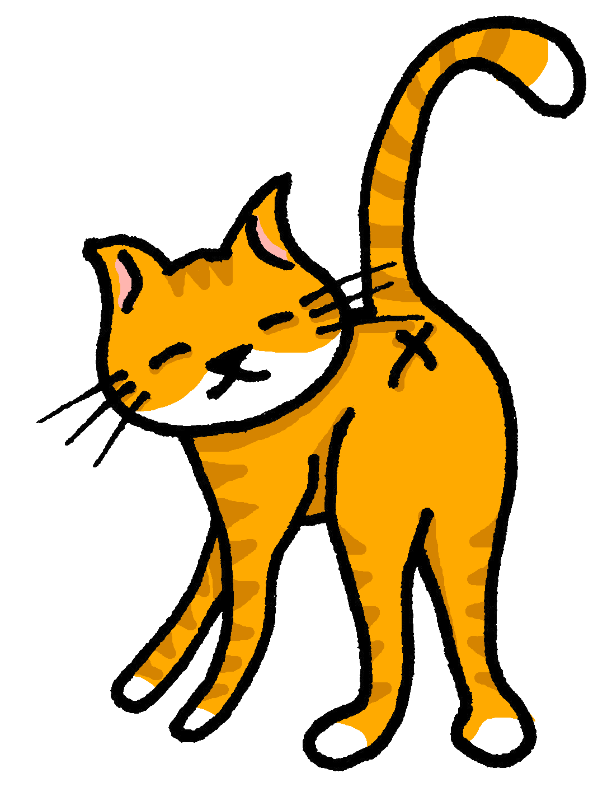
[ch]
chercher
prononcer
bouche
chat
marché
dimanche
[to look for]
Sun
Notes:
Timing: 2 minutes
Aim: to practise the pronunciation of SSC [ch] in four cluster words.
Procedure:
Click to bring up the SSC [ch]. Repeat the SSC [ch] with the class and the source word chercher.
Click to bring up the English translation and picture. Do the gesture, if using.
Click to bring up each cluster word in turn: bouche, chat, marché, dimanche. The pictures appear after the words to give a further opportunity for word repetition.
Suggested gesture: The 3rd video (the woman)’s version is the one I like the best for search, look for: https://www.signbsl.com/sign/search

Slide 4
écouter
Écoute. L’intrus*, c’est quoi ?
L’intrus – odd one out!
Écris 1 – 5 et A, B ou C.
 | A | B | C
 | cinq | chien | chat
 | chemise | cheval | facile
 | médecin* | chasser* | chose
 | méchant | difficile | dimanche
 | chercher | prononcer | chanson
1
2
3
4
5
le/la médecin – doctor | chaser – to chase, chasing
Notes:
Timing: 5 minutes
Aim: to practise aural distinction between SSC [ch] and soft [c/ç].
Procedure
Pupils listen to the sets of three words and identify the odd one out (i.e., two words may have [ch] and only one has soft [c/ç].
Click to check.
Note: teachers may want to listen and check each item or complete all five items before checking. This will depend on the class.
Transcript:
cinq – chien – chat chemise – cheval – facile
médecin – chasser – chose
méchant – difficile – dimanche
chercher – prononcer – chanson
4

Slide 5
Definite articles: singular & plural
This is grammatical, not biological gender! A house (une maison) is not female, it is a feminine noun.
Or use l’ before a noun that begins with a vowel. E.g. l’œil (eye).
[the]
Remember! In French, things, as well as people and animals, are either masculine or feminine. We say that they have gender.
To say the before a singular noun, you use ‘le’ (m) or ‘la’ (f).
Note that the plural of eye is irregular: l’œil (eye) → les yeux.
To say the before all plural nouns (more than one), use ‘les’.
Masculine
Feminine
___ professeure
___ professeures
the (female) teacher
les
the (female) teachers
le
la
___ cheveux
les
___ cheveu
the hair
the hair(s)
la
the phrase
___ phrases
the phrases
___ phrase
___ chats
les
___ chat
les
le
the cats
the cat
les
l’
___ œil
___ yeux
the eye
___ amie
les
l’
___ amies
the (female) friend
the eyes
the (female) friends
Notes:
Timing: 2 minutes
Aim: to recap pupil knowledge of definite articles.
Procedure:
Click through the animations to present the information.
Elicit English meanings of French examples.
Ensure meanings are understood.

Slide 6
vocabulaire
C’est le, la ou les ? [1/9]
mots
le
la
les
yeux
Comment dit-on en anglais ?
[the] eyes
[the] eye
Notes:
Timing: 4 minutes
Aim: to revisit previously taught vocabulary and to introduce three new words.
Procedure: 1. Click to start the timer.
2. Pupils try in pairs to name the three words in French before the timer runs out.
3. Elicit words from pupils, then click to reveal the full written words.
4. If desired, click on the picture to hear the words pronounced.
5. Continue for the next two slides.
Transcript:
une chambre un ordinateur
une idée
6

Slide 7
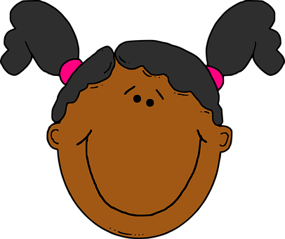
vocabulaire
C’est le, la ou les ? [2/9]
mots
le
la
les
visage
Comment dit-on en anglais ?
[the] faces
[the] face

Slide 8
vocabulaire
C’est le, la ou les ? [3/9]
mots
le
la
les
cheveux
Comment dit-on en anglais ?
[the] (single) hair
[the] hair(s)

Slide 9
vocabulaire
C’est le, la ou les ? [4/9]
mots
le
la
les
médecin
[the] female doctor
Comment dit-on en anglais ?
[the] male doctor

Slide 10
vocabulaire
C’est le, la ou les ? [5/9]
mots
le
la
les
professeurs
[the] male teacher
Comment dit-on en anglais ?
[the] male teachers

Slide 11
vocabulaire
C’est le, la ou les ? [6/9]
mots
le
la
les
nez
Comment dit-on en anglais ?
[the] noses
[the] nose

Slide 12
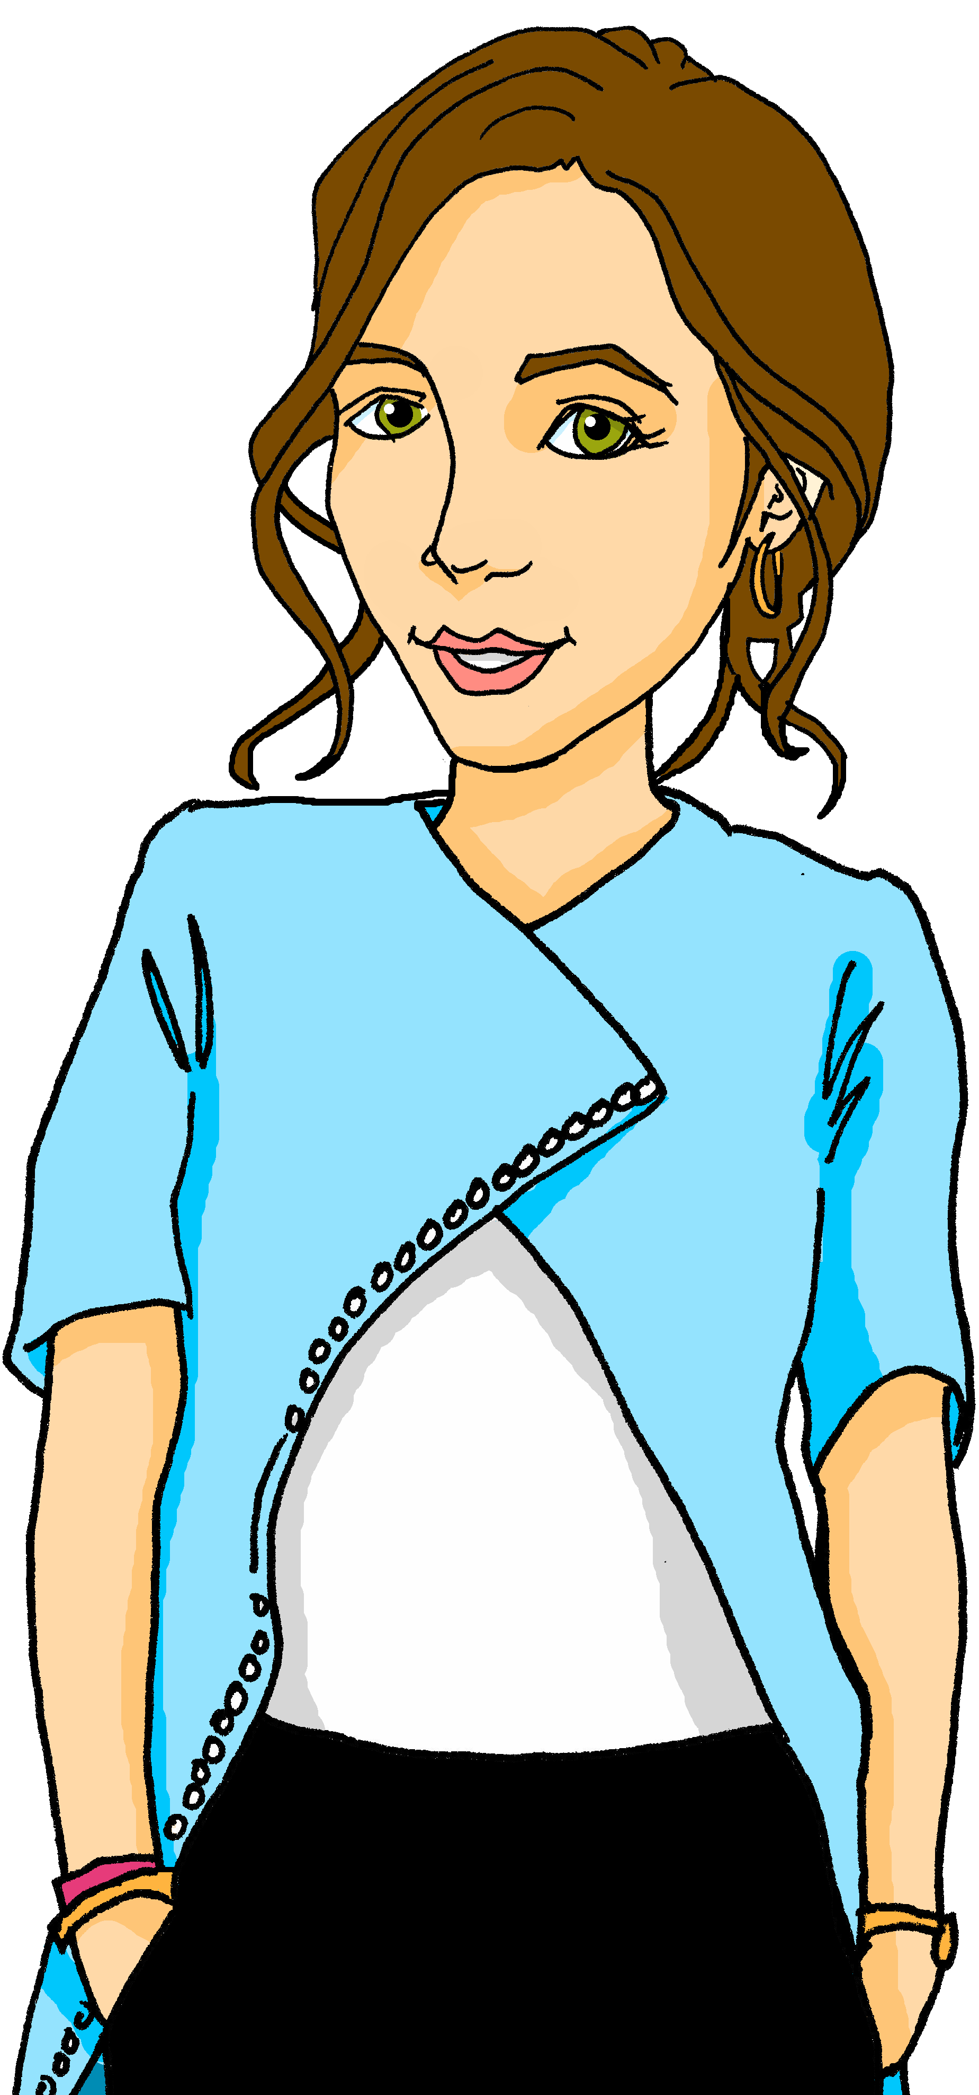
vocabulaire
C’est le, la ou les ? [7/9]
mots
le
la
les
professeure
[the] female teachers
Comment dit-on en anglais ?
[the] female teacher

Slide 13
vocabulaire
C’est le, la ou les ? [8/9]
mots
le
la
les
visages
Comment dit-on en anglais ?
[the] faces
[the] face

Slide 14
vocabulaire
C’est le, la ou les ? [9/9]
mots
le
la
les
médecin
[the] male doctors
Comment dit-on en anglais ?
[the] male doctor

Slide 15
écouter
Jean-Michel décrit des personnes mais il y a un problème avec le son*.
Écoute.
C’est ‘le’, ‘la’ ou ‘les’ ?
le son – the sound
Lis.
Jean-Michel décrit quoi ?
 | le | les | visage | yeux
 | le | les | cheveux | nez
 | le | les | yeux | visage
 | le | les | cheveux | visage
 | les | le | visage | yeux
 | les | la | bouche | yeux
1
1
2
2
3
3
4
4
5
5
6
6
Notes:
Timing: 5 minutes
Aim: to practise aural recognition of definite articles and their connection to nouns of the appropriate gender/number.
Procedure
Pupils listen to the short sentences and decide which noun they are describing, based on the form of the article.
Click to check.
Click again to bring up a 2nd set of audio buttons. Pupils listen again – this time to check their noun selection.
Click to reveal answers.
Note that pupils will listen and read the full versions of these sentences in a subsequent activity.
Transcript 1:
Il a le [visage rond]. Il a les [cheveux longs]. Elle a les [yeux ronds]. Elle a le [visage vert] Elle a les [yeux gris]. Il a la [bouche bleue].
Transcript 2:
Il a le visage [rond]. Il a les cheveux [longs]. Elle a les yeux [ronds]. Elle a le visage [vert] Elle a les yeux [gris]. Il a la bouche [bleue].
15

Slide 16
Adjectives following the noun
Note: in French we often use the definite article ‘the’ in these descriptions. In English, we leave it out or use ‘a’, e.g., has a round face.
We know that many adjectives follow the noun.
Examples:
Il a le visage rond.
Il a le visage ovale.
When there are two adjectives after the noun, join them with ‘et’ (and).
He has a round face.
He has an oval face.
Il a les yeux ronds.
Il a les cheveux longs et bruns.
He has round eyes.
He has long, brown hair.
⚠ Remember: Adjectives agree (match) in gender and number with the noun they are describing.
Notes:
Timing: 2 minutes
Aim: to recap pupil knowledge of postnominal adjectives, singular and plural.
Procedure:
Click through the animations to present the information.
Elicit English meanings of French examples.
Ensure meanings are understood.

Slide 17
écouter
Le son* est bon maintenant. ☺
le son – the sound
Écoute. Comment sont les personnes ?
 | le | les | visage | yeux | has a round face
 | le | les | cheveux | nez | has long hair
 | le | les | yeux | visage | has round eyes
 | le | les | cheveux | visage | has a green face
 | les | le | visage | yeux | has grey eyes
 | les | la | bouche | yeux | has a blue mouth
1
_____
2
_____
3
_____
4
_____
5
_____
6
_____
Notes:
Timing: 5 minutes
Aim: to practise aural comprehension of descriptive sentences with definite articles and postnominal adjectives.
Procedure:
Do number 1 as an example. The previous answers are fixed in place to remind pupils that they have listened to part of this information before. Now they listen to the whole sentence and complete the sentences in English. The gapped sentences provide support for comprehension and make the different syntax (word order) visually more concrete.
Click to correct the example.
Complete 2-6. Elicit answers from pupils and click to reveal written answers.
Transcript 3:
Il a le visage rond. Il a les cheveux longs. Elle a les yeux ronds. Elle a le visage vert Elle a les yeux gris. Il a la bouche bleue.

Slide 18
vocabulaire
Ils ont les cheveux comment ?
Brun is for hair. For brown eyes, use marron, which doesn’t change for plural.
mots
noirs
blonds
bruns
roux
[black]
[blond]
[brown]
[ginger, red]
courts
crépus
longs
[long]
[short]
[frizzy]
Notes:
Timing: 2 minutes
Aim: presentation of three new (crépus, roux, longs) and four previously taught vocabulary items.
Procedure:
Click to reveal the French word and picture. Say the word with pupils.
Elicit the English and click to reveal the written English meaning.
Click to animate the French word and picture again and elicit pupil repetition of the word (without first hearing the teacher voice, so that pupils connect the written form with the pronunciation more independently).
Repeat steps 1-3 for the remaining four items.

Slide 19
lire
Lis les descriptions et complète les phrases.
Écris 1-7 et la phrase.
1 | Jean-Michel a | les | visage | cheveux | crépus | rond
2 | La professeure a | les | yeux | nez | verts | vert
3 | Le médecin a | le | visage | yeux | rond | ronds
4 | Claudine a | la | cheveux | bouche | roux | rouge
5 | Adèle a | les | visage | cheveux | ovale | blonds
6 | Léa a | les | cheveu | yeux | noir | noirs
7 | Pierre a | les | cheveux | nez | courts | long
Notes:
Timing: 4 minutes (the 2nd (comprehension) part of this task is in the follow ups)
Aim: to practise connection of the definitive article with an appropriate noun and correct adjectival form; to practise comprehension this week’s vocabulary in sentence form.
Procedure: 1. Pupils select the correct noun based on the definite article.
2. They then select the correct form of the adjective.
3. Click to correct answers.
4. If desired, click on the green buttons to hear the answers, too. Note: the language in this task will be the focus of a comprehension task in the follow ups.

Slide 20
Au revoir !
bleu
Notes:
20

