Slide 1
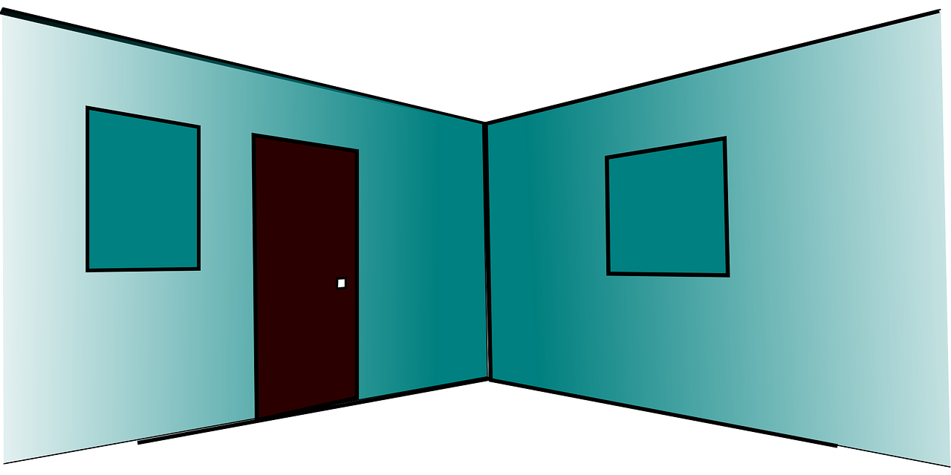
Saying what I and others have
un espace chez nous
bleu
Follow ups 1-5
Term 1 Week 11
Notes:
Artwork by Steve Clarke. Pronoun pictures from NCELP (www.ncelp.org). All additional pictures selected from Pixabay and are available under a Creative Commons license, no
attribution required.
Phonics: revisit liaison
Vocabulary (new words in bold): ont [8] ils [13] elles [38] bureau [273] chaise [3419] chose [125] espace [870] fenêtre [1601] jardin [2284] idée [239] lampe [4699] ordinateur [2201] salle [812] beau belle [393] bon bonne [94] mauvais [274] nouveau nouvelle [52] vieux vielle [671] de² [2] beaucoup de [150] chez [206]
Revisit 1: avoir [8] j’ai [8] il a [8] elle a [8] un [3] une [3] animal [1002] chambre [633] livre [358] maison [325] professeur/ professeure [110] problème [188] tâche [887]amusant [4695] différent [350] idéal [1429] important [215] indépendant [854] lent [2572] lourd [1026] parfait [1600] propre1 [237] sage [2643] strict [1859] très [66]
Revisit 2: sommes [5] nous [31] absent [2016] amusant [4695] calme [1731] content [1841] différent [350] difficile [296] drôle [2166] fort [107] grand [59] jeune [152] lent [2572] malade [1066] méchant [3184] intelligent [2509] indépendant [954] important [215] petit [138] présent [216] prudent [1529] rapide [672] strict [1859] sage [2643] triste [1843]
Londsale, D., & Le Bras, Y. (2009). A Frequency Dictionary of French: Core vocabulary for learners London: Routledge.
The frequency rankings for words that occur in this PowerPoint which have been previously introduced in these resources are given in the SOW and in the resources that first
introduced and formally re-visited those words.
For any other words that occur incidentally in this PowerPoint, frequency rankings will be provided in the notes field wherever possible.

Slide 2
Adjectives before the noun
Remember, some adjectives go before the noun:
These are adjectives that refer to beauty, age, good/bad or size:
B
un beau jardin a beautiful garden
une belle chambre a beautiful bedroom
A
un vieux professeur an old teacher
une jeune enfant a young (female) child
G
une bonne idée a good idea
une mauvaise question a bad question
S
un grand bureau a big desk
une petite maison a small house
Notes:
Use this recap before Follow up 1 Timing: 1 minute
Aim: to recap the adjectives that go before the noun.
Procedure: 1. Click to present the information.
2. Elicit the English meanings.

Slide 3
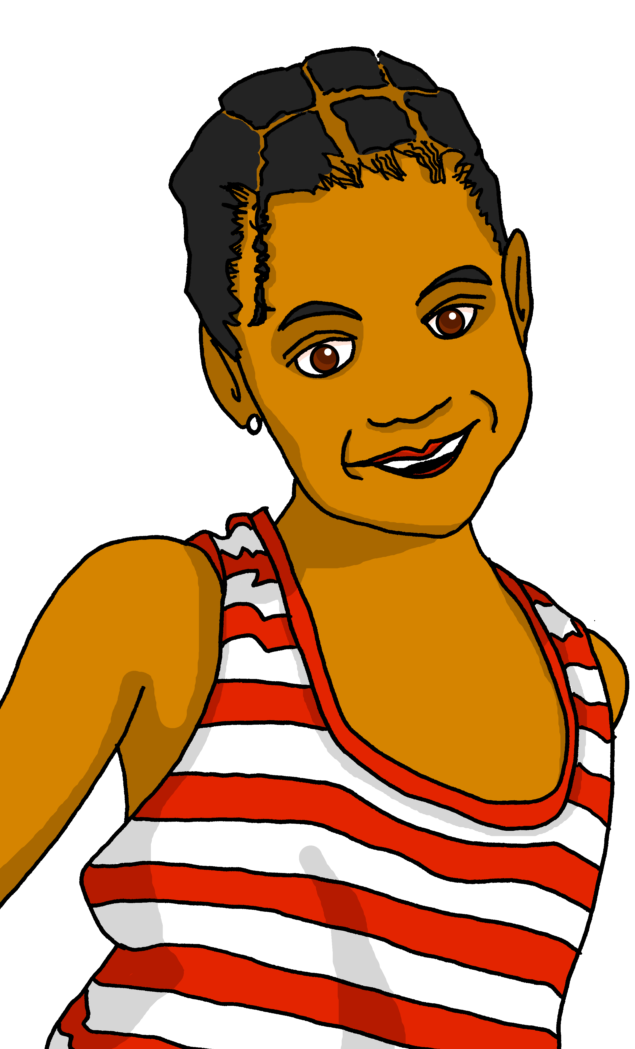
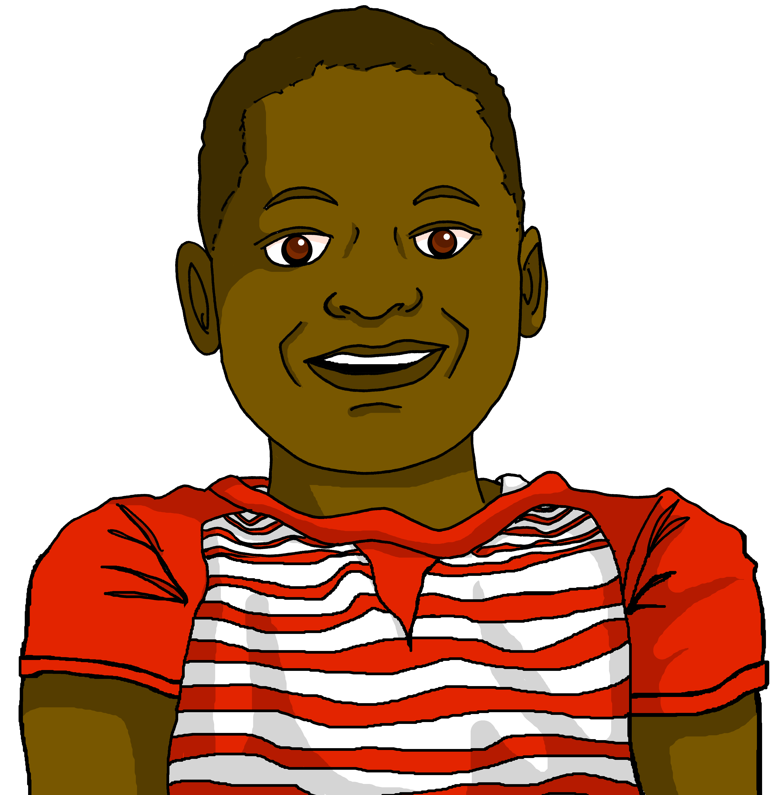
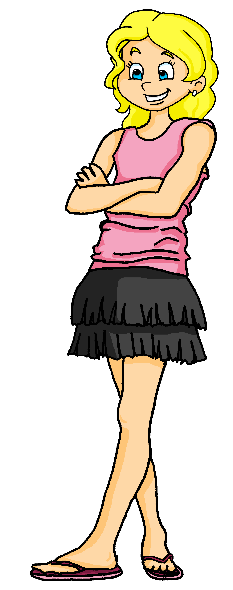
Follow up 1:
Remember!
You pronounce the ‘t’ here because it is followed by a vowel.
Adèle parle à Jean-Michel et Clémentine. Elle dit quoi ?
prononcer
C’est une question importante .
[importante]
C’est une bonne solution .
[bonne]
C’est une mauvaise idée .
[mauvaise]
C’est un excellent ordinateur .
[excellent]
C’est un chien méchant .
[méchant]
C’est un professeur drôle .
[drôle]
C’est une tâche difficile .
[difficile]
C’est un grand espace .
[grand]
Notes:
Timing: 2 minutes
Aim: to practise written recognition of correct adjective placement; to practise liaison with ‘t’.
Procedure:
Clarify the context; Adèle is talking to her cousins Jean-Michel and Clémentine.
Explain that pupils need to say the sentence putting the adjective in the correct place.
Give pupils 30 seconds to talk to their partner about the first sentence, deciding where the adjective should go.
Elicit their responses. Click to reveal the correct word order and click on the speech bubble to hear the sentence.
5. Repeat steps 3-4 with the remaining sentences. Note: teachers will decide whether to give feedback after each sentence or after pupils have had time to work out and practise all the sentences.

Slide 4
Follow up 2:
Adèle et Pierre sont un peu tristes.
Écris deux listes en anglais.
Lis les phrases. Qui a quoi ?
☹
Ils ont un joli espace.
lire
Nous avons un vieux bureau.
Nous avons une mauvaise chaise.
we have | they have
an old desk | a pretty space
a bad chair | a beautiful chair
a small window | a good desk
an old lamp
lots of things
a bad space
Ils ont une belle chaise.
Ils ont un bon bureau.
Nous avons une petite fenêtre.
Nous avons une vielle lampe.
Nous avons beaucoup de choses !
Mais nous avons un mauvais espace.
Notes:
Timing: 5 minutes
Aim: to practise written recognition of 2nd and 3rd person plural forms of avoir and several nouns and prenominal adjectives.
Procedure:
Read the title and instructions and ensure the task scenario is understood. Adèle and Pierre think they don’t have enough space at home, compared to their cousins.
Complete the first one as an example with the class.
Pupils decide from the form of avoir if Adèle is saying ‘we’ or ‘they’ have.
They then write the noun+adjective in English in the correct column (of a table that they draw in their books).
Click to correct.
Pupils complete items 2 – 9. Click to provide feedback on each item.
If desired, click on each sentence to hear it pronounced.

Slide 5
Follow up 3:
Parle en français.
parler
Personne A
1) Ils ont un petit…
……………………………….
Personne B
chambre | espace

They have a small space.
Ils ont un petit…
Ils ont un petit espace.
B
A
Notes:
Timing: 5 minutes
Aim: to practise aural recognition of irregular prenominal adjectives and their connection with correct nouns; to practise aural comprehension of previously taught nouns; to practise clear pronunciation when reading aloud.
Procedure: 1. Use this slide to model the task.
2. Pupil A reads his/her sentence beginning aloud.
3. Pupil B selects the correct noun to finish the sentence, based on the adjective form that s/he hears.
4. Pupil A writes down the full sentence meaning in English.
5. Then they will swap roles and repeat the task. 6. See next slides for answers, and handouts at the end of the presentation.

Slide 6
parler
Round 1
Personne A
1) Ils ont un beau…
……………………………….
2) Nous avons une vieille…
……………………………….
3) Nous avons un bon …
……………………………….
4) Ils ont un nouveau …
……………………………….
5) Ils ont une grande…
………………………………..
Personne B
parler
bureau | table
lampe | livre
chambre | espace
chaise | ordinateur
jardin | fenêtre
They have a beautiful desk
We have an old lamp.
We have a good space
They have a new computer
They have a big window
Notes:
ANSWERS ROUND 1
6

Slide 7
parler
Round 2
Personne B
1) Nous avons une belle…
……………………………….
2) Ils ont un beau…
……………………………….
3) Ils ont une nouvelle…
……………………………….
4) Ils ont une mauvaise…
……………………………….
5) Nous avons un vieux…
………………………………..
Personne A
jardin | maison
parc | chambre
animal | lampe
fenêtre | ordinateur
table | bureau
parler
We have a beautiful house
They have beautiful parc.
They have a new lamp
They have a bad window
We have an old desk
Notes:
ANSWERS ROUND 2
7

Slide 8
Follow up 4:

Écris cinq phrases.
1. Nous avons un petit espace.
1. N_____ a_________ u__ p_______ e________.
écrire
We have a small space.
2. Ils ont une question importante.
2. I_____ o_________ u__ q_______ i________.
They (m, mixed) have an important question.
3. Elles ont une bonne idée.
3. E_____ o_________ u__ b_______ i________.
They (f) have a good idea.
4. Nous avons un problème difficile.
4. N_____ a_________ u__ p_______ d________.
We have a difficult problem.
5. E_____ o_________ u__ n_______ s________.
5. Elles ont une nouvelle solution.
They (f) have a new solution.
Notes:
Timing: 10 minutes (or 5 minutes for 3 sentences)
Aim: to practise written production of this week’s new language.
Procedure:
Click for written versions of the sentences.
Click on the answer sentences to hear them.

Slide 9
vocabulaire
Follow up 5 - Écris en français : Can you get at least 15 points?
mots
 | well-behaved | sad | ill, sick
 | strong | young | we are
 | slow (m) | clean | very
 | old (m) | old (f) | at the house of
 | bad (m) | new (m) | new (f)
 | beautiful (f) | good (m) | good (f)
 | they (f) have | space | beautiful (m)
sage
triste
malade
x3
fort
jeune
nous sommes
lent
propre
très
x2
vieux
vieille
chez
mauvais
nouveau
nouvelle
belle
bon
bonne
x1
elles ont
l’espace
beau
Notes:
Timing: 5-10 minutes
Aim: to practise written production of vocabulary from this week and two revisited weeks.
Procedure: 1. Give pupils a blank grid. They fill in the French meanings of any of the words they know, trying to reach 15 points in total. 2. Remind pupils that adjectives can refer to male or female persons and they should note this in their translations. E.g. pleased (f), short (m).
Note: The most recently learnt and practised words are pink, words from revisit 1 are green and those from revisit 2 are blue, thus more points are awarded for them, to recognise that memories fade and more effort (heavy lifting!) is needed to retrieve them.
9

Slide 10
parler
Round 1
Round 2
Personne A
1) Ils ont un beau…
……………………………….
2) Nous avons une vieille…
……………………………….
3) Nous avons un bon …
……………………………….
4) Ils ont un nouveau …
……………………………….
5) Ils ont une grande…
………………………………..
Personne A
jardin | maison
parc | chambre
animal | lampe
fenêtre | ordinateur
table | bureau
parler





Notes:
Handout A
10

Slide 11
parler
Round 1
Round 2
Personne B
Personne B
1) Nous avons une belle…
……………………………….
2) Ils ont un beau…
……………………………….
3) Ils ont une nouvelle…
……………………………….
4) Ils ont une mauvaise…
……………………………….
5) Nous avons un vieux…
………………………………..
parler
bureau | table
lampe | livre
chambre | espace
chaise | ordinateur
jardin | fenêtre





Notes:
Handout B
11

Slide 12
vocabulaire
Follow up 5 - Écris en français : Can you get at least 15 points?
mots
 | well-behaved | sad | ill, sick
 | strong | young | we are
 | slow (m) | clean | very
 | old (m) | old (f) | at the house of
 | bad (m) | new (m) | new (f)
 | beautiful (f) | good (m) | good (f)
 | they (f) have | space | beautiful (m)
x3
x2
Notes:
HANDOUT
12

