Slide 1
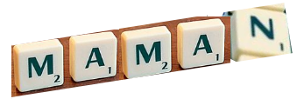
Describing things and people
La fête des mères
N
rouge
Il / elle meaning ‘it’
Saying ‘my’ and ‘your’
soft ç|c
Notes:
Artwork by Steve Clarke. Pronoun pictures from NCELP (www.ncelp.org). All additional pictures selected from Pixabay and are
available under a Creative Commons license, no attribution required.
The AUDIO version of the lesson material includes additional audio for the new language presented (phonics, vocabulary) and audio for the instructions
on the slide.
In addition, it includes VIDEO clips of the phonics and the phonics’ source words. Pupils can be encouraged to look at the shape of the mouth/lips on
slides where these appear, and try to copy it/them.
Phonics: [SFe] [ç] (and soft -c) ici [167] français [251] garçon [1599] cinéma [1623] décider [165]
Vocabulary (new words in bold): professeur, professeure [110] sympathique [4164] comment [234]
Revisit 1: chose [125] des [2] combien [800]
Revisit 2: donner [46] préparer [368] trouver [83] famille [172] frère [1043] mère [645] père [559] sœur [1558] le [1] la [1] à (meaning ‘to’) [4]
Londsale, D., & Le Bras, Y. (2009). A Frequency Dictionary of French: Core vocabulary for learners London: Routledge.
The frequency rankings for words that occur in this PowerPoint which have been previously introduced in these resources are given in the SOW and in the resources that first introduced and formally re-visited those words. For any other words that occur incidentally in this PowerPoint, frequency rankings will be provided in the notes field wherever possible.
1

Slide 2
[ç/c] soft ‘c’
prononcer
[here]
ici
Notes:
Timing: 1 minute
Aim: To consolidate SSC [ç/c]
Procedure: 1. Present the letter(s) and say the [ç/c] sound first, on its own. Pupils repeat it with you. 2. Bring up the word ”ici” on its own, say it, pupils repeat it, so that they have the opportunity to focus all of their attention on the connection between the written word and its sound.
3. A possible gesture for this would be to point to the spot on which one is standing / indicate the room in which the lesson is taking place with a sweeping motion of one’s index finger. 4. Roll back the animations and work through 1-3 again, but this time, dropping your voice completely to listen carefully to the pupils saying the [ç/c] sound, pronouncing ”ici” and, if using, doing the gesture.
2

Slide 3
[ç/c] soft ‘c’
prononcer
cinéma
décider
[here]
français
garçon
ici
Notes:
Timing: 2 minutes
Aim: to consolidate SSC [ç/c]
Procedure:
1. Introduce and elicit the pronunciation of the individual SSC [ç/c] and then the source word again ‘ici’ (with gesture, if using). 2. Then present and elicit the pronunciation of the five cluster words.
The cluster words have been chosen for their high-frequency, from a range of word classes, with the SSC (where possible) positioned within a variety of syllables within the words (e.g. initial, 2nd, final etc.). Additionally, we have tried to use words that build cumulatively on previously taught SSCs (see the Phonics Teaching Sequence document) and do not include new SSCs. Where new SSCs are used, they are often consonants which have a similar symbol-sound correspondence in English.
Word frequency (1 is the most frequent word in French): français [251] garçon [1599] cinéma [1623] décider [165] ici [167]. Source: Londsale, D., & Le Bras, Y. (2009). A Frequency Dictionary of French: Core vocabulary for learners London: Routledge.
3

Slide 4
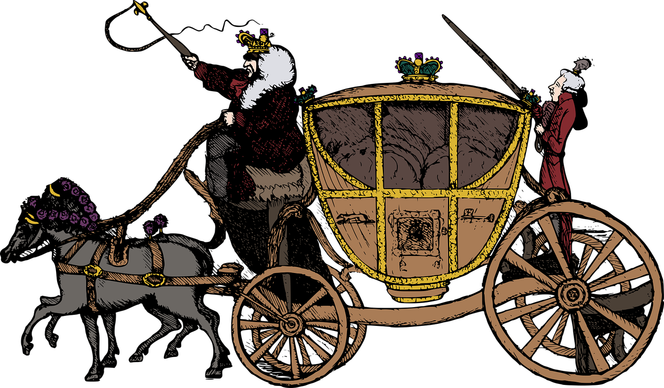
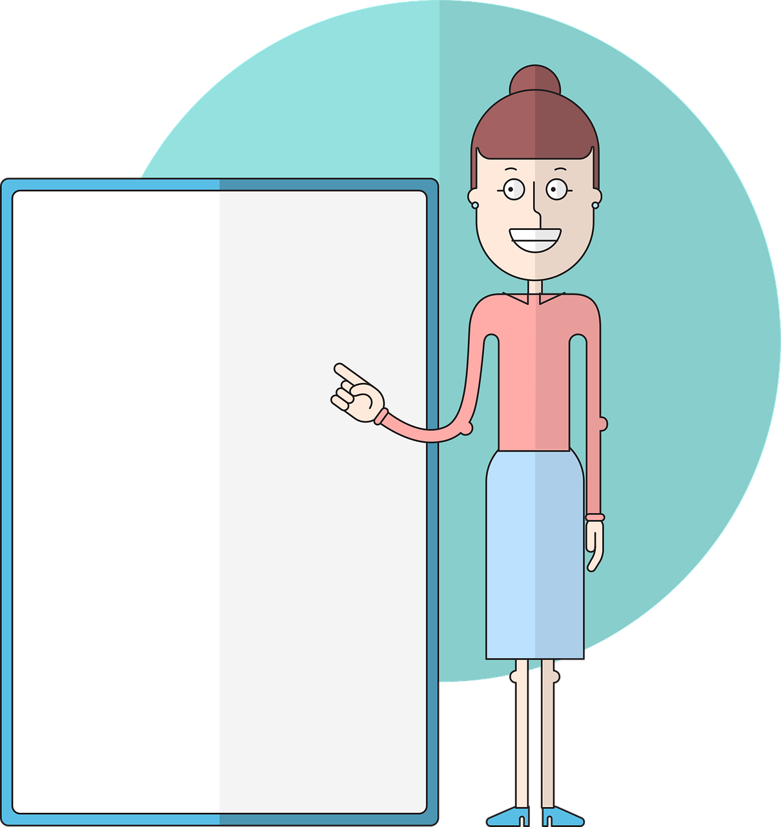
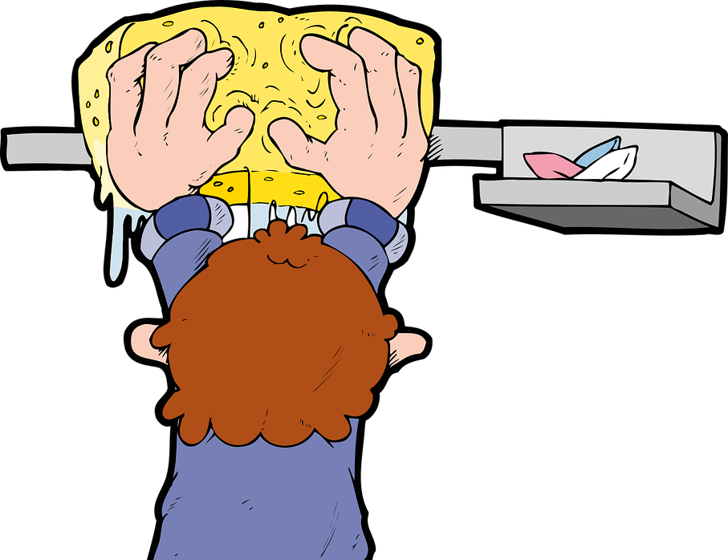
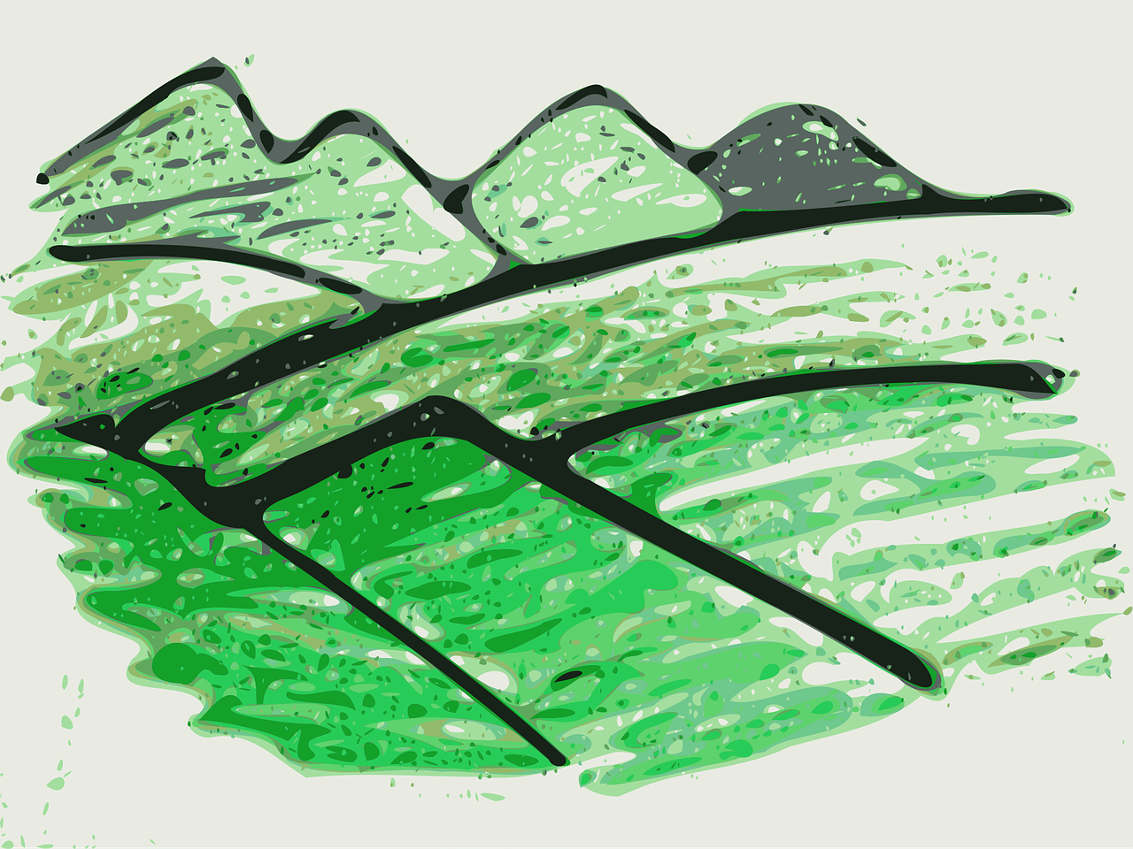
prononcer
Devine* et prononce bien les cinq mots de ton/ta partenaire.
deviner – to guess
carrosse
déçu
glaçon
document
maçon
Canada
leçon
colombe
balançoire
musical
africain
effaçable
colline
escargot
commerçant
école
Notes:
Timing: 3 minutes
Aim: to consolidate SSC [ç/c]
Procedure:
Pupils work in pairs. Pupil A secretly chooses 5 of the 16 words.
Pupil B has 12 guesses to try to get them all. If s/he pronounces the ç as hard ‘a’ and Pupil A spots it, s/he doesn’t have to answer oui/non to that word and B loses one of the 12 guesses.
They then swap over.
Finally, click to reveal the English meanings of the words. Depending on time, first elicit what pupils think them mean. Some are clear cognates, some are inferable from the pictures, but for those that are not obvious, reveal the meanings rather than allow extended guessing.
Word frequency (1 is the most frequent word in French): carosse [>5000] déçu [>5000] glaçon [>5000] document [997] maçon [>5000] Canada [n/a] leçon [1300] colombe [>5000] balançoire [>5000] musical [3168] africain [2289] effaçable [>5000] colline [2937] limaçon [>5000] commerçant [4167] école [477] Source: Londsale, D., & Le Bras, Y. (2009). A Frequency Dictionary of French: Core vocabulary for learners London: Routledge.
4

Slide 5
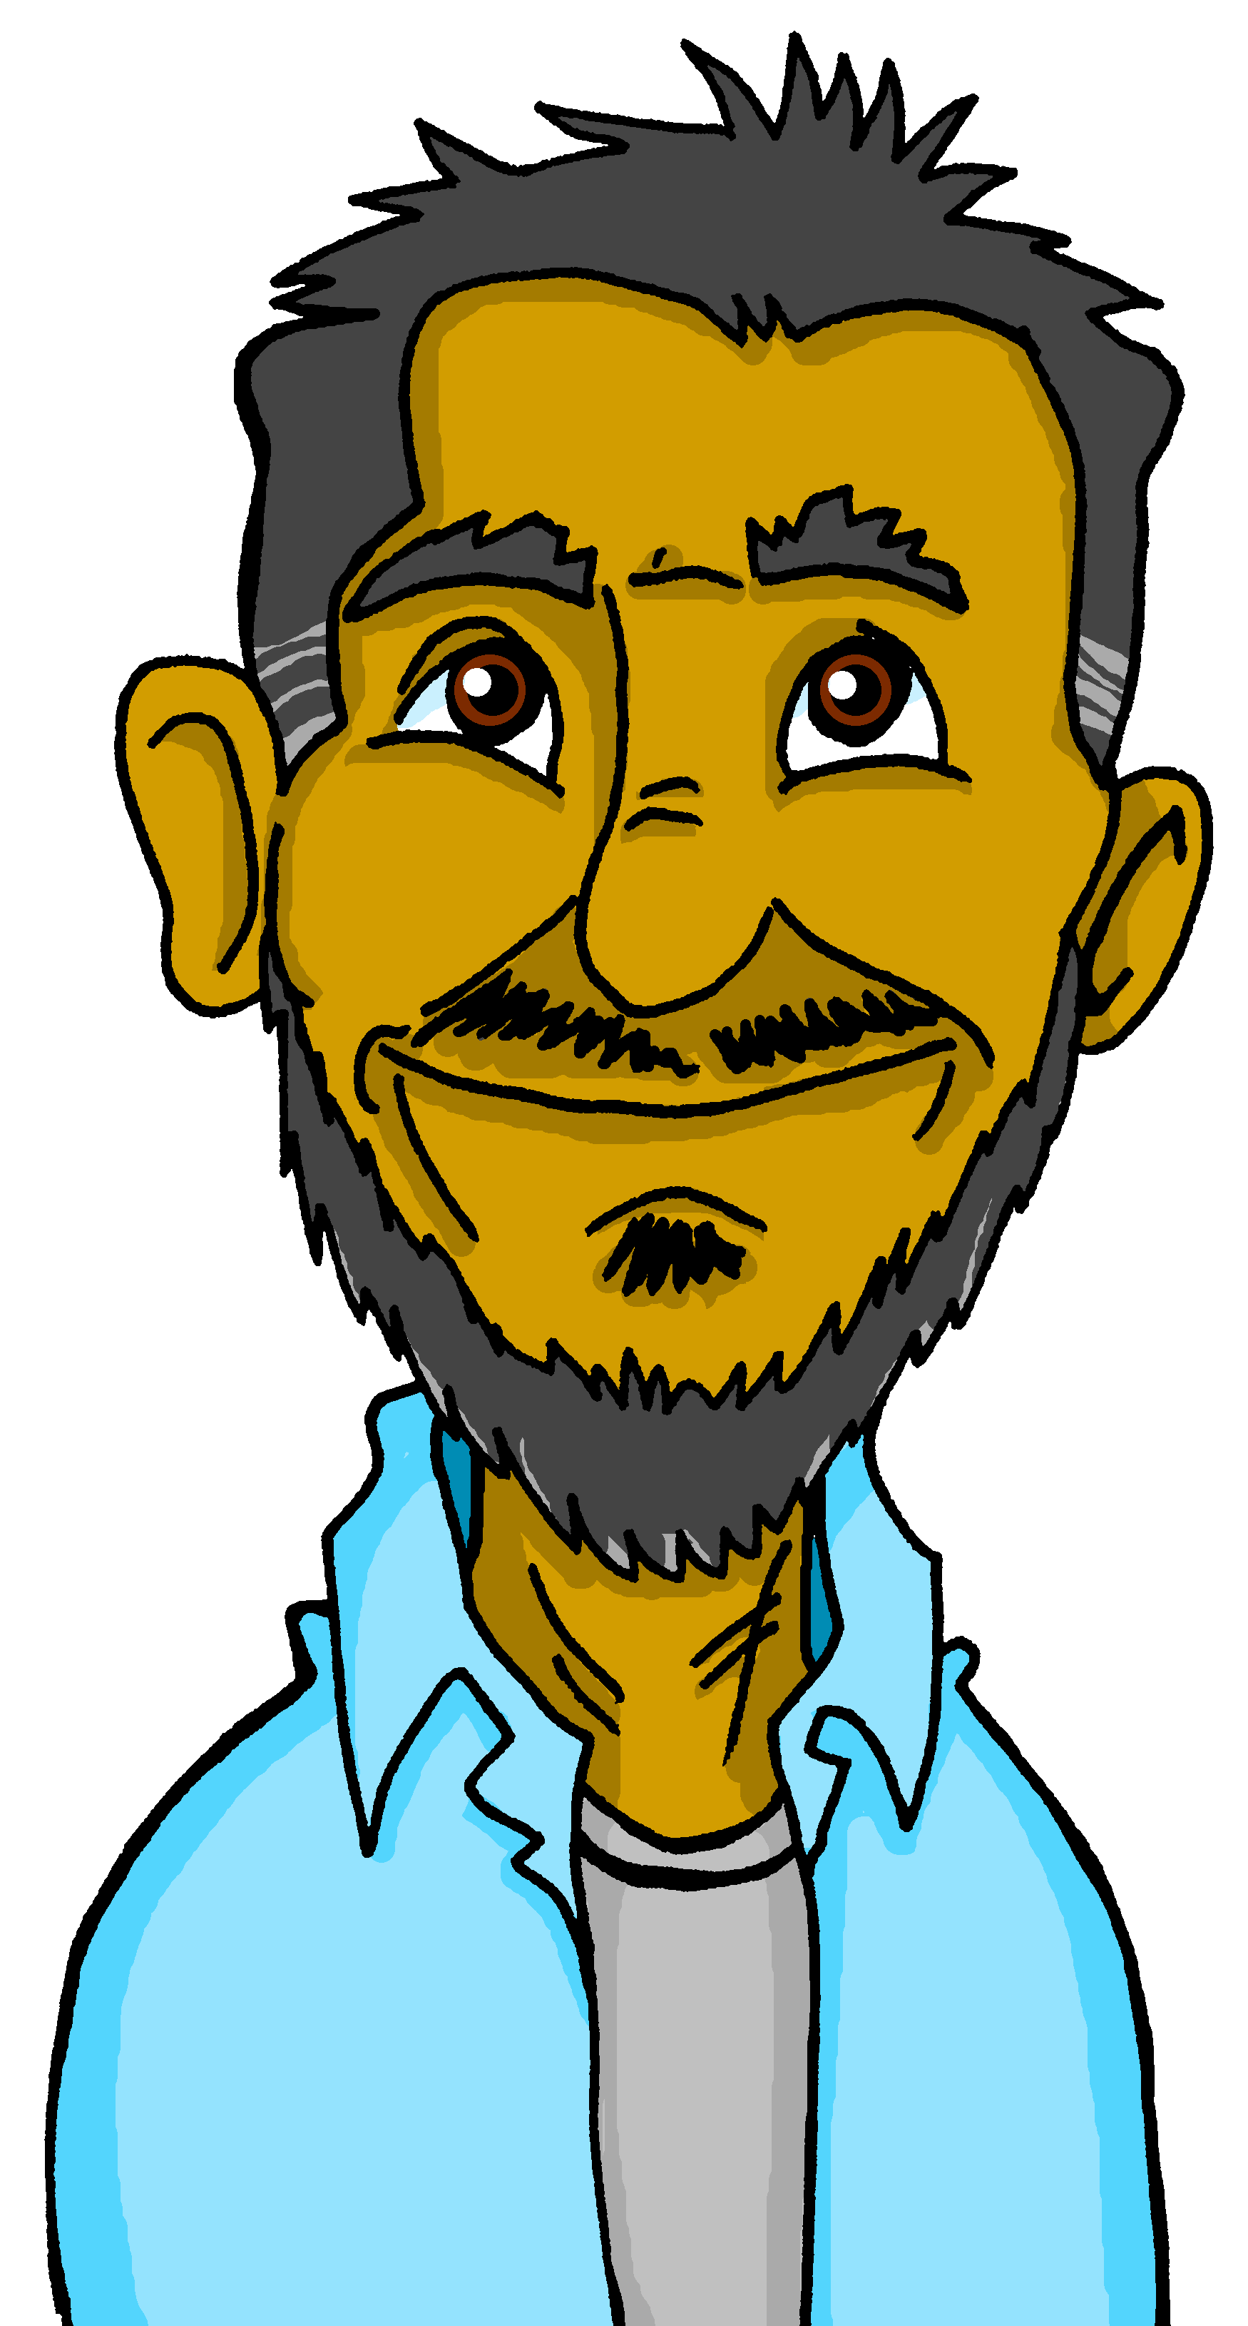
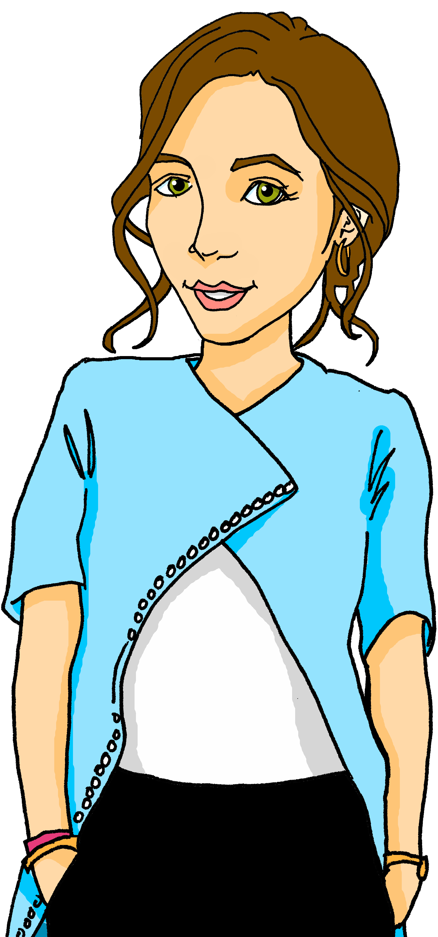
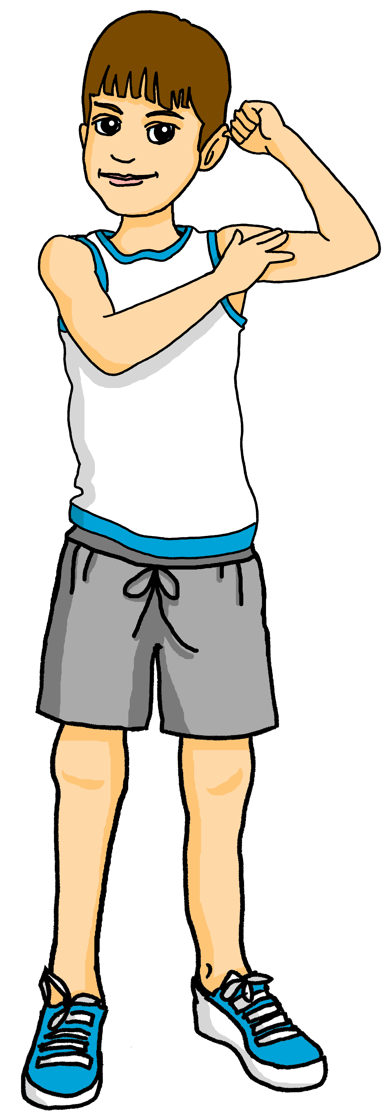
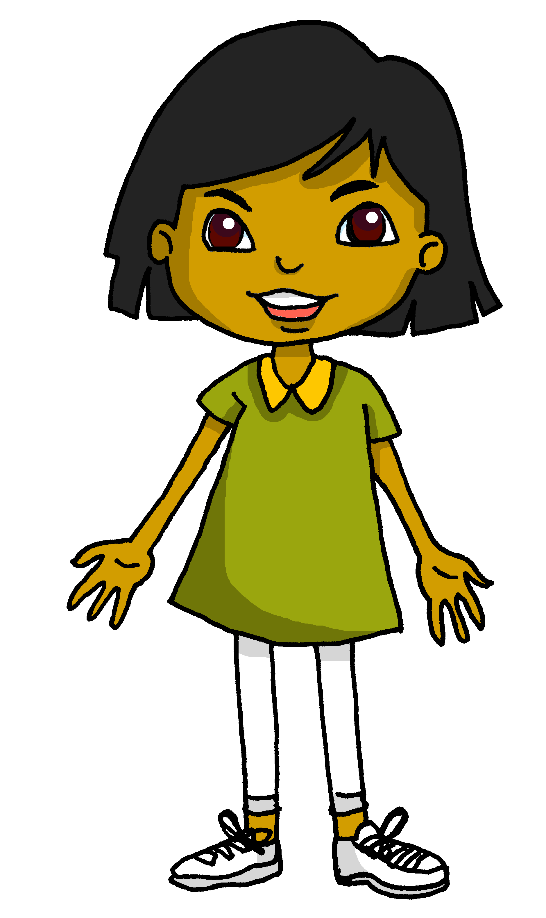
Saying ‘my’ and ‘your’ with singular nouns
Remember how to say ‘my’ before masculine and feminine nouns:
mon frère
my brother
ma sœur
my sister
Some people nouns add ‘e’ for the feminine form (just like some adjectives):
Voici ton professeur.
Voici ta professeure.
This is your (male) teacher.
This is your (female) teacher.
Remember to use ‘mon/ton’ before feminine nouns beginning with a vowel:
Voici mon amie.
Voici mon ami.
Voici mon amie.
Voici mon ami.
This is my (male) friend.
This is my (female) friend.
Notes:
Timing: 2 minutes
Aim: to recap singular possessive adjectives ‘my’ and ‘your’ and the rule for using ‘mon, ton’ and adding –e to make some feminine nouns.
Procedure: 1. Click to present the information.
2. Elicit responses from pupils, following the animated question marks.

Slide 6
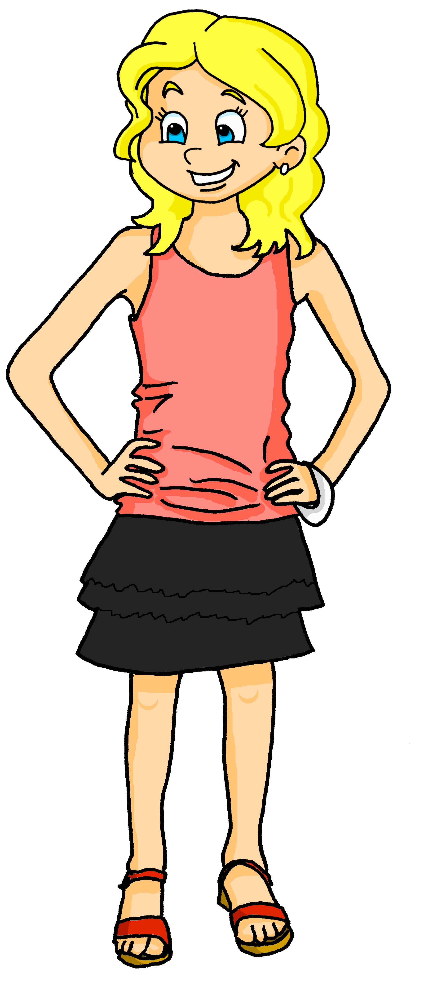
écouter
Adèle décrit des personnes (à Sanaya).
Écoute. Elle décrit qui ? Décide pour chaque phrase (1-6).
Il est comment ?
A
Il est sympathique.
A
B
B
1
Comment means how but ‘Il est comment ?’ means What is he like?
Sympathique means nice. It is often shortened to ‘sympa’.
Notes:
Slide 1 of 6 slides
Timing: 5 minutes
Aim: to practise aural distinction of mon/ma and its connection to an appropriate noun.
Procedure:
Pupils listen to the first part of the sentence (the noun is beeped out)
They identify the correct picture based on the possessive adjective.
Click to reveal the answer. The full sentence audio is activated at the same time.
Note: pupils could also be challenged to say the full sentence in French (rather than just A or B) before the teacher clicks to reveal the answer.
Transcript:
Voici mon [père].
6

Slide 7
écouter
Adèle décrit des personnes.
A
B
2
Notes:
[2/6]
Transcript:
Voici mon [frère].
7

Slide 8
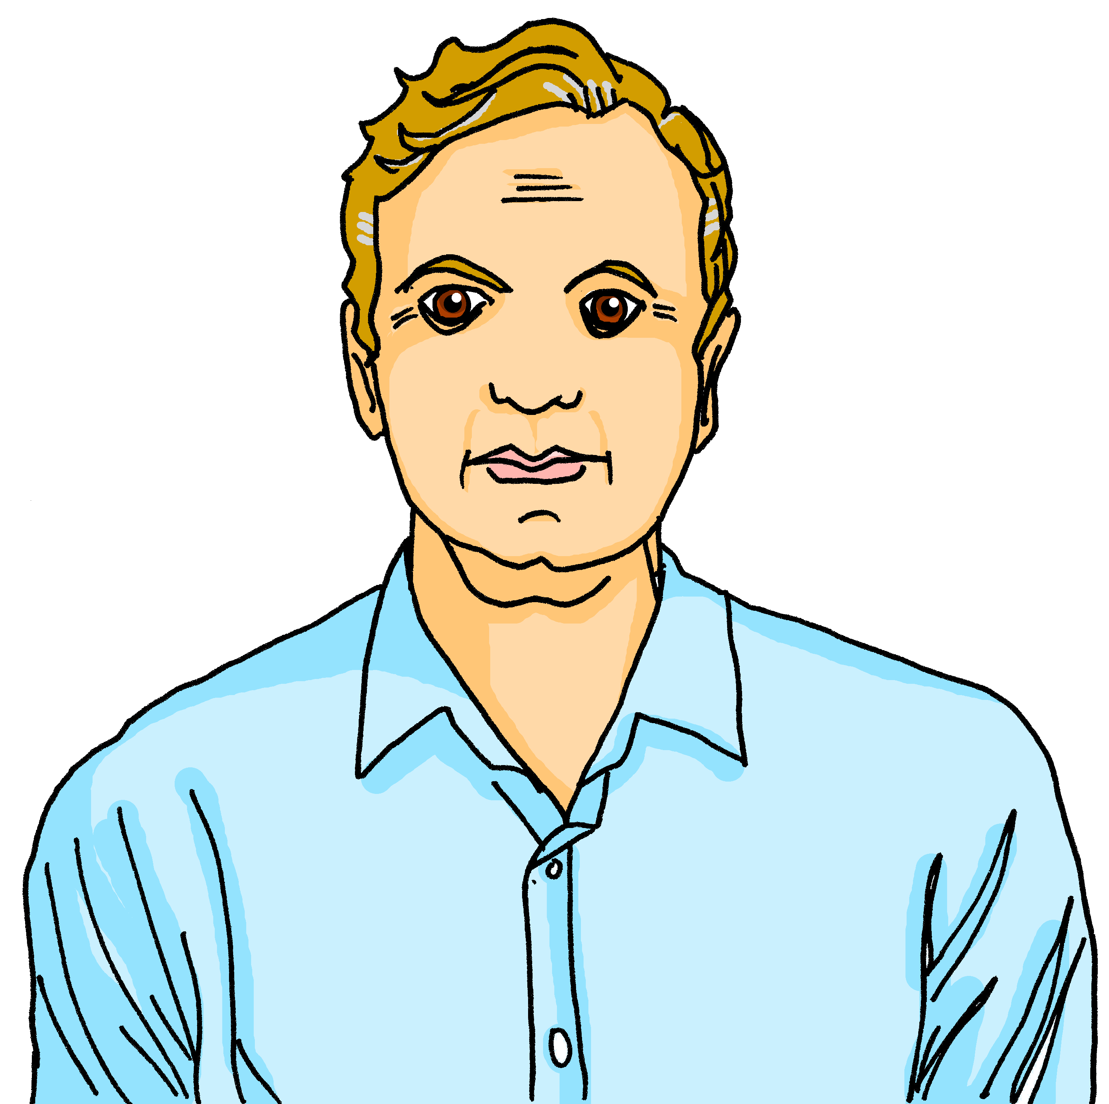
écouter
Adèle décrit des personnes.
la tante – aunt l’oncle - uncle
Elle est comment ?
A
Elle est très sympathique.
B
3
Sympathique or sympa is the same word in masculine and feminine singular.
Notes:
[3/6]
Transcript:
Voici ma [tante].
8

Slide 9
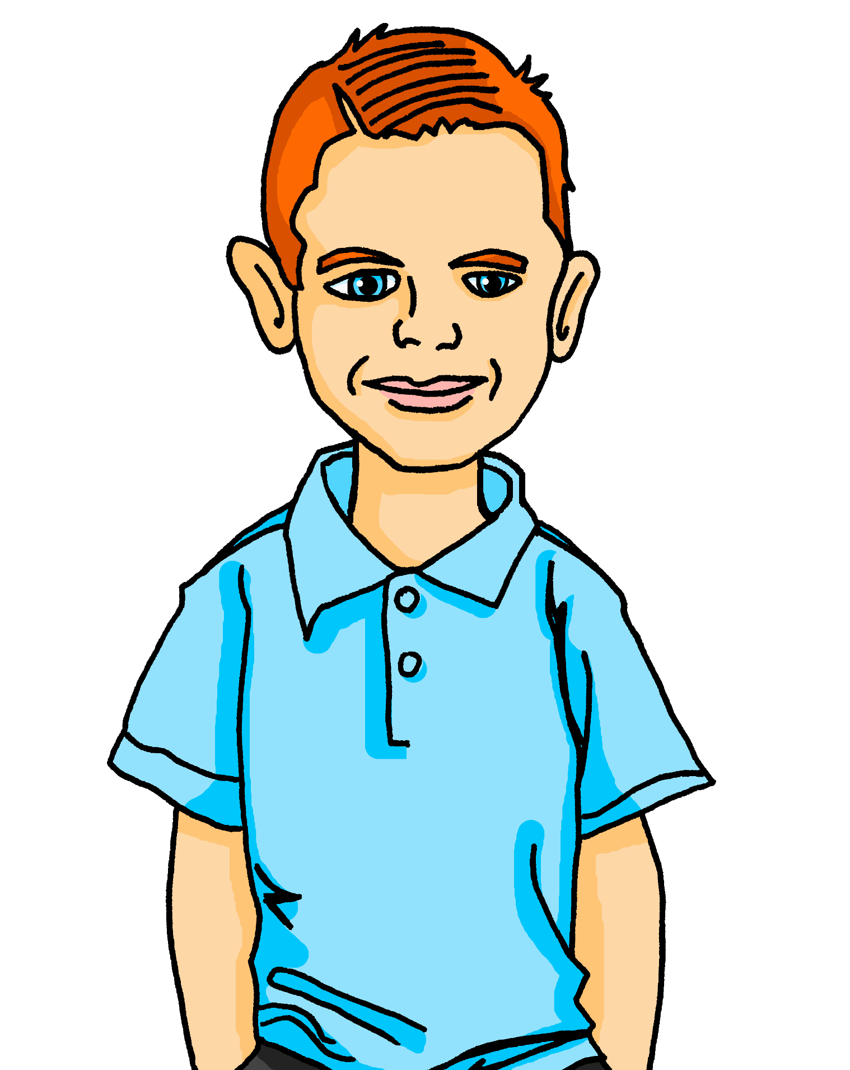
écouter
Adèle décrit des personnes.
A
B
4
Notes:
[4/6]
Transcript:
Voici mon [ami].
9

Slide 10
écouter
Adèle décrit des personnes.
A
B
5
Notes:
[5/6]
Transcript:
Voici ma [professeure].
10

Slide 11
écouter
Adèle décrit des personnes.
Elle est comment ?
Elle est sympathique et mon amie Sanaya est sympa, aussi !
A
B
6
Notes:
[6/6]
Transcript:
Voici ma [mère].
11

Slide 12
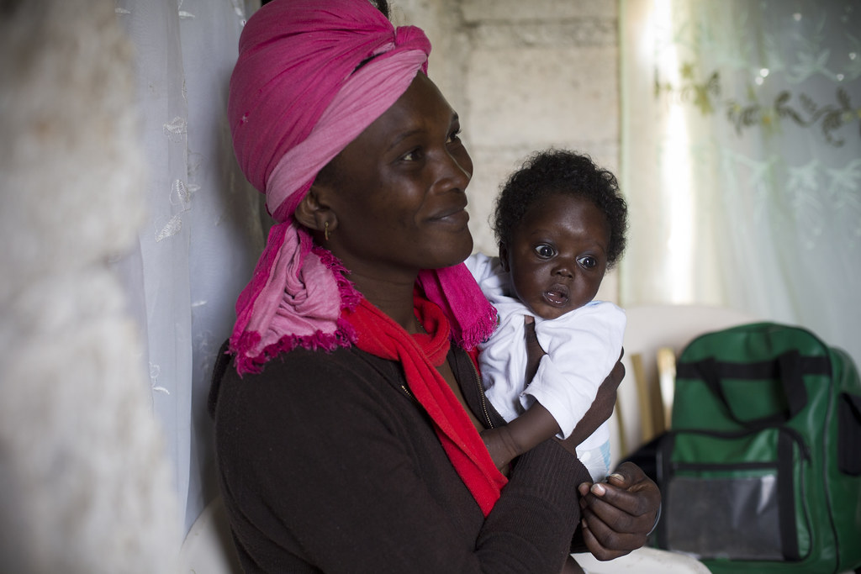
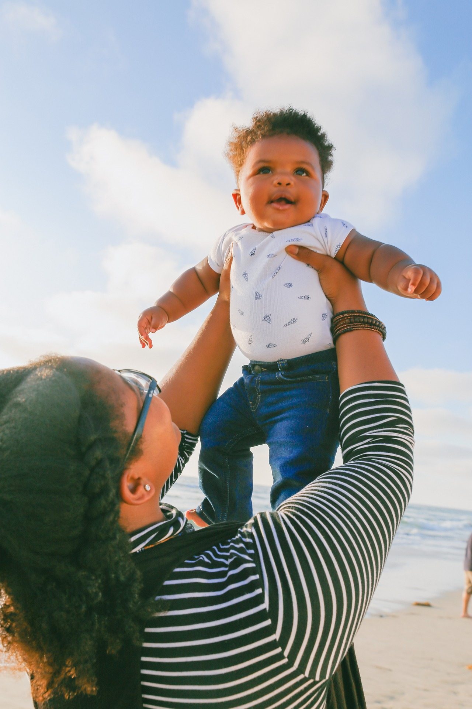
lire
La fête des mères
David Rochkind, USAID
En France et à Haïti la Fête des Mères est le dernier* dimanche de mai. Au Canada, c’est le deuxième* dimanche de mai.
The text is mostly about: Sundays | Mothers’ Day | Fathers’ Day
What do children typically do for this day?
What is the aim of the day?
What is different about Mothers’ Day in Canada?
When is Mothers’ Day in England?
In France this day is celebrated on the last Sunday in: March | April | May
It’s on the 2nd Sunday in May.
To honour mums.
They prepare a small present at school.
The 4th Sunday of Lent, exactly 3 weeks before Easter.
L’idée est d’honorer les mamans. Pour un enfant, la tradition est de préparer un petit cadeau à l’école.
dernier – last deuxième - second
Notes:
Image attribution: David Rochkind, USAID, https://www.flickr.com/photos/usaid_images/22333918010/
Link to licence: https://creativecommons.org/licenses/by-nc/2.0/
Timing: 5 minutes
Aim: to introduce pupils to facts about Mothers’ Day in three French-speaking countries; to practise written comprehension of previously taught language in a longer text.
Procedure:
Read the text aloud, so pupils can follow.
Click for the first question.
Elicit answers from pupils and click to check the answer. Refer pupils back to the text.
Repeat steps 2-3 for the remaining 5 questions.
12

Slide 13
Saying ‘it’ in French
Remember that to say ‘he’ and ‘she’ in French we say ‘il’ and ‘elle’:
Pierre a un cadeau.
He has a present.
Il a un cadeau.
We also use ‘il’ and ‘elle’ to mean ‘it’:
We use ‘il’ for masculine nouns and ‘elle’ for feminine nouns:
Le cadeau est petit.
Il est petit.
It is small.
La peluche est grande.
Elle est grande.
It is big.
Notes:
Timing: 2 minutes
Aim: to introduce the use of il / elle to mean ‘it’ with masculine / feminine nouns
Procedure:
Click through the animations to present the new knowledge orally and in writing.
Elicit the English meanings for the French examples.

Slide 14
lire
What is ‘it’?
The word ‘it’ is a pronoun. This means it replaces a noun:
 |  | What is ‘it’ ? | What is it like?
1 | The bike is fast. | the bike | It is fast.
2 | The car is slow. | the car | It is slow.
3 | The motorbike is expensive. | the motorbike | It is expensive.
4 | The present is green. | the present | It is green.
In English there is only one word for it, no matter which noun it replaces.
 |  | What is ‘it’ ? | What is it like?
1 |  | le vélo | Il est rapide.
2 |  | la voiture | Elle est lente.
3 |  | la moto | Elle est chère.
4 |  | le cadeau | Il est vert.
In French, the word for ‘it’ changes. It is ‘il’ if the noun it replaces is masculine and ‘elle’ for a feminine noun.
Le vélo est rapide.
La voiture est lente.
La moto est chère.
Le cadeau est vert.
Notes:
Timing: 5 minutes
Aim: raising awareness that the word for ‘it’ in French varies depending on the noun it replaces, while in English it does not.
Procedure:
Pupils identify the noun that ‘it’ replaces in each of the English sentences.
Then they answer the question what is ‘it’ like? to focus on the repetition of ‘it’ for all four English sentences.
2. Do the same for the French sentences. Note – if audio is required, click the full French sentences to hear them. When the sentences with pronouns are revealed, the audio for each is also heard.
3. Teacher highlights the difference between the two languages and emphasises the need to think about the gender of the noun being replaced in French.
14

Slide 15
Au revoir !
rouge
Notes:
15

