Slide 1
Saying how many and describing things
rouge
des (some)
combien de
SSC [(a)in]
Notes:
Artwork by Steve Clarke. Pronoun pictures from NCELP (www.ncelp.org). All additional pictures selected from Pixabay and are
available under a Creative Commons license, no attribution required.
The AUDIO version of the lesson material includes additional audio for the new language presented (phonics, vocabulary) and audio for the instructions
on the slide.
In addition, it includes VIDEO clips of the phonics and the phonics’ source words. Pupils can be encouraged to look at the shape of the mouth/lips on
slides where these appear, and try to copy it/them.
Phonics: introduce [(a)in] fin [111] lapin [>5000] main [418] train [232] vingt [1273]
Vocabulary (new words in bold): chose [125] des [2] combien [800]
Revisit 1: aider [413] aimer [232] habiter [1186] école [477] aussi [44] à (meaning ‘in’) [4]
Revisit 2: --
Note: we will also revisit numbers this week, because they were only introduced last week.
il y a [n/a] un [3] deux [41] trois [115] quatre [253] cinq [288] six [450] sept [905] huit [877] neuf [787] dix [372] onze [2447] douze [1664]
Londsale, D., & Le Bras, Y. (2009). A Frequency Dictionary of French: Core vocabulary for learners London: Routledge.
The frequency rankings for words that occur in this PowerPoint which have been previously introduced in these resources are given in the SOW and in the resources that first introduced and formally re-visited those words. For any other words that occur incidentally in this PowerPoint, frequency rankings will be provided in the notes field wherever possible.
1

Slide 2
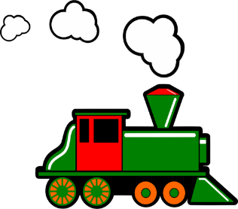
prononcer
[(a)in]
train
Notes:
Timing: 1 minute
Aim: To introduce SSC [(a)in]
Procedure:
Introduce and elicit the pronunciation of the individual SSC [(a)in] and then the source word ‘train’ (with gesture, if using).
Click to bring on the picture and get students to repeat (with gesture, if using).
Note: gesture for train – fist closed, arm by side, forearm at right angle to body, thrust fist forward miming the movement of a fast train
https://www.signbsl.com/sign/train – scroll down to the noun train videos.
Word frequency (1 is the most frequent word in French):
train [232]. Source: Londsale, D., & Le Bras, Y. (2009). A Frequency Dictionary of French: Core vocabulary for learners London: Routledge.
2

Slide 3
prononciation
[(a)in]
train
vingt
fin
main
lapin
Notes:
Timing: 2 minutes
Aim: To consolidate SSC [ain/in].
Procedure:
1. Introduce and elicit the pronunciation of the individual SSC [(a)in] and then the source word again ‘train’ (with gesture, if using). 2. Then present and elicit the pronunciation of the five cluster words.
The cluster words have mainly been chosen for their high-frequency, from a range of word classes, with the SSC (where possible) positioned within a variety of syllables within the words (e.g. initial, 2nd, final etc.).
Word frequency (1 is the most frequent word in French): fin [111] lapin [>5000] main [418] train [232] vingt [1273] Source: Londsale, D., & Le Bras, Y. (2009). A Frequency Dictionary of French: Core vocabulary for learners London: Routledge.
3

Slide 4
écouter
Écoute et identifie les mots.
A
B
C
D
E
F
10
8
6
3
9
7
2. simple
3. lapin
1. bon
4. plein
6. certain
7. bain
5. main
8. humain
10. prince
11. vingt
12. fin
9. insecte
Notes:
Timing: 5 minutes
Aim: to practise aural recognition of words containing SSC [ain/in] from a pool of distractors. This trains students to look for a certain letter combination when they hear a particular sound.
Procedure: 1. Click on boxes to play the words.
2. Pupils note down the number for the word they hear, next to each letter.
3. Elicit answers for some numbers practice by asking ‘A, c’est quel numéro ?’
4. Answers revealed on clicks.
Transcript:
prince humain certain lapin insecte bain
4

Slide 5
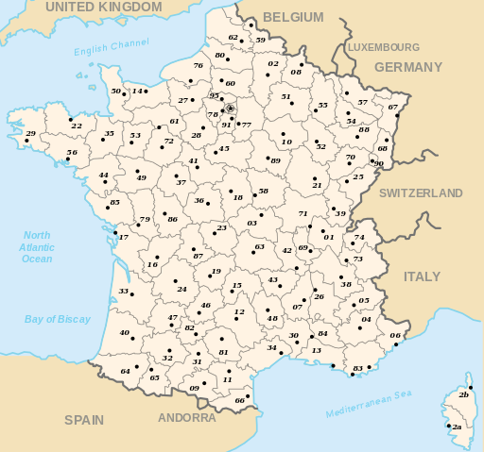
parler
En France, chaque region ou ‘département’ a un numéro.
Écoute les numéros et prononce la ville correspondante.
2) Laon
8) Charleville-Mézières
⚠Say it as though the ‘a’ isn’t there!
lire
⚠Remember Silent Final Consonant!
10) Troyes
3) Moulins
⚠This sounds the same as ‘3’ (trois)!
1) Bourg-en-Bresse
7) Privas
5) Gap
⚠Say the ‘p’ here.
4) Dignes-les-Bains
12) Rodez
6) Nice
⚠’gn’ sounds like the ‘gn’ in lasagne.
⚠Pronounce the ‘z’ – not a SFC!
11) Carcassonne
9) Foix
Notes:
Timing: 3 minutes
Aim: to find out that France is divided up into regions and that they each have a number; to consolidate numbers in oral production and practise several SSC.
Note: this was not designed principally as a phonics task, but as cultural information + numbers practice. There are a few trickier place names here, which don’t follow the rules. Remind pupils that many English places are extremely tricky to pronounce – e.g. Slough – Loughborough. French is far more regular than English in this respect!
Procedure:
Teacher reads the instruction in French.
Teacher says a number 1-12 and pupils pronounce the corresponding capital name.
Click the sound bubble to hear the name pronounced.
Original source:
Image: Départements de France.svg by bayoTranslation into English by Andrew_pmk, Public domain, via Wikimedia Commons
https://en.wikipedia.org/wiki/Departments_of_France#Current_departments
5

Slide 6
des (some)
Remember! To mean ‘a/an’ for masculine nouns, use ‘un’:
Il y a un cahier.
There is an exercise book.
To mean ‘a/an for feminine nouns, use ‘une’:
Il y a une bouteille.
There is a bottle.
To mean ‘some’ (plural), use ‘des’ for all nouns:
Il y a des cahiers.
There are some exercise books.
Il y a des bouteilles.
There are some bottles.
Notes:
Timing: 2 minutes
Aim: To recap the meaning of quoi and how to use it in an intonation question.
Procedure:
Click to present the information.
Elicit the English meanings of the examples.
6

Slide 7
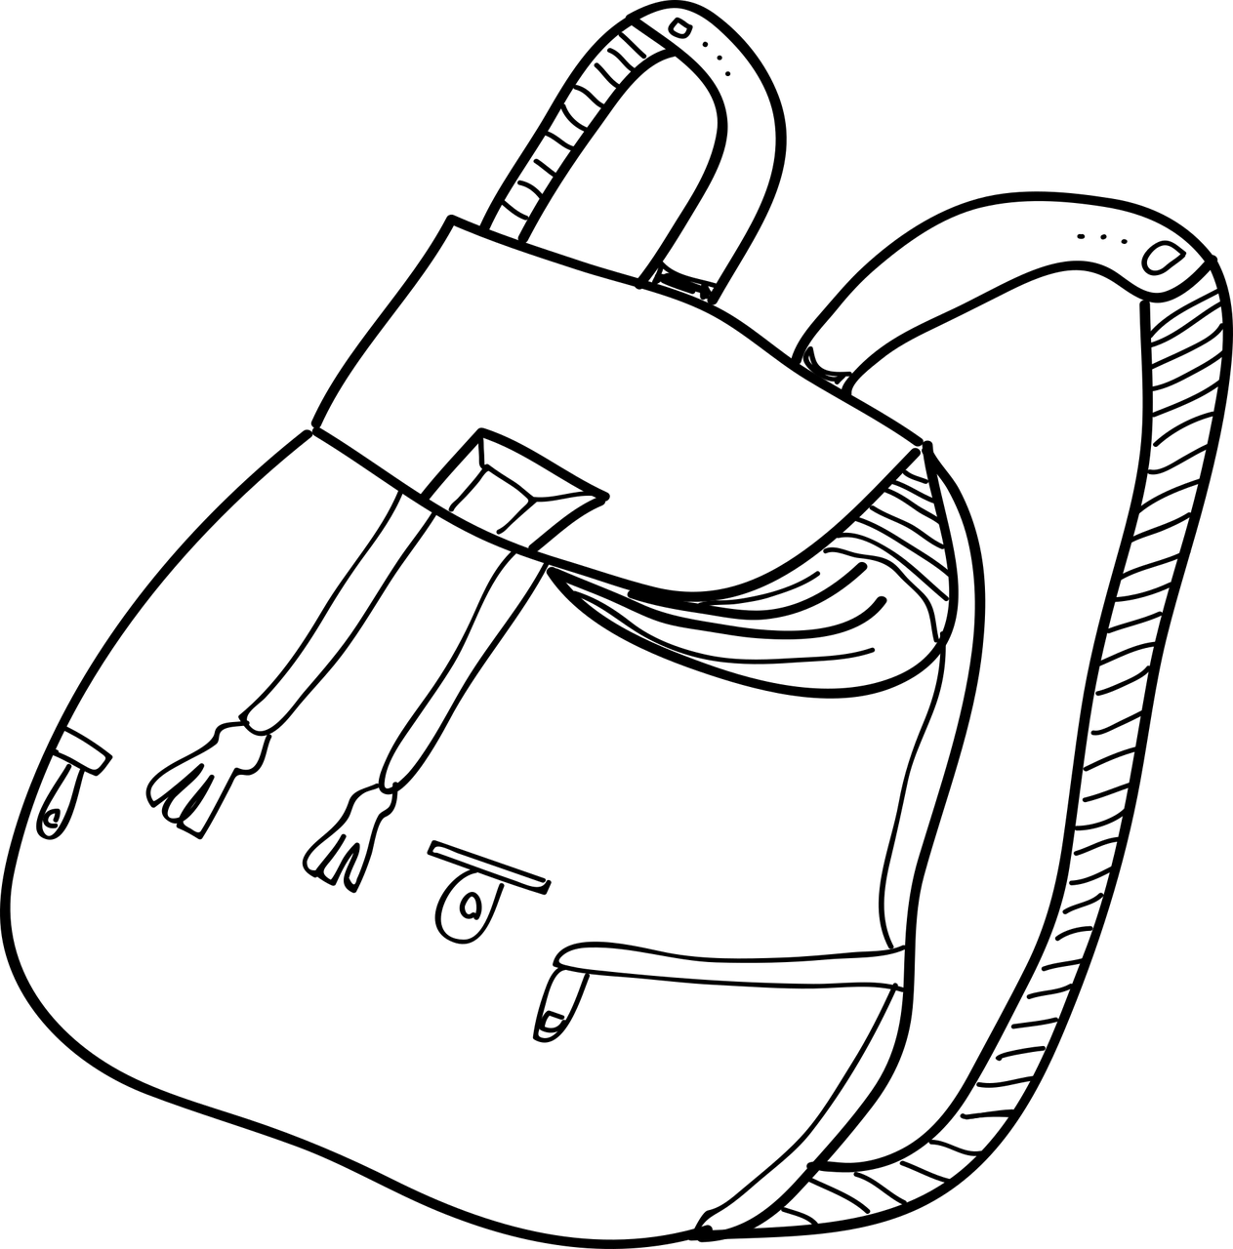
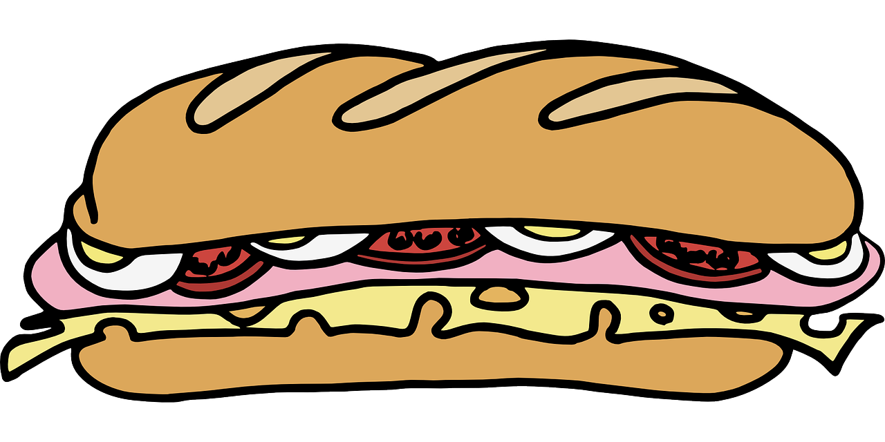
écouter
Écoute et identifie le sac correct.
1
A
B
C
2
3
4
5
6
7
8
Notes:
Timing: 5 minutes
Aim: to practise aural comprehension of vocabulary and articles.
Procedure: 1. Click on numbers to play each sentence.
2. Pupils match what they hear to the bags and decide if and which one they might eliimate.
3. Note that it will only be possible to eliminate B after sentence 5, and C by sentence 8.
Differentiation:
For increased challenge, ask pupils to turn away from the board and make notes in English after listening to each sentence. Then at the end they turn back to the board and work out which bag it is. For more support, provide English true/false statements, and remove the pictures. E.g.
There are some sandwiches.
For even more support, provide a choice of two statements each time (removing the pictures from the slide). E.g.
There is a sandwich. | There are some sandwiches.
Once pupils have listening and selected their statements, teachers could provide the three pictures and students could then select the correct bag, using their answers.
Transcript:
Il y a un sandwich.
Il y a des ballons.
Il y a une règle.
Il y a une gomme.
Il y a des cahiers.
Il y a des crayons.
Il y a une bouteille.
Il y a des stylos.
7

Slide 8
Combien de (how many)
Combien de means ‘how many’:
Il y a combien de livres ?
How many books are there?
Il y a trois livres.
There are three books.
Notes:
Timing: 2 minutes
Aim: To recap the meaning of quoi and how to use it in an intonation question.
Procedure:
Click to present the information.
Elicit the English meanings of the examples.
8

Slide 9
lire
C’est une question ou c’est une phrase ?
⚠Attention !
There is no punctuation!
1
Il y a cinq chiens .
4
Il y a des bouteilles .
2
Il y a combien de chats ?
5
Il y a six règles .
3
Il y a combien de crayons ?
6
Il y a combien de cahiers ?
Notes:
Timing: 3 minutes
Aim: to recognise a ‘how many’ question by the presence or ‘de’.
Procedure:
Teacher reads the instruction in French.
Pupils decide whether each item is a question or statement, depending on the presence or absence of ‘de’.
Elicit the answers from pupils (note they will only be able to say ‘c’est une question’ or ‘c’est une phrase’.
Then click to hear the full sentence and to reveal the written versions.
Transcript:
Il y a cinq chiens. Il y a combien de chats ? Il y a combien de crayons ? Il y a des bouteilles. il y a six règles. Il y a combien de cahiers ?
9

Slide 10
parler
Tu as combien de doigts* ?
trois
3
huit
8
deux
neuf
2
9
quatre
sept
4
7
dix
un
10
1
cinq
5
six
6
le doigt - finger
Notes:
Timing: 3 minutes
Aim: to consolidate numbers in oral production.
Procedure:
Teacher reads the instruction in French.
Pupils work in pairs to say the numbers in order (1-12). They have one minute.
Click to trigger the timer.
To bring up the answers, each number disappears on click, and the correct answer appears.
10

Slide 11
parler
Il y a combien de chiens ?
[1/6]
Il y a un chien.
Il y a deux chiens.
Notes:
[1/6]
Timing: 3 minutes
Aim: to consolidate numbers in oral production with short ‘il y a’ sentences.
Procedure:
Teacher reads the instruction in French.
Pupils answer the question.
Click again for the 2nd dog, and re-ask the question.
11

Slide 12
parler
Il y a combien de chiens ?
[2/6]
Il y a cinq chiens.
Notes:
[2/6]
12

Slide 13
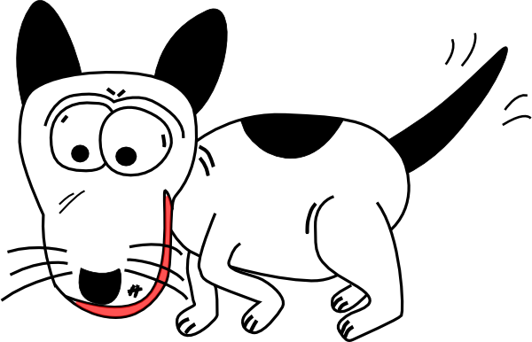
parler
Il y a combien de chiens ?
[3/6]
Il y a cinq chiens…
et un chat.
Notes:
[3/6]
13

Slide 14
parler
Il y a combien de chats ?
[4/6]
Il y a trois chats.
Notes:
[4/6]
14

Slide 15
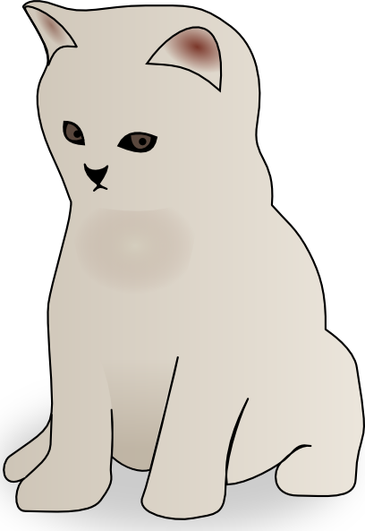
parler
Il y a combien de chats ?
[5/6]
Il y a sept chats.
Notes:
[5/6]
15

Slide 16
parler
Il y a combien de chats ?
[6/6]
Il y a quatre chats.
Notes:
[6/6]
16

Slide 17
Au revoir !
rouge
Notes:
17

