Slide 1
Saying what I and others do
préférer
rouge
Follow ups 1-5
Notes:
Artwork by Steve Clarke. Pronoun pictures from NCELP (www.ncelp.org). All additional pictures selected from Pixabay and are available under a Creative Commons license, no attribution required.
Phonics: introduce [oi] voir [69] avoir [8] au revoir [4/1274] pourquoi ? [193] trois [115]
Vocabulary (new words in bold): préférer [597] village [1295] ville [260] dans [11] en ce moment [n/a] Revisit 1: fête [1490] fille [629] fruit [896] garçon [1599] de¹ [2]
Revisit 2: jour [78] chaque [151] revisit days of the week
Londsale, D., & Le Bras, Y. (2009). A Frequency Dictionary of French: Core vocabulary for learners London: Routledge.
The frequency rankings for words that occur in this PowerPoint which have been previously introduced in these resources are given in the SOW and in the resources that first introduced and formally re-visited those words. For any other words that occur incidentally in this PowerPoint, frequency rankings will be provided in the notes field wherever possible.

Slide 2
prononcer
[oi]
voir
[to see, seeing]
Notes:
Timing: 3 minutes (two slides)
Aim: to recap SSC [oi].
Procedure:
Introduce and elicit the pronunciation of the individual SSC [oi] and the source word ‘voir’.
Click to bring on the picture and get students to repeat (with gesture, if using).
Present and practise the cluster words.
Gesture: gesture for voir
https://www.signbsl.com/sign/see (scroll down to the correct definition of ‘see’ and we recommend the 1st video of these three) – right index finger comes up to the eye and then points away from the body as if tracing the path of sight from the eyes towards an object in view.
2

Slide 3
prononcer
[oi]
voir
to have, having
avoir
Au revoir !
[to see, seeing]
[why?]
trois
pourquoi ?
Notes:
Timing: 2 minutes
Aim: to recap SSC [oi].
Procedure:
Introduce and elicit the pronunciation of the individual SSC [oi] and the source word ‘voir’.
Click to bring on the picture and get students to repeat (with gesture, if using).
Present and practise the cluster words.
Gesture: gesture for voir
https://www.signbsl.com/sign/see (scroll down to the correct definition of ‘see’ and we recommend the 1st video of these three) – right index finger comes up to the eye and then points away from the body as if tracing the path of sight from the eyes towards an object in view.
3

Slide 4
Follow up 1: [1/6]
Écoute. Le mot avec le son [oi], c’est A ou B ?
A
B
spiky hair
trois [three]
trait [trait]
Notes:
Aim: to practise aural recognition of the [oi] sound.
Procedure:
Clarify the task with pupils. They will listen to two words, A and B and note which one contains the [oi] sound.
Click A and then B to listen.
Elicit A or B from the class, orally. (C’est A ou B ?)
Click to confirm and bring up the two words with their English meanings and picture illustration.
Note: if any English meanings are unclear, clarify these with pupils.
5. Repeat steps 2-4 with items 2-7 on the following slides.
Transcript:
trois
trait

Slide 5
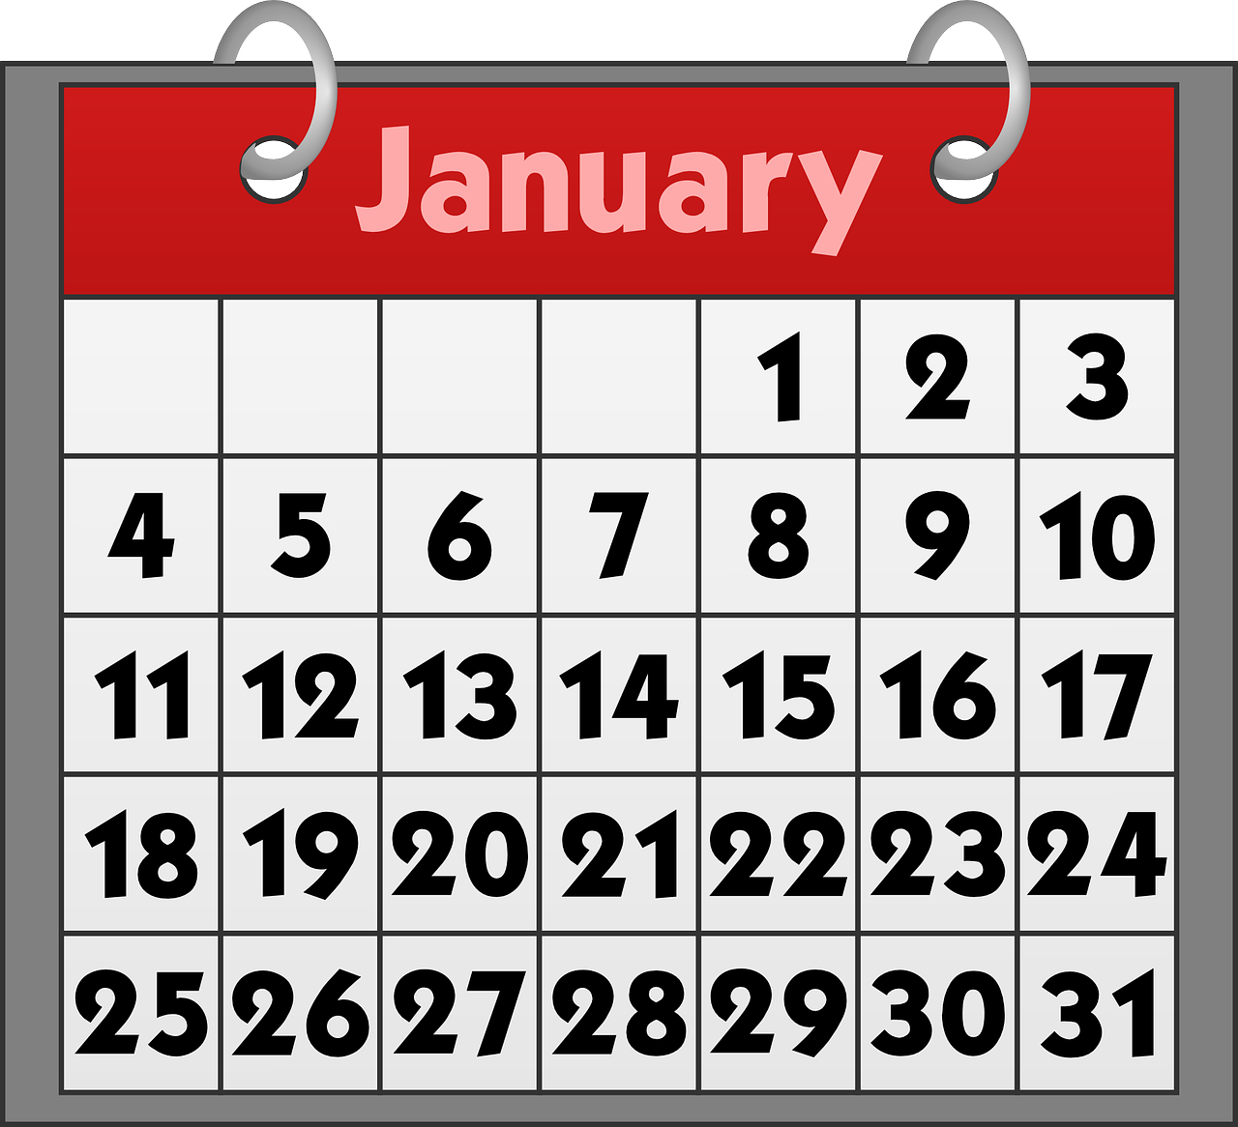
Follow up 1: [2/6]
Écoute. Le mot avec le son [oi], c’est A ou B ?
A
B
Janvier
mois [month]
mais [but]
Notes:
2/6
Transcript:
mois
mais

Slide 6
Follow up 1: [3/6]
Écoute. Le mot avec le son [oi], c’est A ou B ?
A
B
craie [chalk]
croix [cross]
Notes:
3/6
Transcript:
craie
croix

Slide 7
Follow up 1: [4/6]
Écoute. Le mot avec le son [oi], c’est A ou B ?
A
B
fois [time]
fait [fact]
Notes:
4/6
Transcript:
fois fait

Slide 8
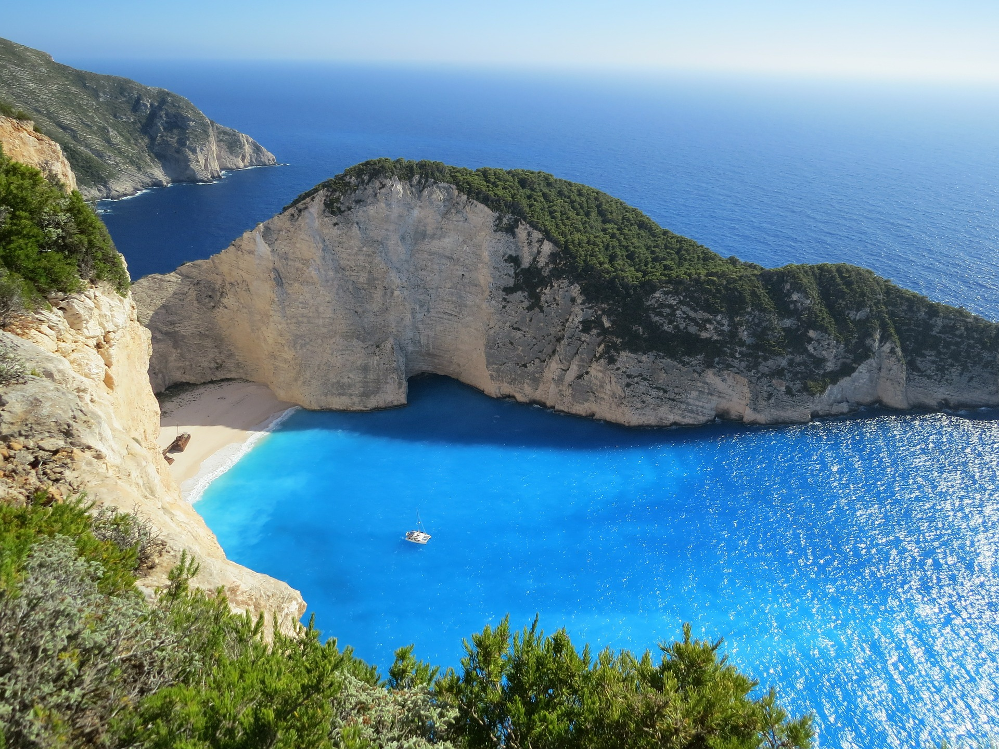
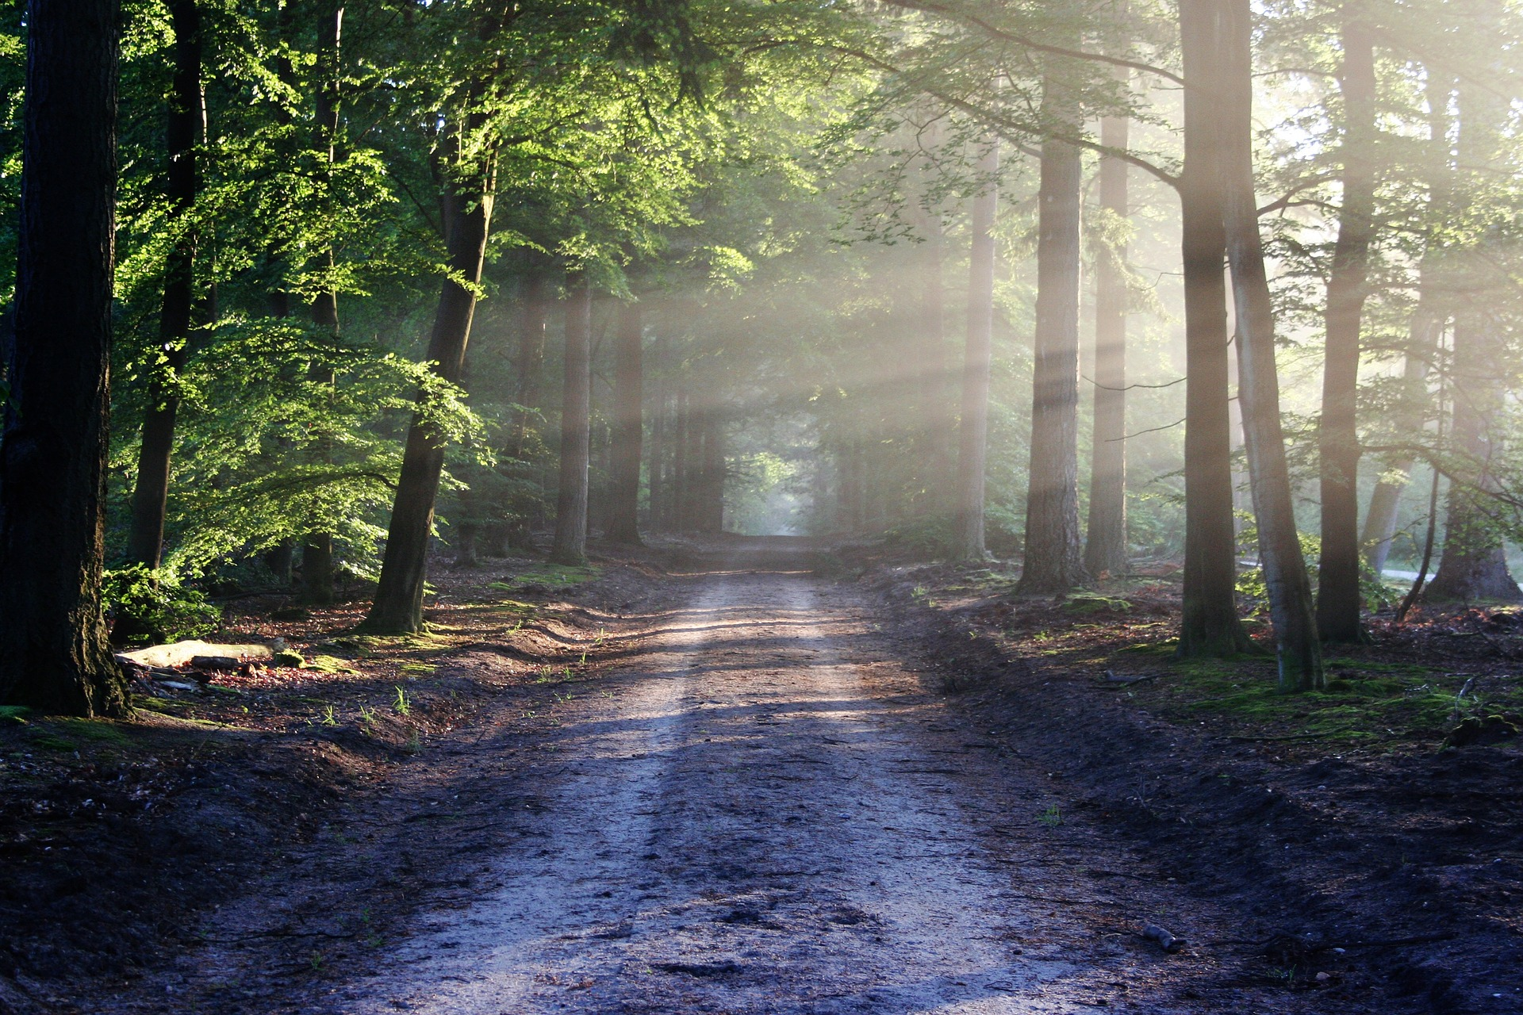
Follow up 1: [5/6]
Écoute. Le mot avec le son [oi], c’est A ou B ?
A
B
baie [bay]
bois [wood]
Notes:
5/6
Transcript:
baie
bois

Slide 9
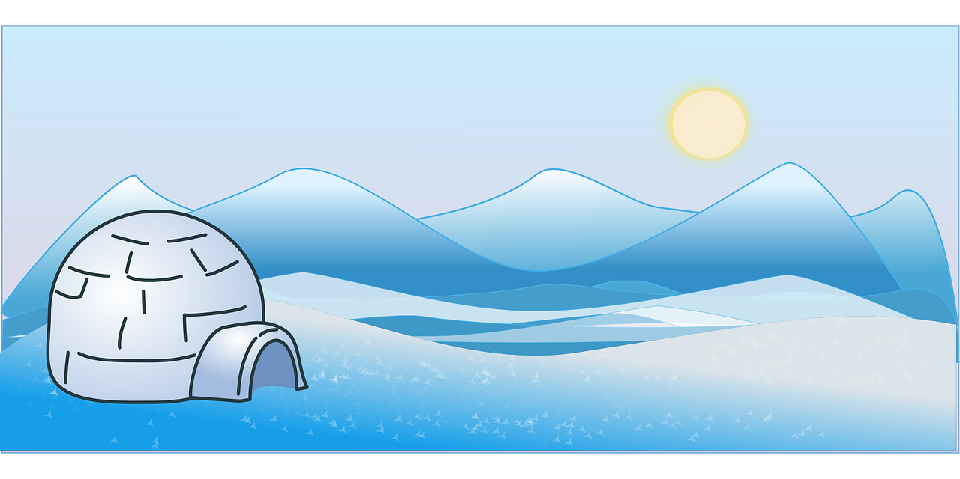
Follow up 1: [6/6]
Écoute. Le mot avec le son [oi], c’est A ou B ?
A
B
froid [cold]
frais [cool]
Notes:
6/6
Transcript:
froid frais

Slide 10
Follow up 2
A Écoute et écris l’article et le mot.
B Écris le mot correct.
écouter
C’est ‘my’, ‘your’, ‘a’ ou ‘the’ ?
E
my | your | a | the
bottle | book
the | my
___ ________ | ma mère
le village | ___ ________
___ ________ | mon déjeuner
___ ________ | ma famille
le weekend | ___ ________
la ville | ___ ________
la mère
1
my | your | a | the
banana | fruit
mon village
2
my | your | a | the
boy | sister
le déjeuner
3
my | your | a | the
day | party
la famille
4
my | your | a | the
brother | house
mon weekend
ma ville
5
my | your | a | the
mum | dad
Notes:
Timing: 10 minutes
Aim: to practise aural comprehension of revisited vocabulary and articles.
Procedure:
(Part A)
Read the instruction in French.
Do [E] with the pupils. Click to listen. Pupils circle the correct article and the corresponding noun.
Click for answer.
Complete items 1-5 and click to correct with the class.
(Part B)
1. Write the word with the correct article.
2. Click to correct.
Transcript 1:
mon [livre]
une [banane] un [garçon]
ta [fête]
ma [maison]
le [père]
Transcript 2:
la mère mon village le déjeuner la famille mon weekend ma famille

Slide 11
Follow up 3:
Pierre est où exactement ? [1/4]
Mont St. Michel is an island that you can read on foot at low tide! It is on the border of Brittany (the region where Adèle and Pierre live) and Normandy.
parler
to watch (a film)
to like (the party)
to help (your brother)
to prefer (Paris)
to live (in a town)
I
You
she
Notes:
Timing: 5 minutes
Aim: to correctly use 1^{st,} 2nd and 3rd person singular verbs in oral production.
Procedure:
Pupils select a pronoun on the vertical axis with verb along the horizontal axis.
They translate the short verb phrase (e.g. I – to watch = je regarde) to identify the square where they think Pierre is.
Click on the square to reveal what is beneath.
Note: pupils might benefit from revisiting the infinitive verbs again before starting the activity. (i.e., regarder, aimer, aider, préférer, habiter).
(!) Pierre is hidden behind….
Tu regardes
Photo attribution: Amaustan, CC BY-SA 4.0 via Wikimedia Commons

Slide 12
Follow up 3:
Pierre est où exactement ? [2/4]
parler
to watch (a film)
to like (the party)
to help (your brother)
to prefer (Paris)
to live (in a town)
I
You
she
Notes:
2/4
(!) Pierre is hidden behind….
Il/elle préfère
Photo attribution: Amaustan, CC BY-SA 4.0 via Wikimedia Commons

Slide 13
Follow up 3:
Pierre est où exactement ? [3/4]
parler
to watch (a film)
to like (the party)
to help (your brother)
to prefer (Paris)
to live (in a town)
I
You
she
Notes:
3/4
(!) Pierre is hidden behind….
j’habite
Photo attribution: Amaustan, CC BY-SA 4.0 via Wikimedia Commons

Slide 14
Follow up 3:
Pierre est où exactement ? [4/4]
parler
to watch (a film)
to like (the party)
to help (your brother)
to prefer (Paris)
to live (in a town)
I
You
she
Notes:
4/4
(!) Pierre is hidden behind….
j’aide
Photo attribution: Amaustan, CC BY-SA 4.0 via Wikimedia Commons

Slide 15
Follow up 4: Écris en français.
J’aide ma mère mais il aide le professeur.
1
_____________________________.
I help my mum but he helps the teacher.
écrire
Je chante à l’école et je chante aussi à la maison.
2
_____________________________.
I sing at school and I also sing at the house/at home.
3
Il habite à Londres mais il préfère Paris.
_____________________________.
He lives in London but he prefers Paris.
Tu aimes l’école mais je préfère le weekend.
4
_____________________________.
You like school but I prefer the weekend.
Elle prépare la fête et elle parle aussi à Maman.
5
____________________________________.
She is preparing the party and she is also talking to mum.
Notes:
Timing: 8 minutes
Aim: to practise written production of vocabulary and structures from this and previous weeks in compound sentences.
Procedure:
Pupils complete the sentences, filling in the missing words from memory.
Click to reveal the written answers.
Click on each number to listen and check answers, as required.
Transcript: J’aide ma mère mais il aide le professeur. Je chante à l’école et je chante aussi à la maison.
Il habite à Londres mais il préfère Paris. Tu aimes l’école mais je préfère le weekend. Elle prépare la fête et elle parle aussi à Maman.
Differentiation:
For less support, remove all the French. For more support, add all French except the verb and aussi. For even more support, provide the missing verb forms, jumbled, in a box on the slide.

Slide 16
vocabulaire
Follow up 5a - Écris en anglais : Can you get at least 15 points?
mots
 | dimanche | jeudi | mardi
 | lundi | mercredi | vendredi
 | de | le jour | chaque
 | le garçon | la fête | le fruit
 | dans | en ce moment | la fille
 | préférer | la ville | le village
Sunday
Thursday
Tuesday
x3
Monday
Wednesday
Friday
from, of
(the) day
each, every
x2
(the) boy
(the) party, celebration
(the) fruit
in
at the moment
(the) girl
x1
to prefer, preferring
(the) town
(the) village
Notes:
Timing: 5-10 minutes
Aim: to practise written comprehension of vocabulary from this week and previous weeks.
Procedure: Give pupils a blank grid. They fill in the English meanings of any of the words they know, trying to reach 15 points in total.
Note: The most recently learnt and practised words are pink, words from the previous week are green and those from earlier are blue, thus more points are awarded for them, to recognise that memories fade and more effort (heavy lifting!) is needed to retrieve them.
16

Slide 17
vocabulaire
Follow up 5b - Écris en français : Can you get at least 15 points?
mots
 | Sunday | Thursday | Tuesday
 | Monday | Wednesday | Friday
 | from, of | (the) day | each, every
 | (the) boy | (the) party, celebration | (the) fruit
 | in | at the moment | (the) girl
 | to prefer, preferring | (the) town | (the) village
dimanche
jeudi
mardi
x3
lundi
mercredi
vendredi
de
le jour
chaque
x2
le garçon
la fête
le fruit
dans
en ce moment
la fille
x1
préférer
la ville
le village
Notes:
Timing: 5-10 minutes
Aim: to practise written comprehension of vocabulary from this week and previous weeks.
Procedure: Give pupils a blank grid. They fill in the French meanings of any of the words they know, trying to reach 15 points in total.
Note: The most recently learnt and practised words are pink, words from the previous week are green and those from earlier are blue, thus more points are awarded for them, to recognise that memories fade and more effort (heavy lifting!) is needed to retrieve them.
17

Slide 18
vocabulaire
Écris en anglais : Can you get at least 15 points?
mots
 | dimanche | jeudi | mardi
 | lundi | mercredi | vendredi
 | de | le jour | chaque
 | le garçon | la fête | le fruit
 | dans | en ce moment | la fille
 | préférer | la ville | le village
x3
x2
x1
Notes:
HANDOUT
18

Slide 19
vocabulaire
Écris en français : Can you get at least 15 points?
mots
 | Sunday | Thursday | Tuesday
 | Monday | Wednesday | Friday
 | from, of | (the) day | each, every
 | (the) boy | (the) party, celebration | (the) fruit
 | in | at the moment | (the) girl
 | to prefer, preferring | (the) town | (the) village
x3
x2
x1
Notes:
HANDOUT
19

