Slide 1
Saying what I and others do
Ma famille et mon ami(e)
possessive adjectives mon, ma, ton, ta
SSC [é/et/ez/er] vs. [è/ê]
rouge
Notes:
Artwork by Steve Clarke. Pronoun pictures from NCELP (www.ncelp.org). All additional pictures selected from Pixabay and are
available under a Creative Commons license, no attribution required.
The AUDIO version of the lesson material includes additional audio for the new language presented (phonics, vocabulary) and audio for the instructions
on the slide.
In addition, it includes VIDEO clips of the phonics and the phonics’ source words. Pupils can be encouraged to look at the shape of the mouth/lips on
slides where these appear, and try to copy it/them.
Phonics: revisit [é] [è] and [e] - répéter [630] frère [1043] cheval [2220]
Vocabulary (new words in bold): passer [90] manger [1338] ami, amie [467] déjeuner [2724] weekend [2475] mon, ma [60] ton, ta [330] voici [1103] Revisit 1: répéter [630] chanter [1820] utiliser [345] phrase [2074] facile [822] important [215] normal [833] avec [23] tous les jours [n/a]
Revisit 2: avoir [8] j’ai, il a, elle a, quoi [297] animal [1002] chien [1744] chat [3138] photo [1412] table [1019] ou [33]
Londsale, D., & Le Bras, Y. (2009). A Frequency Dictionary of French: Core vocabulary for learners London: Routledge.
The frequency rankings for words that occur in this PowerPoint which have been previously introduced in these resources are given in the SOW and in the resources that first introduced and formally re-visited those words. For any other words that occur incidentally in this PowerPoint, frequency rankings will be provided in the notes field wherever possible.
1

Slide 2
prononcer
[è]
[é]
[e]
frère
répéter
cheval
(brother)
Notes:
Timing: 2 minutes
Aim: to recap SSC [è] and [é] and [e].
Procedure:
Introduce and elicit the pronunciation of the individual SSC [è] and the source words ‘frère’, ‘répétér’, which has two spellings of the same sound and SFe.
Click to bring on the picture and get students to repeat (with gesture, if using).
Present and practise the cluster words.
Gesture suggestions: gesture for répéter – hand with thumb and two fingers pointing forwards doing a three downwards motions, one for each syllable of the word.
https://www.signbsl.com/sign/repeat (the 2nd video marked again: repeat with the female signer)
gesture for frère – hands in fists, brought together so knuckles are touching, 2-3 swift up and down movements. https://www.signbsl.com/sign/brother (all 3 videos are similar) gesture for timide – right hand (fingers open palm facing self) brought up towards face as though to cover it https://www.signbsl.com/sign/shy (1st video)
2

Slide 3
prononcer
Dans la classe d’Adèle
Écoute et complète les noms.
C’est [é], [è], ou [e] ?
1
A d è l e
2
3
R e n é
O c é a n e
4
F i d è l e
5
6
S t é p h a n e
M y l è n e
7
A g n è s
8
F r é d é r i c
9
H é l è n e
Notes:
Timing: 5 minutes
Aim: to practise aural distinction of three SSC [è] and [é] and [e].
Procedure:
Pupils write 1 – 9.
Click to listen to each name.
Pupils write either the full name or just the missing letters.
(Note: Some pupils might benefit from a pre-printed sheet with gaps to fill in).
Click to reveal the missing letters.
Elicit the pronunciation of all names from pupils, chorally.
3

Slide 4
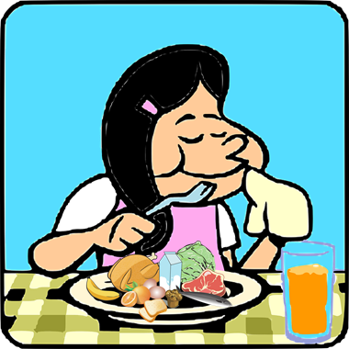
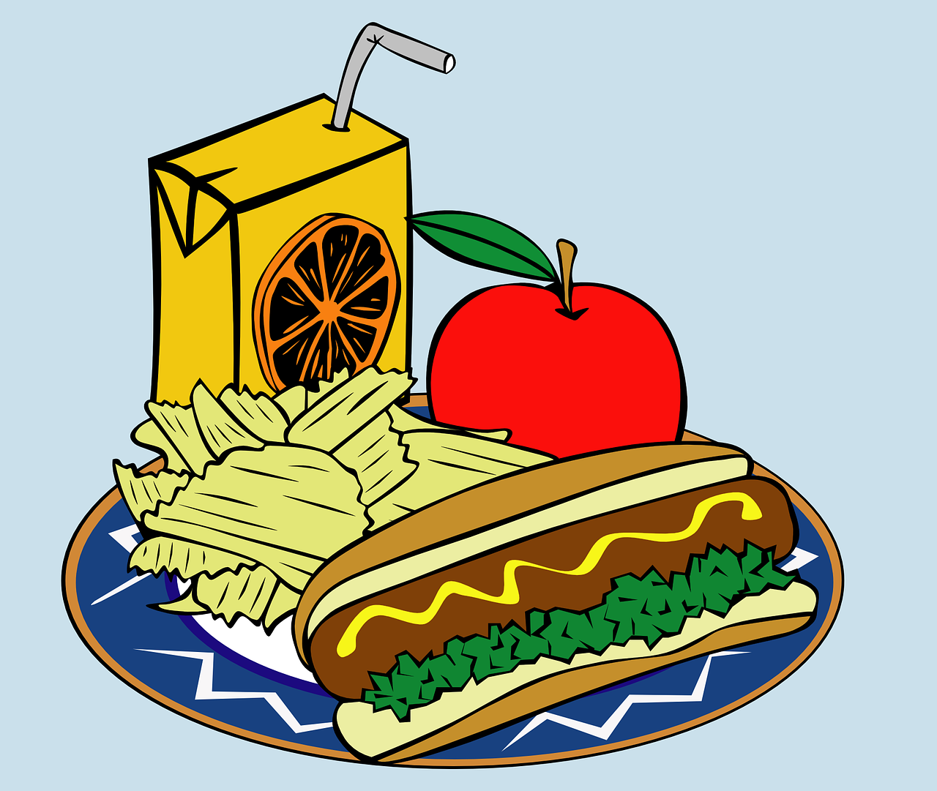
vocabulaire
Lis en anglais et prononce en français.
mots
to pass, spend (time)
passer
to eat, eating
manger
here is, this is
voici
sa
di
(the) lunch
le déjeuner
(the) weekend
le weekend
(the) friend (m)
l’ami
(the) friend (f)
l’amie
Notes:
[1/3]
Timing: 5 minutes (three slides)
Aim: to introduce new vocabulary.
Procedure 1. Pupils either work by themselves or in pairs, reading out the words and recapping their English meaning (1 minute). 2. Then, on the next slide, students try to recall the English orally (chorally), looking at the French (1 minute). 3. Then, on the following slide, they to recall the French meanings orally (again, chorally), looking at the English (1 minute).
Notes:
i) Note that images/words won’t disappear and appear in this activity as in previous resources.
ii) Click on the French words to hear the audio.
4

Slide 5
vocabulaire
C’est quoi en anglais ?
mots
to p_ _ _, s_ _ _ _ (t_ _ _)
passer
to e_ _, e_ _ _ _ _
manger
h_ _ _ i_, t_ _ _ i_
voici
to pass, spend (time)
to eat, eating
here is, this is
sa
di
(t_ _) l_ _ _ _
le déjeuner
(t_ _) w_ _ _ _ _ _
le weekend
(the) lunch
(the) weekend
(the) friend (m)
l’ami
(t_ _) f_ _ _ _ _ (f)
l’amie
(t_ _) f_ _ _ _ _ (m)
(the) friend (f)
Notes:
[2/3]
Procedure: 1. Students try to recall the English orally (chorally), looking at the French (1 minute). 2. Elicit answers and click to reveal. French audio is heard when English meanings appear, for reinforcement. Turn the volume down if you don’t want to hear them.
3. Then, in the following slide, they to recall the French meanings orally (again, chorally), looking at the English (1 minute).
5

Slide 6
vocabulaire
C’est quoi en français ?
mots
p_ _ _ _ _
to eat, eating
m_ _ _ _ _
here is, this is
v_ _ _ _
to pass, spend (time)
passer
manger
voici
sa
di
(the) lunch
le déjeuner
l_ d_ _ _ _ _ _ _
(the) weekend
l_ w_ _ _ _ _ _
le weekend
l’amie
(the) friend (m)
l’_ _ _
(the) friend (f)
l’_ _ _ _
l’ami
Notes:
[3/3]
Procedure: 1. Students recall the French meanings orally (again, chorally), looking at the English (1 minute)
2. Click to reveal the answers.
3. French audio is heard when each French word appears, this time, as a listen and check stage.
6

Slide 7
Saying ‘my’ and ‘your’
We know that all French nouns have gender, and are masculine or feminine.
When the noun starts with a vowel, always use ‘mon’ and ‘ton’: mon ami – my male friend mon amie – my female friend This just makes the words flow better.
We know that there are different words for ‘the’ because of this:
le frère
the brother
la sœur
the sister
le chien
the dog
la famille
the family
For the same reason, there are also different words for ‘my’ and ‘your’:
mon frère
my brother
ma sœur
my sister
ton chien
your dog
ta famille
your family
The French words for ‘my’ and ‘your’ agree with the gender of the noun that follows.
Notes:
Timing: 2 minutes
Aim: to recap singular definite articles and to introduce singular possessive adjectives ‘my’ and ‘your’.
Procedure: 1. Click to present the new information.
2. Elicit responses from pupils, following the animated question marks.

Slide 8
lire
Who has what?
In French, the word for ‘my’ and ‘your’ tells you about the noun:
 |  | chien (m) | maison (f)
 | C’est ton…
 | C’est ma…
 | C’est ta…
 | C’est mon…
1
It is your dog.
2
It is my house.
3
It is your house.
4
It is my dog.
In English, we cannot tell:
 |  | dog | house
 | It’s my…
 | It’s your…
Notes:
Timing: 5 minutes
Aim: to raise awareness that the singular possessive adjectives provide information about the item that is possessed in French, but not in English.
Procedure:
1. Write 1-4 and choose if the sentence refers to a dog, a house, or if it could be either of them.
2. Click to reveal the answers and elicit the English meaning of each sentence.
3. Repeat steps 1-3 with the English sentences.
Note: audio of the sentence beginnings is provided upon clicking the numbered buttons, if required.

Slide 9
écouter
C’est quoi ?
Écoute et décide.
masculine
feminine
 |  | chat | peluche
 |  | film | chanson
 |  | crayon | règle
 |  | livre | gomme
 |  | chapeau | famille
 |  | uniforme | bouteille
1
Voici ton…
2
Voici ma…
3
Voici ta…
4
Voici ton…
5
Voici mon…
6
Voici ma…
Notes:
Timing: 5 minutes
Aim: to practise aural connection of mon, ma, ton, ta with nouns of the correct gender; to practise written comprehension of the possessive adjectives and previously taught nouns in short, simple sentences.
Procedure:
1. Ensure pupils are clear about the task.
2. Click to play number 1 and work through as an example. Pupils listen and decide which noun it must be, based on the form of the possessive adjective they hear.
Note: the table headings masculine and feminine reduce the cognitive load to allow pupils to focus all their attention on connecting the mon/ton with masculine and ma/ta with feminine nouns.
3. Click to reveal the answer.
4. Continue with items 2 – 6 and reveal answers. Full sentence audio is attached to the answer ticks.
5. Click to bring up the sentence beginnings and elicit the English meaning for each sentence, to practise written comprehension of voici, the possessive adjectives and to revisit previously taught nouns.
Transcript:
Voici ton [chat] Voici ma [chanson] Voici ta [règle] Voici ton [livre] Voici mon [chapeau] Voici ma [bouteille]
9

Slide 10
lire
C’est qui* ?
Adèle écrit des messages à Clémentine.
qui = who
Ma mère est calme.
1
mère | frère
Mon frère est triste, aujourd‘hui.
2
1
2
Mon frère chante mal. ☹
3
3
Ma mère regarde un film.
4
4
[1/2]
Notes:
Timing: 5 minutes (two slides)
Aim: to practise gender agreement with mon/ma and ton/ta.
Note: the nouns are limited to people with “biological” gender at this stage to avoid cognitive overload. Invariable adjectives are used so that the possessive adjective is the only clue to the gender of the noun.
Procedure:
Students write 1-8 and write the noun that matches each possessive adjective.
Answers are revealed on clicks.
English translations can also be elicited.
4. If desired, full sentence audio is heard upon clicking the dark blue audio buttons.

Slide 11
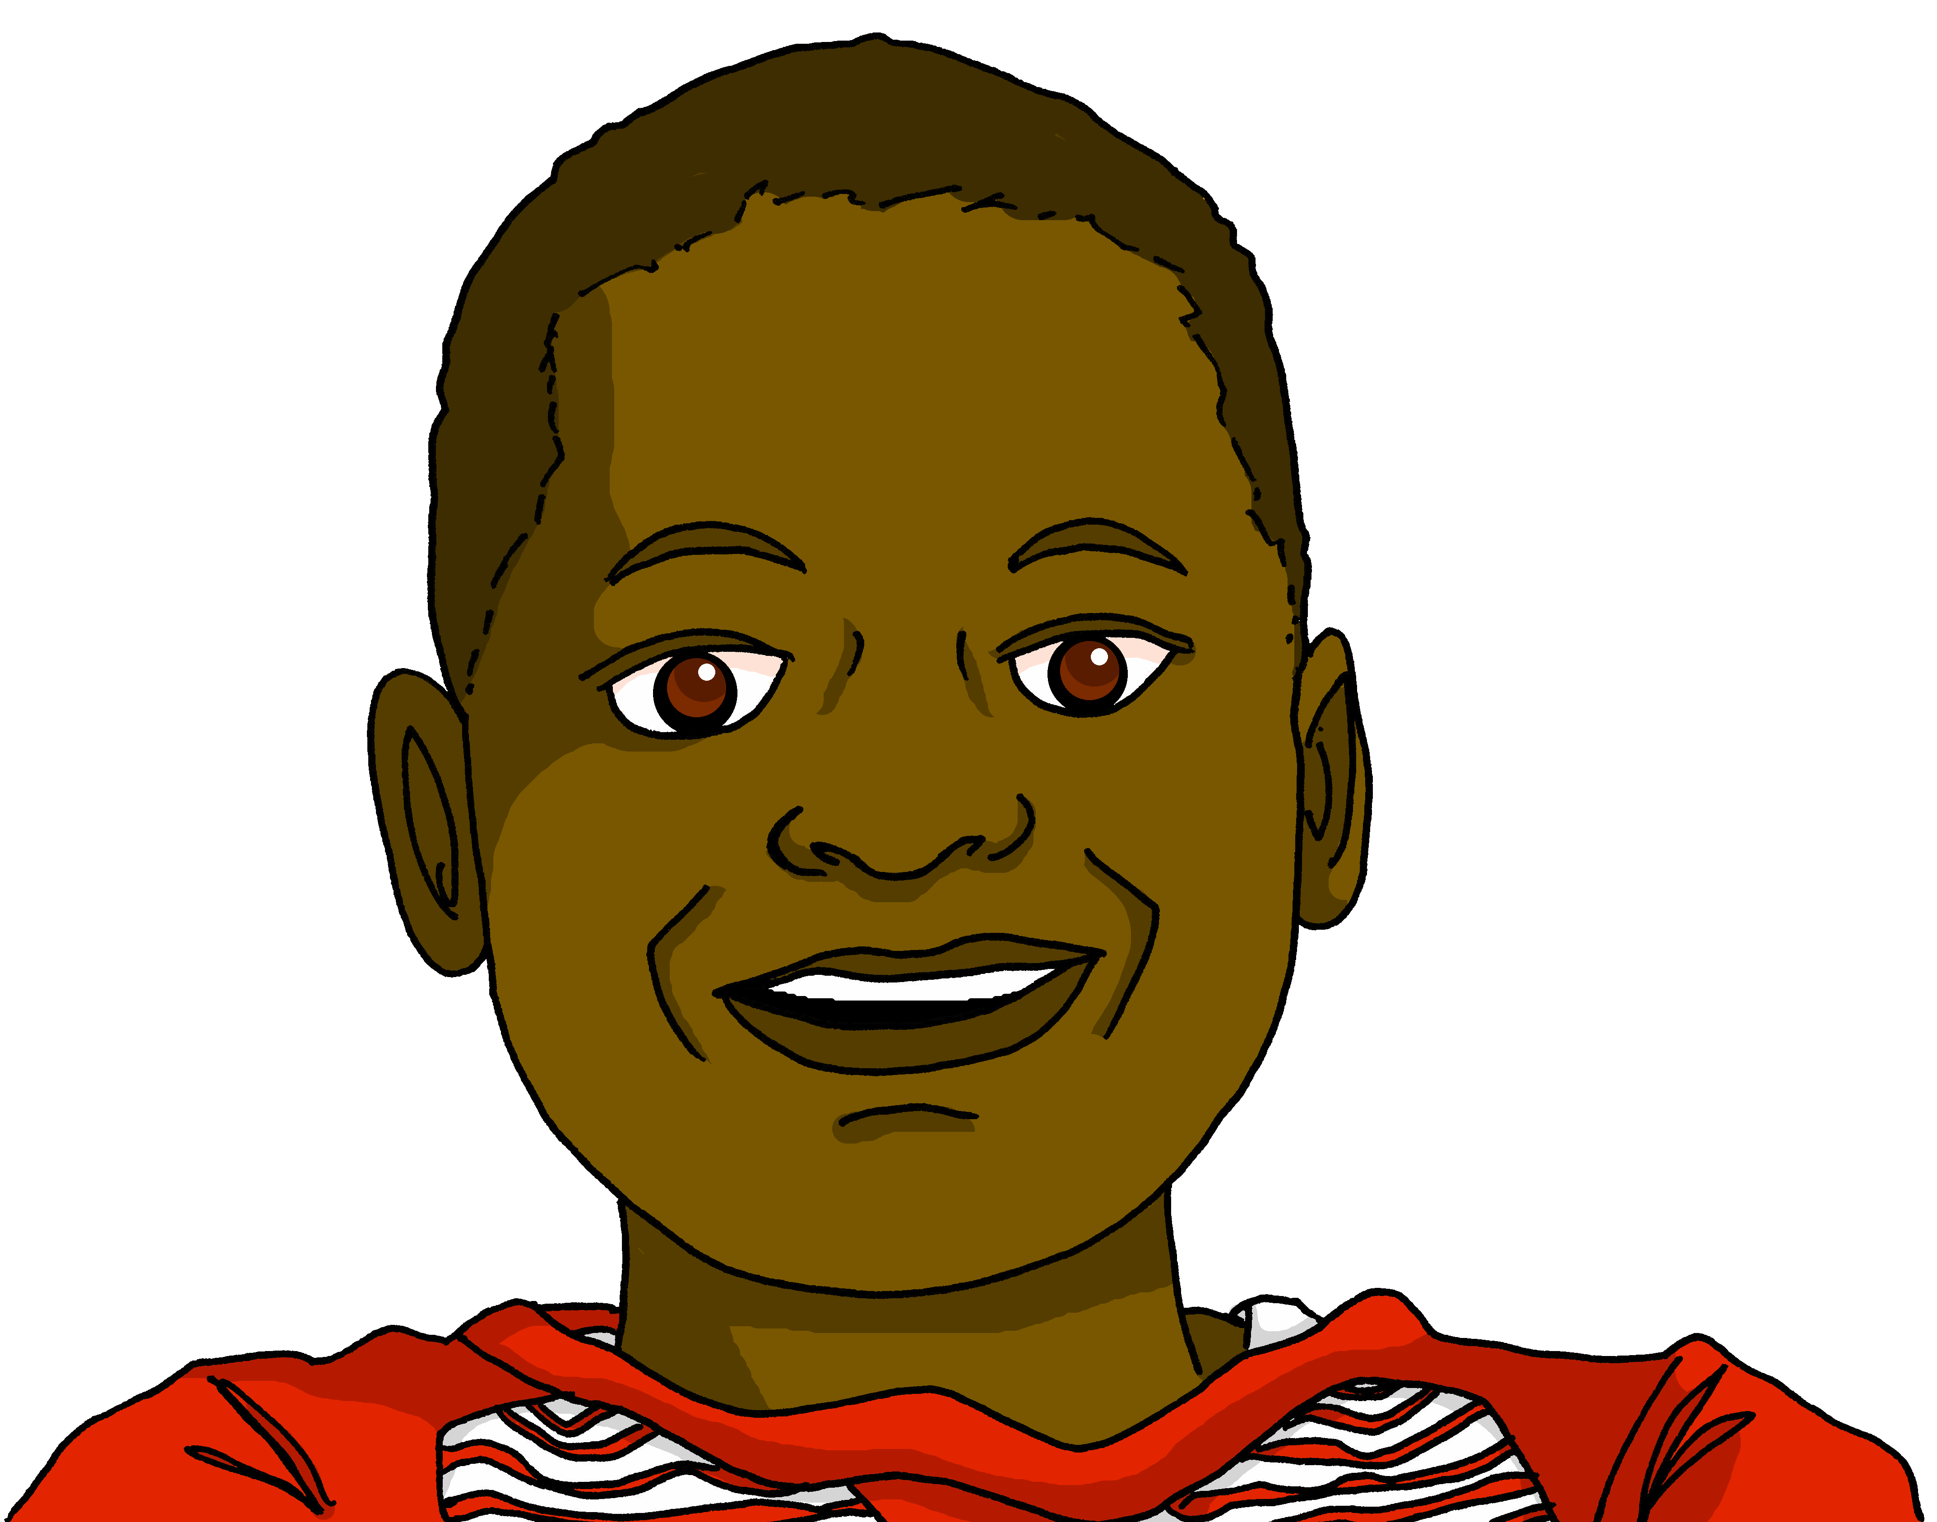
lire
C’est qui* ?
Jean-Michel écrit des questions à Pierre.
qui = who
Ta sœur écoute une chanson ?
5
père | sœur
Ton père passe le weekend à la maison ?
6
5
Ton père prépare le déjeuner ?
6
7
7
Ma sœur mange un sandwich.
8
8
[2/2]
Notes:
[2/2]

Slide 12
Au revoir !
rouge
Notes:
12

