Slide 1
Saying what I and others do
La famille
rouge
Follow ups 1-5
Notes:
Artwork by Steve Clarke. Pronoun pictures from NCELP (www.ncelp.org). All additional pictures selected from Pixabay and are available under a Creative Commons license, no attribution required.
Phonics: revisit closed [eu] and introduce open [eu] un peu [91] peur [755] jeune [152] neuf [787] acteur [1552] seul [102]
Vocabulary (new words in bold): donner [46] préparer [368] trouver [83] famille [172] frère [1043] mère [645] père [559] sœur [1558] le [1] la [1] à (meaning ‘to’) [4]
Revisit 1: --
Revisit 2: un [3] une [3] ballon [3692] bouteille [2979] cahier [4001] jeu [291] orange [3912] peluche [>5000] sac [2343] stylo [>5000] (revisit banane)
Londsale, D., & Le Bras, Y. (2009). A Frequency Dictionary of French: Core vocabulary for learners London: Routledge.
The frequency rankings for words that occur in this PowerPoint which have been previously introduced in these resources are given in the SOW and in the resources that first introduced and formally re-visited those words.
For any other words that occur incidentally in this PowerPoint, frequency rankings will be provided in the notes field wherever possible.

Slide 2
closed [eu]
open [eu]
prononcer
un peu
peur
It sounds like the ‘ur’ in ‘hurt’.
[a bit]
[fear]
This is a closed vowel. When you say this sound, your tongue is near the top of your mouth.
This is an open vowel. When you say this sound, your tongue is near the bottom of your mouth.
Notes:
Timing: 2 minutes
Aim: to recap closed and open [eu].
Procedure:
Click to bring up the closed [eu]. Repeat the SSC [eu] with the class.
Click to bring up the phrase ‘un peu’ (with gesture, if using).
Click to bring up the English translation and picture.
Pupils to practise saying the phrase several times.
Click to bring up the callout about closed vowel tongue position.
Click to bring up the open [eu]. Repeat the SSC with the class.
Click to bring up the word ‘peur’ (with gesture, if using).
Click to bring up the English translation and picture, and the callout hint about ‘hurt’.
Say this SSC several times with the class.
Click to bring up the call out about open SSC [eu].
Practise alternating between ‘peu’ and ‘peur’ several times.

Slide 3
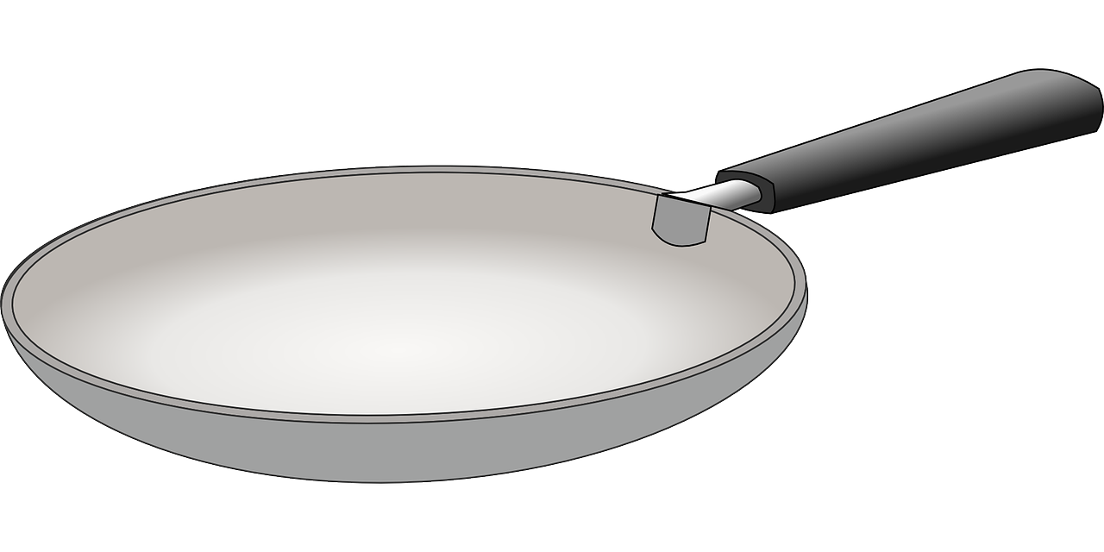
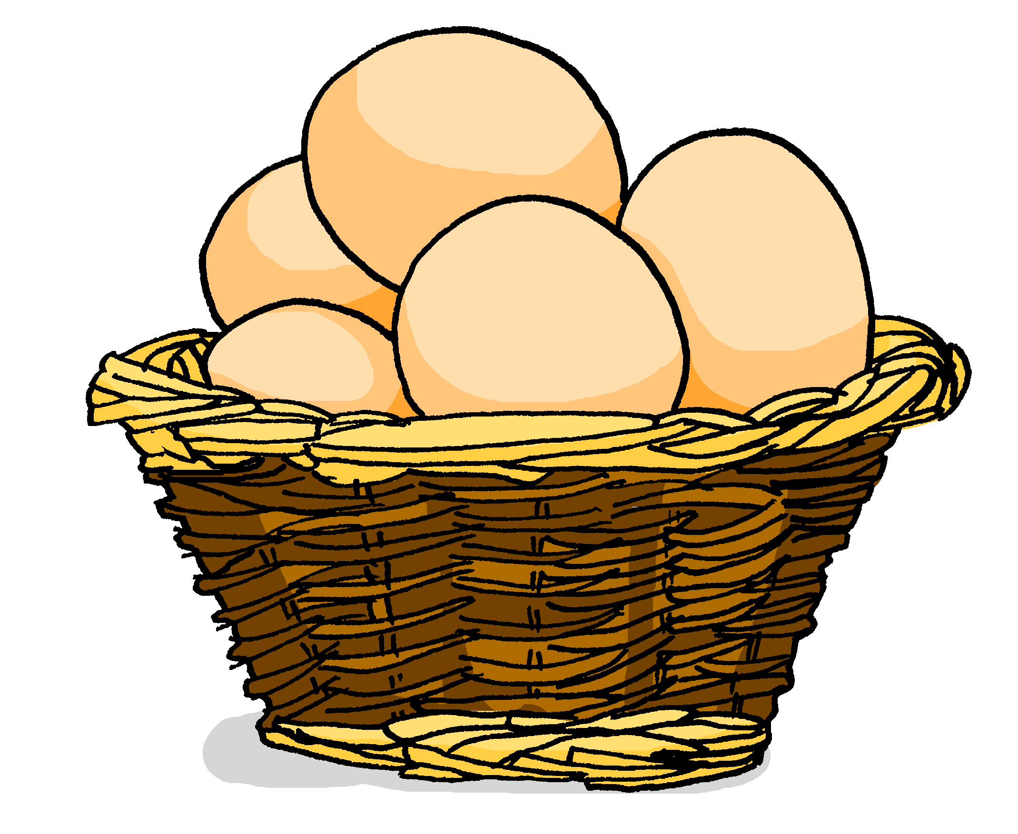
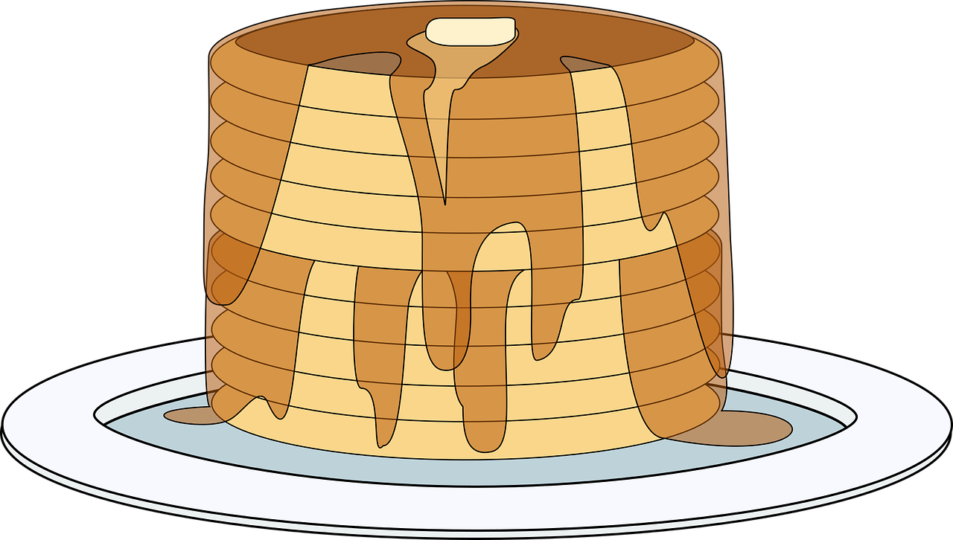
Follow up 1:
La chandeleur
closed and open[eu]
 | closed [eu] | open [eu]
1
2
3
4
5
6
Le deux février en France, c’est la Chandeleur.
C’est une fête* délicieuse.
Adèle, la sœur de Pierre, prépare des crêpes.
Elle utilise des œufs, de la farine et du beurre.
Pierre mange neuf crêpes pour le quatre-heures.*
Bon appétit, Pierre ! Oh non ! Il a mal au cœur* !
le cœur means heart but avoir mal au cœur means to feel sick.
la fête – festival | le quatre-heures – afternoon snack
Notes:
Timing: 3 minutes
Aim: to practise the pronunciation of SSC [é, er] in a short text about the new year.
Procedure:
Tell pupils there will be a maximum of two [eu] sounds per sentence (could be different or the same).
Click for pupils to hear each line. (Click the pink button to hear the audio without text. Mouse clicks bring up each line of text with audio.) Pupils note each time they hear a closed or open [eu]. Click to correct the responses.
Pupils now pronounce the text aloud in pairs, line by line.
If desired, the teacher can click to play each line after pupils have spoken for a listen and check.

Slide 4
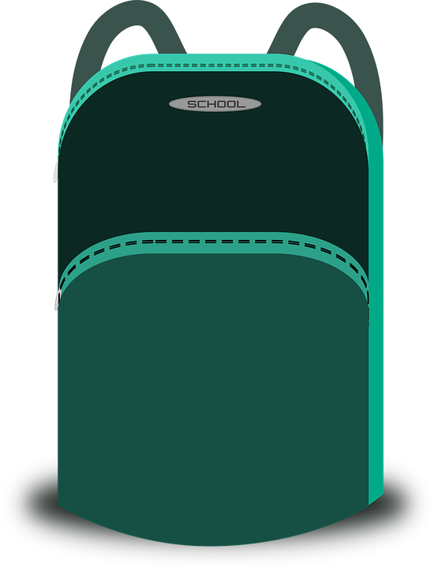
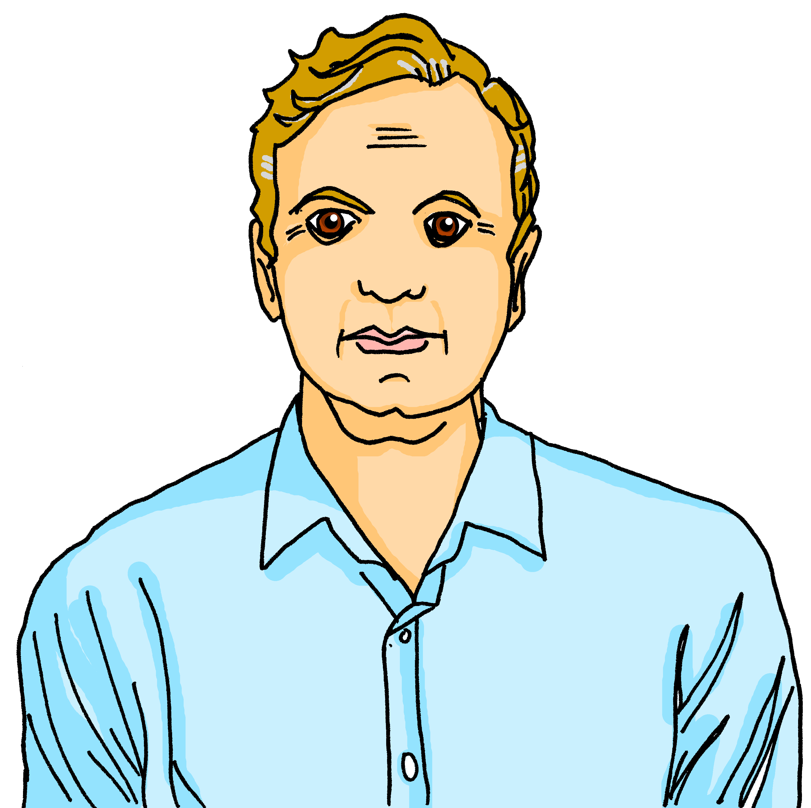
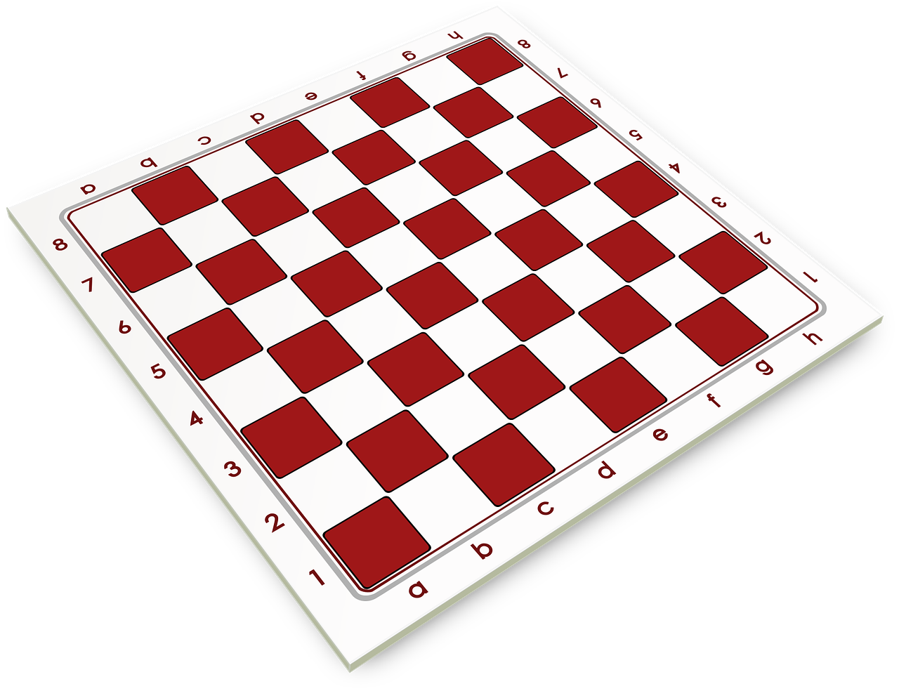
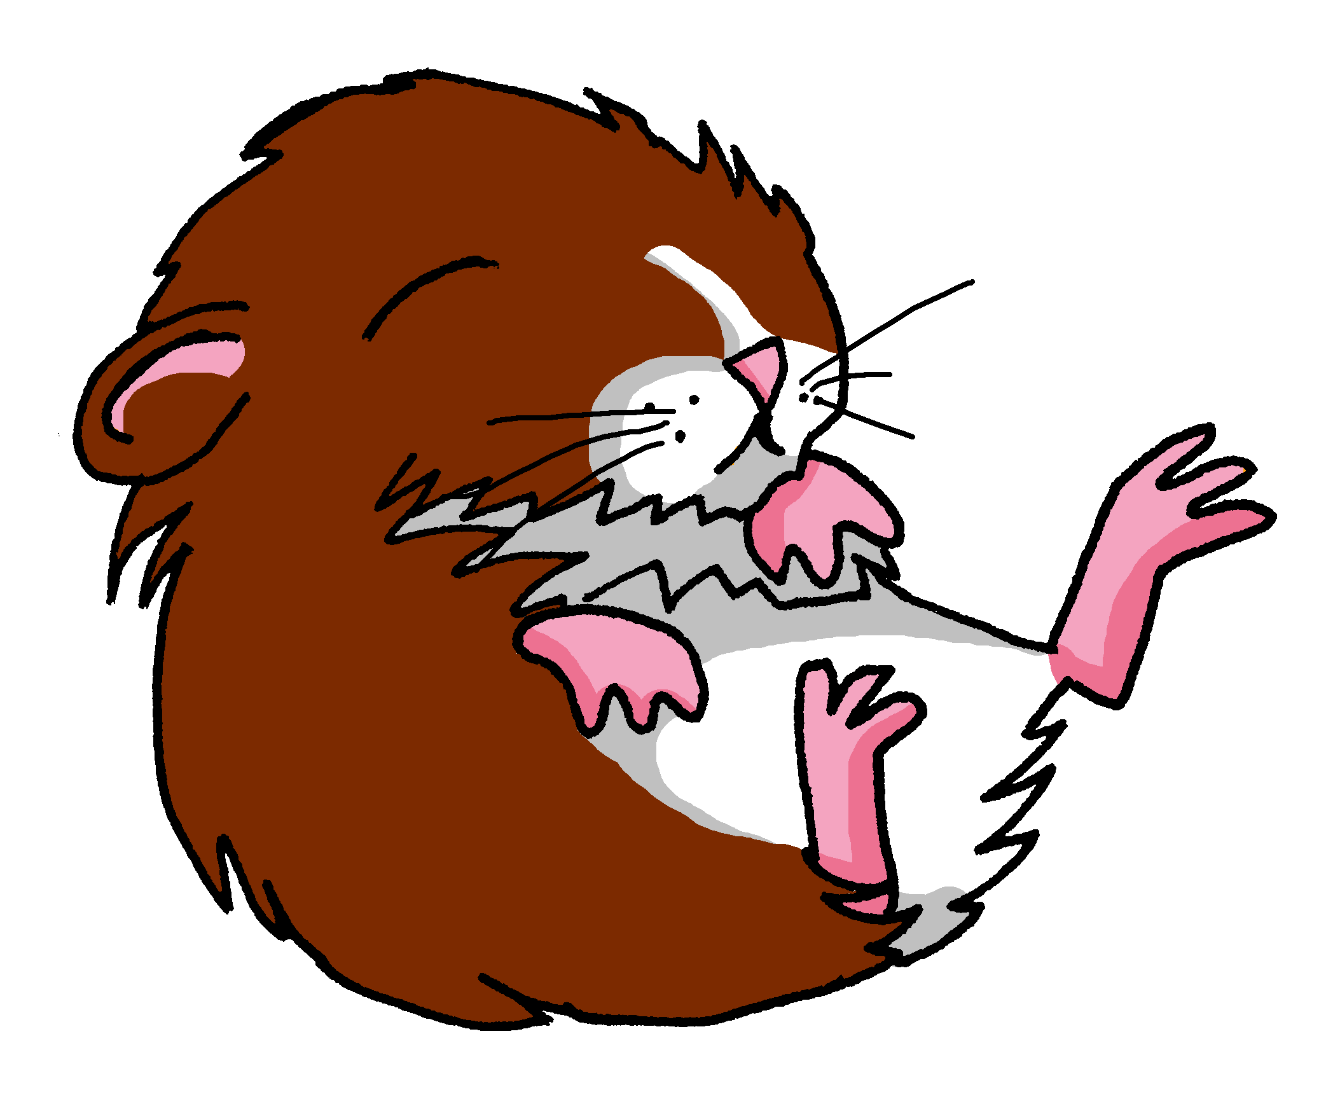
Follow up 2:
Trouve l’intrus.
parler
A
D
le
le
la
le
la
la
B
E
le
la
le
l’
l’
le
C
F
la
la
le
la
le
la
Notes:
Timing: 5 minutes
Aim: To identify the odd one out by identifying the gender of each noun.
Procedure:
See if students can infer what to do from the near cognate intrus in the task instructions.
Call letters A-E and ask ‘C’est où, l’intrus ?’
Students answer with the French word.
Click to reveal answers and articles.
Word frequency of unknown words: intrus [>5000]
Source: Londsale, D., & Le Bras, Y. (2009). A Frequency Dictionary of French: Core vocabulary for learners London: Routledge.

Slide 5
Follow up 3
C’est le ou la (ou l’) ?
mots
vocabulaire
[le]
[la]
(the) bottle
(the) bag
(the) game
(the) exercise book
(the) animal
(the) mother
(the) brother
(the) father
(the) cuddly toy
(the) orange
(the) family
(the) ball
(the) pen
(the) sister
Notes:
Timing: 5 minutes
Aim: to practise aural production of and distinction between le and la; to produce previously taught vocabulary orally and from memory
Procedure:
Click for each word to appear
Pupils produce the word with the correct article ‘le’, ‘la’ or ‘l’.
Click again for it to disappear into the corresponding pacperson’s mouth.

Slide 6
Follow up 4:
Parle en français.
Personne A
Personne B
parler
1. Le [frère] a un cadeau. 2. La [peluche] chante une chanson. 3. La [famille] prépare la maison. 4. La [mère] utilise le stylo. 5. Le [père] porte un uniforme.
Notes:
Timing: 10 minutes
Aim: oral production and aural recognition of definite articles. Note: this activity could also be a writing task on mini whiteboards.
Procedure:
1. Pupils work in pairs. Partner A faces the board, partner B turns away with a copy of their role card on paper or a separate screen (see the handout at the end of this presentation).
2. Partner A reads each sentence to their partner but does not say out loud the word that is crossed out.
3. On their sheet, Partner B ticks the noun that matches the word for the that partner A said. They then write the rest of the sentence in the appropriate gaps.
4. Partner B turns back and checks their solution against the answer slide.
5. Pupils swap roles.
Differentiation: for additional support teachers can pre-provide some of the words, e.g., the object nouns, leaving pupils to write only the correct subject noun from memory and transcribe the verb they hear.

Slide 7
Follow up 4: Personne B – les réponses
parler
1.
1
Le
frère
a
un
cadeau.
2.
2
La
peluche
chante
une
chanson.
3.
3
La
famille
prépare
la
maison.
4.
4
La
mère
utilise
le
stylo.
5.
5
Le
père
porte
un
uniforme.
Notes:
Answers 1. Le [frère] a un cadeau. 2. La [peluche] chante une chanson. 3. La [famille] prépare la maison. 4. La [mère] utilise le stylo. 5. Le [père] porte un uniforme.

Slide 8
Follow up 4:
Parle en français.
Personne B
Personne A
parler
1. Le [père] prépare le gâteau. 2. Le [chien] regarde un film. 3. La [sœur] a le jeu. 4. La [famille] trouve le cadeau. 5. Le [frère] répète la phrase.

Slide 9
Follow up 4: Personne A – les réponses
parler
1.
1.
1
Le
père
prépare
le
gâteau.
2.
2.
2
Le
chien
regarde
un
film.
3.
3.
3
La
sœur
a
le
jeu.
4.
4.
4
La
famille
trouve
le
cadeau.
5.
5.
5
Le
frère
répète
la
phrase.
Notes:
Answers 1. Le [père] prépare le gâteau. 2. Le [chien] regarde un film. 3. La [sœur] a le jeu. 4. La [famille] trouve le cadeau. 5. Le [frère] répète la phrase.

Slide 10
vocabulaire
Follow up 5 - Écris en anglais : Can you get at least 15 points?
mots
 | le sac | la peluche | le stylo
 | le jeu | le cahier | l’orange
 | une | le ballon | la bouteille
 | le | la | un
 | le frère | la sœur | à
 | la famille | la mère | le père
 | donner | préparer | trouver
(the) bag
(the) cuddly toy
(the) pen
x3
(the) game
(the) exercise book
(the) orange
a, an (f)
(the) ball
(the) bottle
x2
the (m)
the (f)
a, an (m)
(the) brother
(the) sister
to, at
(the) family
(the) mother
(the) father
x1
to give, giving
to prepare, preparing
to find, finding
Notes:
Timing: 5-10 minutes
Aim: to practise written comprehension of vocabulary from this week and previous weeks.
Procedure: Give pupils a blank grid. They fill in the English meanings of any of the words they know, trying to reach 15 points in total.
Note: The most recently learnt and practised words are pink, words from the previous week are green and those from earlier are blue, thus more points are awarded for them, to recognise that memories fade and more effort (heavy lifting!) is needed to retrieve them.
10

Slide 11
vocabulaire
Follow up 5 - Écris en français : Can you get at least 15 points?
mots
 | (the) bag | (the) cuddly toy | (the) pen
 | (the) game | (the) exercise book | (the) orange
 | a (f) | (the) ball | (the) bottle
 | the (m) | the (f) | a (m)
 | (the) brother | (the) sister | to, at
 | (the) family | (the) mother | (the) father
 | to give, giving | to prepare, preparing | to find, finding
le sac
la peluche
le stylo
x3
le jeu
le cahier
l’orange
une
le ballon
la bouteille
x2
le
la
un
le frère
la sœur
à
la famille
la mère
le père
x1
donner
préparer
trouver
Notes:
Timing: 5-10 minutes
Aim: to practise written comprehension of vocabulary from this week and previous weeks.
Procedure: Give pupils a blank grid. They fill in the French meanings of any of the words they know, trying to reach 15 points in total.
Note: The most recently learnt and practised words are pink, words from the previous week are green and those from earlier are blue, thus more points are awarded for them, to recognise that memories fade and more effort (heavy lifting!) is needed to retrieve them.
11

Slide 12
Follow up 4: Personne B - handout
parler
1.
2.
3.
4.
5.
Notes:
Handout

Slide 13
Follow up 4: Personne A - handout
parler
1.
2.
3.
4.
5.
Notes:
Handout

Slide 14
vocabulaire
Écris en anglais : Can you get at least 15 points?
mots
 | le sac | la peluche | le stylo
 | le jeu | le cahier | l’orange
 | une | le ballon | la bouteille
 | le | la | un
 | le frère | la sœur | à
 | la famille | la mère | le père
 | donner | préparer | trouver
x3
x2
x1
Notes:
HANDOUT
14

Slide 15
vocabulaire
Écris en français : Can you get at least 15 points?
mots
 | (the) bag | (the) cuddly toy | (the) pen
 | (the) game | (the) exercise book | (the) orange
 | a (f) | (the) ball | (the) bottle
 | the (m) | the (f) | a (m)
 | (the) brother | (the) sister | to, at
 | (the) family | (the) mother | (the) father
 | to give, giving | to prepare, preparing | to find, finding
x3
x2
x1
Notes:
HANDOUT
15

