Slide 1
Saying what I and others do
Activités en classe
rouge
Follow ups 1-5
Notes:
Artwork by Steve Clarke. Pronoun pictures from NCELP (www.ncelp.org). All additional pictures selected from Pixabay and are available under a Creative Commons license, no attribution required.
Phonics: [é] [er] répéter [630] écrire [382] bébé [2271] donner [46] parler [106]
Vocabulary (new words in bold): répéter [630] chanter [1820] utiliser [345] phrase [2074] facile [822] important [215] normal [833] avec [23] tous les jours [n/a] Revisit 1: jour [78] chaque [151] revisit days of the week
Revisit 2: lundi [1091] mardi [1044] mercredi [1168] jeudi [1112] vendredi [1086] samedi [1356] dimanche [1235] aujourd’hui [233] ce (c') [12]
Londsale, D., & Le Bras, Y. (2009). A Frequency Dictionary of French: Core vocabulary for learners London: Routledge.
The frequency rankings for words that occur in this PowerPoint which have been previously introduced in these resources are given in the SOW and in the resources that first introduced and formally re-visited those words.
For any other words that occur incidentally in this PowerPoint, frequency rankings will be provided in the notes field wherever possible.

Slide 2
prononcer
[é]
[er]
répéter
écrire
parler
bébé
donner
[to give]
Notes:
Timing: 2 minutes
Aim: to recap SSC [é] and [er], which are the same sound written differently.
Procedure:
Introduce and elicit the pronunciation of the individual SSC [é] and [er] then the source word ‘répéter’, which has both spellings of the sound.
Click to bring on the picture and get students to repeat (with gesture, if using).
Present and practise the cluster words. Note that pupils already know écrire and parler from term 1.
Gesture: gesture for répéter – hand with thumb and two fingers pointing forwards doing a three downwards motions, one for each syllable of the word.
https:/./www.signbsl.com/sign/repeat (the 2nd video marked again: repeat with the female signer).
Note that the cluster words are also suggestive of simple gestures that teachers may want to use to elicit the words from pupils in the practice phase.
2

Slide 3
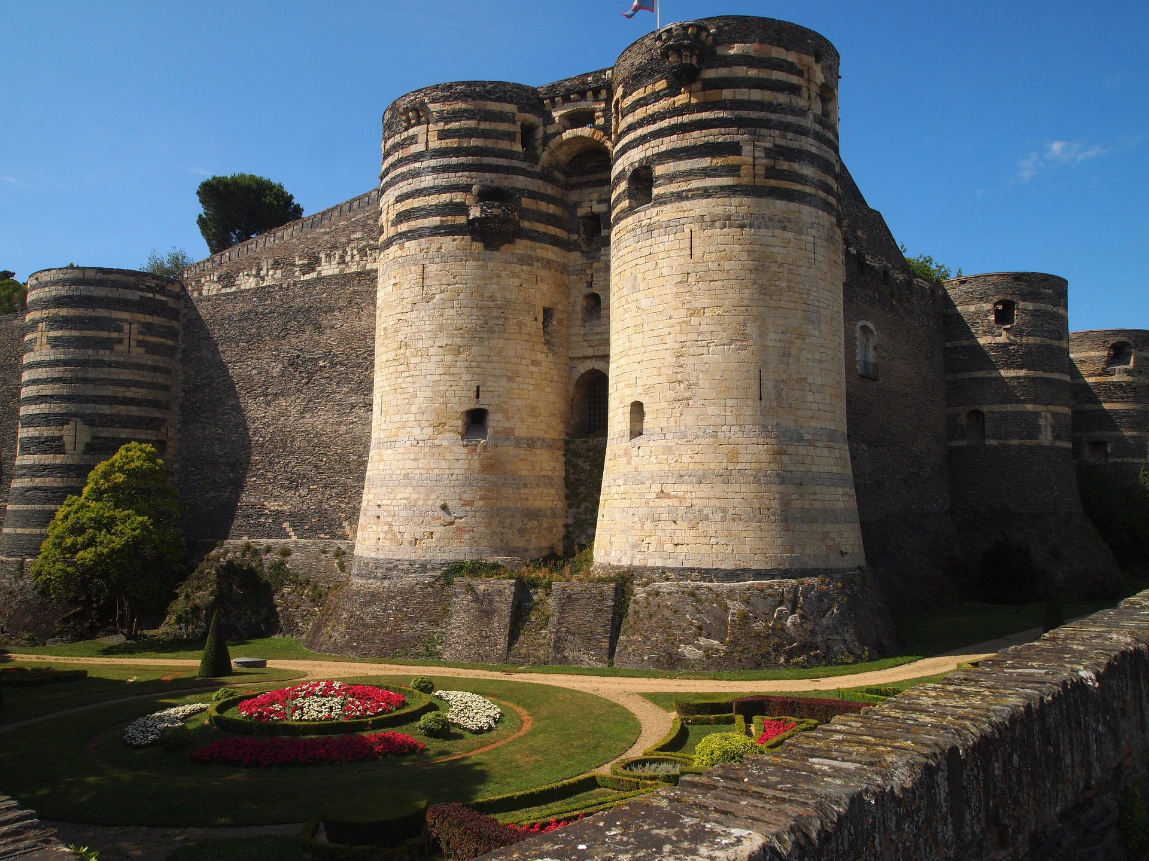
Follow up 1:
Écoute. C’est [e] ou [é]/[er] ?
[é][er]
 | ville
 | G r e n o b l e
 | A n g e r s
 | B é z i e r s
 | B e z o n s
 | M e l u n
 | O r l é a n s
 | C h a m b é r y
 | L e M a n s
Angers a un château. C’est fantastique !
prononcer
1
__
Choisis une ville. Ton/ta partenaire devine.
2
__
Grenoble Angers
Béziers Bezons
Melun Orléans
Chambéry Le Mans
3
__
__
4
__
5
__
6
__
7
__
une ville = a town/city
8
__
deviner = to guess
un chateau = a castle
Notes:
Timing: 3 minutes
Aim: to develop phonological awareness of SSC [é, er].
Procedure: Part A
Click to listen to each city name.
Pupils write the missing letter or letters. Make it clear to pupils that they are differentiating two sounds, but that the é sound can be written in two ways – they will get credit for either way of writing the é sound.
Click to check.
Click to bring up and read the information about Angers.
Part B
Click to bring up instruction.
Partner A writes down one city, partner B tries to guess by asking ‘Tu as… ? + one of the cities on the board.
3. Teachers circulate to listen to pupils’ pronunciation and praise/correct as necessary.
Transcript Grenoble Angers Béziers Bezons Melun Orléans Chambéry Le Mans

Slide 4
Follow up 2: Vocabulaire
mots
Excellent !
vocabulaire
3. une phrase
8. ce, c’
5. important
6. utiliser
1. répéter
10. normal
9. facile
11. tous les jours
2. chanter
4. un jour
7. chaque
12. avec
to repeat, repeating
important
normal
to sing, singing
a day
every day
a phrase
to use, using
this, that
each, every
easy
with
Notes:
Timing: 5 minutes Aim: to practise written comprehension and spoken pronunciation of vocabulary.
Procedure: 1. Students write 1-12 in books.
2. Ask students to say the French word and write down the English translation before the word has faded away (5 sec per word)
3. Click for English translation to be highlighted. 4. Repeat for all 12 items.
5. Check answers by eliciting the French from students, (i.e. so that they are translating back from their written English into spoken French).
6. If desired, click on the English meanings to hear the French.
Note: Students have not yet done numbers but will be taught them explicitly in Week 7. However, in the next few weeks, certain activities will prime for them. Here the teacher can say the number when eliciting the answers, but support understanding by holding up the appropriate number of fingers each time. Obviously, the items proceed in number order in any case, so the finger gesture is more to draw learners attention to the sound – meaning connection of the number with the French word for that number.
ANSWERS 1. répéter
2. chanter
3. une phrase
4. un jour
5. important
6. utiliser
7. chaque
8. ce, c’
9. facile
10. normal 11. tous les jours 12. avec

Slide 5
Follow up 3:
Adèle parle avec sa cousine Clémentine.
Écoute. Le verbe, c’est quoi ?
écouter
Écris la lettre et l’adjectif en anglais.
A
B
 | image | adjectif | information extra
1
D
easy
(to read) in English
2
F
normal
(repeating) in class
C
D
3
A
fun
(to sing) a phrase
(having) an ex. book for vocabulary
4
E
important
5
B
important
(to write) every day
E
F
6
C
impossible
(to speak) with a pencil
to have
Notes:
Timing: 5 minutes
Aim: to practise aural comprehension of the I and you forms of avoir and previously taught nouns.
Procedure:
Read the title / context of the activity.
Click x2 to bring up instructions in French.
To support pupils, elicit the French for A-F.
Do number 1 with them. Click to listen and bring up answer.
Pupils listen to 2-6. The first time of listening, pupils write the letter. The second time, pupils aim to write down the English meaning of the adjective and any additional details.
Click to reveal answers.
Transcript:
1. C’est facile de lire en anglais. 2. Répéter en classe est normal. 3. C’est amusant de chanter une phrase. 4. Avoir un cahier pour le vocabulaire est important. 5. C’est important d’écrire tous les jours. 6. Parler avec un crayon est impossible !

Slide 6
Follow up 4a:
A Lis les phrases.
lire
Le verbe correct, c’est où ?
 | Phrase en français
 | C’est super de chanter le dimanche.
 | Avoir un dictionnaire, c’est normal !
 | C’est important de parler avec Mme Dior.
 | Lire une gomme, c’est impossible !
 | Parler avec un partenaire, c’est facile !
 | C’est amusant de parler en français.
verbe en anglais
to sing | singing | to talk | talking
to use | using | having | to have
speaking | to speak | to repeat | repeating
reading | to read | writing | to write
to talk | talking | to listen | listening
singing | speaking | to sing | to speak
1
2
3
4
5
6
Notes:
Timing: 5 minutes
Aim: to revisit the position of the infinitive in French and its translation into English.
Procedure:
Read the instruction in French.
Click to bring up further instruction and clarify meaning.
Do number 1 with pupils. Paying attention to the position of the infinitive, pupils to identify the correct translation.
Pupils do 2-6.
Go through answers.

Slide 7
Follow up 4b:
B Écris les phrases en anglais.
lire
 | Phrase en français | Phrase en anglais
 | C’est super de chanter le dimanche.
 | Avoir un dictionnaire, c’est normal !
 | C’est important de parler avec Mme Dior.
 | Lire une gomme, c’est impossible !
 | Parler avec un partenaire, c’est facile !
 | C’est amusant de parler en français.
1
It’s great to sing on Sunday.
2
Having a dictionary is normal!
3
It’s important to talk to Mrs Dior.
4
Reading a rubber is impossible!
5
Talking with a partner is easy!
6
It’s fun to speak in French.
Notes:
Timing: 5 minutes
Aim: to practise written comprehension of infinitives and adjectives.
Procedure:
Read the instruction in French.
Pupils use their notes from [A] to translate the sentences.

Slide 8
vocabulaire
Follow up 5 - Écris en français : Can you get at least 15 points?
mots
 | today | this, that | to read, reading
 | Friday | Saturday | Sunday
 | Tuesday | Wednesday | Thursday
 | a day | each, every | Monday
 | normal | with | everyday
 | a phrase | easy | important
 | to sing, singing | to repeat, repeating | to use, using
aujourd’hui
ce, c’
lire
x3
vendredi
samedi
dimanche
mardi
mercredi
jeudi
x2
un jour
chaque
lundi
normal
avec
tous les jours
une phrase
facile
important
x1
chanter
répéter
utiliser
Notes:
Timing: 5-10 minutes
Aim: to practise written comprehension of vocabulary from this week and previous weeks.
Procedure: Give pupils a blank grid. They fill in the French meanings of any of the words they know, trying to reach 15 points in total.
Note: The most recently learnt and practised words are pink, words from the previous week are green and those from week 1 are blue, thus more points are awarded for them, to recognise that memories fade and more effort (heavy lifting!) is needed to retrieve them.
8

Slide 9
vocabulaire
Écris en français : Can you get at least 15 points?
mots
 | today | this, that | to read, reading
 | Friday | Saturday | Sunday
 | Tuesday | Wednesday | Thursday
 | a day | each, every | Monday
 | normal | with | everyday
 | a phrase | easy | important
 | to sing, singing | to repeat, repeating | to use, using
x3
x2
x1
Notes:
HANDOUT
9

