Slide 1
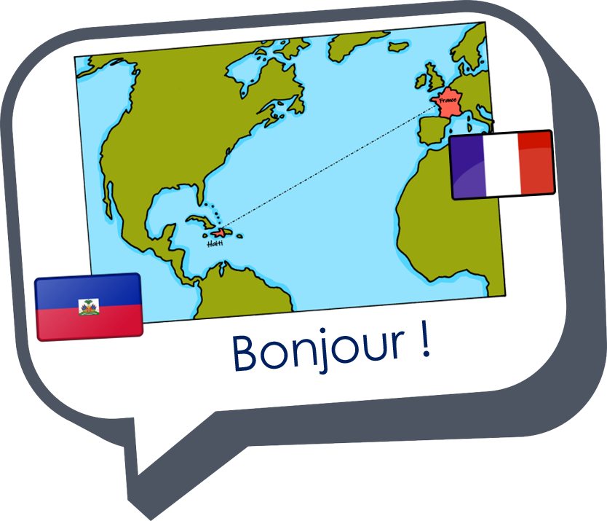
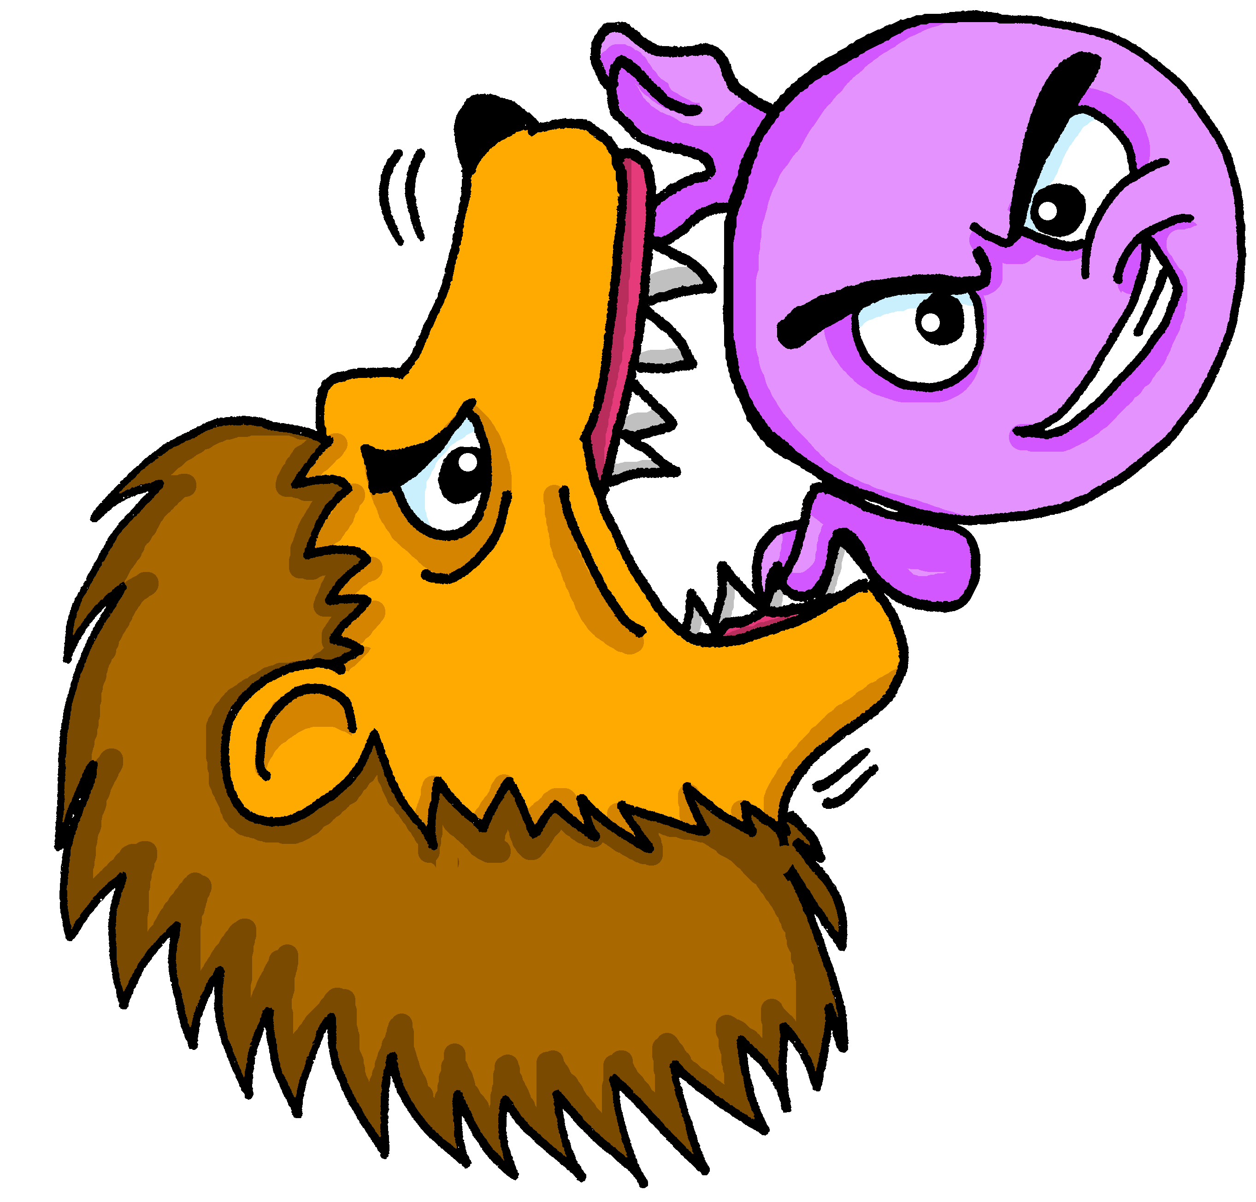
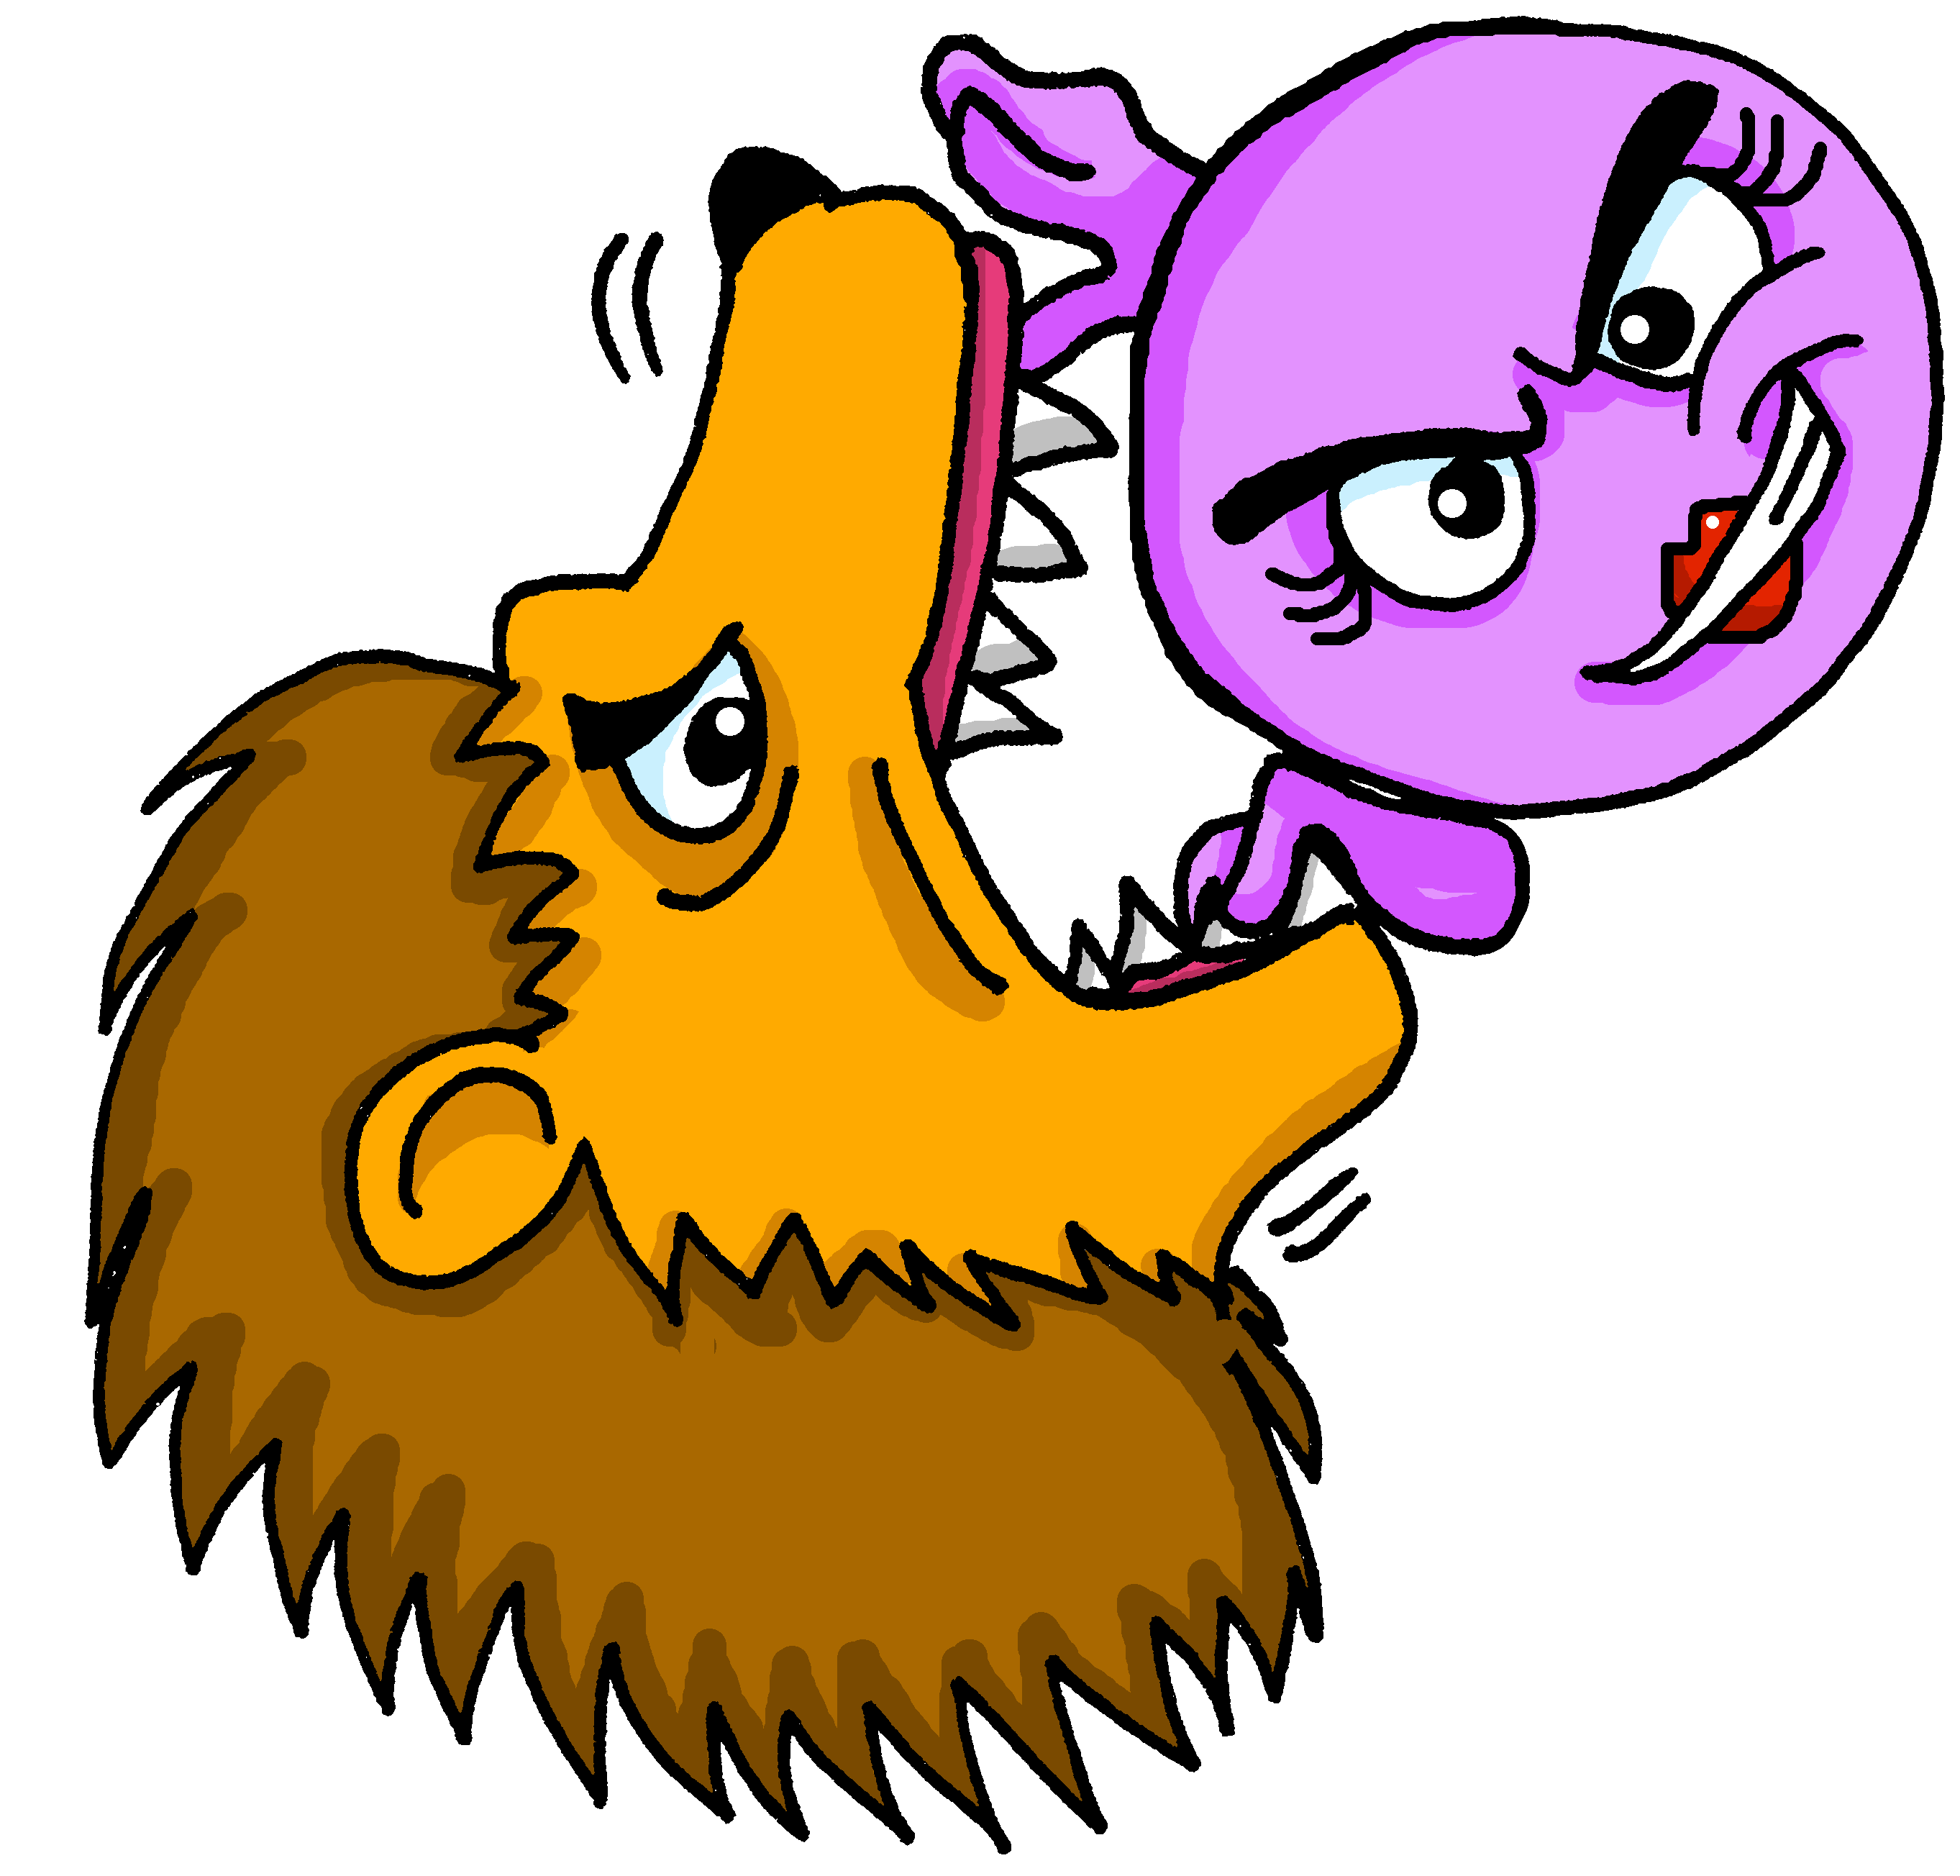
Describing me and others
courageux
courageuse
Review of « Être » : je suis, tu es, il/elle est
Adjectival agreement
(-eux, -euse)
closed and open [eu]
rouge
Notes:
Artwork by Steve Clarke. Pronoun pictures from NCELP (www.ncelp.org). All additional pictures selected from Pixabay and are
available under a Creative Commons license, no attribution required.
The AUDIO version of the lesson material includes additional audio for the new language presented (phonics, vocabulary)
and audio for the instructions on the slide.
In addition, it includes VIDEO clips of the phonics and the phonics’ source words. Pupils can be encouraged to look at the
shape of the mouth/lips on slides where these appear, and try to copy it/them.
Phonics: revisit closed [eu] - deux [41] un peu [91] jeu [291]
Frequency of new words:
Vocabulary: semaine [245] courageux [2198] curieux [2424] heureux [764] sérieux [412] Revisit days of the week
Londsale, D., & Le Bras, Y. (2009). A Frequency Dictionary of French: Core vocabulary for learners London: Routledge.
The frequency rankings for words that occur in this PowerPoint which have been previously introduced in these resources are
given in the SOW and in the resources that first introduced and formally re-visited those words.
For any other words that occur incidentally in this PowerPoint, frequency rankings will be provided in the notes field wherever
possible.
1

Slide 2
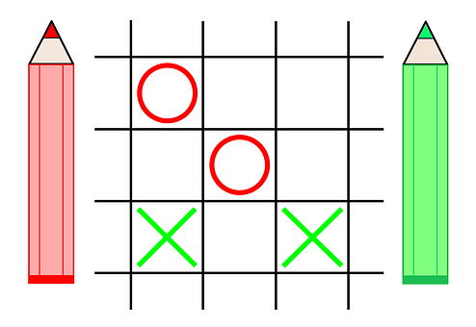
[eu]
deux
prononcer
un peu
un jeu
[a little bit]
[a game]
Notes:
Timing: 1 minute
Aim: to revisit SSC [eu]
Procedure:
Introduce and elicit the pronunciation of the individual SSC [eu].
Click to bring up the source word ‘deux’ (with gesture, if using).
Say the word and bring up the reminder that the final –t is silent.
Pupils to practise saying the word several times.
Repeat the process with ‘un peu’ and ‘un jeu’.
Notes:
a gesture for ‘deux’ might be to do the British Sign Language gesture for two: https://www.signbsl.com/sign/two Note: if teachers want to avoid a backwards ‘v’ they could instead use the front-facing peace ‘v’ symbol.
a gesture for ‘un petit peu’ might be to mimic the gesture from the picture.
pupils have already learnt ‘petit’ and in week 8 they will learn ‘un/une’ meaning ‘a’.
a gesture for ‘un jeu’ might be to use the BSL for ‘game’, as shown here: https://www.youtube.com/watch?v=5Hg3s6pxusM

Slide 3
vocabulaire
Écoute et répète.
mots
sérieux
curieux
serious (m)
curious (m)
Notes:
Timing: 2 minutes (two slides)
Aim: to present and practise new vocabulary for this week.
Procedure:
Click to bring up the word. Say the word.
Click for the English meaning. Say the French word again. Pupils repeat.
Click to bring up the picture. Say the word again, together with pupils this time.
Click for the reminder of the pronounced –s for the feminine form.
Continue with the next four slides.
3

Slide 4
vocabulaire
Écoute et répète.
mots
courageux
heureux
brave (m)
happy (m)
Notes:
Timing: 4 minutes (five slides)
Aim: to present and practise new vocabulary for this week.
Procedure:
Click to bring up the word. Say the word.
Click for the English meaning. Say the French word again. Pupils repeat.
Click to bring up the picture. Say the word again, together with pupils this time.
Click for the reminder of the pronounced –s for the feminine form.
Continue with the next four slides.
4

Slide 5
vocabulaire
Écoute et répète.
mots
brave (m)
curieux
courageux
Notes:
Timing: 2 minutes (four slides)
Aim: to practise written comprehension and pronunciation of this week’s new vocabulary.
Procedure:
Click to bring up the English word and picture prompt.
Click to bring up two options.
Pupils say the correct word.
Click to reveal answer tick.
Continue with next slides.
5

Slide 6
vocabulaire
Lis et identifie.
mots
serious (m)
sérieux
curieux
Notes:
[2/4]
6

Slide 7
vocabulaire
Lis et identifie.
mots
happy (m)
heureux
sérieux
Notes:
[3/4]
7

Slide 8
vocabulaire
Lis et identifie.
mots
curious (m)
courageux
curieux
Notes:
[4/4]
8

Slide 9
Using adjectives
This [eu] is closed, too.
Adjectives ending in -eux change to -euse when describing feminine nouns.
This [eu] is closed, like deux.
-eux ending is often like –ous in English.
Je suis sérieux.
I (a boy) am serious.
Masculine
Tu es sérieux.
You (a boy) are serious.
An ‘e’ at the end means you do pronounce the ‘s’.
Il est sérieux.
He is serious.
Je suis sérieuse.
I (a girl) am serious.
Feminine
Tu es sérieuse.
You (a girl) are serious.
Elle est sérieuse.
She is serious.
Notes:
Timing: 3 minutes
Procedure:
Read the grammar explanation about adjective agreement.
Elicit English translation for the French examples provided.
Draw pupils’ attention to the SFC ‘s’ and to the change you hear when an ‘e’ is added to the feminine form.

Slide 10
vocabulaire
Écoute et répète.
mots
The ‘e’ at the end means you do pronounce the ‘s’. This ‘e’ is called Silent Final ‘e’ [Sfe].
sérieux
sérieuse
serious (m)
serious (f)
Notes:
Timing: 2 minutes (four slides)
Aim: to present and practise new vocabulary for this week in masculine and feminine forms.
Procedure:
Click to bring up the word. Say the word.
Click for the English meaning. Say the French word again. Pupils repeat.
Click to bring up the picture. Say the word again, together with pupils this time.
Click for the reminder of the pronounced –s for the feminine form.
Continue with the next four slides.
10

Slide 11
vocabulaire
Écoute et répète.
mots
curieux
curieuse
curious (m)
curious (f)
Notes:
[2/4]
11

Slide 12
vocabulaire
Écoute et répète.
mots
courageux
courageuse
brave (m)
brave (f)
Notes:
[3/4]
12

Slide 13
vocabulaire
Écoute et répète.
mots
heureux
heureuse
happy (m)
happy (f)
Notes:
[4/4]
13

Slide 14
lire
Lis le texte.
In her diary, Adèle describes how her friends are.
Aïe, aïe, aïe ! She is as clumsy as Pierre! With hot chocolate on it we can’t read the names. Is it Léa or Yves or could it be either?
maintenant – now les deux – both
Léa est courageuse.
Écris :
Léa, Yves ou les deux* ?
Yves est sérieux.
adjectif | Léa | Yves | either | anglais
Yves est curieux.
courageuse
brave
sérieux
serious
Léa est malade aujourd’hui.
curieux
curious
Léa est heureuse.
malade
ill, sick
Yves est calme maintenant*.
heureuse
happy
calme
calm
Notes:
Timing: 8 minutes
Aim: to practise written understanding of adjective agreement and vocabulary from this and previous weeks.
Procedure:
Explain the task to pupils.
Ask students to write down the adjective & the person it refers to (Léa, Yves or either). Encourage them to write down the English meaning too.
The answers are animated – click to bring up the adjective, again for the tick and the name in the diary, and again to reveal the English meaning. For those statements that could be both, you can ask students to suggest who they think it is briefly before revealing the name (Léa ou Yves?).

Slide 15
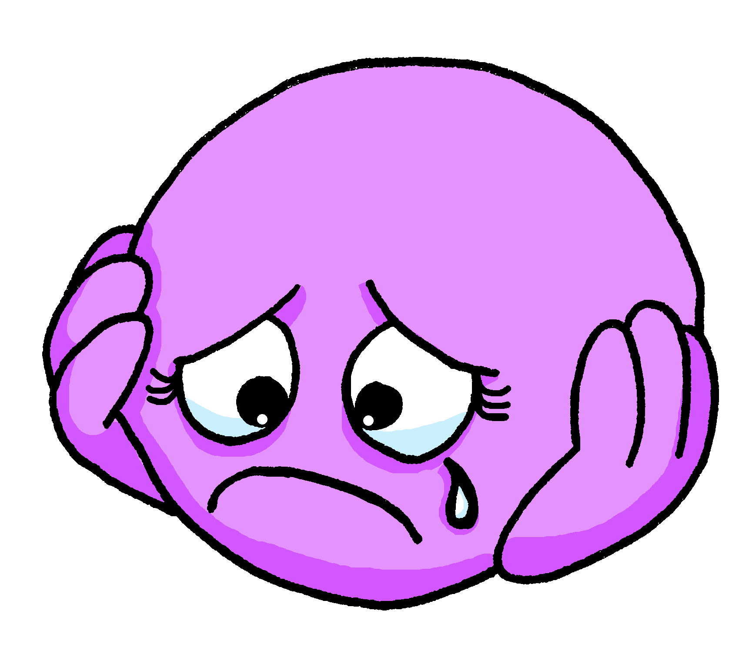
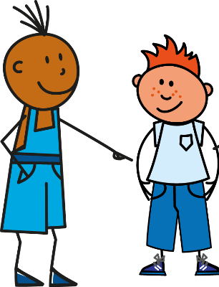
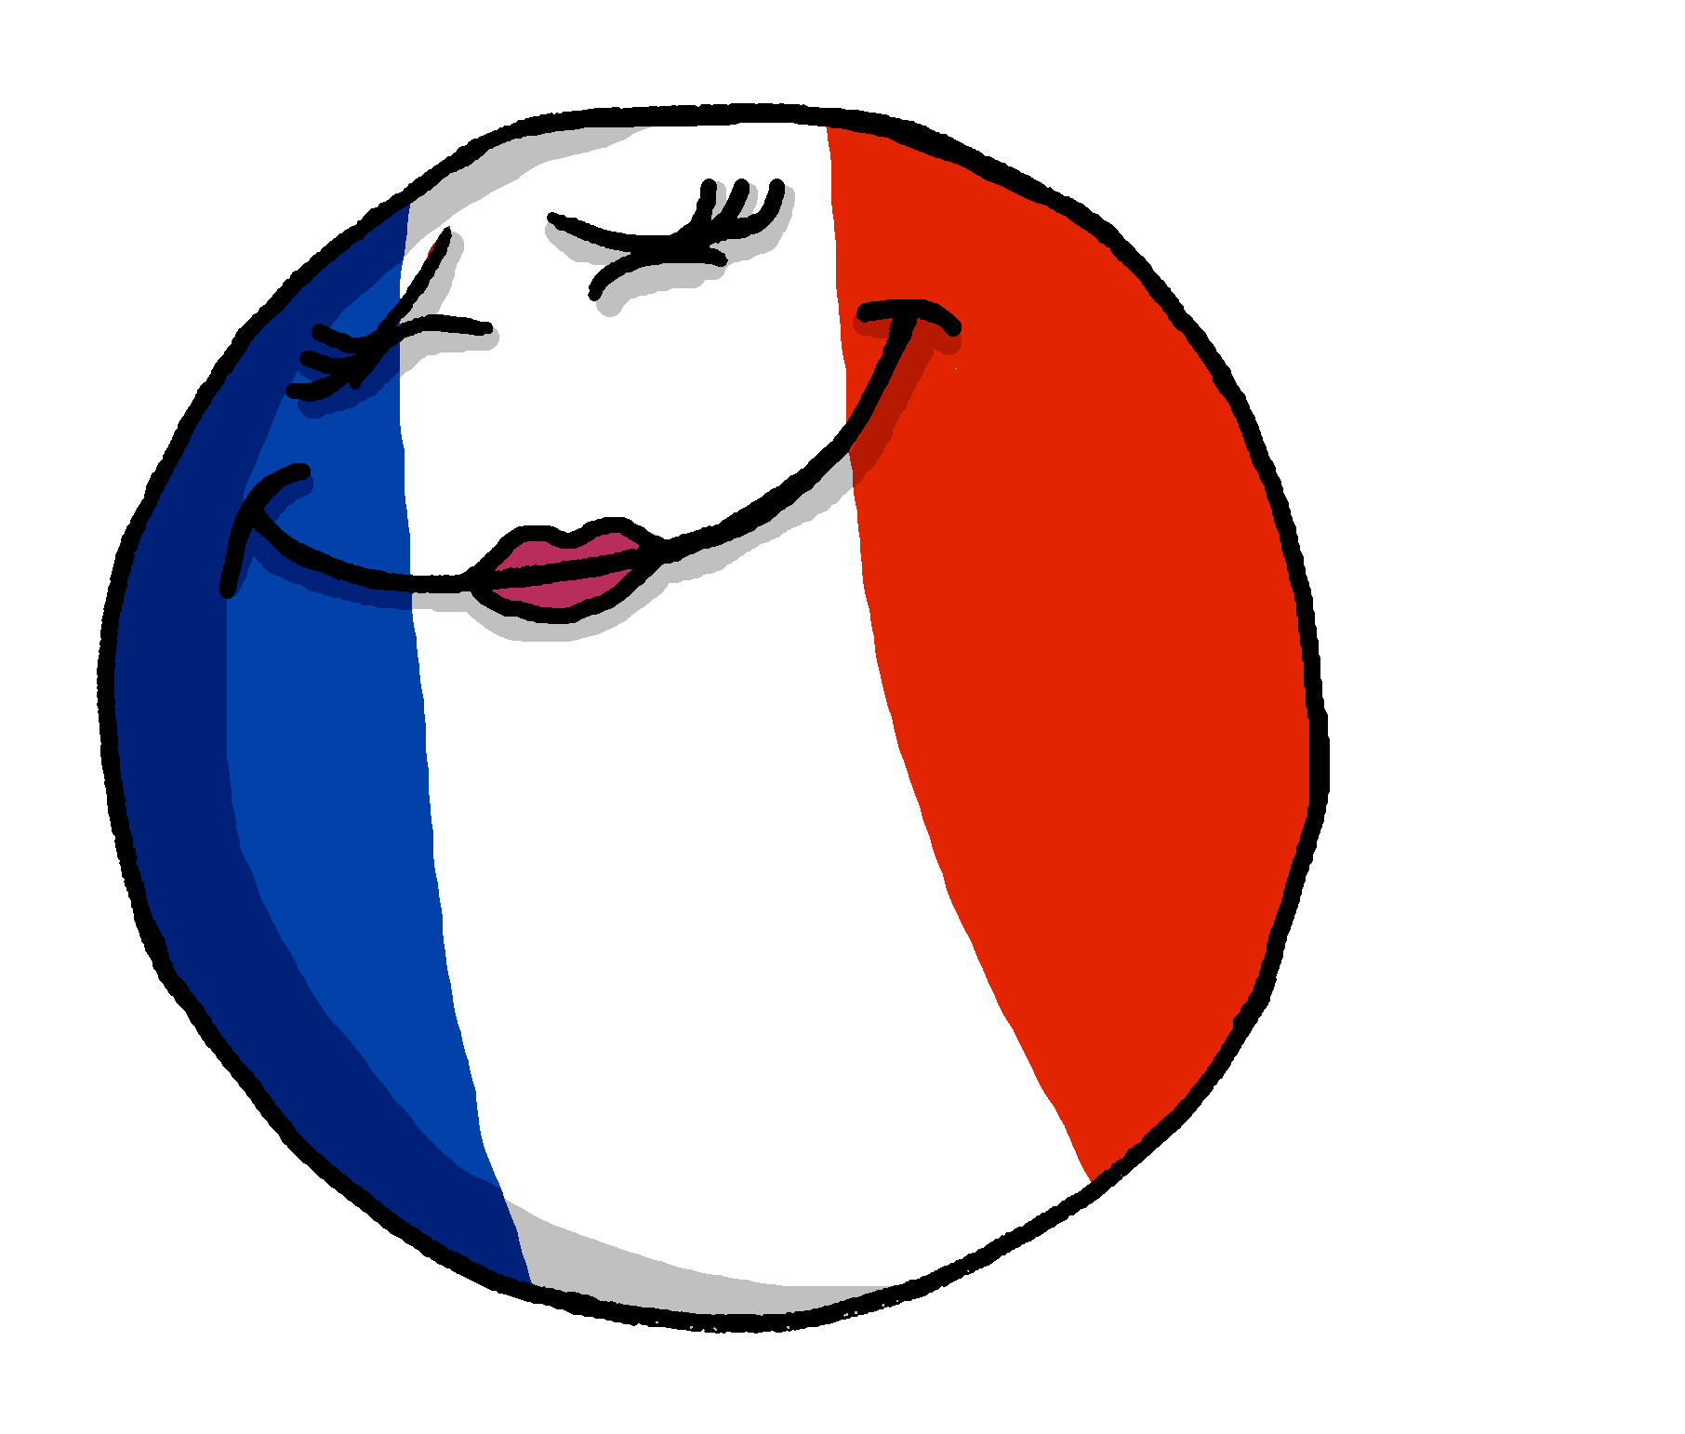
parler
Parle en français.
Navigate the maze.
serious (f.)
sad (m/f)
happy (f.)
curious (m.)
pleased (f.)
you
happy (m.)
tall (f.)
brave (m.)
small (f.)
French (f.)
English (m.)
Notes:
Timing: 2 minutes
Aim: to practise oral production of vocabulary from this week and the revisited week.
Procedure:
Explain the task to pupils.
Ask students to call out each word (in the correct form) when they see the picture and prompt word spinning.
Click again to move the feet on.
Click again to spin the next prompt.
15

Slide 16
Au revoir !
rouge
Notes:
16

