Slide 1
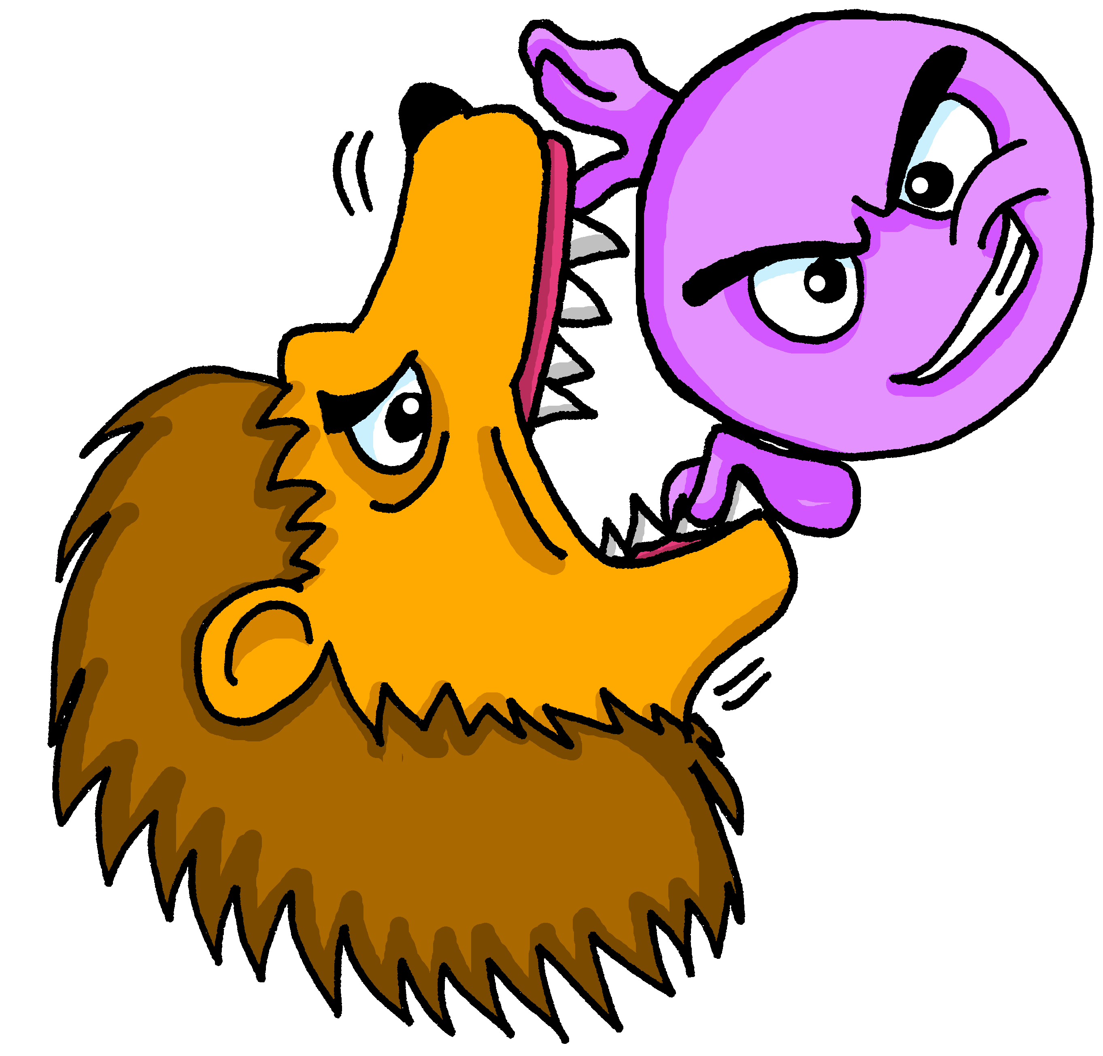
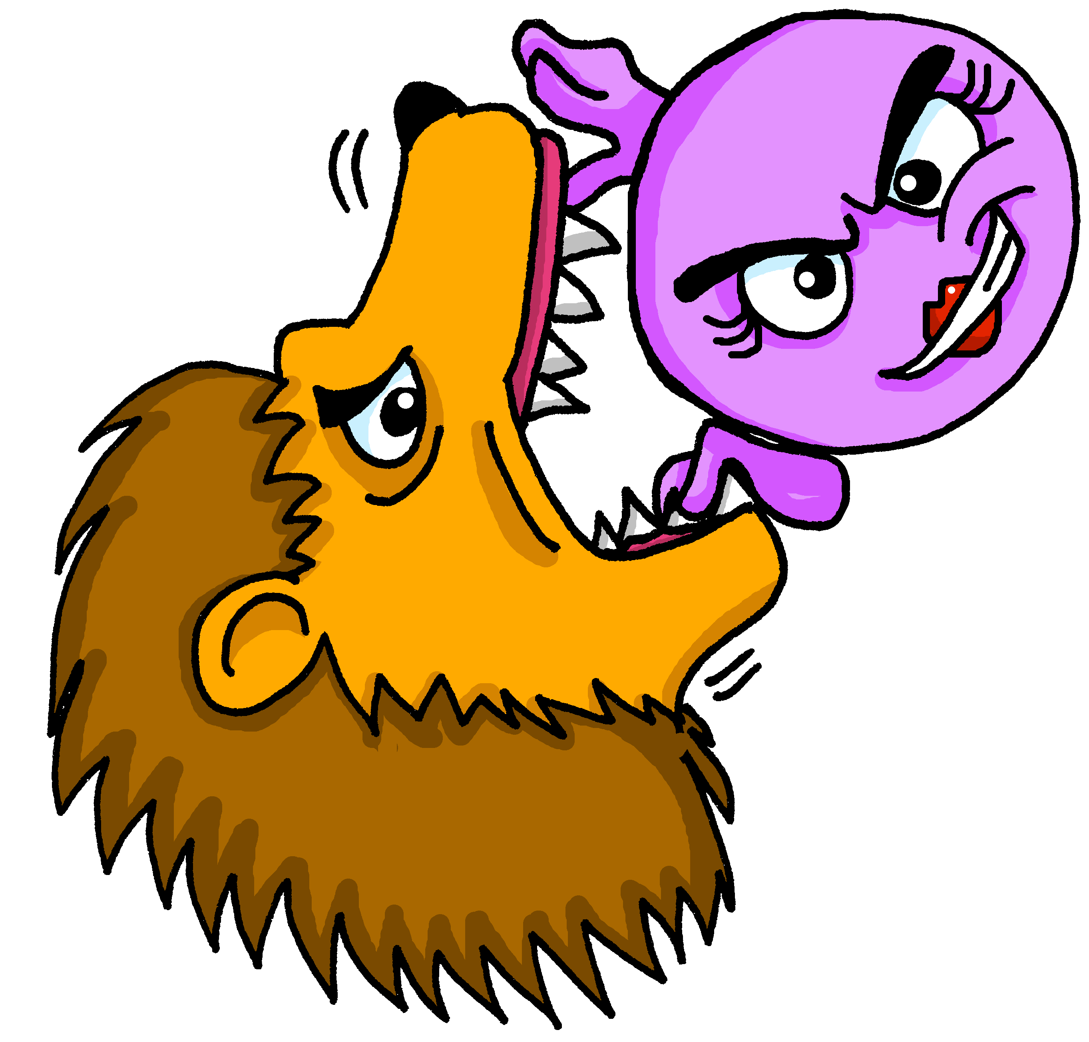
Describing me and others
courageux
courageuse
rouge
Follow ups 1-5
Notes:
Artwork by Steve Clarke. Pronoun pictures from NCELP (www.ncelp.org). All additional pictures selected from Pixabay and are available under a Creative Commons license, no attribution required.
Phonics: revisit closed [eu] [SFC] with words ending in –x - deux [41] un peu [91] jeu [291]
Frequency of new words:
Vocabulary: semaine [245] courageux [2198] curieux [2424] heureux [764] sérieux [412] Revisit days of the week
Londsale, D., & Le Bras, Y. (2009). A Frequency Dictionary of French: Core vocabulary for learners London: Routledge.
The frequency rankings for words that occur in this PowerPoint which have been previously introduced in these resources are given in the SOW and in the resources that first introduced and formally re-visited those words.
For any other words that occur incidentally in this PowerPoint, frequency rankings will be provided in the notes field wherever possible.

Slide 2
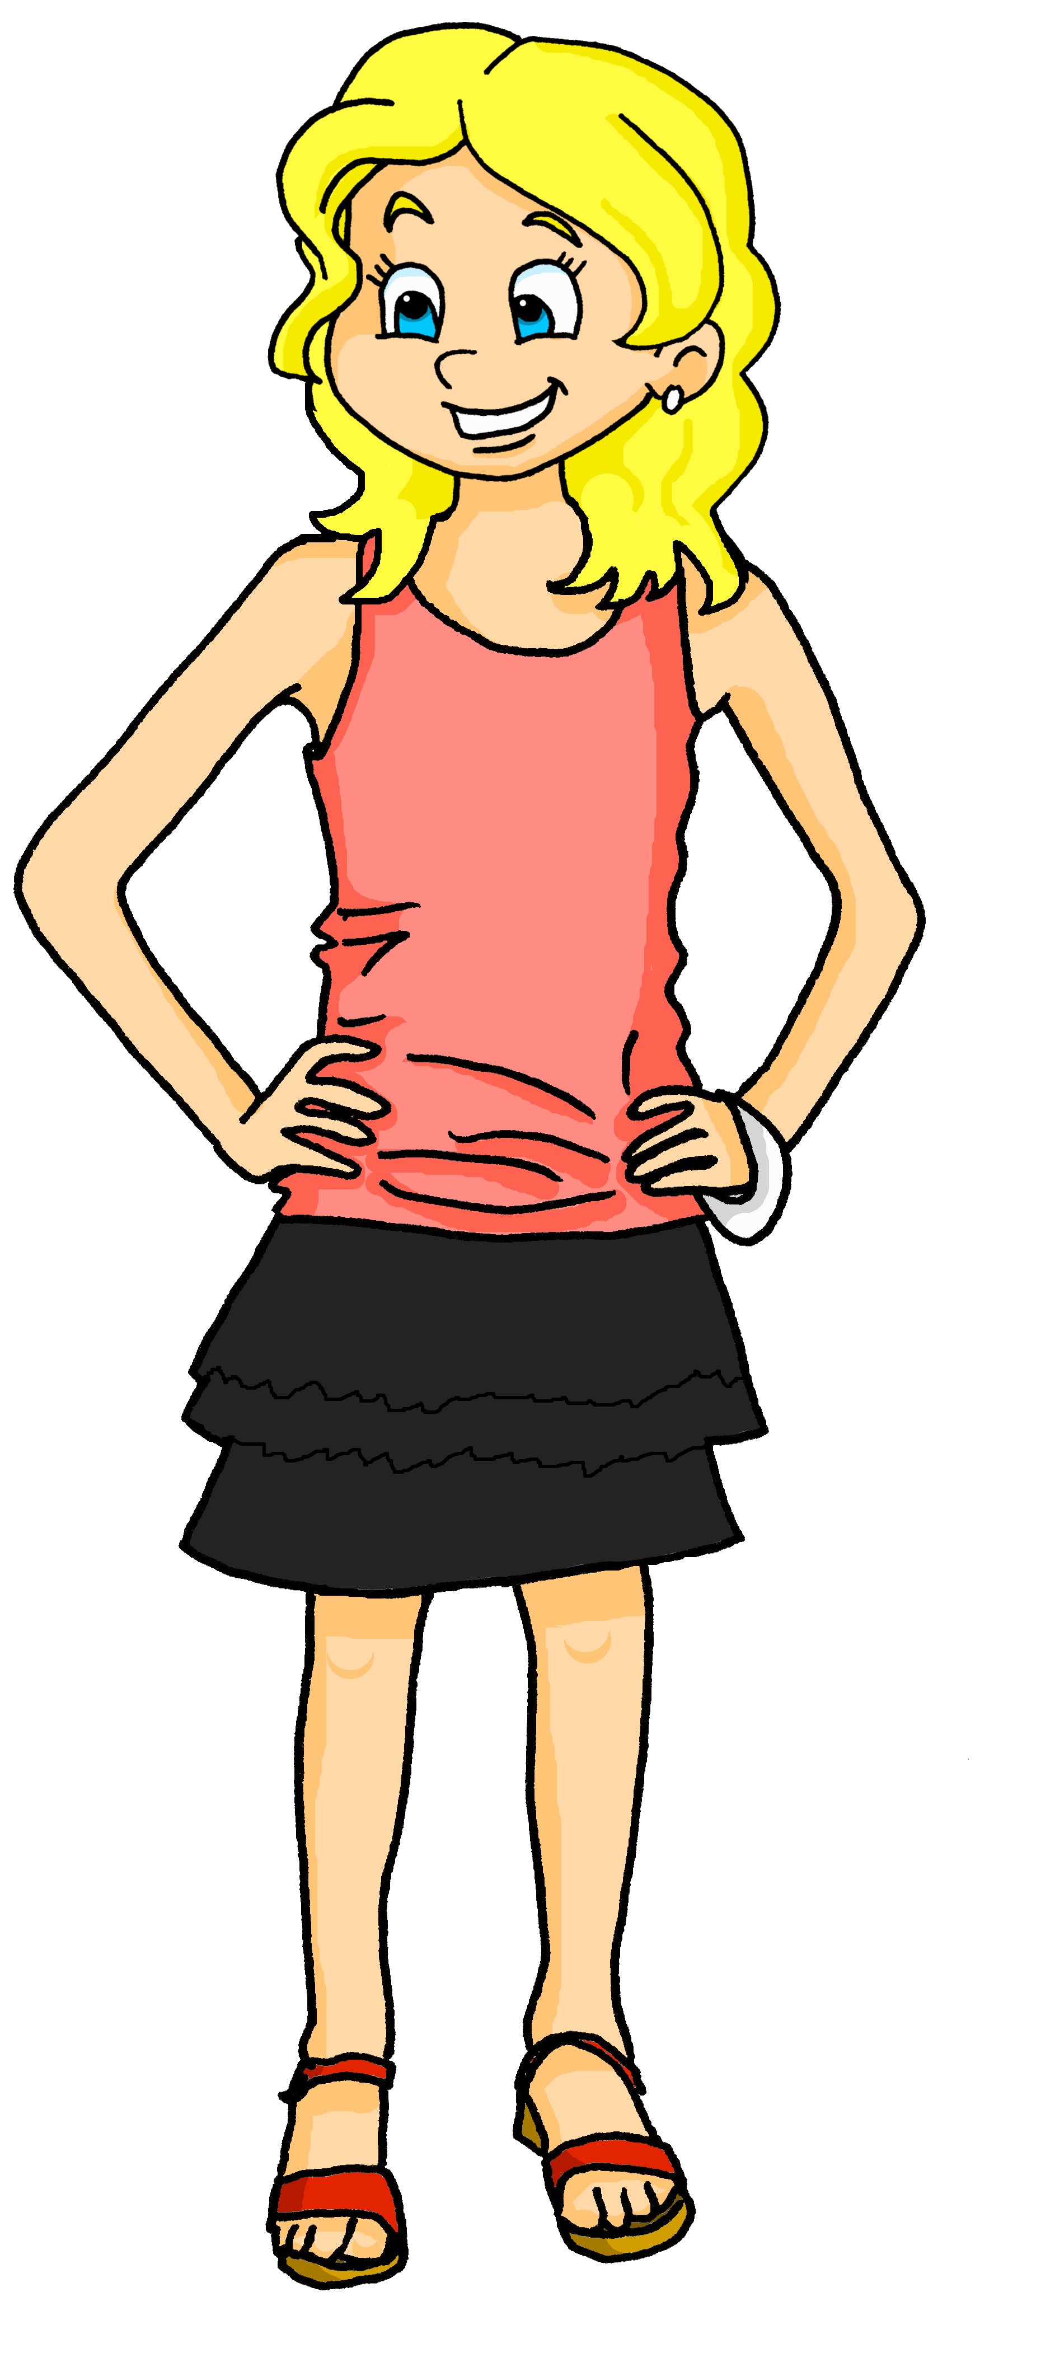
Follow up 1:
A Écoute. Adèle parle. Écris les phrases.
C’est Lulu la tortue (female) ou Chouchou (male)?
écouter
1
Elle est curieuse.
Chouchou
___
_______
2
Elle est heureuse.
___
_______
curious
……………………………………………………....
brave
3
Il est curieux.
___
_______
serious
4
Elle est courageuse.
___
_______
Lulu
5
Il est courageux.
___
_______
curious
……………………………………………………....
happy
6
Il est sérieux.
___
______
brave
Notes:
Timing: 5 minutes (two slides)
Aim: to practise aural recognition of masculine –eux and feminine –euse adjective endings in known words and practise their written production.
Procedure:
Ensure pupils understand the task. They will hear the phrase without the pronoun. They will be able to write the whole phrase by paying attention to the adjective ending.
Click on each audio symbol to listen to the sentence.
Pupils write 1-6 and the full phrase.
Click to reveal the full sentences.
Pupils then write what they know about the two pets in English.
Click to reveal answers.
Transcript [elle] est curieuse. [elle] est heureuse. [il] est curieux. [elle] est courageuse. [il] est courageux. [il] est sérieux.

Slide 3
Follow up 2A:
Écoute.
[eu]
deux
Is the speaker describing a masculine or feminine noun?
écouter
 |  |  | en anglais
mystérieuse |  |  | mysterious
dangereuse |  |  | dangerous
nerveux |  |  | nervous
généreuse |  |  | generous
lumineux |  |  | luminous
furieuse |  |  | furious
merveilleux |  |  | marvellous
Ex
1
2
3
4
5
6
Notes:
Timing: 5 minutes (two slides)
Aim: to practise aural recognition of masculine –eux and feminine –euse adjective endings in some unknown words.
Procedure:
Click on each audio symbol to listen to the word.
Pupils write 1-6 and M or F for each word, paying attention to the ending.
Click for the answer ticks, the French word and then the English word (which pupils may offer suggestions for, as we include some written cognates here).
Transcript Ex. mystérieuse [1] dangereuse [2] nerveux [3] généreuse [4] lumineux [5] furieuse
[6] merveilleux
Frequency of cognates: dangereux [713] furieux [4239] généreux [2015] lumineux [4562] merveilleux [2209] mystérieux [3312] nerveux [3735]
Londsale, D., & Le Bras, Y. (2009). A Frequency Dictionary of French: Core vocabulary for learners London: Routledge.

Slide 4
Follow up 2B:
Prononce les mots.
[eu]
deux
prononcer
miraculeux
nerveuse
furieuse
nerveux
30
silencieuse
silencieux
anxieuse
furieux
calamiteux
S
vigoreuse
dangereux
dangereuse
calamiteuse
miraculeuse
anxieux
0
vigoreux
DÉBUT
Notes:
Aim: to practise SSC [eu] in a read aloud task. Procedure: 1. Partner A writes down 5 of the words on the slide. 2. Partner B, without seeing A’s list, says all the words on the slide as quickly as possible, trying to match all of Partner A’s list before the 30 seconds is up. If s/he succeeds s/he has won the round, if not all five words have been said, Partner B wins the round. Note: Partner A should listen very carefully to B’s pronunciation. S/he doesn’t need to cross a word off if it is a different form (m/f) of the chosen word.
3. Swap roles. 4. Note: this activity can be repeated a couple of times.
5. Click on the words if you want to hear them pronounced by a native speaker.

Slide 5
Follow up 3:
Écoute les mots.
Bonne chance !
Masculine or feminine? Choose the right adjectives to cross the river.
Be careful! Some of the rocks are wobbly.
écouter
1
2
3
4
5
6
happy (f)
curious (m)
French (f)
serious (f)
short (m)
brave (m)
happy (m)
curious (f)
French (m)
serious (m)
short (f)
brave (f)
Notes:
Timing: 5 minutes Aim: aural recognition of masculine and feminine adjectives.
Procedure: 1. Click numbers to hear audio.
2. Students pick which word on a rock is being referred to (the one above or below each time).
3. Click on rock to find out if the answer is right or wrong (wrong answers fall into the water).
4. Continue to the next slide to cross the river. Extra challenge: pupils note the full meaning of the sentence.
Transcript: 1. Tu es heureux ?
2. Je suis curieuse. 3. Tu es française.
4. Tu es sérieux.
5. Il est petit.
6. Je suis courageuse.

Slide 6
Follow up 4:
[eu]
deux
Listen and read the poem. Mathieu, le merveilleux
prononciation
Mathieu a deux yeux bleus Il n’a plus de cheveux Mais il est merveilleux Mathieu est courageux Il n’est pas malheureux Mais il est très curieux
Notes:
Timing: 5 minutes
Aim: to practise oral production of SSC [eu] and [SFC].
Procedure:
Click to play the video from the beginning up to 28s (the first two verses) and ask pupils to follow along.
Play the extract again.
The third time, encourage pupils to read along as you play the clip.
Ask pupils to tell you the words they recognise. (deux, mais, il, est, courageux, heureux, curieux).
Clarify the meaning of the lines.
Translation: Matthew has two blue eyes He has no hair (He no longer has any hair)
But he is marvellous Matthew is brave He is not unhappy But he is very curious
Link: https://www.youtube.com/watch?v=03F-BxFi3y0 Note: these two verses contain a lot of familiar language and structures but even in the first two verses there is unknown language. For example, it is not until next week that pupils will learn avoir (to have) and it will be some time before we introduce negative structures. However, we introduce this part of the poem here for pronunciation practise of [eu] and [SFC].
Frequency of unknown words and cognates: merveilleux [2209] œil (pl. yeux) [474] bleu [1216] plus [19] de [2] cheveu [2296] malheureux [2372]
Londsale, D., & Le Bras, Y. (2009). A Frequency Dictionary of French: Core vocabulary for learners London: Routledge.

Slide 7
Follow up 5:

Écris.
Write a phrase stating the day of the week, and another to describe how you are.
écrire
Aujourd’hui, c’est lundi.
The ending –euse shows that the diary writer is female. How would you write curious in French if the writer were male?
Je suis curieuse.
Notes:
Timing: 10 minutes
Aim: to practise written production of the days of the week and different adjectives.
Procedure:
Pupils write a set of short statements, following the model: Aujourd’hui, c’est lundi. Je suis sérieux | sérieuse.

