Slide 1
Saying what I and others have
rouge
What do I know now?
Notes:
Artwork by Steve Clarke. Pronoun pictures from NCELP (www.ncelp.org). All additional pictures selected from Pixabay and are
available under a Creative Commons license, no attribution required.
This lesson (and week 14’s lesson) contains assessments to check progress in language learnt in the first 12 weeks of the course.
The frequency rankings for words that occur in this PowerPoint which have been previously introduced in these resources are given in the SOW and in the resources that first introduced and formally re-visited those words. For any other words that occur incidentally in this PowerPoint, frequency rankings will be provided in the notes field wherever possible.
1

Slide 2
écouter
Zeenul is from another planet. It likes earth and speaking French but often forgets word meanings, spellings and things like gender and verb forms. Help Zeenul by answering the questions in this quiz.
A For each question, put a cross (x) under the English meaning that matches what you hear.
You will hear each French word twice. Choose one correct answer only.
 | A | B | C | D
1. | goodbye | Monday | today | every
 | ☐ | ☐ | ☐ | ☐
2. | to be | to listen | to have | to write
 | ☐ | ☐ | ☐ | ☐
3. | game | day | hello | Thursday
 | ☐ | ☐ | ☐ | ☐
4. | what | or | yes | there
 | ☐ | ☐ | ☐ | ☐
1
2
3
4
Notes:
Timing: 20-25 minutes (all assessment slides)
Aim: to practise aural comprehension of vocabulary taught in weeks 1-12 of the course.
Procedure:
1. Click the audio buttons to play each item. (The words are recorded twice with a pause to allow pupils to process the information).
2. Pupils can either write 1C, etc.. or if they have the assessment on a print out they can put a X in the correct box.
3. Note that the first item can be completed, with support from the teacher, as an example. It is NOT included in the overall total marks.
3. After items 1-4, continue to the next slide to complete the remainder of the task.
Transcript:
Aujourd’hui
écrire
un jeu
ou
2

Slide 3
écouter
 | A | B | C | D
5. | horse | cat | every | dog
 | ☐ | ☐ | ☐ | ☐
6. | midday | Tuesday | Friday | Wednesday
 | ☐ | ☐ | ☐ | ☐
7. | she | I | he | you
 | ☐ | ☐ | ☐ | ☐
5
6
7
Notes:
[2/2]
Transcript:
5. chaque
6. mercredi
7. il
3

Slide 4
écouter
B For each question, put a cross (x) under the type of word you hear. You will hear each French word twice. Choose one correct answer only.
This word is a good example of …
 | A | B | C | D
1. | a day of the week ☐ | a person ☐ | an animal ☐ | an object ☐
2. | an object ☐ | a mood ☐ | a question word ☐ | a day of the week ☐
3. | an animal ☐ | a greeting ☐ | a person ☐ | an object ☐
4. | a classroom activity ☐ | personality ☐ | a mood ☐ | an object ☐
5. | a food ☐ | an object ☐ | a person ☐ | a greeting ☐
1
2
3
4
5
Notes:
Procedure:
1. Click the audio buttons to play each item. (The words are recorded twice with a pause to allow pupils to process the information).
2. Pupils can either write 1C, etc.. or if they have the assessment on a print out they can put a X in the correct box.
3. Note that the first item can be completed, with support from the teacher, as an example. It is NOT included in the overall total marks.
4. When complete, continue to the reading.
Transcript:
Monsieur
quoi
bonjour
parler
peluche
4

Slide 5
lire
C Help Zeenul to translate the underlined French word to complete each English sentence.
1. J’ai un cadeau. I have a _____________ .
2. Ça va bien. It’s going _____________ .
3. Tu as une gomme. You have a _____________ .
4. Tu es ici ? ______ you here?
5. C’est pour toi ? Is it for _____________ ?
6. Elle est curieuse. She is _____________ .
7. C’est dimanche ? Is it _____________?.
8. Il a un stylo. He has a _____________ .
9. C’est une semaine. It is a ________________.
10. Monsieur Pau a un livre. Mr Pau has a _____________ .
Notes:
Aim: to practise written recall of previously taught vocabulary.
Procedure:
Ensure that the task is clear.
Pupils could write 1 – 10 and the individual English word meanings (or they could fill in if they have printed assessment sheets).
5

Slide 6
écrire
D Translate the underlined English words to complete the French sentence.
1. It’s a rubber. C’est _____ __________. (write two words)
2. Adèle is serious. Adèle est _____________. (write one word)
3. It’s going badly. _____ _____ mal. (write two words)
4. Is it for me? C’est _______ _______? (write two words)
5. He has a bottle. Il a ______ _______________. (write two words)
6. A pencil is perfect. Un ___________ est __________. (write two words)
7. Every day it’s great. ___________ _______ c’est super. (write two words)
8. He is brave. . Il est ___________________. (write one word)
9. Today it’s Saturday. Aujourd’hui, c’est____________. (write two words)
10. No, Mrs Pau is funny! ___, ________Pau est ____________ ! (write three words)
Notes:
Aim: to practise written production of previously taught vocabulary.
Procedure:
Ensure that the task is clear.
Pupils could write 1 – 10 and the individual English word meanings (or they could fill in if they have printed assessment sheets).
6

Slide 7
lire
Grammar
A Put a (X) next to the person the sentence is about.
1 | ☐ I ☐ you _{[singular]} ☐ she/he | …es intelligent. |  | 4 | ☐ I ☐ you _{[singular]} ☐ she/he | …a une photo.
2 | ☐ I ☐ you _{[singular]} ☐ she/he | …suis curieux. |  | 5 | ☐ I ☐ you _{[singular]} ☐ she/he | …ai un animal.
3 | ☐ I ☐ you _{[singular]} ☐ she/he | …est calme. |  | 6 | ☐ I ☐ you _{[singular]} ☐ she/he | …as une règle.
Notes:
Aim: to practise written understanding of previously taught grammar features.
Procedure:
Ensure that the task is clear.
Pupils could write 1 – 6 and the correct English pronoun (or they could fill in if they have printed assessment sheets).
7

Slide 8
lire
Grammar
B Put a (X) next to two words that could finish this sentence about Léon (a boy).
 | Tick two boxes.
1. Léon est _______. | a) méchante | ☐
 | b) petite | ☐
 | c) anglais | ☐
 | d) malade | ☐
 | e) heureuse | ☐
Put a (X) next to two words that could finish this sentence about Sophie (a girl).
 | Tick two boxes.
2. Sophie est _______. | a) sérieux | ☐
 | b) triste | ☐
 | c) grand | ☐
 | d) français | ☐
 | e) courageuse | ☐
Notes:
Aim: to practise written understanding of previously taught grammar features.
Procedure:
Ensure that the task is clear.
Pupils could write the answers only (or they could fill in if they have printed assessment sheets).
8

Slide 9
écrire
Grammar
C Write the French word for ‘a’. 1. _______ cahier (m) 2. _______ peluche (f)
D Write the French for the English given in brackets.
1. Tu ________ une table. (have) 2. Il ________ calme. (is) 3. Tu ________ content ? (are) 4. Je ________ intelligent. (am)
Notes:
Aim: to practise written production of previously taught grammar features.
Procedure:
Ensure that the task is clear.
Pupils could write the answers only (or they could fill in if they have printed assessment sheets).
9

Slide 10
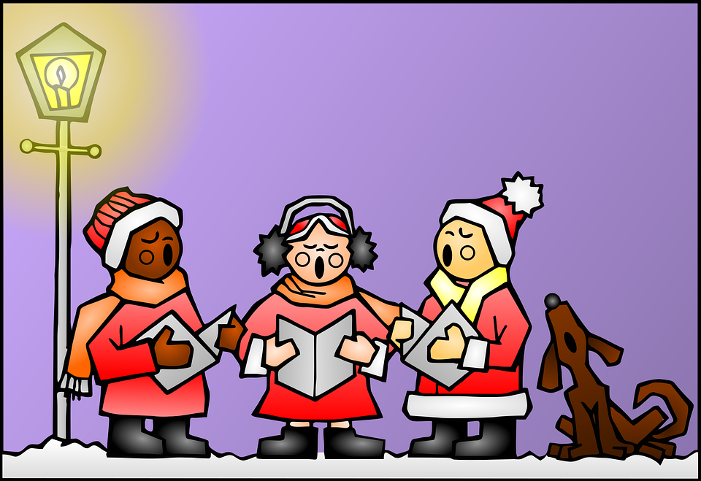
écouter
Une chanson: Canon de Noёl
A Écoute et complète.
B Puis, lis et chante.
N N Voici venir les rennes.
O O Nous aurons des cadeaux.
E E Les enfants sont joyeux.
L L C'est le soir de Noël.
Noël, Noël, N, O ,E, L.
Noël, Noël, N, O ,E, L.
_
_ _
_ _ _
_ _
_ _
le Noёl - Christmas
venir – to come, coming le renne –reindeer
aurons – (we) will have
sont – (they) are
le soir –evening
_
_
Notes:
Timing: flexible
Note: the majority of this lesson will be taken up with the vocabulary and grammar parts of the assessment. However, this Christmas carol can fit in either at the end of this week’s lesson or in the follow up time this week. There are no other follow up materials this week, as we anticipate schools will be busy at this time of term. The song would make a good addition to a Christmas assembly.
Aim: to enjoy a French Christmas song; to listen out for key SSC and transcribe them; to join in with the song whilst listening and reading.
Song with no written text: https://www.youtube.com/watch?v=_9-Pa_o7chc Song with text: https://www.youtube.com/watch?v=1FO2kU5v6T8
Handout with words: http://www.ac-grenoble.fr/ecoles/bv/IMG/pdf/canon_de_noel.pdf
Procedure: 1. Pupils listen and fill in the missing letters. These are SSC that pupils have practised this term (handout is available at the end of this presentation). 2. Click to reveal answers. 3. Play video so pupils can join in with the song.
10

Slide 11
Au revoir !
rouge
Notes:
11

Slide 12
écouter
Zeenul is from another planet. It likes earth and speaking French but often forgets word meanings, spellings and things like gender and verb forms. Help Zeenul by answering the questions in this quiz.
A For each question, put a cross (x) under the English meaning that matches what you hear.
You will hear each French word twice. Choose one correct answer only.
 | A | B | C | D
1. | goodbye | Monday | today | every
 | ☐ | ☐ | ☐ | ☐
2. | to be | to listen | to have | to write
 | ☐ | ☐ | ☐ | ☐
3. | game | day | hello | Thursday
 | ☐ | ☐ | ☐ | ☐
4. | what | or | yes | there
 | ☐ | ☐ | ☐ | ☐
1
2
3
4
Notes:
ANSWERS
Transcript:
Aujourd’hui
écrire
un jeu
ou
12

Slide 13
écouter
 | A | B | C | D
5. | horse | cat | every | dog
 | ☐ | ☐ | ☐ | ☐
6. | midday | Tuesday | Friday | Wednesday
 | ☐ | ☐ | ☐ | ☐
7. | she | I | he | you
 | ☐ | ☐ | ☐ | ☐
5
6
7
Notes:
ANSWERS [2/2]
Transcript:
5. chaque
6. mercredi
7. il
13

Slide 14
écouter
B For each question, put a cross (x) under the type of word you hear. You will hear each French word twice. Choose one correct answer only.
This word is a good example of …
 | A | B | C | D
1. | a day of the week ☐ | a person ☐ | an animal ☐ | an object ☐
2. | an object ☐ | a mood ☐ | a question word ☐ | a day of the week ☐
3. | an animal ☐ | a greeting ☐ | a person ☐ | an object ☐
4. | a classroom activity ☐ | personality ☐ | a mood ☐ | an object ☐
5. | a food ☐ | an object ☐ | a person ☐ | a greeting ☐
1
2
3
4
5
Notes:
ANSWERS
Transcript:
Monsieur
quoi
bonjour
parler
peluche
14

Slide 15
lire
C Help Zeenul to translate the underlined French word to complete each English sentence.
1. J’ai un cadeau. I have a _____________ .
2. Ça va bien. It’s going _____________ .
3. Tu as une gomme. You have a _____________ .
4. Tu es ici ? ______ you here?
5. C’est pour toi ? Is it for _____________ ?
6. Elle est curieuse. She is _____________ .
7. C’est dimanche ? Is it _____________?.
8. Il a un stylo. He has a _____________ .
9. C’est une semaine. It is a ________________.
10. Monsieur Pau a un livre. Mr Pau has a _____________ .
present
well
rubber
Are
you
curious
Sunday
pen
week
book
Notes:
ANSWERS
15

Slide 16
écrire
D Translate the underlined English words to complete the French sentence.
1. It’s a rubber. C’est _____ __________. (write two words)
2. Adèle is serious. Adèle est _____________. (write one word)
3. It’s going badly. _____ _____ mal. (write two words)
4. Is it for me? C’est _______ _______? (write two words)
5. He has a bottle. Il a ______ _______________. (write two words)
6. A pencil is perfect. Un ___________ est __________. (write two words)
7. Every day it’s great. ___________ _______ c’est super. (write two words)
8. He is brave. . Il est ___________________. (write one word)
9. Today it’s Saturday. Aujourd’hui, c’est____________. (write two words)
10. No, Mrs Pau is funny! ___, ________Pau est ____________ ! (write three words)
une gomme
sérieuse
Ça va
pour moi
une bouteille
crayon
parfait
Chaque
jour
courageux
samedi
Non
Madame
amusante
Notes:
ANSWERS
16

Slide 17
lire
Grammar
A Put a (X) next to the person the sentence is about.
1 | ☐ I ☐ you _{[singular]} ☐ she/he | …es intelligent. |  | 4 | ☐ I ☐ you _{[singular]} ☐ she/he | …a une photo.
2 | ☐ I ☐ you _{[singular]} ☐ she/he | …suis curieux. |  | 5 | ☐ I ☐ you _{[singular]} ☐ she/he | …ai un animal.
3 | ☐ I ☐ you _{[singular]} ☐ she/he | …est calme. |  | 6 | ☐ I ☐ you _{[singular]} ☐ she/he | …as une règle.
Notes:
ANSWERS
17

Slide 18
lire
Grammar
B Put a (X) next to two words that could finish this sentence about Léon (a boy).
 | Tick two boxes.
1. Léon est _______. | a) méchante | ☐
 | b) petite | ☐
 | c) anglais | ☐
 | d) malade | ☐
 | e) heureuse | ☐
Put a (X) next to two words that could finish this sentence about Sophie (a girl).
 | Tick two boxes.
2. Sophie est _______. | a) sérieux | ☐
 | b) triste | ☐
 | c) grand | ☐
 | d) français | ☐
 | e) courageuse | ☐
Notes:
ANSWERS
18

Slide 19
écrire
Grammar
C Write the French word for ‘a’. 1. _______ cahier (m) 2. _______ peluche (f)
D Write the French for the English given in brackets.
1. Tu ________ une table. (have) 2. Il ________ calme. (is) 3. Tu ________ content ? (are) 4. Je ________ intelligent. (am)
un
une
as
est
es
suis
Notes:
ANSWERS
19

Slide 20
chanter
Une chanson: Canon de Noёl
A Écoute et complète.
B Puis, lis et chante.
N N Voic_ venir les rennes.
O O N_ _s aurons des cad_ _ _x.
E E Les enfants s_ _t joy_ _x.
L L C'est l_ soir d_ Noël.
Noël, Noël, N, O ,E, L.
Noël, Noël, N, O ,E, L.
le Noёl - Christmas
venir – to come, coming le renne –reindeer
aurons – (we) will have
sont – (they) are
le soir –evening
Notes:
HANDOUT
20

