Slide 1
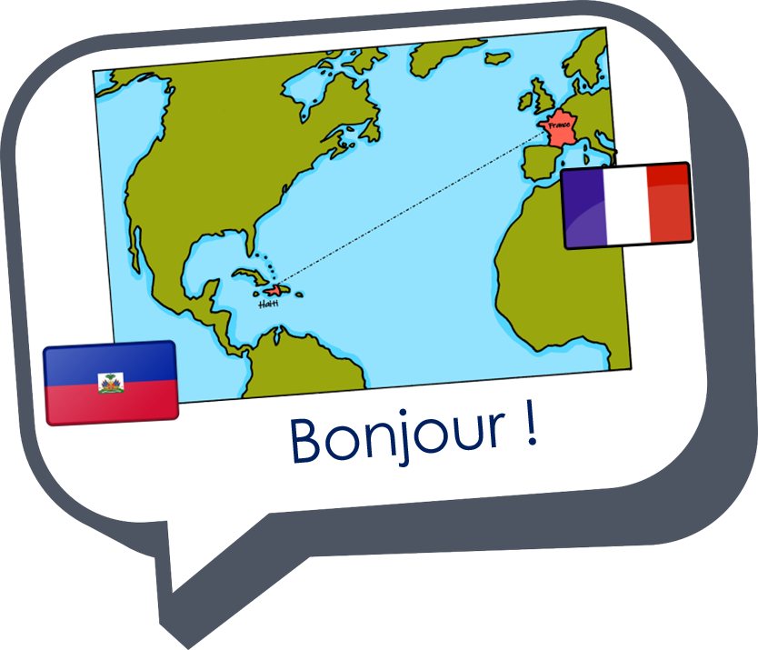
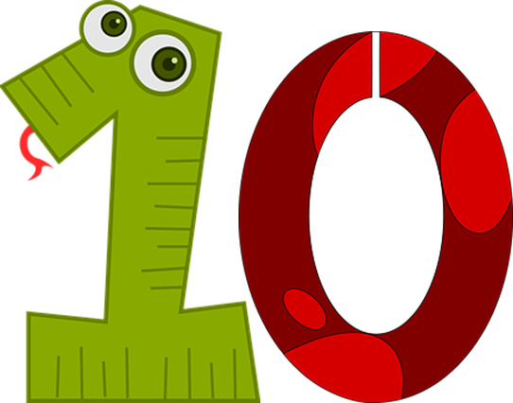
Saying how many and describing things
jaune
les nombres 1-12
la liaison
Notes:
Artwork by Steve Clarke. Pronoun pictures from NCELP (www.ncelp.org). All additional pictures selected from Pixabay and are
available under a Creative Commons license, no attribution required.
The AUDIO version of the lesson material includes additional audio for the new language presented (phonics, vocabulary) and audio for the instructions
on the slide.
In addition, it includes VIDEO clips of the phonics and the phonics’ source words. Pupils can be encouraged to look at the shape of the mouth/lips on
slides where these appear, and try to copy it/them.
Phonics: introduce liaison after x- and s-: deux enfants, trois oranges
Vocabulary (new words in bold): il y a [n/a] un [3] deux [41] trois [115] quatre [253] cinq [288] six [450] sept [905] huit [877] neuf [787] dix [372] onze [2447] douze [1664] Revisit 1: jouer [219] ami, amie [467] en ligne [n/a] dehors [1217] mon, ma [60] ton, ta [330] voici [1103]
Revisit 2: --
Londsale, D., & Le Bras, Y. (2009). A Frequency Dictionary of French: Core vocabulary for learners London: Routledge.
The frequency rankings for words that occur in this PowerPoint which have been previously introduced in these resources are given in the SOW and in the resources that first introduced and formally re-visited those words. For any other words that occur incidentally in this PowerPoint, frequency rankings will be provided in the notes field wherever possible.
1

Slide 2
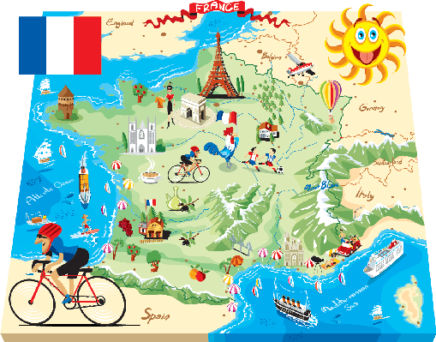
prononcer
Liaison
Regarde l’image. C’est un pays ? C’est une personne ? Ou c’est un sport ?
⚠Remember the liaison: C’est un(e)…
Notes:
Timing: 3 minutes
Aim: to practise t- liaison in sentences with c’est + indefinite articles un/une.
Procedure:
Click to reveal the picture.
Elicit an oral response from pupils (c’est un pays/une personne/un sport.
Click on the picture to confirm.
Repeat steps 1-3 with the next five slides.
Transcript:
C’est un pays.
2

Slide 3
prononcer
Liaison
Regarde l’image. C’est un pays ? C’est une personne ? Ou c’est un sport ?
⚠Remember the liaison: C’est un(e)…
Notes:
Transcript:
C’est un pays.
3

Slide 4
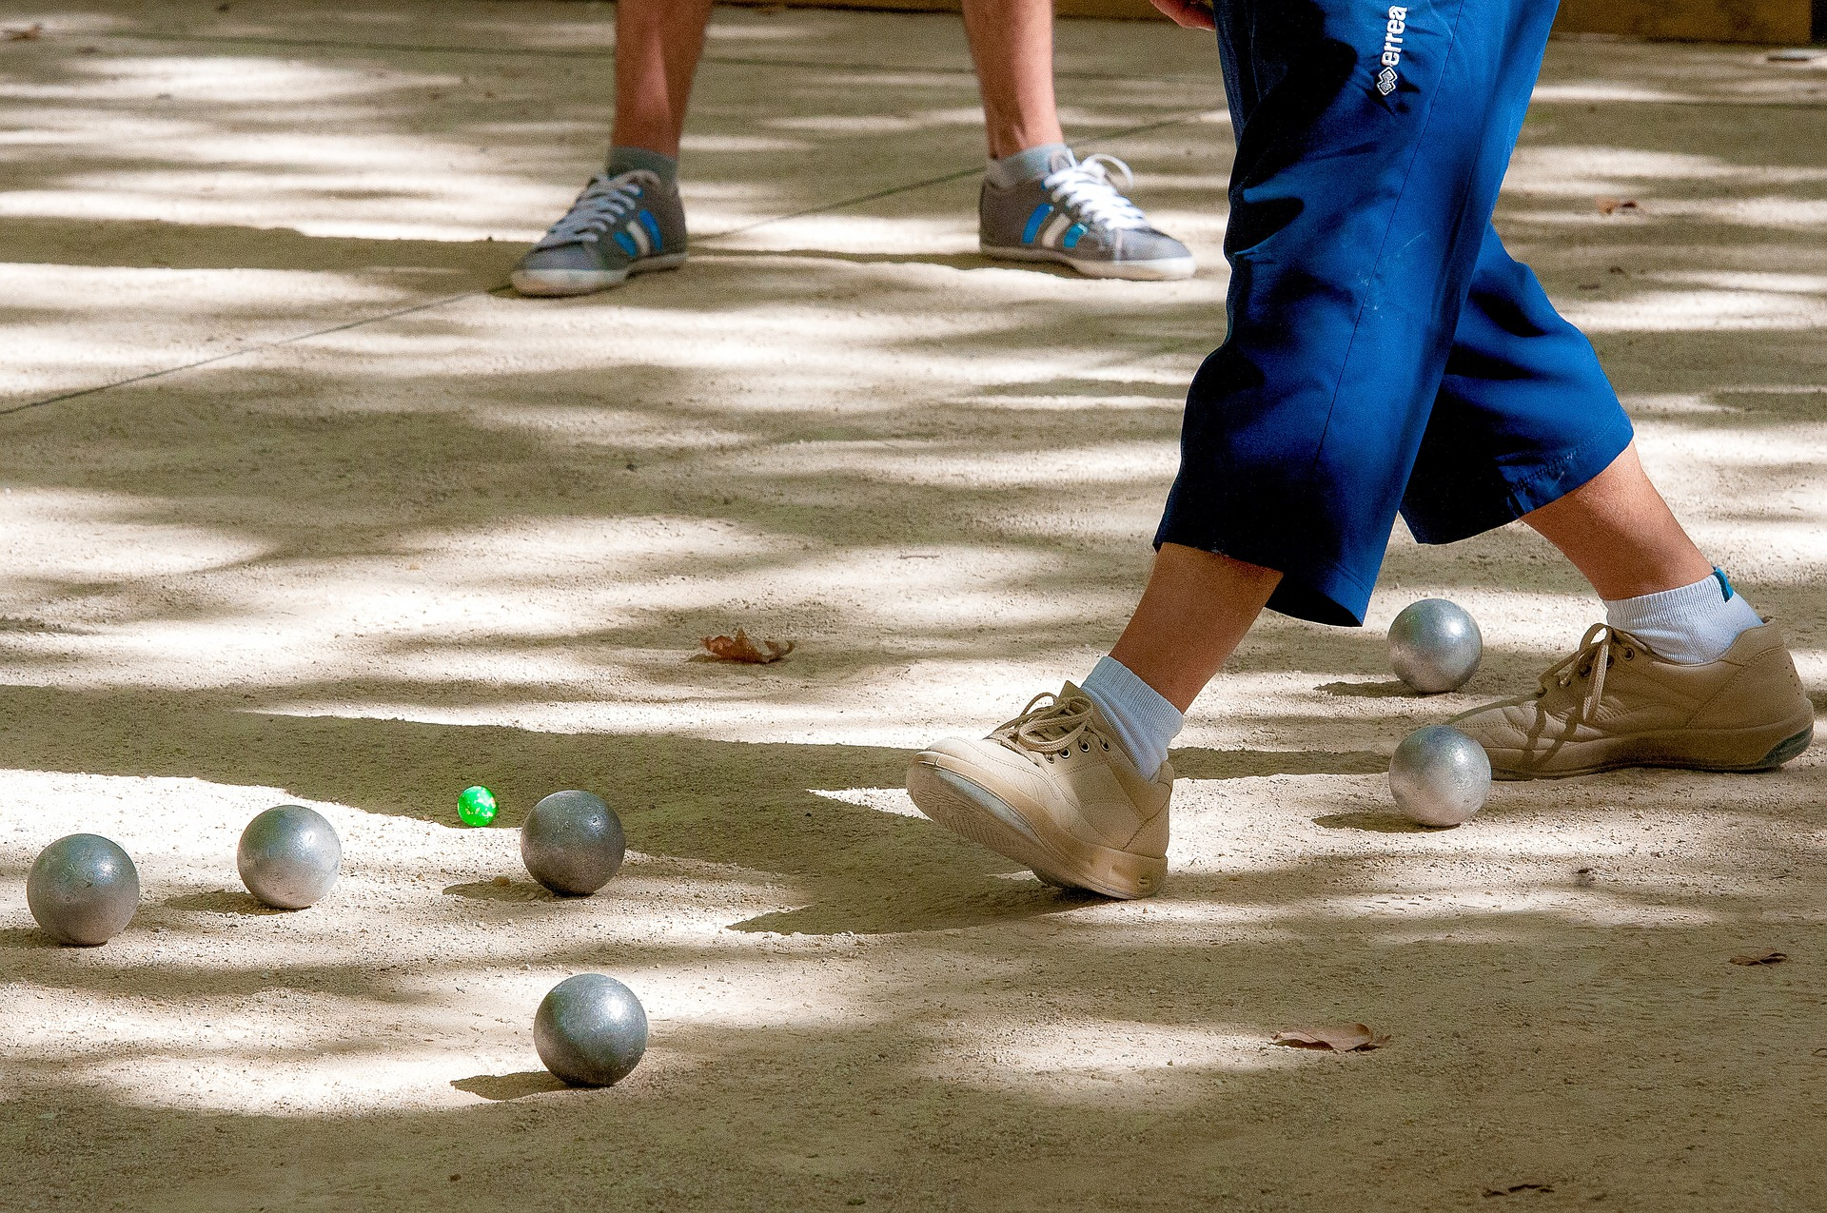
prononcer
Liaison
Regarde l’image. C’est un pays ? C’est une personne ? Ou c’est un sport ?
⚠Remember the liaison: C’est un(e)…
La pétanque est un sport français comme les boules*.
les boules - bowls
Notes:
Transcript:
C’est un sport.
4

Slide 5
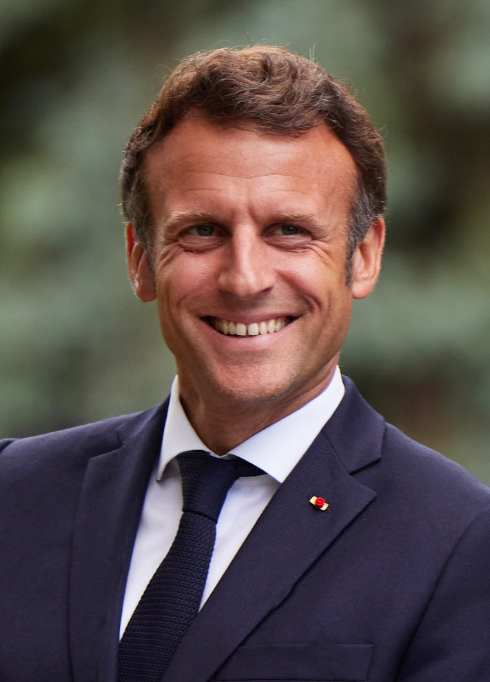
prononcer
Liaison
Regarde l’image. C’est un pays ? C’est une personne ? Ou c’est un sport ?
⚠Remember the liaison: C’est un(e)…
C’est Emmanuel Macron, le Président de la France.
Notes:
Transcript:
C’est une personne.
Picture attribution: President.gov.ua, CC BY 4.0, via Wikimedia Commons
5

Slide 6
prononcer
Liaison
Regarde l’image. C’est un pays ? C’est une personne ? Ou c’est un sport ?
⚠Remember the liaison: C’est un(e)…
C’est Haïti, un pays et une ile.
Notes:
Transcript:
C’est une personne et un pays.
6

Slide 7
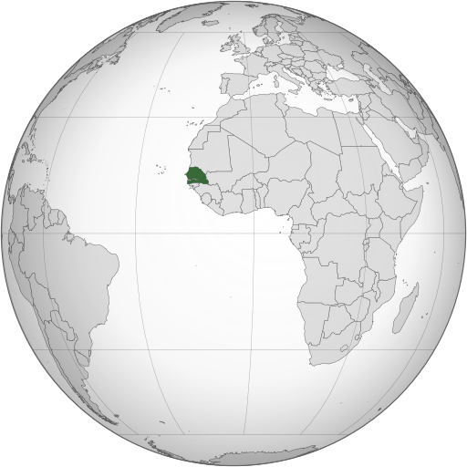
prononcer
Liaison
Regarde l’image. C’est un pays ? C’est une personne ? Ou c’est un sport ?
⚠Remember the liaison: C’est un(e)…
C’est Sénegal, un pays en Afrique. La langue officielle est le français, mais la majorité parle wolof.
Notes:
Transcript:
C’est un pays.
Picture attribution: Flappiefh, CC BY-SA 3.0 >, via Wikimedia Commons
7

Slide 8
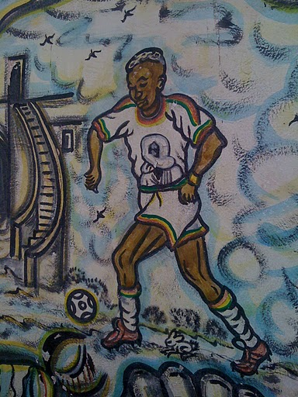
prononcer
Liaison
Regarde l’image. C’est un pays ? C’est une personne ? Ou c’est un sport ?
⚠Remember the liaison: C’est un(e)…
Le football est un sport très populaire au Sénegal. 2022 Sénegal participe au coupe du monde au Qatar.
Notes:
Transcript:
C’est une personne et un sport.
Attribution: Benoît Prieur, CC0, via Wikimedia Commons
8

Slide 9
vocabulaire
Pratique les nombres.
mots
un
deux
trois
Notes:
Timing: 5 minutes (8 slides) Aim: to introduce numbers 1-12
Procedure: 1. Click to present and say the numbers. 2. Pupils repeat.
9

Slide 10
vocabulaire
Pratique les nombres.
mots
u_
d_ _ x
tr_ _s
Notes:
[2/8]
Procedure: 1. Click to present the gapped numbers.
2. Elicit the numbers orally from pupils.
10

Slide 11
vocabulaire
Pratique les nombres.
mots
quatre
cinq
six
Notes:
[3/8]
Procedure: 1. Click to present and say the numbers. 2. Pupils repeat.
11

Slide 12
vocabulaire
Pratique les nombres.
mots
q_ _tr_
c_n_
s_x
Notes:
[4/8]
Procedure: 1. Click to present the gapped numbers.
2. Elicit the numbers orally from pupils.
12

Slide 13
vocabulaire
Pratique les nombres.
mots
sept
huit
neuf
Notes:
[5/8]
Procedure: 1. Click to present and say the numbers. 2. Pupils repeat.
13

Slide 14
vocabulaire
Pratique les nombres.
mots
s_ _ t
_ui_
n_u_
Notes:
[6/8]
Procedure: 1. Click to present the gapped numbers.
2. Elicit the numbers orally from pupils.
14

Slide 15
vocabulaire
Pratique les nombres.
mots
dix
onze
douze
Notes:
[7/8]
Procedure: 1. Click to present and say the numbers. 2. Pupils repeat.
15

Slide 16
vocabulaire
Pratique les nombres.
mots
d_x
o_ _ e
d_ _ _ e
Notes:
[8/8]
Procedure: 1. Click to present the gapped numbers.
2. Elicit the numbers orally from pupils.
16

Slide 17
parler
Lis les nombres.
quatre
onze
sept
lire
cinq
60
dix
deux
douze
six
huit
trois
neuf
un
S
- - - - - - - - - - - - - - - - - - - - - - - - - - - - - - -
un
deux
trois
quatre
cinq
six
sept
neuf
douze
0
huit
dix
onze
DÉBUT
Notes:
Timing: 3 minutes
Aim: to practise written comprehension and pronunciation/read aloud of numbers.
Procedure:
Teacher reads the instruction in French.
Pupils work in pairs to say the numbers in order (1-12). They have one minute.
Click to trigger the timer.
To bring up the answers, each number disappears on click, and the correct answer appears.
17

Slide 18
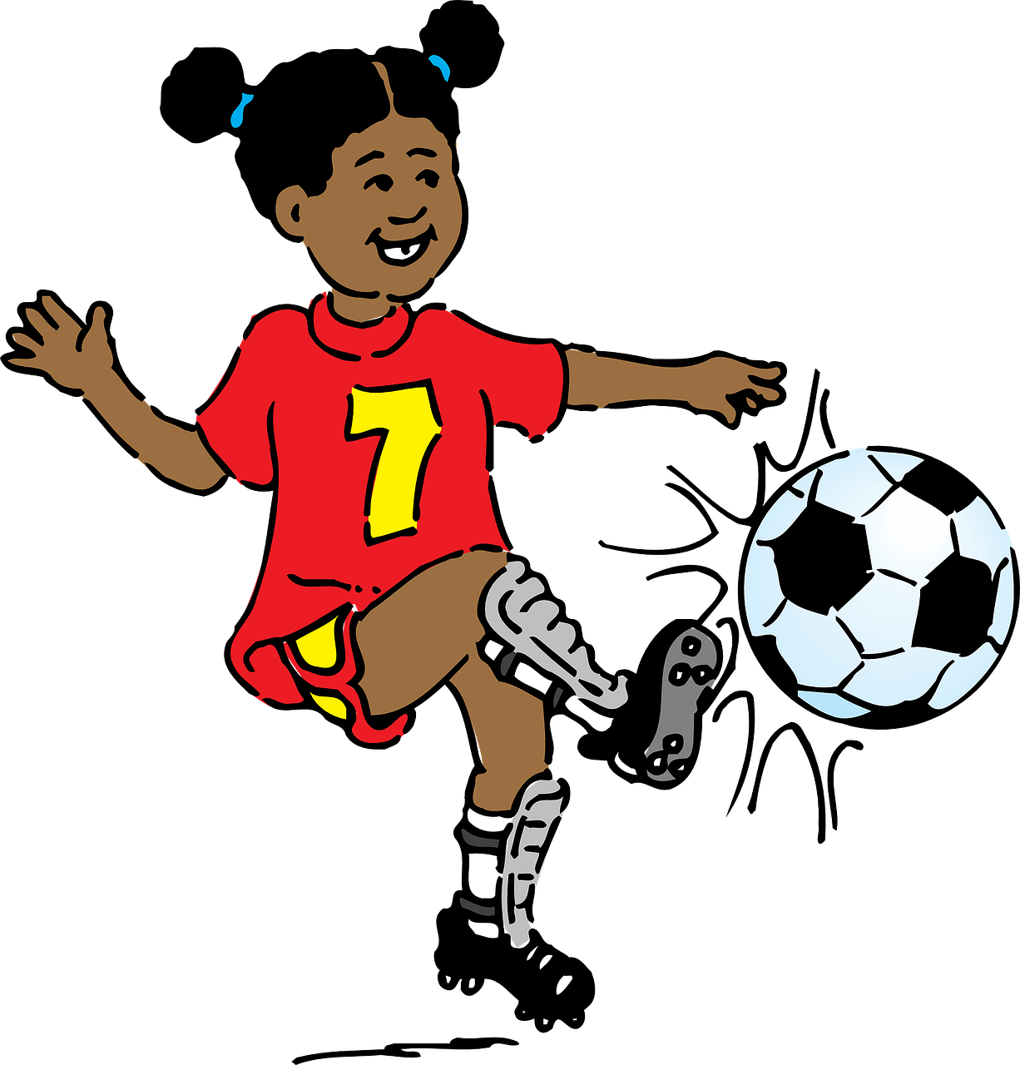
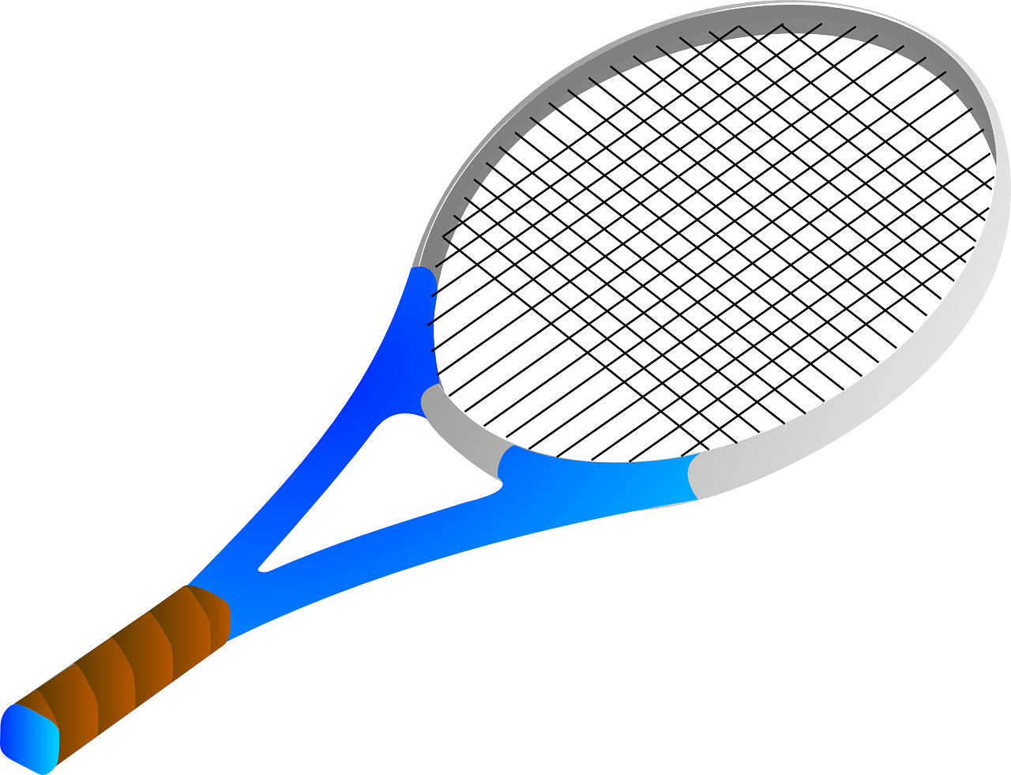
Il y a
To say how many of something there are, use il y a + number:
Il y a un sport.
⚠ Remember: un/une means a/an and one.
There is a/one sport.
Il y a deux sports.
There are two sports.
Add –s to make many French nouns plural, as in English. But it is silent!
he has = ____ ___ there is, there are = ___ ___ __
⚠ Il y a means there is AND there are.
il a
il y a
Notes:
Timing: 2 minutes
Aim: to introduce il y a + number.
Procedure:
Click through the animations to present the information.
Elicit English translations for the French examples provided.

Slide 19
écouter
Adèle parle. Elle décrit des choses.
Does she say what Pierre (he) has or what there is in the house generally?
[he has]
[there is/there are]
[nombre ?]
1
1
3
2
8
3
5
4
10
5
1
6
Notes:
Timing: 5 minutes
Aim: to practise aural comprehension of il a and il y a.
Procedure:
Pupils write the numbers 1-6 and label two columns ‘he has’ and ‘there is, there are’.
Click to listen and decide if they hear ‘il a’ or ‘il y a’.
Click to listen again, if required, and note the number of items that is mentioned.
Click to reveal the answers.
Transcript:
Il a une radio. Il y a trois télévisions.
Il y a huit images de pays. Il a cinq livres de musique. Il a dix crayons. Il y a un chat.
19

Slide 20
lire
Lis les phrases et décide. Identifie le mot correct.
A
B
Il a une radios.| radio.
Il y a trois télévisions.| télévision.
Il y a huit image. | images.
Il a cinq livre. | livres.
Il a dix crayons. | crayon.
Il y a un chats.| chat.
16
How many items does Pierre have in total?
Does Pierre himself have anything to eat?
b. What can Pierre do?
c. Would you prefer to have what Pierre has or what is lying round the house?
no
listen to radio, read a book, draw
Notes:
Timing: 5 minutes
Aim: to pay attention to the form of the noun and its match to number; to understand il a, il y a, numbers and previously taught vocabulary.
Procedure:
These are the same items as in the previous task. Pupils can therefore write A or B next to each number, depending on whether the singular or plural form is needed.
Model number 1 with the class, so pupils are clear that they select the spelling of the noun based on the number that it follows.
Click to reveal the correct noun.
Pupils complete 2 – 6.
Teacher clicks to correct.
Pupils then answer the comprehension questions. Teacher gives pupils time in pairs and then solicits answers from pupils, clicking to reveal the answers.

Slide 21
parler
Prononce les nombres dans le bon ordre.
lire
60
- - - - - - - - - - - - - - - - - - - - - - - - - - - - - - -
un
deux
trois
quatre
cinq
six
sept
huit
neuf
dix
onze
douze
0
DÉBUT
Notes:
Timing: 3 minutes
Aim: to consolidate numbers in oral production.
Procedure:
Teacher reads the instruction in French.
Pupils work in pairs to say the numbers in order (1-12). They have one minute.
Click to trigger the timer.
To bring up the answers, each number disappears on click, and the correct answer appears.
21

Slide 22
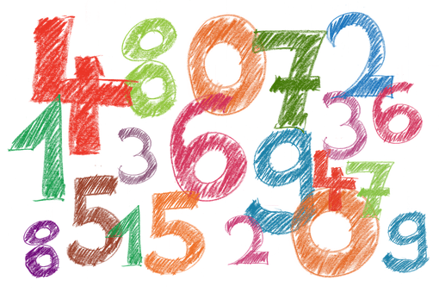
écouter
Écris six nombres.
Notes:
Suggested additional activity - Bingo
Aim: to practise aural comprehension of numbers.
Procedure:
Pupils write down 8 digits. They can repeat numbers, if they wish.
The teacher calls out numbers 1-12, in any order.
Pupils call ‘¡Bingo!’ if they have a horizontal row of four numbers checked off, and then play resumes for a full house.
Note: A great alternative is to play ‘strip bingo’; this is where pupils have a strip of paper and write down 6 numbers in any order from left to right. As the teacher calls out numbers, pupils can only rip off matching numbers from either end of their strip, if they hear them called. It is the pupil whose final remaining number is called, who wins.
22

Slide 23
Au revoir !
jaune
Notes:
23

