Slide 1
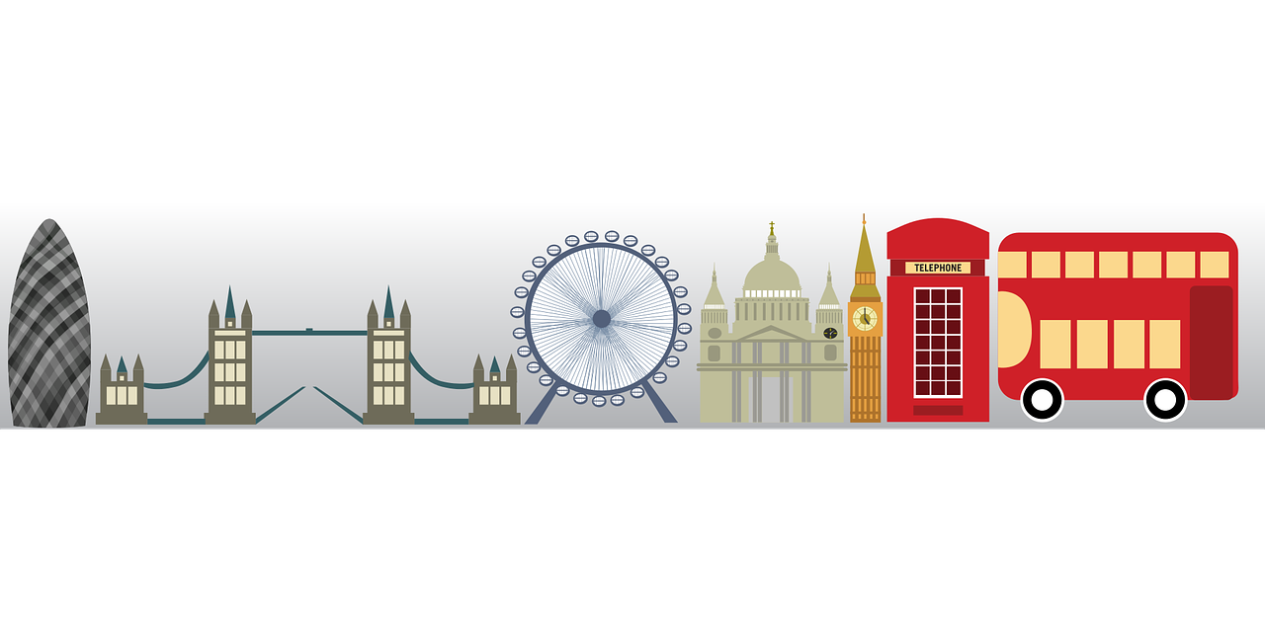
Saying what I and others do
L o n d r e s
jaune
-ER verbs – present tense
meanings of ‘à’
SSC [oi]
Notes:
Artwork by Steve Clarke. Pronoun pictures from NCELP (www.ncelp.org). All additional pictures selected from Pixabay and are
available under a Creative Commons license, no attribution required.
The AUDIO version of the lesson material includes additional audio for the new language
presented (phonics, vocabulary) and audio for the instructions on the slide.
In addition, it includes VIDEO clips of the phonics and the phonics’ source words. Pupils can be
encouraged to look at the shape of the mouth/lips on slides where these appear, and try to copy
it/them.
Phonics: introduce [oi] voir [69] avoir [8] au revoir [4/1274] pourquoi ? [193] trois [115]
Vocabulary: à (meaning ‘to, at, on, in’)[4] arriver [174] montrer [108] rester [100] voyage [904] souvent [287] en ce moment [n/a]
Revisit 1: émission [1074] radio [1526] tante [3891] télévision [1179] grand2 [59] petit2 [138] de2 [2]
Revisit 2: chaque [151] jour [78] revisit days of the week
Londsale, D., & Le Bras, Y. (2009). A Frequency Dictionary of French: Core vocabulary for learners London: Routledge.
The frequency rankings for words that occur in this PowerPoint which have been previously introduced in these resources are given
in the SOW and in the resources that first introduced and formally re-visited those words.
For any other words that occur incidentally in this PowerPoint, frequency rankings will be provided in the notes field wherever
possible.
1

Slide 2
prononcer
[oi]
voir
[to see, seeing]
Notes:
Timing: 3 minutes (two slides)
Aim: to introduce SSC [oi].
Procedure:
Introduce and elicit the pronunciation of the individual SSC [oi] and the source word ‘voir’.
Click to bring on the picture and get students to repeat (with gesture, if using).
Present and practise the cluster words.
Gesture: gesture for voir
https://www.signbsl.com/sign/see (scroll down to the correct definition of ‘see’ and we recommend the 1st video of these three) – right index finger comes up to the eye and then points away from the body as if tracing the path of sight from the eyes towards an object in view.
2

Slide 3
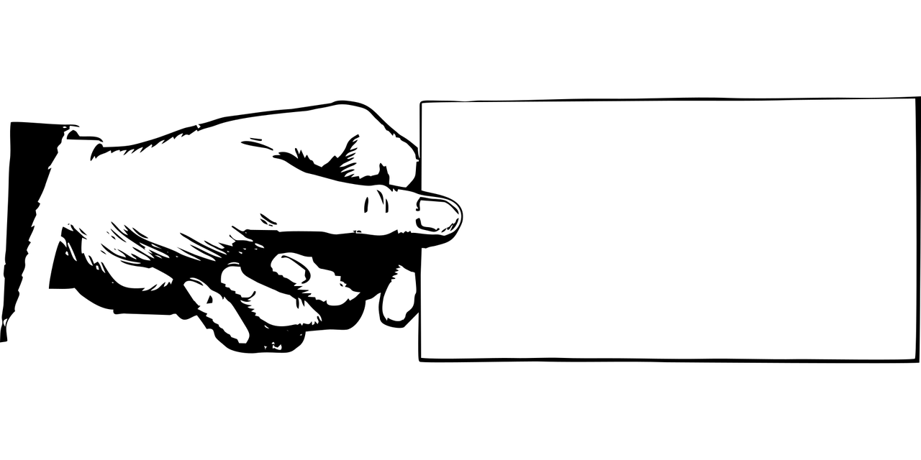
prononcer
[oi]
voir
to have, having
avoir
Au revoir !
[to see, seeing]
[why?]
trois
pourquoi ?
Notes:
Timing: 2 minutes
Aim: to recap SSC [oi].
Procedure:
Introduce and elicit the pronunciation of the individual SSC [oi] and the source word ‘voir’.
Click to bring on the picture and get students to repeat (with gesture, if using).
Present and practise the cluster words.
Gesture: gesture for voir
https://www.signbsl.com/sign/see (scroll down to the correct definition of ‘see’ and we recommend the 1st video of these three) – right index finger comes up to the eye and then points away from the body as if tracing the path of sight from the eyes towards an object in view.
3

Slide 4
écouter
. Écoute les noms des animaux. C’est [ien] ou [(a)in]?
Écoute. C’est [oi] ou [ai] ?
. Écoute les noms des animaux. C’est [ien] ou [(a)in]?
Écris 1- 8 : [oi] ou [ai].
1
C r o i x
8
P l a i s i r
_ _
_ _
2
D o u a i
_ _
B l o i s
7
_ _
3
P o n t o i s e
_ _
6
P o i t i e r s
C h o i s y
_ _
4
_ _
5
F o n t a i n e
_ _
Notes:
Timing: 6 minutes
Aim: to practise aural recognition of and distinction between [oi] and [ai].
Procedure:
Click to play audio.
Pupils write either [oi] or [ai]. Click to correct the first one.
Repeat for items 2-8.
Click to check answers.
5. Give pupils a further minute to pronounce all the French towns.
Transcript:
Croix Douai Pontoise Choisy Fontaine
Poitiers Blois Plaisir
4

Slide 5
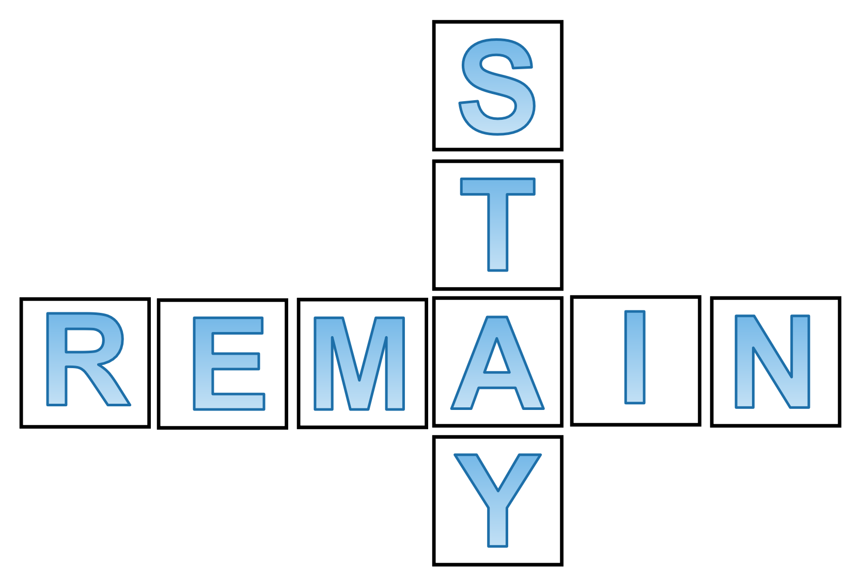
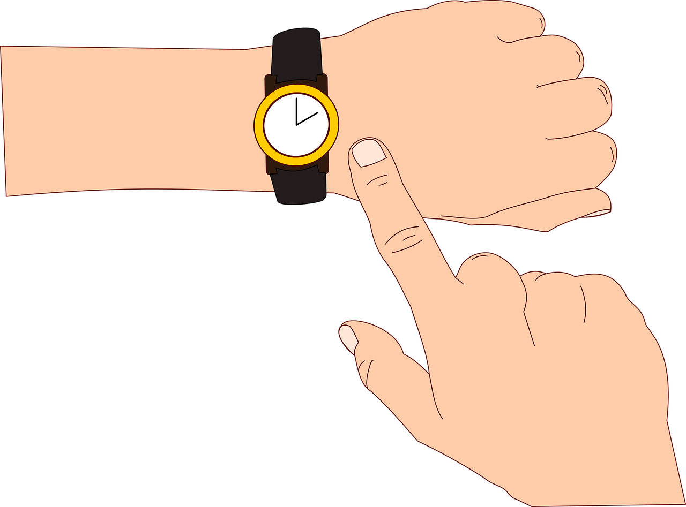
vocabulaire
Écoute et répète.
mots
rester
montrer
arriver
[to remain, remaining]
[to show, showing]
[to arrive, arriving]
le voyage
en ce moment
[trip, journey]
[at the moment]
Notes:
Timing: 4 minutes
Aim: to introduce key vocabulary for this week.
Procedure: 1. Teacher clicks to present the French words one by one. Pupils can repeat. (1 minute)
2. Pupils either work individually or in pairs, reading the French words out loud and looking at the English meanings (1 minute). 3. Then the teacher removes the English words or pictures (one by one) and pupils try to recall the English orally (chorally), looking at the French (1 minute).
4. When teacher clicks, the French words re-appear (with audio in the audio version). 5. Then the French meanings are removed (one by one) and pupils try to recall them orally (again, chorally), looking at the English (1 minute) 6. Further rounds of learning can be facilitated by one pupil turning away from the board, and his/her partner asking him/her the meanings (‘Comment dit-on XXX en anglais/français ?’). This activity can work from L2 → L1 or L1 → L2.

Slide 6
Translating the French present tense into English
English has two present tense forms but French has one:
You speak to Pierre.
Tu parles à Pierre.
You are speaking to Pierre.
It could be either meaning.
Adverbs of time tell us which English form to use:
Tu parles à Pierre chaque semaine.
This is for a regular, repeated action in the present, like a routine.
You speak to Pierre every week.
Tu parles à Pierre en ce moment.
This is for something that is ongoing, happening now.
You are speaking to Pierre at the moment.
Notes:
Timing: 2 minutes
Aim: To compare the English and the French present tenses and focus on the importance of time adverbs in deciding which English translation to use.
Procedure:
Click to present the information.
Elicit the English meanings of the examples.
6

Slide 7
lire
Claudine est très occupée* !
occupé - busy
Choose the correct adverb for each of her activities.
1
I prepare visits every day.
I prepare visits…
at the moment | every day.
My assistant is showing me the plan
2
My assistant is showing me the plan…
at the moment | every day.
at the moment.
I am staying in London at the
3
I am staying in London …
at the moment | every day.
moment.
4
I present five ideas every day.
I present five ideas…
at the moment | every day.
She organises the trip to Paris
5
She organises the trip to Paris…
at the moment | every day.
every day.
Notes:
Timing: 3 minutes
Aim: to increase awareness of English present tense use (present simple and present continuous) with adverbs of time.
Procedure:
Ensure that the context is clear. Claudine (Adèle and Pierre’s mum) is very busy with her work, which involves organises trips. She is currently in London.
Model the first item, eliciting the correct time phrase.
Given pupils one minute to discuss items 2-5.
Elicit responses chorally and click to display the answers.
7

Slide 8
écouter
Claudine parle à Pierre !
Claudine phones Pierre from London.
Écoute. Le verbe correct en anglais, c’est quoi ?
1
Do you play|Are you playing online?
If you hear chaque semaine(every week) use the simple present.
2
My group arrives|is arriving in London.
3
Louise organises|is organising a visit.
If you hear en ce moment use the continuous (-ing) present.
4
She looks for|is looking for an idea.
5
I talk|am talking to your teacher.
6
You listen|are listening to your teacher, yes?
7
What do you draw|What are you drawing?
Notes:
Timing: 7 minutes
Aim: to practise aural recognition of two French adverb time phrases and their connection with the correct English verb forms.
Procedure:
Click to bring up the two callouts to remind pupils about the time phrases they will hear.
Click to listen to item 1. Elicit the correct English verb. Click to reveal the written answer.
Repeat step 2 for items 2-7.
Transcript: 1. Tu joues en ligne en ce moment ? 2. Mon groupe arrive à Londres en ce moment.
3. Louise organise une visite chaque semaine. 4. Elle cherche une idée en ce moment. 5. Je parle à ta professeure chaque semaine.
6. Tu écoutes ta prof chaque semaine, oui ?
7. Tu dessines quoi en ce moment, Pierre ? Une image ? C’est super !
8

Slide 9
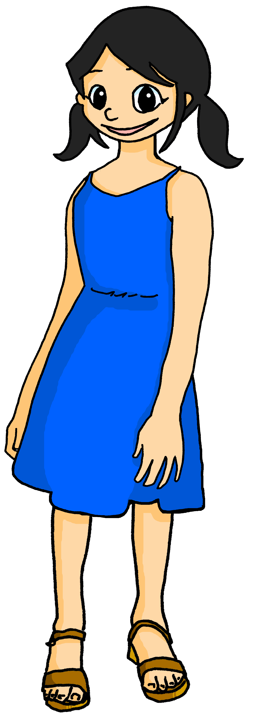
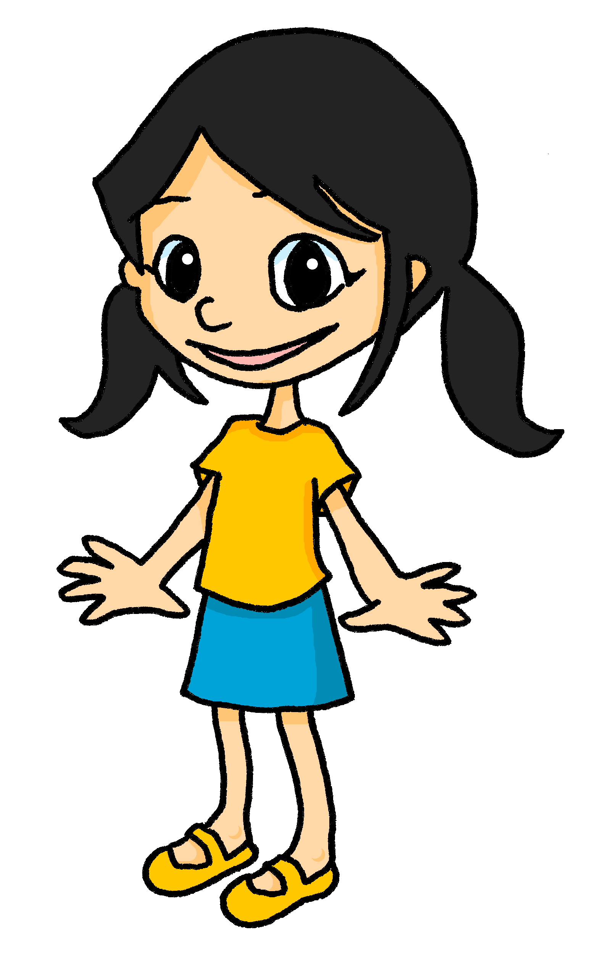
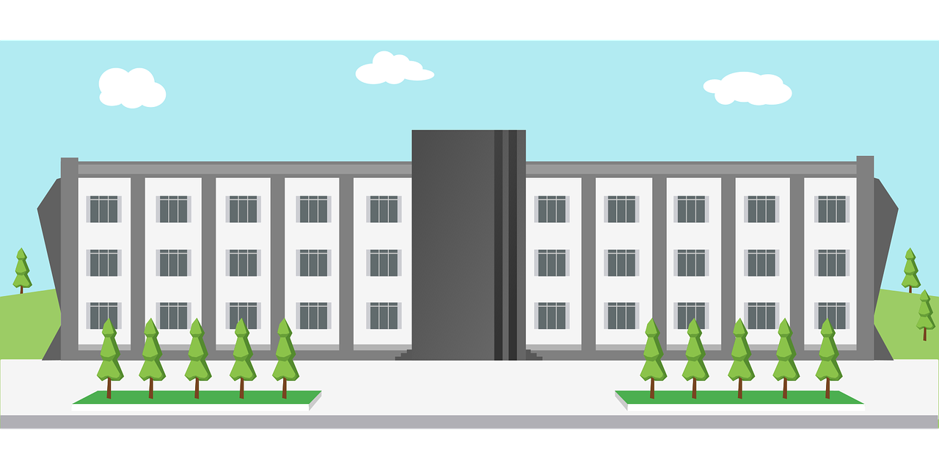
Meanings of ‘à’ (to, at, on, in)
Use à to mean ‘to’:
Je montre un message à Léa.
I show a message to Léa.
Use à also to mean ‘at’:
Mon grand-père enseigne à l’université.
My grandad teaches at the university.
Notes:
Timing: 2 minutes (two slides)
Aim: to recap previously taught meanings of à (to, a, ont) and introduce a further meaning (in).
Procedure: 1. Click to present the information.
2. Elicit responses from pupils, following the animated question marks.

Slide 10
Meanings of ‘à’ (to, at, on, in)
We also sometimes use à to mean ‘on’:
Mylène chante à la radio.
Mylène sings on the radio.
Use à to mean ‘in’ with town and city names, too:
Je reste à Paris.
I remain/stay in Paris.
Notes:
Slide 2/2

Slide 11
lire
Pierre rêve*.
souvent - often
Mais c’est Léa ou Yves ? Décide pour chaque phrase.
1
2
Voici mon amie.
Il reste souvent* à New York.
Léa
Yves
à
in
Léa
Elle dessine une image – c’est super !
Léa
8
à
3
Elle parle à ma grand-mère.
to
Yves
Il montre un jeu en ligne à mon grand-père.
à
to
7
Léa
Yves
5
Elle enseigne l’anglais à l’université.
4
Léa
Il présente une émission à la télé.
à
on
Mon amie est très intelligente.
à
6
at
Notes:
Timing: 7 minutes
Aim: to practise written comprehension of a range of new and previously learnt vocabulary; to understand the different meanings of à in sentences.
Procedure:
Ensure that the context is clear. Pierre is having a dream about his friends, Léa (a girl) and Yves (a boy). Which sentence is about which person? Mention that because this is a dream, some of the sentences may seem unusual.
Complete number 1 as an example with pupils.
Pupils complete 2-8.
Click to correct and clarify any misunderstandings.
Click to highlight the first instance of à, and elicit the meaning in English.
Continue with the remaining 5 items.
If time allows, elicit any details that Pierre gives about his friends. (See answers below).
ANSWERS Yves – is staying New York today, is presenting a tv programme, is showing an online game to Pierre’s grandad.
Léa – is talking to Pierre’s grandma, teaches English at university, is very intelligent, is drawing a great picture.
11

Slide 12
Au revoir !
jaune
Notes:
12

