Slide 1
Describing me and others
jaune
Follow ups 1-5
Notes:
Artwork by Steve Clarke. Pronoun pictures from NCELP (www.ncelp.org). All additional pictures selected from Pixabay and are
available under a Creative Commons license, no attribution required.
The AUDIO version of the lesson material includes additional audio for the new language
presented (phonics, vocabulary) and audio for the instructions on the slide.
In addition, it includes VIDEO clips of the phonics and the phonics’ source words. Pupils can be
encouraged to look at the shape of the mouth/lips on slides where these appear, and try to copy
it/them.
Phonics: introduce [ai] vrai [292] maison [325] aider [413] aimer [242] semaine [245]
Frequency of new words:
Vocabulary: aimer [232] préférer [597] sport [2011] et [6] mais [30]
Revisit 1: enseigner [2134] poser [218] anglais² [784] français² [251] grand-mère [3883] grand-père [3748] musique [1139] le [1] la [1]
Revisit 2: moi [132] toi [510] carte [955] 2298] idéal [1429] de1 [6] pour [10]
Londsale, D., & Le Bras, Y. (2009). A Frequency Dictionary of French: Core vocabulary for learners London: Routledge.
The frequency rankings for words that occur in this PowerPoint which have been previously introduced in these resources are given
in the SOW and in the resources that first introduced and formally re-visited those words.
For any other words that occur incidentally in this PowerPoint, frequency rankings will be provided in the notes field wherever
possible.

Slide 2
prononcer
[ai]
[è]
[ai] and [è] sound the same in French.
vrai
frère
(brother)
Notes:
Timing: 5 minutes (two slides)
Aim: to consolidate [ai] and [è] and teach pupils that it is the same sound in French.
Procedure:
Present the letter(s) and say the [ai] sound first, on its own. Pupils repeat it with you.
2. Bring up the word ”vrai” on its own, say it, pupils repeat it.
3. Repeat again, along with the picture, and with gesture, if using.
4. Present [è] and say the sound on its own. Pupils repeat it.
5. Bring up the word “frère” on its own, say it, pupils repeat it. 6. Repeat again, along with the picture.
7. Ask pupils what they notice (i.e., that they sound the same).
8. Click to bring up the callout to confirm this.
Suggested gesture: gesture for vrai – either mime a tick Or use the BSL (4th video is the best one): https://www.signbsl.com/sign/true
Word frequency (1 is the most frequent word in French):
vrai [292]
Source: Londsale, D., & Le Bras, Y. (2009). A Frequency Dictionary of French: Core vocabulary for learners London: Routledge.
2

Slide 3
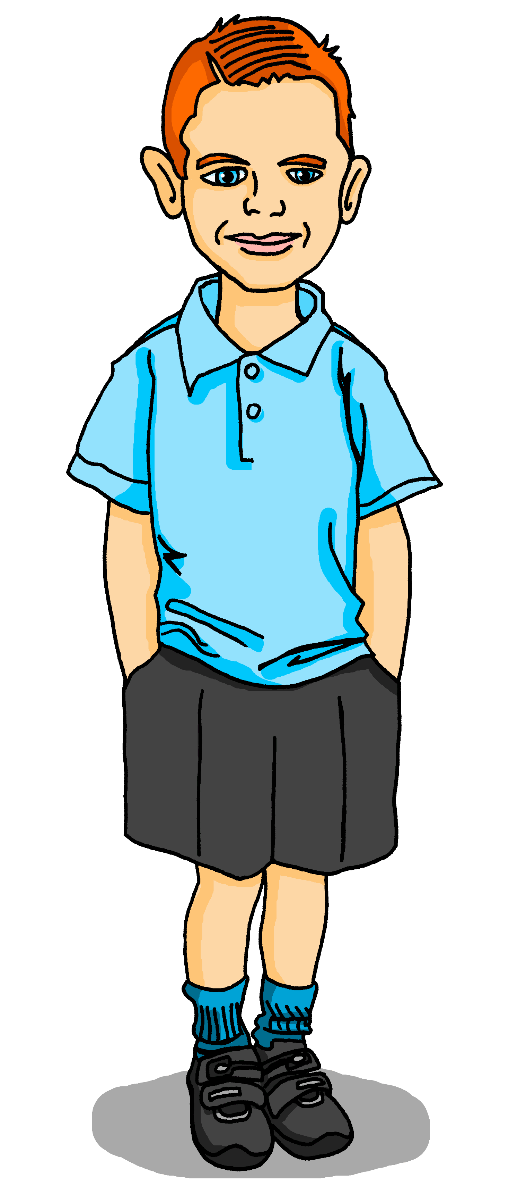
Follow up 1:
.
Max is practising the [ai] [è] sound. Can you help?
Écoute et lis les phrases.
.
Prononce les phrases avec Max.
All the highlighted letters have the same [ai] [è] sound.
1
Mon anniversaire est le treize septembre.
2
J’aime cette saison, c’est vrai !
3
Mais l’anniversaire de ma mère…
4
…est dans la première semaine de mai.
5
Moi, je préfère cette saison, c’est parfait !
l’anniversaire = birthday
cet(te) = this
première = first parfait = perfect
Notes:
Aim: to practise connecting different spellings of the same sound.
Procedure:
Click each line to listen, and pupils read along.
Click to bring up the instruction to pronounce the text, highlight all the instances of the [ai | è] sound and the callout to remind pupils about this.
Give pupils the opportunity to practise pronouncing the text.
Click on Max to hear the text again in full. Encourage pupils to join in.
Transcript:
Mon anniversaire est le treize septembre
J’aime cette saison, c’est vrai !
Mais l’anniversaire de ma mère…
…est dans la première semaine de mai
Moi, je préfère cette saison, c’est parfait !

Slide 4
vocabulaire
.
Follow up 2:
C’est ‘le’ ou ‘la’ ? Max organise les mots.
mots
télévision
amie
le, l’
grand-mère
la, l’
pays
grand-père
pays
sport
image
tante
jour
université
visite
dessin
chat
université
dessin
crayon
tante
visite
chat
lit
émission
jour
texte
musique
sport
lit
musique
bureau
radio
grand-père
amie
crayon
image
texte
grand-mère
bureau
radio
émission
télévision
Notes:
Timing: 4 minutes
Aim: to practise connecting taught nouns with their gender / definite article.
Procedure:
Each item is triggered, allowing the teacher to elicit answers in any order from pupils.
When pupils say a noun with its correct article, e.g. le sac, the teacher clicks on the word and the animation sees it slot into the correctly gendered box.
3. Repeat for all 20 nouns.
4

Slide 5
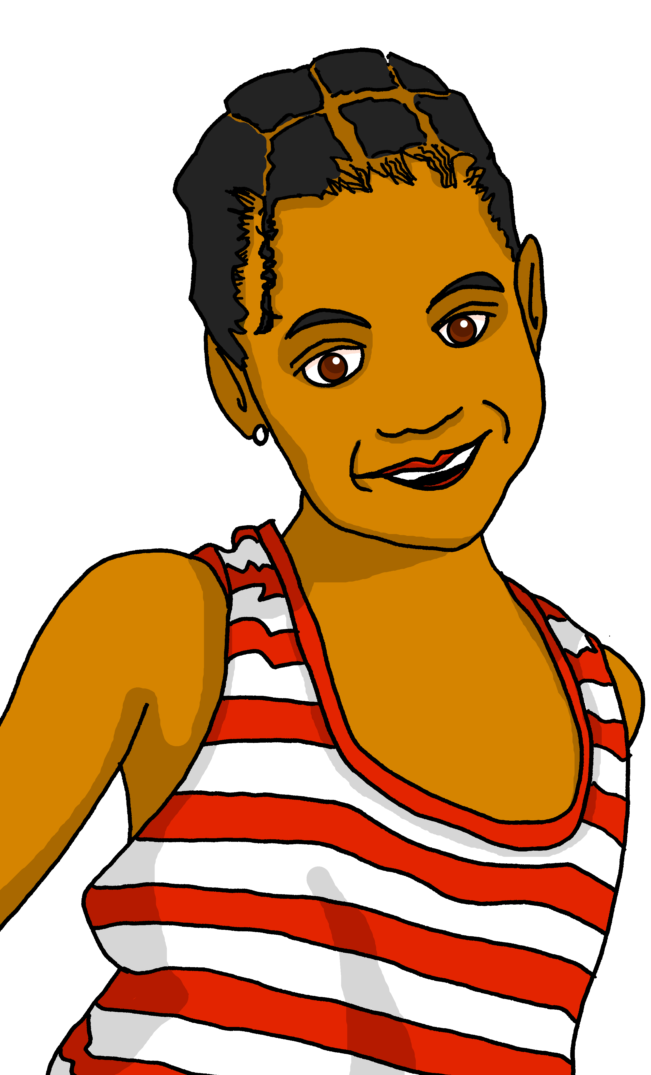
Follow up 3:
écouter
Adèle aime la chambre de Clémentine.
Elle aime quoi exactement ?
.
Je suis la cousine de Adèle !
 | A ou B | A ou B
 | chat | radio | chaise | dessin
 | bureau | chambre | photo | cheval
 | texte |télévision | message | carte
 | univers | maison | crayon | musique
1
1
2
2
3
3
4
4
Notes:
Timing: 8 minutes
Aim: to practise aural distinction of ton / ta and their connection with previously taught nouns.
Procedure:
Read the title and clarify the activity. Eugénie likes her older sister’s room and lots of her sister’s things. But which things does she mention?
Ensure that pupils know they will hear either ‘ton’ or ‘ta’ and they need to connect this with the correct noun, depending on the gender. They won’t hear the noun (thing) itself mentioned. They must decide for each word if it goes with ‘ton’ or ta’.
Do number 1 with pupils all together to model the task. Click to play audio.
Pupils write 1. and either A or B (x 2)
Elicit answers from pupils, checking their understanding.
Click the green audio button to listen and check. Clarify any misunderstandings.
Repeat for items 2-5.
Click to check answers and audio buttons to listen and check.
With the answers on display, ask pupils to tell you what it is that Eugénie says she likes. (See answers listed below).
Transcript 1:
“J’aime ton [chat] et j’aime aussi ta [chaise].” “J’aime ton [bureau] mais je préfère ton [cheval].”
“J’aime ta [télévision] et j’aime aussi ta [carte].”
“J’aime ton [univers] mais je préfère ta [musique].”
Transcript 2:
“J’aime ton chat et j’aime aussi ta chaise.” “J’aime ton bureau mais je préfère ton cheval.”
“J’aime ta télévision et j’aime aussi ta carte.”
“J’aime ton univers mais je préfère ta musique.”
Answers: 1. cat, chair 2. desk, horse 3. tv, card 4. universe, music

Slide 6
Follow up 4:
.
Parle en français.
Écris cinq phrases en anglais. Utilise les mots ici.
Ton/ta partenaire dit tes phrases en français.
parler
You can join two sentences together with ‘and...also’ or ‘but’
 |  |  | affiche bureau chaise chat crayon dessin idée musique sport texte | et…. aussi… mais….
30
préfère
mon
tu
je/j’
aime
ton
ma
il
aimes
S
ta
elle
préfères
le
la
0
DÉBUT
Notes:
Timing: 5 minutes Aim: to practise written comprehension and spoken production using vocabulary and grammar from this week to communicate a range of messages about food and drink.
Procedure:
Both pupils write 5 sentences (in English) made up of words from the table.
They swap sentences.
Partner A tries to say all B’s sentences in French within 30 seconds (without or without using the support).
Then Partner B tries to say all A’s sentences in French within 30 seconds.

Slide 7
vocabulaire
Follow up Extra - Écris en anglais : Can you get at least 15 points?
mots
 | idéal | de | pour
 | moi | toi | la carte
 | la grand-mère | le | la
 | l’anglais | le français | le grand-père
 | enseigner | poser (une question) | la musique
 | aussi | mais | et
 | aimer | préférer | le sport
ideal
of
for
x3
me
you
map
grandmother
the (m)
the (f)
x2
English
French
grandfather
to teach, teaching
to ask (a question)
music
also,too
but
and
x1
to like/love, liking/loving
to prefer, preferring
sport
Notes:
Timing: 5-10 minutes
Aim: to practise written comprehension of vocabulary from this week and previous weeks.
Procedure: Give pupils a blank grid. They fill in the English meanings of any of the words they know, trying to reach 15 points in total.
Note: The most recently learnt and practised words are pink, words from the previous week are green and those from earlier are blue, thus more points are awarded for them, to recognise that memories fade and more effort (heavy lifting!) is needed to retrieve them.
7

Slide 8
vocabulaire
Follow up Extra - Écris en français : Can you get at least 15 points?
mots
 | ideal | of | for
 | me | you | map
 | grandmother | the (m) | the (f)
 | English | French | grandfather
 | to teach, teaching | to ask, asking (a question) | music
 | also/too | but | and
 | to like/ to love | to prefer, prefering | sport
idéal
de
pour
x3
moi
toi
la carte
la grand-mère
le
la
x2
l’anglais
le français
le grand-père
enseigner
poser (une question)
la musique
aussi
mais
et
x1
aimer
préférer
le sport
Notes:
Timing: 5-10 minutes
Aim: to practise written comprehension of vocabulary from this week and previous weeks.
Procedure: Give pupils a blank grid. They fill in the English meanings of any of the words they know, trying to reach 15 points in total.
Note: The most recently learnt and practised words are pink, words from the previous week are green and those from earlier are blue, thus more points are awarded for them, to recognise that memories fade and more effort (heavy lifting!) is needed to retrieve them.
8

Slide 9
vocabulaire
Écris en anglais : Can you get at least 15 points?
mots
 | idéal | de | pour
 | moi | toi | la carte
 | la grand-mère | le | la
 | l’anglais | le français | le grand-père
 | enseigner | poser (une question) | la musique
 | aussi | mais | et
 | aimer | préférer | le sport
x3
me
x2
x1
Notes:
HANDOUT
9

Slide 10
vocabulaire
Écris en français : Can you get at least 15 points?
mots
 | ideal | of | for
 | me | you | map
 | grandmother | the (m) | the (f)
 | English | French | grandfather
 | to teach, teaching | to ask, asking (a question) | music
 | also/too | but | and
 | to like/ to love | to prefer, prefering | sport
x3
x2
x1
Notes:
HANDOUT
10

