Slide 1
Describing me and others
Ma famille et mon ami(e)
jaune
Follow ups 1-5
Notes:
Artwork by Steve Clarke. Pronoun pictures from NCELP (www.ncelp.org). All additional pictures selected from Pixabay and are
available under a Creative Commons license, no attribution required.
The AUDIO version of the lesson material includes additional audio for the new language presented (phonics, vocabulary) and audio for the instructions
on the slide.
In addition, it includes VIDEO clips of the phonics and the phonics’ source words. Pupils can be encouraged to look at the shape of the mouth/lips on
slides where these appear, and try to copy it/them.
Phonics: revisit [é] [è] and [e] - répéter [630] frère [1043] cheval [2220]
Vocabulary (new words in bold): jouer [219] ami, amie [467] en ligne [n/a] dehors [1217] mon, ma [60] ton, ta [330] voici [1103]
Revisit 1: organiser [791] préparer [368] visiter [1378] parc [1240] université [1192] musée [2216] visite [1072] avec [23]
Revisit 2: tu as [8] question [144] réponse [456] où [48] dans [11] sur [16] sous [122]
Londsale, D., & Le Bras, Y. (2009). A Frequency Dictionary of French: Core vocabulary for learners London: Routledge.
The frequency rankings for words that occur in this PowerPoint which have been previously introduced in these resources are given in the SOW and in the resources that first introduced and formally re-visited those words. For any other words that occur incidentally in this PowerPoint, frequency rankings will be provided in the notes field wherever possible.

Slide 2
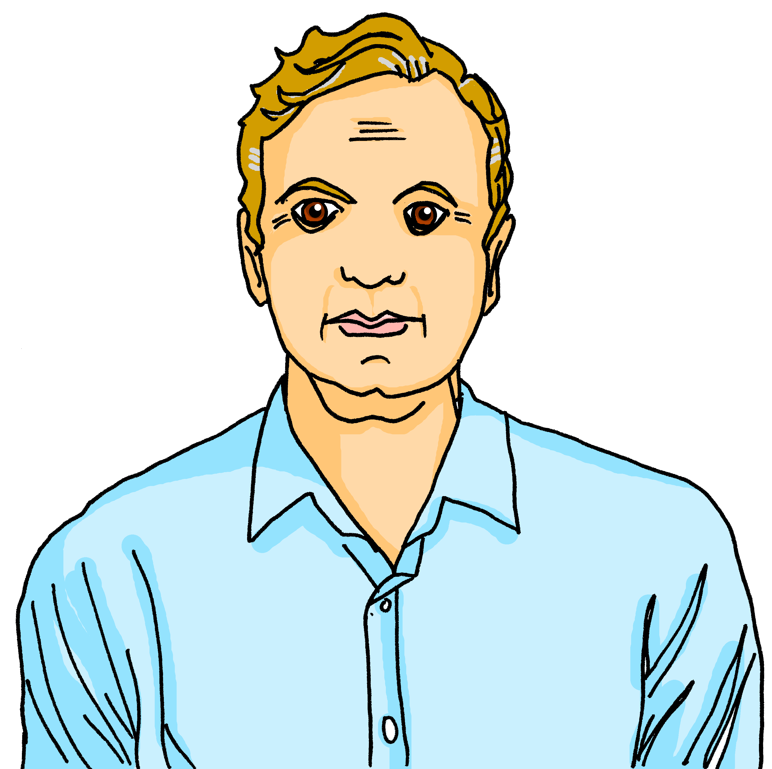
Follow up 1:
La famille Kergosien
1
2
3
4
5
A n n i c k
J a c q u e s
M y l è n e
H e r v é
C l a u d i n e
_
_
_
_
_ _
6
7
8
9
C l é m e n t i n e
J e a n – M i c h e l
A d è l e
P i e r r e
_ _
_ _
_
_
10
11
12
13
L u l u
É l o i
C h o u c h o u
M é d o r
_
_
_
_ _
_ _
_
Notes:
Timing: 5 minutes
Aim: to revisit a range of previously taught SSC.
Procedure:
Students write 1-8 and the SSC that they hear. Each dash represents a missing letter.
Click the number to play the word (two plays are recommended).
Click to reveal the missing letter(s).
The teacher can then elicit the names from pupils again, giving French prompts, e.g. ‘La mère de Clémentine, c’est qui ?’ This revisits the possessive ‘de’ taught last week.
Transcript:
Annick
Jacques Mylène Hervé Claudine Clémentine Jean-Michel Adèle Pierre Lulu
Éloi (pupils will meet the SSC ‘oi’ next week) Chouchou Médor

Slide 3
Translating the French present tense into English
In French there is one way to talk about things in the present:
We use the simple present for regular, repeated actions.
Ma tante prépare une émission.
In English, there are two ways:
My aunt prepares a programme.
My aunt prepares a programme every week.
Ma tante prépare une émission chaque semaine.
We use the continuous present for ongoing actions.
My aunt is preparing a programme.
My aunt is preparing a programme today.
Ma tante prépare une émission aujourd’hui.
Notes:
Timing: 2 minutes
Aim: to contrast the use of the simple present and continuous present in English with the present tense in French.
Procedure:
Click through the animations to present the information.
Elicit English translations for the French example provided.

Slide 4
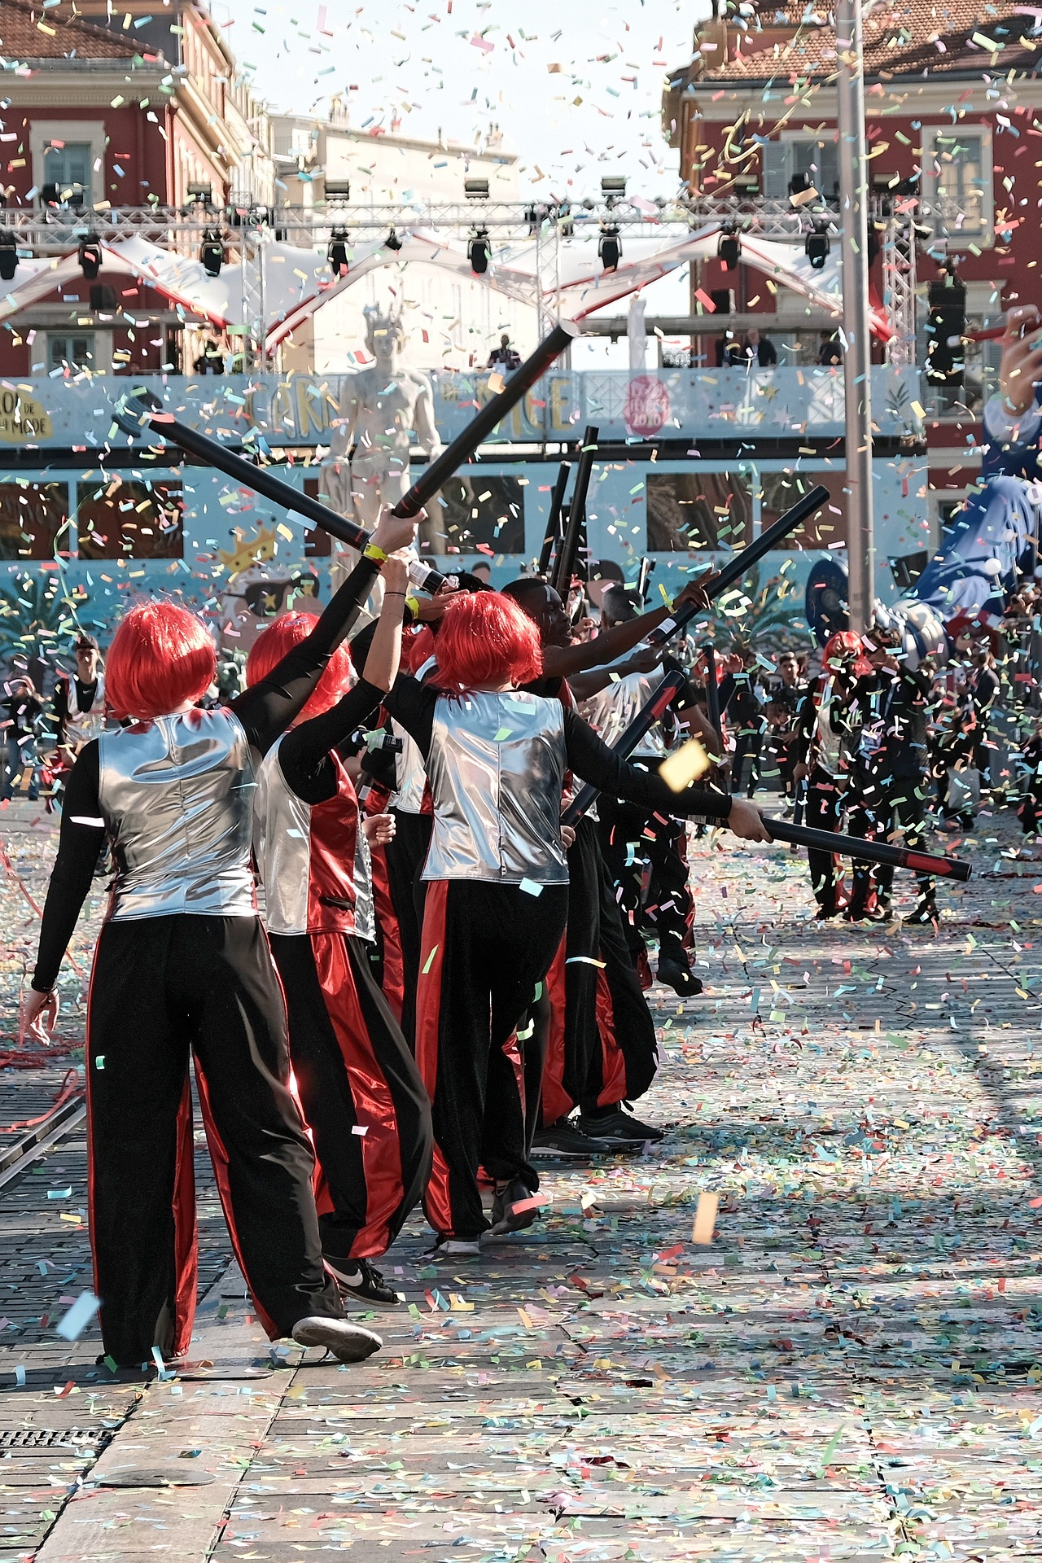
Follow up 2:
Adèle écrit des messages à Mylène.
Adèle is exchanging Whatsapp with her aunt Mylène.
What is she saying?
lire
Écris en anglais.
Adèle is messaging about what is going on right now/ today.
1
Tu organises ta visite à l’université de Nice.
You are organising your visit to Nice university.
2
Pierre joue en ligne avec un ami.
Pierre is playing online with a friend.
3
J’écoute la radio dans ma chambre.
I am listening to the radio in my room.
4
Tu présentes avec ton amie, aujourd’hui ?
Are you presenting with your friend today?
5
Mon chat joue dehors.
My cat is playing outside.
Notes:
Timing: 5 minutes
Aim: to practise written translation of the present tense, using the continuous present in English.
Procedure:
Read the title / context of the activity. Adèle is in still in Menton with Mylène (her aunt) at the citrus festival. Pierre is messaging her from home.
Elicit the English for Adèle’s speech bubble to revisit the meaning of ‘de’ in this context, i.e. I am Pierre’s sister (the sister of Pierre).
Remind pupils that we are talking about ongoing activities.
Pupils translate either the whole sentences or just the verb and pronoun (the bold text).
Elicit responses and click to confirm the translations.

Slide 5
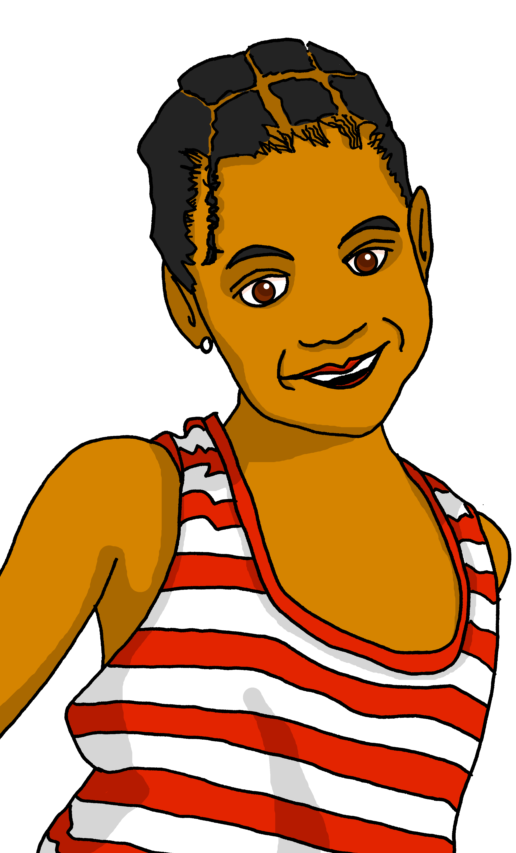
Follow up 3:
Clémentine parle avec Adèle.
Je suis la cousine de Clémentine !
Clémentine is talking about what people are doing during the week. What is she saying?
écouter
Écris en anglais.
 | en anglais
 | I’m playing outside with Jean-Michel.
 | Dad is listening to a music programme on the radio.
 | My mother is watching the television.
 | My grandad is preparing the dinner.
 | Mylène is presenting a tv programme about the Nice Carnival.
1
___________
________
2
___________
___________
_______
3
_______
4
_______
5
______________
___ ___________
Clémentine is also messaging about ongoing actions.
Notes:
Timing: 5 minutes
Aim: to practise aural comprehension and translation of present tense verbs, possessive adjectives and previously taught vocabulary.
Procedure:
Read the title / context of the activity.
Elicit the English for Adèle’s speech bubble to revisit the meaning of ‘de’ in this context, i.e. I am Clémentine’s cousin (the cousin of Clémentine).
Do number 1 with them. Click to listen, pupils write the missing English words.
Bring up the answer.
Pupils listen to 2-5 and write the missing word or words.
Click to reveal answers.
Transcript:
1. Je joue dehors avec Jean-Michel. 2. Papa écoute une émission de musique à la radio.
3. Ma mère regarde la télévision.
4. Mon grand-père prépare le diner.
5. Mylène présente une émission de télé sur le Carnaval de Nice.

Slide 6
Follow up 4:
Écris en anglais.
lire
l’amie
l’ami
dehors
voici
5
ma
4
ta
ton
la tante
3
mon
2
jouer
en ligne
1
Notes:
Timing: 5 minutes (two slides)
Aim: to practise written comprehension of vocabulary.
Procedure:
Tell pupils to be ready to write the English meanings of key vocabulary There will be 11 altogether and they should prepare to work from the bottom of the slide, left to right.
Explain the scenario – it’s raining and the raindrops will splash down and cover the words. They need to write the English. Tell them they will have 5 seconds to get a headstart on the rain.
Click to start number animation.
Click once more to start raindrops. The timing has been carefully set! Don’t click again or all the raindrops will appear at once.
When finished move to the next slide to check answers.

Slide 7
Follow up 4:
Réponses
lire
l’amie
l’ami
(the) friend (f)
(the) friend (m)
dehors
voici
ma
outside
here is, this is
my (f)
ta
ton
la tante
your (f)
your (m)
(the) aunt
jouer
en ligne
mon
to eat, eating
online
my (m)
Notes:
Procedure:
Elicit responses from the bottom, left to right, from pupils.
Click to bring up a written version of the answer.

Slide 8
Follow up 5:
C’est qui ?
Partenaire A: Ask a question to discover the activity. Then ask another question to discover the person.
Partenaire B: Answer ‘oui’ or ‘non’ to each question.
parler
E.g. Is the person preparing?
Adèle
Océane
C’est Adèle !
La personne prépare ?
La personne prépare une émission ?
is preparing a visit
is preparing a programme
Aurélie
René
Oui !
Non !
Oui !
is teaching French
is pronouncing a word
Notes:
Time: 5 minutes (two slides)
Aim: to use raised intonation and present tense oral production to guess their partner’s character.
Read the title in French – C’est qui ? Who is it?
Tell students they are going to work in pairs. Partners take it in turns to ask yes/no questions to try to figure out the other player’s secretly-chosen character. The partner guessing needs to use raised question intonation and the correct verb and then noun to narrow down their options correctly!
Model the task. Click to bring the speech bubbles to make sure students are clear about what the exchange should look like (La personne chante ? / Oui / Non). When the answer is ‘oui’ all those who do not have ‘sing’ as an activity are eliminated.
Click to bring up the question La personne chante à la radio ? When the answer is ‘Non’ this eliminates René, leaving only Adèle.
5. The final statement confirms the identity of the person.
6. Tell pupils that asking the more general question first and then a more specific question should enable them to guess everyone after two questions.
7.Give students 30 seconds to write down 4 names (mixture of male/female).
8. The aim is to work with their partners, to identify all 8 people as quickly as possible.
Note: the activity can be done differently, if pupils are required to ask full questions. The two-phase question process here reduces the cognitive load, allowing pupils to focus first on just the verb, and then prompting a repetition with noun addition.

Slide 9
Follow up 5:
C’est qui ?
à la radio = on the radio
Adèle
Océane
René
Hélène
parler
is preparing a visit
is preparing a programme
is pronouncing a word
playing online
Fidèle
Mylène
Stéphane
Aurélie
is teaching music
is visiting the museum
is asking a question
is teaching French
Agnès
Frédéric
Cécile
Éric
is pronouncing a text
is visiting the university
is putting down a pencil
is playing outside
Notes:
Display this slide for the speaking activity.
If needed, click on the English phrase to hear the matching question: Does the person….?
Transcript: La personne prépare une visite ?
La personne prépare une émission ?
La personne prononce un mot ?
La personne joue en ligne ?
La personne enseigne la musique ?
La personne visite le musée ?
La personne pose une question ?
La personne enseigne le français ?
La personne prononce un texte ?
La personne pose un stylo ?
La personne visit l’université ?
La personne joue dehors ?

Slide 10
vocabulaire
Follow up Extra - Écris en anglais : Can you get at least 15 points?
mots
 | tu as | sur | la réponse
 | sous | dans | où
 | organiser | la visite | le musée
 | ton | avec | visiter
 | l’amie | mon | ma
 | en ligne | ta | l’ami
 | jouer | dehors | voici
(the) cat
on (top of)
what?
x3
under(neath)
in
where
to organise
the visit
museum
x2
your (m)
with (f)
to visit, visiting
(the) friend (f)
my (m)
my (f)
online
your (f)
(the) friend (m)
x1
to pass, spend (time)
outside
here is, this is
Notes:
Timing: 5-10 minutes
Aim: to practise written comprehension of vocabulary from this week and previous weeks.
Procedure: Give pupils a blank grid. They fill in the English meanings of any of the words they know, trying to reach 15 points in total.
Note: The most recently learnt and practised words are pink, words from the previous week are green and those from earlier are blue, thus more points are awarded for them, to recognise that memories fade and more effort (heavy lifting!) is needed to retrieve them.
10

Slide 11
vocabulaire
Follow up Extra - Écris en français : Can you get at least 15 points?
mots
 | in | on (top of) | under(neath)
 | you have | (the) answer | where
 | (the) visit | (the) museum | with
 | your (m) | to organise | to visit, visiting
 | my (m) | my (f) | your (f)
 | (the) lunch | (the) friend (m) | (the) friend (f)
 | to play | here is, this is | online
dans
sur
sous
x3
tu as
la réponse
où
la visite
le musée
avec
x2
ton
organiser
visiter
mon
ma
ta
dehors
l’ami
l’amie
x1
jouer
voici
en ligne
Notes:
Timing: 5-10 minutes
Aim: to practise written comprehension of vocabulary from this week and previous weeks.
Procedure: Give pupils a blank grid. They fill in the French meanings of any of the words they know, trying to reach 15 points in total.
Note: The most recently learnt and practised words are pink, words from the previous week are green and those from earlier are blue, thus more points are awarded for them, to recognise that memories fade and more effort (heavy lifting!) is needed to retrieve them.
11

Slide 12
vocabulaire
Écris en anglais : Can you get at least 15 points?
mots
 | tu as | sur | la réponse
 | sous | dans | où
 | organiser | la visite | le musée
 | ton | avec | visiter
 | l’amie | mon | ma
 | en ligne | ta | l’ami
 | jouer | dehors | voici
x3
x2
x1
Notes:
HANDOUT
12

Slide 13
vocabulaire
Écris en français : Can you get at least 15 points?
mots
 | in | on (top of) | under(neath)
 | you have | (the) answer | where
 | (the) visit | (the) museum | with
 | your (m) | to organise | to visit, visiting
 | my (m) | my (f) | your (f)
 | (the) lunch | (the) friend (m) | (the) friend (f)
 | to play | here is, this is | online
x3
x2
x1
Notes:
HANDOUT
13

