Slide 1
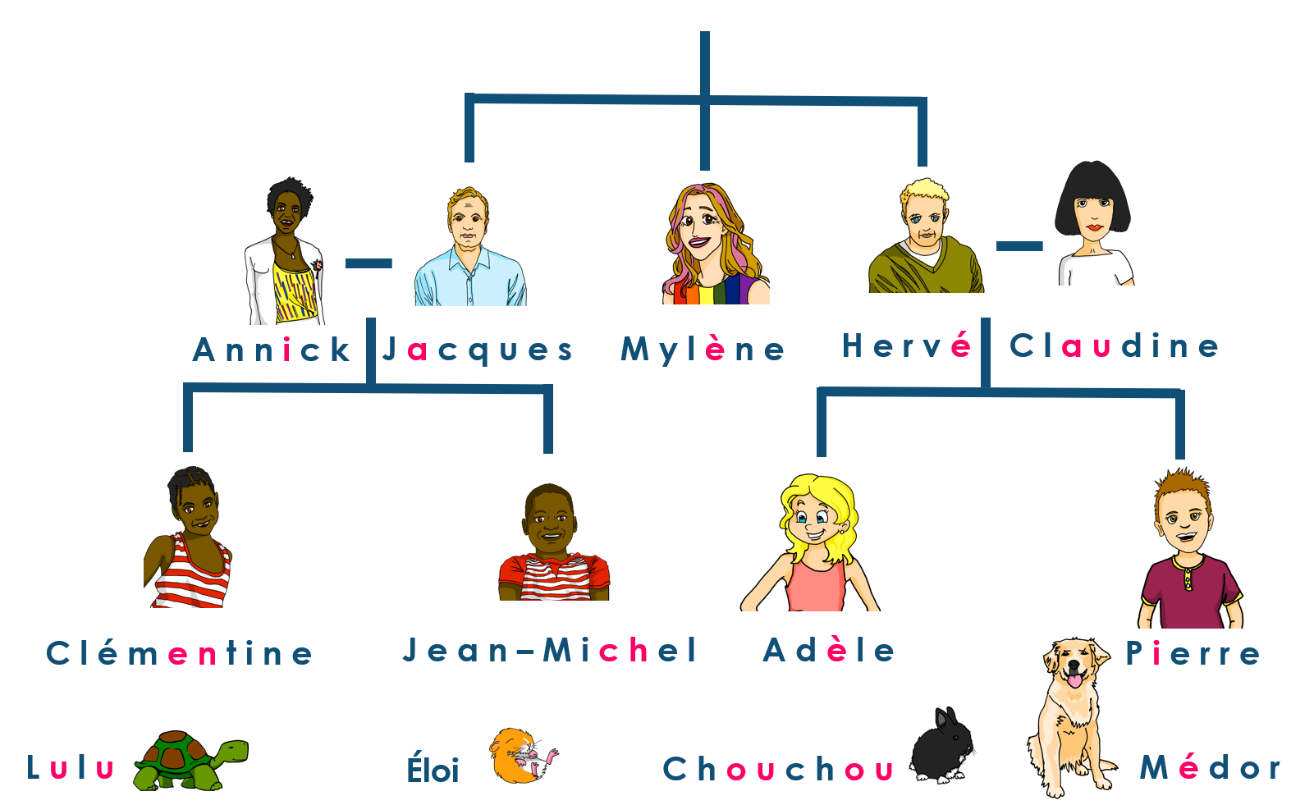
Saying what I and others do
Mylène, la tante d’Adèle
jaune
Uses of ‘de’
Singular adjectives
SSC [è|ê]
Notes:
Artwork by Steve Clarke. Pronoun pictures from NCELP (www.ncelp.org). All additional pictures selected from Pixabay and are
available under a Creative Commons license, no attribution required.
The AUDIO version of the lesson material includes additional audio for the new language presented (phonics, vocabulary) and audio for the instructions
on the slide.
In addition, it includes VIDEO clips of the phonics and the phonics’ source words. Pupils can be encouraged to look at the shape of the mouth/lips on
slides where these appear, and try to copy it/them.
Phonics: SSC Phonics: introduce [è] [ê] - fête [1490] tête [343] frère [1043] être [5], problème [188]
Vocabulary (new words in bold): émission [1074] radio [1526] tante [3891] télévision [1179] grand² [59] petit² [138] de¹ [2]
Revisit 1: chercher [336] dessiner [2086] présenter [209] prononcer [706] image [659] mot [220] pays [114] texte [631] facile [822] intéressant [1244]
Revisit 2: avoir [8] j’ai, il a, elle a, quoi [297] chat [3138] crayon [>5000] dessin [2624] message [792]
Londsale, D., & Le Bras, Y. (2009). A Frequency Dictionary of French: Core vocabulary for learners London: Routledge.
The frequency rankings for words that occur in this PowerPoint which have been previously introduced in these resources are given in the SOW and in the resources that first introduced and formally re-visited those words. For any other words that occur incidentally in this PowerPoint, frequency rankings will be provided in the notes field wherever possible.
Serpent: Shesmax, CC BY-SA 4.0 <https://creativecommons.org/licenses/by-sa/4.0>, via Wikimedia Commons
Roi: Punx, CC BY-SA 4.0 <https://creativecommons.org/licenses/by-sa/4.0>, via Wikimedia Commons
Woman: Lyly, CC BY-SA 3.0 <https://creativecommons.org/licenses/by-sa/3.0>, via Wikimedia Commons
Floats: Honeydew, CC BY-SA 3.0 <https://creativecommons.org/licenses/by-sa/3.0>, via Wikimedia Commons
Affiche: Édouard John Menta (1858 - 1914), Public domain, via Wikimedia Commons
Bataille de fleurs, Zil, CC BY-SA 3.0 <https://creativecommons.org/licenses/by-sa/3.0>, via Wikimedia Commons
Femme de fleurs: Zil, CC BY-SA 3.0 <https://creativecommons.org/licenses/by-sa/3.0>, via Wikimedia Commons
Femme de fleurs2: Zil, CC BY-SA 3.0 <https://creativecommons.org/licenses/by-sa/3.0>, via Wikimedia Commons
Des tetes: Jean-François Bouillet, CC BY-SA 2.0 <https://creativecommons.org/licenses/by-sa/2.0>, via Wikimedia Commons
1

Slide 2
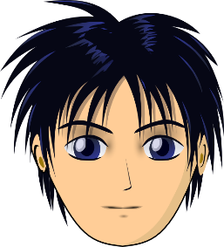
prononcer
[è|ê]
[è] and [ê] sound almost the same. [ê] is a little longer and deeper.
to be, being
fête
être
frère
(brother)
(party, celebration)
tête
problème
(head)
Notes:
Timing: 2 minutes
Aim: to recap SSC [è] and [ê] which are almost the same sound.
Procedure:
Introduce and elicit the pronunciation of the individual SSC [è] and the source word ‘xxx’, which has both spellings of the sound.
Click to bring on the picture and get students to repeat (with gesture, if using).
Present and practise the cluster words.
Gesture: gesture for fête: raise both hands in the air (middle three fingers facing down in a partial fist, with thumb and pinkie facing upwards) and move up and down alternate left and right to suggest a celebration-style dance.
Source: https://www.signbsl.com/sign/party (the 3rd video from the right is the best one, in my view)
2

Slide 3
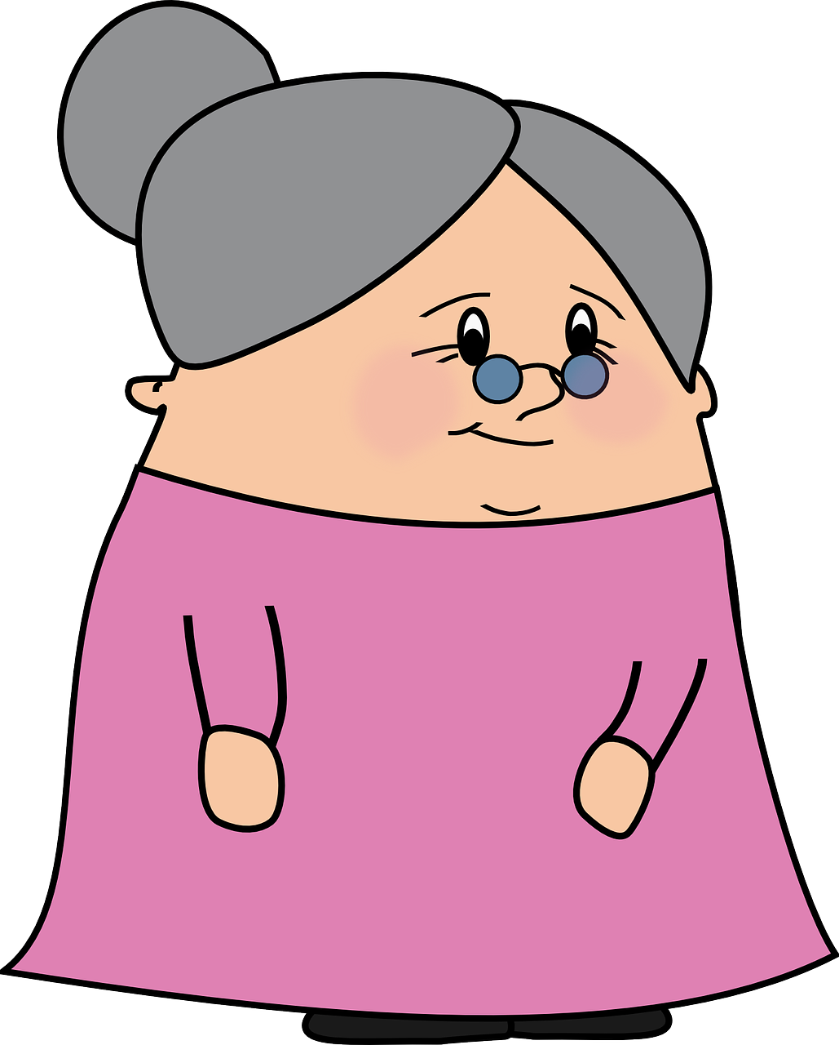
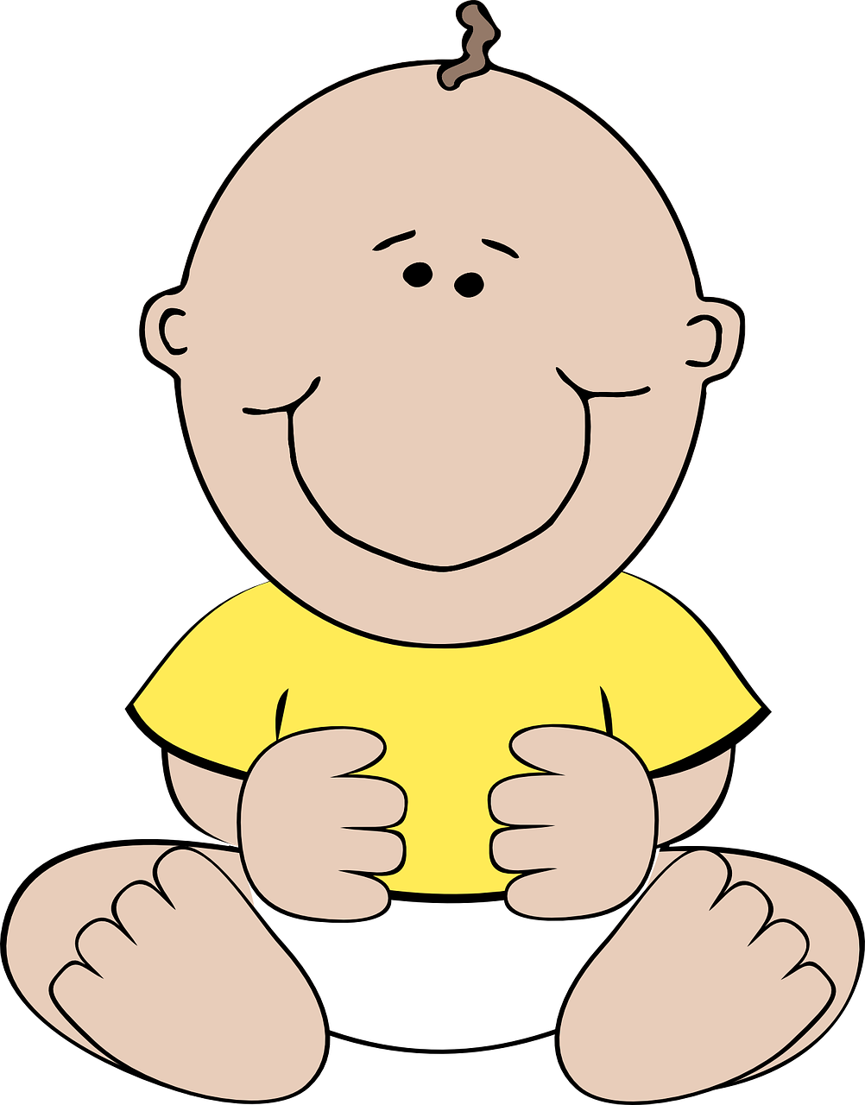
prononcer
Prononce les mots. [1/9]
Le son [è|ê], c’est dans le mot A ou B ?
A
B
la grand-mère
le bébé
Notes:
Timing: 5 minutes (9 slides)
Aim: to practise spoken recall of vocabulary; to connect the SSC [è|ê] with a number of previously taught words, differentiating it from other vowel sounds, namely [e] and [i]
Procedure:
Give pupils 30 seconds (think-pair-share) to retrieve the French words for the images.
Say trois-deux-un and elicit the two words, chorally.
Ask pupils to tell you which word has the SSC [è|ê]. i.e. Le son [è|ê], c’est dans le mot A ou B ?
Click to bring up the two words and then again to highlight the correct word.
Note: if pupils are not able to recall any of the words themselves, just click to bring up the written forms earlier, and pupils can read them aloud.
Frequency:
bébé [2271]
Note: bébé is an SSC cluster word and hasn’t been explicitly taught as vocabulary, but it is anticipated that pupils will remember it as it is a near cognate.
3

Slide 4
prononcer
Prononce les mots. [2/9]
Le son [è|ê], c’est dans le mot A ou B ?
A
B
elle
je
Notes:
Timing: 5 minutes (9 slides)
Aim: to practise spoken recall of vocabulary; to connect the SSC [è|ê] with a number of previously taught words, differentiating it from other vowel sounds, namely [e] and [i]
Procedure:
Give pupils 30 seconds (think-pair-share) to retrieve the French words for the images.
Say trois-deux-un and elicit the two words, chorally.
Ask pupils to tell you which word has the SSC [è|ê]. i.e. Le son [è|ê], c’est dans le mot A ou B ?
Click to bring up the two words and then again to highlight the correct word.
Note: if pupils are not able to recall any of the words themselves, just click to bring up the written forms earlier, and pupils can read them aloud.
Frequency:
bébé [2271]
Note: bébé is an SSC cluster word and hasn’t been explicitly taught as vocabulary, but it is anticipated that pupils will remember it as it is a near cognate.
4

Slide 5
prononcer
Prononce les mots. [3/9]
Le son [è|ê], c’est dans le mot A ou B ?
A
B
[to present, presenting]
[to draw, drawing]
tu présentes
tu dessines
Notes:
Timing: 5 minutes (9 slides)
Aim: to practise spoken recall of vocabulary; to connect the SSC [è|ê] with a number of previously taught words, differentiating it from other vowel sounds, namely [e] and [i]
Procedure:
Give pupils 30 seconds (think-pair-share) to retrieve the French words for the images.
Say trois-deux-un and elicit the two words, chorally.
Ask pupils to tell you which word has the SSC [è|ê]. i.e. Le son [è|ê], c’est dans le mot A ou B ?
Click to bring up the two words and then again to highlight the correct word.
Note: if pupils are not able to recall any of the words themselves, just click to bring up the written forms earlier, and pupils can read them aloud.
Frequency:
bébé [2271]
Note: bébé is an SSC cluster word and hasn’t been explicitly taught as vocabulary, but it is anticipated that pupils will remember it as it is a near cognate.
5

Slide 6
prononcer
Prononce les mots. [4/9]
Le son [è|ê], c’est dans le mot A ou B ?
A
B
to have, having
to be, being
avoir
être
Notes:
Timing: 5 minutes (9 slides)
Aim: to practise spoken recall of vocabulary; to connect the SSC [è|ê] with a number of previously taught words, differentiating it from other vowel sounds, namely [e] and [i]
Procedure:
Give pupils 30 seconds (think-pair-share) to retrieve the French words for the images.
Say trois-deux-un and elicit the two words, chorally.
Ask pupils to tell you which word has the SSC [è|ê]. i.e. Le son [è|ê], c’est dans le mot A ou B ?
Click to bring up the two words and then again to highlight the correct word.
Note: if pupils are not able to recall any of the words themselves, just click to bring up the written forms earlier, and pupils can read them aloud.
Frequency:
bébé [2271]
Note: bébé is an SSC cluster word and hasn’t been explicitly taught as vocabulary, but it is anticipated that pupils will remember it as it is a near cognate.
6

Slide 7
prononcer
Prononce les mots. [5/9]
Le son [è|ê], c’est dans le mot A ou B ?
A
B
le texte
petit
Notes:
Timing: 5 minutes (9 slides)
Aim: to practise spoken recall of vocabulary; to connect the SSC [è|ê] with a number of previously taught words, differentiating it from other vowel sounds, namely [e] and [i]
Procedure:
Give pupils 30 seconds (think-pair-share) to retrieve the French words for the images.
Say trois-deux-un and elicit the two words, chorally.
Ask pupils to tell you which word has the SSC [è|ê]. i.e. Le son [è|ê], c’est dans le mot A ou B ?
Click to bring up the two words and then again to highlight the correct word.
Note: if pupils are not able to recall any of the words themselves, just click to bring up the written forms earlier, and pupils can read them aloud.
Frequency:
bébé [2271]
Note: bébé is an SSC cluster word and hasn’t been explicitly taught as vocabulary, but it is anticipated that pupils will remember it as it is a near cognate.
7

Slide 8
prononcer
Prononce les mots. [6/9]
Le son [è|ê], c’est dans le mot A ou B ?
A
B
la question
la réponse
Notes:
Timing: 5 minutes (9 slides)
Aim: to practise spoken recall of vocabulary; to connect the SSC [è|ê] with a number of previously taught words, differentiating it from other vowel sounds, namely [e] and [i]
Procedure:
Give pupils 30 seconds (think-pair-share) to retrieve the French words for the images.
Say trois-deux-un and elicit the two words, chorally.
Ask pupils to tell you which word has the SSC [è|ê]. i.e. Le son [è|ê], c’est dans le mot A ou B ?
Click to bring up the two words and then again to highlight the correct word.
Note: if pupils are not able to recall any of the words themselves, just click to bring up the written forms earlier, and pupils can read them aloud.
Frequency:
bébé [2271]
Note: bébé is an SSC cluster word and hasn’t been explicitly taught as vocabulary, but it is anticipated that pupils will remember it as it is a near cognate.
8

Slide 9
prononcer
Prononce les mots. [7/9]
Le son [è|ê], c’est dans le mot A ou B ?
A
B
l’image
le message
Notes:
Timing: 5 minutes (9 slides)
Aim: to practise spoken recall of vocabulary; to connect the SSC [è|ê] with a number of previously taught words, differentiating it from other vowel sounds, namely [e] and [i]
Procedure:
Give pupils 30 seconds (think-pair-share) to retrieve the French words for the images.
Say trois-deux-un and elicit the two words, chorally.
Ask pupils to tell you which word has the SSC [è|ê]. i.e. Le son [è|ê], c’est dans le mot A ou B ?
Click to bring up the two words and then again to highlight the correct word.
Note: if pupils are not able to recall any of the words themselves, just click to bring up the written forms earlier, and pupils can read them aloud.
Frequency:
bébé [2271]
Note: bébé is an SSC cluster word and hasn’t been explicitly taught as vocabulary, but it is anticipated that pupils will remember it as it is a near cognate.
9

Slide 10
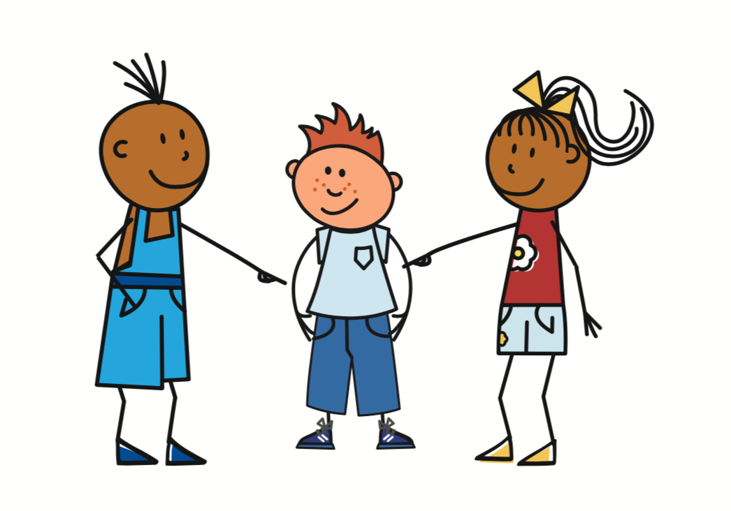
prononcer
Prononce les mots. [8/9]
Le son [è|ê], c’est dans le mot A ou B ?
A
B
[to look for, looking for]
[to pronounce, pronouncing]
il cherche
il prononce
Notes:
Timing: 5 minutes (9 slides)
Aim: to practise spoken recall of vocabulary; to connect the SSC [è|ê] with a number of previously taught words, differentiating it from other vowel sounds, namely [e] and [i]
Procedure:
Give pupils 30 seconds (think-pair-share) to retrieve the French words for the images.
Say trois-deux-un and elicit the two words, chorally.
Ask pupils to tell you which word has the SSC [è|ê]. i.e. Le son [è|ê], c’est dans le mot A ou B ?
Click to bring up the two words and then again to highlight the correct word.
Note: if pupils are not able to recall any of the words themselves, just click to bring up the written forms earlier, and pupils can read them aloud.
Frequency:
bébé [2271]
Note: bébé is an SSC cluster word and hasn’t been explicitly taught as vocabulary, but it is anticipated that pupils will remember it as it is a near cognate.
10

Slide 11
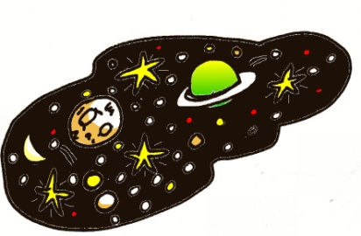
prononcer
Prononce les mots. [9/9]
Le son [è|ê], c’est dans le mot A ou B ?
A
B
univers
midi
Notes:
Timing: 5 minutes (9 slides)
Aim: to practise spoken recall of vocabulary; to connect the SSC [è|ê] with a number of previously taught words, differentiating it from other vowel sounds, namely [e] and [i]
Procedure:
Give pupils 30 seconds (think-pair-share) to retrieve the French words for the images.
Say trois-deux-un and elicit the two words, chorally.
Ask pupils to tell you which word has the SSC [è|ê]. i.e. Le son [è|ê], c’est dans le mot A ou B ?
Click to bring up the two words and then again to highlight the correct word.
Note: if pupils are not able to recall any of the words themselves, just click to bring up the written forms earlier, and pupils can read them aloud.
Frequency:
bébé [2271]
Note: bébé is an SSC cluster word and hasn’t been explicitly taught as vocabulary, but it is anticipated that pupils will remember it as it is a near cognate.
11

Slide 12
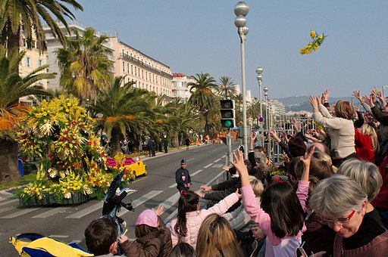
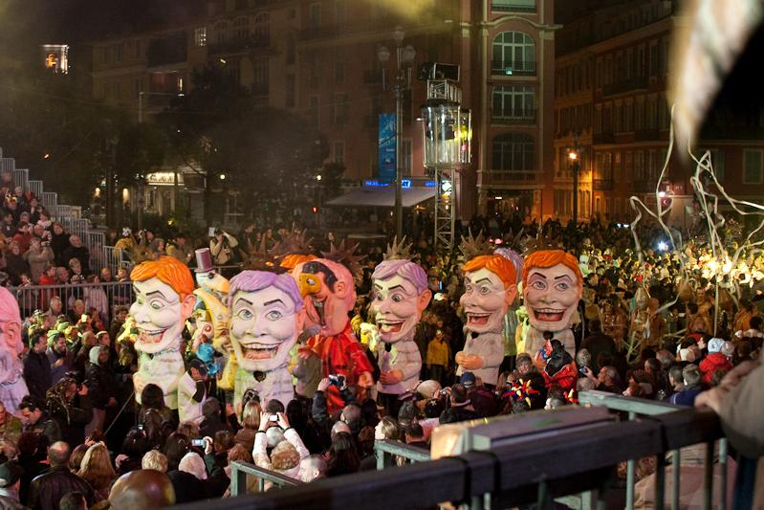
lire
de
Le Carnaval de Nice
Voici Mylène. Elle est la tante de Pierre et d’Adèle.
de
d
Elle est journaliste.
de
Aujourd’hui, Mylène est ici pour le Carnaval de Nice.
Nice
Elle prépare une émission de télévision.
de
Elle chante aussi à la radio. Samedi, elle présente une émission de radio.
de
de means ‘of’ but notice what we say in English: le Carnaval de Nice = the Nice Carnival la tante de Pierre = Pierre’s aunt
la statue de la Liberté = the statue of liberty
voici = this is
Notes:
Timing: 5 minutes
Aim: to introduce the context of the lesson, the Nice Carnival, which takes place in February.
Procedure:
Click to present the text, line by line.
Ensure pupils are clear about the meaning.
Mylène, a new character, is the sister of Jacques (Jean-Michel and Clémentine’s dad) and Hervé (Adèle and Pierre’s dad and so their aunt).
Click to highlight all the examples of the new word ‘de’.
Click to bring up information about how ‘de’ is translated into English. There will be more practice of this in the next activity on the next slide.
6. Teachers might want to use the link below to show pupils a little more about the festival.
Just clicking on the homepage brings up some filmed images of the festival for 2023, with lots children watching the parades and dancing.
Further information: https://www.nicecarnaval.com/fr/
Picture attribution:
Floats: Honeydew, CC BY-SA 3.0 <https://creativecommons.org/licenses/by-sa/3.0>, via Wikimedia Commons
Des tetes: Jean-François Bouillet, CC BY-SA 2.0 <https://creativecommons.org/licenses/by-sa/2.0>, via Wikimedia Commons
12

Slide 13
Using adjectives
Remember that adjectives change their spelling to match the gender of the noun:
Le grand-père d’Adèle est grand.
Adèle’s grandfather is tall.
La tante de Pierre est petite.
Pierre’s aunt is short.
Note that grand means big as well as tall, and petit means small as well as short:
Le pays est petit.
The country is small.
La fête est grande.
The party is big.
Notes:
Timing: 2 minutes
Aim: to recap the first meanings of grand/petit and introduce the second meanings.
Procedure:
Click to present the information.
Elicit the English meanings of the examples.
13

Slide 14
vocabulaire
Écoute et répète.
les noms des animaux. C’est [ien] ou [(a)in]?
mots
la télévision
la radio
Note: de means from AND of
l’émission
de
la tante
Notes:
Timing: 2 minutes
Aim: to consolidate the new vocabulary that we have just introduced.
Procedure: 1. Teacher clicks to ‘disappear’ each item in random order.
2. Each time, pupils say the French word and then the English word.
3. Click again for the word to reappear (with audio in the audio version).
4. After ‘de’ disappears, the callout reminding pupils of the first meaning they met (from) appears. (Term 1 Week 11).

Slide 15
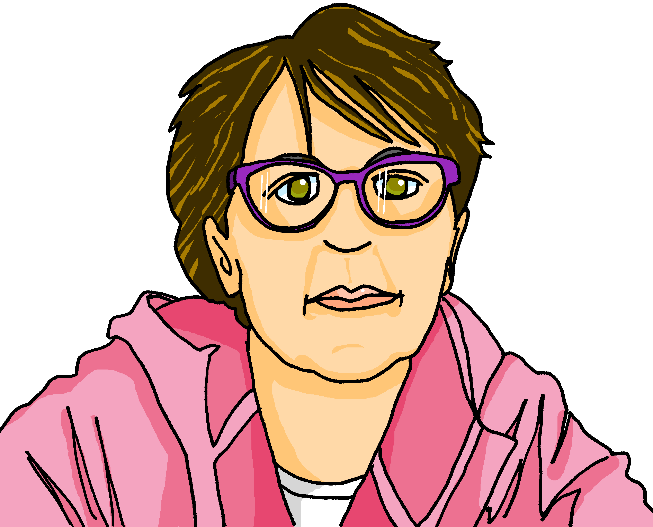
écouter
Écoute. C’est l’image A ou B ? [1/6]
1a
A
B
1b
Notes:
Timing: 5 minutes (6 slides)
Aim: to reinforce the connection between noun and gender (as expressed by the definite article)
Procedure:
1. Click the audio button top left to listen to just the article ‘le’ or ‘la’.
2. Pupils select the correct image based on hearing the article and identifying with a previously taught noun.
3. Click the audio button bottom right to hear the full sentence.
4. Elicit the English meaning of the full sentence from pupils, chorally, paying attention to which translation (big/tall/short/small) is the correct one.
Transcript:
Le [grand-père est grand].
15

Slide 16
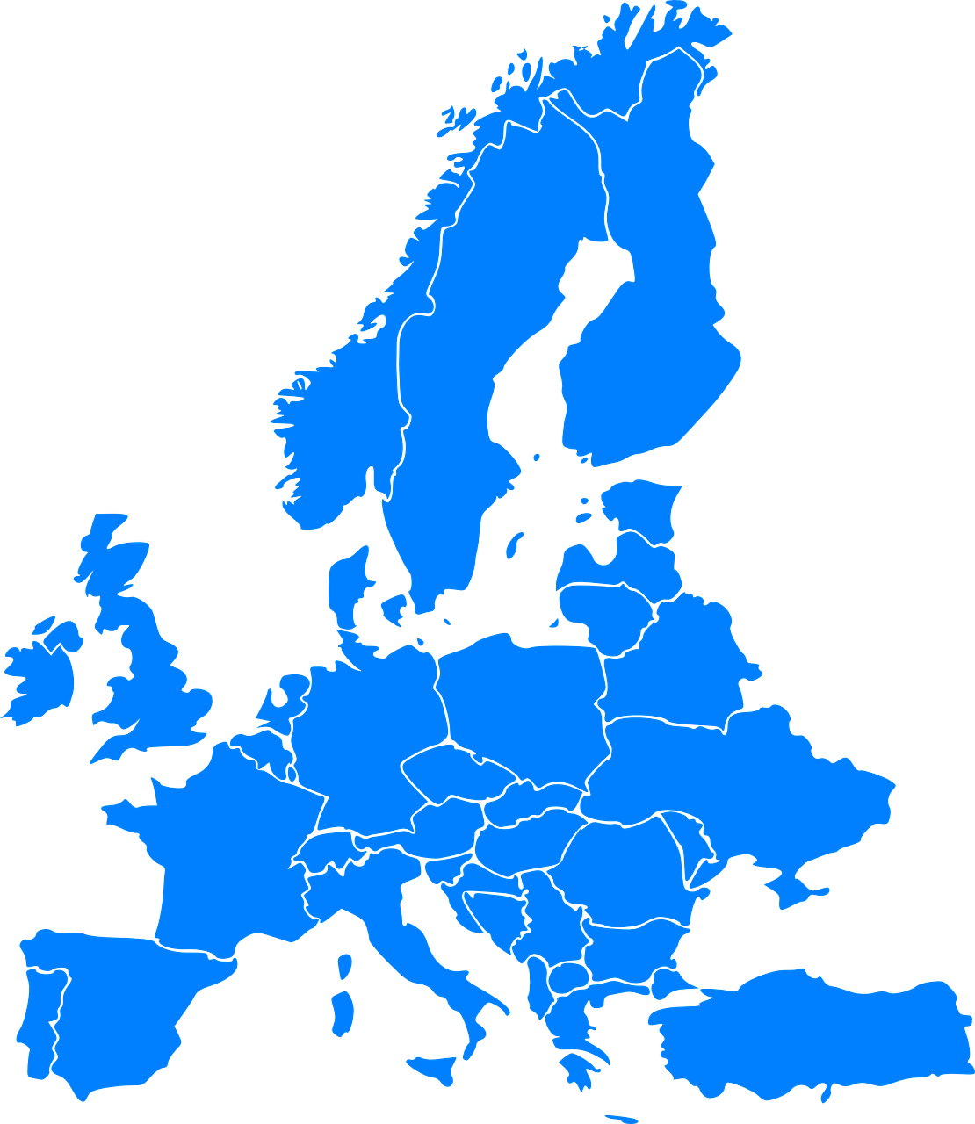
écouter
Écoute. C’est l’image A ou B ? [2/6]
2a
A
B
2b
Notes:
[2/6]
Transcript:
Le [pays est grand].
16

Slide 17
écouter
Écoute. C’est l’image A ou B ? [3/6]
3a
A
B
3b
Notes:
[2/6]
Transcript:
Le [pays est grand].
17

Slide 18
écouter
Écoute. C’est l’image A ou B ? [4/6]
4a
A
B
4b
Notes:
[2/6]
Transcript:
Le [pays est grand].
18

Slide 19
écouter
Écoute. C’est l’image A ou B ? [5/6]
5a
A
B
5b
Notes:
[2/6]
Transcript:
Le [pays est grand].
19

Slide 20
écouter
Écoute. C’est l’image A ou B ? [6/6]
6a
A
B
(party, celebration)
6b
Notes:
Timing: 5 minutes (6 slides)
Aim: to reinforce the connection between noun and gender (as expressed by the definite article)
Procedure:
1. Click the audio button top left to listen to just the article ‘le’ or ‘la’.
2. Pupils select the correct image based on hearing the article and identifying with a previously taught noun.
3. Click the audio button bottom right to hear the full sentence.
4. Elicit the English meaning of the full sentence from pupils, chorally, paying attention to which translation (big/tall/short/small) is the correct one.
Transcript:
Le [grand-père est grand].
20

Slide 21
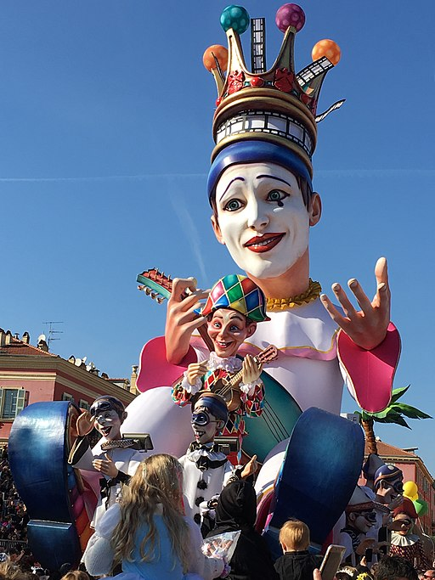
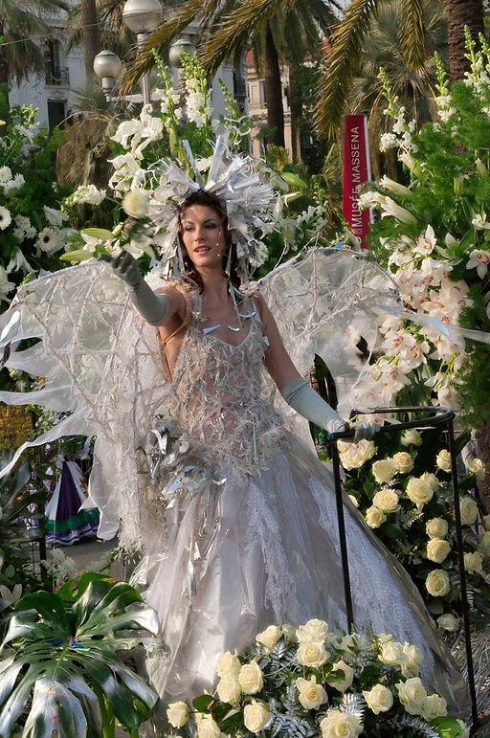
lire
‘de’ [of]
en français
en anglais
la grand-mère de Pierre
Pierre’s grandma
Marie-Ange
de in French can be ‘s in English
la tante d’Adèle
Adèle’s aunt
Mylène
la profession de Mylène
Mylène’s profession
de in French can be nothing in English
le Carnaval de Nice
the Nice Carnival
l’émission de télé
the tv programme
la bataille* de fleurs*
the flower battle
la bataille = the battle la fleur = flower
Notes:
Timing: 3 minutes
Aim: to provide further practice in understanding ‘de’.
Procedure:
Click to present the French text. Pupils read it aloud, chorally.
Elicit the English translation from pupils and click to confirm.
Continue with items 2-6.
21

Slide 22
lire
Le mot correct, c’est quoi ?
Écris l’adjectif en anglais.
l’adjectif en anglais
1 | La professeure| Pierre est petite.
2 | Le parc| L’université est petit.
3 | La chambre| Le musée est grand.
4 | La Fête | Le Carnaval de Nice est grande.
5 | L’image| Le chat de Mylène est petit.
6 | Le grand-père | La grand-mère d’Adèle est grande.
1
short
2
small
3
big
4
big
5
small
6
tall
Notes:
Timing: 5 minutes
Aim: to practise written comprehension of two polysemous adjectives (adjectives with more than one meaning) and the connection of their forms with appropriate nouns.
Procedure:
Model number 1: Elicit the correct noun from pupils, according to the form of the adjective.
Click to confirm the noun.
Elicit the English meaning of the adjective ‘petit’.
Click to confirm.
Pupils complete items 2-6.
Click to reveal audio buttons.
Use the audio buttons for pupils to listen for and check their noun choices.
Elicit and check the English meanings of the adjectives.
22

Slide 23
Au revoir !
jaune
Notes:
23

